Slide 1
Recurrence Relations
Decision 2 Chapter 7
Westie's Workshop

Slide 2
Teachings for Exercise 7C

Slide 3
Solving Second-Order Recurrence Relations
A second-order linear recurrence relation has the form
u_{n} = au_{n−1} + bu_{n−2} + g(n)
where a and b are real constants
If g(n) = 0 it is homogeneous
If u_{n} = F(n) and u_{n} = G(n) are solutions of a linear recurrence relation, then u_{n} = aF(n) + bG(n) is also a solution
This is why the general solution is a combination of two solutions
Consider the recurrence relation u_{n} = 2u_{n−1} − u_{n−2}, n ≥ 2.
Verify that the following particular solutions satisfy this recurrence relation.
a) u_{n} = 3n b) u_{n} = 5 c) u_{n} = 3n + 5
a) u_{n−1} = 3n − 3, u_{n−2} = 3n − 6
2u_{n−1} − u_{n−2} = 2(3n − 3) − (3n − 6) = 3n = u_{n}
So u_{n} = 3n satisfies the recurrence relation
b) u_{n−1} = 5, u_{n−2} = 5
2u_{n−1} − u_{n−2} = 2 × 5 − 5 = 5 = u_{n}
So u_{n} = 5 satisfies the recurrence relation
c) u_{n−1} = 3n + 2, u_{n−2} = 3n − 1
2u_{n−1} − u_{n−2} = 2(3n + 2) − (3n − 1) = 3n + 5 = u_{n}
So u_{n} = 3n + 5 satisfies it: 3n + 5 is a combination of the solutions in a and b
7C

Slide 4
Solving Second-Order Recurrence Relations
Try u_{n} = Ar^{n} in u_{n} = au_{n−1} + bu_{n−2}:
Ar^{n} = Aar^{n−1} + Abr^{n−2}
Multiply by r^{2−n}: r² − ar − b = 0
This is the auxiliary (characteristic) equation
Distinct real roots α, β:
u_{n} = Aα^{n} + Bβ^{n}
Repeated root α:
u_{n} = (A + Bn)α^{n}
a) Find a general solution to the recurrence relation u_{n} = 2u_{n−1} + 8u_{n−2}, n ≥ 2
b) Verify that your general solution from part a satisfies the recurrence relation.
c) Given that u₀ = 4 and u₁ = 10, find a particular solution.
a) r² − 2r − 8 = 0 ⇒ (r − 4)(r + 2) = 0 ⇒ r = 4 or r = −2
General solution: u_{n} = A(4^{n}) + B(−2)^{n}
b) 2u_{n−1} + 8u_{n−2} = 2(A(4^{n−1}) + B(−2)^{n−1}) + 8(A(4^{n−2}) + B(−2)^{n−2})
8 × 4^{n−2} = 2 × 4^{n−1}
= 2A(4^{n−1}) + 2B(−2)^{n−1} + 2A(4^{n−1}) − 4B(−2)^{n−1}
= 4A(4^{n−1}) − 2B(−2)^{n−1}
= A(4^{n}) + B(−2)^{n} = u_{n}
c) u₀ = 4 ⇒ A + B = 4
u₁ = 10 ⇒ 4A − 2B = 10
Solving simultaneously: A = 3 and B = 1
u_{n} = 3(4^{n}) + (−2)^{n}
7C

Slide 5
Solving Second-Order Recurrence Relations
You can solve u_{n} = au_{n−1} + bu_{n−2} using the auxiliary equation r² − ar − b = 0
Distinct real roots α, β:
u_{n} = Aα^{n} + Bβ^{n}
Repeated root α:
u_{n} = (A + Bn)α^{n}
Complex roots re^{±iθ}:
u_{n} = r^{n}(A cos nθ + B sin nθ)
A and B are arbitrary constants: you need two initial conditions to find them
Solve the recurrence relation a_{n} = 3a_{n−1} − 2a_{n−2}, with a₁ = 5 and a₂ = 3
r² − 3r + 2 = 0 ⇒ (r − 1)(r − 2) = 0 ⇒ r = 1 or r = 2
A root of 1 gives a constant term
General solution: a_{n} = A(1^{n}) + B(2^{n}) = A + B(2^{n})
a₁ = A + 2B = 5
a₂ = A + 4B = 3
⇒ A = 7, B = −1
a_{n} = 7 − 2^{n}
Check by generating terms: 5, 3, −1, −9, −25 from both the closed form and the recurrence relation
7C

Slide 6
Solving Second-Order Recurrence Relations
You can solve u_{n} = au_{n−1} + bu_{n−2} using the auxiliary equation r² − ar − b = 0
Distinct real roots α, β:
u_{n} = Aα^{n} + Bβ^{n}
Repeated root α:
u_{n} = (A + Bn)α^{n}
Complex roots re^{±iθ}:
u_{n} = r^{n}(A cos nθ + B sin nθ)
A and B are arbitrary constants: you need two initial conditions to find them
Solve the recurrence relation u_{n} = 4u_{n−1} − 4u_{n−2}, with u₀ = 1 and u₁ = 1
r² − 4r + 4 = 0 ⇒ (r − 2)² = 0 ⇒ r = 2 (repeated)
General solution: u_{n} = (A + Bn)2^{n}
u₀ = 1 ⇒ A = 1
u₁ = 1 ⇒ 2(A + B) = 1 ⇒ 2 + 2B = 1 ⇒ B = −½
u_{n} = (1 − ½n)2^{n}
You could also write this as u_{n} = 2^{n} − n2^{n−1}
7C

Slide 7
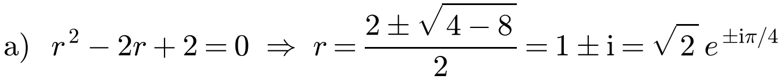
Solving Second-Order Recurrence Relations
Complex roots come in a conjugate pair: x ± iy = re^{±iθ}
Form 1: u_{n} = Aα^{n} + Bβ^{n} (A and B may be complex)
Form 2: u_{n} = r^{n}(C cos nθ + D sin nθ) (only real numbers)
The values of the arbitrary constants depend on which form you use
a) Find the general solution to the recurrence relation u_{n} = 2u_{n−1} − 2u_{n−2}
b) Given that u₀ = 1 and u₂ = 2, find the particular solution to the recurrence relation.
Form 1: u_{n} = A(1 + i)^{n} + B(1 − i)^{n}
Form 2: u_{n} = (√2)^{n}(C cos (nπ/4) + D sin (nπ/4))
b) First find u₁: u₂ = 2u₁ − 2u₀ ⇒ 2 = 2u₁ − 2 ⇒ u₁ = 2
Using form 1:
u₀ = A + B = 1 (1)
u₁ = A(1 + i) + B(1 − i) = 2 ⇒ A + B + (A − B)i = 2
⇒ (A − B)i = 1 ⇒ A − B = −i (2)
This simplifies to u_{n} = (1 + i)^{n−1} + (1 − i)^{n−1}, since (1 − i)(1 + i) = 2
7C

Slide 8
Solving Second-Order Recurrence Relations
Using form 2, the constants are real
Using the addition formula, the solution is
u_{n} = (√2)^{n+1} sin((n + 1)π/4)
The sequence oscillates between positive and negative values, with increasing size; every term is an integer
a) Find the general solution to the recurrence relation u_{n} = 2u_{n−1} − 2u_{n−2}
b) Given that u₀ = 1 and u₂ = 2, find the particular solution to the recurrence relation.
b) Using form 2, with u₀ = 1 and u₁ = 2:
u₀ = (√2)⁰(C cos 0 + D sin 0) = 1 ⇒ C = 1
u₁ = √2(C cos (π/4) + D sin (π/4)) = 2
⇒ 1 × √2 × (√2/2) + D × √2 × (√2/2) = 2
⇒ 1 + D = 2 ⇒ D = 1
u_{n} = (√2)^{n}(cos (nπ/4) + sin (nπ/4))
Check: u₂ = 2(cos (π/2) + sin (π/2)) = 2, as given
7C

Slide 9
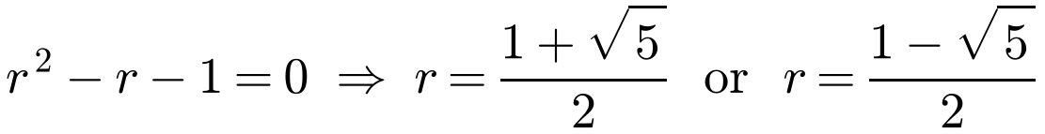
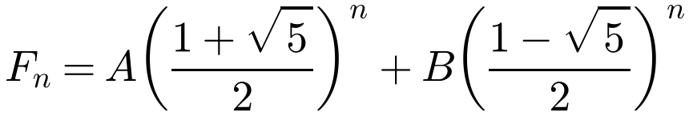
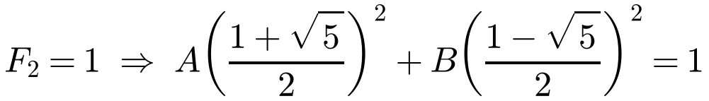
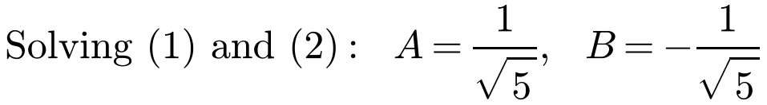
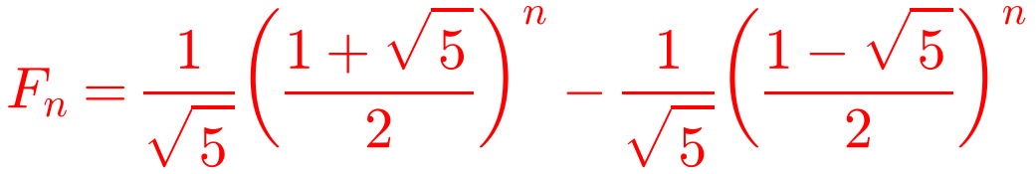
Solving Second-Order Recurrence Relations
The Fibonacci sequence has distinct real (irrational) roots
Write two simultaneous equations from the initial conditions
You can solve them on your calculator, but show enough working to make it clear you have used the initial conditions
The Fibonacci sequence is defined recursively as F_{n} = F_{n−1} + F_{n−2}, n > 2, with F₁ = 1 and F₂ = 1. Find a closed form for F_{n}.
7C

Slide 10
Solving Second-Order Recurrence Relations
For u_{n} = au_{n−1} + bu_{n−2} + g(n): general solution = C.F. + P.S.
The P.S. cannot have terms in common with the C.F.
Solve the recurrence relation
a_{n+2} + 4a_{n+1} + 3a_{n} = 5(−2)^{n}, n ≥ 0, with a₀ = 2 and a₁ = −1
Associated homogeneous relation: a_{n+2} + 4a_{n+1} + 3a_{n} = 0
Form of g(n)
Form of P.S.
r² + 4r + 3 = 0 ⇒ (r + 1)(r + 3) = 0 ⇒ r = −1 or r = −3
p, α, β ≠ 1
λ
C.F.: a_{n} = A(−1)^{n} + B(−3)^{n}
pn + q, α, β ≠ 1
λn + μ
−2 is not a root, so use λ(−2)^{n}
kp^{n}, p ≠ α, β
λp^{n}
Try P.S. a_{n} = λ(−2)^{n}:
p, α = 1, β ≠ 1
λn
λ(−2)^{n+2} + 4λ(−2)^{n+1} + 3λ(−2)^{n} = 5(−2)^{n}
pn + q, α = 1, β ≠ 1
λn² + μn
Divide both sides by (−2)^{n}
p, α = β = 1
λn²
4λ − 8λ + 3λ = 5 ⇒ λ = −5
pn + q, α = β = 1
λn³ + μn²
P.S.: a_{n} = −5(−2)^{n}
kα^{n}, α ≠ β
λnα^{n}
General solution: a_{n} = A(−1)^{n} + B(−3)^{n} − 5(−2)^{n}
kα^{n}, α = β
λn²α^{n}
Roots of the auxiliary equation are α and β
7C

Slide 11
Solving Second-Order Recurrence Relations
For u_{n} = au_{n−1} + bu_{n−2} + g(n): general solution = C.F. + P.S.
The P.S. cannot have terms in common with the C.F.
Solve the recurrence relation
a_{n+2} + 4a_{n+1} + 3a_{n} = 5(−2)^{n}, n ≥ 0, with a₀ = 2 and a₁ = −1
a_{n} = A(−1)^{n} + B(−3)^{n} − 5(−2)^{n}
Form of g(n)
Form of P.S.
a₀ = 2: A + B − 5 = 2 ⇒ A + B = 7
p, α, β ≠ 1
λ
a₁ = −1: −A − 3B + 10 = −1 ⇒ A + 3B = 11
pn + q, α, β ≠ 1
λn + μ
kp^{n}, p ≠ α, β
λp^{n}
⇒ A = 5 and B = 2
p, α = 1, β ≠ 1
λn
a_{n} = 5(−1)^{n} + 2(−3)^{n} − 5(−2)^{n}
pn + q, α = 1, β ≠ 1
λn² + μn
p, α = β = 1
λn²
Check with n = 2:
Closed form: a₂ = 5 + 18 − 20 = 3
Recurrence: a₂ + 4a₁ + 3a₀ = 5(−2)⁰ ⇒ a₂ = 5 + 4 − 6 = 3
pn + q, α = β = 1
λn³ + μn²
kα^{n}, α ≠ β
λnα^{n}
kα^{n}, α = β
λn²α^{n}
Roots of the auxiliary equation are α and β
7C

Slide 12
Solving Second-Order Recurrence Relations
If g(n) = kα^{n} where α is already a root of the auxiliary equation, multiply the P.S. by n
Here 4 is a root, so the C.F. already contains B(4^{n}): you cannot use λ(4^{n})
Try λn(4^{n}) instead
If the question asks for the general solution, leave the two arbitrary constants in your answer
Find the general solution to s_{n} = 3s_{n−1} + 4s_{n−2} + 4^{n}
s_{n} − 3s_{n−1} − 4s_{n−2} = 0: r² − 3r − 4 = 0 ⇒ (r + 1)(r − 4) = 0
C.F.: s_{n} = A(−1)^{n} + B(4^{n})
Try P.S. s_{n} = λn(4^{n}):
λn(4^{n}) = 3λ(n − 1)(4^{n−1}) + 4λ(n − 2)(4^{n−2}) + 4^{n}
4^{n−1} = ¼(4^{n})
λn(4^{n}) = ¾λ(n − 1)(4^{n}) + ¼λ(n − 2)(4^{n}) + 4^{n}
Divide by 4^{n}
λn = ¾λn − ¾λ + ¼λn − ½λ + 1
0 = −(5/4)λ + 1 ⇒ λ = 4/5
P.S.: s_{n} = (4/5)n(4^{n})
s_{n} = A(−1)^{n} + B(4^{n}) + (4/5)n(4^{n})
7C

