Slide 1
Recurrence Relations
Decision 2 Chapter 7
Westie's Workshop

Slide 2
Teachings for Exercise 7B

Slide 3
Solving First-Order Recurrence Relations
Solving a recurrence relation means finding a closed form u_{n} = f(n)
The order of a recurrence relation is the difference between the highest and lowest subscripts
A first-order linear recurrence relation has the form u_{n} = au_{n−1} + g(n), where a is a real constant
If g(n) = 0 it is homogeneous
Back substitution: keep replacing the previous term using the recurrence relation
Find a closed form for the sequence a_{n} = 5a_{n−1}, n > 0; a₀ = 1
a_{n} = 5a_{n−1}
a_{n−1} = 5a_{n−2}
= 5 × 5a_{n−2} = 5²a_{n−2}
= 5² × 5a_{n−3} = 5³a_{n−3}
= … = 5^{n}a₀
a₀ = 1, so the closed form is a_{n} = 5^{n}
This is the geometric sequence 1, 5, 25, 125, …
7B

Slide 4
Solving First-Order Recurrence Relations
The solution to the first-order homogeneous linear recurrence relation u_{n} = au_{n−1} is
u_{n} = u₀a^{n} or u_{n} = u₁a^{n−1}
By back substitution: u_{n} = au_{n−1} = a²u_{n−2} = … = a^{n}u₀
Unless you are told to prove it by induction, you can write these solutions down
Solve the recurrence relation a_{n} = 2a_{n−1}, n ≥ 1, with a₀ = 3
a_{n} = a₀(2^{n})
Homogeneous, linear, first-order, so use u_{n} = u₀a^{n}
a_{n} = 3(2^{n})
7B

Slide 5
Solving First-Order Recurrence Relations
Think of the general solution to u_{n} = au_{n−1} as u_{n} = ca^{n}, where c is an arbitrary constant
Use the initial condition to find c: this gives a particular solution
This is like finding general and particular solutions of a differential equation
Solve the recurrence relation a_{n} = −3a_{n−1}, n ≥ 1, with a₁ = 6
Method 1
a_{n} = a₁(−3)^{n−1} = 6(−3)^{n−1}
Use u_{n} = u₁a^{n−1}
Method 2
General solution: a_{n} = c(−3)^{n}
a₁ = 6 ⇒ 6 = c(−3)¹ ⇒ c = −2
Particular solution: a_{n} = −2(−3)^{n}
The two answers are equivalent: −2(−3)^{n} = −2(−3)(−3)^{n−1} = 6(−3)^{n−1}
7B

Slide 6
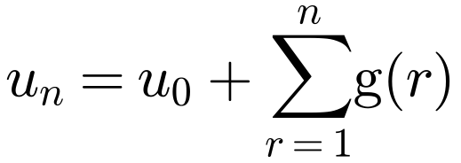
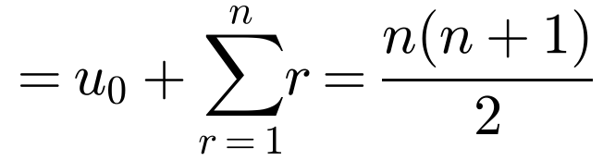
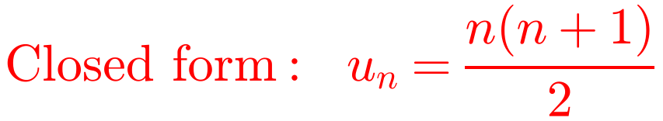
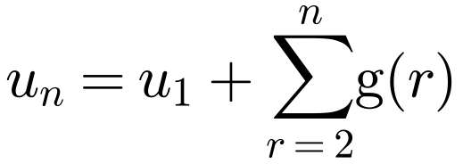
Solving First-Order Recurrence Relations
You can solve some non-homogeneous recurrence relations by back substitution (iteration)
For u_{n} = u_{n−1} + g(n):
Find a solution to the recurrence relation u_{n} = u_{n−1} + n, n ≥ 1, with u₀ = 0
u_{n} = u_{n−1} + n
Replace n by n − 1 in the relation, then substitute
= (u_{n−2} + (n − 1)) + n
= …
= u₀ + 1 + 2 + … + n
u₀ = 0, and the sum of the first n integers
If u₁ is given instead of u₀:
7B

Slide 7
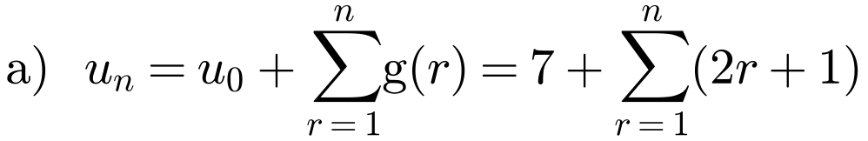
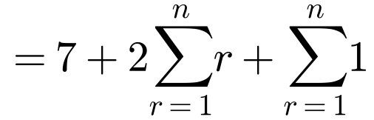
Solving First-Order Recurrence Relations
Use the formula for u_{n} = u_{n−1} + g(n), then standard results for sums
Σ r = ½n(n + 1)
Σ 1 = n
Solve the following recurrence relations.
a) u_{n} = u_{n−1} + 2n + 1, n ≥ 1, with u₀ = 7
b) u_{n} = u_{n−1} + 5^{n}, n ∈ ℕ, with u₁ = 3
= 7 + n(n + 1) + n
u_{n} = n² + 2n + 7
Check: u₁ = u₀ + 3 = 10, and 1 + 2 + 7 = 10
7B

Slide 8
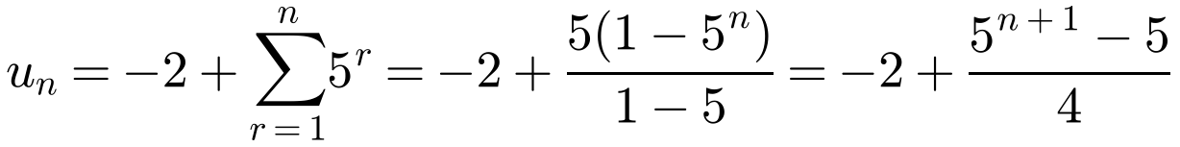
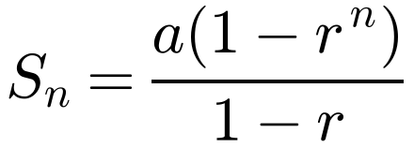
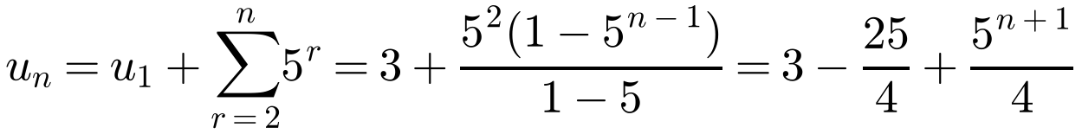
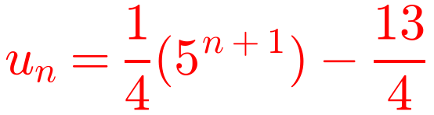
Solving First-Order Recurrence Relations
If the initial condition is u₁, either work back to find u₀, or start the sum at r = 2
Σ 5^{r} is a geometric series with first term 5 and common ratio 5
Solve the following recurrence relations.
a) u_{n} = u_{n−1} + 2n + 1, n ≥ 1, with u₀ = 7
b) u_{n} = u_{n−1} + 5^{n}, n ∈ ℕ, with u₁ = 3
b) Method 1
u₀ = u₁ − 5¹ = −2
Method 2
Check: u₁ = 25/4 − 13/4 = 3
7B

Slide 9
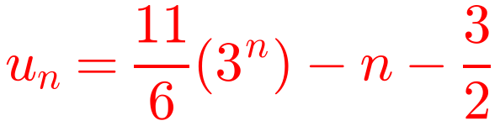
Solving First-Order Recurrence Relations
To solve u_{n} = au_{n−1} + g(n):
• C.F.: general solution of u_{n} = au_{n−1}, i.e. ca^{n}
• P.S.: choose a form, substitute and find the coefficients
• General solution: u_{n} = C.F. + P.S.
• Use the initial condition to find c
Solve the recurrence relation u_{n} = 3u_{n−1} + 2n, n ∈ ℤ⁺, with u₁ = 3
C.F.: u_{n} = 3u_{n−1} ⇒ u_{n} = c(3^{n})
g(n) = 2n is of the form pn + q, so include a constant μ
P.S.: try u_{n} = λn + μ
λn + μ = 3(λ(n − 1) + μ) + 2n
λn + μ = 3λn − 3λ + 3μ + 2n
Form of g(n)
Form of P.S.
0 = (2λ + 2)n + (2μ − 3λ)
Equate coefficients: true for all n
p, a ≠ 1
λ
2λ + 2 = 0 and 2μ − 3λ = 0 ⇒ λ = −1, μ = −3/2
pn + q, a ≠ 1
λn + μ
P.S.: u_{n} = −n − 3/2
kp^{n}, p ≠ a
λp^{n}
General solution: u_{n} = c(3^{n}) − n − 3/2
ka^{n}
λna^{n}
p, a = 1
λn
u₁ = 3 ⇒ 3 = 3c − 1 − 3/2 ⇒ c = 11/6
pn + q, a = 1
λn² + μn
The P.S. satisfies the recurrence relation, but not necessarily the initial condition
Check: u₂ = 3(3) + 4 = 13 and (11/6)(9) − 2 − 3/2 = 13
7B

Slide 10
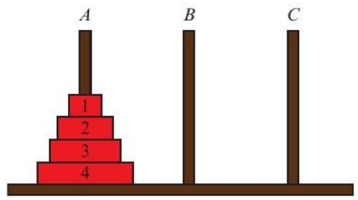
Solving First-Order Recurrence Relations
The Tower of Hanoi puzzle: transfer a pile of disks from one peg to another using an intermediate peg. Only one disk at a time can be moved; a disk can only be moved if it is the top disk on a pile; a larger disk can never be placed on a smaller one.
b)
Move
Disk
From
To
1
1
A
B
a) Find the minimum number of moves needed to transfer two disks from one peg to another.
b) Show that three disks can be transferred from one peg to another in 7 moves.
2
2
A
C
3
1
B
C
4
3
A
B
a) 3 moves: disk 1 A to B, disk 2 A to C, then disk 1 B to C
5
1
C
A
6
2
C
B
7
1
A
B
After move 4, disk 3 is on B with disks 1 and 2 on C
All three disks are on B after 7 moves
7B

Slide 11
Solving First-Order Recurrence Relations
The Tower of Hanoi puzzle: transfer a pile of disks from one peg to another using an intermediate peg. Only one disk at a time can be moved; a disk can only be moved if it is the top disk on a pile; a larger disk can never be placed on a smaller one.
c) Before moving the largest disk (disk n), all the other n − 1 disks must be moved onto one peg, say C: d_{n−1} moves.
Then move disk n to peg B: 1 move.
Then move the other n − 1 disks onto disk n: d_{n−1} moves.
c) Explain why the minimum number of moves, d_{n}, needed to transfer n disks satisfies d_{n} = 2d_{n−1} + 1, with d₁ = 1.
d) Solve this recurrence relation for d_{n}.
e) Hence determine the minimum number of moves needed to transfer 15 disks.
d_{n} = d_{n−1} + 1 + d_{n−1} = 2d_{n−1} + 1; one disk takes one move, so d₁ = 1
d) C.F.: d_{n} = c(2^{n}). P.S.: try d_{n} = λ: λ = 2λ + 1 ⇒ λ = −1
General solution: d_{n} = c(2^{n}) − 1
d₁ = 1 ⇒ 1 = 2c − 1 ⇒ c = 1, so d_{n} = 2^{n} − 1
e) d₁₅ = 2¹⁵ − 1 = 32 767 moves
7B

