Slide 1
Game Theory
Decision 2 Chapter 6
Westie's Workshop

Slide 2
Teachings for Exercise 6C

Slide 3
Optimal Strategies for Games with No Stable Solution
In a mixed strategy, each action is assigned a probability and is selected with the given probability
The probabilities of all the available actions must add up to 1
The expected pay-off is the sum of each outcome multiplied by its probability
The optimal mixed strategy for player A is the mixed strategy that maximises the minimum expected pay-off for all possible actions by player B
(the ‘safest’ mixed strategy)
A two-player zero-sum game is represented by the following pay-off matrix.
B plays 1
B plays 2
A plays 1
4
−2
A plays 2
−5
3
Player A is considering three different mixed strategies:
Strategy X: play row 1 with probability 0.5 and row 2 with probability 0.5
Strategy Y: play row 1 with probability 0.6 and row 2 with probability 0.4
Strategy Z: play row 1 with probability 0.9 and row 2 with probability 0.1
Find the expected pay-offs for each mixed strategy.
Strategy X:
Strategy
If B plays 1
If B plays 2
If B plays 1: 4 × 0.5 − 5 × 0.5 = −0.5
If B plays 2: −2 × 0.5 + 3 × 0.5 = 0.5
X
−0.5
0.5
Strategy Y:
Y
0.4
0
If B plays 1: 4 × 0.6 − 5 × 0.4 = 0.4
If B plays 2: −2 × 0.6 + 3 × 0.4 = 0
Z
3.1
−1.5
Strategy Z:
If B plays 1: 4 × 0.9 − 5 × 0.1 = 3.1
If B plays 2: −2 × 0.9 + 3 × 0.1 = −1.5
The minimum expected pay-offs are −0.5 (X), 0 (Y) and −1.5 (Z)
Strategy Y maximises the minimum expected pay-off, so Y is the best of the three
6C

Slide 4
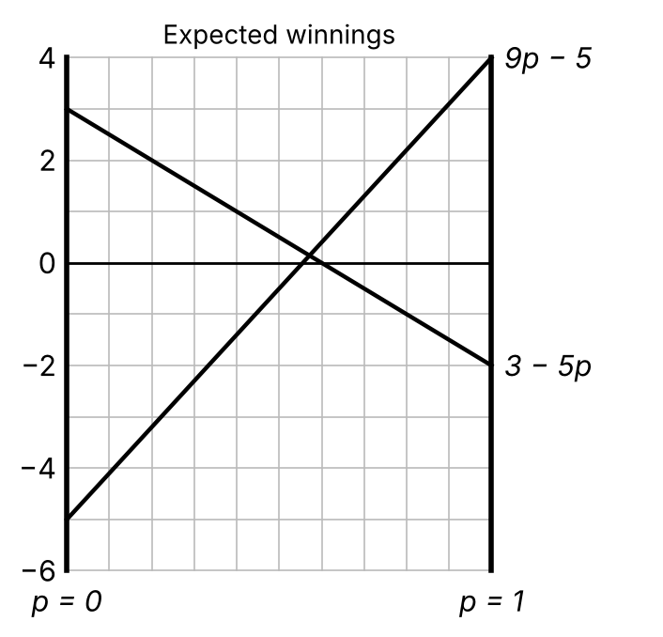
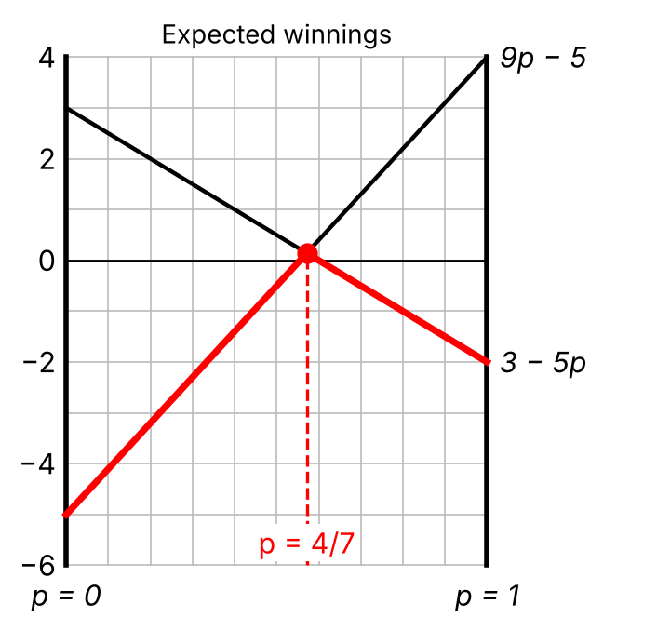
Optimal Strategies for Games with No Stable Solution
For a game with no stable solution, the value of the game to A is the expected pay-off for A’s optimal mixed strategy
To find the optimal mixed strategy for a player with two choices in a 2 × n or n × 2 game:
Set the probability of one choice as p, so the other has probability 1 − p
Find the expected winnings in terms of p
Draw a graph showing the expected winnings as straight lines
Choose the intersection point that maximises the minimum winnings
Lines stop at p = 0 and p = 1 because p is a probability: draw vertical ‘rugby posts’
A two-person zero-sum game is represented by the following pay-off matrix:
B plays 1
B plays 2
Find the optimal mixed strategy
a for player A b for player B.
In each case state the value of the game to that player.
A plays 1
4
−2
A plays 2
−5
3
a Let A play row 1 with probability p and row 2 with probability 1 − p
If B plays column 1, A’s expected winnings are
4p − 5(1 − p) = 9p − 5
If B plays column 2, A’s expected winnings are
−2p + 3(1 − p) = 3 − 5p
The red line shows the minimum of A’s expected winnings: its highest point is at the intersection
At the intersection: 9p − 5 = 3 − 5p, so 14p = 8 and p = 4/7
A should play row 1 with probability 4/7 and row 2 with probability 3/7
The value of the game for A is 9 × 4/7 − 5 = 1/7
In Example 8 the safest strategy had p = 0.6: the optimal p = 4/7 = 0.571… is close to this
6C

Slide 5
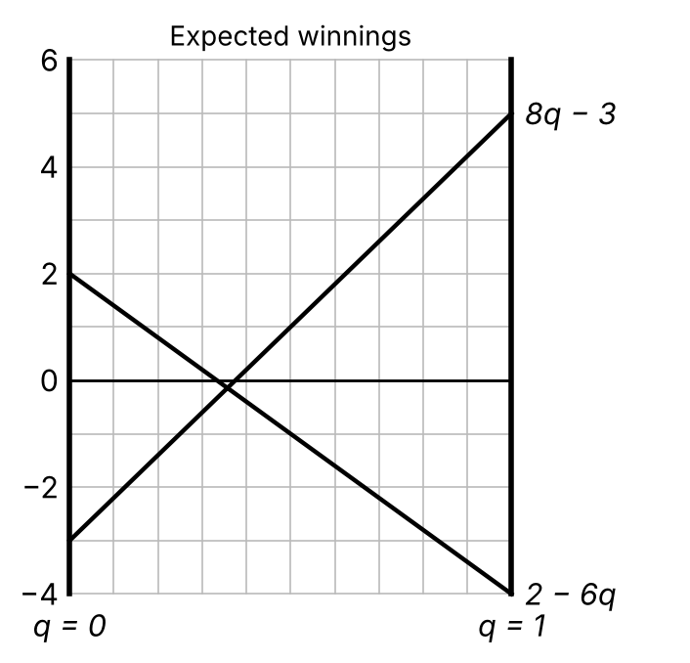
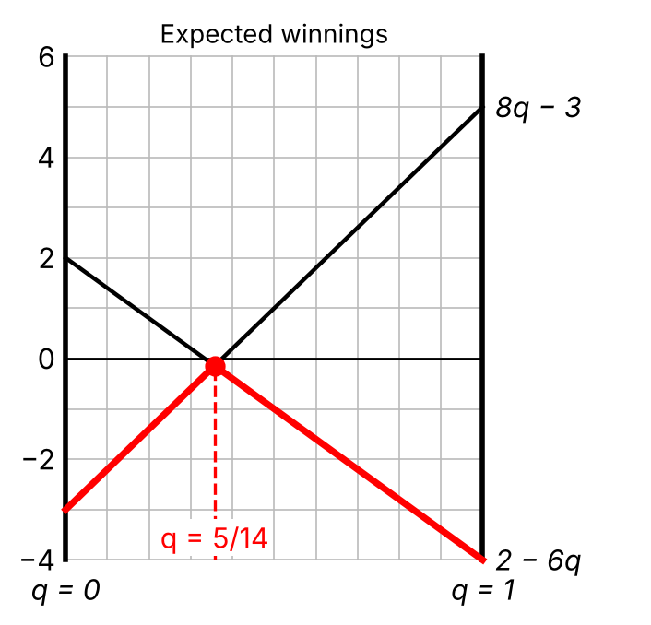
Optimal Strategies for Games with No Stable Solution
The pay-off matrix is from A’s point of view, so to find B’s expected winnings put a minus sign in front of A’s
In a two-person zero-sum game, if the value of the game to player A is v, then the value of the game to player B will be −v
In a 2 × 2 game with no stable solution the optimal mixed strategy always occurs where the expected winnings are equal, but you should always draw a graph
(Example 9 continued) Find the optimal mixed strategy for player B and state the value of the game to B.
B plays 1
B plays 2
A plays 1
4
−2
A plays 2
−5
3
b Let B play column 1 with probability q and column 2 with probability 1 − q
If A plays row 1, B’s expected winnings are
−[4q − 2(1 − q)] = 2 − 6q
If A plays row 2, B’s expected winnings are
−[−5q + 3(1 − q)] = 8q − 3
At the intersection: 2 − 6q = 8q − 3, so 14q = 5 and q = 5/14
B should play column 1 with probability 5/14 and column 2 with probability 9/14
The value of the game for B is 2 − 6 × 5/14 = −1/7
The value to A was 1/7 and the value to B is −1/7
6C

Slide 6
Optimal Strategies for Games with No Stable Solution
To determine the optimal mixed strategy for the player with two choices in a 2 × n game, where n = 2, 3 or 4:
Find that player’s expected winnings for each of the other player’s choices
If there is more than one intersection point, the probability giving the highest minimum point gives the best strategy
Alf and Bert play a zero-sum game, represented by the pay-off matrix below.
Bert plays 1
Bert plays 2
Bert plays 3
Row minimum
Alf plays 1
−5
2
−1
−5
Alf plays 2
2
−3
1
−3
Column maximum
2
2
1
a Verify that this game has no stable solution.
b Determine Alf’s best strategy and the value of the game to him.
a The row maximin is −3 and the column minimax is 1. −3 ≠ 1 so by the stable solution theorem there is no stable solution
b Alf has only two choices, so let Alf play row 1 with probability p and row 2 with probability 1 − p
If Bert plays column 1, Alf’s expected winnings are −5p + 2(1 − p) = 2 − 7p
If Bert plays column 2, Alf’s expected winnings are 2p − 3(1 − p) = 5p − 3
If Bert plays column 3, Alf’s expected winnings are −p + (1 − p) = 1 − 2p
6C

Slide 7
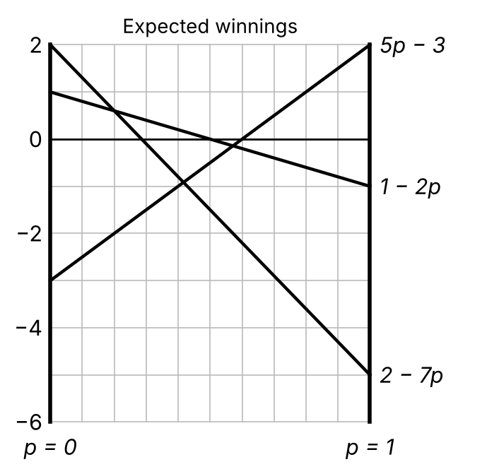
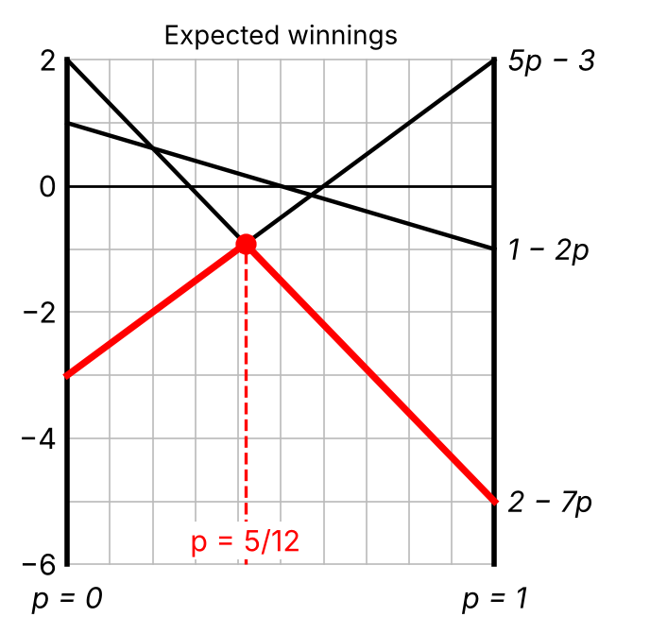
Optimal Strategies for Games with No Stable Solution
Choose the highest point of intersection with no lines underneath it
You must draw a graph to identify the correct point of intersection
You should then only need to solve one pair of equations to find p
Here the intersections at p = 1/5 and p = 4/7 have a line below them, so they are not optimal
(Example 10 continued) Alf’s expected winnings are 2 − 7p, 5p − 3 and 1 − 2p.
The highest minimum winnings are where 2 − 7p = 5p − 3, giving p = 5/12
So Alf should play row 1 with probability 5/12 and row 2 with probability 7/12
The value of the game to Alf is 2 − 7 × 5/12 = −11/12
6C

Slide 8
Optimal Strategies for Games with No Stable Solution
The same method works for the player with two choices in an n × 2 game
Here B has two choices, so work with B’s expected winnings (put a minus sign in front of A’s)
Always check for a stable solution first
A and B play a zero-sum game, given by the pay-off matrix below. Determine B’s best strategy, and the value of the game to B.
B plays 1
B plays 2
Row minimum
A plays 1
4
−1
−1
A plays 2
3
4
3
A plays 3
1
7
1
A plays 4
−2
8
−2
Column maximum
4
8
The row maximin is 3 and the column minimax is 4. 3 ≠ 4 so there is no stable solution
B has only two choices: let B play column 1 with probability q and column 2 with probability 1 − q
If A plays row 1, B’s expected winnings are −[4q − (1 − q)] = 1 − 5q
If A plays row 2, B’s expected winnings are −[3q + 4(1 − q)] = q − 4
If A plays row 3, B’s expected winnings are −[q + 7(1 − q)] = 6q − 7
If A plays row 4, B’s expected winnings are −[−2q + 8(1 − q)] = 10q − 8
6C

Slide 9
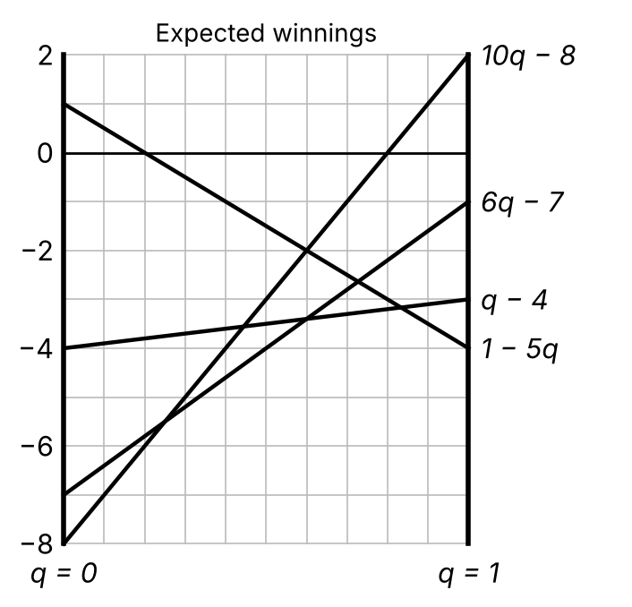
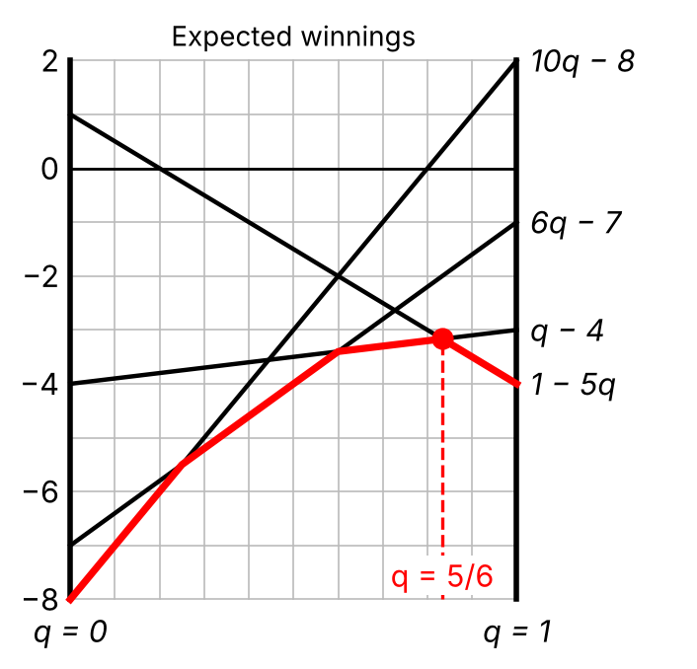
Optimal Strategies for Games with No Stable Solution
The optimal solution is not necessarily the lowest point of intersection
Look from the ‘bottom up’ to find the highest point of intersection with no lines crossing below it
(Example 11 continued) B’s expected winnings are 1 − 5q, q − 4, 6q − 7 and 10q − 8.
The highest minimum winnings are where 1 − 5q = q − 4, giving q = 5/6
So B should play column 1 with probability 5/6 and column 2 with probability 1/6
The value of the game to B is 5/6 − 4 = −19/6
So the value of the game to A is 19/6, which lies between the row maximin 3 and the column minimax 4
6C

