Slide 1
Flows in Networks 1
Decision 2 Chapter 3
Westie's Workshop

Slide 2
Teachings for Exercise 3B

Slide 3
Cuts and Their Capacities
A cut, in a network with source S and sink T, is a set of arcs whose removal separates the network into two parts X and Y, where X contains at least S and Y contains at least T
The capacity (value) of a cut is the sum of the capacities of those arcs in the cut which are directed from X to Y
Imagine the arcs are water pipes broken by the cut: how much water flows into the ‘puddle’ on the sink side?
This network has three different cuts drawn on it, C₁, C₂ and C₃.
A
8
D
14
11
4
6
S
3
C
T
5
15
7
16
B
9
E
C₁
C₃
C₂
C₁ separates {S} from {A, B, C, D, E, T}: capacity = 14 + 15 = 29
C₂: flowing into the cut are AD, CD and ET: capacity = 8 + 6 + 16 = 30
C₃: flowing into the cut are AD, AC, BC and BE: capacity = 8 + 4 + 7 + 9 = 28
3B

Slide 4
Cuts and Their Capacities
When evaluating the capacity of a cut, only include the capacities of the arcs flowing into the cut (from the source side to the sink side)
Arcs which are cut, but whose direction flows out of the cut, contribute zero to the capacity of the cut
Different cuts usually give different values
The diagram shows a capacitated directed network. The number on each arc represents the capacity of that arc. Determine the values of cuts C₄ and C₅.
A
8
D
C₅
14
11
4
6
S
3
C
T
5
15
7
16
B
9
E
C₄
Flowing into C₄ are SA (14), BC (7) and BE (9): C₄ = 14 + 7 + 9 = 30
AB is cut, but it flows from the sink side to the source side (out of the cut), so it contributes nothing
Flowing into C₅ are DT (11), AC (4), AB (3) and SB (15): C₅ = 11 + 4 + 3 + 15 = 33
CD, although cut, flows out of the cut. Notice that AB was not included in C₄ but is included in C₅
3B

Slide 5
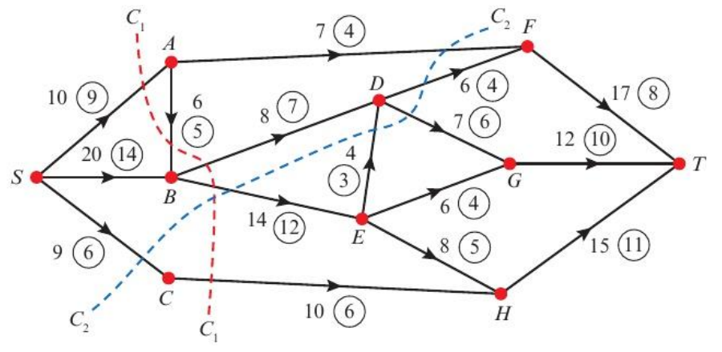
Cuts and Their Capacities
When a diagram shows both capacities and a flow, the value of a cut is calculated using the capacities
Work out which side of the cut each vertex is on, then check the direction of every arc that crosses the cut
The diagram shows a capacitated directed network. The number on each arc represents the capacity of that arc. The numbers in circles represent an initial flow pattern. Find the values of cuts C₁ and C₂.
C₁: SA, BD, BE and CH flow into the cut. AB flows out of the cut, so contributes zero.
Value of cut C₁ = 10 (SA) + 8 (BD) + 14 (BE) + 10 (CH) = 42
C₂: AF, DF, DG, BE and SC flow into the cut. ED flows out of the cut, so contributes zero.
Value of cut C₂ = 7 (AF) + 6 (DF) + 7 (DG) + 14 (BE) + 9 (SC) = 43
Watch out: use the capacities to evaluate the cut, not the flow along each arc
3B

