Slide 1
The Simplex Algorithm
Decision 1 Chapter 7
Westie's Workshop

Slide 2
Teachings for Exercise 7B

Slide 3
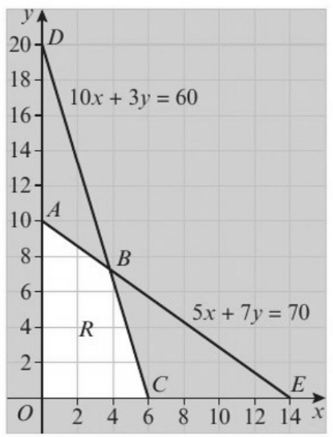
The Simplex Method
The simplex algorithm starts at one vertex and moves between vertices in sequence, increasing the objective function and one of the variables each time, until it reaches an optimal solution
The simplex method lets you decide whether a vertex is optimal and, if not, which adjacent vertex to move to
Slack variables are essential when using the simplex algorithm
Explain the significance of the slack variables in the graphical representation of the linear programming problem below.
Maximise P = 3x + 2y
subject to:
5x + 7y + r = 70
10x + 3y + s = 60
x, y, r, s ≥ 0
The feasible region, R, is shown.
The first constraint is represented by the line ABE, where 5x + 7y = 70.
This is also the line where r = 0
The second constraint is represented by the line DBC, where 10x + 3y = 60.
This is also the line where s = 0
So the four lines forming the boundary of R are x = 0, y = 0, r = 0 and s = 0
7B

Slide 4
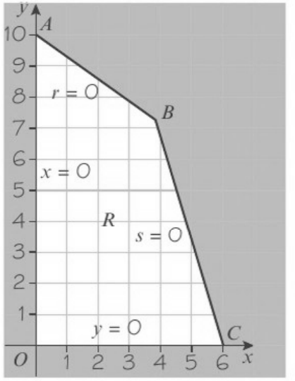
The Simplex Method
Which variables are zero at each vertex of R?
Vertex
Coordinates
Zero variables
O
(0, 0)
x = 0, y = 0
A
(0, 10)
x = 0, r = 0
B
(42/11, 80/11)
r = 0, s = 0
C
(6, 0)
y = 0, s = 0
At each vertex precisely two of the four variables x, y, r and s are zero
The boundary of R drawn using x = 0, y = 0, r = 0 and s = 0
7B

Slide 5
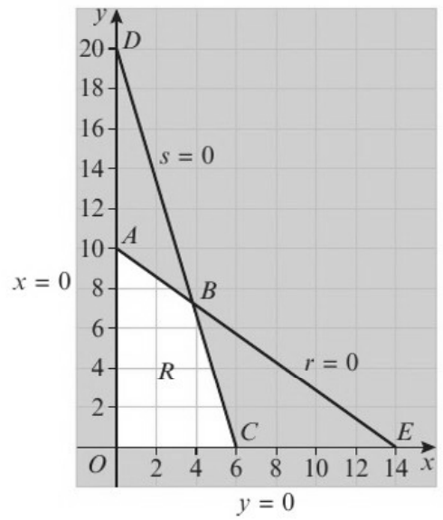
The Simplex Method
The algebraic simplex method
Write the constraints as equations and the objective as P − 3x − 2y = 0
Start at the origin, where P = 0
Increase the variable that increases P fastest, keeping the others at zero
Stop at the first vertex you reach (the smallest limit) and use that equation to eliminate the variable from the others
Make P the subject: if a coefficient is positive P can still increase; if all are negative P is optimal
Explain, in detail, how the algebraic simplex algorithm is used to solve the following problem, relating each stage to the given graph.
Maximise P = 3x + 2y
subject to:
5x + 7y + r = 70
10x + 3y + s = 60
x, y, r, s ≥ 0
5x + 7y + r = 70 (1)
10x + 3y + s = 60 (2)
P − 3x − 2y = 0 (3)
Start at O(0, 0), where P = 0. This is not optimal
P = 3x + 2y: increasing x adds 3 per unit, so increase x keeping y = 0 (move right along the x-axis)
(1): y = 0, r = 0 gives x = 14 (2): y = 0, s = 0 gives x = 6
You reach C (y = s = 0) first, so use equation (2) to eliminate x
7B

Slide 6
The Simplex Method
x + 3/10 y + 1/10 s = 6 (5) = (2) ÷ 10
11/2 y + r − 1/2 s = 40 (4) = (1) − 5(5)
P − 11/10 y + 3/10 s = 18 (6) = (3) + 3(5)
P = 18 + 11/10 y − 3/10 s, so at C (y = s = 0), P = 18
Increasing y increases P (increasing s would decrease it), so increase y keeping s = 0: travel along s = 0 from C towards B
(4): s = r = 0 gives y = 80/11 = 7 3/11
(5): s = x = 0 gives y = 20
You reach B (r = s = 0) first, so use equation (4) to eliminate y
Each elimination is just solving simultaneous equations
The equation you divide is the pivot row of a simplex tableau
7B

Slide 7
The Simplex Method
y + 2/11 r − 1/11 s = 80/11 (7) = (4) ÷ 11/2
x − 3/55 r + 7/55 s = 42/11 (8) = (5) − 3/10 (7)
P + 1/5 r + 1/5 s = 26 (9) = (6) + 11/10 (7)
P = 26 − 1/5 r − 1/5 s
Increasing r or s would decrease P, so you have reached the optimal solution
Profit = 26 when x = 42/11, y = 80/11, r = 0 and s = 0 (vertex B)
7B

Slide 8
The Simplex Method
The same method works with three (or more) variables
Increase the variable with the largest coefficient in P, keeping the others at zero
Work out the limit each equation puts on it: the smallest limit is the vertex you reach first
When P = constant − (positive multiples of variables), P is optimal
Show, in detail, the application of the algebraic simplex algorithm to the linear programming problem below.
Maximise P = 10x + 12y + 8z
subject to: 2x + 2y ≤ 5, 5x + 3y + 4z ≤ 15, x, y, z ≥ 0
Introduce slack variables r and s:
2x + 2y + r = 5 (1)
5x + 3y + 4z + s = 15 (2)
P − 10x − 12y − 8z = 0 (3)
Start at (0, 0, 0), where P = 0. P = 10x + 12y + 8z, so increase y (the biggest increase), keeping x = z = 0
(1): x = z = r = 0 gives y = 5/2 (2): x = z = s = 0 gives y = 5
So you reach (0, 5/2, 0) first: use equation (1) to eliminate y
7B

Slide 9
The Simplex Method
Eliminate the variable you increased
Divide its equation so the coefficient is 1, then add or subtract multiples of it from the other equations
This equation corresponds to the pivot row in the simplex tableau
x + y + 1/2 r = 5/2 (4) = (1) ÷ 2
2 x + 4 z − 3/2 r + s = 15/2 (5) = (2) − 3(4)
P + 2 x − 8 z + 6 r = 30 (6) = (3) + 12(4)
P = 30 − 2x + 8z − 6r
You can still increase P by increasing z (keep x and r zero; increasing them would decrease P)
(4) has no z term, so gives no limit. (5): x = r = s = 0 gives z = 15/8
So use equation (5) to eliminate z
7B

Slide 10
The Simplex Method
Stop when P cannot be increased
When every variable in P = … has a negative coefficient, increasing any of them would decrease P
State the value of P and of every variable, including the slack variables
1/2 x + z − 3/8 r + 1/4 s = 15/8 (7) = (5) ÷ 4
x + y + 1/2 r = 5/2 (4) unchanged (no z term)
P + 6 x + 3 r + 2 s = 45 (8) = (6) + 8(7)
P = 45 − 6x − 3r − 2s, so at the current vertex (x = r = s = 0) P = 45
Increasing x, r or s would decrease the profit, so this is optimal
Profit = 45 when x = 0, y = 5/2, z = 15/8, r = 0 and s = 0
r = 0 and s = 0 mean both constraints are at capacity
7B

Slide 11
The Simplex Method
A simplex tableau holds the coefficients of the equations
One row for each constraint; the bottom row is the objective, written as P − 3x − 2y = 0
The basic variables are the ones that are not currently zero. Any variable not listed as basic is 0
Start at the origin: the slack variables are the basic variables. This is the basic feasible solution
Solve the linear programming problem in Example 6 using simplex tableaux.
Maximise P = 3x + 2y
subject to: 5x + 7y + r = 70, 10x + 3y + s = 60
x, y, r, s ≥ 0
Basic var.
x
y
r
s
Value
r
5
7
1
0
70
5x + 7y + r = 70
s
10
3
0
1
60
10x + 3y + s = 60
P
−3
−2
0
0
0
P − 3x − 2y = 0
Reading across: r = 70, s = 60, P = 0, and x = y = 0 (not basic)
This is the basic feasible solution: all the constraints are satisfied, but P can be improved
7B

Slide 12
The Simplex Method
The simplex tableau method
1 Pivot column: most negative entry in the objective row
2 θ = value ÷ entry in the pivot column (positive entries only)
3 Pivot row: the smallest positive θ. The pivot is where the pivot row and column meet
4 Divide the pivot row by the pivot and change its basic variable
5 Use the pivot row to make every other entry in the pivot column 0
6 Repeat until there are no negatives in the objective row
Basic var.
x
y
r
s
Value
θ values
r
5
7
1
0
70
70 ÷ 5 = 14
s
10
3
0
1
60
60 ÷ 10 = 6
P
−3
−2
0
0
0
Pivot column: x (most negative value in the P row is −3)
Pivot row: s (smallest positive θ = 6), so the pivot is 10
Basic var.
x
y
r
s
Value
Row operations
r
0
11/2
1
−1/2
40
R1 − 5R2
x
1
3/10
0
1/10
6
R2 ÷ 10
P
0
−11/10
0
3/10
18
R3 + 3R2
There is still a negative value (−11/10) in the objective row, so repeat
7B

Slide 13
The Simplex Method
The simplex tableau method
1 Pivot column: most negative entry in the objective row
2 θ = value ÷ entry in the pivot column (positive entries only)
3 Pivot row: the smallest positive θ. The pivot is where the pivot row and column meet
4 Divide the pivot row by the pivot and change its basic variable
5 Use the pivot row to make every other entry in the pivot column 0
6 Repeat until there are no negatives in the objective row
Basic var.
x
y
r
s
Value
θ values
r
0
11/2
1
−1/2
40
40 ÷ 11/2 = 80/11
x
1
3/10
0
1/10
6
6 ÷ 3/10 = 20
P
0
−11/10
0
3/10
18
Pivot column: y (most negative value in the P row is −11/10)
Pivot row: r (smallest positive θ = 80/11), so the pivot is 11/2
Basic var.
x
y
r
s
Value
Row operations
y
0
1
2/11
−1/11
80/11
R1 ÷ 11/2
x
1
0
−3/55
7/55
42/11
R2 − (3/10)R1
P
0
0
1/5
1/5
26
R3 + (11/10)R1
No negative values in the objective row, so this tableau is optimal
P = 26, x = 42/11, y = 80/11, r = 0, s = 0
Compare with Example 6: each tableau matches a set of equations
7B

Slide 14
The Simplex Method
The simplex method maximises. To minimise P, maximise Q = −P
Use the standard simplex tableau method on Q
The minimum value of P is the negative of the maximum value of Q
The values of x, y and the slack variables are the same
Minimise P = 3x − y
subject to: 2x + y ≤ 12, x + 4y ≤ 8, x ≥ 0, y ≥ 0
Define Q = −P = −3x + y
Maximise Q = −3x + y subject to 2x + y + r = 12, x + 4y + s = 8
In the tableau the objective row is Q + 3x − y = 0
Basic var.
x
y
r
s
Value
r
2
1
1
0
12
s
1
4
0
1
8
Q
3
−1
0
0
0
Basic feasible solution: x = 0, y = 0, r = 12, s = 8, Q = 0
7B

Slide 15
The Simplex Method
Basic var.
x
y
r
s
Value
θ values
r
2
1
1
0
12
12 ÷ 1 = 12
s
1
4
0
1
8
8 ÷ 4 = 2
Q
3
−1
0
0
0
Pivot column: y (most negative value in the Q row is −1)
Pivot row: s (smallest positive θ = 2), so the pivot is 4
Basic var.
x
y
r
s
Value
Row operations
r
7/4
0
1
−1/4
10
R1 − R2
y
1/4
1
0
1/4
2
R2 ÷ 4
Q
13/4
0
0
1/4
2
R3 + R2
There are no negative values in the objective row, so the solution is optimal
Maximum value of Q = 2, when x = 0, y = 2, r = 10, s = 0
So the minimum value of P = −2, when x = 0, y = 2, r = 10, s = 0
7B

Slide 16
The Simplex Method
Use the steps in order every time
Write the pivot row first in each new tableau, then use it to work out the other rows
Label every row with its row operation, e.g. R2 − 3R1
To verify a solution, substitute the values into the original objective function and constraints
a Use simplex tableaux to solve the linear programming problem below (from Example 7).
Maximise P = 10x + 12y + 8z
subject to: 2x + 2y ≤ 5, 5x + 3y + 4z ≤ 15, x, y, z ≥ 0
b Verify your solution using the original problem.
2x + 2y + r = 5, 5x + 3y + 4z + s = 15, P − 10x − 12y − 8z = 0
Basic var.
x
y
z
r
s
Value
r
2
2
0
1
0
5
s
5
3
4
0
1
15
P
−10
−12
−8
0
0
0
7B

Slide 17
The Simplex Method
Basic var.
x
y
z
r
s
Value
θ values
r
2
2
0
1
0
5
5 ÷ 2 = 5/2
s
5
3
4
0
1
15
15 ÷ 3 = 5
P
−10
−12
−8
0
0
0
Pivot column: y (most negative value in the P row is −12)
Pivot row: r (smallest positive θ = 5/2), so the pivot is 2
Basic var.
x
y
z
r
s
Value
Row operations
y
1
1
0
1/2
0
5/2
R1 ÷ 2
s
2
0
4
−3/2
1
15/2
R2 − 3R1
P
2
0
−8
6
0
30
R3 + 12R1
The y column now contains just one 1 (where the pivot was) and zeros. There is still a negative (−8) in the objective row, so repeat
7B

Slide 18
The Simplex Method
Basic var.
x
y
z
r
s
Value
θ values
y
1
1
0
1/2
0
5/2
5/2 ÷ 0: not valid
s
2
0
4
−3/2
1
15/2
15/2 ÷ 4 = 15/8
P
2
0
−8
6
0
30
Pivot column: z (most negative value in the P row is −8)
Pivot row: s (smallest positive θ = 15/8), so the pivot is 4
Basic var.
x
y
z
r
s
Value
Row operations
y
1
1
0
1/2
0
5/2
R1 no change
z
1/2
0
1
−3/8
1/4
15/8
R2 ÷ 4
P
6
0
0
3
2
45
R3 + 8R2
No negatives in the objective row, so the tableau is optimal
a P = 45, x = 0, y = 5/2, z = 15/8, r = 0, s = 0
b 10x + 12y + 8z = 0 + 30 + 15 = 45 = P ✓
2x + 2y = 0 + 5 = 5 ≤ 5 ✓ 5x + 3y + 4z = 0 + 15/2 + 15/2 = 15 ≤ 15 ✓ x, y, z ≥ 0 ✓
7B

Slide 19
The Simplex Method
Only use positive θ values
A zero or negative entry in the pivot column does not limit how far you can increase that variable, so that row cannot be the pivot row
Write the equations of a tableau by reading across each row; the objective row starts ‘P +’
a Use the simplex tableau method to solve the following linear programming problem.
Maximise P = 3x + 4y − 5z
subject to: 2x − 3y + 2z + r = 4, x + 2y + 4z + s = 8, y − z + t = 6, x, y, z, r, s, t ≥ 0
b State the values of the objective function and every variable at the optimal point.
c Write down the equations given by your optimal tableau.
d Use the profit equation you wrote down in part c to explain why your final tableau is optimal.
Basic var.
x
y
z
r
s
t
Value
r
2
−3
2
1
0
0
4
s
1
2
4
0
1
0
8
t
0
1
−1
0
0
1
6
P
−3
−4
5
0
0
0
0
7B

Slide 20
The Simplex Method
Basic var.
x
y
z
r
s
t
Value
θ values
r
2
−3
2
1
0
0
4
4 ÷ −3: not valid
s
1
2
4
0
1
0
8
8 ÷ 2 = 4
t
0
1
−1
0
0
1
6
6 ÷ 1 = 6
P
−3
−4
5
0
0
0
0
Pivot column: y (most negative value in the P row is −4)
Pivot row: s (smallest positive θ = 4; −4/3 cannot be used), so the pivot is 2
Basic var.
x
y
z
r
s
t
Value
Row operations
r
7/2
0
8
1
3/2
0
16
R1 + 3R2
y
1/2
1
2
0
1/2
0
4
R2 ÷ 2
t
−1/2
0
−3
0
−1/2
1
2
R3 − R2
P
−1
0
13
0
2
0
16
R4 + 4R2
The only negative entry in the objective row is now in the x column, so repeat
7B

Slide 21
The Simplex Method
Basic var.
x
y
z
r
s
t
Value
θ values
r
7/2
0
8
1
3/2
0
16
16 ÷ 7/2 = 32/7
y
1/2
1
2
0
1/2
0
4
4 ÷ 1/2 = 8
t
−1/2
0
−3
0
−1/2
1
2
2 ÷ −1/2: not valid
P
−1
0
13
0
2
0
16
Pivot column: x (most negative value in the P row is −1)
Pivot row: r (smallest positive θ = 32/7), so the pivot is 7/2
Basic var.
x
y
z
r
s
t
Value
Row operations
x
1
0
16/7
2/7
3/7
0
32/7
R1 ÷ 7/2
y
0
1
6/7
−1/7
2/7
0
12/7
R2 − (1/2)R1
t
0
0
−13/7
1/7
−2/7
1
30/7
R3 + (1/2)R1
P
0
0
107/7
2/7
17/7
0
144/7
R4 + R1
There are no negatives in the objective row, so you have an optimal solution
7B

Slide 22
The Simplex Method
Basic var.
x
y
z
r
s
t
Value
x
1
0
16/7
2/7
3/7
0
32/7
y
0
1
6/7
−1/7
2/7
0
12/7
t
0
0
−13/7
1/7
−2/7
1
30/7
P
0
0
107/7
2/7
17/7
0
144/7
b P = 144/7, x = 32/7, y = 12/7, z = 0, r = 0, s = 0, t = 30/7
Read the basic variables from the first and last columns; all other variables are zero
c x + 16/7 z + 2/7 r + 3/7 s = 32/7
y + 6/7 z − 1/7 r + 2/7 s = 12/7
−13/7 z + 1/7 r − 2/7 s + t = 30/7
P + 107/7 z + 2/7 r + 17/7 s = 144/7
d P = 144/7 − 107/7 z − 2/7 r − 17/7 s
Increasing z, r or s would decrease the profit, so the solution is optimal
7B

