Slide 1
The Travelling Salesman Problem
Decision 1 Chapter 5
Westie's Workshop

Slide 2
Teachings for Exercise 5B

Slide 3
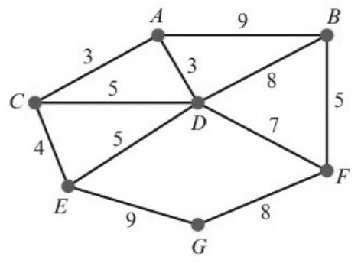
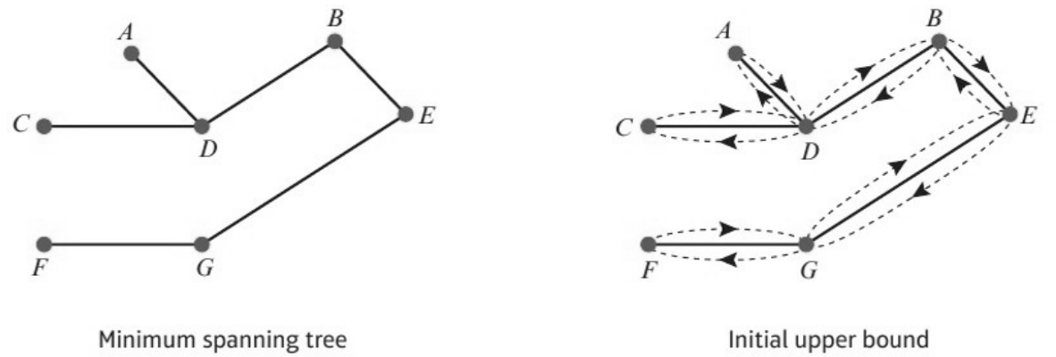
Using a Minimum Spanning Tree Method to Find an Upper Bound
You can use a minimum spanning tree method to find an upper bound for the practical problem
1 Find the minimum spanning tree (Prim or Kruskal): this guarantees every vertex is included
2 Double this minimum connector, so that completing the cycle is guaranteed
3 Seek ‘shortcuts’ using arcs not in the tree
An initial upper bound is found by finding the weight of the minimum spanning tree and doubling it
a Use Kruskal’s algorithm to find a minimum spanning tree for the network on the right.
b Hence find an initial upper bound for the travelling salesman problem.
a Arcs in order of weight:
Arc
Weight
A
B
AC
3
include
3
3
AD
3
include
CE
4
include
C
7
5
BF
5
include
D
CD
5
reject
4
F
DE
5
reject
E
8
DF
7
include
BD
8
reject
G
FG
8
include
Weight of MST = 3 + 3 + 4 + 5 + 7 + 8 = 30
AB
9
Tree complete
EG
9
b Initial upper bound = 2 × 30 = 60
5B

Slide 4
Using a Minimum Spanning Tree Method to Find an Upper Bound
When using a table it is easier to use Prim’s algorithm
1 Choose a starting vertex: label its column 1 and cross out its row
2 Look down all labelled columns for the smallest undeleted value
3 Circle it: this arc joins the next vertex
4 Label that vertex’s column with the next number and cross out its row
5 Repeat until every row is crossed out
The weight of the tree is the sum of the circled values
The table of least distances for a network is given below. Find an initial upper bound for the travelling salesman problem for this network.
1
2
4
3
5
A
B
A
B
C
D
E
11
A
–
11
13
19
31
13
8
B
11
–
24
8
22
C
13
24
–
32
18
C
D
D
19
8
32
–
14
14
E
31
22
18
14
–
E
Order of arc selection: AB, BD, AC, DE
Weight of the minimum spanning tree = 11 + 8 + 13 + 14 = 46
Initial upper bound = 2 × 46 = 92
5B

Slide 5
Using a Minimum Spanning Tree Method to Find an Upper Bound
The initial upper bound is not very good, since you repeat every arc of the tree
You can improve the initial upper bound by looking for shortcuts
A shortcut uses an arc that is not in the tree to bypass a repeated section of the tree
Starting from the initial upper bound found in the previous example, use a shortcut to reduce the upper bound to below 70.
A
11
B
Initial walk (each arc twice):
A B D E D B A C A = 92
13
8
C
D
Use CE (18) instead of repeating CA (13), AB (11), BD (8) and DE (14)
18
14
Saves 13 + 11 + 8 + 14 − 18 = 28
E
A
B
C
D
E
A
–
11
13
19
31
Route: A B D E C A
B
11
–
24
8
22
C
13
24
–
32
18
Improved upper bound = 11 + 8 + 14 + 18 + 13 = 64
D
19
8
32
–
14
Check: 92 − 28 = 64
E
31
22
18
14
–
5B

Slide 6
Using a Minimum Spanning Tree Method to Find an Upper Bound
The table shows the distances, in miles, between eight cities. A politician has to visit each city, starting and finishing at A. She wishes to minimise the total distance travelled.
a Find a minimum spanning tree for this network.
b Hence find an upper bound for this problem.
c Use shortcuts to reduce this upper bound to a value below 1300 miles.
1
2
3
8
4
6
7
5
A
B
C
D
E
F
G
H
A
–
47
84
382
120
172
299
144
B
47
–
121
402
155
193
319
165
C
84
121
–
456
200
246
373
218
D
382
402
456
–
413
220
155
289
E
120
155
200
413
–
204
286
131
F
172
193
246
220
204
–
144
70
G
299
319
373
155
286
144
–
160
Use Prim’s algorithm on the table
Number each column as its vertex joins the tree, cross out its row and circle the arc chosen
Make your method clear by stating the order of arc selection
H
144
165
218
289
131
70
160
–
a Order of arc selection: AB, AC, AE, EH, HF, FG, GD
B
47
A
E
H
F
G
D
120
131
70
144
155
C
84
Weight of MST = 47 + 84 + 120 + 131 + 70 + 144 + 155 = 751 miles
b Initial upper bound = 2 × 751 = 1502 miles
5B

Slide 7
Using a Minimum Spanning Tree Method to Find an Upper Bound
Look at the tree for arcs that bypass long repeated sections
For each shortcut: saving = (sum of the arcs no longer repeated) − (the shortcut arc)
Problem-solving
Check your answer: initial upper bound − savings = improved upper bound
c Use shortcuts to reduce the upper bound of 1502 miles to a value below 1300 miles.
B
47
A
E
H
F
G
D
121
120
131
70
144
155
C
84
382
Looking at the tree, likely shortcuts are AD and BC
AD saves 120 + 131 + 70 + 144 + 155 − 382 = 238 miles
BC saves 47 + 84 − 121 = 10 miles
Tour: A B C A E H F G D A
Tour length = 47 + 121 + 84 + 120 + 131 + 70 + 144 + 155 + 382 = 1254 miles
Check: 1502 − 238 − 10 = 1254, which is below 1300
5B

Slide 8
Using a Minimum Spanning Tree Method to Find an Upper Bound
There are many other shortcuts that could be tried
Aim to make the upper bound as low as possible to reduce the interval in which the optimal solution is contained
Selecting shortcuts: try these other shortcuts for the previous example.
BD: saves 265 miles
Tour A B D G F H E A C A, length 1237 miles
CB + AF + FD: saves 238 miles
Tour A B C A E H F G D F A, length 1264 miles
CD: saves 248 miles
Tour A B A E H F G D C A, length 1254 miles
Of these, the best upper bound is 1237 miles, since it is the smallest
5B

