Slide 1
The Travelling Salesman Problem
Decision 1 Chapter 5
Westie's Workshop

Slide 2
Teachings for Exercise 5A

Slide 3
The Classical and Practical Travelling Salesman Problems
You need to know the terminology of the travelling salesman problem
A walk in a network is a finite sequence of edges such that the end vertex of one edge is the start vertex of the next
A walk which visits every vertex, returning to its starting vertex, is called a tour
If a tour visits every vertex exactly once, it is a Hamiltonian cycle
The travelling salesman problem involves finding a tour of minimum total weight
There is no efficient algorithm for solving the problem
So we use a heuristic algorithm: one that finds a good solution, which is not necessarily the optimal solution
Optimal solution
Lower bound
Upper bound
Find upper bounds and select the smallest, and lower bounds and select the largest, to ‘trap’ the optimal solution in as narrow an interval as possible
There are two variations of the problem
Classical problem: each vertex must be visited exactly once before returning to the start
Practical problem: each vertex must be visited at least once before returning to the start
If you convert the network into a complete network of least distances, the two problems are equivalent
5A

Slide 4
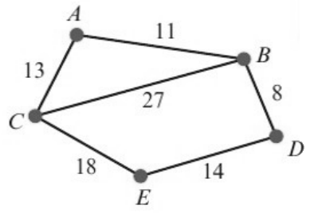
The Classical and Practical Travelling Salesman Problems
The triangle inequality states:
longest side of any triangle ≤ sum of the two shorter sides
If it does not hold in a triangle, replace the longest arc by the sum of the two shorter ones, creating a network of shortest distances
The distance matrix for a complete network of least distances is called a table of least distances
It shows the shortest path between any two points in the network
You can usually complete one by inspection: the shortest route may not be the direct one, so check carefully
Create a table of least distances for the network opposite.
A
B
C
D
E
AB, AC direct. AD: ABD = 19. AE: ACE = 31 (ABDE = 33)
A
–
11
13
19
31
Table is symmetrical: copy row A into column A
B
11
–
24
8
22
C
13
24
–
32
18
BC: BAC = 24 (direct 27). BD = 8. BE: BDE = 22
D
19
8
32
–
14
Copy row B into column B
E
31
22
18
14
–
CD: CED = 32 and CABD = 32. CE = 18 direct
Copy row C into column C
DE = 14 direct
5A

Slide 5
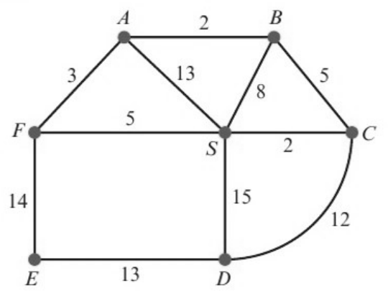
The Classical and Practical Travelling Salesman Problems
You will only need to find tables of least distances for undirected networks
So the finished table will be symmetrical about its leading diagonal, e.g. the least distance from A to S is the same as from S to A
The network shows the distances, in km, between the central sorting office at S and six post offices A, B, C, D, E and F. Complete the table of least distances, stating your shortest route for each of the entries.
S
A
B
C
D
E
F
S
–
8
7
2
14
19
5
A
8
–
2
7
19
17
3
B
7
2
–
5
17
19
5
C
2
7
5
–
12
21
7
D
14
19
17
12
–
13
19
E
19
17
19
21
13
–
14
F
5
3
5
7
19
14
–
SA: SFA, length 8
AC: ABC, length 7
SB: SCB, length 7
BE: BAFE, length 19
SD: SCD, length 14
BF: BAF, length 5
SE: SFE, length 19
DF: DCSF, length 19
Check: every entry is filled and the table is symmetrical about the leading diagonal
5A

