Slide 1
Route Inspection
Decision 1 Chapter 4
Westie's Workshop

Slide 2
Teachings for Exercise 4C

Slide 3
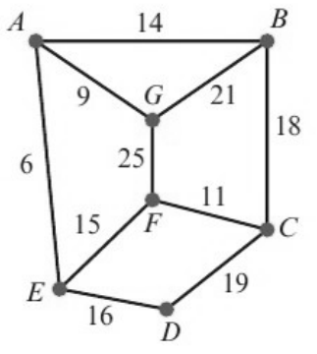
Networks with More Than Four Odd Nodes
If the network has more than four odd nodes, additional information will be given that restricts the number of pairings you need to consider
If the route must start at X and finish at Y (both odd), then X and Y stay odd: pair up the other odd nodes
A night watchman has to patrol a network of paths as shown in the diagram. The number shown on each arc represents the time taken, in minutes, to walk between the labelled points. (Total weight of network is 154)
a) Use the route inspection algorithm, starting at A and finishing at C, to find the minimum time taken to traverse each arc at least once.
b) State a possible route.
a) There are 6 odd nodes: A, B, C, E, F, G
Number of possible pairings
The route starts at A and finishes at C, so these stay odd. Pair the remaining odd nodes B, E, F and G
Odd nodes
Pairings
2
1
Pairing
Paths
Total
4
3
BE + FG
20 + 25
45
6
3 × 5 = 15
BF + EG
29 + 15
44
8
7 × 15 = 105
BG + EF
21 + 15
36
10
9 × 105 = 945
BE = BAE, BF = BCF, EG = EAG
Least sum 36: repeat paths BG and EF
Minimum time = 154 + 36 = 190 minutes
b) A possible route is ABGAEFGBCFEDC
4C

Slide 4
Networks with More Than Four Odd Nodes
Problem-solving
Draw the network with the new path. You don’t know its weight, so label it x
Find the new shortest route in terms of x and use it to write an equation
An extra path is added joining B and F directly. After the addition of this path, the minimum time needed to traverse all the paths, starting at A and finishing at C, is reduced by twice the length of time needed to traverse this path.
c) Calculate the time needed to traverse the new path, BF.
B and F are now even. The odd nodes are A, C, E and G
A and C stay odd (start and finish), so find the shortest way to join E and G:
EA + AG = 6 + 9 = 15
x
Minimum time = 154 + x + 15
So 154 + x + 15 = 190 − 2x
Original 190, reduced by 2x
3x = 21
x = 7
The new path BF takes 7 minutes to traverse
4C

Slide 5
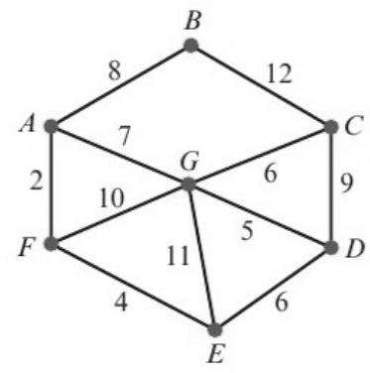
Networks with More Than Four Odd Nodes
When the route can finish at one of two places, consider each finishing point separately
Compare all the pairings for either situation before choosing the pairing that adds the least weight
The network represents the roads that must be travelled by a police patrol car. The length of each road in kilometres is shown on each arc. The patrol starts at A and can finish at either of two police stations, at G or D. (Total weight of network is 80)
a) Find the length of the shortest route such that every road is traversed at least once.
b) State which police station the patrol car finishes at, and which roads must be traversed twice.
a) The odd nodes are A, C, D, E, F, G
Finish at G: pair C, D, E, F
Finish at D: pair C, E, F, G
Pairing
Paths
Total
Pairing
Paths
Total
CD + EF
9 + 4
13
CE + FG
15 + 9
24
CE + DF
15 + 10
25
CF + EG
15 + 11
26
CF + DE
15 + 6
21
CG + EF
6 + 4
10
Shortest paths: CE = CDE, DF = DEF, CF = CGAF, FG = FAG
Least weight added is 10 (CG + EF)
Shortest route = 80 + 10 = 90 km
b) The patrol car finishes at station D, and roads CG and EF must be traversed twice
4C

