Slide 1
Route Inspection
Decision 1 Chapter 4
Westie's Workshop

Slide 2
Teachings for Exercise 4B

Slide 3
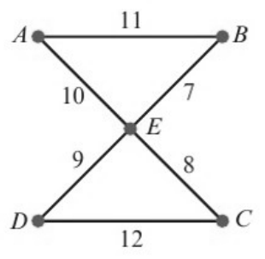
Using the Route Inspection Algorithm
The route inspection (Chinese postman) algorithm finds the shortest route in a network that traverses every arc at least once and returns to its starting point
If all the vertices in the network have even degree, the network is Eulerian
Then the length of the shortest route is equal to the total weight of the network
The diagram shows a network of trails on a BMX course. The number on each edge is the length, in metres, of the trail. Hannah wants to start at A, traverse every trail on the network, then return to A. Find the length of the shortest path she could take.
Vertex
A
B
C
D
E
Degree
2
2
2
2
4
All vertices are even, so the network is Eulerian
Shortest route = 11 + 7 + 8 + 12 + 9 + 10 = 57 m
A possible route:
A
B
E
C
D
E
A
4B

Slide 4
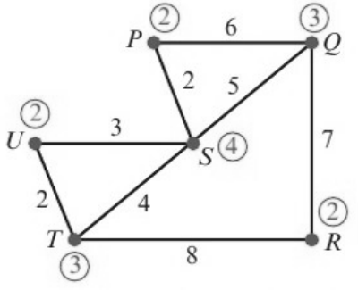
Using the Route Inspection Algorithm
If a network has exactly two odd vertices, it is semi-Eulerian
The shortest route = total weight of the network + the shortest path between the two odd vertices
The numbers in circles show the degree of each vertex. You can label graphs like this in your exam to speed up your working
The diagram shows a network of undersea cables. The number on each arc is the length, in kilometres, of that cable. A diver needs to inspect the cables, and needs to find a route of minimum length that traverses every cable and starts and finishes at S. (Total weight of network is 37)
a) State the cables that will need to be traversed twice. b) State the minimum length of the diver’s route.
There are two odd vertices, Q and T
Paths from Q to T:
QRT = 7 + 8 = 15
QPST = 6 + 2 + 4 = 12
QST = 5 + 4 = 9
Shortest path is QST, length 9
a) The cables that need to be traversed twice are QS and ST
b) Total length = total weight + length of path from Q to T
= 37 + 9 = 46 km
Adding a repeat of QS and ST gives every vertex an even degree, so the redrawn network is Eulerian
4B

Slide 5
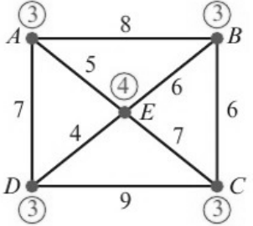
Using the Route Inspection Algorithm
If the network has more than two odd vertices, you need to consider all the possible pairings of the odd vertices
The route inspection algorithm:
1 Identify any vertices with odd degree
2 Consider all possible complete pairings of these vertices
3 Select the complete pairing that has the least sum
4 Add a repeat of the arcs indicated by this pairing to the network
With four odd vertices there are three possible pairings: you must consider all three
A route is needed that starts at A, traverses every arc in this network, and returns to A. Find a possible route and state its length. (Total weight of network is 52)
A, B, C and D have odd degree
Pairing
Shortest paths
Total
AB + CD
8 + 9
17
AC + BD
12 + 10
22
AC = AEC, BD = BED
AD + BC
7 + 6
13
Least sum is AD + BC = 13, so repeat arcs AD and BC
A possible route is ABCEBCDEADA
Total length = 52 + 13 = 65
4B

Slide 6
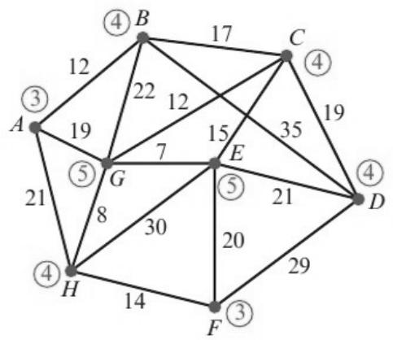
Using the Route Inspection Algorithm
Label the degree of each vertex and identify the odd vertices
Find the shortest path between each pair by inspection, but check carefully: the shortest path may not be the direct arc
The diagram represents a network of roads. The numbers on the arcs represent the lengths of each road in miles. The roads need to be resurfaced. The council wants to find the shortest possible route which traverses every road and starts and ends at A. (Total weight of network is 301)
a) Determine the length of this route. You must show your method and working, and state clearly which roads must be traversed twice.
The odd vertices are A, E, F and G
Shortest paths: A to E is AGE = 26, F to G is FHG = 22, A to F is AHF = 35
Pairing
Shortest paths
Total
AE + FG
26 + 22
48
AF + EG
35 + 7
42
AG + EF
19 + 20
39
Least sum is 39: pair A with G and E with F, so repeat roads AG and EF
Shortest route = 301 + 39 = 340 miles
4B

Slide 7
Using the Route Inspection Algorithm
If the route can start and finish at different vertices, choose them so that the path between the remaining odd vertices is as short as possible
Start and finish at two of the odd vertices: they stay odd
The council decides that, in order to save money, the route can start and end at different vertices.
b) State which two vertices should be chosen to minimise the length of the new route. Give a reason for your answer, and state the length of the new route.
Pair
Shortest path
Length
AE
AGE
26
AF
AHF
35
AG
AG
19
EF
EF
20
EG
EG
7
FG
FHG
22
The least length between any pair of odd vertices is EG = 7, so only EG is repeated
So start at A and finish at F (the other two odd vertices)
New route has length 301 + 7 = 308 miles
Watch out: the single pair with the least distance might not be one of the pairs you used in part a
4B

