Slide 1
Route Inspection
Decision 1 Chapter 4
Westie's Workshop

Slide 2
Teachings for Exercise 4A

Slide 3
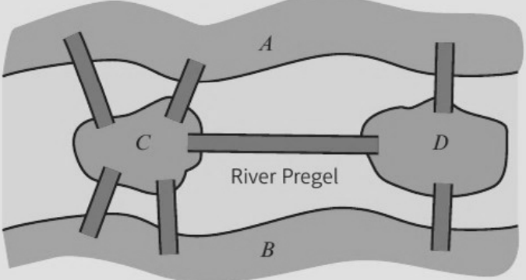
Eulerian Graphs
Leonhard Euler (1735) and the bridges of Königsberg
Euler realised the sizes and shapes of the land masses did not matter
He drew each land mass as a vertex (node) and each bridge as an edge (arc): the first graph
Every time you walk onto a land mass you must leave by a different bridge, so a land mass you pass through must touch an even number of bridges
The diagram represents the city of Königsberg. Two islands (C and D) are linked to each other and to the mainland (A and B) by seven bridges.
Prove that it is impossible to find a route which crosses every bridge exactly once.
Land mass
A
B
C
D
Bridges (degree)
3
3
5
3
All four vertices are odd.
A route crossing every bridge exactly once can only exist if there are 0 or 2 odd vertices, so the walk is impossible.
4A

Slide 4
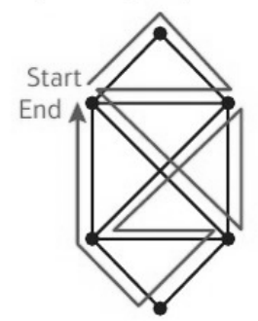
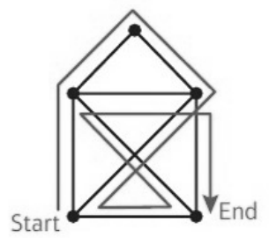
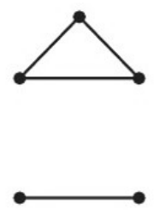
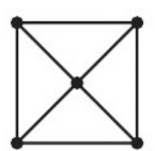
Eulerian Graphs
You can decide whether a graph is Eulerian, semi-Eulerian or neither from the degrees of its vertices
An Eulerian graph contains a trail that includes every edge and starts and finishes at the same vertex (an Eulerian circuit). Any connected graph whose vertices are all even is Eulerian
A semi-Eulerian graph contains a trail that includes every edge but starts and finishes at different vertices. Any connected graph with exactly two odd vertices is semi-Eulerian
The trail must start at one odd vertex and end at the other
Exactly two odd vertices: semi-Eulerian. Start at one odd vertex, end at the other
All vertices even: Eulerian. The circuit can start and end anywhere
More than two odd vertices: neither
Not connected: neither
Eulerian and semi-Eulerian graphs can be drawn without taking your pen off the paper and without repeating any arcs
4A

Slide 5
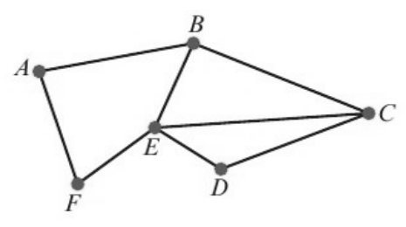
Eulerian Graphs
Find the degree of every vertex first
The degree of a vertex is the number of arcs incident to it
Even vertices have even degree, odd vertices have odd degree
Exactly two odd vertices: semi-Eulerian, so the trail must start at one odd vertex and finish at the other
a) State whether this graph is Eulerian, semi-Eulerian or neither.
b) If possible, find a trail that traverses each edge of this graph exactly once.
Vertex
A
B
C
D
E
F
Degree
2
3
3
2
4
2
a) Exactly 2 odd vertices (B and C), so the graph is semi-Eulerian
b)
B
A
F
E
D
C
E
B
C
Starts at one odd vertex (B) and ends at the other (C)
4A

Slide 6
Eulerian Graphs
The hand-shaking lemma
Sum of orders of the nodes = 2 × number of edges
So the sum of the orders is always even, and every graph has an even number of odd vertices
Eulerian and semi-Eulerian graphs must be connected
A connected graph has 5 nodes. The orders of the nodes are 4, 6, 3, p and 2.
a) Explain why the graph cannot be Eulerian.
b) Explain why the graph must be semi-Eulerian.
c) Give the number of edges contained in the network in terms of p.
d) Draw a graph with two nodes which is neither Eulerian nor semi-Eulerian.
a) The graph has an odd node (order 3). Every node of an Eulerian graph must have even order, so it cannot be Eulerian.
b) The number of odd nodes must be even, so p must be odd. The graph has exactly two odd nodes (3 and p), so it is semi-Eulerian.
c) Sum of the orders of the nodes = 2 × number of edges
Number of edges = (4 + 6 + 3 + p + 2) ÷ 2
= (p + 15) ÷ 2
d)
A
Two vertices and no edges: not connected, so neither Eulerian nor semi-Eulerian
B
4A

