Slide 1
Algorithms on Graphs
Decision 1 Chapter 3
Westie's Workshop

Slide 2
Teachings for Exercise 3E

Slide 3
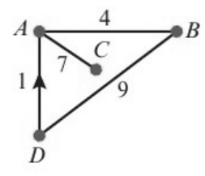
Floyd’s Algorithm
A level only: Floyd’s algorithm finds the shortest path between every pair of vertices
Initial distance table: direct distances, ∞ where there is no direct route
Initial route table: every entry in each column is that column’s letter
Iteration k: shade row k and column k. For each unshaded entry Z compare it with X + Y, the two shaded values in its row and column
If X + Y < Z, write X + Y and put the kth letter in the route table
n vertices means n iterations
This distance graph shows the direct distances, by road, between four towns A, B, C and D, in miles. The road from D to A is one-way, as shown by the arrow. a Use Floyd’s algorithm to produce a table of shortest distances. Give the distance table and route table for each iteration. b Find the route of minimum length from C to D.
Initial tables
A
B
C
D
A
B
C
D
A
–
4
7
∞
A
A
B
C
D
B
4
–
∞
9
B
A
B
C
D
C
7
∞
–
∞
C
A
B
C
D
D
1
9
∞
–
D
A
B
C
D
First iteration (via A)
A
B
C
D
A
B
C
D
A
–
4
7
∞
A
A
B
C
D
B
4
–
11
9
B
A
B
A
D
C
7
11
–
∞
C
A
A
C
D
D
1
5
8
–
D
A
A
A
D
4 + 7 = 11 < ∞, 1 + 4 = 5 < 9, 1 + 7 = 8 < ∞
3E

Slide 4
Floyd’s Algorithm
In the second iteration every change is a detour through B, so B goes in the route table
In the third iteration no value is improved, so nothing changes
Always compare with the values from the previous iteration
This distance graph shows the direct distances, by road, between four towns A, B, C and D, in miles. The road from D to A is one-way, as shown by the arrow. a Use Floyd’s algorithm to produce a table of shortest distances. Give the distance table and route table for each iteration. b Find the route of minimum length from C to D.
Second iteration (via B)
A
B
C
D
A
B
C
D
A
–
4
7
13
A
A
B
C
B
4 + 9 = 13 < ∞
11 + 9 = 20 < ∞
B
4
–
11
9
B
A
B
A
D
C
7
11
–
20
C
A
A
C
B
D
1
5
8
–
D
A
A
A
D
Third iteration (via C)
A
B
C
D
A
B
C
D
A
–
4
7
13
A
A
B
C
B
B
4
–
11
9
B
A
B
A
D
C
7
11
–
20
C
A
A
C
B
D
1
5
8
–
D
A
A
A
D
No changes in the third iteration
3E

Slide 5
Floyd’s Algorithm
To find a route, use the route table
Look at the entry in row (start), column (end). If it is not the end letter, the route detours through that vertex
Repeat for each part of the route until every stage is direct
The distance table gives the length of the route
This distance graph shows the direct distances, by road, between four towns A, B, C and D, in miles. The road from D to A is one-way, as shown by the arrow. a Use Floyd’s algorithm to produce a table of shortest distances. Give the distance table and route table for each iteration. b Find the route of minimum length from C to D.
Fourth iteration (via D)
A
B
C
D
A
B
C
D
A
–
4
7
13
A
A
B
C
B
B
4
–
11
9
B
A
B
A
D
C
7
11
–
20
C
A
A
C
B
D
1
5
8
–
D
A
A
A
D
No changes, so these are the final tables
b) Row C, column D is B: the route goes C … B … D
Row C, column B is A: the route goes C A B D
CA gives A, AB gives B, BD gives D: no more detours
Route CABD, length 20 miles (row C, column D of the distance table)
3E

Slide 6
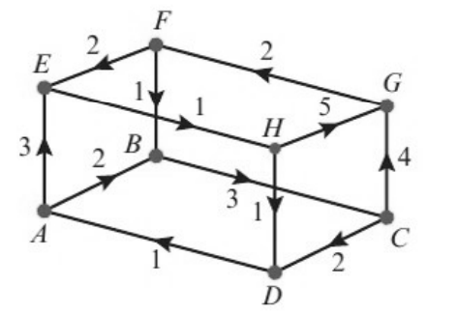
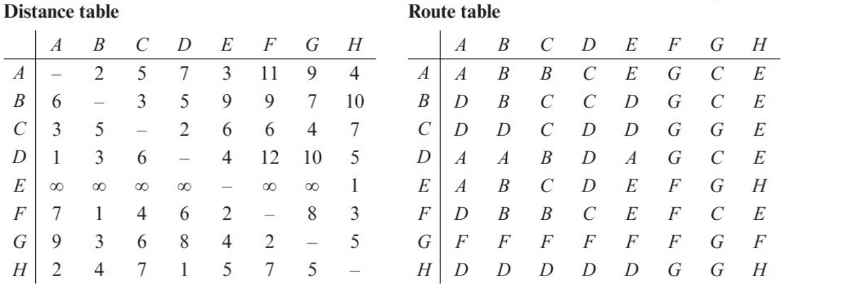
Floyd’s Algorithm
8 departure gates in an airport, linked by travellators and escalators, are modelled by the directed network. The weight of each edge is the travel time, in minutes, between gates. 7 iterations of Floyd’s algorithm give the tables below.
a Apply the final iteration to give the final distance and route tables.
b Sarah needs to get from gate D to gate F. State the minimum time needed and determine the route she should take.
After 7 iterations (A to G). Only the final iteration, through H, remains.
3E

Slide 7
Floyd’s Algorithm
a) Final iteration: shade row H and column H
A
B
C
D
E
F
G
H
A
B
C
D
E
F
G
H
A
–
2
5
5
3
11
9
4
A
A
B
B
H
E
G
C
E
B
6
–
3
5
9
9
7
10
B
D
B
C
C
D
G
C
E
C
3
5
–
2
6
6
4
7
C
D
D
C
D
D
G
G
E
D
1
3
6
–
4
12
10
5
D
A
A
B
D
A
G
C
E
E
3
5
8
2
–
8
6
1
E
H
H
H
H
E
H
H
H
F
5
1
4
4
2
–
8
3
F
H
B
B
H
E
F
C
E
G
7
3
6
6
4
2
–
5
G
H
F
F
H
F
F
G
F
H
2
4
7
1
5
7
5
–
H
D
D
D
D
D
G
G
H
11 values change, e.g. E to A: 1 + 2 = 3 < ∞. Each changed entry in the route table becomes H.
Row E was all ∞ because the only arc out of E goes to H.
b) Row D, column F of the distance table: 12 minutes
Row D, column F of the route table is G: D → G → F
Row D, column G is C: D → C → G → F
Keep checking each stage until every stage is direct (DA, AB, BC, CG, GF)
Row D, column C is B: D → B → C → G → F
Row D, column B is A: D → A → B → C → G → F
Sarah’s quickest route is DABCGF, taking 12 minutes
3E

