Slide 1
Algorithms on Graphs
Decision 1 Chapter 3
Westie's Workshop

Slide 2
Teachings for Exercise 3D

Slide 3
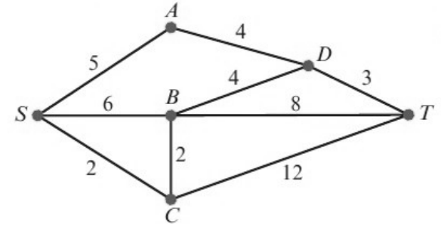
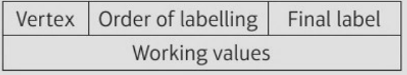
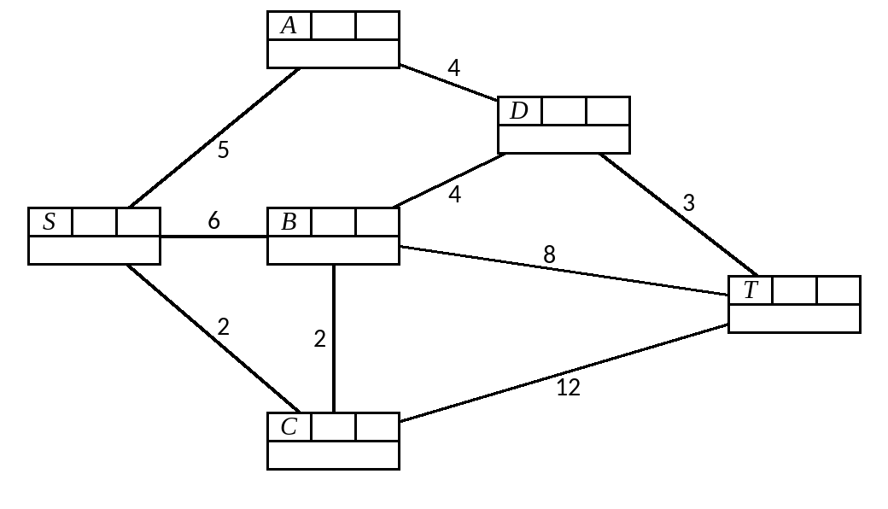
Using Dijkstra’s Algorithm to Find the Shortest Path
Dijkstra’s algorithm finds the shortest path between two vertices
1 Give the start vertex S the final label 0
2 Give a working value to each vertex Y directly connected to X, the vertex that has just got its final label: final label of X + weight of XY (only replace an existing working value if the new one is smaller)
3 The smallest working value at any vertex without a final label becomes its final label
4 Repeat 2 and 3 until T gets its final label
Once a vertex has a final label it is not revisited
Use Dijkstra’s algorithm to find the shortest route from S to T in the network.
4
5
5
5
8
8
1
0
3
4
6
4
6
11
14
12
11
2
2
2
3D

Slide 4
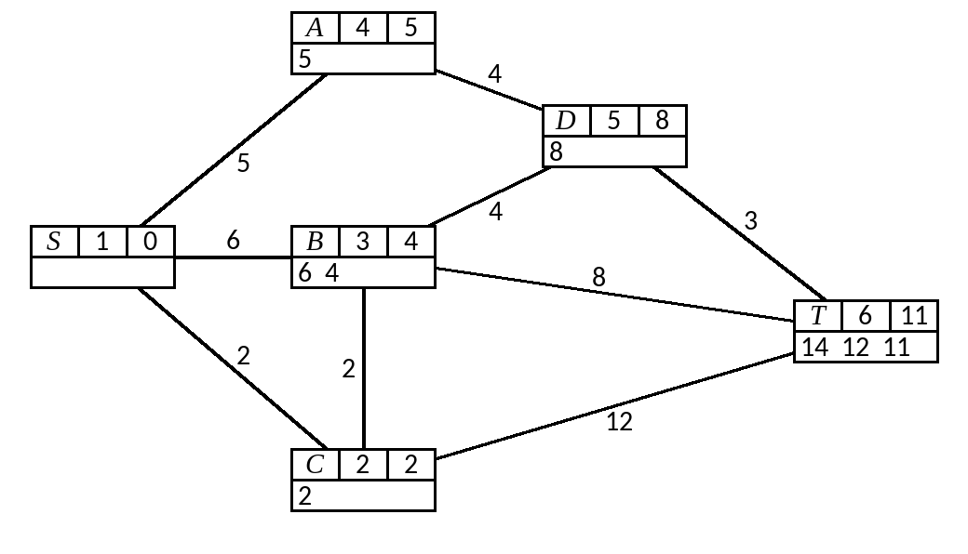
Using Dijkstra’s Algorithm to Find the Shortest Path
To find the route, trace back from T to S
Include arc AB (where B is already on the route) when:
final label of B − final label of A = weight of AB
Unless you are asked to explain, you can find the route from the labelled diagram by inspection
11 − 2 = 9 ≠ 12, so CT is not on the route
11 − 4 = 7 ≠ 8, so BT is not on the route
11 − 8 = 3, so DT is on the route
Shortest route SCBDT,
length 11
8 − 4 = 4 BD
4 − 2 = 2 CB
2 − 0 = 2 SC
3D

Slide 5
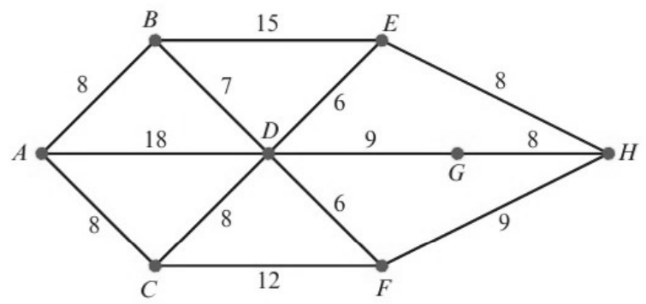
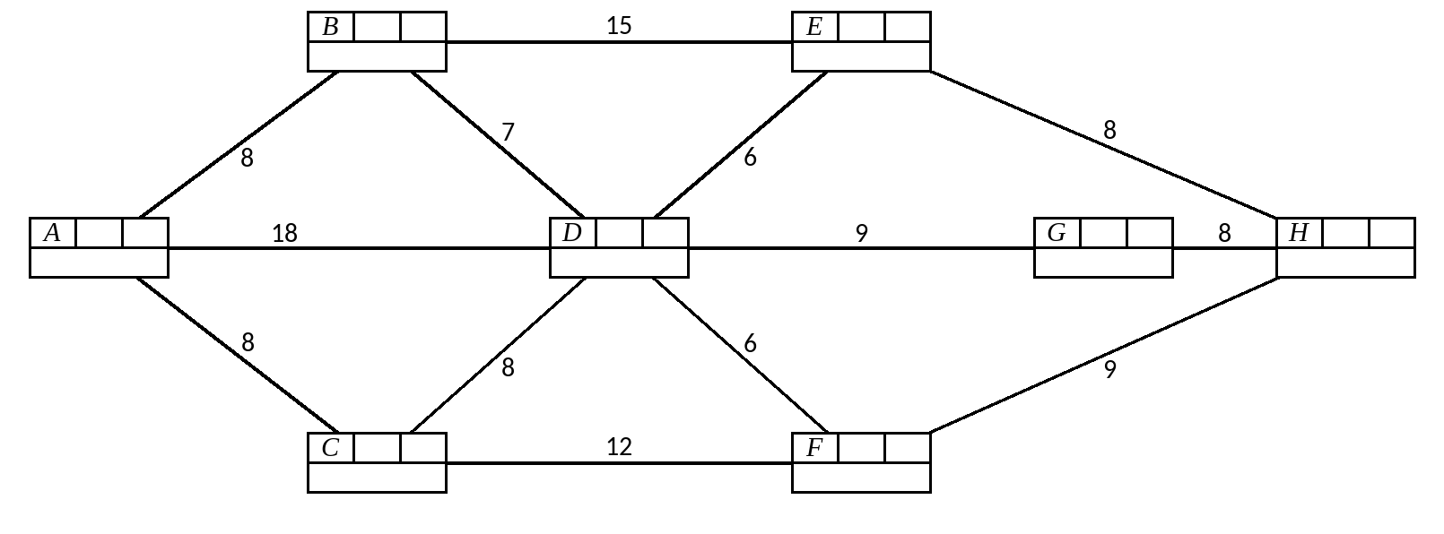
Using Dijkstra’s Algorithm to Find the Shortest Path
You can use Dijkstra’s algorithm to find the shortest route from the start to any vertex with a final label
Use Dijkstra’s algorithm in this network to find the length of the shortest route:
a from A to H b from A to G. List the routes you use.
3
8
6
21
8
23
21
1
0
4
15
7
24
8
29
18
16
15
24
29
2
8
5
20
8
20
The working values at B and C are both 8, so either can be given its final label first
3D

Slide 6
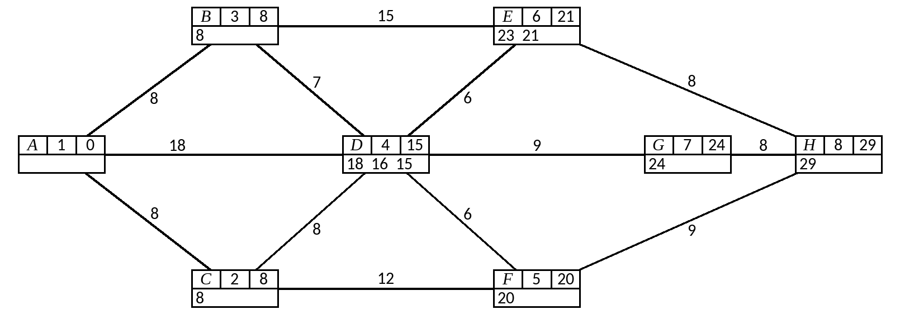
Using Dijkstra’s Algorithm to Find the Shortest Path
a) Shortest route A to H has length 29
b) G already has a final label: 24
either 29 − 21 = 8 EH
or 29 − 20 = 9 FH
24 − 15 = 9 DG
21 − 15 = 6 DE
20 − 8 = 12 CF
15 − 8 = 7 BD
15 − 8 = 7 BD
8 − 0 = 8 AC
8 − 0 = 8 AB
8 − 0 = 8 AB
Route ABDG, length 24
Two shortest routes: ABDEH and ACFH, length 29
3D

Slide 7
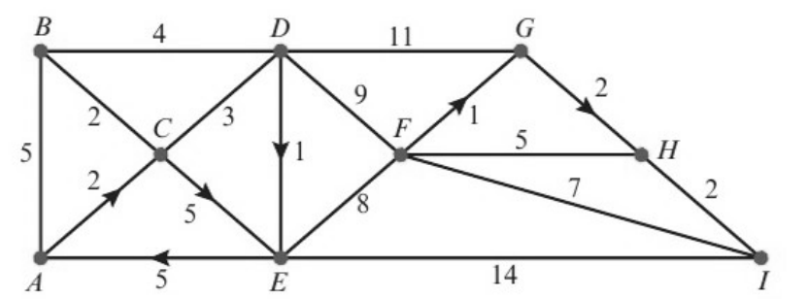
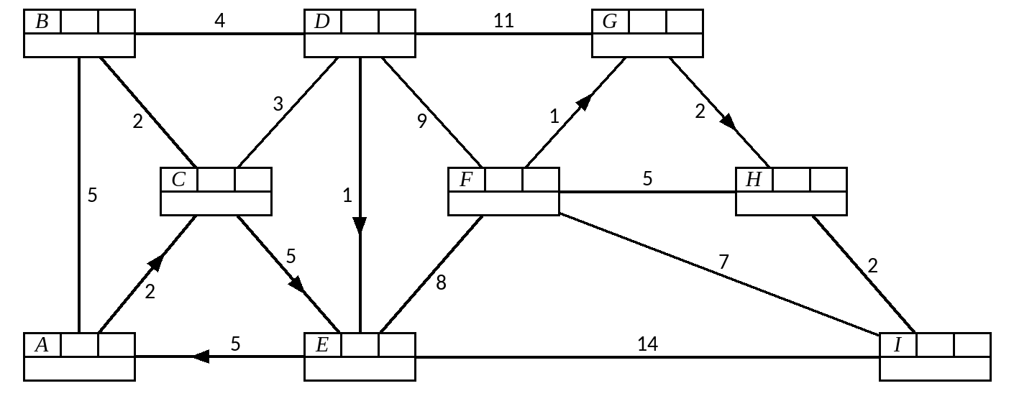
Using Dijkstra’s Algorithm to Find the Shortest Path
Dijkstra’s algorithm works on directed networks too (like one-way streets)
The network represents part of a road system in a city. Some roads are one-way, shown by directed arcs. The number on each arc is the time, in minutes, to travel along that arc.
a Show that there are two quickest routes from A to I. Explain how you found your routes from your labelled diagram.
Road HI is closed due to roadworks. b Find the quickest route from A to I, avoiding HI.
3
4
4
5
7
15
5
4
5
16
15
2
2
6
14
8
17
2
14
19
17
1
0
5
6
9
19
7
6
20
19
Notice 5 is never a working value at E: you cannot travel directly from A to E
3D

Slide 8
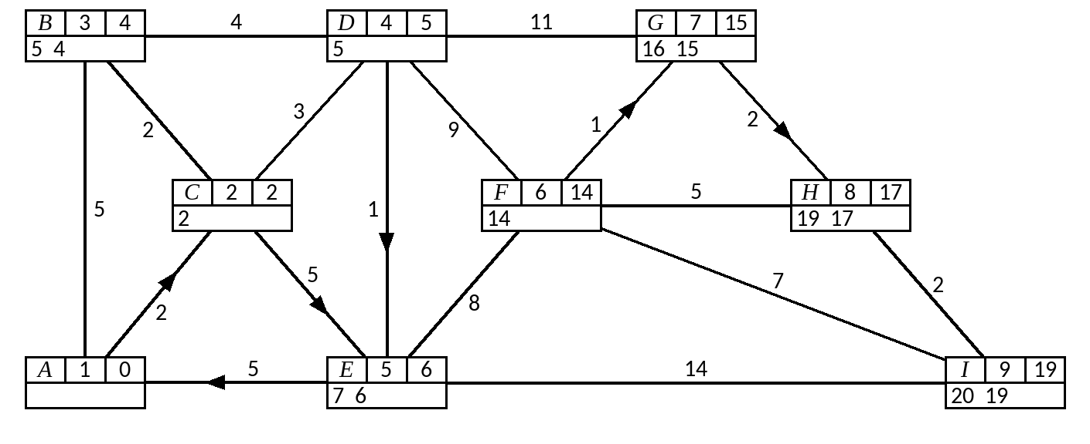
Using Dijkstra’s Algorithm to Find the Shortest Path
a) ACDFGHI since
and ACDEFGHI since
b) Without HI, I would get final label 20
19 − 17 = 2 HI
19 − 17 = 2 HI
20 − 6 = 14 EI
17 − 15 = 2 GH
17 − 15 = 2 GH
6 − 5 = 1 DE
15 − 14 = 1 FG
15 − 14 = 1 FG
5 − 2 = 3 CD
14 − 5 = 9 DF
14 − 6 = 8 EF
2 − 0 = 2 AC
5 − 2 = 3 CD
6 − 5 = 1 DE
Quickest route avoiding HI: ACDEI, 20 minutes
2 − 0 = 2 AC
5 − 2 = 3 CD
2 − 0 = 2 AC
Both routes take 19 minutes
3D

