Slide 1
Algorithms on Graphs
Decision 1 Chapter 3
Westie's Workshop

Slide 2
Teachings for Exercise 3A

Slide 3
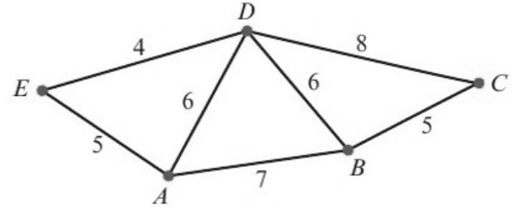
Kruskal’s Algorithm
Kruskal’s algorithm finds a minimum spanning tree (MST)
A minimum spanning tree is a spanning tree such that the total length of its arcs is as small as possible (also called a minimum connector)
1 Sort the arcs into ascending order of weight
2 Select the arc of least weight to start the tree
3 Consider the next arc of least weight: reject it if it would form a cycle, otherwise add it
4 Repeat step 3 until all vertices are connected
A spanning tree of a network with n vertices has n − 1 arcs
Use Kruskal’s algorithm to find a minimum spanning tree for this network. List the arcs in the order that you consider them. State the weight of your tree.
Order of arcs: DE(4), AE(5), BC(5), AD(6), BD(6), AB(7), CD(8)
DE(4) add
AE(5) add
5 vertices, so the tree needs 4 arcs. All vertices are now connected, so stop
BC(5) add
AD(6) reject: it would make the cycle AEDA
BD(6) add
Weight = 4 + 5 + 5 + 6 = 20
3A

Slide 4
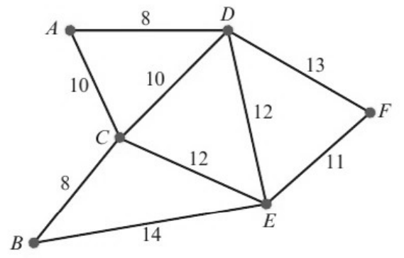
Kruskal’s Algorithm
If there is a choice of equal arcs, consider each in turn
The spanning tree does not have to stay connected as it grows, but the finished tree must be connected
Kruskal’s algorithm can seem chaotic: the chosen arcs jump around the network
It helps to sketch the tree as you go, so cycles are easy to spot
Use Kruskal’s algorithm and show that there are four minimum spanning trees for this network. State their weight.
Order of arcs
8: AD, BC
10: AC, CD
11: EF
12: CE, DE
13: DF
14: BE
AD(8) add
BC(8) add
AC(10) add
CD(10) reject: cycle ACDA
EF(11) add
CE(12) add
All 6 vertices are connected with 5 arcs, so this is a minimum spanning tree
3A

Slide 5
Kruskal’s Algorithm
Both arcs of length 8 and the arc of length 11 are always included
You can never include both arcs of length 10 or both arcs of length 12 (they would make a cycle) ...
... but you must always include one of each
All four trees are minimum spanning trees, so they have the same total weight
using AC and CE
using AC and DE
using CD and CE
using CD and DE
Weight of each tree = 8 + 8 + 10 + 11 + 12 = 49
3A

