Slide 1
Graphs and Networks
Decision 1 Chapter 2
Westie's Workshop

Slide 2
Teachings for Exercise 2E

Slide 3
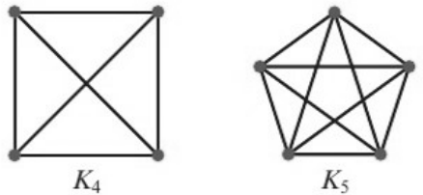
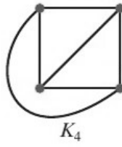
The Planarity Algorithm
You need to be able to determine whether a graph is planar (A level only)
A planar graph is one that can be drawn in a plane such that no two edges meet except at a vertex
If a graph contains a Hamiltonian cycle you can apply the planarity algorithm to decide whether it is planar
Both of these graphs have edges crossing, so it appears that neither is planar. Can either be redrawn with no edges crossing?
This version of K₄ shows the same connections, but no edges cross
The same cannot be done with K₅. So K₄ is planar, but K₅ is not
2E

Slide 4
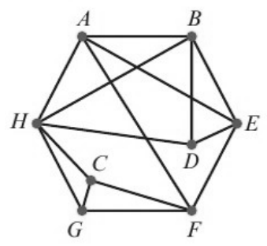
The Planarity Algorithm
The planarity algorithm
1 Identify a Hamiltonian cycle.
2 Draw a polygon with vertices labelled to match the ones in the Hamiltonian cycle.
3 Draw edges inside the polygon to match the edges of the original graph not already represented by the polygon itself.
4 Make a list of all edges inside the polygon, in any order.
5 Choose any unlabelled edge in your list and label it ‘I’. If all edges are now labelled then the graph is planar.
6 Look at any unlabelled edges that cross the edge(s) just labelled:
• If there are none, go back to step 5
• If any of these edges cross each other, the graph is non-planar
• If none of these edges cross each other, give them the opposite label to the edge(s) just labelled
• If all edges are now labelled, the graph is planar. Otherwise, go back to the start of step 6
Use the planarity algorithm to determine whether this graph is planar.
Step 1: ABDEFGCHA
A
B
H
D
C
E
G
F
Step 2: polygon
Step 3: other edges inside
Step 4: AE, AF, BH, BE, DH, FC, GH
Count to check: 7 edges inside the polygon so 7 edges in the list
2E

Slide 5
The Planarity Algorithm
Edges labelled ‘I’ are drawn inside the Hamiltonian cycle, edges labelled ‘O’ outside
Two edges that cross inside the cycle would also cross outside it
The safest way to show the graph is planar is to draw it with no crossings
Step 5:
AE(I), AF, BH, BE, DH, FC, GH
Choose any edge, label it I
Step 6:
BH and DH cross AE: AE(I), AF, BH(O), BE, DH(O), FC, GH
They don’t cross each other, so label them O
Step 6:
AF and BE cross BH or DH: AE(I), AF(I), BH(O), BE(I), DH(O), FC, GH
They don’t cross each other, so label them I
Step 6:
No unlabelled edges cross AF or BE
Go back to step 5
Step 5:
AE(I), AF(I), BH(O), BE(I), DH(O), FC(I), GH
Choose an unlabelled edge, label it I
Step 6:
GH crosses FC: AE(I), AF(I), BH(O), BE(I), DH(O), FC(I), GH(O)
All edges labelled, so the graph is planar
A
B
H
D
I edges inside (red), O edges outside (blue)
C
E
G
F
2E

Slide 6
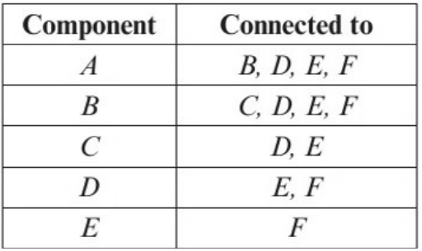
The Planarity Algorithm
An electronics company attaches components A, B, C, D, E and F to a circuit board. These components are to be connected by wires that are not allowed to cross. The table gives information about the connections.
Step 1:
ABCDEFA
A
B
Steps 2, 3: polygon and other edges
Step 4:
AD, AE, BD, BE, BF, CE, DF
F
C
Step 5:
AD(I), AE, BD, BE, BF, CE, DF
Choose any edge, label it I
Step 6:
BE, BF, CE cross AD: AD(I), AE, BD, BE(O), BF(O), CE(O), DF
E
D
They don’t cross each other, so label them O
Step 6:
AE, BD, DF cross BE, BF or CE
Using the Hamiltonian cycle ABCDEFA, apply the planarity algorithm to determine whether the connections can be made without any wires crossing.
AE and DF cross each other, so the graph is non-planar. The connections cannot be made without wires crossing.
BE, BF and CE must all be in the same set (all crossed by AD).
AE and DF must therefore be in the other set (each crosses one of BE, BF, CE).
But AE and DF cross, so the graph cannot be drawn without crossings.
Each connection is only shown once in the table, e.g. A to B but not B to A
2E

