Slide 1
Graphs and Networks
Decision 1 Chapter 2
Westie's Workshop

Slide 2
Teachings for Exercise 2D

Slide 3
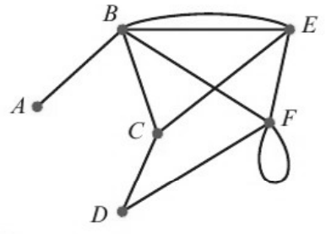
Representing Graphs and Networks Using Matrices
You can use an adjacency matrix to represent a graph or network
Each entry in an adjacency matrix describes the number of arcs joining the corresponding vertices
You should be able to write down the adjacency matrix given the graph, and draw a graph given the adjacency matrix
Use an adjacency matrix to represent this graph.
A
B
C
D
E
F
A
0
1
0
0
0
0
B
1
0
1
0
2
1
C
0
1
0
1
1
0
D
0
0
1
0
0
1
E
0
2
1
0
0
1
F
0
1
0
1
1
2
The 2 in row B, column E: there are 2 direct connections between B and E
The 2 in row F, column F: a loop from F to F. It could be travelled in either direction, so it counts as 2
2D

Slide 4
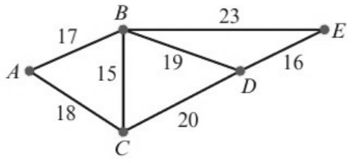
Representing Graphs and Networks Using Matrices
The matrix associated with a weighted graph is called a distance matrix
In a distance matrix, the entries represent the weight of each arc, not the number of arcs
Use a dash where there is no direct arc
Use a distance matrix to represent this network.
A
B
C
D
E
A
—
17
18
—
—
B
17
—
15
19
23
C
18
15
—
20
—
The matrix is symmetrical about the leading diagonal (top left to bottom right). This is the case for any non-directed network
D
—
19
20
—
16
E
—
23
—
16
—
2D

Slide 5
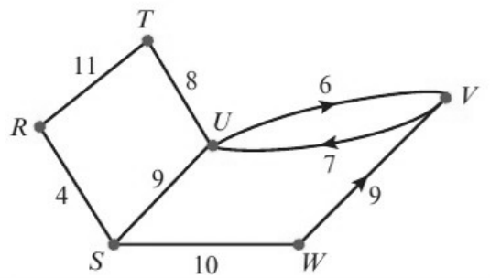
Representing Graphs and Networks Using Matrices
If the network has directed edges the distance matrix will not be symmetrical
Read the matrix from the row vertex to the column vertex
An edge with no arrow can be travelled in either direction
Use a distance matrix to represent this directed network.
R
S
T
U
V
W
R
—
4
11
—
—
—
S
4
—
—
9
—
10
T
11
—
—
8
—
—
U
—
9
8
—
6
—
6: a direct link from U to V
V
—
—
—
7
—
—
7: a direct link from V to U
W
—
10
—
—
9
—
9: a direct link from W to V
This matrix is not symmetrical about the leading diagonal
2D

