Slide 1
Graphs and Networks
Decision 1 Chapter 2
Westie's Workshop

Slide 2
Teachings for Exercise 2C

Slide 3
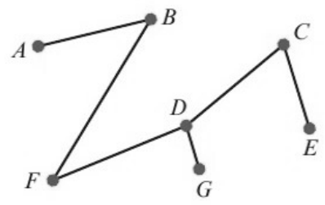
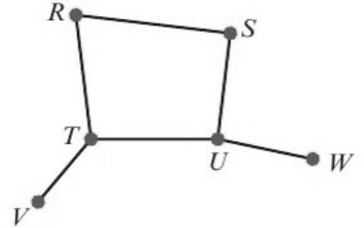
Special Types of Graph
You need to know about some special types of graph
A tree is a connected graph with no cycles
Explain why the first graph is a tree but the second graph is not.
A tree: it is connected and has no cycles
Not a tree: it contains the cycle RTUSR
2C

Slide 4
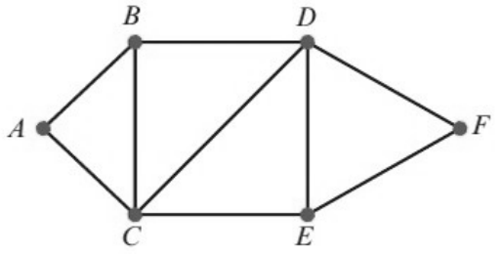
Special Types of Graph
A spanning tree of a graph, G, is a subgraph which includes all the vertices of G and is also a tree
A subgraph is part of the original graph: its vertices and edges all belong to G
Find two possible spanning trees for this graph.
B
D
B
D
A
F
A
F
C
E
C
E
There are many other possible spanning trees
Each has all 6 vertices and 5 edges, is connected and has no cycles
2C

Slide 5
Special Types of Graph
A complete graph is a graph in which every vertex is directly connected by a single edge to each of the other vertices
The complete graph with n vertices is written as Kₙ
Draw the complete graphs K₃, K₄ and K₆.
K₃
K₄
K₆
Every vertex is joined to every other vertex exactly once.
In Kₙ each vertex has degree n − 1
2C

Slide 6
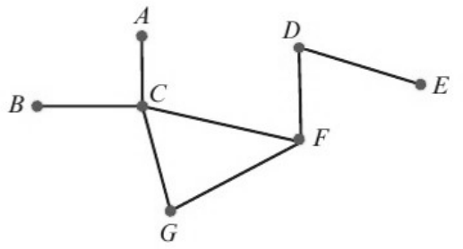
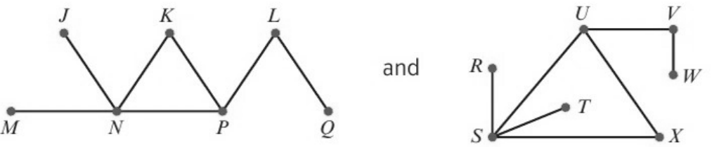
Special Types of Graph
Isomorphic graphs are graphs which show the same information but may be drawn differently
For two graphs to be isomorphic, they must have the same numbers of vertices of the same degrees, and these vertices must be connected together in the same ways
If there is an edge between two vertices in one graph, then there is also an edge between the two corresponding vertices in the other graph
If graphs are isomorphic it is possible to pair equivalent vertices
Show that this graph
is isomorphic to each of these graphs by pairing equivalent vertices.
First graph
A
B
C
D
E
F
G
Second
J
M
N
L
Q
P
K
Third
R
T
S
V
W
U
X
C is the only vertex of degree 4
A and B have degree 1 and join C
G and F form a triangle with C
2C

