Slide 1
Graphs and Networks
Decision 1 Chapter 2
Westie's Workshop

Slide 2
Teachings for Exercise 2B

Slide 3
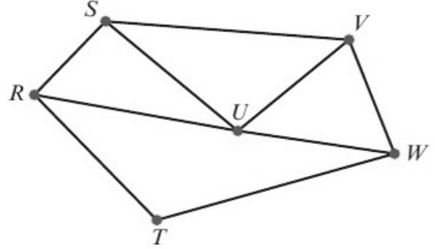
Graph Theory
You need to be familiar with the basic terminology used to describe graphs
A walk is a route through a graph along edges from one vertex to the next
A path is a walk in which no vertex is visited more than once
A trail is a walk in which no edge is visited more than once
A cycle is a walk in which the end vertex is the same as the start vertex and no other vertex is visited more than once
A Hamiltonian cycle is a cycle that includes every vertex
For the graph below, give an example of a walk, a path, a trail, a cycle and a Hamiltonian cycle.
a walk is RSUWVU
It is ok to include a vertex or an edge more than once on a walk
a path is RSUVW
No vertex repeated
a trail is RUSVUW
Vertex U is repeated but no edge is
a cycle is RSUR
It is not necessary to include every vertex in a cycle
a Hamiltonian cycle is RSUVWTR
Every vertex, back to the start
2B

Slide 4
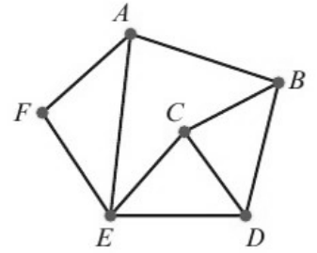
Graph Theory
In any undirected graph, the sum of the degrees of the vertices is equal to 2 × the number of edges
As a consequence, the number of odd vertices must be even, including possibly zero
This result is known as Euler’s handshaking lemma
The degree (valency or order) of a vertex is the number of edges incident to it
a) Find the sum of the valencies of the vertices in this graph.
b) Verify that your answer to part a is twice the number of edges in the graph.
Vertex
Valency
A
3
B
3
The number of vertices of odd degree is even (there are 4 of them)
C
3
D
3
E
4
F
2
Total
18
b) The graph has 9 edges
Sum of valencies = 18 = 2 × 9 = 2 × number of edges
2B

Slide 5
Graph Theory
Use Euler’s handshaking lemma to form an equation
Sum of valencies = 2 × number of edges
A graph has 5 nodes and 8 edges. The valencies of the nodes are x, x − 1, x + 1, 2x − 1 and x − 1. Find the value of x.
Sum of valencies = x + (x − 1) + (x + 1) + (2x − 1) + (x − 1)
= 6x − 2
Collect like terms
Sum of valencies = 2 × number of edges
= 2 × 8 = 16
Handshaking lemma
6x − 2 = 16
Equate
6x = 18
+2
x = 3
÷6
2B

