Slide 1
Graphs and Networks
Decision 1 Chapter 2
Westie's Workshop

Slide 2
Teachings for Exercise 2A

Slide 3
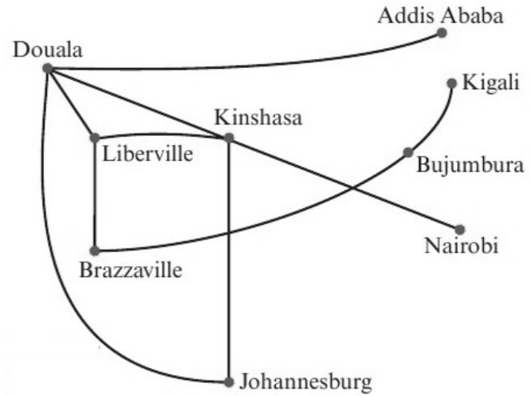
Modelling with Graphs
You need to know how graphs and networks can be used to create mathematical models
A graph consists of points (called vertices or nodes) which are connected by lines (edges or arcs)
A vertex is a point on a graph. Vertices are sometimes called nodes
An edge is a line segment joining vertices. Edges are sometimes called arcs
This graph shows the routes flown by an airline.
a) Explain why this is a graph.
b) Describe what is represented by i) the vertices ii) the edges.
c) Describe two possible flight routes from Johannesburg to Liberville.
The graph only shows which cities are connected. There is no scale and it is not weighted, so it shows no distances or real positions
a) It has vertices connected by edges
b) i) Cities served by the airline
ii) Flight routes connecting cities
c) Johannesburg to Douala to Liberville
Johannesburg to Kinshasa to Liberville
2A

Slide 4
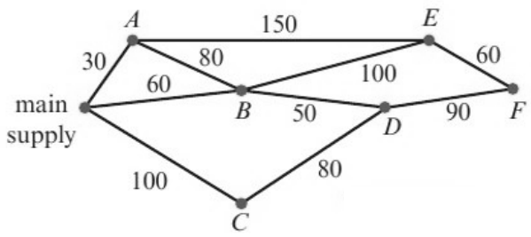
Modelling with Graphs
If a graph has a number associated with each edge (usually called its weight), then the graph is known as a weighted graph or network
The weights could be distances, times, costs...
This network shows the lengths of pipes running between water standpipes on a camp site. The lengths on the edges are given in metres.
a) Write down the length of the pipe connecting standpipe B to standpipe D.
b) Write a list of the standpipes that are directly connected to standpipe E.
This is an example of a weighted network
a) 50 m
b) A, B, F
2A

Slide 5
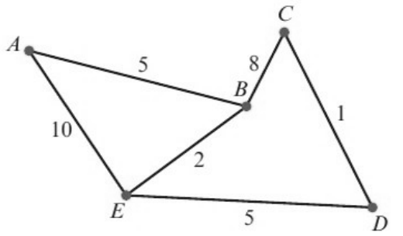
Modelling with Graphs
A weighted network is not usually drawn to scale
The quickest route may not be the route which appears to be the shortest
You need to consider the weight on each arc
The network shows the times taken, in minutes, by a car to travel along some sections of road.
Calculate the minimum time needed to travel from A to D and give the route taken.
Route
Time needed (mins)
ABCD
5 + 8 + 1 = 14
ABED
5 + 2 + 5 = 12
AED
10 + 5 = 15
The minimum time required is 12 minutes along the route ABED
2A

