Slide 1
Algorithms
Decision 1 Chapter 1
Westie's Workshop

Slide 2
Teachings for Exercise 1F

Slide 3
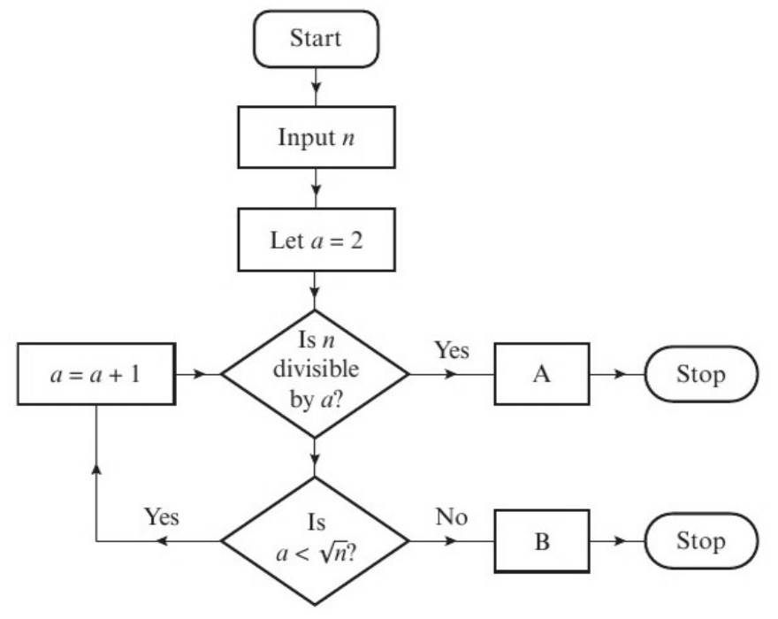
Order of an Algorithm
The order (or complexity) of an algorithm tells you how changes in the size of a problem affect the approximate run time
If an algorithm has order f(n), increasing the size of the problem from n to m will increase the run time by a factor of approximately f(m) ÷ f(n)
When finding the order, consider the worst case (the maximum number of steps)
An algorithm is defined by this flow diagram, where n > 2 and n is an integer.
a) Describe what the algorithm does.
b) Suggest suitable output text for boxes A and B.
c) Determine the order of the algorithm.
a) The algorithm tests whether or not n is prime
b) Box A: n is not prime
Box B: n is prime
c) Let the size of the problem be n
At each step the algorithm tests whether n is divisible by a
If n is prime, the answer at this step will never be ‘yes’, so the algorithm continues until a ≥ √n
The maximum number of steps needed is given by the integer part of √n
So the algorithm has order √n
The maximum number of steps will not always be needed: if n is even, the algorithm only needs one step. You should consider the worst case.
1F

Slide 4
Order of an Algorithm
The number of steps needed is often used to find the order of an algorithm
Bubble sort: a list of n items needs at most (n − 1) + (n − 2) + … + 2 + 1 = ½n(n − 1) = ½n² − ½n comparisons. This is quadratic, so the bubble sort has quadratic order
Common orders: linear (n), quadratic (n²), cubic (n³)
An algorithm needing 50n² + 11n + 90 steps also has quadratic order
A given list-searching algorithm has linear order.
To search a list with 500 values, the algorithm takes approximately 0.036 seconds.
Estimate the time taken by this algorithm to search a list containing 1250 values.
1250 ÷ 500 = 2.5
The size of the problem has increased by a factor of 2.5
0.036 × 2.5 = 0.09
Linear order, so the time taken increases by the same factor, 2.5
The time taken to search a list containing 1250 values is approximately 0.09 seconds
1F

Slide 5
Order of an Algorithm
If the size of a problem is increased by some factor k then:
an algorithm of linear order will take approximately k times as long to complete
an algorithm of quadratic order will take approximately k² times as long to complete
an algorithm of cubic order will take approximately k³ times as long to complete
The bubble sort algorithm has quadratic order.
a) Given that it takes a computer 0.2 seconds to sort a list of 1600 numbers using the bubble sort, estimate the time needed to sort a list of 480 000 numbers.
b) Comment on the suitability of the bubble sort algorithm for sorting large data sets.
a) 480 000 ÷ 1600 = 300
The size of the problem has increased by a factor of 300
0.2 × 300² = 18 000
Quadratic order, so the time increases by a factor of 300² = 90 000
It would take approximately 18 000 seconds, or 5 hours, to sort 480 000 numbers
b) The time needed for a bubble sort increases quickly as n increases, so the bubble sort algorithm is not suitable for large data sets
Quick sort has, on average, order n log n. Increasing the size from 1600 to 480 000 would increase its run time by a factor of about (480 000 × log 480 000) ÷ (1600 × log 1600) ≈ 532, a lot less than 300² = 90 000
1F

