Slide 1
Algorithms
Decision 1 Chapter 1
Westie's Workshop

Slide 2
Teachings for Exercise 1B

Slide 3
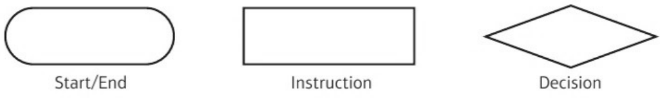
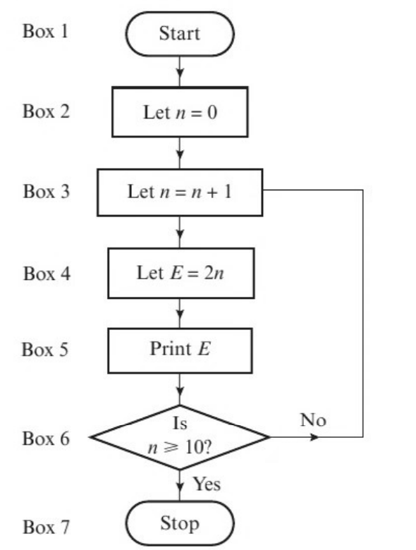
Flow Charts
In a flow chart, the shape of each box tells you about its function
The flow chart describes an algorithm.
a) Implement this algorithm using a trace table.
b) Alter box 4 to read ‘Let E = 3n’ and implement the algorithm again. How does this alter the algorithm?
The boxes are linked by arrowed lines. Follow each step in order
a)
n
E
Box 6
b)
n
E
Box 6
0
0
1
2
no
1
3
no
2
4
no
2
6
no
3
6
no
3
9
no
4
8
no
4
12
no
5
10
no
n is a counter: it stops the algorithm after the loop has run 10 times
5
15
no
6
12
no
6
18
no
7
14
no
7
21
no
8
16
no
8
24
no
9
18
no
9
27
no
10
20
yes
10
30
yes
Output is 2, 4, 6, 8, 10, 12, 14, 16, 18, 20
Output is 3, 6, 9, 12, 15, 18, 21, 24, 27, 30
This gives the first ten multiples of 3 rather than the first ten multiples of 2
1B

Slide 4
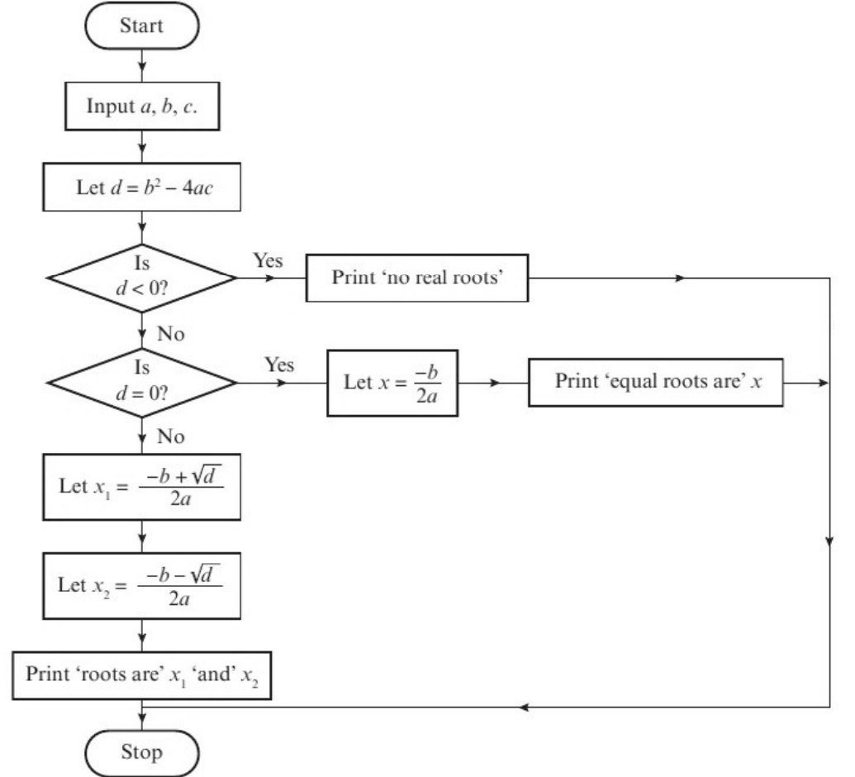
Flow Charts
A decision box contains a question whose answer is either ‘yes’ or ‘no’
Follow the arrow that matches the answer
You should recognise d = b² − 4ac as the discriminant of the equation
This flow chart can be used to find the roots of an equation of the form ax² + bx + c = 0.
Demonstrate this algorithm for these equations:
a) 6x² − 5x − 11 = 0 b) x² − 6x + 9 = 0 c) 4x² + 3x + 8 = 0
a)
a
b
c
d
d < 0?
d = 0?
x₁
x₂
6
−5
−11
289
no
no
11/6
−1
d = (−5)² − 4 × 6 × (−11) = 25 + 264 = 289, x₁ = (5 + 17) ÷ 12 = 11/6, x₂ = (5 − 17) ÷ 12 = −1
Roots are 11/6 and −1
b)
a
b
c
d
d < 0?
d = 0?
x
1
−6
9
0
no
yes
3
d = (−6)² − 4 × 1 × 9 = 36 − 36 = 0, x = 6 ÷ 2 = 3
Equal roots are 3
c)
a
b
c
d
d < 0?
4
3
8
−119
yes
d = 3² − 4 × 4 × 8 = 9 − 128 = −119
No real roots
1B

Slide 5
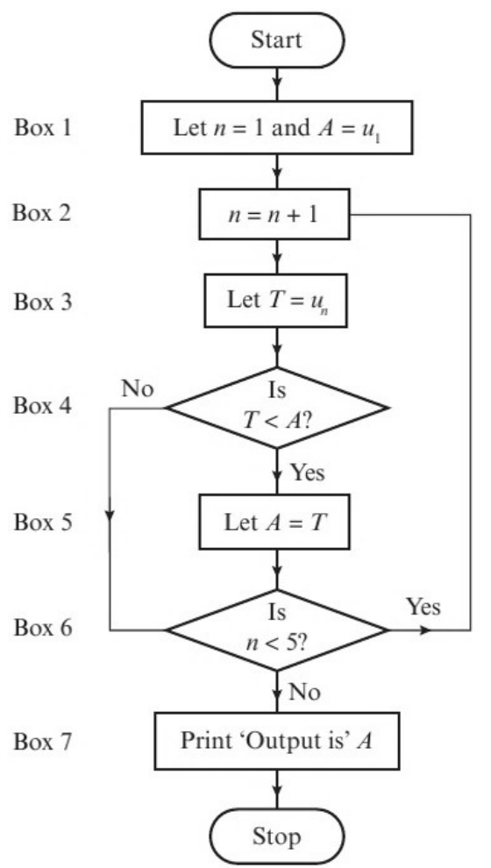
Flow Charts
Tackle a flow chart one box at a time, recording every step in a trace table
n
A
T
T < A?
n < 5?
Box 1
1
10
Box 2
2
Apply the algorithm shown by the flow chart to the data:
u₁ = 10, u₂ = 15, u₃ = 9, u₄ = 7, u₅ = 11
What does the algorithm do?
Box 3
15
Box 4
No
Box 6
Yes
Box 2
3
Box 3
9
Box 4
Yes
Box 5
9
Box 6
Yes
Box 2
4
Box 3
7
Box 4
Yes
Box 5
7
Box 6
Yes
Box 2
5
Box 3
11
Box 4
No
Box 6
No
Box 7
Output is 7
The algorithm selects the smallest number from a list
1B

