Slide 1




Stats Past Paper Questions
Revision Past Paper Questions
Go back to home screen to select a topic
Go back to topic screen to select a question
Go to the mark scheme for that question
Go back to the question from the mark scheme
Or see more solutions
Or go back to first solutions
Not that a * symbol represents that this question was from the AS course
Next

Slide 2
Notes on operating this resource
When creating this, I used and to quickly navigate between slides directly before or after the slide in question.
As some mark schemes give additional notes, you can continue to see answers by clicking but you will not return to the original question with one click of .
To view the original question again, continue to click which should take you back.
Next

Slide 3
Notes on Stats Questions and this resource
For more questions on other topics, please see my AS PowerPoint
As well as the practice papers, I have attached the Sample Assessment Materials and Specimen papers and links to older specification past paper questions.
Some of these older questions will contain topics which are no longer covered by the current specifications or be phrased differently due to the shift to using technology in the new specifications. In particular, students may struggle with some when these go between distributions (including the Poisson distribution).
Furthermore, as I am personally not too familiar with S3 and the overlap with the stats side of the new course, I have left out almost all Normal distribution questions from S3 which means there are not many hypothesis testing question on this topic. If someone with a greater understanding of this overlap do please feel free to update the resource and let me know!
Edexcel have provided ‘student-friendly’ mark schemes to help explain where marks are awarded along with expected student solutions. These have been attached where possible in addition to the official mark scheme and labelled SF
Questions involving the large data set have been coloured green
Large Data Set
Next

Slide 4
Home
Data Processing
Binomial Distribution
Probability
LDS Qs
Correlation and Regression
Normal Distribution

Slide 5
New Spec Q’s
*Poisson Distribution not on new spec
Old Spec Binomial Distribution
Jan 2006 (i)
June 2007 (iii)
Jan 2010 (i)
Jan 2012 (i)
June 2014
Jan 2006 (ii)
Jan 2008 (i)
Jan 2010 (ii)
Jan 2012 (ii)
June 2015
May 2006 (i)*
Jan 2008 (ii)
May 2010 (i)*
May 2012 (i)
June 2016
May 2006 (ii)
May 2008 (i)*
May 2010 (ii)
May 2012 (ii)*
June 2017 (i)
Jan 2007 (i)*
May 2008 (ii)
Jan 2011 (i)*
May 2012 (iii)
June 2017 (ii)
Jan 2007 (ii)*
Jan 2009 (i)
Jan 2011 (ii)
Jan 2013 (i)
June 2018 (i)
Jan 2007 (iii)*
Jan 2009 (ii)*
May 2011 (i)
Jan 2013 (ii)
June 2018 (ii)
June 2007 (i)*
May 2009 (i)*
May 2011 (ii)
May 2013 (i)
June 2007 (ii)
May 2009 (ii)
May 2011 (iii)*
May 2013 (ii)*

Slide 6
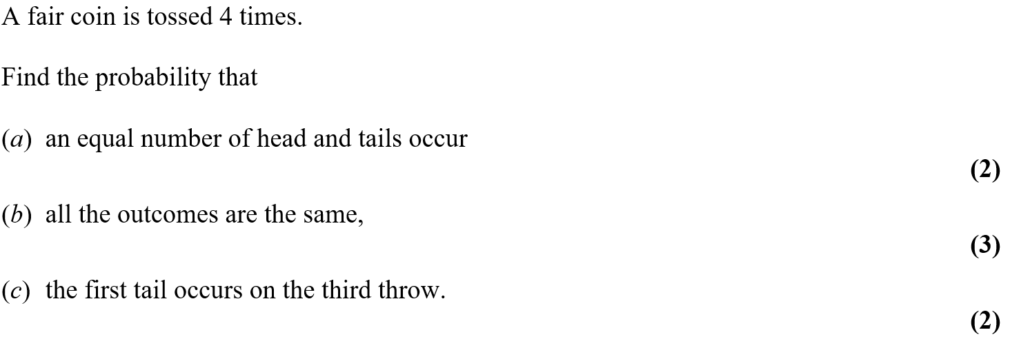
Jan 2006

Slide 7
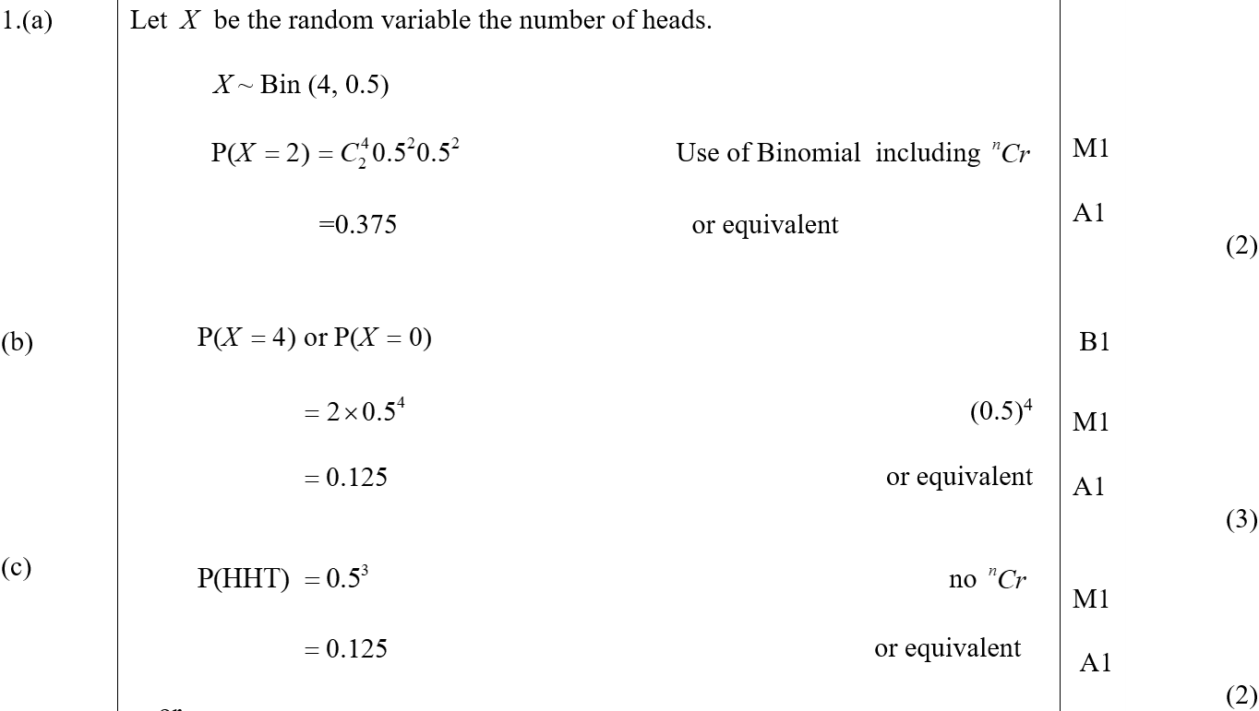
Jan 2006
A
B
C

Slide 8
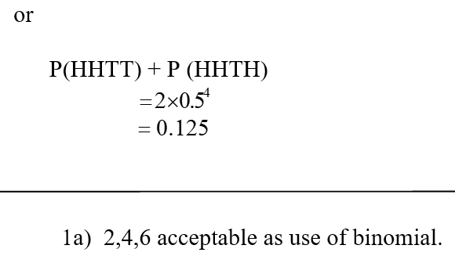
Jan 2006
C Alternative
A notes

Slide 9
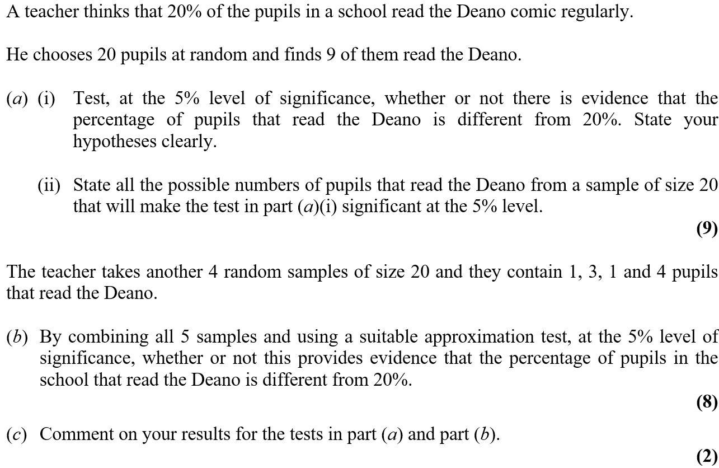
Jan 2006

Slide 10
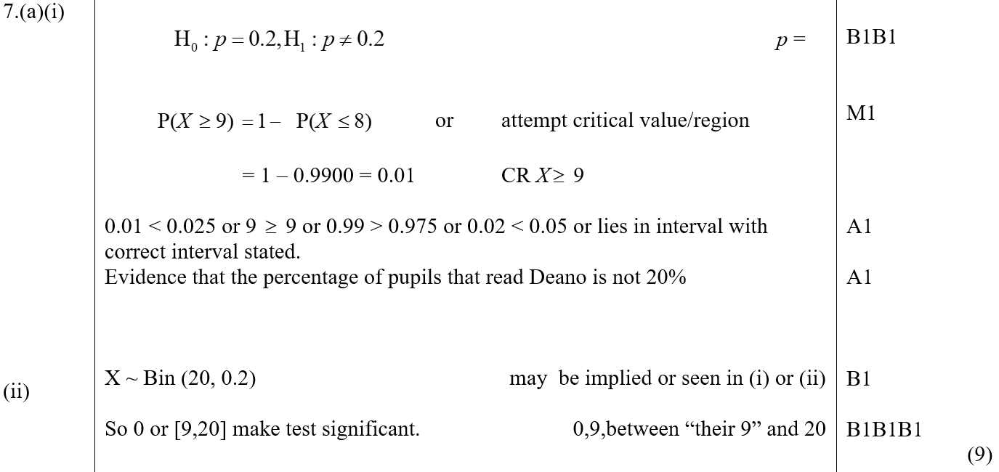
Jan 2006
A (i)
A (ii)

Slide 11
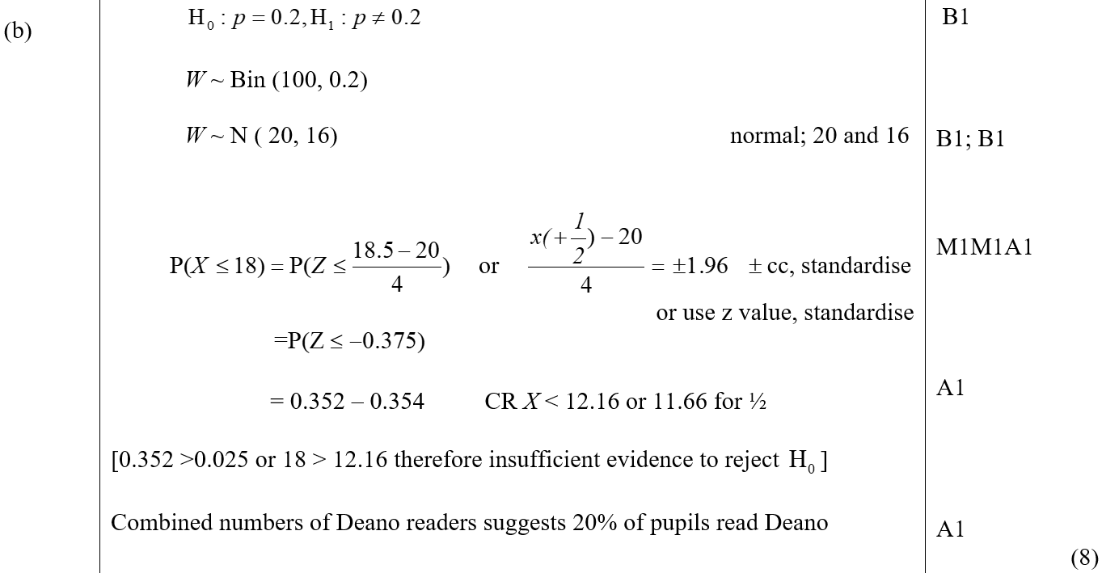
Jan 2006
B

Slide 12
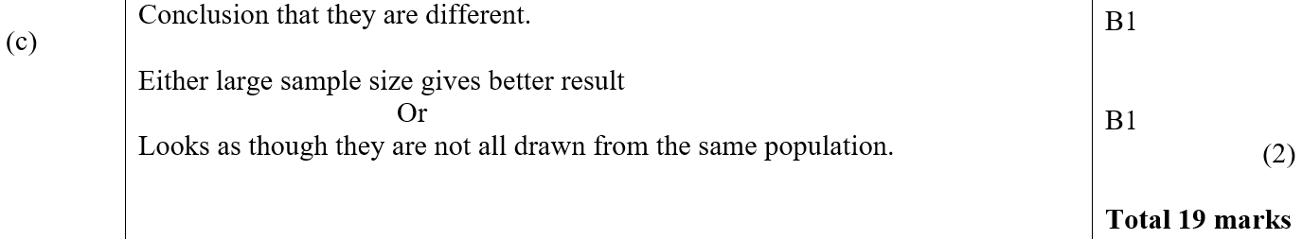
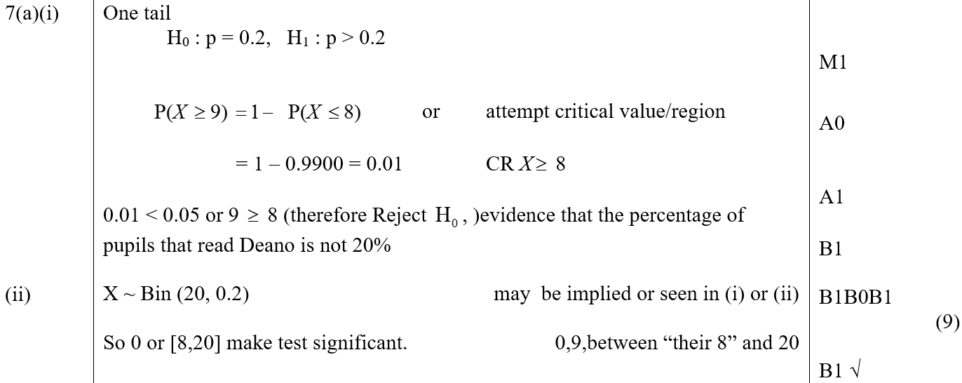
Jan 2006
C
A reduced marks for 1 tailed approach

Slide 13
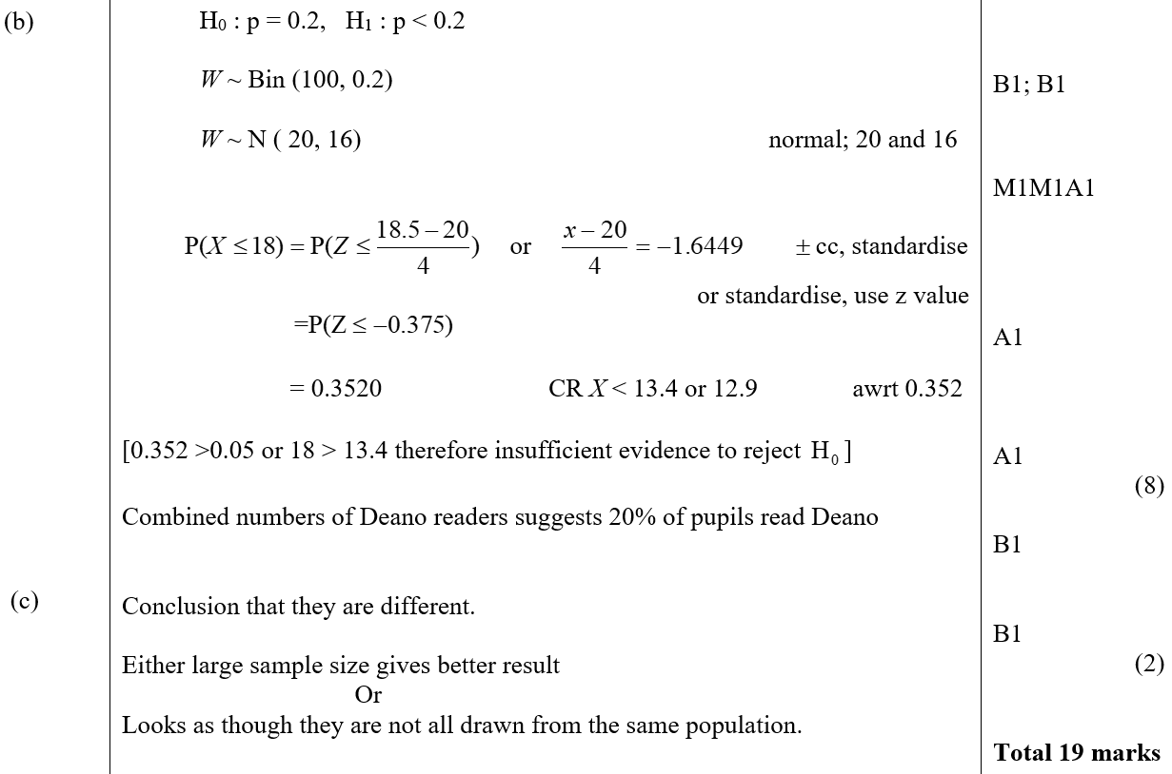
Jan 2006
B marks for 1 tailed approach
C marks for 1 tailed approach

Slide 14
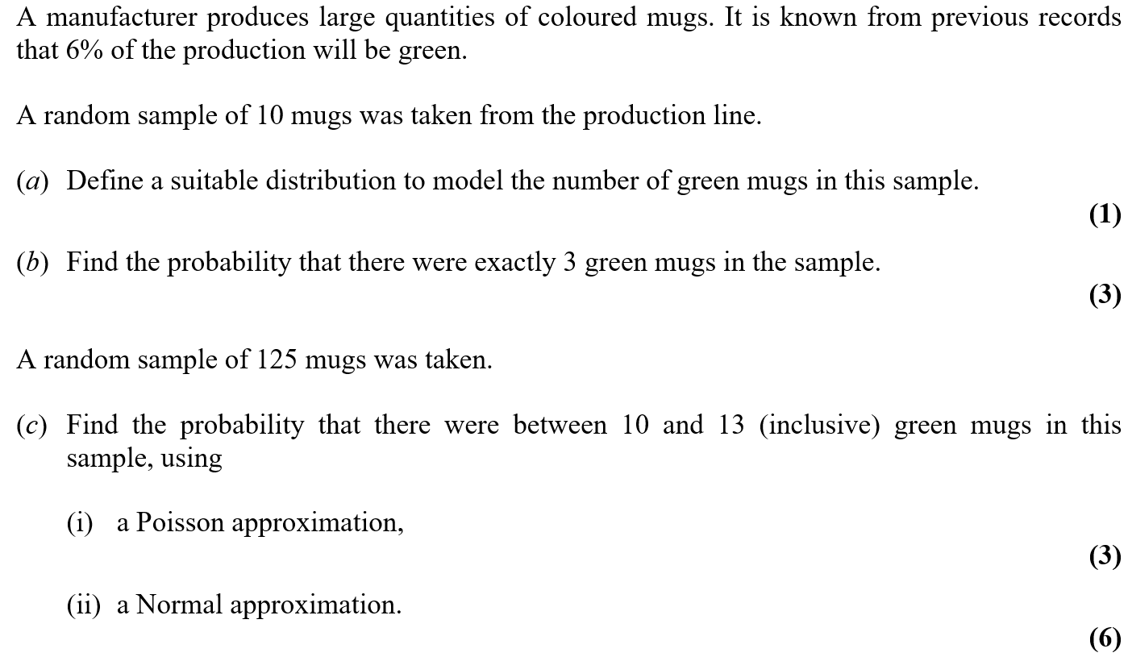
May 2006

Slide 15
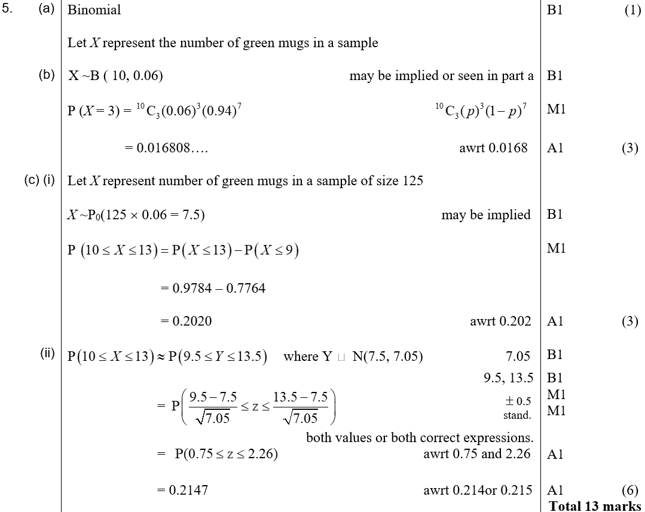
May 2006
A
B
C (i)
C (ii)

Slide 16
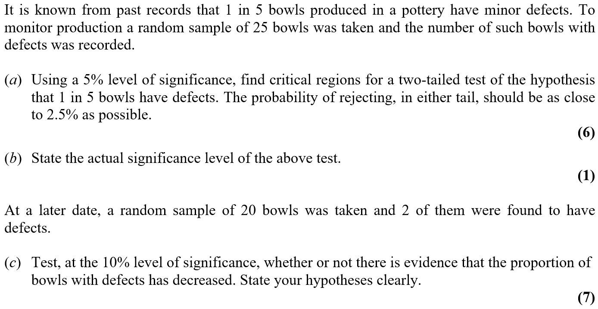
May 2006

Slide 17
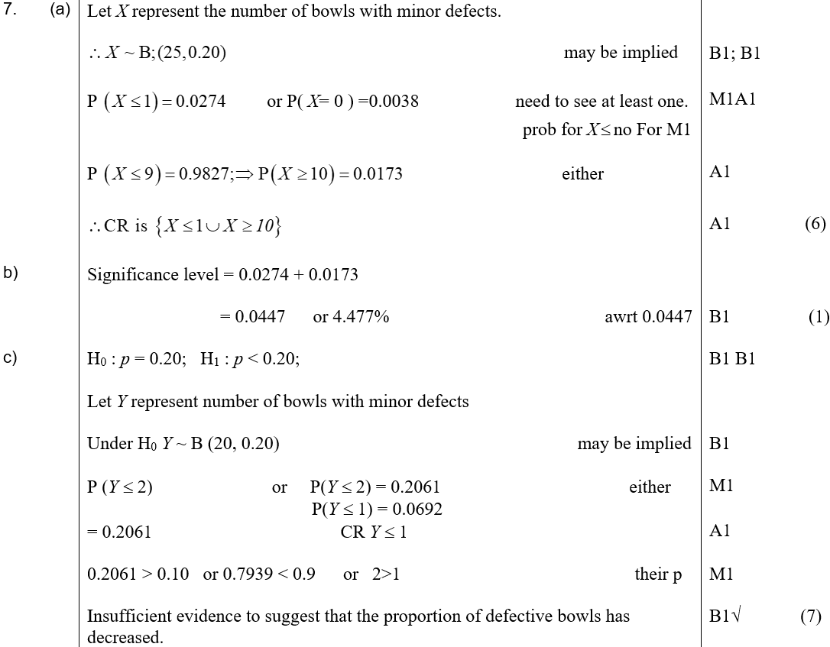
May 2006
A
B
C

Slide 18
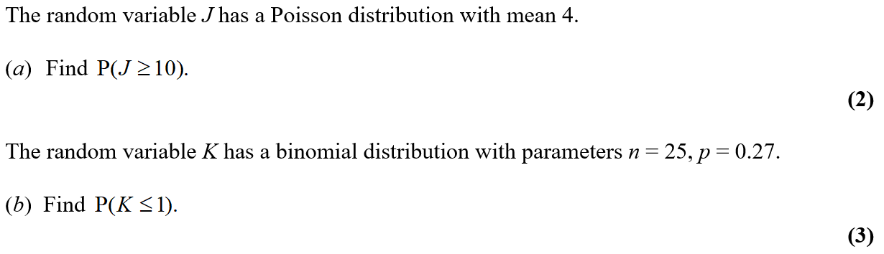
Jan 2007

Slide 19
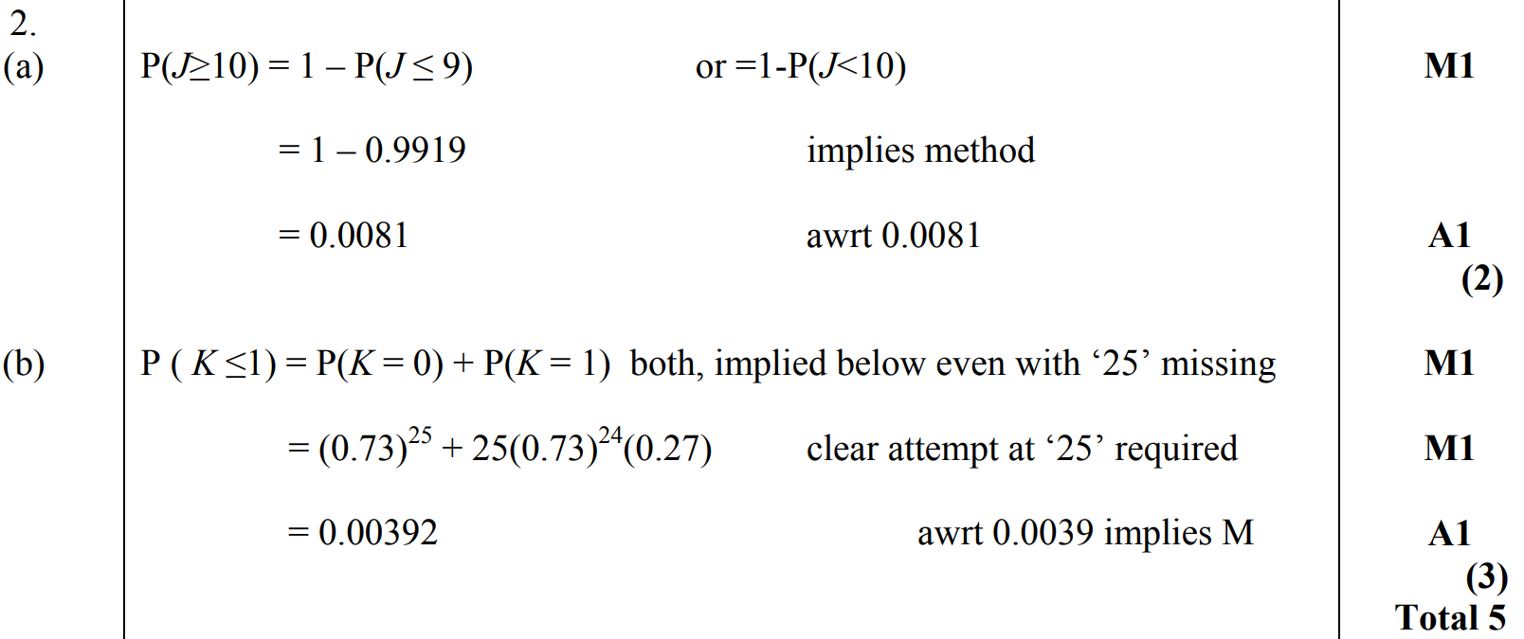
Jan 2007
A
B

Slide 20
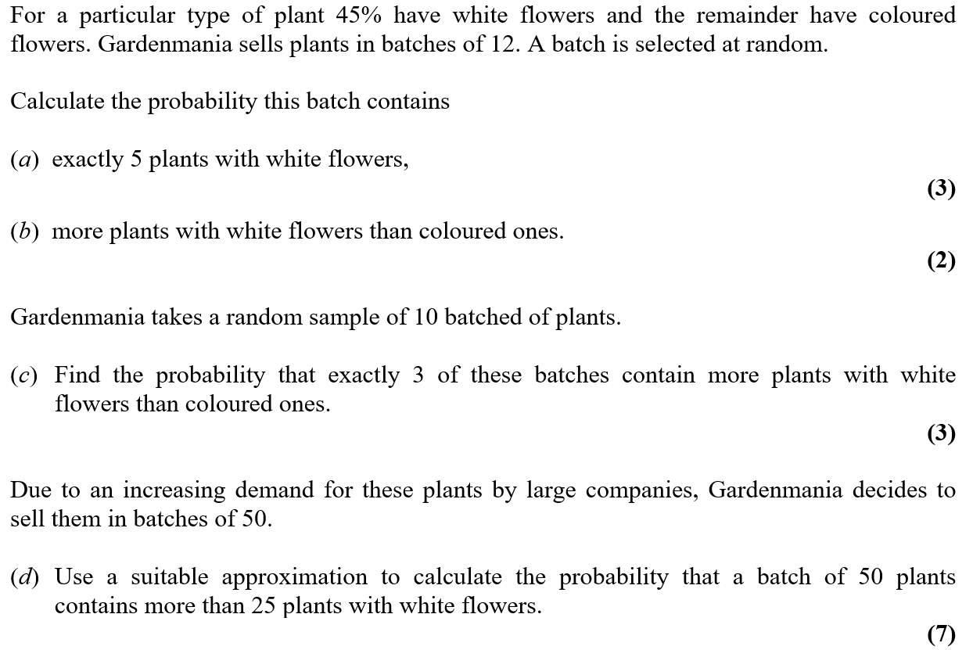
Jan 2007

Slide 21
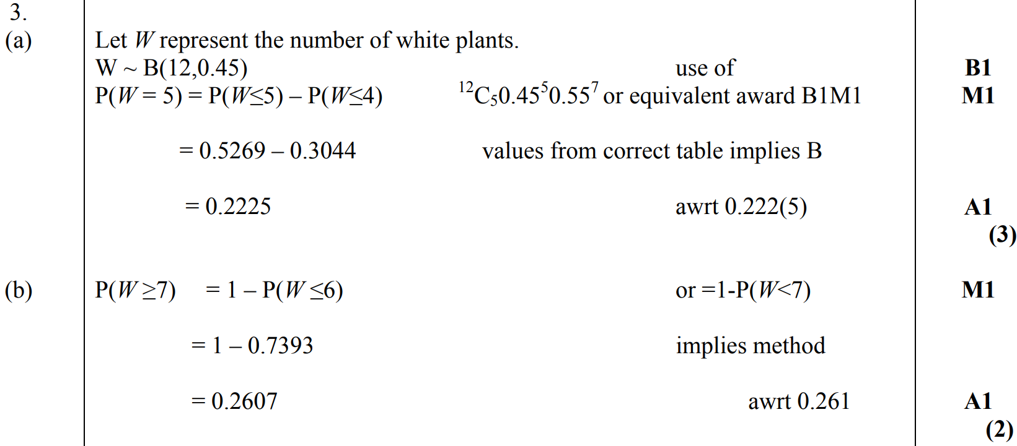
Jan 2007
A
B

Slide 22
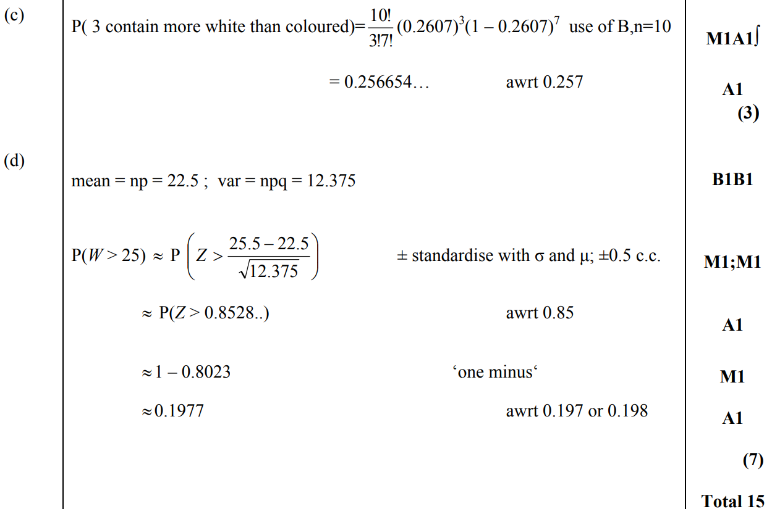
Jan 2007
C
D

Slide 23
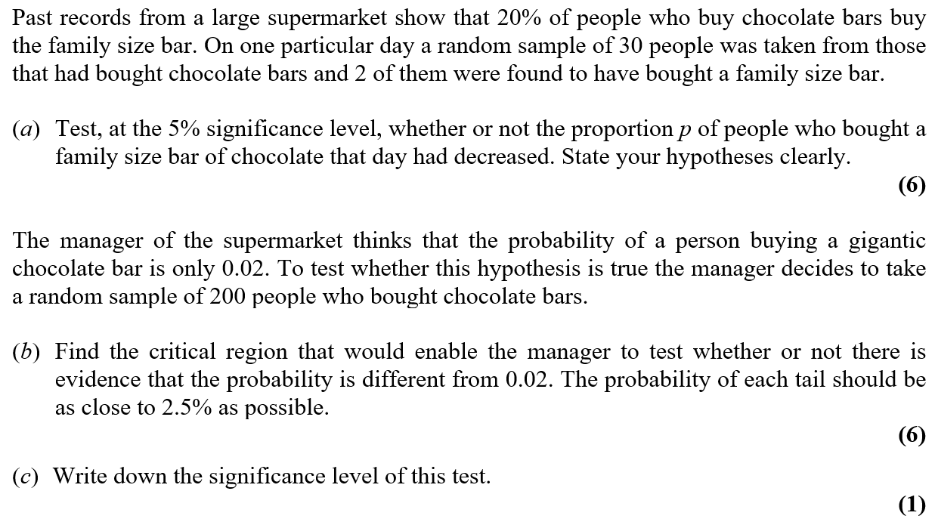
Jan 2007

Slide 24
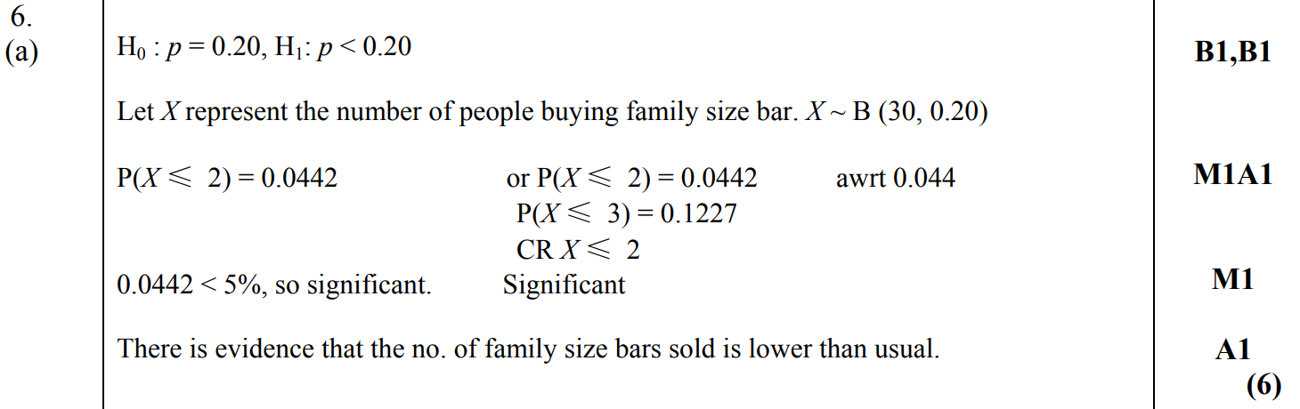
Jan 2007
A

Slide 25
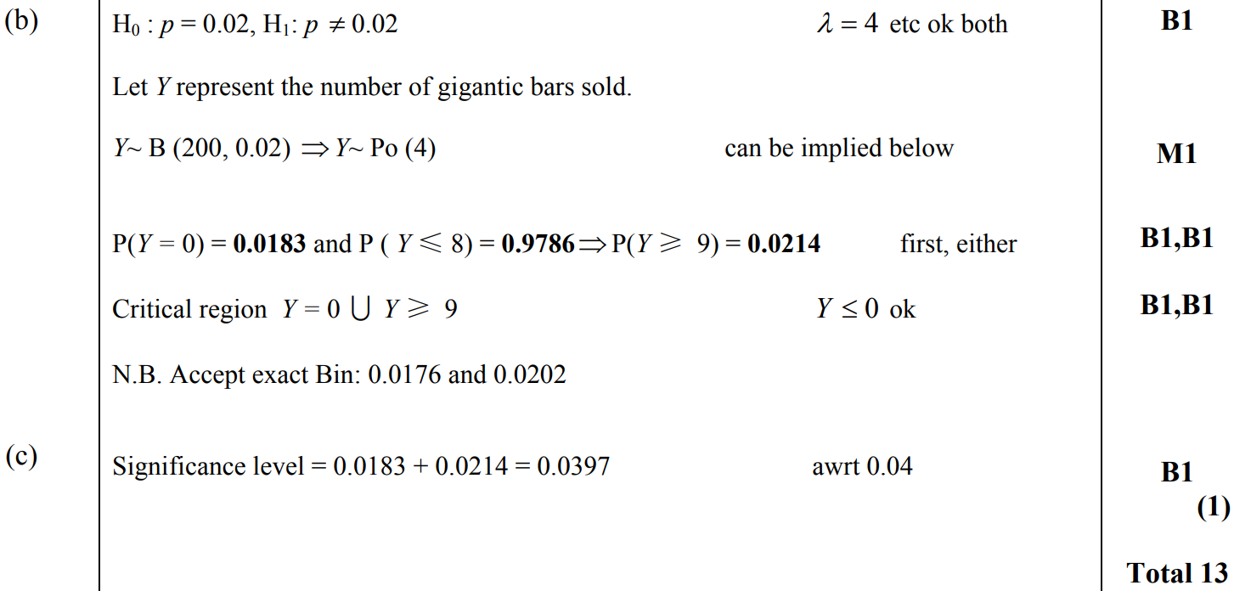
Jan 2007
B
C

Slide 26
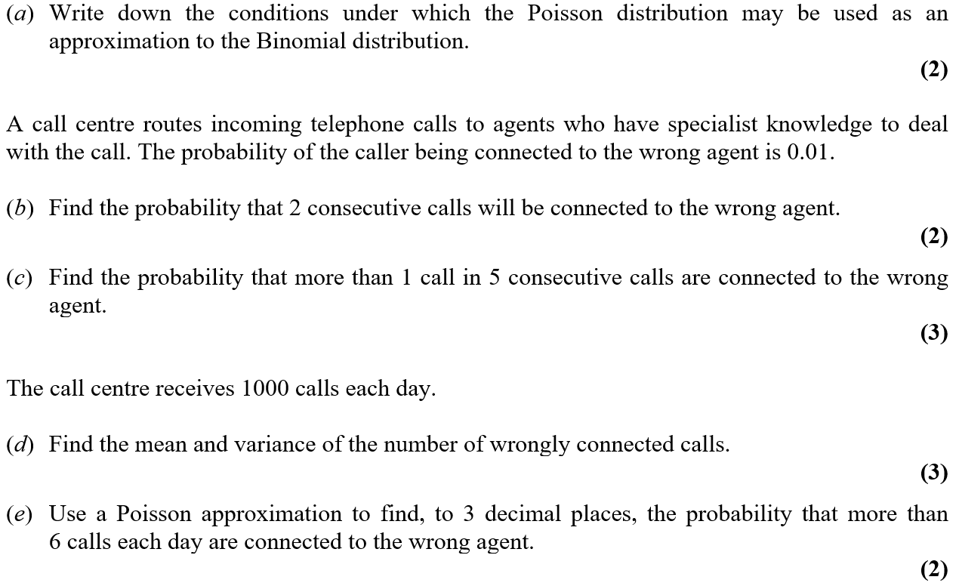
June 2007

Slide 27
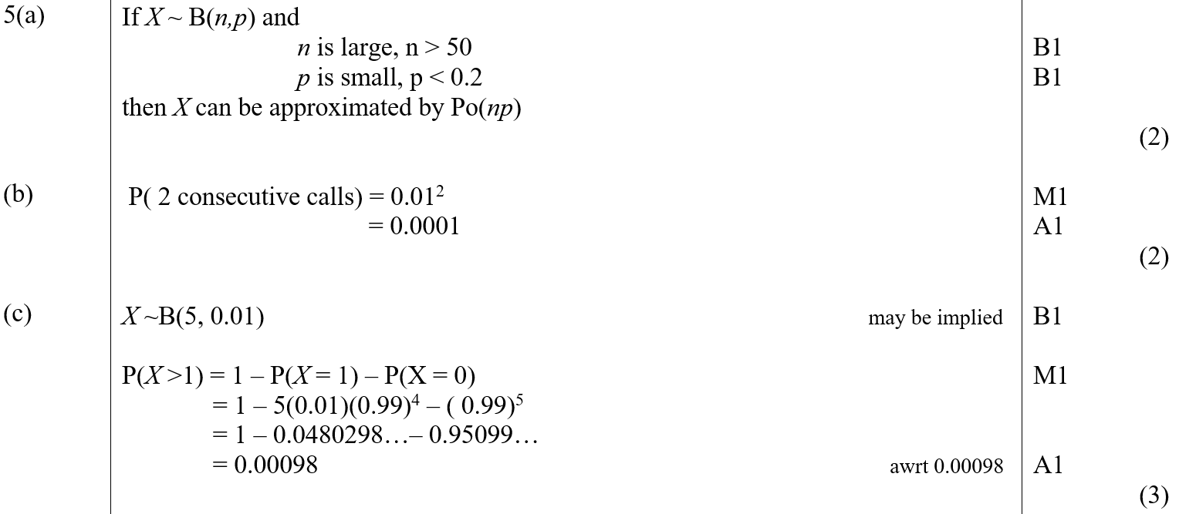
June 2007
A
B
C

Slide 28
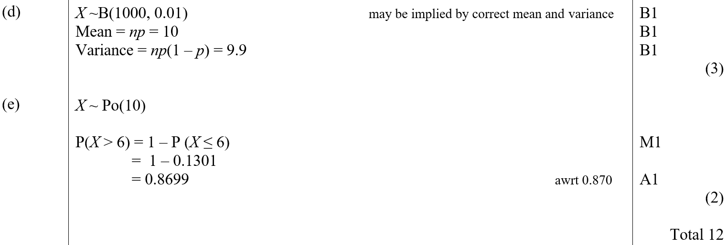
June 2007
D
E

Slide 29
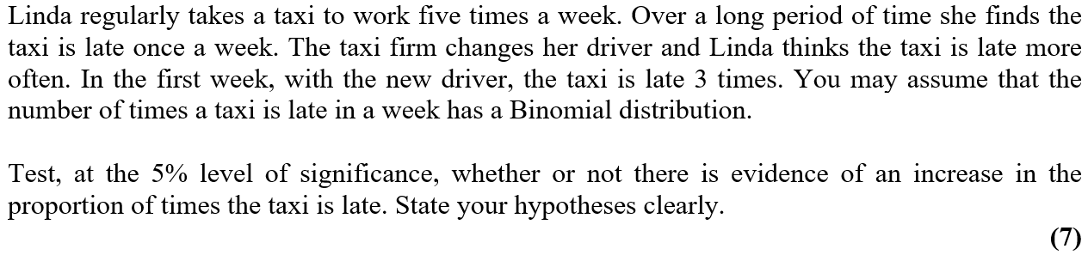
June 2007

Slide 30
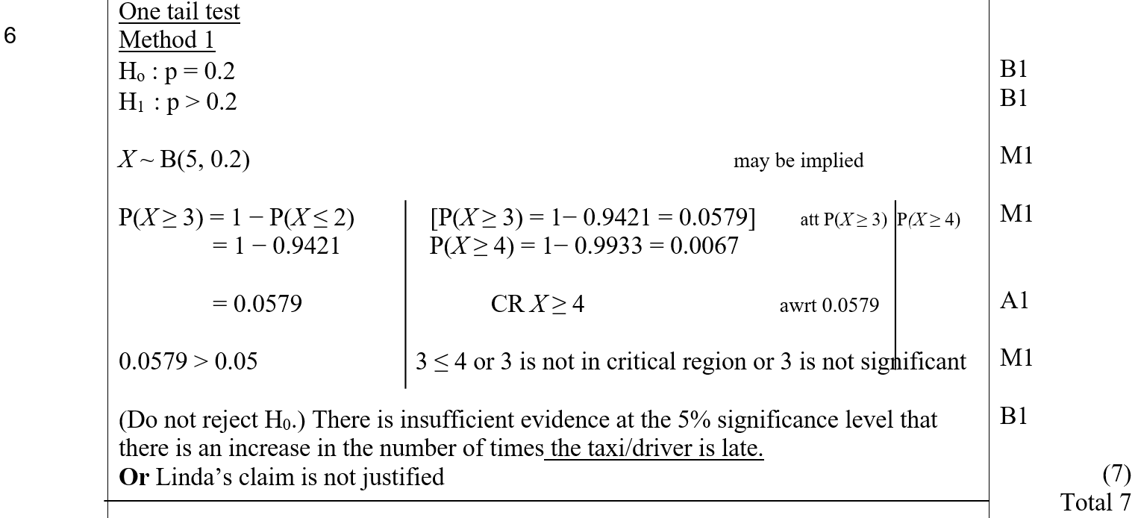
June 2007
A (One-Tailed)

Slide 31
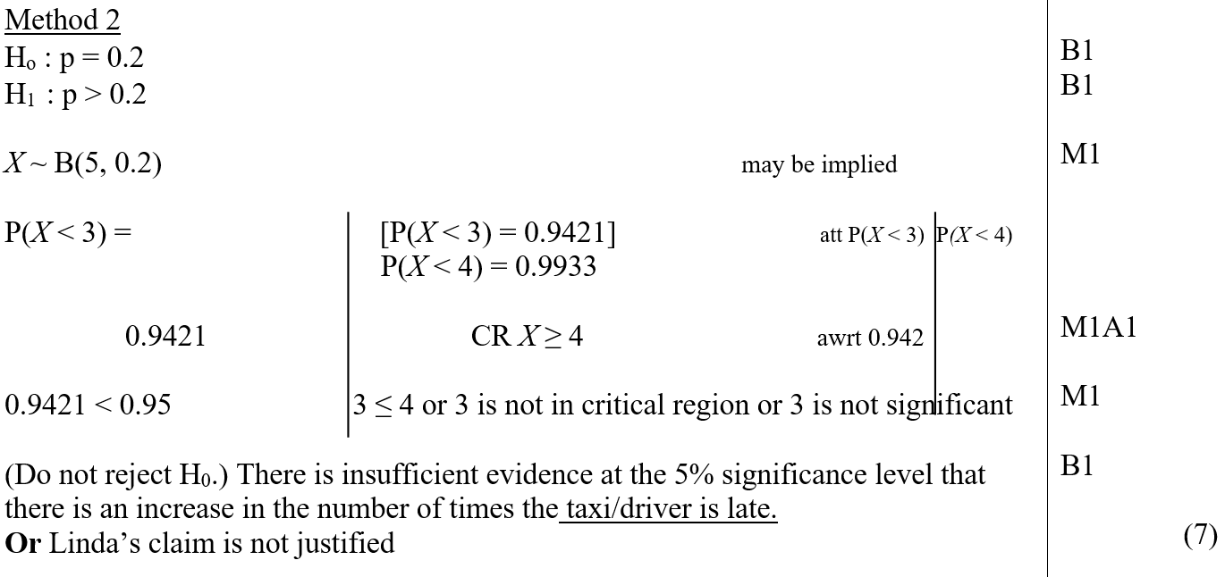
June 2007
A Alternative (One-Tailed)

Slide 32
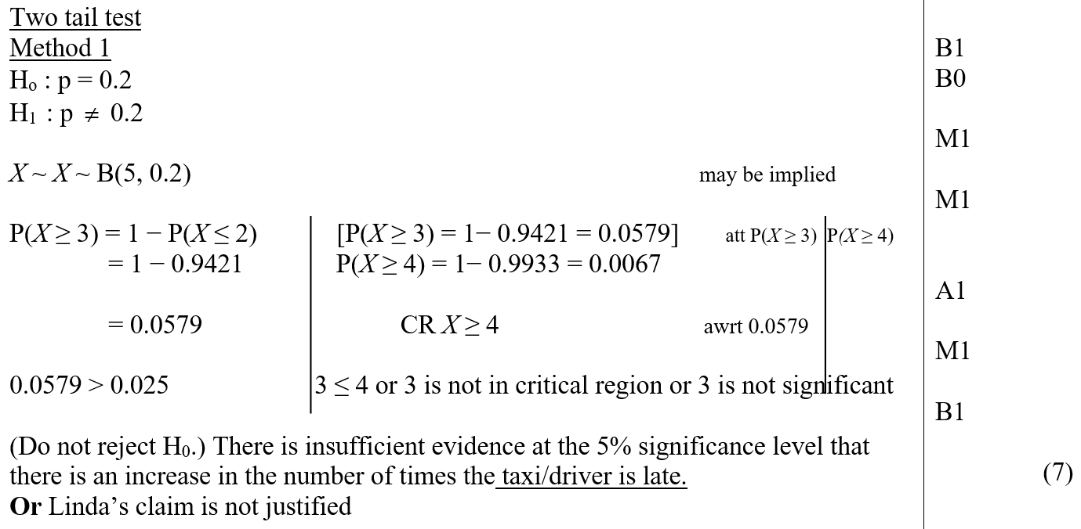
June 2007
A (Two-Tailed)

Slide 33
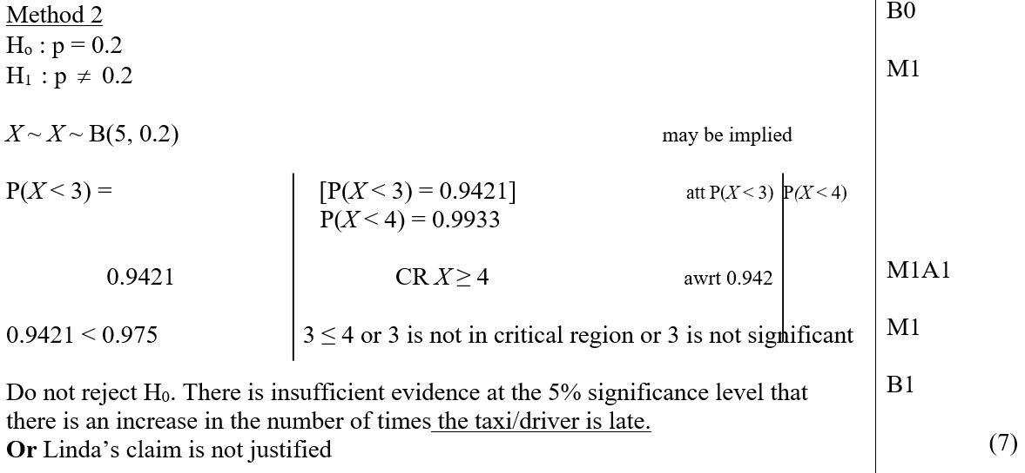
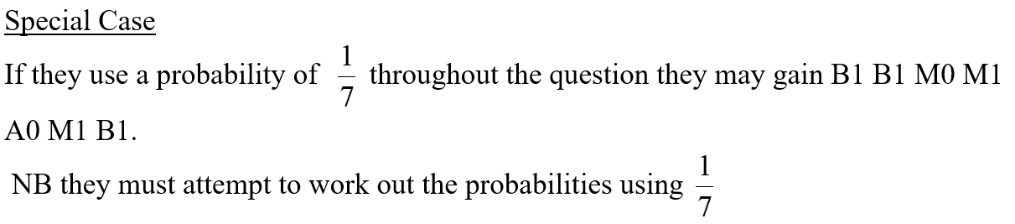
June 2007
A Alternative (Two-Tailed)
Special Case

Slide 34
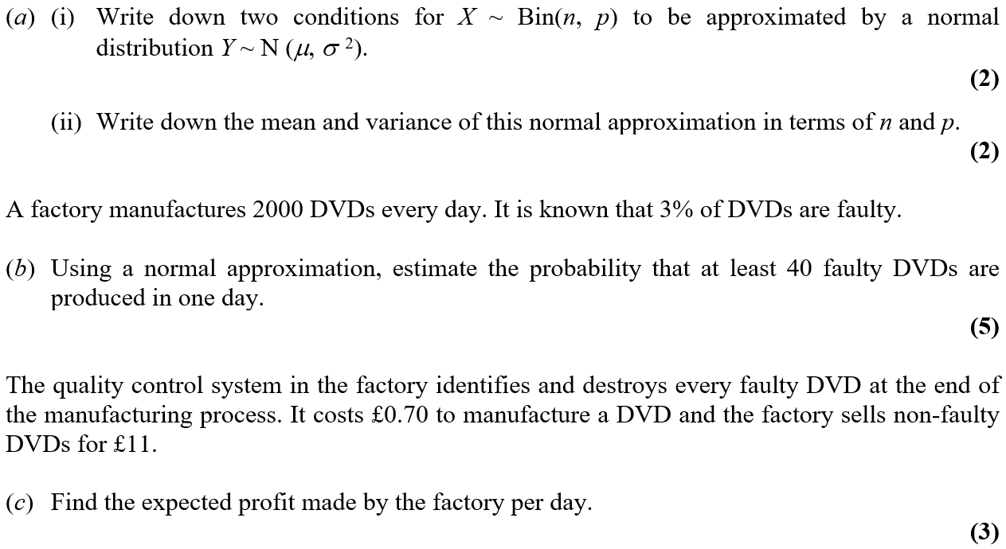
June 2007

Slide 35
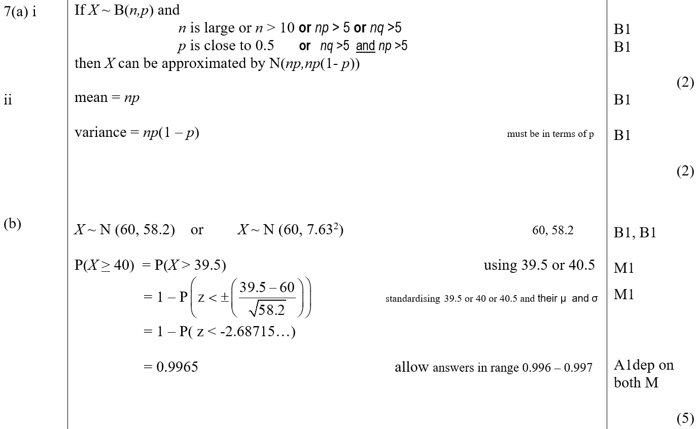
June 2007
A (i)
A (ii)
B

Slide 36
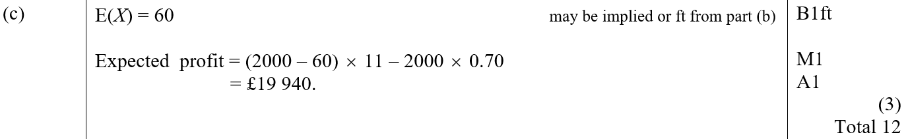
June 2007
C

Slide 37
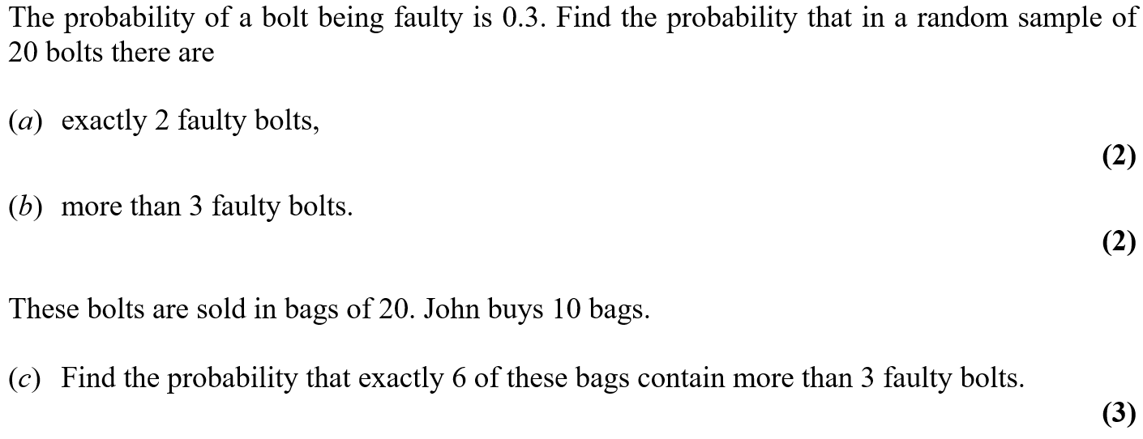
Jan 2008

Slide 38
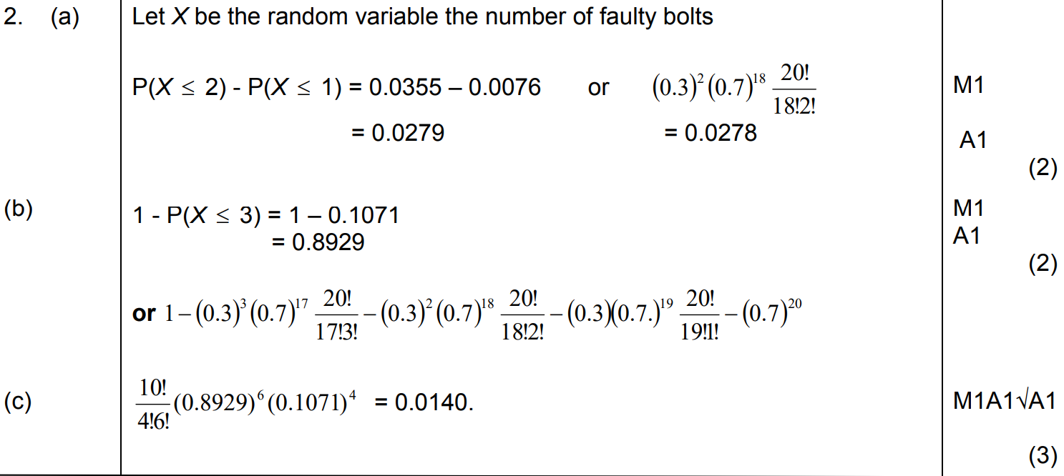
Jan 2008
A
B
C

Slide 39
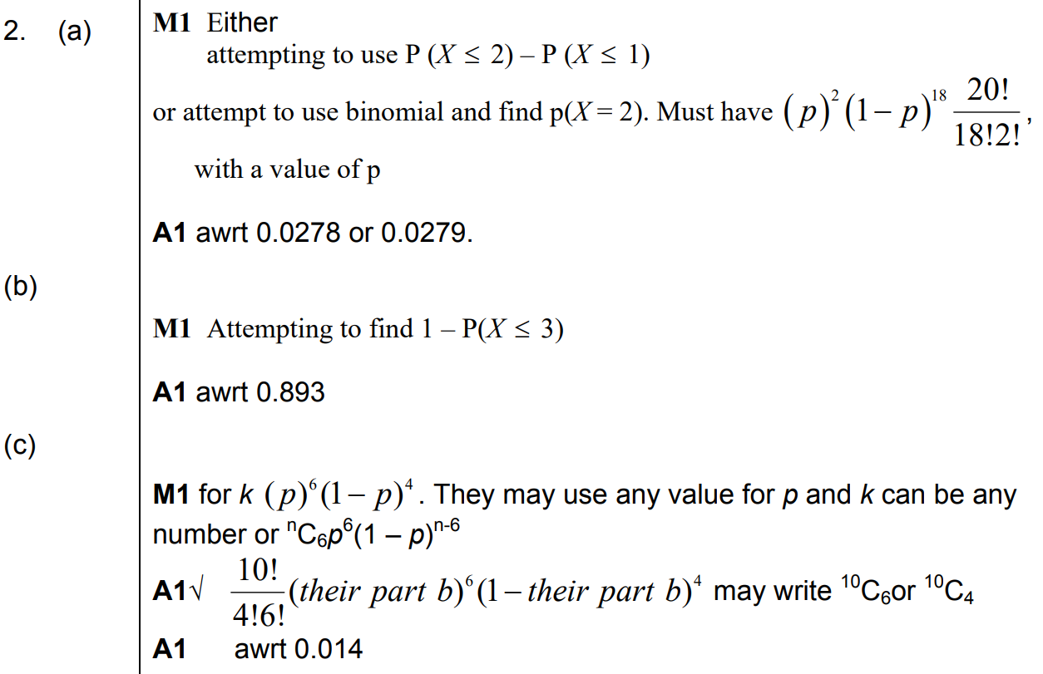
Jan 2008
A notes
B notes
C notes

Slide 40
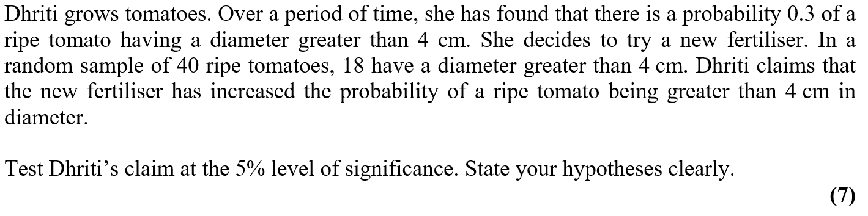
Jan 2008

Slide 41
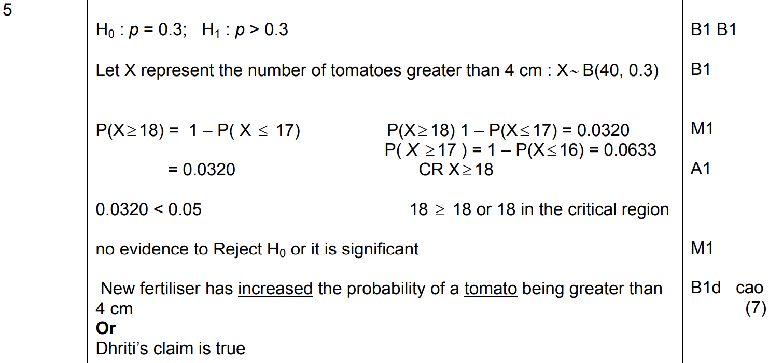
Jan 2008
A

Slide 42
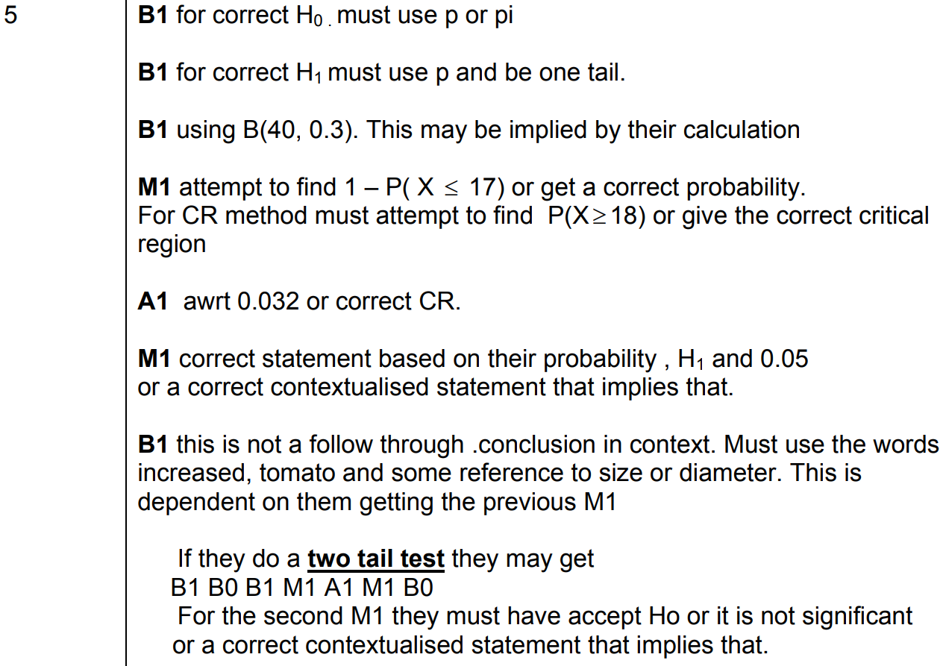
Jan 2008
A notes

Slide 43
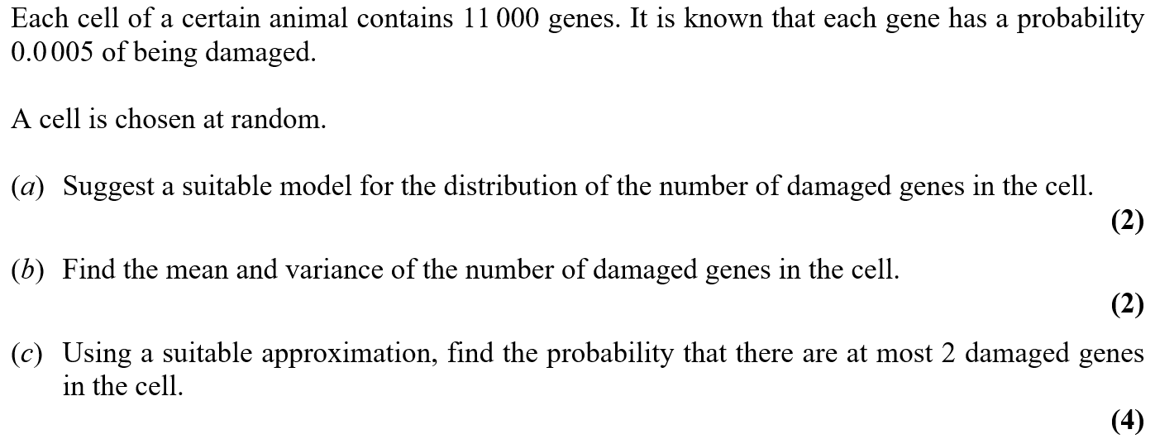
May 2008

Slide 44
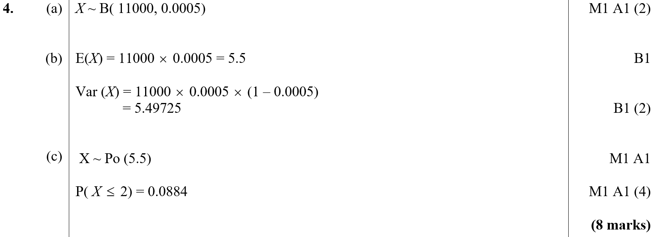
May 2008
A
B
C

Slide 45
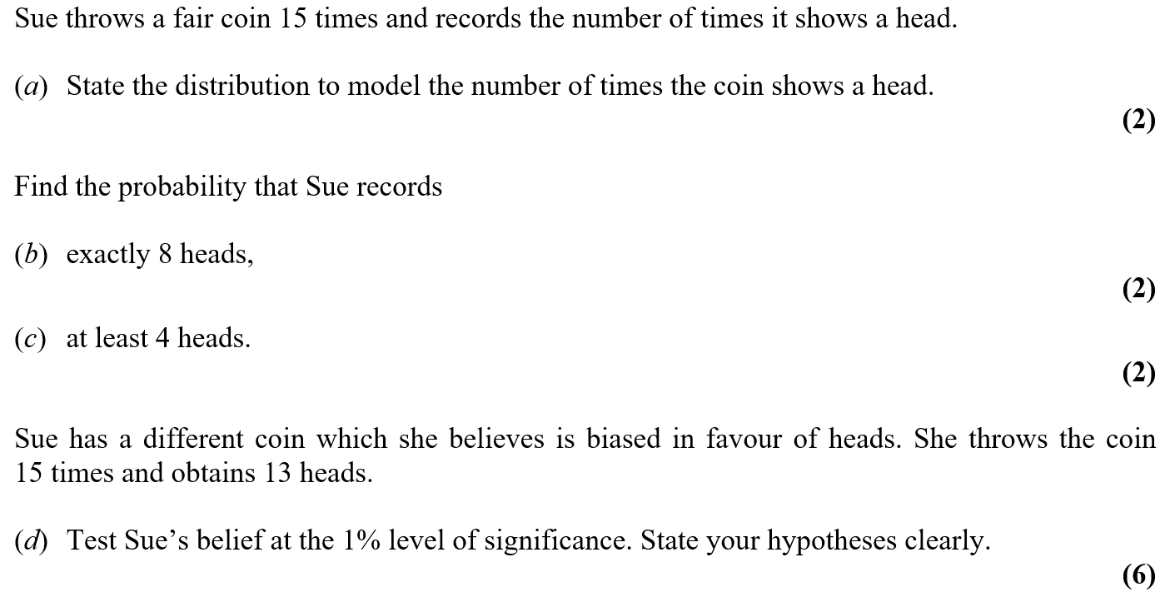
May 2008

Slide 46
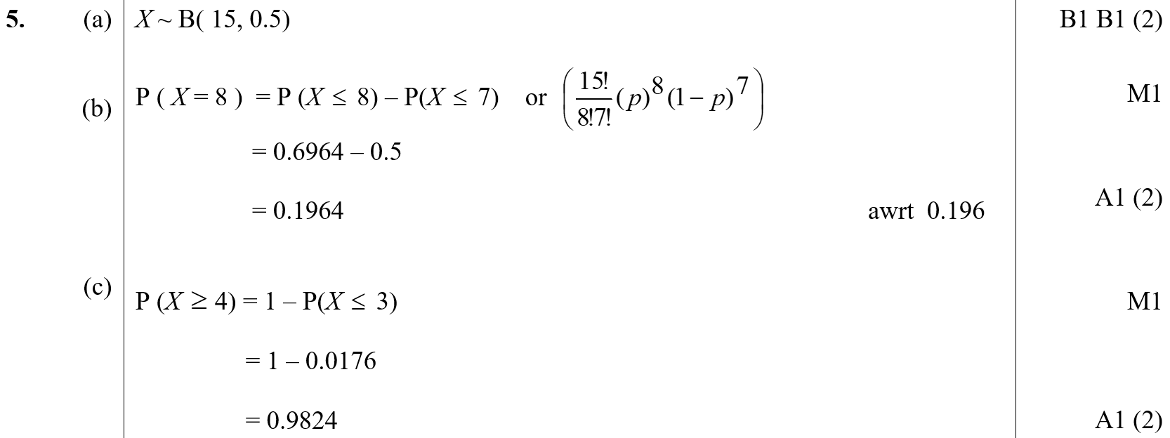
May 2008
A
B
C

Slide 47
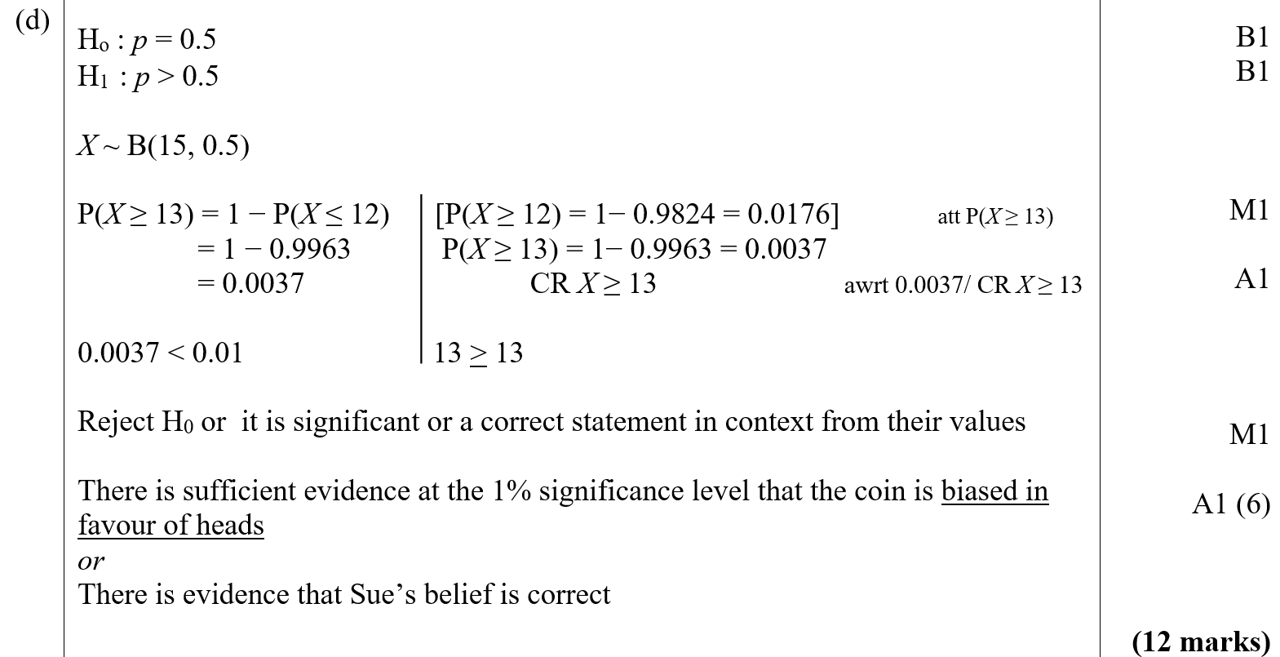
May 2008
D

Slide 48
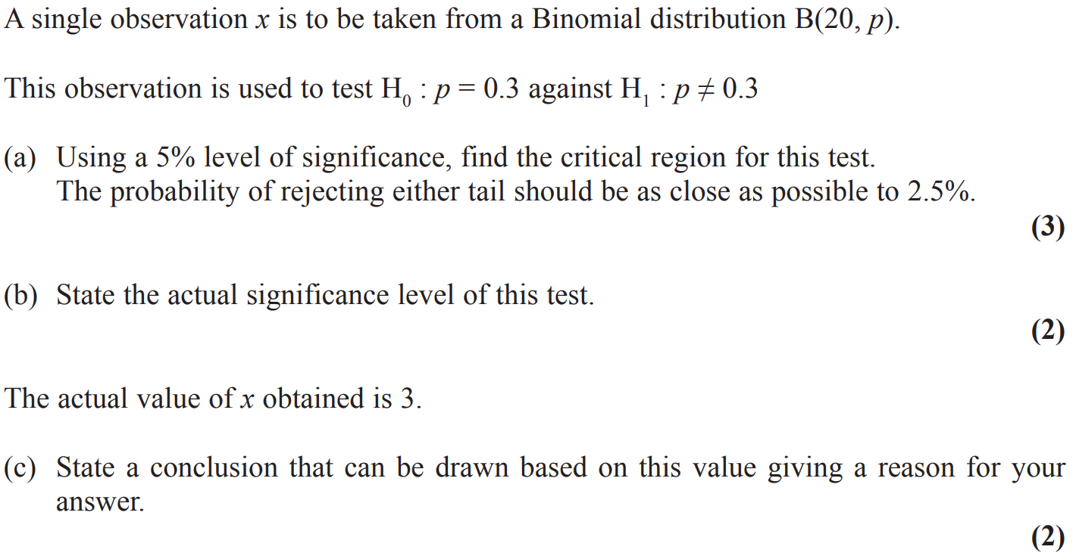
Jan 2009

Slide 49
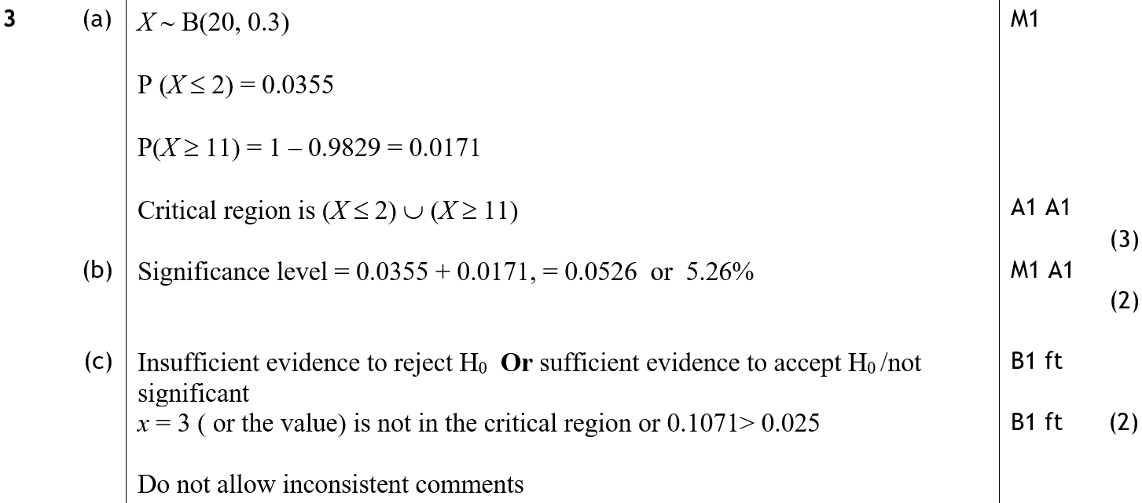
Jan 2009
A
B
C

Slide 50
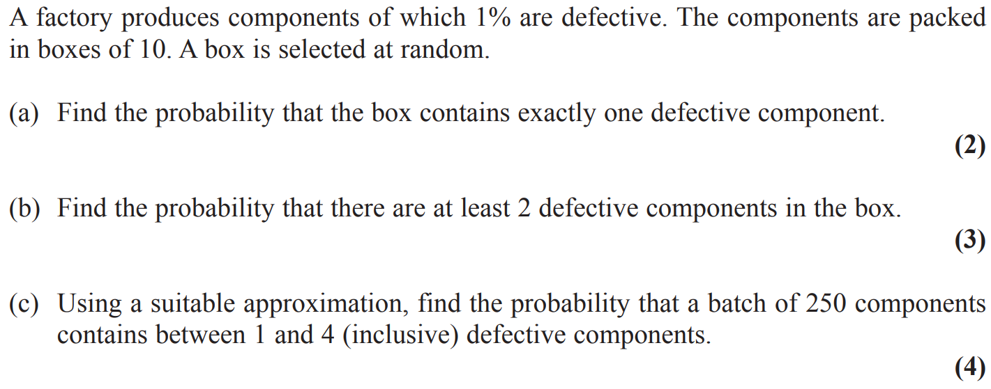
Jan 2009

Slide 51
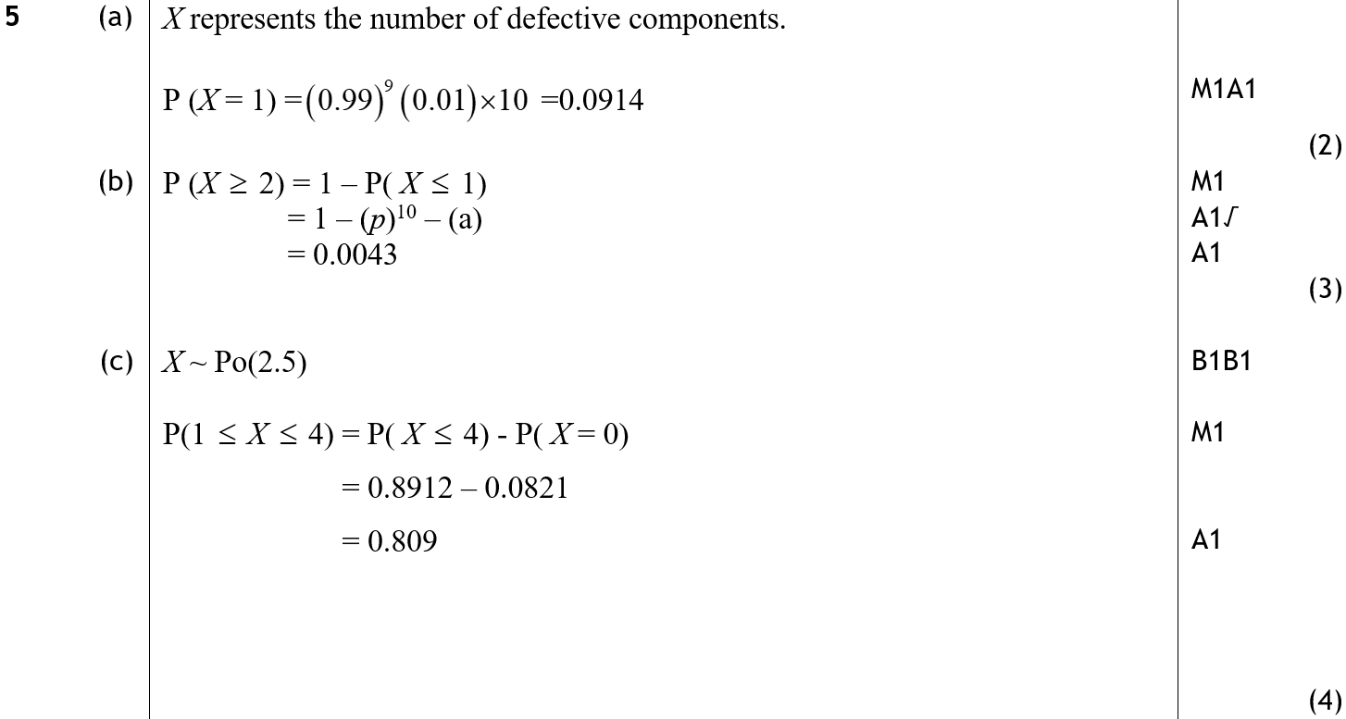
Jan 2009
A
B
C

Slide 52
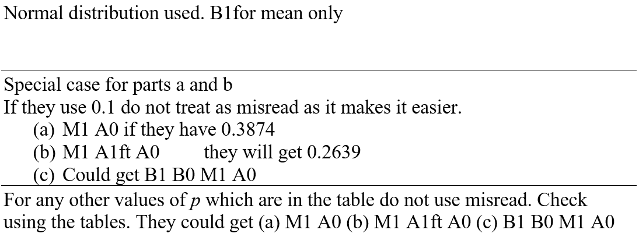
Jan 2009
notes

Slide 53
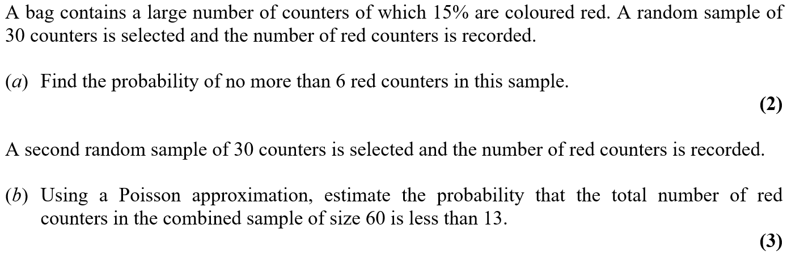
May 2009

Slide 54

May 2009
A
B

Slide 55

May 2009

Slide 56

May 2009
A
B
C

Slide 57

Jan 2010

Slide 58

Jan 2010
A
B
C
D

Slide 59

Jan 2010
A notes
B notes
C notes
D notes

Slide 60

Jan 2010

Slide 61

Jan 2010
A
B
C
D

Slide 62

Jan 2010
A notes
B notes
C notes
D notes

Slide 63

May 2010

Slide 64

May 2010
A
B
C
D

Slide 65

May 2010
A notes
B notes
C notes
D notes

Slide 66

May 2010

Slide 67

May 2010
A
B
C
D
E

Slide 68

May 2010
A notes
B notes
C notes
D notes
E notes

Slide 69

Jan 2011

Slide 70

Jan 2011
A
B
C
D

Slide 71

Jan 2011
A notes
B notes
D notes

Slide 72

Jan 2011

Slide 73

Jan 2011
A

Slide 74

Jan 2011
A notes

Slide 75

May 2011

Slide 76

May 2011
A
B

Slide 77

May 2011

Slide 78

May 2011
A
B

Slide 79

May 2011

Slide 80

May 2011
A
B
C

Slide 81

Jan 2012

Slide 82

Jan 2012
A

Slide 83

Jan 2012
A notes

Slide 84

Jan 2012

Slide 85

Jan 2012
A
B
C
D

Slide 86

Jan 2012
A notes
B notes
C notes
D notes

Slide 87

May 2012

Slide 88

May 2012
A
B

Slide 89

May 2012
A notes
B notes

Slide 90

May 2012

Slide 91

May 2012
A (i)
A (ii)
B

Slide 92

May 2012
C
A notes
B notes

Slide 93

May 2012
C notes

Slide 94

May 2012

Slide 95

May 2012
A (i)
A (ii)
B

Slide 96

May 2012
A (i) notes
A (ii) notes
B notes

Slide 97

Jan 2013

Slide 98

Jan 2013
A (i)
A (ii)
B

Slide 99

Jan 2013
C

Slide 100

Jan 2013
A (ii) notes
B notes
C notes

Slide 101

Jan 2013

Slide 102

Jan 2013
A
B
C

Slide 103

Jan 2013
D
A notes

Slide 104

Jan 2013
C notes
D notes

Slide 105

May 2013

Slide 106

May 2013
A
B

Slide 107

May 2013
A notes
B notes

Slide 108

May 2013

Slide 109

May 2013
A
B
C

Slide 110

May 2013
D
A notes
B notes
C notes
D notes

Slide 111

June 2014

Slide 112

June 2014
A (i)
A (ii)
B
C

Slide 113

June 2014
A (i) notes
A (ii) notes
B notes
C notes

Slide 114

June 2015

Slide 115

June 2015
A

Slide 116

June 2015
B

Slide 117

June 2016

Slide 118

June 2016
A
B (i)
B (ii)

Slide 119

June 2016
C

Slide 120

June 2017

Slide 121

June 2017
A

Slide 122

June 2017
B

Slide 123

June 2017

Slide 124

June 2017
A
B

Slide 125

June 2017
C

Slide 126

June 2018

Slide 127

June 2018
A
B
C
D

Slide 128

June 2018
A notes
B notes
C notes
D notes

Slide 129

June 2018

Slide 130

June 2018
A
B
C
D
E

Slide 131

June 2018
A notes
B notes
C notes
E notes

Slide 132
Old Spec Q’s
Binomial Distribution
SAM
2018
2019
2021
2022
(i)
2022
(ii)
2022
(iii)

Slide 133

SAM

Slide 134

SAM
A
B
C

Slide 135

SAM
D
E

Slide 136


SAM
A notes
B notes
C notes
D notes
E notes

Slide 137


2018

Slide 138

2018
A
B
C
D
E
F

Slide 139

2018
A (SF)
B (SF)
C (SF)

Slide 140

2018
D (SF)
E (SF)
F (SF)

Slide 141

2018
A notes
B notes
C notes
D notes
E notes
F notes

Slide 142

2019

Slide 143

2019
A
B (i)
B (ii)
C
D
E

Slide 144

2019
A SF
B (i) SF
B (ii) SF
C SF
D SF
E SF

Slide 145

2019
A notes
B (i) notes
B (ii) notes
C notes
E notes

Slide 146

2021

Slide 147

2021
A
B (i)
B (ii)
C
D

Slide 148

2021
A SF
B (i) SF
B (ii) SF
C SF
D SF

Slide 149

2021
A notes
B (i) notes
B (ii) notes
C notes
D notes

Slide 150

2022

Slide 151

2022
A (i)
A (ii)
B

Slide 152

2022
A (i) notes
A (ii) notes
B notes

Slide 153

2022

Slide 154

2022
A
B (i)
B (ii)
C
D

Slide 155

2022
A notes
B (i) notes
B (ii) notes
C notes
D notes

Slide 156

2022

Slide 157

2022
A
B
C
D

Slide 158

2022
A notes
B notes
C notes
D notes

Slide 159
New Spec Q’s
Old Spec Probability
Jan 2006 (i)
May 2008 (ii)
Jan 2011
May 2014 (i)
Jan 2006 (ii)*
Jan 2009
May 2011
May 2014 (ii)
Jan 2006 (iii)
May 2009 (i)
Jan 2012 (i)
June 2015
May 2006
May 2009 (ii)
Jan 2012 (ii)
June 2016
Jan 2007
Jan 2010 (i)
May 2012 (i)
June 2017
June 2007
Jan 2010 (ii)
May 2012 (ii)
June 2018
Jan 2008
May 2010 (i)
Jan 2013
May 2008 (i)
May 2010 (ii)
May 2013
*discrete uniform distribution

Slide 160

Jan 2006

Slide 161

A
Jan 2006
B
C

Slide 162

Jan 2006

Slide 163

Jan 2006
A
B(i)
B(ii)

Slide 164

Jan 2006

Slide 165


Jan 2006
A
B
C
D

Slide 166


May 2006

Slide 167


May 2006
A
B
C
D
E

Slide 168

Jan 2007

Slide 169

Jan 2007
A
B (i)
B (ii)
C

Slide 170

Jan 2007
A
B
C

Slide 171

June 2007

Slide 172

June 2007
A
B
C

Slide 173

June 2007
A
B
C

Slide 174


Jan 2008

Slide 175


Jan 2008
A
B
C
D
E
F

Slide 176

Jan 2008
A
B
C,D,E
C
D
E
F

Slide 177

May 2008

Slide 178


A
May 2008
B
C
D

Slide 179


May 2008

Slide 180


May 2008
A
B
C
D

Slide 181

Jan 2009

Slide 182

Jan 2009
A
B
C

Slide 183

Jan 2009
A
B
C
Diagrams
A errors
B errors

Slide 184

May 2009

Slide 185


May 2009
A
B (i)
B (ii)
C

Slide 186

May 2009
A
B (i)
B (ii)
C

Slide 187

May 2009

Slide 188

A (i)
May 2009
A (ii)
B
C
D
A

Slide 189

Jan 2010

Slide 190

Jan 2010
A
B

Slide 191

Jan 2010
A
B
A
B

Slide 192


Jan 2010

Slide 193

A
Jan 2010
B
C
D

Slide 194

Jan 2010
A
B
C
D

Slide 195




May 2010

Slide 196

May 2010
A
B
C
D

Slide 197


May 2010

Slide 198

May 2010
A
B
C
D
E

Slide 199



Jan 2011

Slide 200

Jan 2011
A

Slide 201


Jan 2011
B
C
D
E
F

Slide 202

Jan 2011
B
C
E
F

Slide 203


May 2011

Slide 204

May 2011
A
B
C
D
E

Slide 205

May 2011
B
C
D
E

Slide 206

Jan 2012

Slide 207

Jan 2012
A
B
C
D

Slide 208


Jan 2012

Slide 209

Jan 2012
A
B
C
D
E

Slide 210



May 2012

Slide 211

May 2012
A
B
C
D
E

Slide 212


May 2012

Slide 213

May 2012
A
B
C
D

Slide 214


Jan 2013

Slide 215

Jan 2013
A
B
C
D
E

Slide 216



May 2013

Slide 217

May 2013
A
B
C
D
E

Slide 218

May 2014

Slide 219


May 2014
A
B
C
D

Slide 220

May 2014

Slide 221


May 2014
A
B
C
D

Slide 222

June 2015

Slide 223

June 2015
A
B
C
D

Slide 224

June 2015
E
A notes
C notes
D notes
E notes

Slide 225


June 2016

Slide 226

June 2016
A
B
C
D (i)
D (ii)
E

Slide 227

June 2016
B notes
C notes
D (i) notes
D (ii) notes
E notes

Slide 228

June 2017

Slide 229

June 2017
A
B
C
D
E

Slide 230

June 2017
A, B & C notes
D notes
E notes

Slide 231

June 2018

Slide 232

June 2018
A
B
C
D

Slide 233

June 2018
A notes
B notes
C notes
D notes

Slide 234
Old Spec Q’s
Probability
Practice G (i)
SAM
2021
(i)
Practice G (ii)
2018*
2021
(ii)*
Practice H
2019
2022
Practice I (i)
2020
(i)
Practice I (ii)
2020
(ii)*
*Discrete Random Variable

Slide 235

Practice Paper G

Slide 236

Practice Paper G
A
B

Slide 237

Practice Paper G
C
D

Slide 238

Practice Paper G

Slide 239

Practice Paper G
A
B

Slide 240

Practice Paper G
C
D

Slide 241


Practice Paper H

Slide 242

Practice Paper H
A
B
C

Slide 243

Practice Paper H
D
E

Slide 244

Practice Paper I

Slide 245

Practice Paper
Practice Paper I
A
B

Slide 246

Practice Paper
Practice Paper I
C
D

Slide 247

Practice Paper I

Slide 248

Practice Paper I
A
B (i)

Slide 249


Practice Paper I
B (ii)
B (ii) (Alternative)

Slide 250

Practice Paper I
C

Slide 251

SAM

Slide 252


SAM
A
B
A notes
B notes

Slide 253

SAM
C
D

Slide 254

SAM
C notes
D notes

Slide 255

2018

Slide 256


2018
A
B
C
D
A (SF)
B (SF)

Slide 257


2018
C (SF)
D (SF)
A notes
B notes

Slide 258

2018
C notes
D notes

Slide 259

2019

Slide 260

2019
A
B
C
D

Slide 261

2019
A SF
B SF
C SF

Slide 262


2019
D SF
A notes
B notes
C notes
D notes

Slide 263

2020

Slide 264

2020
A
B
C
D (i)
D (ii)

Slide 265

2020
A SF
B SF
C SF
D (i) SF
D (ii) SF

Slide 266

2020
A notes
B notes
C notes
D (i) notes
D (ii) notes

Slide 267

2020

Slide 268

2020
A
B
C

Slide 269

2020
A SF
B SF

Slide 270

2020
C SF

Slide 271

2020
A notes
B notes
C notes

Slide 272



2021

Slide 273

2021
A
B (i)
B (ii)
C (i)
C (ii)
D

Slide 274



2021
A SF
B (i) SF
Venn
B (ii) SF
C (i) SF
C (ii) SF
D SF

Slide 275


2021
A SF
B (i) SF
B (ii) SF
C (i) SF
C (ii) SF
D SF
Venn

Slide 276

2021

Slide 277

2021
A
B

Slide 278

2021
A SF
B SF

Slide 279

2021
A notes
B notes

Slide 280




2022

Slide 281

2022
A
B
C
D
E
F

Slide 282

2022
A notes
B notes
C notes
D notes
E notes
F notes

Slide 283
New Spec Q’s
Old Spec Correlation and Regression
Jan 2006
Jan 2009 (i)
Jan 2011 (ii)
May 2013
May 2006
Jan 2009 (ii)
May 2011 (i)
May 2014
Jan 2007
May 2009 (i)
May 2011 (ii)
June 2015 (i)
June 2007 (i)
May 2009 (ii)
Jan 2012
June 2015 (ii)
June 2007 (ii)
Jan 2010
May 2012 (i)
June 2016 (i)
Jan 2008(i)
May 2010 (i)
May 2012 (ii)
June 2016 (ii)
Jan 2008 (ii)
May 2010 (ii)
Jan 2013 (i)
June 2017
May 2008
Jan 2011 (i)
Jan 2013 (ii)
June 2018

Slide 284


Jan 2006

Slide 285


Jan 2006
A
B
C
D
E
F

Slide 286


May 2006

Slide 287

May 2006
A
B
C
D
E
F

Slide 288


Jan 2007

Slide 289

Jan 2007
A
B
C
D
E
F

Slide 290

Jan 2007
B
C
D
E
F

Slide 291

June 2007

Slide 292

June 2007
A
B
C
A
B
C

Slide 293


June 2007

Slide 294

June 2007
A
B
C
D
E

Slide 295

June 2007
A
B
C
D
E

Slide 296


Jan 2008

Slide 297

Jan 2008
A
B

Slide 298

Jan 2008
A
B

Slide 299


Jan 2008

Slide 300

Jan 2008
A
B
C
D

Slide 301

Jan 2008
A
B
C
D

Slide 302

May 2008

Slide 303

A
May 2008
B
C
D
E
F

Slide 304


Jan 2009

Slide 305

Jan 2009
A
B
C
D
E

Slide 306

Jan 2009
A
B
C
D
E

Slide 307


Jan 2009

Slide 308

Jan 2009
A
B
C
D
E
F

Slide 309

Jan 2009
A
B
C
D
E
F

Slide 310

May 2009

Slide 311


A
May 2009
B
C
A
B
C

Slide 312

May 2009

Slide 313

A
May 2009
B
C
A
B
C

Slide 314


Jan 2010

Slide 315

A
Jan 2010
B
C
D
E
F
G

Slide 316

Jan 2010
A
B
C
D
E
F
G

Slide 317

Jan 2010
D&F

Slide 318

May 2010

Slide 319

May 2010
A
B
C

Slide 320


May 2010

Slide 321

A
May 2010
B
C
D
E
F

Slide 322

May 2010
A

Slide 323

Jan 2011

Slide 324

Jan 2011
A
B
C

Slide 325

Jan 2011
A
B
C

Slide 326

Jan 2011

Slide 327

A
Jan 2011
B
A
B

Slide 328

May 2011

Slide 329

May 2011
A
B
C
D
E

Slide 330


May 2011
A
B
C
D
E

Slide 331


May 2011

Slide 332

May 2011
A
B
C
D
E

Slide 333

May 2011
A
B
C
D
E

Slide 334


Jan 2012

Slide 335

A
Jan 2012
B
C
D
E (i)
E (ii)
F

Slide 336


May 2012

Slide 337

May 2012
A
B
C

Slide 338


May 2012

Slide 339

A
May 2012
B
C
D

Slide 340

May 2012
E
F

Slide 341


Jan 2013

Slide 342

Jan 2013
A
B
C

Slide 343


Jan 2013

Slide 344

Jan 2013
A
B
C
D

Slide 345


May 2013

Slide 346

May 2013
A
B
C
D
E
F

Slide 347


May 2014

Slide 348

May 2014
A
B
C
D
E
F
G

Slide 349


June 2015

Slide 350

June 2015
A
B
C
D

Slide 351

June 2015
A notes
B notes
C notes
D notes

Slide 352


June 2015

Slide 353

June 2015
A
B
C
D
E
F

Slide 354

June 2015
A notes
B notes
C notes
D notes
E notes
F notes

Slide 355


June 2016

Slide 356

June 2016
A
B
C
D
E

Slide 357

June 2016
A notes
B notes
C notes
D notes
E notes

Slide 358


June 2016

Slide 359

June 2016
A
B
C
D
E

Slide 360

June 2016
A notes
B notes
C notes
D notes
E notes

Slide 361


June 2017

Slide 362

June 2017
A
B
C
D
E
F
G

Slide 363

June 2017
A notes
B notes
C notes
D notes
E notes
F notes
G notes

Slide 364

June 2018

Slide 365

June 2018
A
B
C
D
E

Slide 366

June 2018
A notes
B notes
C notes
D notes
E notes

Slide 367
Old Spec Q’s
Correlation and Regression
Practice G (i)
SAM
Practice G (ii)
2018
Practice H (i)
2019
Practice H (ii)
2020
Practice H (iii)
2021
Practice I (i)
2022
Practice I (ii)
Practice I (iii)

Slide 368

Practice Paper G

Slide 369

Practice Paper G
A
B
C

Slide 370

Practice Paper G
D
E

Slide 371





Practice Paper G

Slide 372

Practice Paper G
A
B
C

Slide 373


Practice Paper G
D
E
E notes

Slide 374

Practice Paper G
F
G

Slide 375

Practice Paper H

Slide 376

Practice Paper H
A
B
C

Slide 377



Practice Paper H

Slide 378

Practice Paper H
A
B

Slide 379


Practice Paper H

Slide 380

Practice Paper H
A
B
C

Slide 381

Practice Paper I

Slide 382

Practice Paper I
A
B
C

Slide 383



Practice Paper I

Slide 384


Practice Paper I
A
B
C
C notes

Slide 385






Practice Paper I

Slide 386

Practice Paper I
A
B
C

Slide 387

Practice Paper I
D
E

Slide 388

SAM

Slide 389

SAM
A
B
C
D

Slide 390

SAM
A notes
B notes
C notes
D notes

Slide 391

2018

Slide 392

2018
A
B
C
D
E

Slide 393

2018
A (SF)
B (SF)

Slide 394


2018
C (SF)
D (SF)
E (SF)
A notes

Slide 395

2018
B notes
C notes
D notes
E notes

Slide 396

2019

Slide 397

2019
A
B
C

Slide 398

2019
A SF
B SF
C SF

Slide 399

2019
A notes
B notes
C notes

Slide 400



2020

Slide 401

2020
A
B (i)
B (ii)
C
D

Slide 402

2020
A SF
B (i) SF
B (ii) SF
C SF
D SF

Slide 403

2020
A notes
B (i) notes
B (ii) notes
C notes
D notes

Slide 404


2021

Slide 405

2021
A
B
C
D

Slide 406

2021
A SF
B SF
C SF
D SF

Slide 407

2021
A notes
B notes
C notes
D notes

Slide 408



2022

Slide 409

2022
A
B
C

Slide 410

2022
A notes
B notes
C notes

Slide 411
New Spec Q’s
*Skew and Stem & Leaf not on new spec
Old Spec Data Processing
Jan 2006
S&L*
Jan 2008 (ii)
histogram
Jan 2011 (ii)
Box plot*
May 2013 (ii)
S2 & S3 sampling
May 2006 (i)
Box plot
May 2008
S&L*
Jan 2011 (iii)*
May 2014 (i) S&L, Box Plot*
May 2006
Jan 2006
Jan 2007
May 2006
May 2006 (ii)
Jan 2009
histogram*
May 2011
Some normal distribution*
May 2014 (ii)
Jan 2008
June 2009
Jan 2007 (i)*
May 2009 (i) histogram
May 2009
June 2010
Jan 2012 (i)
histogram
May 2014 (iii) histogram*
Jan 2007 (ii)
histogram
May 2010
June 2012
May 2009 (ii)
Some Normal distribution*
Jan 2012 (ii)
S&L*
June 2013
Jan 2007 (iii)
General
June 2015
Box plot
May 2011
May 2012
histogram
June 2015
June 2007 (i)
Some normal distribution*
June 2016 (i)
Jan 2010 (i)
S&L*
June 2016
Jan 2013
histogram*
June 2016 (ii) Histogram
Jan 2010 (ii)*
June 2017
June 2007 (ii)
histogram*
May 2013 (i)
Box and S&L*
June 2017 Histogram*
Jan 2008 (i)*
May 2010*
Jan 2011 (i)
June 2018 Histogram*

Slide 412


Jan 2006

Slide 413

Jan 2006
A
B
C
D
E

Slide 414


May 2006

Slide 415


May 2006
A
B
C
D
E

Slide 416


May 2006

Slide 417

May 2006
A
B
C
D

Slide 418


Jan 2007

Slide 419

Jan 2007
A
B
C
D
E
F
G

Slide 420

Jan 2007
B
C
D
E
F

Slide 421

Jan 2007

Slide 422


Jan 2007
A
B
C
D
B
C
D

Slide 423

Jan 2007

Slide 424

Jan 2007
A
B
A
B

Slide 425


June 2007

Slide 426

June 2007
A
B
C
D
E

Slide 427

June 2007
A
B
C
D
E

Slide 428


June 2007

Slide 429

June 2007
A
B
C
D
E
F

Slide 430

June 2007
B
C
D
E
F

Slide 431


Jan 2008

Slide 432

Jan 2008
A
B
C
D

Slide 433

Jan 2008
A
B
C
D

Slide 434


Jan 2008

Slide 435

Jan 2008
A

Slide 436



May 2008

Slide 437


A
May 2008
B
C (i)
C (ii)
D
E

Slide 438


Jan 2009

Slide 439

Jan 2009
A
B
C
D
E

Slide 440

Jan 2009
A
B
C
D
E

Slide 441

May 2009

Slide 442

May 2009
A
B

Slide 443


May 2009

Slide 444

May 2009
A
B
C
D

Slide 445

May 2009
A
B
C
D

Slide 446


Jan 2010

Slide 447

Jan 2010
A
B
C
D

Slide 448

Jan 2010
B
C
D

Slide 449


Jan 2010

Slide 450

Jan 2010
A
B
C
D
E

Slide 451

Jan 2010
B
C
D
E

Slide 452


May 2010

Slide 453

May 2010
A
B
C
D
E

Slide 454

Jan 2011

Slide 455

Jan 2011
A
B
A
B

Slide 456



Jan 2011

Slide 457

Jan 2011
A
B
C

Slide 458

Jan 2011
A
B
C

Slide 459


Jan 2011

Slide 460

Jan 2011
A
B
C

Slide 461

Jan 2011
A
B
C

Slide 462


May 2011

Slide 463

May 2011
A
B
C
D
E

Slide 464


May 2011
A
B
C
D
E

Slide 465

Jan 2012

Slide 466


Jan 2012
A
B
A
B

Slide 467



Jan 2012

Slide 468

Jan 2012
A
B
C
D
E

Slide 469


May 2012

Slide 470

May 2012
A
B
C
D
E

Slide 471




Jan 2013

Slide 472

A
Jan 2013
B
C
D
E
F

Slide 473




May 2013

Slide 474

May 2013
A
B
C
D

Slide 475



May 2013

Slide 476

May 2013
A
B
C
D
E
F

Slide 477



May 2014

Slide 478

May 2014
A
B
C

Slide 479

May 2014

Slide 480

May 2014
A

Slide 481


May 2014

Slide 482


May 2014
A
B
C
D

Slide 483



June 2015

Slide 484

June 2015
A
B
C
D
E
F

Slide 485

June 2015
C notes
D notes
E notes
F notes

Slide 486
June 2016

Slide 487
June 2016
A
B
C
D
E

Slide 488
June 2016
A notes
B notes
C notes
D notes
E notes

Slide 489


June 2016

Slide 490

June 2016
A
B
C (i)
C (ii)
D
E
F (i)
F (ii)

Slide 491

June 2016
A notes
B notes
C (i) notes
C (ii) notes
D notes
E notes
F (i) notes
F (ii) notes

Slide 492


June 2017

Slide 493

June 2017
A
B
C
D
E
F
G

Slide 494

June 2017
A notes
B notes
C (i) notes
D notes
E notes
F notes
G notes

Slide 495


June 2018

Slide 496

June 2018
A
B
C
D
E
F

Slide 497

June 2018
A notes
B notes
C notes
D notes
E notes
F notes

Slide 498

Jan 2006

Slide 499

Jan 2006
A

Slide 500

May 2006

Slide 501

May 2006
A
B
C

Slide 502

May 2006

Slide 503

May 2006
A
B

Slide 504

Jan 2007

Slide 505

Jan 2007
A
B (i)
B (ii)

Slide 506

Jan 2008

Slide 507

Jan 2008
A
B
C
D
A notes

Slide 508

Jan 2008
B notes
C notes
D notes

Slide 509

May 2009

Slide 510

May 2009
A
B
C

Slide 511

June 2009

Slide 512

June 2009
A
B (i)
B (ii)

Slide 513

June 2009
A notes
B (i) notes
B (ii) notes

Slide 514

June 2010

Slide 515

June 2010
A
B
A notes

Slide 516

May 2010

Slide 517

May 2010
A
B
C
D
A notes

Slide 518

May 2010
B notes
C notes
D notes

Slide 519
May 2011

Slide 520
May 2011
A
B

Slide 521

June 2012

Slide 522

June 2012
A
B
C
D

Slide 523

June 2012
A notes
C notes
D notes

Slide 524

June 2013

Slide 525


June 2013
A (i)
A (ii)
A notes

Slide 526

June 2014

Slide 527
June 2014
A
B
C

Slide 528

June 2015

Slide 529
June 2015
A

Slide 530

June 2016

Slide 531

June 2016
A

Slide 532

June 2016
B
notes

Slide 533

June 2017

Slide 534

June 2017
A
B
C

Slide 535
Old Spec Q’s
Data Processing
SAM
2018
2019
2020
2021
2022

Slide 536


SAM

Slide 537

SAM
A
B
C

Slide 538


SAM
D
E
F
A notes
B notes

Slide 539

SAM
C notes
D notes
E notes
F notes

Slide 540


2018

Slide 541

2018
A
B
C
D
E
F
G

Slide 542

2018
A (SF)
B (SF)
C (SF)
D (SF)

Slide 543

2018
E (SF)
F (SF)

Slide 544

2018
G (SF)

Slide 545

2018
B notes
E notes
F notes
G notes

Slide 546



2019

Slide 547

2019
A
B
C
D
E

Slide 548

2019
A SF
B SF
C SF

Slide 549

2019
D SF
E SF

Slide 550

2019
A notes
C notes
D notes
E notes

Slide 551


2020

Slide 552

2020
A
B
C
D
E
F
G

Slide 553

2020
A SF
B SF
C SF
D SF
E SF
F SF
G SF

Slide 554

2020
A notes
B notes
C notes
D notes
E notes
F notes
G notes

Slide 555

2021

Slide 556

2021
A
B
C
D

Slide 557

2021
A SF
B SF
C SF
D SF

Slide 558

2021
A notes
B notes
C notes
D notes

Slide 559
2022

Slide 560
2022
A
B (i)
B (ii)
C
D

Slide 561
2022
A notes
B (i) notes
B (ii) notes
C notes
D notes

Slide 562
New Spec Q’s
*Poisson Distribution not on new spec
Old Spec Normal Distribution
S1 & S2 no Hypothesis Testing
S3 Hypothesis Testing
Jan 2006
May 2010
June 2015
S2 May 2006*
S2 June 2018
S3 June 2007
May 2006
Jan 2011
June 2016 (i)
S2 June 2007
S3 June 2010
Jan 2007
May 2011 (i)
June 2016 (ii)
S2 Jan 2008*
S3 June 2011
June 2007
May 2011 (ii)
June 2017
S2 May 2008
Jan 2008
Jan 2012
June 2018 (i)
S2 May 2011 (i)*
May 2008
May 2012
June 2018 (ii)
S2 May 2012
Jan 2009
Jan 2013
S2 June 2014
May 2009
May 2013
S2 June 2016
Jan 2010
May 2014
S2 June 2017

Slide 563

Jan 2006

Slide 564

Jan 2006
A
B
C
D

Slide 565

May 2006

Slide 566

May 2006
A
B
C

Slide 567

Jan 2007

Slide 568

Jan 2007
A
B

Slide 569

Jan 2007
A
B

Slide 570

June 2007

Slide 571



June 2007
A
B
A
B

Slide 572

Jan 2008

Slide 573

Jan 2008
A
B
C

Slide 574

Jan 2008
A
B
C

Slide 575

May 2008

Slide 576

May 2008
A
B
C

Slide 577

Jan 2009

Slide 578

Jan 2009
A
B
C
D

Slide 579

Jan 2009
A
B
C
D

Slide 580

May 2009

Slide 581


A
May 2009
B
C
D
A
C
D

Slide 582

Jan 2010

Slide 583

Jan 2010
A
B
C
D

Slide 584

Jan 2010
A
B
C
D

Slide 585


May 2010

Slide 586

A
May 2010
B
C
D
E

Slide 587

Jan 2011

Slide 588

Jan 2011
A
B
C

Slide 589

Jan 2011
A
B
C

Slide 590

May 2011

Slide 591

May 2011
A
B
A
B

Slide 592

May 2011

Slide 593

May 2011
A
B

Slide 594

May 2011
A
B

Slide 595

Jan 2012

Slide 596

Jan 2012
A
B
C

Slide 597

May 2012

Slide 598

May 2012
A
B
C

Slide 599

Jan 2013

Slide 600

Jan 2013
A
B
C

Slide 601

May 2013

Slide 602

May 2013
A
B
C

Slide 603

May 2014

Slide 604


May 2014
A
B
C

Slide 605

June 2015

Slide 606

June 2015
A (i)
A (ii)
A (iii)
A (iv)
B

Slide 607

June 2015
A (iii) notes
A (iv) notes
B notes

Slide 608
June 2016

Slide 609
June 2016
A
B
C (i)
C (ii)
D
E
F (i)
F (ii)

Slide 610
June 2016
A notes
B notes
C (i) notes
C (ii) notes
D notes
E notes
F (i) notes
F (ii) notes

Slide 611

June 2016

Slide 612

June 2016
A
B
C

Slide 613

June 2016
A notes
B notes
C notes

Slide 614

June 2017

Slide 615

June 2017
A
B
C

Slide 616

June 2017
A notes
B notes
C notes

Slide 617

June 2018

Slide 618

June 2018
A
B
B Alternative

Slide 619


June 2018
A notes
B notes
B Alternative notes
Diagram

Slide 620

June 2018

Slide 621

June 2018
A
B
C
D

Slide 622

June 2018
A notes
B notes
C notes
D notes

Slide 623
May 2006

Slide 624
May 2006
A
B
C (i)
C (ii)

Slide 625
June 2007

Slide 626
June 2007
A (i)
A (ii)
B

Slide 627
June 2007
C

Slide 628

June 2007

Slide 629

June 2007
A
A notes

Slide 630

Jan 2008

Slide 631

Jan 2008
A (i)
A (ii)

Slide 632

Jan 2008
B
A (i) notes

Slide 633


Jan 2008
A (ii) notes

Slide 634

Jan 2008
B

Slide 635

May 2008

Slide 636

May 2008
A

Slide 637

June 2010

Slide 638

June 2010
A

Slide 639

June 2010
A notes

Slide 640
May 2011

Slide 641
May 2011
A
B
C

Slide 642

June 2011

Slide 643

June 2011
A

Slide 644
May 2012

Slide 645
May 2012
A (i)
A (ii)
B

Slide 646
May 2012
C
A notes
B notes

Slide 647
May 2012
C notes

Slide 648

June 2014

Slide 649

June 2014
A
B
C
D

Slide 650

June 2014
A notes
B notes
C notes
D notes

Slide 651

June 2016

Slide 652

June 2016
A

Slide 653

June 2016
Alternative for final 3 marks

Slide 654
June 2017

Slide 655
June 2017
A
B

Slide 656
June 2017
C

Slide 657
June 2018

Slide 658
June 2018
A
B
C
D
E

Slide 659
June 2018
A notes
B notes
C notes
E notes

Slide 660
Old Spec Q’s
Normal Distribution
Practice G
(i)
SAM
(i)
2021
Practice G (ii)
SAM
(ii)
2022
(i)
Practice H (i)
SAM
(iii)
2022
(ii)
Practice H (ii)
2018
Practice H (iii)
2019
(i)
Practice H (iv)
2019
(ii)
Practice I
2020

Slide 661



Practice Paper G

Slide 662


Practice Paper G
A
B
A notes

Slide 663



Practice Paper G
C
D
D notes

Slide 664


Practice Paper G

Slide 665

Practice Paper G
A

Slide 666

Practice Paper H

Slide 667

Practice Paper H
A

Slide 668

Practice Paper H

Slide 669

Practice Paper H
A
B

Slide 670

Practice Paper H

Slide 671

Practice Paper H
A
B
C

Slide 672

Practice Paper H
D
E

Slide 673

Practice Paper H

Slide 674

Practice Paper H
A
B

Slide 675

Practice Paper I

Slide 676

Practice Paper I
A

Slide 677

Practice Paper I
B
C

Slide 678
SAM

Slide 679
SAM
A
B
C

Slide 680
SAM
D
E
F
A notes
B notes

Slide 681
SAM
C notes
D notes
E notes
F notes

Slide 682

SAM

Slide 683

SAM
A
B

Slide 684

SAM
C

Slide 685

SAM
A notes
B notes
C notes

Slide 686
SAM

Slide 687
SAM
A
B
C

Slide 688
SAM
D
E

Slide 689
SAM
A notes
B notes
C notes
D notes
E notes

Slide 690

2018

Slide 691

2018
A
B
C
D

Slide 692

2018
A (SF)
B (SF)

Slide 693

2018
C (SF)
D (SF)

Slide 694

2018
A notes
B notes
C notes
D notes

Slide 695
2019

Slide 696
2019
A
B
C
D
E

Slide 697
2019
A SF
B SF
C SF

Slide 698
2019
D SF
E SF

Slide 699
2019
A notes
C notes
D notes
E notes

Slide 700

2019

Slide 701

2019
A
B
C

Slide 702

2019
A SF
B SF

Slide 703

2019
B SF

Slide 704

2019
A notes
B notes
C notes

Slide 705

2020

Slide 706

2020
A
B
C (i)
C (ii)
C (iii)
D

Slide 707

2020
A SF
B SF

Slide 708

2020
C (i) SF
C (ii) SF
C (iii) SF

Slide 709

2020
D SF

Slide 710

2020
A notes
B notes
C (i) notes
C (ii) notes
C (iii) notes
D notes

Slide 711

2021

Slide 712

2021
A
B
C
D

Slide 713

2021
A SF
B SF
C SF
D SF

Slide 714

2021
A notes
B notes
C notes
D notes

Slide 715
2022

Slide 716
2022
A (i)
A (ii)
B

Slide 717
2022
A (i) notes
A (ii) notes
B notes

Slide 718

2022

Slide 719

2022
A
B
C
D

Slide 720

2022
A notes
B notes
C notes
D notes

Slide 721
LDS Questions
SAM
2018
2019
2020
2021
2022
*there may be other Q’s that have used the large data set, but these are the ones that require students to apply their knowledge of the large data set

Slide 722
SAM

Slide 723
SAM
A
B
C
D

Slide 724
SAM
A notes
B notes
C notes
D notes

Slide 725
2018

Slide 726
2018
A
B
C
D
A (SF)
B (SF)

Slide 727
2018
C (SF)
D (SF)
A notes
B notes

Slide 728
2018
C notes
D notes

Slide 729
2019

Slide 730
2019
A
B
C
D
E

Slide 731
2019
A SF
B SF
C SF

Slide 732
2019
D SF
E SF

Slide 733
2019
A notes
C notes
D notes
E notes

Slide 734
2020

Slide 735
2020
A
B (i)
B (ii)
C
D

Slide 736
2020
A SF
B (i) SF
B (ii) SF
C SF
D SF

Slide 737
2020
A notes
B (i) notes
B (ii) notes
C notes
D notes

Slide 738
2021

Slide 739
2021
A
B
C
D

Slide 740
2021
A SF
B SF
C SF
D SF

Slide 741
2021
A notes
B notes
C notes
D notes

Slide 742
2022

Slide 743
2022
A
B (i)
B (ii)
C
D

Slide 744
2022
A notes
B (i) notes
B (ii) notes
C notes
D notes

