Slide 1
AQA MCQs
Pure Qs
SAM Paper 1 Q1
SAM Paper 1 Q2
2018 Paper 2 Q1
2019 Paper 1 Q2
2019 Paper 1 Q3
2020 Paper 3 Q1
2021 Paper 2 Q1
SAM Paper 2 Q1
2018 Paper 2 Q2
2019 Paper 1 Q3
2020 Paper 1 Q1a
2020 Paper 3 Q2
2021 Paper 2 Q2
SAM Paper 2 Q2
2018 Paper 2 Q3
2019 Paper 2 Q1
2020 Paper 1 Q1b
2020 Paper 3 Q3
2021 Paper 2 Q3
SAM Paper 3 Q1
2018 Paper 3 Q1
2019 Paper 2 Q2
2020 Paper 1 Q2
2021 Paper 1 Q1
2021 Paper 3 Q1
2018 Paper 1 Q1
2018 Paper 3 Q2
2019 Paper 2 Q3
2020 Paper 1 Q3
2021 Paper 1 Q2
2021 Paper 3 Q2
2018 Paper 1 Q2
2018 Paper 3 Q3
2019 Paper 1 Q1
2020 Paper 2 Q1
2021 Paper 1 Q3
2021 Paper 3 Q3
2018 Paper 1 Q3
2019 Paper 1 Q1
2019 Paper 1 Q2
2020 Paper 2 Q2
2021 Paper 1 Q4

Slide 2
SAM Paper 1 Q1
$$\frac{2}{5}$$
$$\frac{5}{2}$$
$$−\frac{2}{5}$$
$$−\frac{5}{2}$$
$$60 seconds timer (click to start)$$

Slide 3
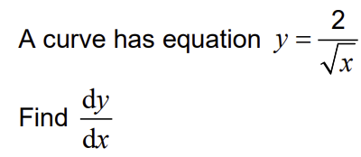
SAM Q1
SAM Paper 1 Q2
$$\frac{\sqrt{3}}{x}$$
$$\frac{1}{x\sqrt{x}}$$
$$−\frac{1}{x\sqrt{x}}$$
$$−\frac{1}{2x\sqrt{x}}$$
$$60 seconds timer (click to start)$$

Slide 4
SAM Paper 2 Q1
$$\left|x\right|<\frac{2}{3}$$
$$\left|x\right|<1$$
$$\left|x\right|<\frac{3}{2}$$
$$\left|x\right|<3$$
$$60 seconds timer (click to start)$$

Slide 5
SAM Paper 2 Q2
$$5$$
$$20$$
$$40$$
$$200$$
$$60 seconds timer (click to start)$$

Slide 6
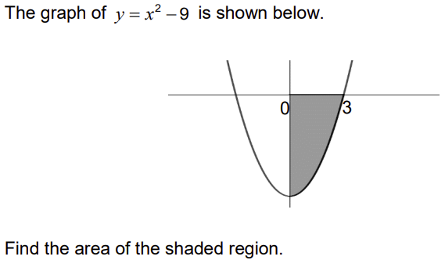
SAM Paper 3 Q1
$$−18$$
$$−6$$
$$6$$
$$18$$
$$60 seconds timer (click to start)$$

Slide 7
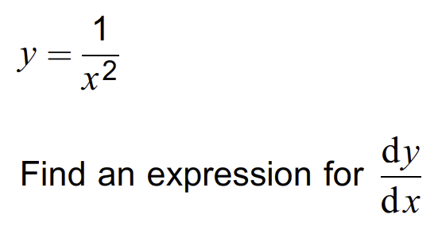
2018 Paper 1 Q1
$$\frac{dy}{dx}=\frac{0}{2x}$$
$$\frac{dy}{dx}=x^{−2}$$
$$\frac{dy}{dx}=−\frac{2}{x}$$
$$\frac{dy}{dx}=−\frac{2}{x^{3}}$$
$$60 seconds timer (click to start)$$

Slide 8
2018 Paper 1 Q2
$$y=5×5^{x}$$
$$y=5^{\frac{5}{x}}$$
$$y=\frac{1}{5}×5^{x}$$
$$y=5^{5x}$$
$$60 seconds timer (click to start)$$

Slide 9
2018 Paper 1 Q3
$$8$$
$$2π$$
$$4$$
$$π$$
$$60 seconds timer (click to start)$$

Slide 10
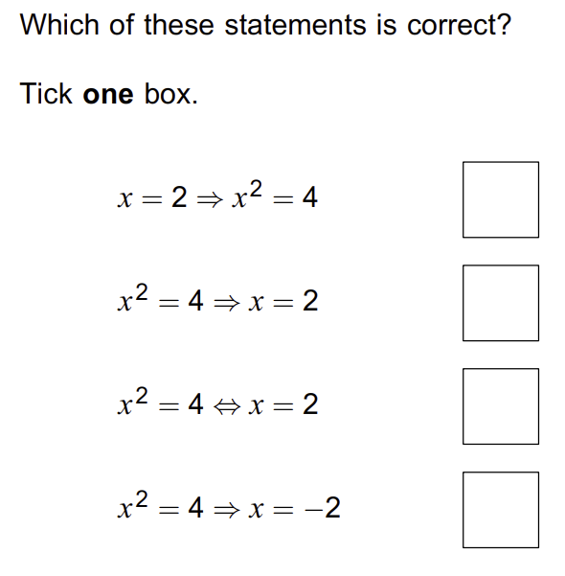
2018 Paper 2 Q1
A
B
C
D
$$A$$
$$B$$
$$C$$
$$D$$
$$60 seconds timer (click to start)$$

Slide 11
2018 Paper 2 Q2
$$24$$
$$4$$
$$21$$
$$84$$
$$60 seconds timer (click to start)$$

Slide 12
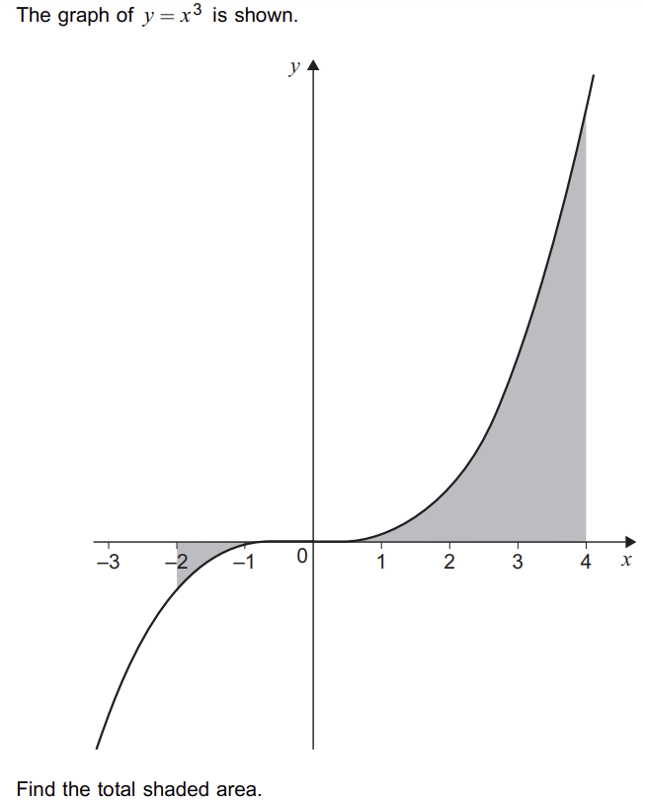
2018 Paper 2 Q3
$$−68$$
$$60$$
$$68$$
$$124$$
$$60 seconds timer (click to start)$$

Slide 13
2018 Paper 3 Q1
3$π$
$$9π$$
$$16π$$
$$81π$$
$$60 seconds timer (click to start)$$

Slide 14
2018 Paper 3 Q2
$$0$$
$$4$$
$$7$$
$$q$$
$$60 seconds timer (click to start)$$

Slide 15
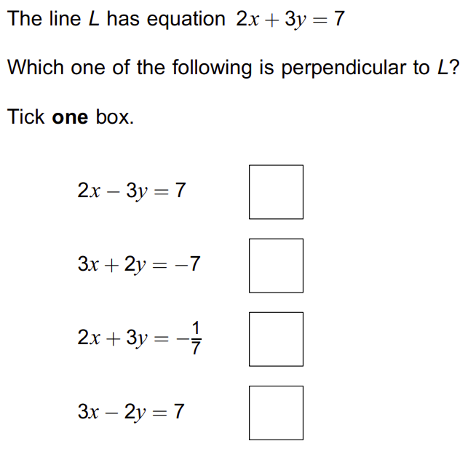
2018 Paper 3 Q3
A
B
C
D
$$A$$
$$B$$
$$C$$
$$D$$
$$60 seconds timer (click to start)$$

Slide 16
2019 Paper 1 Q1
$$−2\log_{10}\left(\frac{1}{a}\right)$$
$$2\log_{10}\left(a\right)$$
$$\log_{10}\left(a^{2}\right)$$
$$−4\log_{10}\left(\sqrt{a}\right)$$
$$60 seconds timer (click to start)$$

Slide 17
2019 Paper 1 Q2
$$\frac{dy}{dx}=e^{kx}$$
$$\frac{dy}{dx}={ke}^{kx}$$
$$\frac{dy}{dx}={kxe}^{kx−1}$$
$$\frac{dy}{dx}=\frac{e^{kx}}{k}$$
$$60 seconds timer (click to start)$$

Slide 18
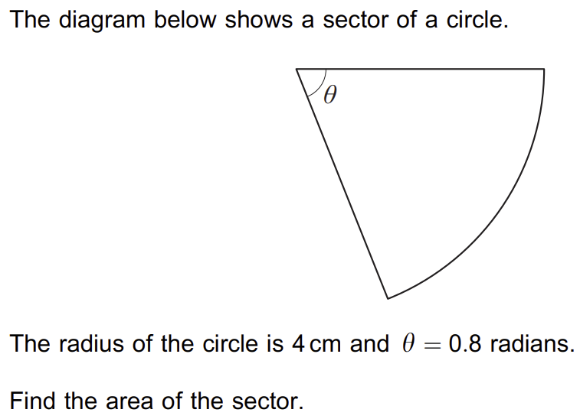
2019 Paper 1 Q3
$$1.28 {cm}^{2}$$
$$3.2 {cm}^{2}$$
$$6.4 {cm}^{2}$$
$$12.8 {cm}^{2}$$
$$60 seconds timer (click to start)$$

Slide 19
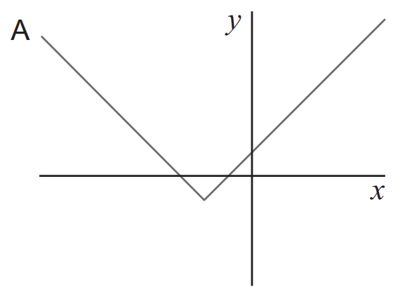
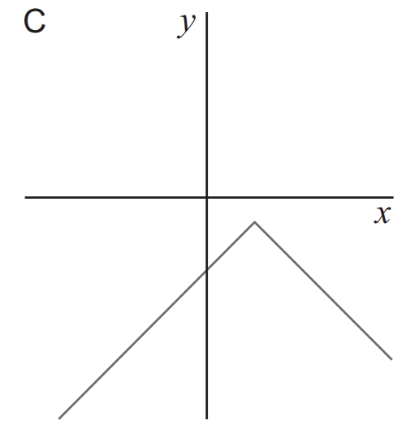
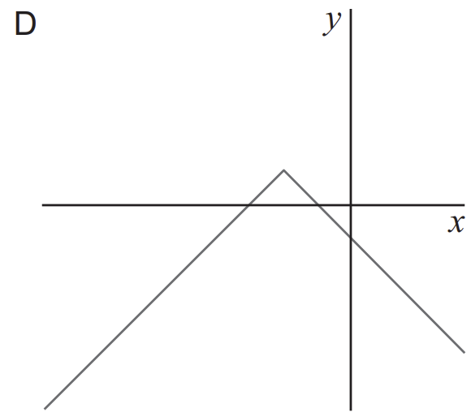
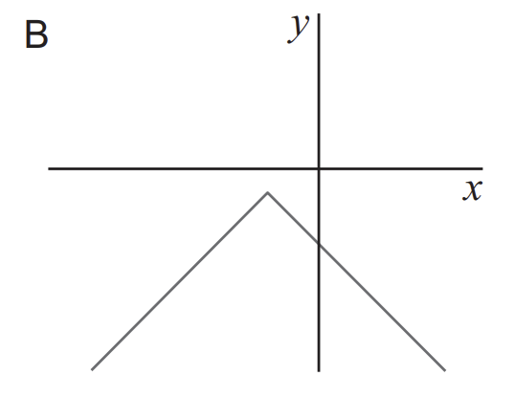
2019 Paper 2 Q1
$$A$$
$$B$$
$$C$$
$$D$$
$$60 seconds timer (click to start)$$

Slide 20
2019 Paper 2 Q2
$$a^{\frac{2}{15}}$$
$$a^{\frac{4}{15}}$$
$$a^{\frac{8}{15}}$$
$$a^{\frac{16}{15}}$$
$$60 seconds timer (click to start)$$

Slide 21
2019 Paper 2 Q3
$$f\left(x\right)=x^{3}$$
$$f\left(x\right)=2x+1$$
$$f\left(x\right)=x^{2}$$
$$f\left(x\right)=e^{x}$$
$$60 seconds timer (click to start)$$

Slide 22
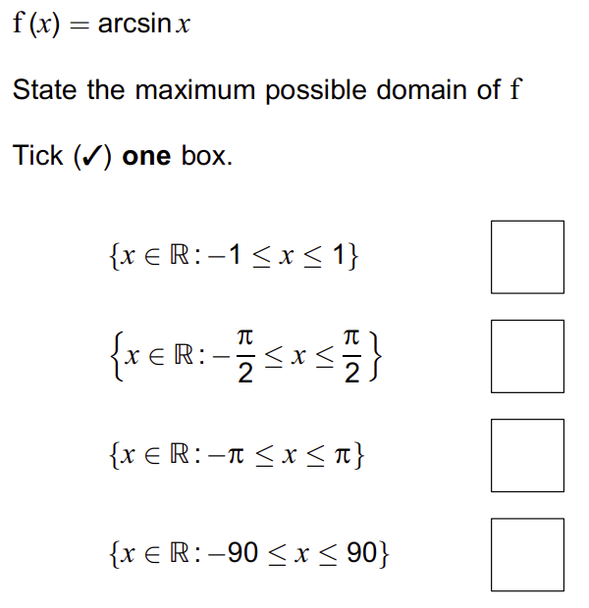
2019 Paper 3 Q1
A
B
C
D
$$A$$
$$B$$
$$C$$
$$D$$
$$60 seconds timer (click to start)$$

Slide 23
2019 Paper 3 Q2
$$\frac{50}{147}$$
$$1650$$
$$3300$$
$$161700$$
$$60 seconds timer (click to start)$$

Slide 24
2019 Paper 3 Q3
$$u_{n+1}=1+\frac{1}{u_{n}}$$
$$u_{n}=2−{0.9}^{n−1}$$
$$u_{n+1}=1+0.5u_{n}$$
$$u_{n}={0.9}^{n−1}$$
$$60 seconds timer (click to start)$$

Slide 25
2020 Paper 1 Q1a
$$\left|x\right|<\frac{2}{9}$$
$$\left|x\right|<\frac{2}{3}$$
$$\left|x\right|<1$$
$$\left|x\right|<\frac{9}{2}$$
$$60 seconds timer (click to start)$$

Slide 26
2020 Paper 1 Q1b
$$1$$
$$2$$
$$3$$
$$9$$
$$60 seconds timer (click to start)$$

Slide 27
2020 Paper 1 Q2
$$f\left(x\right)=\frac{1}{x}$$
$$f\left(x\right)=x$$
$$f\left(x\right)=x^{3}$$
$$f\left(x\right)=\frac{2x+1}{x+2}$$
$$60 seconds timer (click to start)$$

Slide 28
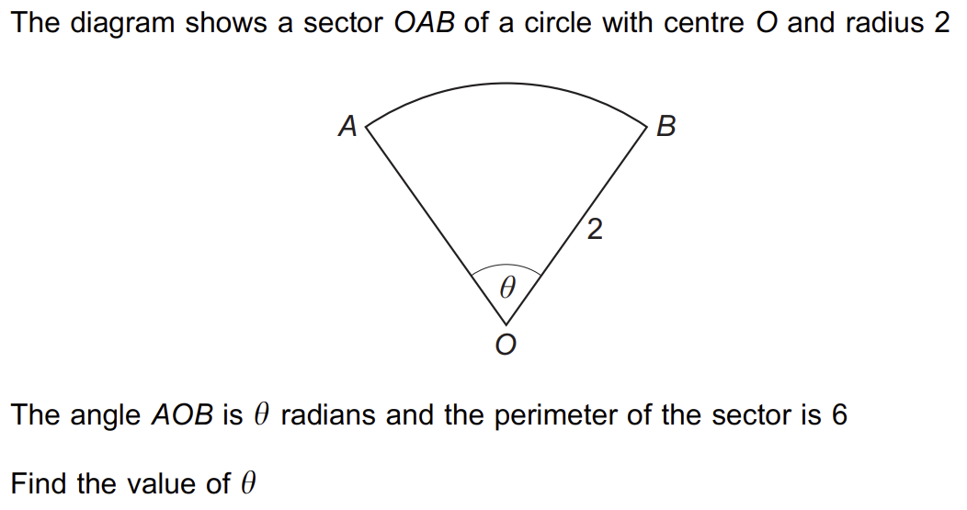
2020 Paper 1 Q3
$$1$$
$$\sqrt{3}$$
$$2$$
$$3$$
$$60 seconds timer (click to start)$$

Slide 29
2020 Paper 2 Q1
$$f\left(x\right)=e^{x}$$
$$f\left(x\right)={−e}^{1−x}$$
$$f\left(x\right)=−e^{x−1}$$
$$f\left(x\right)={−e}^{−x}$$
$$60 seconds timer (click to start)$$

Slide 30
2020 Paper 2 Q2
$$cot\left(x\right)=0$$
$$ln\left(x\right)=0$$
$$\left|x+1\right|=0$$
$$sec\left(x\right)=0$$
$$60 seconds timer (click to start)$$

Slide 31
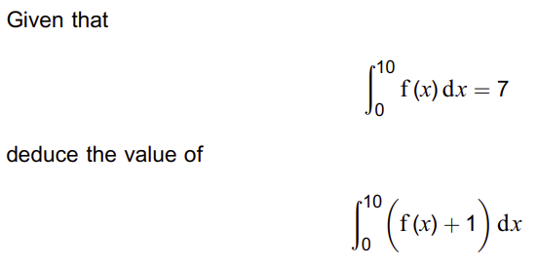
2020 Paper 3 Q1
$$−3$$
$$7$$
$$8$$
$$17$$
$$60 seconds timer (click to start)$$

Slide 32
2020 Paper 3 Q2
$$6$$
$$8$$
$$10$$
$$14$$
$$60 seconds timer (click to start)$$

Slide 33
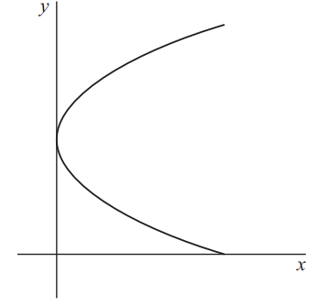
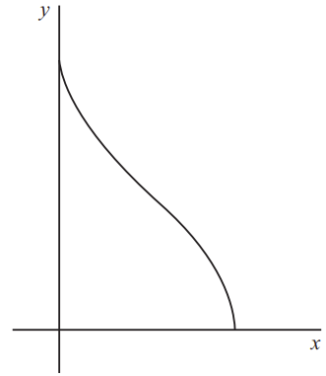
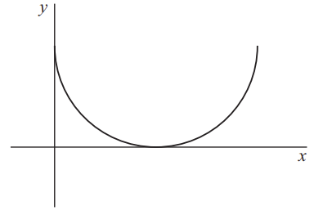
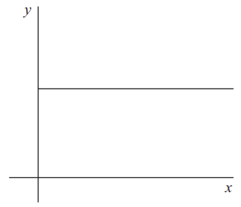
2020 Paper 3 Q3
$$A$$
$$B$$
$$C$$
$$D$$
$$60 seconds timer (click to start)$$

Slide 34
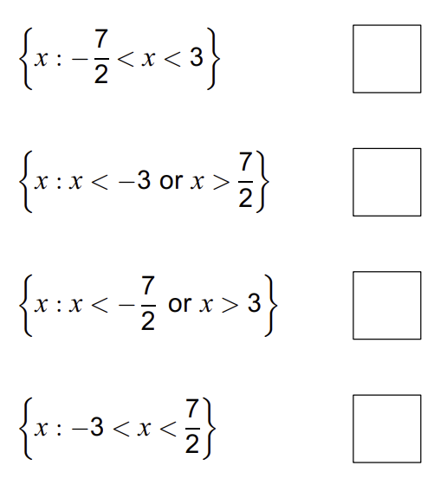
2021 Paper 1 Q1
A
B
C
D
$$A$$
$$B$$
$$C$$
$$D$$
$$60 seconds timer (click to start)$$

Slide 35
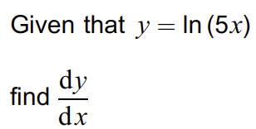
2021 Paper 1 Q2
$$\frac{dy}{dx}=\frac{1}{x}$$
$$\frac{dy}{dx}=\frac{1}{5x}$$
$$\frac{dy}{dx}=\frac{5}{x}$$
$$\frac{dy}{dx}=ln(5)$$
$$60 seconds timer (click to start)$$

Slide 36
2021 Paper 1 Q3
$$The sum to$$
$$infinity does$$
$$not exist$$
$$−6$$
$$−3$$
$$6$$
$$60 seconds timer (click to start)$$

Slide 37
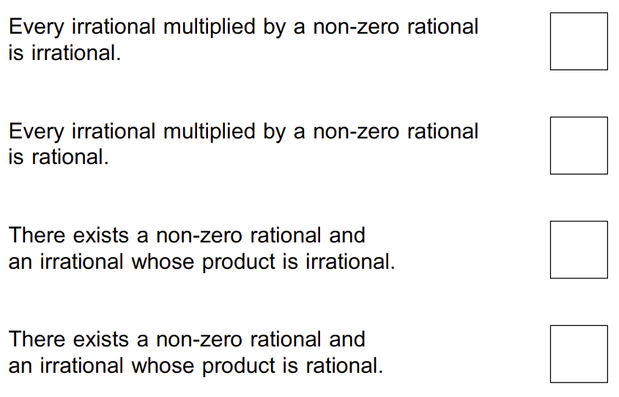
2021 Paper 1 Q4
A
B
C
D
$$A$$
$$B$$
$$C$$
$$D$$
$$60 seconds timer (click to start)$$

Slide 38
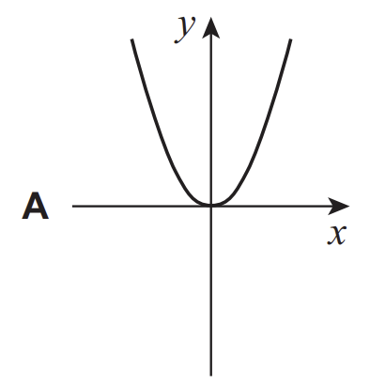
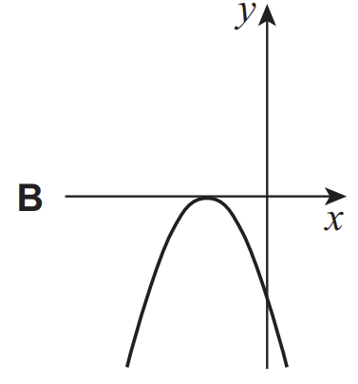
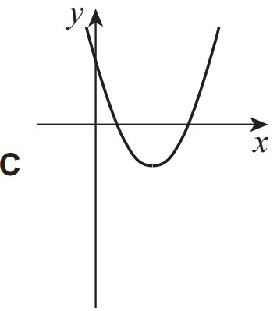
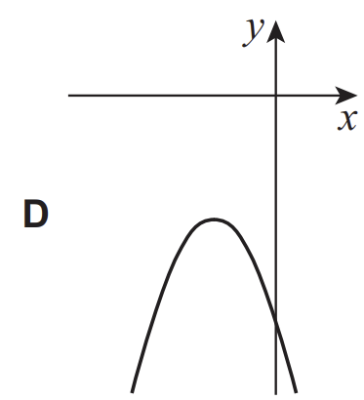
2021 Paper 2 Q1
$$A$$
$$B$$
$$C$$
$$D$$
$$60 seconds timer (click to start)$$

Slide 39
2021 Paper 2 Q2
$$f′\left(7\right)≠0$$
$$f^{′}(7)=0$$
$$f^{′′}(7)≠0$$
$$f^{′′}(7)=0$$
$$60 seconds timer (click to start)$$

Slide 40
2021 Paper 2 Q3
$$−a$$
$$0$$
$$a$$
$$95a$$
$$60 seconds timer (click to start)$$

Slide 41
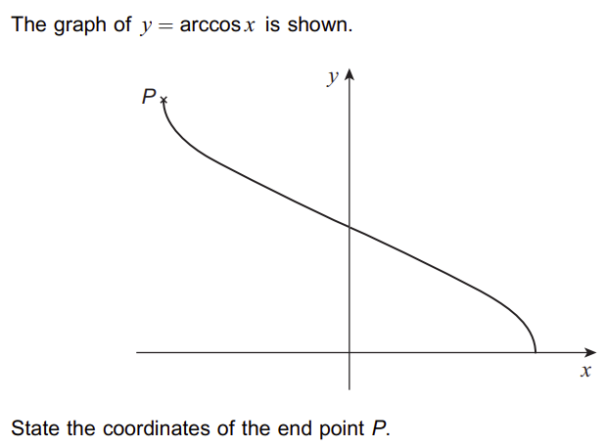
2021 Paper 3 Q1
$$(−π,1)$$
$$(−1,π)$$
$$\left(−\frac{π}{2},1\right)$$
$$\left(−1,\frac{π}{2}\right)$$
$$60 seconds timer (click to start)$$

Slide 42
2021 Paper 3 Q2
$$−2$$
$$2$$
$$\frac{(6−2x)}{(x−3)}$$
$$\frac{(2x−6)}{(x−3)}$$
$$60 seconds timer (click to start)$$

Slide 43
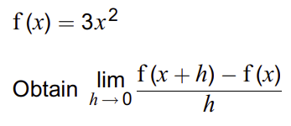
2021 Paper 3 Q3
$$\frac{3h^{2}}{h}$$
$$x^{3}$$
$$\frac{3{(x+h)}^{2}−3x^{2}}{h}$$
$$6x$$
$$60 seconds timer (click to start)$$

