Slide 1
AQA MCQs
Mechanics Qs
SAM Paper 2 Q10
2020 Paper 2 Q10
2018 Paper 2 Q10
2020 Paper 2 Q11
2018 Paper 2 Q11
2020 Paper 2 Q12
2019 Paper 2 Q10
2021 Paper 2 Q11
2019 Paper 2 Q11
2021 Paper 2 Q12
2019 Paper 2 Q12

Slide 2
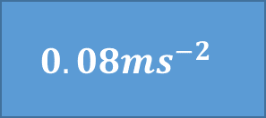
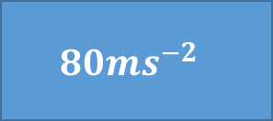
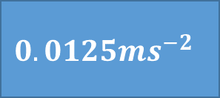
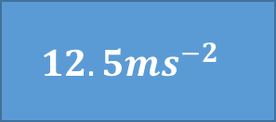
SAM Paper 2 Q10
$$12.5{ms}^{−2}$$
$$0.08{ms}^{−2}$$
$$0.0125{ms}^{−2}$$
$$80{ms}^{−2}$$
$$60 seconds timer (click to start)$$

Slide 3
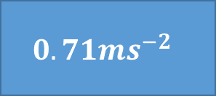
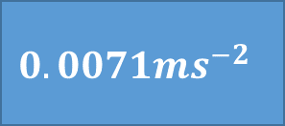
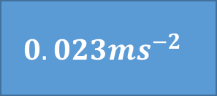
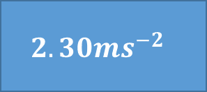
2018 Paper 2 Q10
$$2.30{ms}^{−2}$$
$$0.71{ms}^{−2}$$
$$0.0071{ms}^{−2}$$
$$0.023{ms}^{−2}$$
$$60 seconds timer (click to start)$$

Slide 4
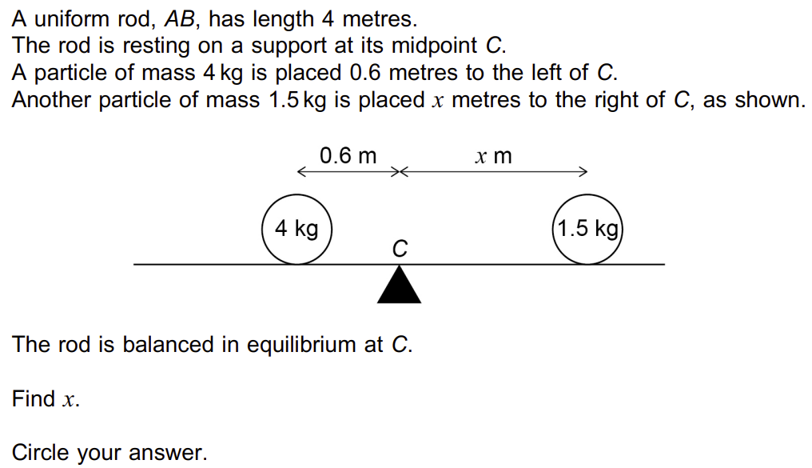
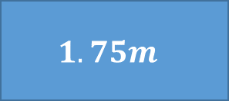
2018 Paper 2 Q11
$$1.8m$$
$$1.5m$$
$$1.75m$$
$$1.6m$$
$$60 seconds timer (click to start)$$

Slide 5
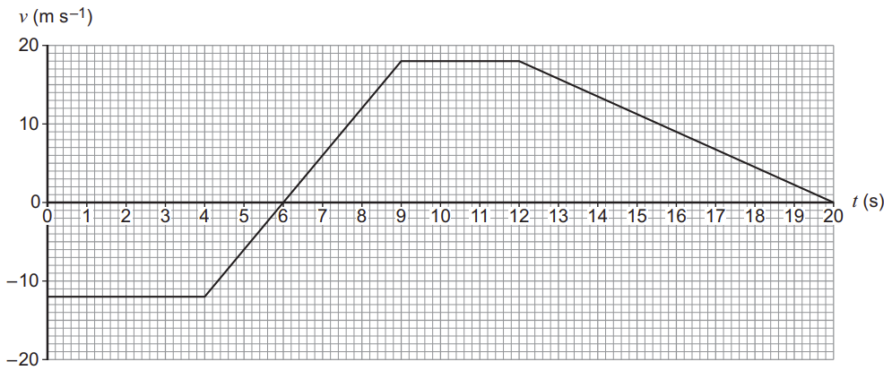
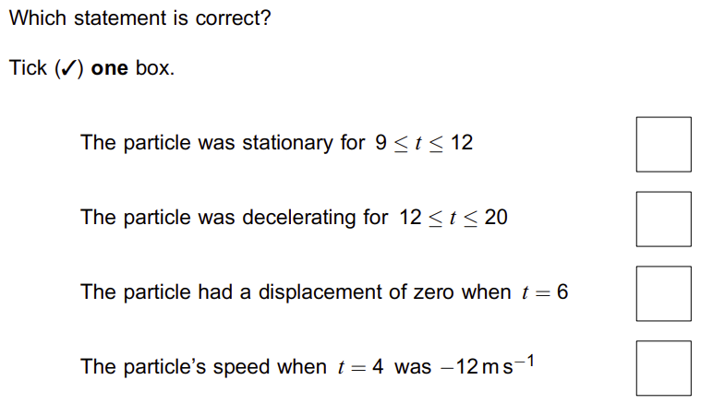
2019 Paper 2 Q10
A
B
C
D
$$A$$
$$B$$
$$C$$
$$D$$
$$60 seconds timer (click to start)$$

Slide 6
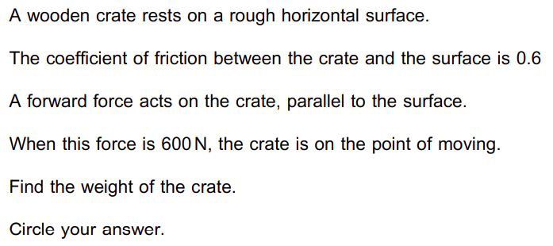
2019 Paper 2 Q11
$$1000N$$
$$100kg$$
$$360N$$
$$36kg$$
$$60 seconds timer (click to start)$$

Slide 7
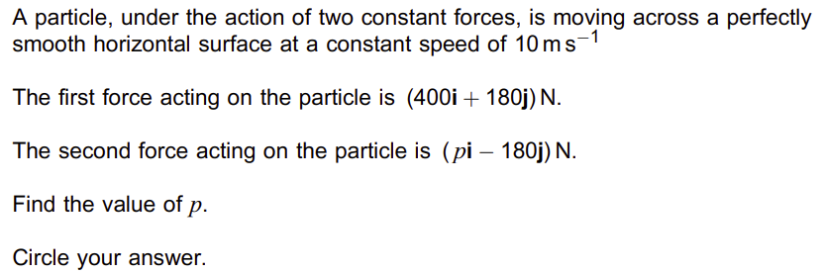
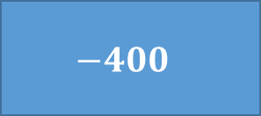
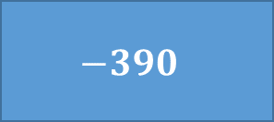
2019 Paper 2 Q12
$$−400$$
$$−390$$
$$390$$
$$400$$
$$60 seconds timer (click to start)$$

Slide 8
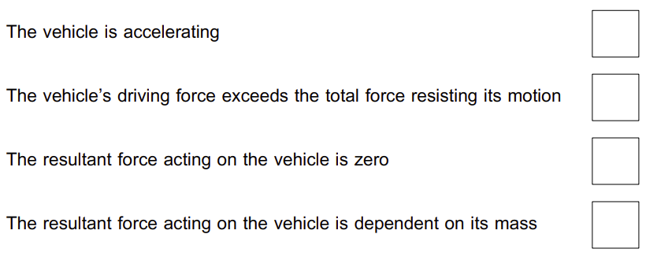
2020 Paper 2 Q10
A
B
C
D
$$A$$
$$B$$
$$C$$
$$D$$
$$60 seconds timer (click to start)$$

Slide 9
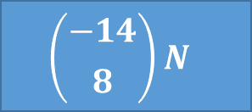
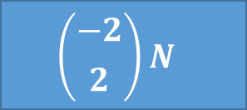
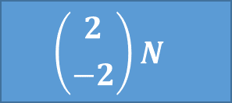
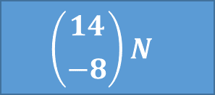
2020 Paper 2 Q11
$$\left({2 \atop −2}\right)N$$
$$\left({14 \atop −8}\right)N$$
$$\left({−2 \atop 2}\right)N$$
$$\left({−14 \atop 8}\right)N$$
$$60 seconds timer (click to start)$$

Slide 10
2020 Paper 2 Q12
$$−6$$
$$−5$$
$$5$$
$$6$$
$$60 seconds timer (click to start)$$

Slide 11
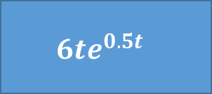
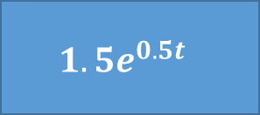
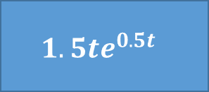
2021 Paper 2 Q11
$$1.5e^{0.5t}$$
$$6e^{0.5t}$$
$$1.5te^{0.5t}$$
$$6te^{0.5t}$$
$$60 seconds timer (click to start)$$

Slide 12
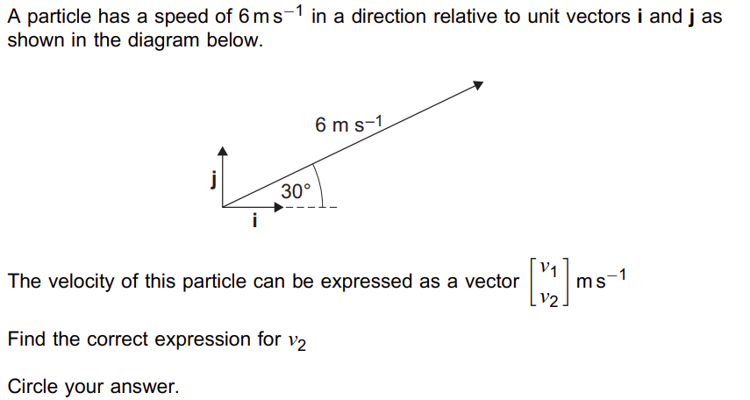
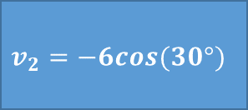
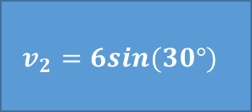
2021 Paper 2 Q12
$$v_{2}=6cos(30°)$$
$$v_{2}=6sin(30°)$$
$$v_{2}=−6sin(30°)$$
$$v_{2}=−6cos(30°)$$
$$60 seconds timer (click to start)$$

