Slide 1
AQA MCQs
SAM P1 Q1
SAM P2 Q4
SAM P3 Q27
N17 P3 Q3
J18 P1 Q16
J18 P3 Q3
SAM P1 Q2
SAM P2 Q11
J17 P1 Q1
N17 P3 Q4
J18 P1 Q17
J18 P3 Q4
GCSE Qs
SAM P1 Q3
SAM P2 Q13
J17 P1 Q2
N17 P3 Q7
J18 P1 Q22
J18 P3 Q13
SAM P1 Q4
SAM P2 Q19
J17 P1 Q3
J17 P2 Q3
J17 P3 Q3
N17 P1 Q3
N17 P2 Q3
N17 P3 Q15
J18 P2 Q1
J18 P3 Q15
SAM P1 Q13a
SAM P3 Q1
J17 P1 Q4
J17 P2 Q4
J17 P3 Q4
N17 P1 Q4
N17 P2 Q4
N17 P3 Q16
J18 P2 Q2
J18 P3 Q16
SAM P1 Q23a
SAM P3 Q2
J17 P1 Q9
J17 P2 Q12
J17 P3 Q8a
N17 P1 Q9
N17 P2 Q11
N17 P3 Q20
J18 P2 Q3
J18 P3 Q24b
SAM P1 Q23b
SAM P3 Q3
J17 P1 Q15
J17 P2 Q16
J17 P3 Q8b
N17 P1 Q16
N17 P2 Q13
J18 P1 Q1
J18 P2 Q4
More Questions
SAM P1 Q23c
SAM P3 Q4
J17 P1 Q20
J17 P2 Q26a
J17 P3 Q14
N17 P1 Q18
N17 P2 Q18a
J18 P1 Q2
J18 P2 Q15
SAM P2 Q1
SAM P3 Q9
J17 P1 Q22
J17 P2 Q26b
J17 P3 Q21
N17 P1 Q23
N17 P2 Q18b
J18 P1 Q3
J18 P2 Q22
SAM P2 Q2
SAM P3 Q14b
J17 P2 Q1
J17 P3 Q1
N17 P1 Q1
N17 P2 Q1
N17 P3 Q1
J18 P1 Q4
J18 P3 Q1
SAM P2 Q3
SAM P3 Q23a
J17 P2 Q2
J17 P3 Q2
N17 P1 Q2
N17 P2 Q2
N17 P3 Q2
J18 P1 Q13
J18 P3 Q2

Slide 2
AQA MCQs
Previous Questions
N18 P2 Q3
N18 P3 Q25
N19 P3 Q4
N20 P1 Q24
N20 P3 Q4
N18 P1 Q1
N18 P2 Q4
N18 P3 Q28
N19 P3 Q18
N20 P2 Q1
N20 P3 Q19
GCSE Qs
N18 P1 Q2
N18 P2 Q14
J19 P1 Q1
N19 P3 Q20
N20 P2 Q2
N20 P3 Q24b
N18 P1 Q3
N18 P2 Q17
J19 P1 Q2
J19 P2 Q3
J19 P3 Q4
N19 P1 Q4
N19 P2 Q4
N19 P3 Q23
N20 P2 Q3
N20 P3 Q25
N18 P1 Q4
N18 P2 Q23
J19 P1 Q3
J19 P2 Q4
J19 P3 Q8
N19 P1 Q12
N19 P2 Q15
N20 P1 Q1
N20 P2 Q4
N20 P3 Q27
N18 P1 Q11
N18 P3 Q1
J19 P1 Q4
J19 P2 Q9a
J19 P3 Q14
N19 P1 Q14
N19 P2 Q19
N20 P1 Q2
N20 P2 Q21
Even More Questions
N18 P1 Q16
N18 P3 Q2
J19 P1 Q12
J19 P2 Q12
J19 P3 Q22a
N19 P1 Q17
N19 P2 Q20
N20 P1 Q3
N20 P2 Q22
N18 P1 Q27a
N18 P3 Q3
J19 P1 Q19
J19 P2 Q23
J19 P3 Q22b
N19 P1 Q21
N19 P2 Q22
N20 P1 Q4
N20 P2 Q24b
N18 P1 Q27b
N18 P3 Q4
J19 P1 Q24
J19 P3 Q1
N19 P1 Q1
N19 P2 Q1
N19 P3 Q1
N20 P1 Q15
N20 P3 Q1
N18 P2 Q1
N18 P3 Q13
J19 P2 Q1
J19 P3 Q2
N19 P1 Q2
N19 P2 Q2
N19 P3 Q2
N20 P1 Q19
N20 P3 Q2
N18 P2 Q2
N18 P3 Q17
J19 P2 Q2
J19 P3 Q3
N19 P1 Q3
N19 P2 Q3
N19 P3 Q3
N20 P1 Q22b
N20 P3 Q3

Slide 3
AQA MCQs
Previous Questions
N21 P2 Q3
N21 P3 Q2
N21 P1 Q1
N21 P2 Q4
N21 P3 Q3
GCSE Qs
N21 P1 Q2
N21 P2 Q10i
N21 P3 Q4
N21 P1 Q3
N21 P2 Q10ii
N21 P3 Q17
N21 P1 Q4
N21 P2 Q10iii
N21 P3 Q18
N21 P1 Q14
N21 P2 Q10iv
N21 P3 Q19
N21 P1 Q17
N21 P2 Q16a
N21 P3 Q23a
N21 P1 Q20
N21 P2 Q16b
N21 P1 Q24b
N21 P2 Q19a
N21 P2 Q1
N21 P2 Q20
N21 P2 Q2
N21 P3 Q1

Slide 4
SAM Paper 1 Q1
$$400×0.07$$
$$400×0.7$$
$$400×1.07$$
$$400×1.7$$
$$60 seconds timer (click to start)$$

Slide 5
SAM Paper 1 Q2
$$3^{8}$$
$$9^{8}$$
$$3^{16}$$
$$9^{16}$$
$$60 seconds timer (click to start)$$

Slide 6
SAM Paper 1 Q3
$$550{cm}^{2}$$
$$5500{cm}^{2}$$
$$55000{cm}^{2}$$
$$5500000{cm}^{2}$$
$$60 seconds timer (click to start)$$

Slide 7
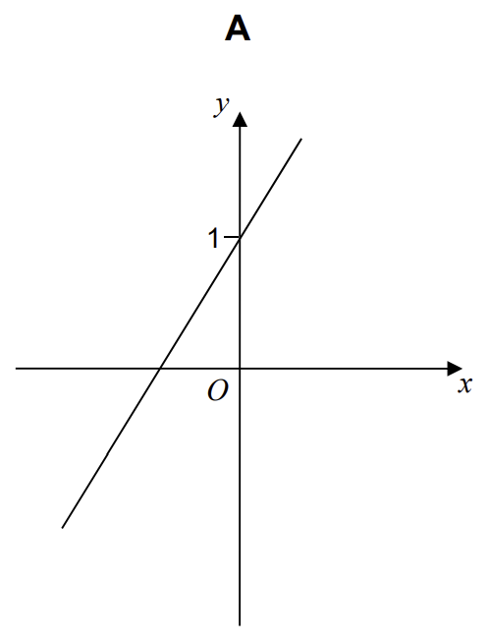
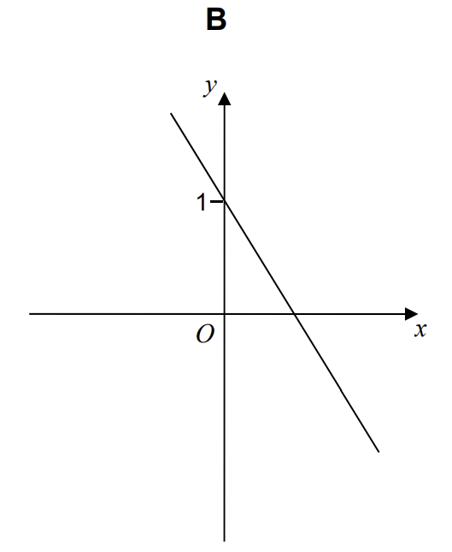
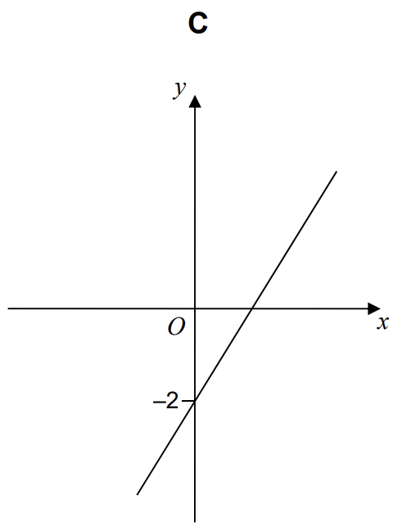
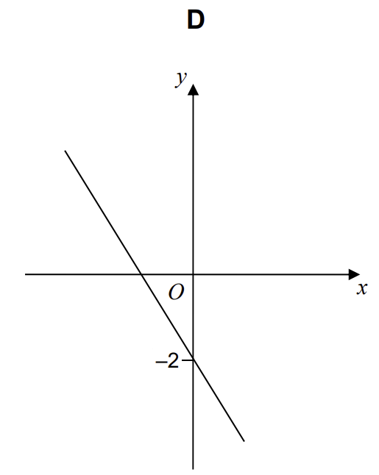
SAM Paper 1 Q4
$$A$$
$$B$$
$$C$$
$$D$$
$$60 seconds timer (click to start)$$

Slide 8
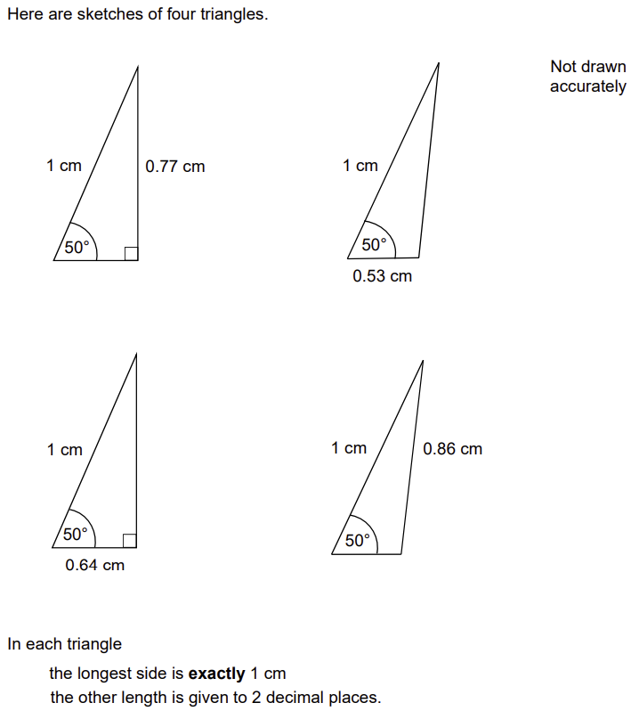
SAM Paper 1 Q13a
$$0.77$$
$$0.53$$
$$0.64$$
$$0.86$$
$$60 seconds timer (click to start)$$

Slide 9
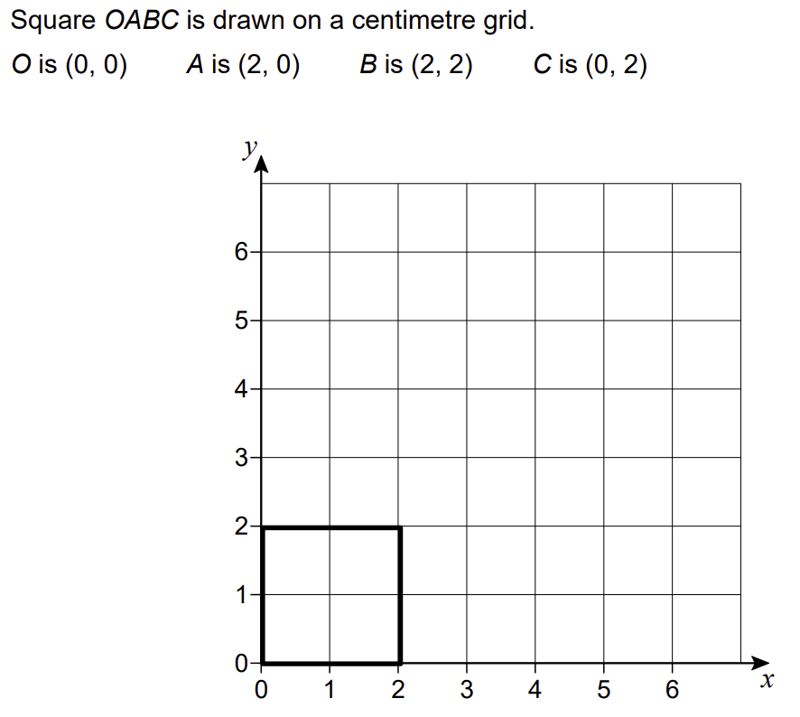
SAM Paper 1 Q23a
$$0$$
$$1$$
$$2$$
$$4$$
$$60 seconds timer (click to start)$$

Slide 10
SAM Paper 1 Q23b
$$0$$
$$1$$
$$2$$
$$4$$
$$60 seconds timer (click to start)$$

Slide 11
SAM Paper 1 Q23c
$$0$$
$$1$$
$$2$$
$$4$$
$$60 seconds timer (click to start)$$

Slide 12
SAM Paper 2 Q1
$$1 2 3 4$$
$$1 2 4 7$$
$$1 2 4 8$$
$$1 2 3 5$$
$$60 seconds timer (click to start)$$

Slide 13
SAM Paper 2 Q2
$$SSS$$
$$SAS$$
$$AAA$$
$$RHS$$
$$60 seconds timer (click to start)$$

Slide 14
SAM Paper 2 Q3
$$a+20a^{2}$$
$$21a^{2}$$
$$28a^{2}−a$$
$$2a+15a^{2}$$
$$60 seconds timer (click to start)$$

Slide 15
SAM Paper 2 Q4
$$y=2x−5$$
$$y=5x+2$$
$$y=3x−2$$
$$y=−\frac{1}{5}x−2$$
$$60 seconds timer (click to start)$$

Slide 16
SAM Paper 2 Q11
$$4x(x–8)=0$$
$$\left(x−4\right)(x+8)=0$$
$$x^{2}–32=0$$
$$(x +4)(x−8)=0$$
$$60 seconds timer (click to start)$$

Slide 17
SAM Paper 2 Q13
$$5:3$$
$$15:9$$
$$25:9$$
$$125:27$$
$$60 seconds timer (click to start)$$

Slide 18
SAM Paper 2 Q19
$$−3x$$
$$\frac{3}{x}$$
$$\frac{1}{3x}$$
$$\frac{x}{3}$$
$$60 seconds timer (click to start)$$

Slide 19
SAM Paper 3 Q1
$$1000$$
$$10000$$
$$100000$$
$$1000000$$
$$60 seconds timer (click to start)$$

Slide 20
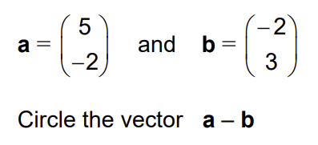
SAM Paper 3 Q2
$$\left({−3 \atop −5}\right)$$
$$\left({7 \atop 1}\right)$$
$$\left({3 \atop 1}\right)$$
$$\left({7 \atop −5}\right)$$
$$60 seconds timer (click to start)$$

Slide 21
SAM Paper 3 Q3
$$0.6$$
$$0.66$$
$$0.667$$
$$0.67$$
$$60 seconds timer (click to start)$$

Slide 22
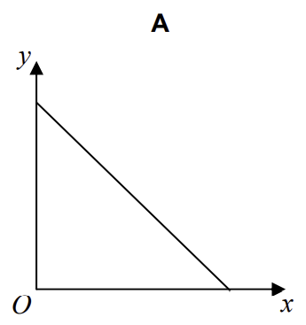
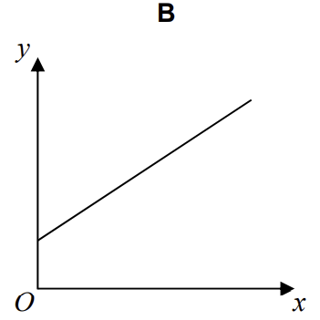
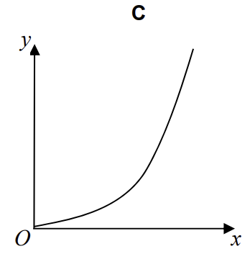
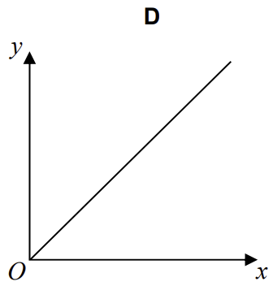
SAM Paper 3 Q4
$$A$$
$$B$$
$$C$$
$$D$$
$$60 seconds timer (click to start)$$

Slide 23
SAM Paper 3 Q9
$$pentagon$$
$$hexagon$$
$$octogan$$
$$decagon$$
$$60 seconds timer (click to start)$$

Slide 24
SAM Paper 3 Q14b
$$2^{n+2}+2^{n+1}$$
$$2^{2n}+2^{2(n−1)}$$
$$8^{n}+8^{n−1}$$
$$2^{n+2}+2^{n−1}$$
$$60 seconds timer (click to start)$$

Slide 25
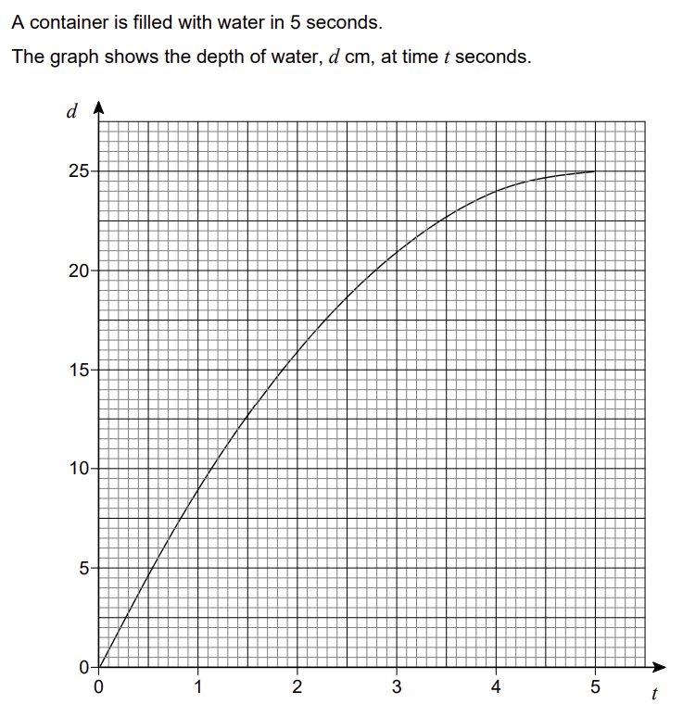
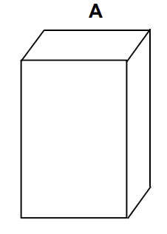
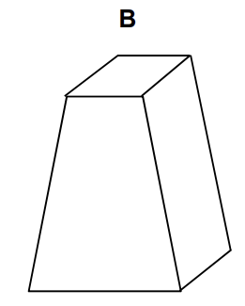
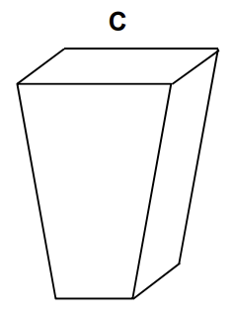
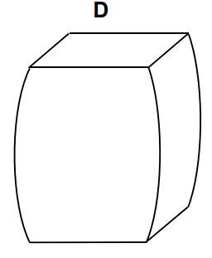
SAM Paper 3 Q23a
$$A$$
$$B$$
$$C$$
$$D$$
$$60 seconds timer (click to start)$$

Slide 26
SAM Paper 3 Q27
$$y=x^{2}−5x−2$$
$$y=−x^{2}+5x+2$$
$$y=−x^{2}+5x−2$$
$$y=x^{2}+5x+2$$
$$60 seconds timer (click to start)$$

Slide 27
June 2017
Paper 1 Q1
$$4^{8}$$
$$2^{8}$$
$$2^{15}$$
$$4^{15}$$
$$60 seconds timer (click to start)$$

Slide 28
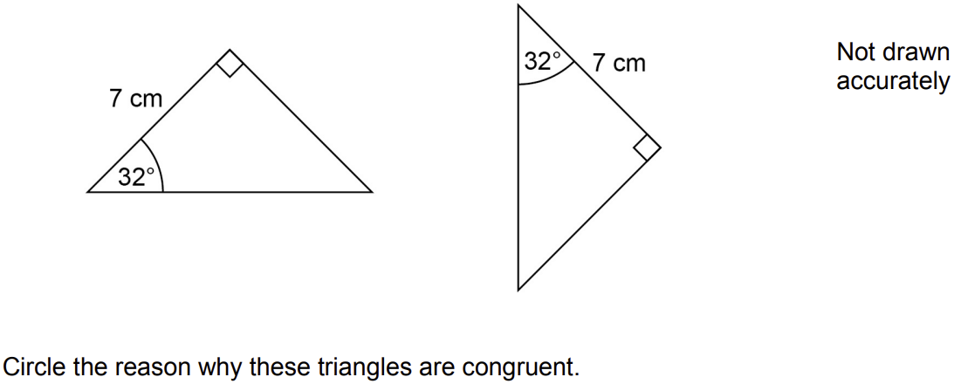
June 2017
Paper 1 Q2
$$SSS$$
$$SAS$$
$$ASA$$
$$RHS$$
$$60 seconds timer (click to start)$$

Slide 29
June 2017
Paper 1 Q3
$$2, 4, 6, 8, 10$$
$$2, 3, 5, 8, 12$$
$$2, 6, 18, 54, 162$$
$$2, 6, 10, 14, 18$$
$$60 seconds timer (click to start)$$

Slide 30
June 2017
Paper 1 Q4
$$b is \frac{4}{7} of a$$
$$b is \frac{3}{7} of a$$
$$b is \frac{4}{3} of a$$
$$b is \frac{3}{4} of a$$
$$60 seconds timer (click to start)$$

Slide 31
June 2017
Paper 1 Q9
$$×2$$
$$×4$$
$$no change$$
$$÷2$$
$$÷4$$
$$60 seconds timer (click to start)$$

Slide 32
June 2017
Paper 1 Q15
$$0$$
$$1$$
$$2$$
$$3$$
$$4$$
$$60 seconds timer (click to start)$$

Slide 33
June 2017
Paper 1 Q20
$$8$$
$$16$$
$$32$$
$$128$$
$$60 seconds timer (click to start)$$

Slide 34
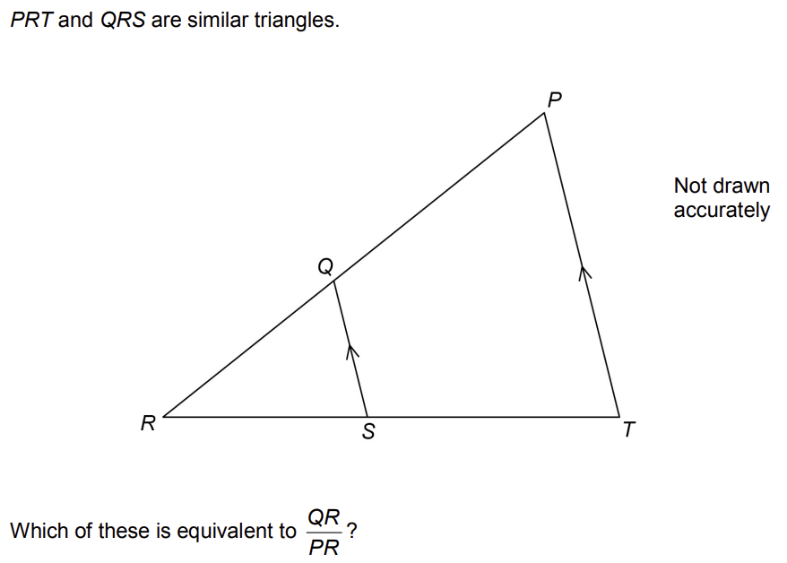
June 2017
Paper 1 Q22
$$\frac{RS}{ST}$$
$$\frac{QS}{PT}$$
$$\frac{PT}{QS}$$
$$\frac{RT}{RS}$$
$$60 seconds timer (click to start)$$

Slide 35
June 2017
Paper 2 Q1
$$0.04$$
$$0.048$$
$$0.049$$
$$0.05$$
$$60 seconds timer (click to start)$$

Slide 36
June 2017
Paper 2 Q2
$$360{cm}^{2}$$
$$3600{cm}^{2}$$
$$3.6{cm}^{2}$$
$$0.36{cm}^{2}$$
$$60 seconds timer (click to start)$$

Slide 37
June 2017
Paper 2 Q3
$$(3,5)$$
$$(4,6)$$
$$(5,7)$$
$$(6,10)$$
$$60 seconds timer (click to start)$$

Slide 38
June 2017
Paper 2 Q4
$$n−8$$
$$98−8n$$
$$8n+82$$
$$8n−98$$
$$60 seconds timer (click to start)$$

Slide 39
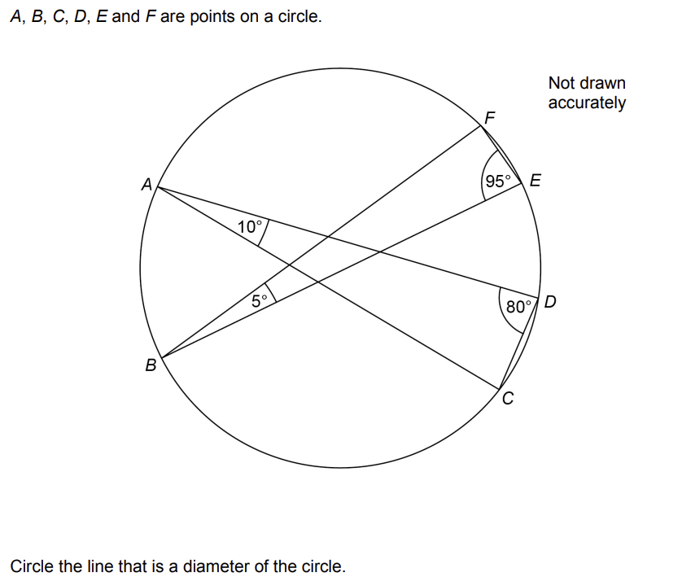
June 2017
Paper 2 Q12
$$BE$$
$$AD$$
$$AC$$
$$BF$$
$$60 seconds timer (click to start)$$

Slide 40
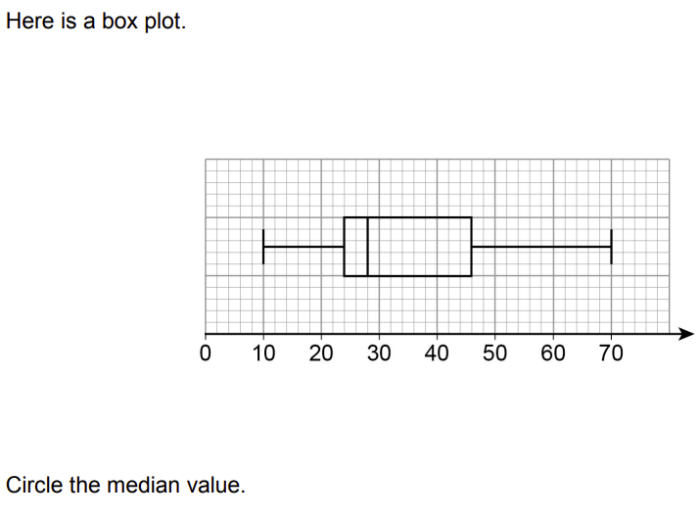
June 2017
Paper 2 Q16
$$28$$
$$35$$
$$24$$
$$22$$
$$60 seconds timer (click to start)$$

Slide 41
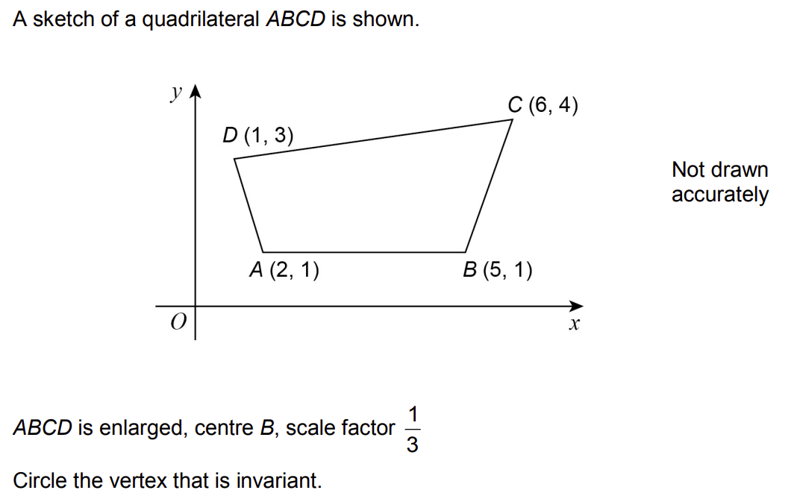
June 2017
Paper 2 Q26b
$$A$$
$$B$$
$$C$$
$$D$$
$$60 seconds timer (click to start)$$

Slide 42
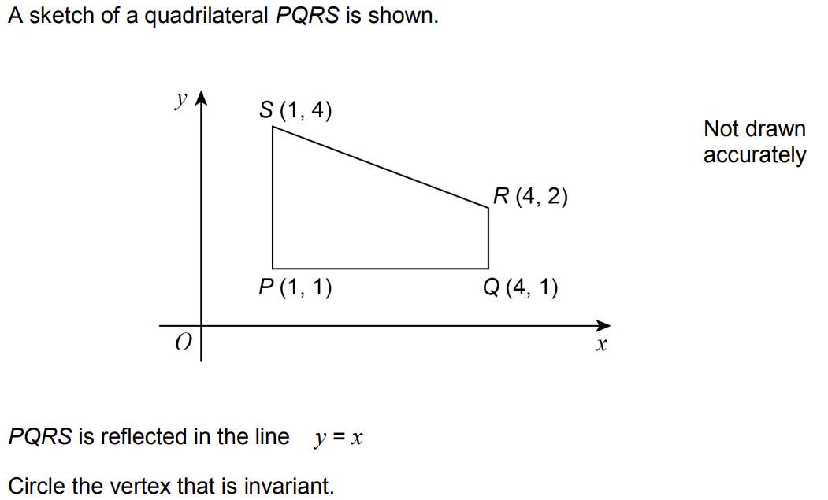
June 2017
Paper 2 Q26b
$$P$$
$$Q$$
$$R$$
$$S$$
$$60 seconds timer (click to start)$$

Slide 43
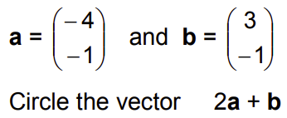
June 2017
Paper 3 Q1
$$\left({−5 \atop −3}\right)$$
$$\left({−11 \atop −3}\right)$$
$$\left({−5 \atop −1}\right)$$
$$\left({−11 \atop −1}\right)$$
$$60 seconds timer (click to start)$$

Slide 44
June 2017
Paper 3 Q2
$$0$$
$$1$$
$$2$$
$$3$$
$$60 seconds timer (click to start)$$

Slide 45
June 2017
Paper 3 Q3
$$w=\frac{2y}{x}$$
$$w=\frac{2x}{y}$$
$$w=\frac{y}{2x}$$
$$w=\frac{x}{2y}$$
$$60 seconds timer (click to start)$$

Slide 46
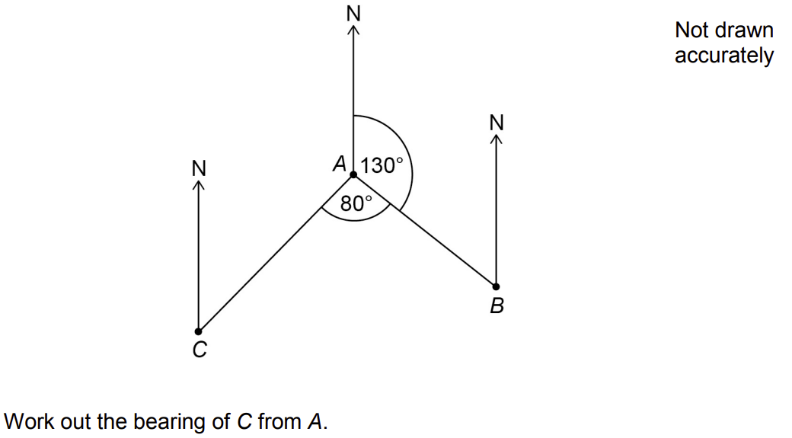
June 2017
Paper 3 Q4
$$030°$$
$$130°$$
$$150°$$
$$210°$$
$$60 seconds timer (click to start)$$

Slide 47
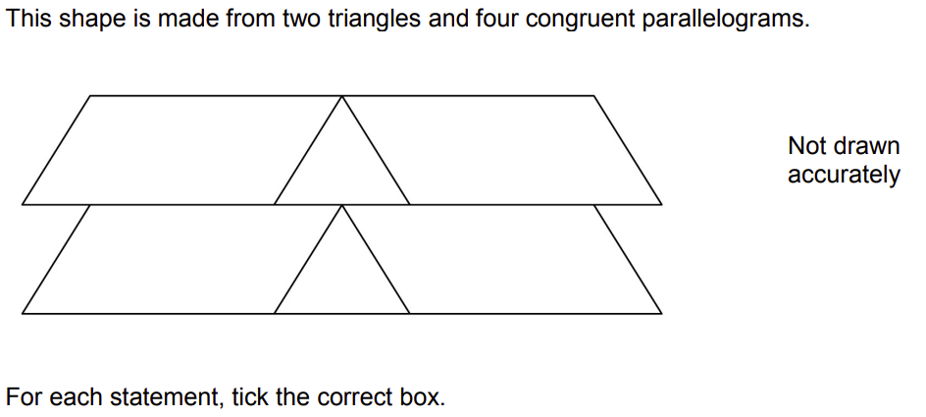
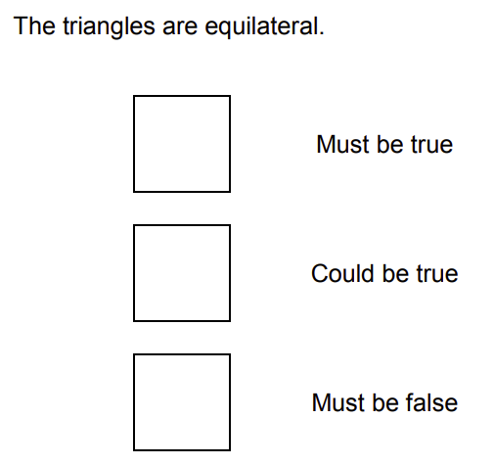
June 2017
Paper 3 Q8a
A
B
C
$$A$$
$$B$$
$$C$$
$$60 seconds timer (click to start)$$

Slide 48
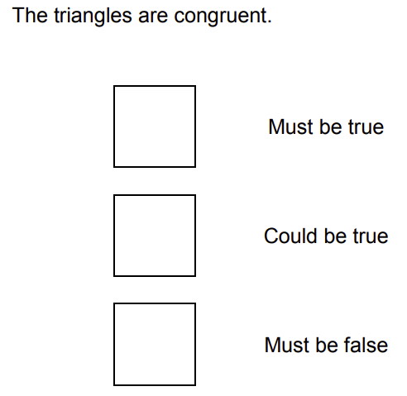
June 2017
Paper 3 Q8b
A
B
C
$$A$$
$$B$$
$$C$$
$$60 seconds timer (click to start)$$

Slide 49
June 2017
Paper 3 Q14
$$y is directly$$
$$proportional to x$$
$$y is directly$$
$$proportional to \frac{1}{x}$$
$$y is inversely$$
$$proportional to \frac{1}{x}$$
$$x is directly$$
$$proportional to y$$
$$60 seconds timer (click to start)$$

Slide 50
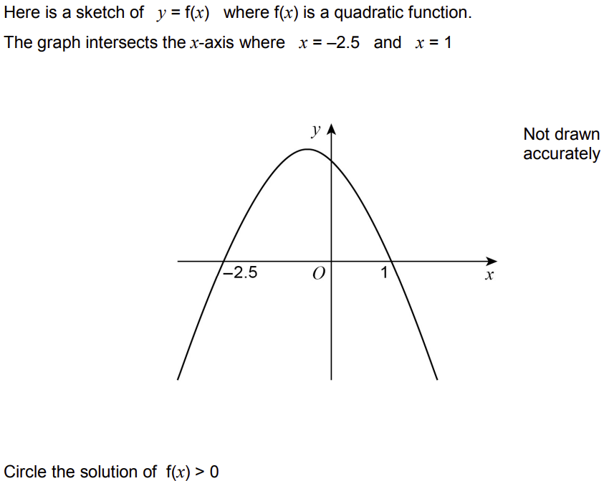
June 2017
Paper 3 Q21
$$x<−2.5 or x>1$$
$$x>−2.5 or x>1$$
$$−2.5<x<1$$
$$x>−2.5 or x<1$$
$$60 seconds timer (click to start)$$

Slide 51
November 2017
Paper 1 Q1
$$10$$
$$14$$
$$50$$
$$100$$
$$60 seconds timer (click to start)$$

Slide 52
November 2017
Paper 1 Q2
$$800×{10}^{6}$$
$$8×{10}^{8}$$
$$8×{10}^{9}$$
$$0.8×{10}^{10}$$
$$60 seconds timer (click to start)$$

Slide 53
November 2017
Paper 1 Q3
$${16a}^{10}$$
$${16a}^{7}$$
$${8a}^{10}$$
$${8a}^{7}$$
$$60 seconds timer (click to start)$$

Slide 54
November 2017
Paper 1 Q4
$$÷2$$
$$×2$$
$$÷5$$
$$×5$$
$$60 seconds timer (click to start)$$

Slide 55
November 2017
Paper 1 Q9
$$\frac{n+1}{2}$$
$$n−1$$
$$n$$
$$n+1$$
$$60 seconds timer (click to start)$$

Slide 56
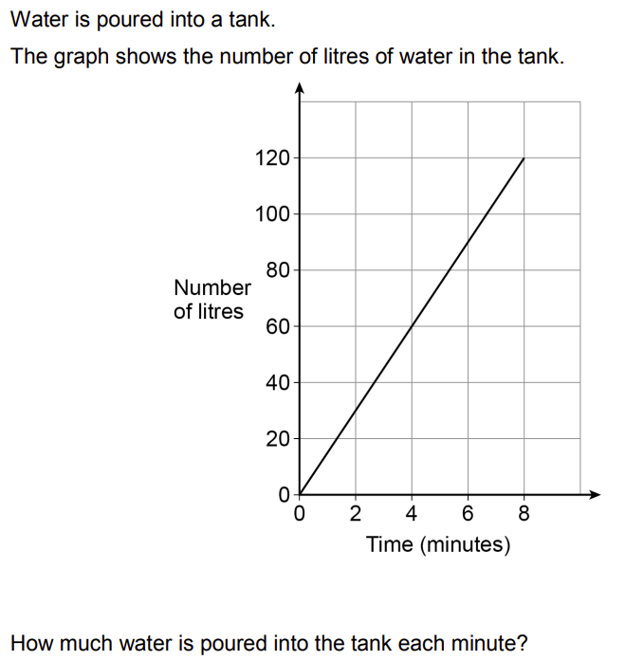
November 2017
Paper 1 Q16
$$1.5 litres$$
$$15 litres$$
$$30 litres$$
$$120 litres$$
$$60 seconds timer (click to start)$$

Slide 57
November 2017
Paper 1 Q18
$$−\frac{3}{2}$$
$$−\frac{2}{5}$$
$$\frac{2}{5}$$
$$\frac{3}{2}$$
$$60 seconds timer (click to start)$$

Slide 58
November 2017
Paper 1 Q23
$$(5,3)$$
$$(5,−3)$$
$$(3,5)$$
$$(−3,5)$$
$$60 seconds timer (click to start)$$

Slide 59
November 2017
Paper 2 Q1
$$\frac{15}{4}$$
$$\frac{29}{8}$$
$$\frac{31}{8}$$
$$\frac{15}{8}$$
$$60 seconds timer (click to start)$$

Slide 60
November 2017
Paper 2 Q2
$$10\%$$
$$40\%$$
$$150\%$$
$$250\%$$
$$60 seconds timer (click to start)$$

Slide 61
November 2017
Paper 2 Q3
$$\left(−\frac{1}{2}, −\frac{1}{8}\right)$$
$$\left(5, 125\right)$$
$$\left(\frac{1}{3}, \frac{1}{9}\right)$$
$$\left(−1, −1\right)$$
$$60 seconds timer (click to start)$$

Slide 62
November 2017
Paper 2 Q4
$$kg/m^{2}$$
$$m^{2}/kg$$
$$kg/m^{3}$$
$$m^{3}/kg$$
$$60 seconds timer (click to start)$$

Slide 63
November 2017
Paper 2 Q11
$$\frac{x^{2}}{{2x}^{2}+3}$$
$$\frac{x^{2}}{{6x}^{2}+1}$$
$$\frac{x^{2}}{{2x}^{2}+1}$$
$$\frac{1}{2}+x^{2}$$
$$60 seconds timer (click to start)$$

Slide 64
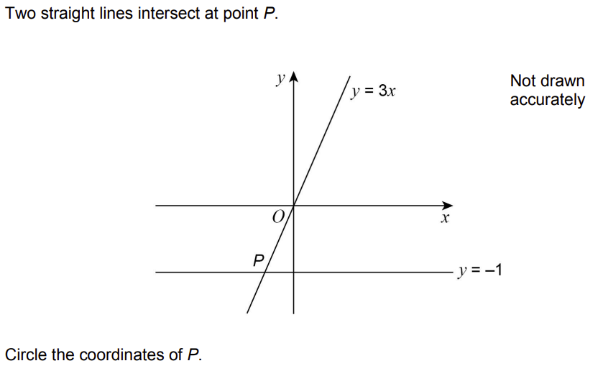
November 2017
Paper 2 Q13
$$\left(−3, −1\right)$$
$$\left(−1, −\frac{1}{3}\right)$$
$$\left(−1, −3\right)$$
$$\left(−\frac{1}{3}, −1\right)$$
$$60 seconds timer (click to start)$$

Slide 65
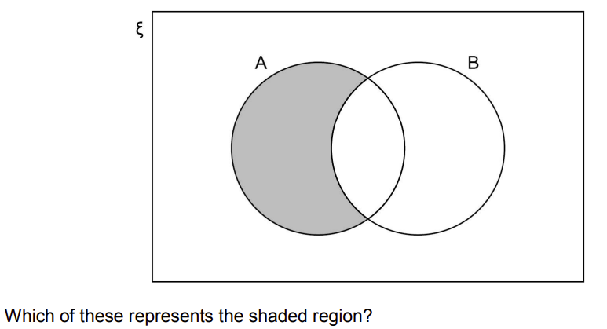
November 2017
Paper 2 Q18a
$$A$$
$$B′$$
$$A∩B′$$
$$A∪B′$$
$$60 seconds timer (click to start)$$

Slide 66
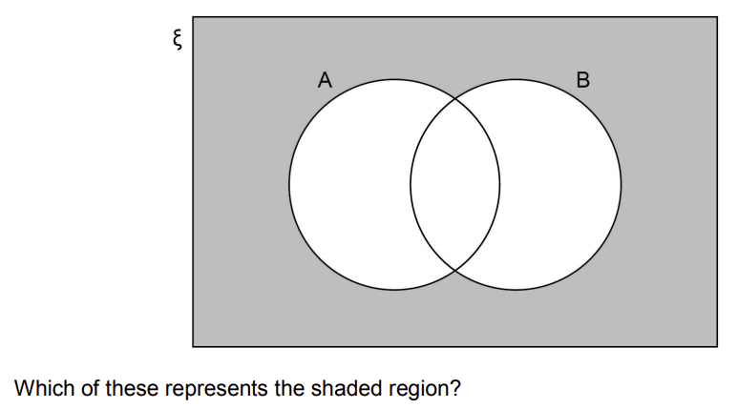
November 2017
Paper 2 Q18b
$$(A∪B)′$$
$$(A∩B)′$$
$$A′∩B$$
$$A′∪B′$$
$$60 seconds timer (click to start)$$

Slide 67
November 2017
Paper 3 Q1
$$−4≤x<5$$
$$−4≤x≤5$$
$$−4<x<5$$
$$−4<x≤5$$
$$60 seconds timer (click to start)$$

Slide 68
November 2017
Paper 3 Q2
$$1:100$$
$$100:1$$
$$1:2$$
$$2:1$$
$$60 seconds timer (click to start)$$

Slide 69
November 2017
Paper 3 Q3
$$−12−2n$$
$$−8−2n$$
$$n+2$$
$$2n−12$$
$$60 seconds timer (click to start)$$

Slide 70
November 2017
Paper 3 Q4
$$y=−5$$
$$x−y=0$$
$$x=3$$
$$x+y=0$$
$$60 seconds timer (click to start)$$

Slide 71
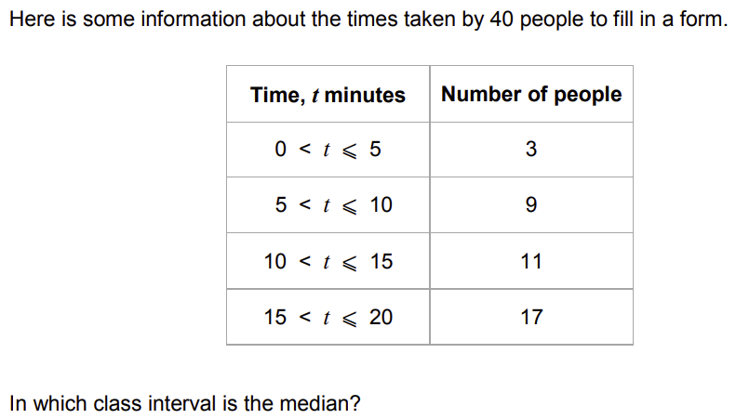
November 2017
Paper 3 Q7
$$0<t≤5$$
$$5<t≤20$$
$$10<t≤15$$
$$15<t≤20$$
$$60 seconds timer (click to start)$$

Slide 72
November 2017
Paper 3 Q15
$$2xy^{2}$$
$$12x^{3}y^{2}$$
$$2xy$$
$$24x^{4}y^{3}$$
$$60 seconds timer (click to start)$$

Slide 73
November 2017
Paper 3 Q16
$$18$$
$$−18$$
$$36$$
$$−36$$
$$60 seconds timer (click to start)$$

Slide 74
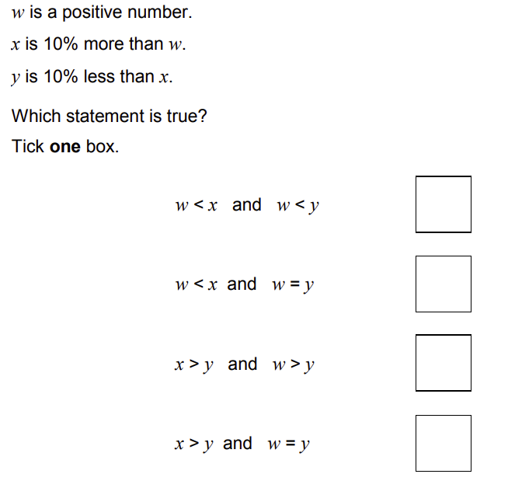
November 2017
Paper 3 Q20
A
B
C
D
$$A$$
$$B$$
$$C$$
$$D$$
$$60 seconds timer (click to start)$$

Slide 75
June 2018
Paper 1 Q1
$$40$$
$$80$$
$$400$$
$$4000$$
$$60 seconds timer (click to start)$$

Slide 76
June 2018
Paper 1 Q2
$$\left({−2 \atop 3}\right)$$
$$\left({−3 \atop 2}\right)$$
$$\left({3 \atop −2}\right)$$
$$\left({2 \atop −3}\right)$$
$$60 seconds timer (click to start)$$

Slide 77
June 2018
Paper 1 Q3
$$8a^{2}+2a$$
$$12a^{2}$$
$$5a−4a^{2}$$
$$3a−6a^{2}$$
$$60 seconds timer (click to start)$$

Slide 78
June 2018
Paper 1 Q4
$$5$$
$$50$$
$$500$$
$$5000$$
$$60 seconds timer (click to start)$$

Slide 79
June 2018
Paper 1 Q13
$$15000{mm}^{3}$$
$$1.5{mm}^{3}$$
$$0.0015{mm}^{3}$$
$$150{mm}^{3}$$
$$60 seconds timer (click to start)$$

Slide 80
June 2018
Paper 1 Q16
$$5:6$$
$$6:5$$
$$4:5$$
$$5:4$$
$$60 seconds timer (click to start)$$

Slide 81
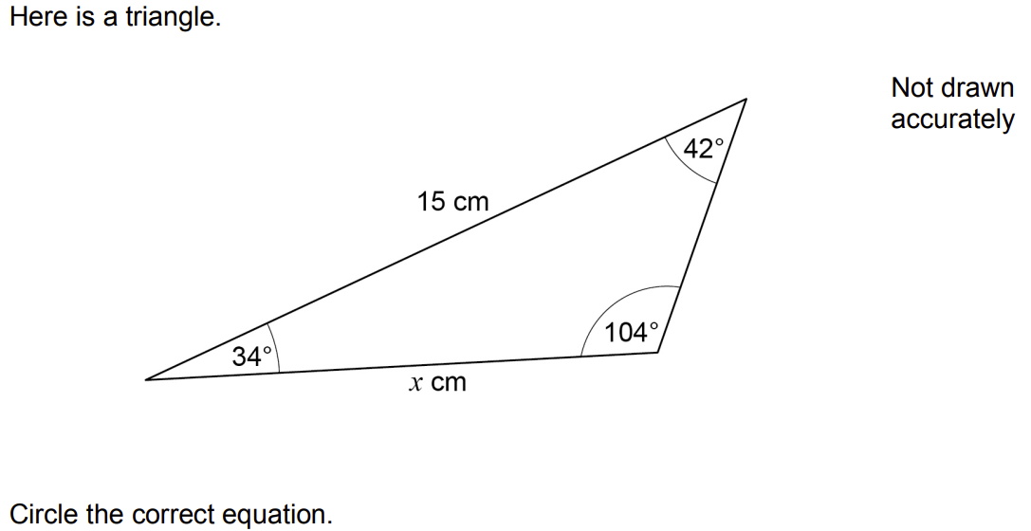
June 2018
Paper 1 Q17
$$\frac{sin(x)}{42}=\frac{sin(15)}{104}$$
$$\frac{x}{sin(42)}=\frac{15}{sin(104)}$$
$$\frac{sin(x)}{34}=\frac{sin(15)}{104}$$
$$\frac{x}{sin(42)}=\frac{15}{sin(34)}$$
$$60 seconds timer (click to start)$$

Slide 82
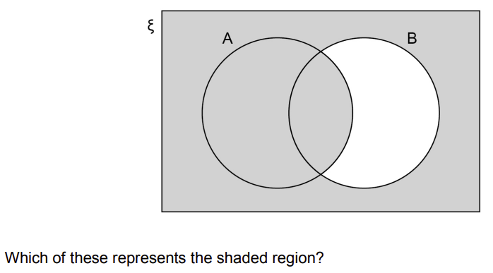
June 2018
Paper 1 Q22
$$A∩B′$$
$$B′$$
$$A∪B′$$
$$A′∪B′$$
$$60 seconds timer (click to start)$$

Slide 83
June 2018
Paper 2 Q1
$$segment$$
$$chord$$
$$sector$$
$$arc$$
$$60 seconds timer (click to start)$$

Slide 84
June 2018
Paper 2 Q2
$$0.25×{10}^{4}$$
$$6×{10}^{7}$$
$$38×{10}^{−3}$$
$$4×{10}^{\frac{1}{2}}$$
$$60 seconds timer (click to start)$$

Slide 85
June 2018
Paper 2 Q3
$$2:5$$
$$5:2$$
$$3:2$$
$$2:3$$
$$60 seconds timer (click to start)$$

Slide 86
June 2018
Paper 2 Q4
$$4\%$$
$$25\%$$
$$300\%$$
$$400\%$$
$$60 seconds timer (click to start)$$

Slide 87
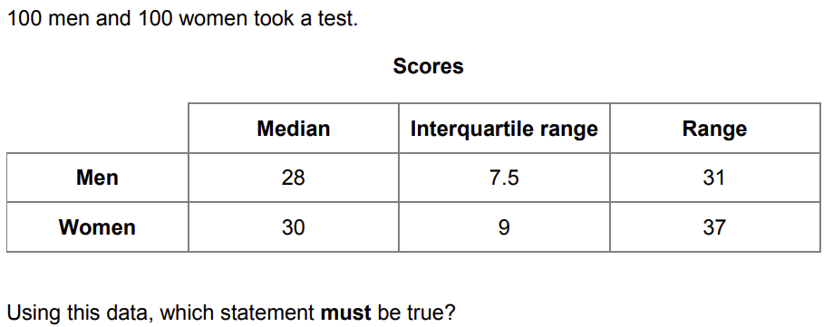
June 2018
Paper 2 Q15
$$men had a higher$$
$$average score$$
$$than women$$
$$men had more$$
$$consistent scores$$
$$than women$$
$$a woman had the$$
$$highest score$$
$$a man had the$$
$$lowest score$$
$$60 seconds timer (click to start)$$

Slide 88
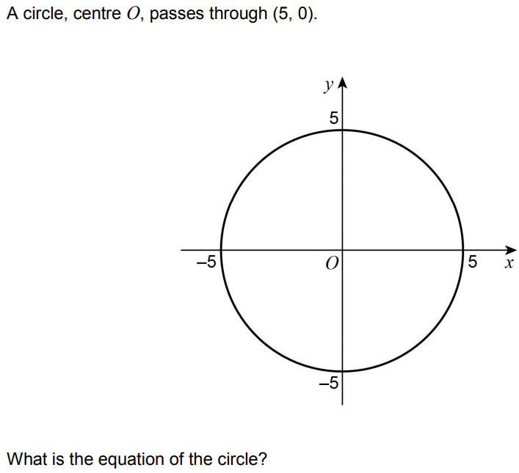
June 2018
Paper 2 Q22
$$x^{2}+y^{2}=25$$
$$x^{2}+y^{2}=5$$
$$x^{2}+y^{2}=10$$
$$x^{2}+y^{2}=100$$
$$60 seconds timer (click to start)$$

Slide 89
June 2018
Paper 3 Q1
$$0.56$$
$$0.6$$
$$0.525$$
$$0.5$$
$$60 seconds timer (click to start)$$

Slide 90
June 2018
Paper 3 Q2
$$−2,−1,0,1,2,3$$
$$−1,0,1,2,3$$
$$−2,−1,0,1,2,3,4$$
$$−1,0,1,2,3,4$$
$$60 seconds timer (click to start)$$

Slide 91
June 2018
Paper 3 Q3
$$3.2\dot{7}$$
$$3.27$$
$$3.277$$
$$3.20\dot{7}$$
$$60 seconds timer (click to start)$$

Slide 92
June 2018
Paper 3 Q4
$$18°$$
$$36°$$
$$144°$$
$$162°$$
$$60 seconds timer (click to start)$$

Slide 93
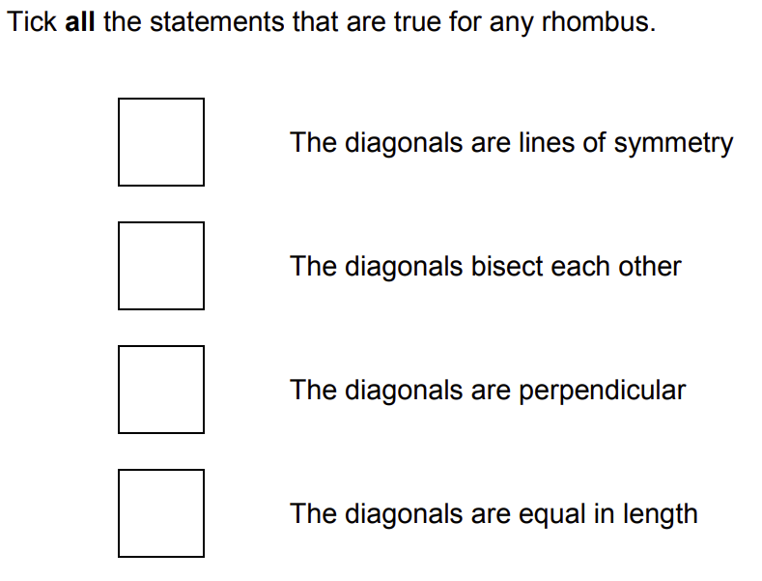
June 2018
Paper 3 Q13
A
B
C
D
$$A$$
$$B$$
$$C$$
$$D$$
$$60 seconds timer (click to start)$$

Slide 94
June 2018
Paper 3 Q15
$$4x+3$$
$$3x+4$$
$$4(x+3)$$
$$x+12$$
$$60 seconds timer (click to start)$$

Slide 95
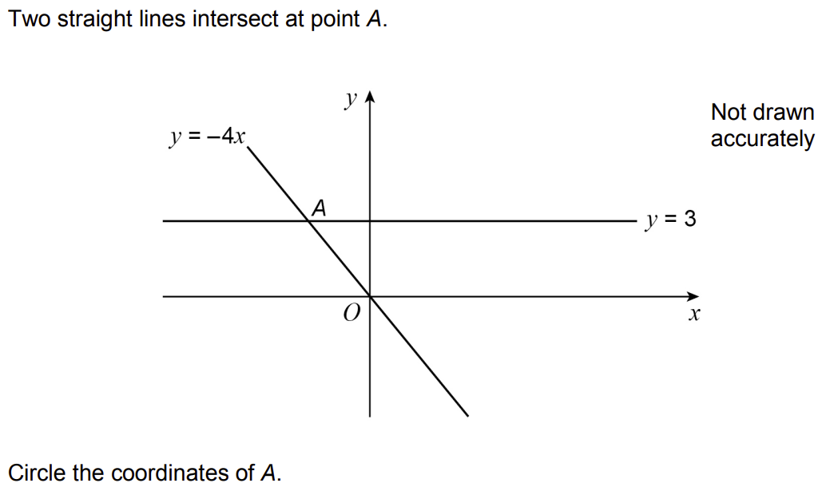
June 2018
Paper 3 Q16
$$\left(−\frac{3}{4}, 3\right)$$
$$\left(−4, 3\right)$$
$$\left(−12, 3\right)$$
$$\left(−\frac{4}{3}, 3\right)$$
$$60 seconds timer (click to start)$$

Slide 96
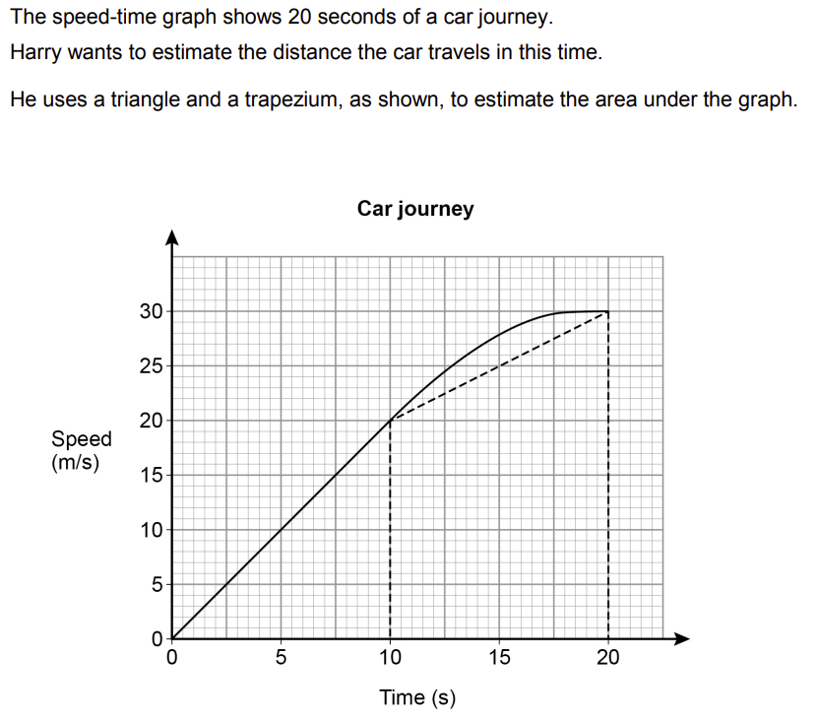
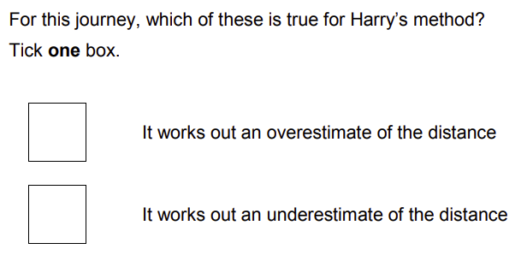
June 2018
Paper 3 Q24b
A
B
C
$$A$$
$$B$$
$$C$$
$$60 seconds timer (click to start)$$

Slide 97
November 2018
Paper 1 Q1
$$5^{6}$$
$$5^{8}$$
$${25}^{6}$$
$${25}^{8}$$
$$60 seconds timer (click to start)$$

Slide 98
November 2018
Paper 1 Q2
$$40π$$
$$80π$$
$$200π$$
$$1600π$$
$$60 seconds timer (click to start)$$

Slide 99
November 2018
Paper 1 Q3
$$22a$$
$$8a$$
$$28a$$
$$2a$$
$$60 seconds timer (click to start)$$

Slide 100
November 2018
Paper 1 Q4
$$\frac{1}{2}$$
$$\frac{\sqrt{3}}{2}$$
$$0$$
$$1$$
$$60 seconds timer (click to start)$$

Slide 101
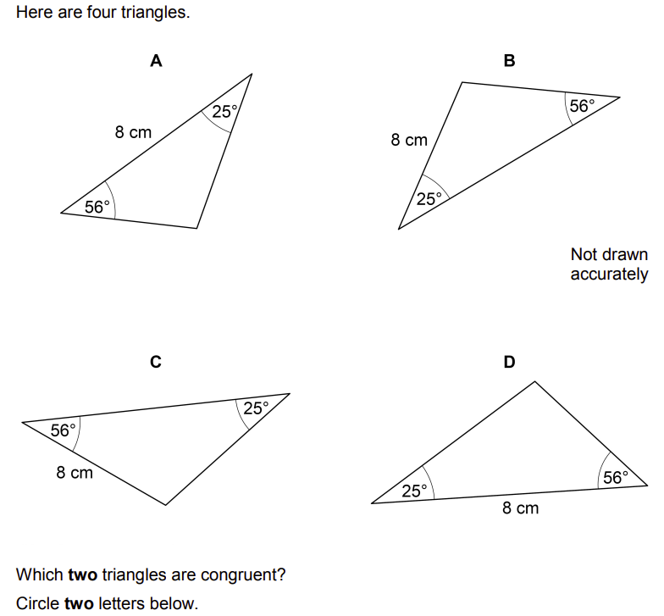
November 2018
Paper 1 Q11
$$A$$
$$B$$
$$C$$
$$D$$
$$60 seconds timer (click to start)$$

Slide 102
November 2018
Paper 1 Q16
$$27000$$
$$90$$
$$2700$$
$$9000$$
$$60 seconds timer (click to start)$$

Slide 103
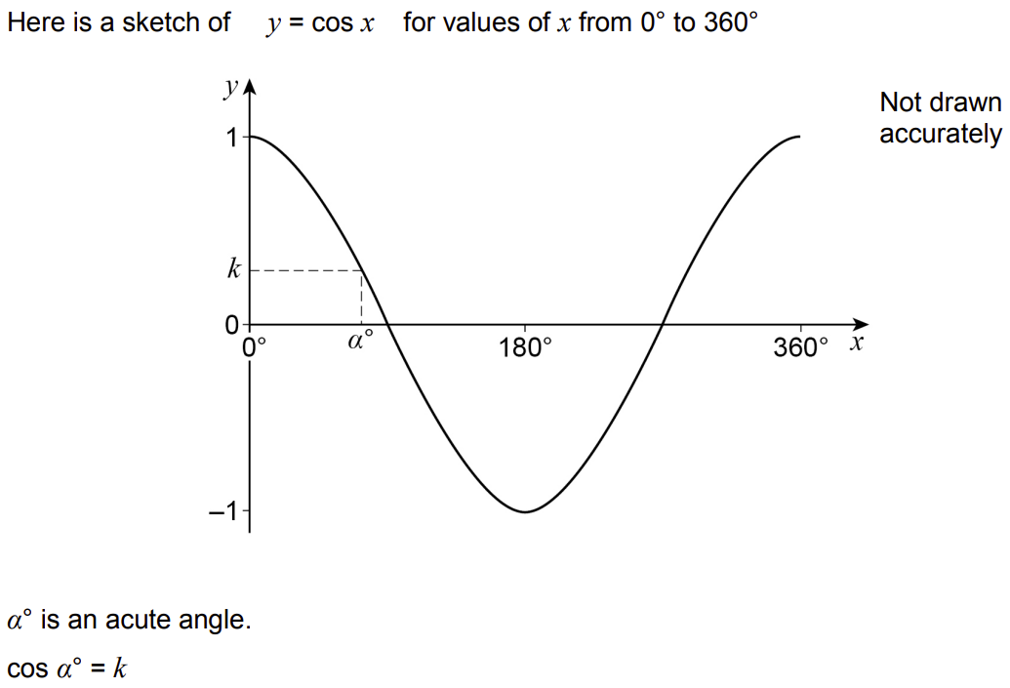
November 2018
Paper 1 Q27a
$$1−k$$
$$k$$
$$−k$$
$$−1−k$$
$$60 seconds timer (click to start)$$

Slide 104
November 2018
Paper 1 Q27b
$$k−1$$
$$k+1$$
$$−k$$
$$k$$
$$60 seconds timer (click to start)$$

Slide 105
November 2018
Paper 2 Q1
$$A or B or both$$
$$A but not B$$
$$not A and not B$$
$$A and B$$
$$60 seconds timer (click to start)$$

Slide 106
November 2018
Paper 2 Q2
$$(1,5)$$
$$(3,4)$$
$$(3,5)$$
$$(6,8)$$
$$60 seconds timer (click to start)$$

Slide 107
November 2018
Paper 2 Q3
$$1,3,5,7,9$$
$$1,3,6,10,15$$
$$1,4,9,16,25$$
$$1,3,9,27,81$$
$$60 seconds timer (click to start)$$

Slide 108
November 2018
Paper 2 Q4
$$050°$$
$$110°$$
$$130°$$
$$220°$$
$$60 seconds timer (click to start)$$

Slide 109
November 2018
Paper 2 Q14
$$2n$$
$$3n$$
$$n+2$$
$$2n+3$$
$$60 seconds timer (click to start)$$

Slide 110
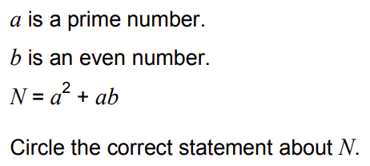
November 2018
Paper 2 Q17
$$could be$$
$$even or odd$$
$$always even$$
$$always prime$$
$$always odd$$
$$60 seconds timer (click to start)$$

Slide 111
November 2018
Paper 2 Q23
$$\frac{1}{3}a$$
$$\frac{1}{4}a$$
$$−\frac{1}{3}a$$
$$−\frac{1}{4}a$$
$$60 seconds timer (click to start)$$

Slide 112
November 2018
Paper 3 Q1
$$up$$
$$down$$
$$left$$
$$right$$
$$60 seconds timer (click to start)$$

Slide 113
November 2018
Paper 3 Q2
$$\frac{5}{2}$$
$$\frac{1}{4}$$
$$\frac{4}{1}$$
$$\frac{2}{5}$$
$$60 seconds timer (click to start)$$

Slide 114
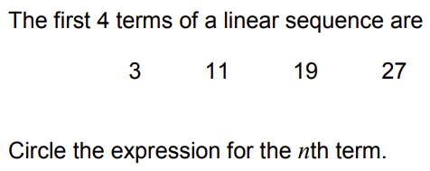
November 2018
Paper 3 Q3
$$8−5n$$
$$n+8$$
$$8n+3$$
$$8n−5$$
$$60 seconds timer (click to start)$$

Slide 115
November 2018
Paper 3 Q4
$$10$$
$$120$$
$$240$$
$$24000$$
$$60 seconds timer (click to start)$$

Slide 116
November 2018
Paper 3 Q13
$$20$$
$$200$$
$$250$$
$$300$$
$$60 seconds timer (click to start)$$

Slide 117
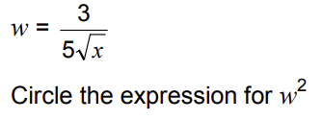
November 2018
Paper 3 Q17
$$\frac{6}{10x^{2}}$$
$$\frac{9}{25x^{2}}$$
$$\frac{6}{10x}$$
$$\frac{9}{25x}$$
$$60 seconds timer (click to start)$$

Slide 118
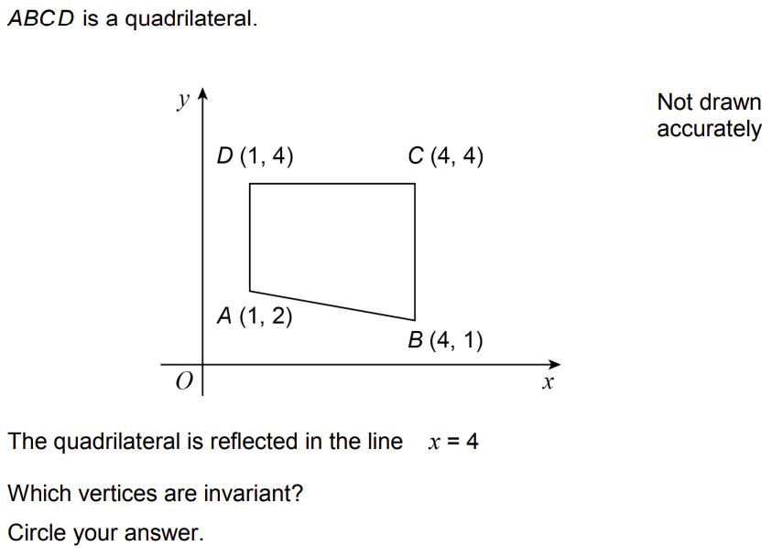
November 2018
Paper 3 Q25
$$A and D$$
$$C and D$$
$$B and C$$
$$B and D$$
$$60 seconds timer (click to start)$$

Slide 119
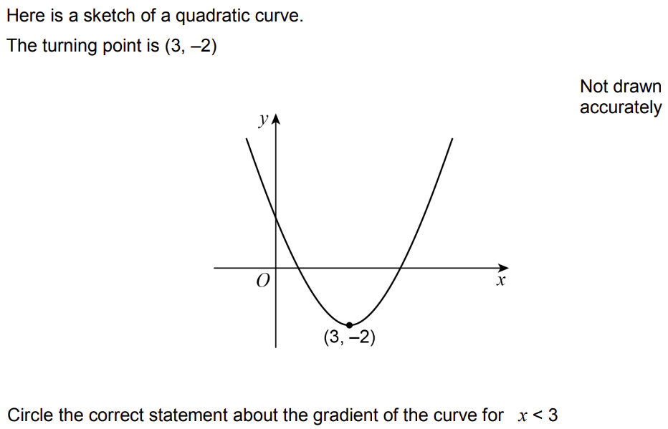
November 2018
Paper 3 Q28
$$gradient is$$
$$positive$$
$$gradient is$$
$$negative$$
$$gradient is$$
$$zero$$
$$gradient could$$
$$be any value$$
$$60 seconds timer (click to start)$$

Slide 120
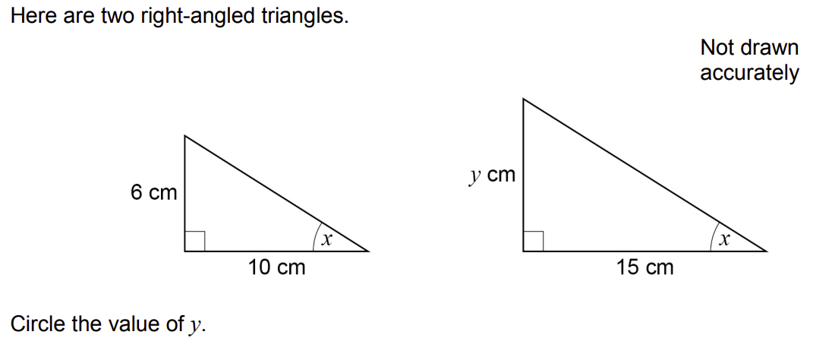
June 2019
Paper 1 Q1
$$11$$
$$7.5$$
$$9$$
$$4$$
$$60 seconds timer (click to start)$$

Slide 121
June 2019
Paper 1 Q2
$$1\frac{4}{9}$$
$$3\frac{1}{3}$$
$$2\frac{4}{9}$$
$$2\frac{7}{9}$$
$$60 seconds timer (click to start)$$

Slide 122
June 2019
Paper 1 Q3
$$3π$$
$$6π$$
$$12π$$
$$18π$$
$$60 seconds timer (click to start)$$

Slide 123
June 2019
Paper 1 Q4
$$\frac{39}{8}$$
$$\frac{37}{8}$$
$$\frac{185}{4}$$
$$\frac{17}{4}$$
$$60 seconds timer (click to start)$$

Slide 124
June 2019
Paper 1 Q12
$$−9,2,−7,−5,−12$$
$$−3,5,−2,3,1$$
$$0,−3,−3,0,−3$$
$$−1,−1,−2,−3,1$$
$$60 seconds timer (click to start)$$

Slide 125
June 2019
Paper 1 Q19
$$\frac{1}{9}$$
$$\frac{1}{99}$$
$$\frac{1}{10}$$
$$\frac{11}{100}$$
$$60 seconds timer (click to start)$$

Slide 126
June 2019
Paper 1 Q24
$$1$$
$$0$$
$$−\frac{1}{2}$$
$$−1$$
$$60 seconds timer (click to start)$$

Slide 127
June 2019
Paper 2 Q1
$$(−1,4)$$
$$(−1,−4)$$
$$(−1,2)$$
$$(−1,6)$$
$$60 seconds timer (click to start)$$

Slide 128
June 2019
Paper 2 Q2
$$11.5m≤height<12.5m$$
$$11.5m≤height≤12.5m$$
$$11.5m<height≤12.5m$$
$$11.5m<height<12.5m$$
$$60 seconds timer (click to start)$$

Slide 129
June 2019
Paper 2 Q3
$$10:1$$
$$1:10$$
$$5:2$$
$$2:5$$
$$60 seconds timer (click to start)$$

Slide 130
June 2019
Paper 2 Q4
$$A∪B$$
$$(A∩B)′$$
$$A∩B$$
$$A′∪B′$$
$$60 seconds timer (click to start)$$

Slide 131
June 2019
Paper 2 Q9a
$$continuous$$
$$discrete$$
$$grouped$$
$$ungrouped$$
$$60 seconds timer (click to start)$$

Slide 132
June 2019
Paper 2 Q12
$$0.3$$
$$0.32$$
$$0.342$$
$$0.4$$
$$60 seconds timer (click to start)$$

Slide 133
June 2019
Paper 2 Q23
$$4:5$$
$$16:25$$
$$64:125$$
$$256:625$$
$$60 seconds timer (click to start)$$

Slide 134
June 2019
Paper 3 Q1
$$\frac{2}{5}$$
$$\frac{1}{4}$$
$$\frac{4}{1}$$
$$\frac{5}{2}$$
$$60 seconds timer (click to start)$$

Slide 135
June 2019
Paper 3 Q2
$$\frac{6}{25}$$
$$\frac{6}{10}$$
$$\frac{9}{25}$$
$$\frac{9}{5}$$
$$60 seconds timer (click to start)$$

Slide 136
June 2019
Paper 3 Q3
$$5$$
$$45$$
$$75$$
$$150$$
$$60 seconds timer (click to start)$$

Slide 137
June 2019
Paper 3 Q4
$$−5$$
$$−3$$
$$3$$
$$5$$
$$60 seconds timer (click to start)$$

Slide 138
June 2019
Paper 3 Q8
$$x=\frac{y}{3}−2$$
$$x=\frac{y+2}{3}$$
$$x=\frac{y−2}{3}$$
$$x=\frac{y}{3}+2$$
$$60 seconds timer (click to start)$$

Slide 139
June 2019
Paper 3 Q14
A
B
C
D
$$A$$
$$B$$
$$C$$
$$D$$
$$60 seconds timer (click to start)$$

Slide 140
June 2019
Paper 3 Q22a
$$\frac{12}{29}$$
$$\frac{13}{29}$$
$$\frac{15}{29}$$
$$\frac{20}{29}$$
$$60 seconds timer (click to start)$$

Slide 141
June 2019
Paper 3 Q22b
$$\frac{7}{15}$$
$$\frac{8}{15}$$
$$\frac{7}{29}$$
$$\frac{8}{29}$$
$$60 seconds timer (click to start)$$

Slide 142
November 2019
Paper 1 Q1
$$250÷1.15$$
$$250×0.15$$
$$250×0.85$$
$$250÷0.85$$
$$60 seconds timer (click to start)$$

Slide 143
November 2019
Paper 1 Q2
$$x=−1$$
$$x=0$$
$$x=\frac{2}{3}$$
$$x=\frac{3}{2}$$
$$60 seconds timer (click to start)$$

Slide 144
November 2019
Paper 1 Q3
$$(4,6)$$
$$(5,6.5)$$
$$(6,7)$$
$$(8,12)$$
$$60 seconds timer (click to start)$$

Slide 145
November 2019
Paper 1 Q4
$$2x^{4}$$
$$6x^{4}$$
$$8x^{4}$$
$$16x^{4}$$
$$60 seconds timer (click to start)$$

Slide 146
November 2019
Paper 1 Q12
A
B
C
D
$$A$$
$$B$$
$$C$$
$$D$$
$$60 seconds timer (click to start)$$

Slide 147
November 2019
Paper 1 Q14
$$19$$
$$90$$
$$830$$
$$900$$
$$60 seconds timer (click to start)$$

Slide 148
November 2019
Paper 1 Q17
$$\left({−6 \atop −17}\right)$$
$$\left({−6 \atop −13}\right)$$
$$\left({0 \atop 17}\right)$$
$$\left({0 \atop −13}\right)$$
$$60 seconds timer (click to start)$$

Slide 149
November 2019
Paper 1 Q21
$$0.70\dot{3}\dot{8}$$
$$0.703\dot{8}$$
$$0.703\dot{8}\dot{3}$$
$$0.703\dot{8}\dot{4}$$
$$60 seconds timer (click to start)$$

Slide 150
November 2019
Paper 2 Q1
$$32x^{3}$$
$$12x^{3}+20x^{2}$$
$$7x^{3}+9x^{2}$$
$$12x^{3}+5$$
$$60 seconds timer (click to start)$$

Slide 151
November 2019
Paper 2 Q2
$${10}^{3}$$
$${10}^{5}$$
$${10}^{6}$$
$${10}^{9}$$
$$60 seconds timer (click to start)$$

Slide 152
November 2019
Paper 2 Q3
$$\frac{7}{32}$$
$$\frac{5}{8}$$
$$\frac{2}{3}$$
$$\frac{1}{2}$$
$$60 seconds timer (click to start)$$

Slide 153
November 2019
Paper 2 Q4
$$y=x$$
$$y=−x^{2}$$
$$y=−{10}^{3}$$
$$y=\frac{1}{x}$$
$$60 seconds timer (click to start)$$

Slide 154
November 2019
Paper 2 Q15
$$w=y^{6}$$
$$y=\sqrt[3]{y^{2}}$$
$$y=\sqrt[3]{y^{3}}$$
$$w=y^{5}$$
$$60 seconds timer (click to start)$$

Slide 155
November 2019
Paper 2 Q19
$$periodic$$
$$exponential$$
$$cubic$$
$$quadratic$$
$$60 seconds timer (click to start)$$

Slide 156
November 2019
Paper 2 Q20
$$(7,26)$$
$$(7,30)$$
$$(5,28)$$
$$(9,28)$$
$$60 seconds timer (click to start)$$

Slide 157
November 2019
Paper 2 Q22
A
B
C
D
$$A$$
$$B$$
$$C$$
$$D$$
$$60 seconds timer (click to start)$$

Slide 158
November 2019
Paper 3 Q1
$$0.13$$
$$26$$
$$13:50$$
$$0.26$$
$$60 seconds timer (click to start)$$

Slide 159
November 2019
Paper 3 Q2
$$\frac{2}{3}$$
$$\frac{3}{2}$$
$$3$$
$$5$$
$$60 seconds timer (click to start)$$

Slide 160
November 2019
Paper 3 Q3
$$2x$$
$$−2x$$
$$22x$$
$$−22x$$
$$60 seconds timer (click to start)$$

Slide 161
November 2019
Paper 3 Q4
$$0.365≤x<6.375$$
$$6.36≤x<6.38$$
$$0.369≤x<6.379$$
$$0.365≤x<6.3749$$
$$60 seconds timer (click to start)$$

Slide 162
November 2019
Paper 3 Q18
$$−\frac{1}{7}$$
$$\frac{1}{7}$$
$$−\frac{3}{2}$$
$$\frac{3}{2}$$
$$60 seconds timer (click to start)$$

Slide 163
November 2019
Paper 3 Q20
$$1$$
$$2$$
$$\sqrt{2}$$
$$2\sqrt{2}$$
$$60 seconds timer (click to start)$$

Slide 164
November 2019
Paper 3 Q23
$$\frac{8}{3}$$
$$\frac{1}{6}$$
$$\frac{3}{7}$$
$$\frac{3}{8}$$
$$60 seconds timer (click to start)$$

Slide 165
November 2020
Paper 1 Q1
$$\frac{15}{4}$$
$$\frac{19}{4}$$
$$\frac{21}{4}$$
$$\frac{23}{4}$$
$$60 seconds timer (click to start)$$

Slide 166
November 2020
Paper 1 Q2
$$\left({3 \atop 2}\right)$$
$$\left({−3 \atop 2}\right)$$
$$\left({3 \atop −2}\right)$$
$$\left({−3 \atop −2}\right)$$
$$60 seconds timer (click to start)$$

Slide 167
November 2020
Paper 1 Q3
$$100$$
$$1000$$
$$10000$$
$$1000000$$
$$60 seconds timer (click to start)$$

Slide 168
November 2020
Paper 1 Q4
$$\frac{6}{5}$$
$$\frac{1}{6}$$
$$−\frac{1}{6}$$
$$−\frac{6}{5}$$
$$60 seconds timer (click to start)$$

Slide 169
November 2020
Paper 1 Q15
$$6:1$$
$$1:6$$
$$3:2$$
$$2:3$$
$$60 seconds timer (click to start)$$

Slide 170
November 2020
Paper 1 Q19
$$\frac{3x}{10}$$
$$\frac{2x}{15}$$
$$\frac{x}{25}$$
$$\frac{x^{2}}{50}$$
$$60 seconds timer (click to start)$$

Slide 171
November 2020
Paper 1 Q22b
$$×2$$
$$×16$$
$$÷2$$
$$÷16$$
$$60 seconds timer (click to start)$$

Slide 172
November 2020
Paper 1 Q24
A
B
C
D
$$A$$
$$B$$
$$C$$
$$D$$
$$60 seconds timer (click to start)$$

Slide 173
November 2020
Paper 2 Q1
$$x+4x≡5x$$
$$6x≡18$$
$$2x+1≡7$$
$$7x+9≡x$$
$$60 seconds timer (click to start)$$

Slide 174
November 2020
Paper 2 Q2
$$RHS$$
$$ASA$$
$$SSS$$
$$SAS$$
$$60 seconds timer (click to start)$$

Slide 175
November 2020
Paper 2 Q3
$$0.9×{10}^{−3}$$
$$6×{10}^{0.5}$$
$$5.2×{10}^{−4}$$
$$12×{10}^{7}$$
$$60 seconds timer (click to start)$$

Slide 176
November 2020
Paper 2 Q4
$$\frac{1}{2}a$$
$$a$$
$$a^{2}$$
$$a^{3}$$
$$60 seconds timer (click to start)$$

Slide 177
November 2020
Paper 2 Q21
$$(−1,1)$$
$$(0.3,3)$$
$$(0.8,0.2)$$
$$(2.5,4)$$
$$60 seconds timer (click to start)$$

Slide 178
November 2020
Paper 2 Q22
$$A$$
$$B$$
$$C$$
$$D$$
$$60 seconds timer (click to start)$$

Slide 179
November 2020
Paper 2 Q24b
$$y=x+6$$
$$y=−x$$
$$y=2$$
$$x=−4$$
$$60 seconds timer (click to start)$$

Slide 180
November 2020
Paper 3 Q1
$$A or B or both$$
$$A but not B$$
$$not A and not B$$
$$A and B$$
$$60 seconds timer (click to start)$$

Slide 181
November 2020
Paper 3 Q2
$$y=−2x$$
$$y=2x$$
$$y=\frac{1}{2}x$$
$$y=−\frac{1}{2}x$$
$$60 seconds timer (click to start)$$

Slide 182
November 2020
Paper 3 Q3
$$25\%$$
$$75\%$$
$$300\%$$
$$400\%$$
$$60 seconds timer (click to start)$$

Slide 183
November 2020
Paper 3 Q4
$$\frac{1}{2}$$
$$2$$
$$\frac{1}{8}$$
$$\frac{1}{16}$$
$$60 seconds timer (click to start)$$

Slide 184
November 2020
Paper 3 Q19
$$x<1 and y<−3$$
$$x<1 and y>−3$$
$$x>1 and y>−3$$
$$x>1 and y<−3$$
$$60 seconds timer (click to start)$$

Slide 185
November 2020
Paper 3 Q24b
A
B
C
D
$$A$$
$$B$$
$$C$$
$$D$$
$$60 seconds timer (click to start)$$

Slide 186
November 2020
Paper 3 Q25
$$3$$
$$6$$
$$9$$
$$18$$
$$60 seconds timer (click to start)$$

Slide 187
November 2020
Paper 3 Q27
$$(−1,−6)$$
$$(1,6)$$
$$(−1,6)$$
$$(1,−6)$$
$$60 seconds timer (click to start)$$

Slide 188
November 2021
Paper 1 Q1
$$8a$$
$$15a$$
$$a^{8}$$
$$a^{15}$$
$$60 seconds timer (click to start)$$

Slide 189
November 2021
Paper 1 Q2
$$\frac{4}{10}$$
$$\frac{20}{50}$$
$$\frac{26}{70}$$
$$\frac{120}{300}$$
$$60 seconds timer (click to start)$$

Slide 190
November 2021
Paper 1 Q3
$$hexagonal prism$$
$$hexagon−based$$
$$prism$$
$$pentagonal prism$$
$$pentagon−based$$
$$prism$$
$$60 seconds timer (click to start)$$

Slide 191
November 2021
Paper 1 Q4
$$y=kx$$
$$y=k+x$$
$$y=kx−x$$
$$y=\frac{k}{x}$$
$$60 seconds timer (click to start)$$

Slide 192
November 2021
Paper 1 Q14
$$\frac{7}{x}$$
$$\frac{7}{2x}$$
$$\frac{12}{x}$$
$$\frac{12}{x^{2}}$$
$$60 seconds timer (click to start)$$

Slide 193
November 2021
Paper 1 Q17
$$\left({5 \atop −6}\right)$$
$$\left({5 \atop −8}\right)$$
$$\left({−5 \atop 8}\right)$$
$$\left({−5 \atop 6}\right)$$
$$60 seconds timer (click to start)$$

Slide 194
November 2021
Paper 1 Q20
$${cm}^{2}/g$$
$${cm}^{3}/g$$
$$g/{cm}^{2}$$
$$g/{cm}^{3}$$
$$60 seconds timer (click to start)$$

Slide 195
November 2021
Paper 1 Q24b
$$\frac{2x^{2}−x}{2}$$
$$\frac{2x−1}{2}$$
$$x^{2}−x$$
$$x^{2}−1$$
$$60 seconds timer (click to start)$$

Slide 196
November 2021
Paper 2 Q1
$$x−1$$
$$−5x$$
$$x−5$$
$$5x$$
$$60 seconds timer (click to start)$$

Slide 197
November 2021
Paper 2 Q2
$$1:2$$
$$2:1$$
$$1:3$$
$$3:1$$
$$60 seconds timer (click to start)$$

Slide 198
November 2021
Paper 2 Q3
$$\frac{16}{81}$$
$$\frac{14}{81}$$
$$\frac{16}{81}$$
$$\frac{32}{81}$$
$$60 seconds timer (click to start)$$

Slide 199
November 2021
Paper 2 Q4
$$ASA$$
$$RHS$$
$$SAS$$
$$SSS$$
$$60 seconds timer (click to start)$$

Slide 200
November 2021
Paper 2 Q10i
$$Always true$$
$$Sometimes true$$
$$Never true$$
$$60 seconds timer (click to start)$$

Slide 201
November 2021
Paper 2 Q10ii
$$Always true$$
$$Sometimes true$$
$$Never true$$
$$60 seconds timer (click to start)$$

Slide 202
November 2021
Paper 2 Q10iii
$$Always true$$
$$Sometimes true$$
$$Never true$$
$$60 seconds timer (click to start)$$

Slide 203
November 2021
Paper 2 Q10iv
$$Always true$$
$$Sometimes true$$
$$Never true$$
$$60 seconds timer (click to start)$$

Slide 204
November 2021
Paper 2 Q16a
$$\sqrt{3} x$$
$$\sqrt[3]{3x^{2}}$$
$$\sqrt{x^{3}}$$
$$\sqrt[3]{3} x$$
$$60 seconds timer (click to start)$$

Slide 205
November 2021
Paper 2 Q16b
$$x is a$$
$$whole number$$
$$x is not a$$
$$whole number$$
$$x might be a$$
$$whole number$$
$$60 seconds timer (click to start)$$

Slide 206
November 2021
Paper 2 Q19a
$$10 seconds$$
$$9 seconds$$
$$6 seconds$$
$$4 seconds$$
$$60 seconds timer (click to start)$$

Slide 207
November 2021
Paper 2 Q20
$$0.5cm$$
$$5cm$$
$$50 cm$$
$$500cm$$
$$60 seconds timer (click to start)$$

Slide 208
November 2021
Paper 3 Q1
$$b=\sqrt{a}+3$$
$$b=\sqrt{a}−3$$
$$b=\sqrt{a+3}$$
$$b=\sqrt{a−3}$$
$$60 seconds timer (click to start)$$

Slide 209
November 2021
Paper 3 Q2
$$0.\dot{5}$$
$$0.55$$
$$0.545$$
$$0.5\dot{4}\dot{5}$$
$$60 seconds timer (click to start)$$

Slide 210
November 2021
Paper 3 Q3
$$\left(0,1\right)$$
$$\left(0,−1\right)$$
$$\left(0,\frac{2}{3}\right)$$
$$\left(0,−\frac{2}{3}\right)$$
$$60 seconds timer (click to start)$$

Slide 211
November 2021
Paper 3 Q4
$${\left(x+8\right)}^{2}$$
$${\left(x−8\right)}^{2}$$
$$\left(x+8\right)\left(x−8\right)$$
$$x\left(x−64\right)$$
$$60 seconds timer (click to start)$$

Slide 212
November 2021
Paper 3 Q17
$$−2\frac{7}{8}$$
$$2.8$$
$$3$$
$$−\frac{7}{2}$$
$$60 seconds timer (click to start)$$

Slide 213
November 2021
Paper 3 Q18
$$1$$
$$0$$
$$w$$
$$w^{2}$$
$$60 seconds timer (click to start)$$

Slide 214
November 2021
Paper 3 Q19
$$\sqrt{11}$$
$$2\sqrt{11}$$
$$\sqrt{22}$$
$$22$$
$$60 seconds timer (click to start)$$

Slide 215
November 2021
Paper 3 Q23a
$$(2,32)$$
$$(32,2)$$
$$(2,256)$$
$$(256,2)$$
$$60 seconds timer (click to start)$$

