Slide 1
Functions as graphs

Slide 2
If f(x) = x² and we draw the graph of y = f(x), this means we are really drawing the graph of y =
y = f(x)
f(x) = x²
y = f(x)
f(x) = x²
y = x²

Slide 3
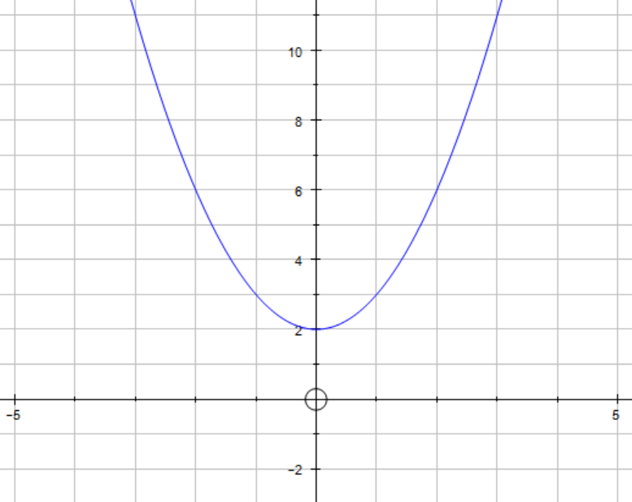
Eg. f(x) =x² + 2
Draw the graph of y = f(x)
This means draw the graph of y = x² + 2

Slide 4
You can use your graph to find values of your function and other things
Think of your x-axis as your possible inputs (known as the domain)
Think of your y-axes as all the possible outputs (known as the range)
Find f(2)
= 6
This means find the output (y value) when the input is 2 (x = 2)
Go up from x=2 until you meet the graph.
Then go across to the y-axis to see what value this corresponds to. (ensure you show construction lines)

Slide 5
You can use your graph to find values of your function and other things
Think of your x-axis as your possible inputs (known as the domain)
Think of your y-axes as all the possible outputs (known as the range)
Solve f(x) = 3
x = -1, 1
This means find the input (x value) when the output is 3 (y = 3)
Go up across from y=2 until you meet the graph. Be careful as you may get more than one answer!
Then go down to the x-axis to see what value this corresponds to. (ensure you show construction lines)

Slide 6
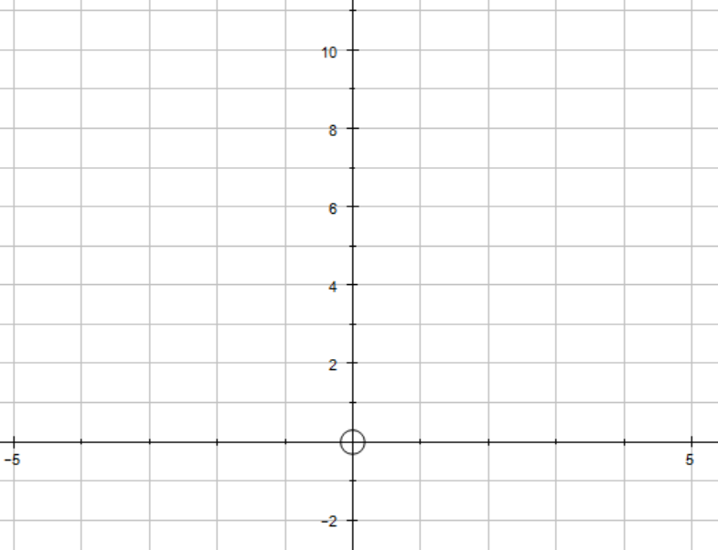
You can use your graph to find values of your function and other things
We generally use f(x) do denote the range of a function
Think of your x-axis as your possible inputs (known as the domain)
Think of your y-axes as all the possible outputs (known as the range)
State the range of f(x)
$y≥2$ or
$$f(x)≥2$$
This means describe all possible outputs there could be on the y axis
$y≥2$
Imagine your graph gets squashed up against the y axis
What values are represented on the numberline?

Slide 7
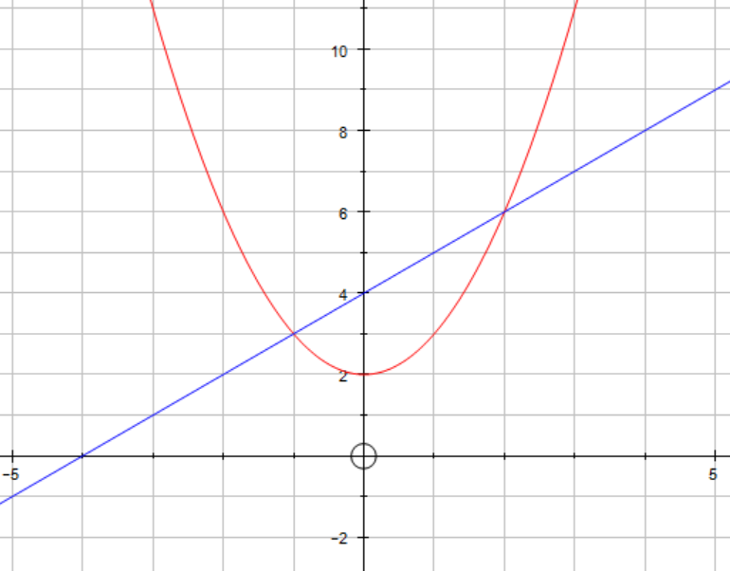
You can use your graph to find values of your function and other things
Sometimes more than one function may be drawn
f(x)
Solve f(x) = g(x)
x = -1, 2
This means find the input (x value) when the same for f and g (where the graphs meet!)
g(x)
Find the intersection points and go down to see where they meet the x axis

Slide 8
Adaptations of questions
Remember that linear graphs are in the form of y = mx +c
Where m is the gradient and y is the y intercept
f(x) = h(x) has two solutions at x = -3 and x = 2
h(x) can be written in the form of h(x) = m x + c
Find the values of m and c
Mark the two points on the graph, as h(x) is a linear graph it must be a straight line, so connect the two points with a straight line
Find the gradient and y- intercept of the new line
h(x) = - x + 8

