Slide 2
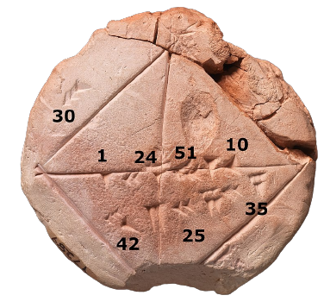
Unit:
1
Section:
Number
Topic:
Significant Figures and Decimal Places
Rounding means making a number simpler but keeping its value close to what it was. The result is less accurate, but easier to use.
The concept of rounding is very old. Ancient clay tablets found in Mesopotamia contain tables with rounded values of reciprocals and square roots.
A wavy equals sign (≈: approximately equal to) is sometimes used to indicate rounding of exact numbers, e.g., 9.98 ≈ 10. This sign was introduced by Alfred George Greenhill in 1892.

Slide 3
Significant Figures and Decimal Places
Reminder
Significant figures (s.f.)
Decimal Places (d.p.)
The first s.f. is the first non-zero digit in a number, counting from left to right.
Count after the decimal point, going from left to right.
Example
Example
Highlight the 1st s.f. in the following numbers:
a) $27400$ b) $0.124$ c)$0.0004187$
Write the following numbers correct to 2 d.p.:
a) $3.02402≈3.02$ b) $0.095623≈0.10$
Write the following numbers correct to 2 s.f.:
a) $3161≈3200$ b) $0.01223≈0.012$
Make sure the place value is the same after you have rounded.
Notice the extra zero – this is needed to show that we are writing to 2 d.p.
Key Points
The first significant figure is the first non-zero digit of the number, reading from left to right.
For decimal places, count after the decimal point (reading from left to right)
If the next number is greater than or equal to 5, round up.

Slide 4
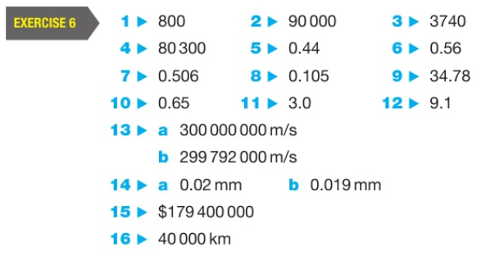
Significant Figures and Decimal Places
Practice
Complete ex 6 from page 14 of your textbooks.
Show appropriate workings.
Answers (p388):
Key Points
The first significant figure is the first non-zero digit of the number, reading from left to right.
For decimal places, count after the decimal point (reading from left to right)
If the next number is greater than or equal to 5, round up.

Slide 5
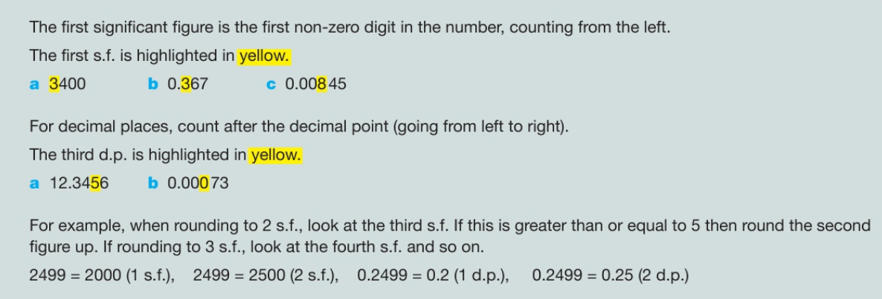
Significant Figures and Decimal Places
Summary

