Slide 2
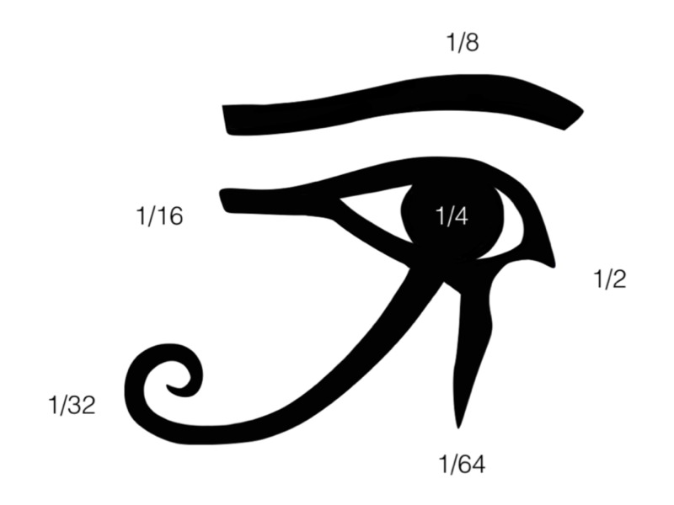
Unit:
1
Section:
Number
Topic:
Working With Fractions
Did you know that fractions as we use them today didn't exist in Europe until the 17th century? In fact, at first, fractions weren't even thought of as numbers, just a way of comparing whole numbers with each other.
From as early as 1800 BC, the Egyptians were writing fractions. The ancient Egyptian writing system was all in pictures which were called hieroglyphs and in the same way, they had pictures for the numbers, and they used parts of the Eye of Horus to represent fractions.
The word fraction comes from the Latin "fractio" which means to break.

Slide 3
Working with Fractions
Prior Knowledge Check
Multiplying and dividing directed numbers
Finding the lowest common multiple
Finding common factors
$$−3×5=−15$$
Find the factors of 12:
What is the lowest common multiple of 12 and 20?
$$1, 2, 3, 4, 6, 12$$
$$21÷7=3$$
$$7×−11=−77$$
Find the factors of 20:
$$60$$
$$−4×−5=20$$
$$1, 2, 4, 5, 10, 20$$
Equivalent fractions
Mixed numbers
$$\frac{12}{40}=\frac{3}{10}$$
$$3\frac{1}{4}=\frac{13}{4}$$
$$\frac{3}{4}=\frac{21}{28}$$
$$1\frac{9}{11}=\frac{20}{11}$$

Slide 4
Working with Fractions
Simplifying Fractions
Simplifying fractions means to make the fraction as simple as possible. To simplify a fraction, divide both the top and bottom of the fraction by a common factor. The simplest form is when the numerator and denominator have no common factors.
Example
Example
Write $\frac{60}{105}$ in its simplest form.
Write $\frac{0.9}{4.5}$ in its simplest form.
$$÷5$$
$$÷3$$
$$×10$$
$÷$5
$$\frac{60}{105}= \frac{12}{21} = \frac{4}{7}$$
$$\frac{0.9}{4.5}= \frac{9}{45} = \frac{1}{5}$$
$$÷5$$
$$÷3$$
$$×10$$
$÷$5
Can we do this in a single step?
Fractions must have whole numbers for numerator and denominator.

Slide 5
Working with Fractions
Converting Fractions to Decimals
To convert a fraction to a decimal, divide the numerator by the denominator. If required, you can use short division or a calculator to do this. This will give us our answer as a decimal:
Example
Example
Write $\frac{5}{8}$ as a decimal.
Write $\frac{7}{30}$ as a decimal.
Often, your answer will need to be rounded.
$$5÷8=0.625$$
$$7÷30=0.233333…$$
$$=0.23 (2dp)$$
Converting Decimals to Fractions
To change a decimal to a fraction is straightforward but needs a bit of care.
First, we identify the place value of our decimal. For example, 0.76 is 76 hundredths.
Next, we write the digits of the decimal as a fraction over that place value.
Example
Write 0.39 as a fraction
=
$$\frac{39}{100}$$
$$0.39$$
The numerator comes from the digits of the decimal
The 9 digit is in the hundredths column, so we write the fraction out of 100

Slide 6
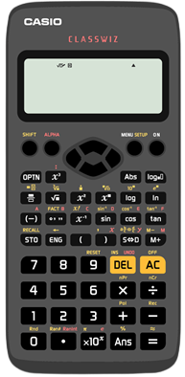
Working with Fractions
Converting Fractions to Decimals
To convert a fraction to a decimal, divide the numerator by the denominator.
We can do these conversions on a calculator using the ÷ or the fractions button:
÷
fractions
To change $\frac{7}{12}$ to a decimal, we can type:
The button changes from fraction form to decimal.
S↔D
S↔D
7
1
2
=
S↔D
Or, we can type:
The button changes from fraction form to decimal.
S↔D
7
÷
1
2
=
S↔D
Both methods work really well and give the same answer:
$$0.583333…$$

Slide 7
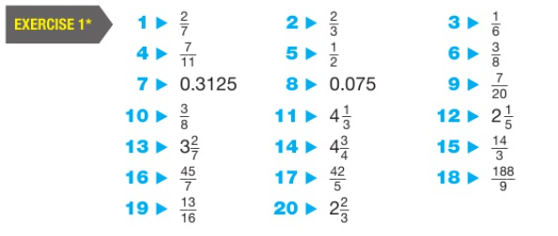
Working with Fractions
Practice
Complete ex 1 from page 4 of your textbooks.
Show appropriate workings.
Important:
We cannot use a calculator for algebraic fractions, such as $\frac{x}{4}=\frac{7}{x}.$
Complete this exercise without the calculator so you can practice the skills needed in when working with algebra.
Answers (p388):
Key Points:
Always simplify fractions$.$
When working with mixed numbers, convert to improper fractions before doing calculations.

Slide 8
Working with Fractions
Multiplying Fractions
$\frac{1}{2}×\frac{3}{4}$ means “one half of three quarters”.
Here is $\frac{3}{4}$ of a rectangle:
Let’s halve the red part…
So $\frac{1}{2}×\frac{3}{4}=\frac{3}{8}$
Work out $\frac{1}{2}×\frac{3}{4}$
$=\frac{1×3}{2×4}$
$=\frac{3}{8}$
Example
Multiply the numerators and multiply the denominators together
Simplify if possible!
Example
Work out $5×\frac{3}{11}=\frac{5}{1}×\frac{3}{11}$
$=\frac{5×3}{1×11}$
$=\frac{15}{33}$
Write whole numbers as fractions:
$$5=\frac{5}{1}$$
Key Points:
Always simplify fractions$.$
When working with mixed numbers, convert to improper fractions before doing calculations.

Slide 9
Working with Fractions
Multiplying Fractions
Example
Example
Work out $\frac{3}{5}×\frac{4}{9}$
$=\frac{3×4}{5×9}$
$=\frac{12}{45}$
$=\frac{4}{15}$
Work out $\frac{30}{49}×\frac{21}{24}$
$=\frac{30×21}{49×24}$
$=\frac{5×3}{7×4}$
$=\frac{15}{28}$
For questions involving bigger numbers, it’s easier to simplify before multiplying
Multiply the numerators and multiply the denominators together
$$5$$
$$3$$
$$7$$
$$4$$
Simplify if possible!
Key Points:
Always simplify fractions$.$
When working with mixed numbers, convert to improper fractions before doing calculations.

Slide 10
Working with Fractions
Multiplying Fractions
Try the appropriate group of questions in your book. Show suitable workings:
1) $\frac{1}{5}×\frac{2}{5}=\frac{2}{25}$ 2) $\frac{1}{2}×\frac{3}{7}$ $=\frac{3}{14}$ 3) $\frac{1}{4}×\frac{3}{5}$ $=\frac{3}{20}$
4) $\frac{1}{5}×\frac{2}{9}$ $=\frac{2}{45}$ 5) $\frac{1}{6}×\frac{5}{8}$ $=\frac{5}{48}$ 6) $\frac{1}{7}×\frac{2}{5}$ $=\frac{2}{35}$
Starting
1) $\frac{2}{3}×\frac{4}{5}$ $=\frac{8}{15}$ 2) $\frac{2}{5}×\frac{2}{3}$ $=\frac{4}{15}$ 3) $\frac{4}{7}×\frac{3}{5}=\frac{12}{35}$
4) $\frac{3}{4}×\frac{7}{8}$ $=\frac{21}{32}$ 5) $\frac{6}{11}×\frac{4}{7}$ $=\frac{24}{77}$ 6) $\frac{5}{9}×\frac{2}{7}$ $=\frac{10}{63}$
Secure
1) $\frac{2}{3}×\frac{6}{7}$ $=\frac{4}{4}$ 2) $\frac{3}{4}×\frac{8}{11}$ $=\frac{6}{11}$ 3) $\frac{15}{17}×\frac{4}{5}$ $=\frac{12}{17}$
4) $\frac{1}{2}×\frac{14}{15}$ $=\frac{7}{15}$ 5) $\frac{11}{21}×\frac{3}{4}$ $=\frac{11}{28}$ 6) $\frac{2}{5}×\frac{20}{21}$ $=\frac{8}{21}$
Extension
Excelling
$$2\frac{1}{7}×1\frac{2}{5}=3$$
v

Slide 11
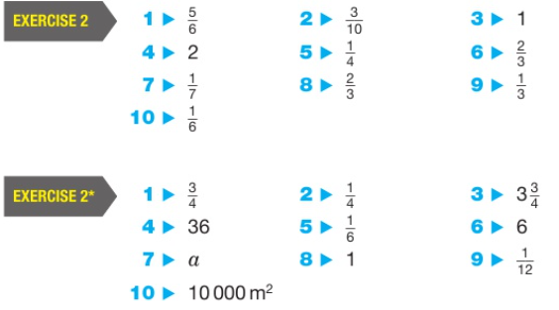
Working with Fractions
Practice
Complete ex 2 from page 7 of your textbooks.
Show appropriate workings.
Answers (p388):
Key Points:
Always simplify fractions$.$
When working with mixed numbers, convert to improper fractions before doing calculations.
If possible, divide by common factors before multiplying
Treat whole numbers as fractions.

Slide 12
Working with Fractions
Reciprocals
To get the reciprocal of a number, we divide 1 by the number. For example, the reciprocal of 2 is:
$$1÷2= \frac{1}{2}$$
We can think of a whole number as being$\frac{"number"}{1}$, so the reciprocal is just like "flipping it over":
Every number has a reciprocal except 0
$\frac{1}{0}$ is undefined
For fractions, flip the whole fraction over:
For example, the reciprocal of $\frac{3}{4}=\frac{4}{3}$
Find the reciprocals of the following numbers:
1. $\frac{1}{2}$ 2. $\frac{1}{3}$ 3. $6$
4. $\frac{3}{4}$ 5. $5$ 6. $1$
$$→2$$
$$→3$$
$→\frac{1}{6}$
$→\frac{4}{3}$
$→\frac{1}{5}$
$$→1$$

Slide 13
Working with Fractions
Dividing Fractions
$\frac{1}{2}÷\frac{1}{8}$ means “how many eighths are there in one half?”
Here is $\frac{1}{2}$ of a rectangle:
Let’s split the rectangle into eighths…
So $\frac{1}{2}÷\frac{1}{8}=4$
Example
Work out $\frac{1}{2}÷\frac{1}{8}$
$\frac{1}{2}×\frac{8}{1}$
$=\frac{1×4}{1×1}$
$=$ $4$
Multiply by the reciprocal of the divisor
$$2$$
$$1$$
Simplify if possible!

Slide 14
Working with Fractions
Dividing Fractions
Example
Work out $\frac{2}{3}÷\frac{1}{4}$
$=\frac{2}{3}×\frac{4}{1}$
$=\frac{8}{3}$
Example
Work out 3$\frac{2}{5}÷\frac{9}{15}$
$=\frac{17}{5}×\frac{15}{9}$
$=\frac{51}{9}$
$=4\frac{6}{9}=4\frac{2}{3}$
$$3$$
$$1$$
Simplify if possible!
Key Points:
Always simplify fractions$.$
When working with mixed numbers, convert to improper fractions before doing calculations.
When dividing by a fraction, take the reciprocal of the divisor and then multiply.
If possible, divide by common factors before multiplying
Treat whole numbers as fractions.

Slide 15
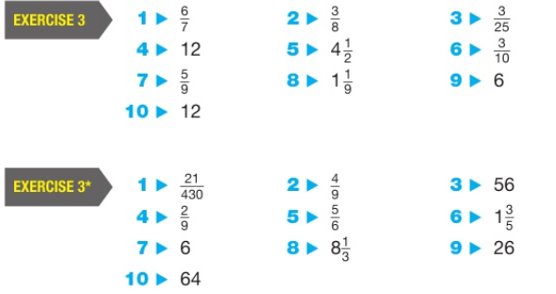
Working with Fractions
Practice
Complete ex 3 from page 9 of your textbooks.
Show appropriate workings.
Answers (p388):
Key Points:
Always simplify fractions$.$
When working with mixed numbers, convert to improper fractions before doing calculations.
When dividing by a fraction, take the reciprocal of the divisor and then multiply.
If possible, divide by common factors before multiplying
Treat whole numbers as fractions.

Slide 16
Working with Fractions
Adding and Subtracting Fractions
$\frac{2}{7}+\frac{1}{6}$
$\frac{ }{42}+\frac{ }{42}$
$\frac{15}{42}$
Find a common denominator (lowest common multiple)
Example
Example
$\frac{2}{5}−\frac{1}{4}$
$\frac{ }{20}−\frac{ }{20}$
$\frac{3}{20}$
$$×6$$
$×$7
Find equivalent fractions with that common denominator
$$×4$$
$$×5$$
$$8$$
7
$$8$$
$$5$$
Add or subtract
÷3
÷3
Simplify
$$\frac{5}{14}$$

Slide 17
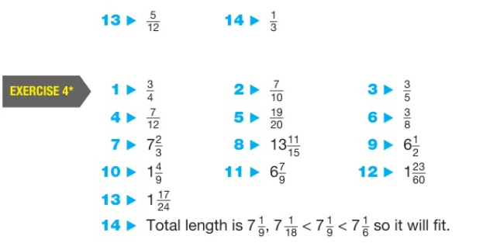
Working with Fractions
Practice
Complete ex 4 from page 10 of your textbooks.
Show appropriate workings.
Answers (p388):
Key Points:
Always simplify fractions$.$
When working with mixed numbers, convert to improper fractions before doing calculations.
Find a common denominator and rewrite the calculation using equivalent fractions

Slide 18
Working with Fractions
Summary

