Slide 2
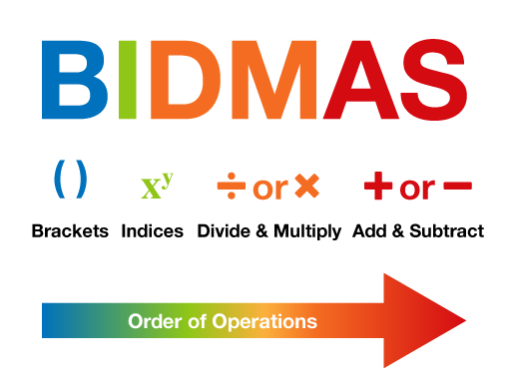
Unit:
1
Section:
Number
Topic:
Order of Operations
The answer to the question:
$$3+4×2$$
depends on whether you do the multiplication or the addition first.
$$3+4×2=14$$
$$3+4×2=11$$
To avoid ambiguity, and to makes sure that everyone gets the same result, there are rules for the order of operations.
The mnemonic BIDMAS will help you to remember the correct order.

Slide 3
Order of Operations
Refresher
Example
Example
The line (vinculum) in a fraction acts like brackets.
$$\frac{3+4}{2}=\frac{(3+4)}{2}$$
$$7−3÷\left(5−2\right)×2^{2}+5$$
$$\frac{16−3×4}{6÷3+2}$$
$$7−3÷3×2^{2}+5$$
When there are multiple ×/÷ to do, work from left to right.
When there are multiple +/- to do, work from left to right.
$$\frac{16−12}{2+2}$$
$$7−3÷3×4+5$$
$$7−4+5$$
$$\frac{4}{4}$$
$$8$$
$$1$$
Key Points
1st B Brackets
2nd I Indices
3rd DM Divide/Multiply
4th AS Add/Subtract
Read left to right when there are only +/- or ×/÷

Slide 4
Order of Operations
Practice
Complete ex 5 from page 12 of your textbooks.
Show appropriate workings.
Answers (p388):
Key Points
1st B Brackets
2nd I Indices
3rd DM Divide/Multiply
4th AS Add/Subtract
Read left to right when there are only +/- or ×/÷

Slide 5
Order of Operations
Extension
A popular mathematical puzzle:
Use exactly four 4's to form every integer from 0 to 20, using only the operators +, −, ×, ÷, (), square roots and indices.
0 | $$44−44$$ | 7 | $$\left(4+4\right)−(4÷4)$$ | 14 | $$4+4+4+4$$
1 | $$44÷44$$ | 8 | $$\left(4×4\right)+(4−4)$$ | 15 | $$\left(4×4\right)−4÷4$$
2 | $$\left(4÷4\right)+(4÷4)$$ | 9 | $$\left(4+4\right)+(4÷4)$$ | 16 | $$\left(4×4\right)−4+4$$
3 | $$(4+4+4)÷4)$$ | 10 | $$(44−4)÷4$$ | 17 | $$\left(4×4\right)+(4÷4)$$
4 | $$\left(4÷4\right)+(4÷4)$$ | 11 | $$\left(44÷4\right)−\sqrt{4}$$ | 18 | $$\left(4×4+4\right)−\sqrt{4}$$
5 | $$\left(\left(4×4\right)÷4\right)+4$$ | 12 | $$4×(4−4÷4)$$ | 19
6 | $$4+(\left(4+4\right)÷4)$$ | 13 | $$\left(44÷4\right)+\sqrt{4}$$ | 20 | $$4×(4+4÷4)$$
0 | $$44−44$$ | 7 | $$\left(4+4\right)−(4÷4)$$ | 14 | $$4+4+4+4$$
1 | $$44÷44$$ | 8 | $$\left(4×4\right)+(4−4)$$ | 15 | $$\left(4×4\right)−4÷4$$
2 | $$\left(4÷4\right)+(4÷4)$$ | 9 | $$\left(4+4\right)+(4÷4)$$ | 16 | $$\left(4×4\right)−4+4$$
3 | $$(4+4+4)÷4)$$ | 10 | $$(44−4)÷4$$ | 17 | $$\left(4×4\right)+(4÷4)$$
4 | $$\left(4÷4\right)+(4÷4)$$ | 11 | $$\left(44÷4\right)−\sqrt{4}$$ | 18 | $$\left(4×4+4\right)−\sqrt{4}$$
5 | $$\left(\left(4×4\right)÷4\right)+4$$ | 12 | $$4×(4−4÷4)$$ | 19
6 | $$4+(\left(4+4\right)÷4)$$ | 13 | $$\left(44÷4\right)+\sqrt{4}$$ | 20 | $$4×(4+4÷4)$$
$$\left(4!−4\right)−(4÷4)$$
It is possible to do 19 if we can use factorials.
$$4!=4×3×2×1=24$$
Extension:
How far can you keep going?

Slide 6
Order of Operations
Summary

