Slide 3
Pythagoras’ Theorem

Slide 4
First, draw a right-angled triangle.
Now we can label the sides.
The longest side is called the HYPOTENUSE. Let’s label this h.
The other two sides are the LEGS of the triangle. We can call them a and b. It doesn’t matter which way round we do this.
h
a
b
Notes:
Possibly stop here and draw more right-angled triangles, asking the students to identify the hypotenuse f or each one.

Slide 5
a
b
Next, let’s draw the same triangle, rotated through 90°.
h
We can label the sides again.
What is this angle?
h
How do we know?
a
b
Notes:
Perhaps use a 30, 60, 90 triangle to explain why the marked angle is 90. Then extend to x, y, 90 to generalize.

Slide 6
a
b
We can do this again.
b
And again.
h
a
We can see a big square.
And a smaller square on the inside.
h
a
a
b
b
a
b

Slide 7
a
b
What’s the area of the triangles?
b
h
Each one has area = ½ab.
There are 4 triangles so the total for all of them is 2ab.
h
a

Slide 8
What is the area of the small square?
h
Area = h².
h

Slide 9
a
b
Now let’s think about the large square.
b
ab
b²
This time the area = (a+b)².
We can make that easier to understand by splitting up the square.
The area of each purple rectangle is ab.
a²
ab
a
The area of the blue square is a².
The area of the green square is b².
So the total area is a² + b² + 2ab
Notes:
This method is used so we don’t have to expand the brackets

Slide 10
a
b
a
b
If we take the green triangles away from the big square we are left with the small square.
b
Area of large square = a² + b² + 2ab
Area of the 4 triangles = 2ab
Area large square minus the 4 triangles
= a² + b² + 2ab - 2ab
= a² + b²
a
Area of small square = h²
That must mean that:
a² + b² = h²
b

Slide 11
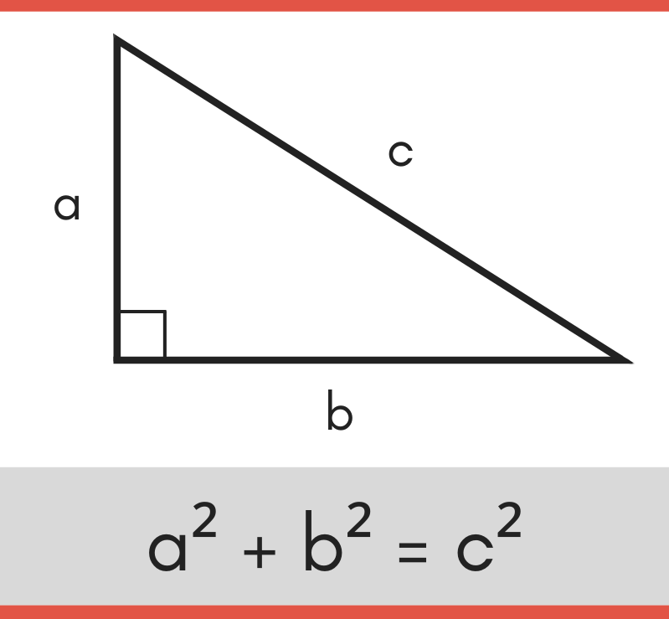
So this shows that
a² + b² = h²
This is sometimes shown as:
a² + b² = c²
This is Pythagoras’ Theorem, after the ancient Greek mathematician who first proved it.
The proof we have just done was by the Indian mathematician Bhaskara in about 603CE
There are over 100 different proofs of Pythagoras’ Theorem.
Notes:
Introduce and emphasise that c must be the hypotenuse in the alternate form.

Slide 12
We can Pythagoras to find the missing sides of a right-angled triangle.
And substitute it in the formula.
Ex1
a² + b² = h²
Find the length of side x.
a² + b² = x²
6² + 8² = x²
Solution
Find the hypotenuse.
Start by writing the formula.
36 + 64 = x²
We can substitute these into the formula too.
x
Now start calculating.
100 = x²
6 cm
√100 = x
The legs are interchangeable. Let’s call this one a
10 = x
8 cm
So this leg can be b.
x = 10cm

Slide 13
We can Pythagoras to find the missing sides of a right-angled triangle.
And substitute it in the formula.
Ex2
a² + b² = h²
Find the length of side x.
5.2² + x² = 8²
a² + b² = 8²
Solution
Find the hypotenuse.
Start by writing the formula.
27.04 + x² = 64
We can substitute these into the formula too.
Now start calculating.
8 cm
x² =64-27.04
5.2 cm
The legs are interchangeable. Let’s call this one a
x² = 36.96
x = √36.96
x = 6.07947366…
x
x = 6.1cm (1dp)
So this leg can be b.

Slide 14
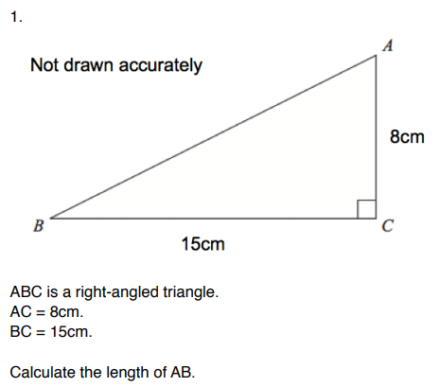
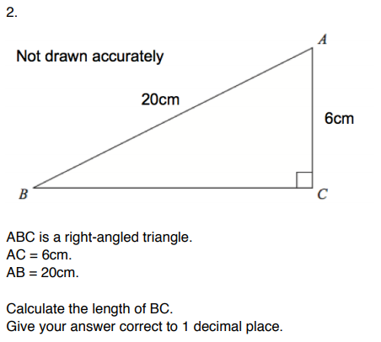
Notes:
Examples are taken from the Corbett Maths exam-style questions.

Slide 15
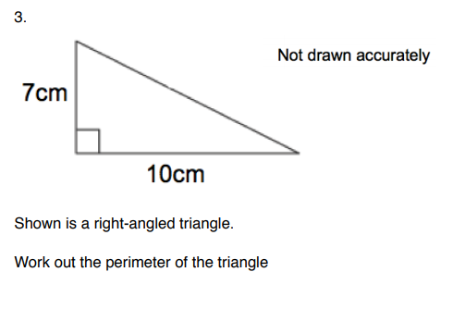
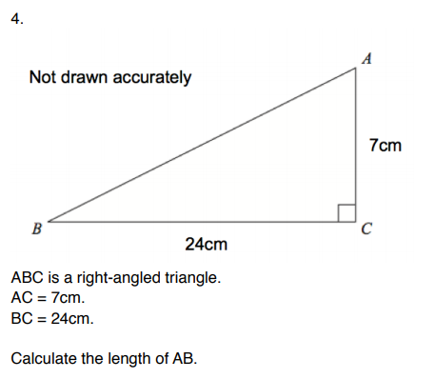
Notes:
Examples are taken from the Corbett Maths exam-style questions.

Slide 16
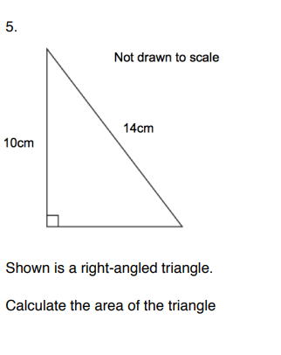
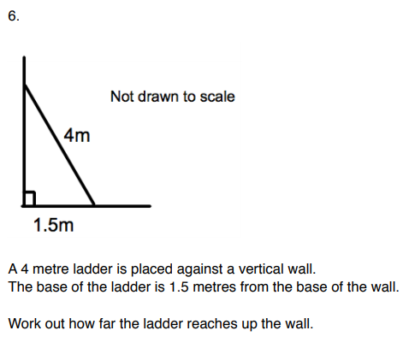
Notes:
Examples are taken from the Corbett Maths exam-style questions.

Slide 17
This work is licensed under the Creative Commons Attribution-ShareAlike 4.0 International License. To view a copy of this license, visit:
http://creativecommons.org/licenses/by-sa/4.0/
or send a letter to Creative Commons, PO Box 1866, Mountain View, CA 94042, USA.
Adapted from work by CParkinson3
https://www.tes.com/teaching-resources/shop/cparkinson3

