Slide 1
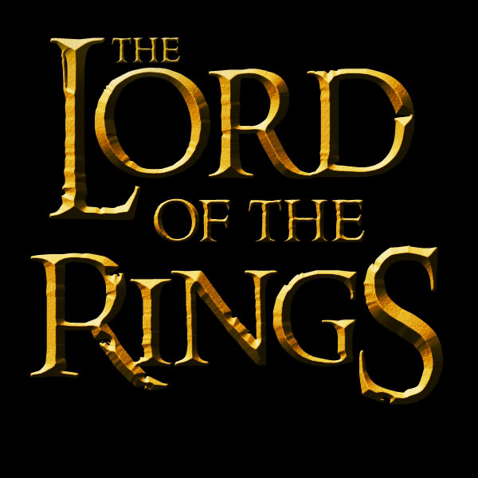

Slide 3
You must find the rings before Sauron can regain them and once again threaten Middle Earth
Use the Map of Middle Earth, Logic and your own knowledge of Loci to find as many as you can…
The rings have all gone missing!

Slide 4
The Elven rings
The furthest away any Elven ring is from Rivendell is exactly 250 miles
one ring is in a river 150 miles from Erabor, the lonely mountain
another is on a path and is the same distance away the river Hoarwell as it is the river Loudwater
The final ring is on the outskirts of a forest which is not Mirkwood.

Slide 5
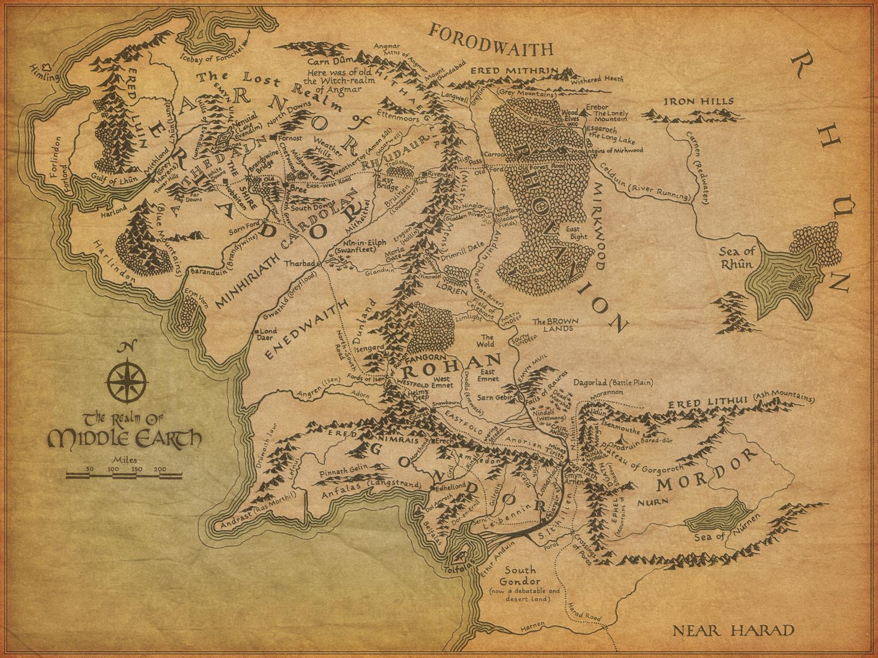

Slide 6
The rings of the Dwarf Lords
All Dwarven rings have been lost in the Mountains
One ring was lost 225 miles from Mithlond (Grey Havens)
Another is situated the same distance away from the lonely Mountain, as it is from Dol Guldur
As an Eagle flew from Erech to Mount Gundabad, 3 rings were lost
2 rings are due east of Lond Daer

Slide 8
The rings of Men
2 rings are in separate locations, but both are 250 miles from Lond Daer and 150 miles from Hobbiton
A third ring is Lost in a river at a point equidistant from Minas Tirith and Helms deep and 200 Miles from Lorien
The fourth is as far away from Edoras as Isengard is, but due North.
The remaining 5 are all in different rivers due East of Bree

Slide 10
The One Ring
The Ring of Power is located the same distance away from
Snowbourne, Dol Guldur and Ettenmoors

