Slide 1


Slide 2

Fraction

Slide 3
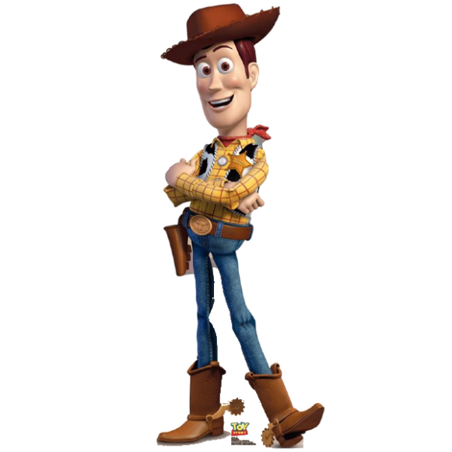
Woody's Fraction Ranch:
Help Woody get each fraction into the correct pen for the night.
1
2
7
21
12
36
75
100
1
3
9
15
3
6
60
100
18
36
12
20
18
24
3
4
3
5
9
12
10
20
4
12

Slide 4
Feed The Animals
A bag of feed weighs 24kg, so can you help Woody weigh out the feed for each animal?
1
3
7
12
The sheep need of a bag.
The cows need of a bag.
5
8
The llamas need of a bag.
5
6
The pigs need of a bag.
1
4
The chickens need of a bag.
Which animal has the most feed?
Can you show why using fractions?

Slide 5
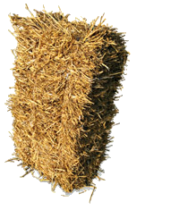

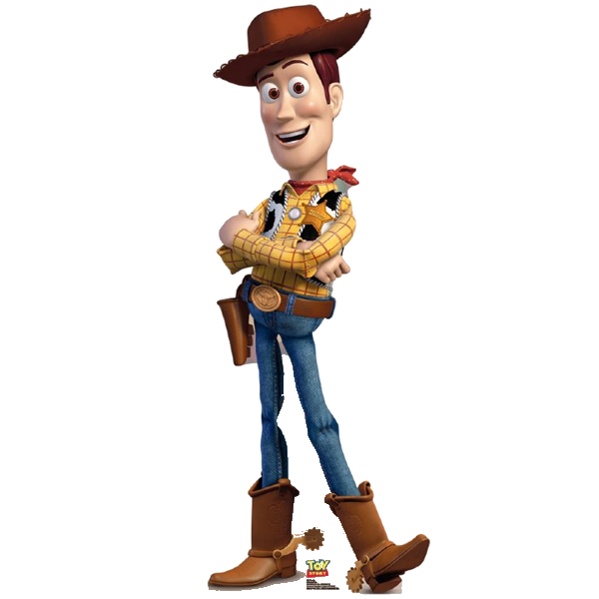
Baling Out
Help Woody get these parts of straw bales in to whole bales by checking that they add up to one in each case. If they don't add to one, tell Woody how much more or less of a bale he needs.
1
6
1
8
1
3
3
4
1
2
1
16
1
6
3
5
1
4
3
8
11
24
3
10

