Slide 1
Super Hero Stores - MIDSEASON SALE!

Slide 2
Super Hero Stores are having a sale and the local super heroes are taking advantage by stocking up whilst it's cheap.
Unfortunately the price label printer has broken, so the items still have their original price together with the percentage reduction.
Can you calculate what each superhero should pay for each item in the sale?

Slide 3
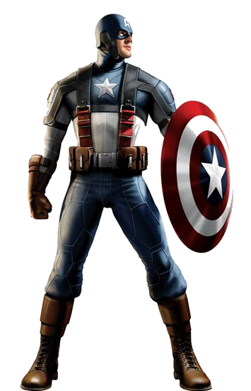
Captain America:
I need a new shield!
1
2
Shield: price!
Original cost: $500

Slide 4
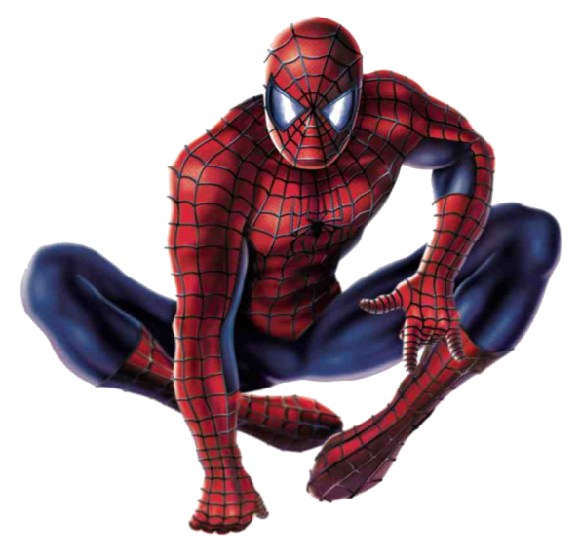
Spiderman:
I want a new net!
1
4
Net: off!
Original cost: $50

Slide 5
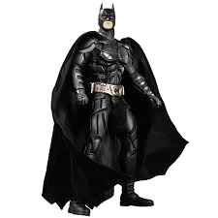
Batman:
I need a tyre for the Batmobile!
1
5
Tyre: off!
Original cost: $250

Slide 6
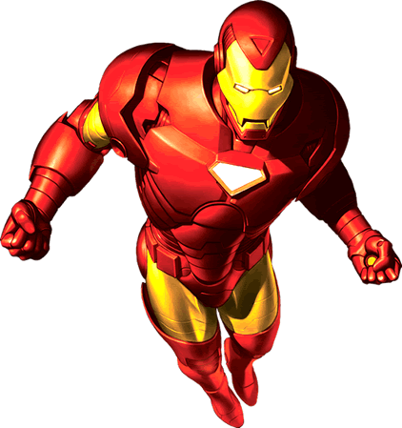
Ironman:
I want a new bomb!
2
3
Bomb: of original price!
Original cost: $600

Slide 7
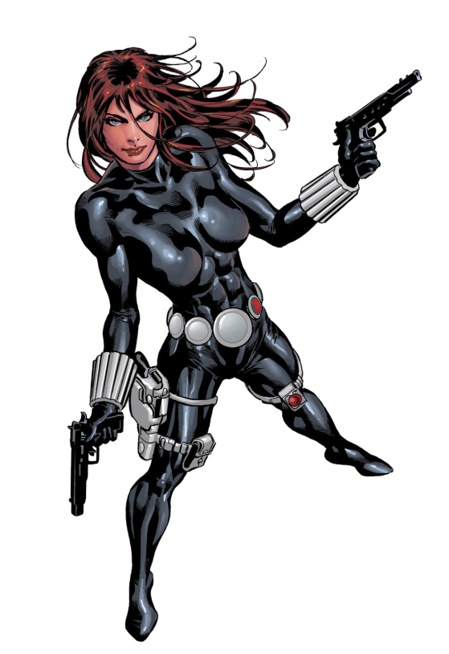
Black Widow:
I fancy a new gun!
3
8
Gun: of original price!
Original cost: $240

Slide 8
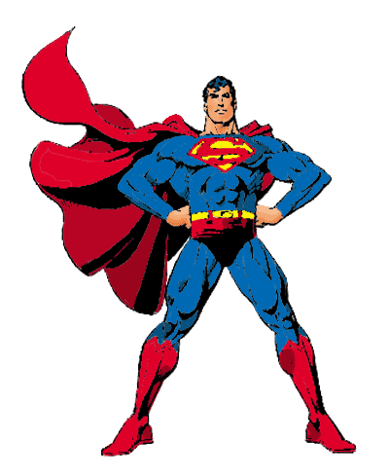
Superman:
My cape's ripped!
3
8
Cape: off!
Original cost: $160

Slide 9
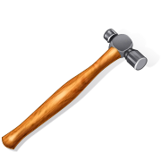
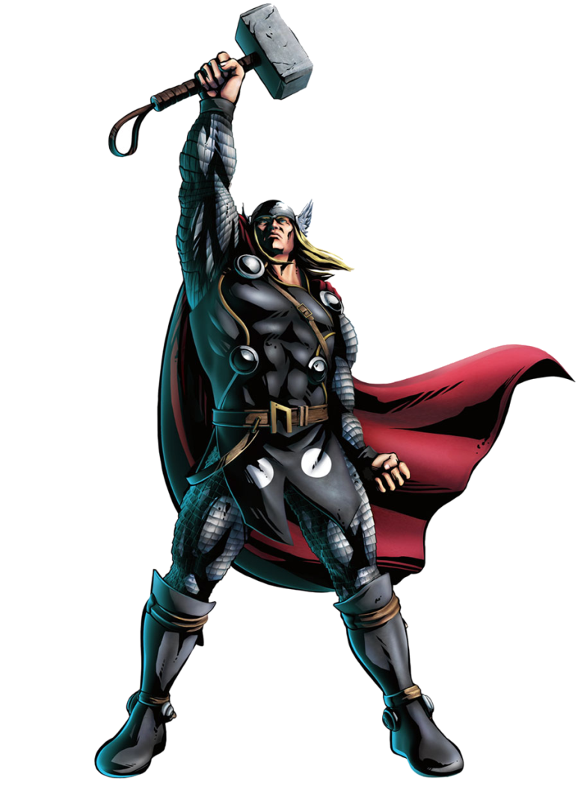
Thor:
I've chipped my hammer!
5
7
Hammer: of original price!
Original cost: $140

Slide 10
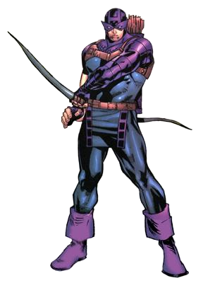
Hawkeye:
I've snapped my bow!
5
6
Bow: of the original!
Original cost: $90

Slide 11
Keep your eyes open for other deals!

