Slide 1

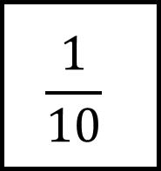

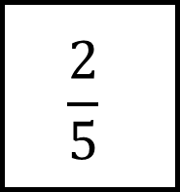
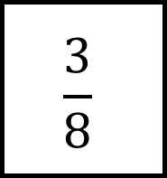
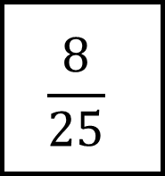

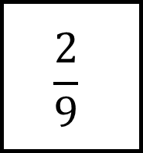

Multiplying and Dividing Fractions Spider 1
$$\frac{1}{10}$$
You must show all your workings!
$$\frac{20}{23}$$
$$\frac{3}{7}$$
$$\frac{3}{8}$$
$$\frac{2}{5}$$
$$\frac{8}{25}$$
$$\frac{3}{8}$$
$$\frac{2}{3}$$
The fraction in the centre is multiplied by the fraction on each leg to give the fraction at the end.
Give your answers in their lowest terms.
$$\frac{2}{9}$$

Slide 2
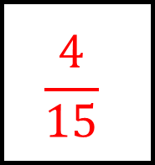
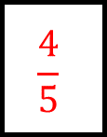
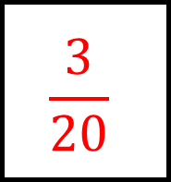
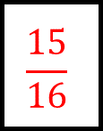
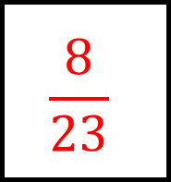
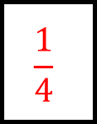
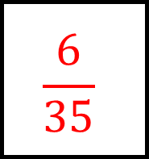
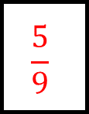
Multiplying and Dividing Fractions Spider 1 - Answers
$$\frac{1}{10}$$
$$\frac{8}{23}$$
$$\frac{6}{35}$$
You must show all your workings!
$$\frac{1}{4}$$
$$\frac{20}{23}$$
$$\frac{3}{7}$$
$$\frac{3}{8}$$
$$\frac{2}{5}$$
$$\frac{8}{25}$$
$$\frac{15}{16}$$
$$\frac{4}{5}$$
$$\frac{3}{8}$$
$$\frac{5}{9}$$
$$\frac{2}{3}$$
The fraction in the centre is multiplied by the fraction on each leg to give the fraction at the end.
$$\frac{3}{20}$$
$$\frac{4}{15}$$
Give your answers in their lowest terms.
$$\frac{2}{9}$$

Slide 3

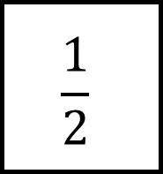

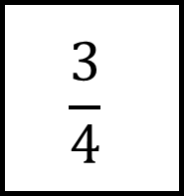
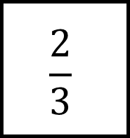
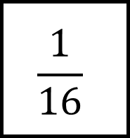

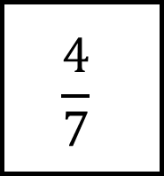

Multiplying and Dividing Fractions Spider 2
$$\frac{1}{2}$$
You must show all your workings!
$$\frac{20}{27}$$
$$\frac{4}{5}$$
$$\frac{2}{3}$$
$$\frac{3}{4}$$
$$\frac{1}{16}$$
$$\frac{12}{13}$$
$$\frac{8}{15}$$
The fraction in the centre is multiplied by the fraction on each leg to give the fraction at the end.
Give your answers in their lowest terms.
$$\frac{4}{7}$$

Slide 4
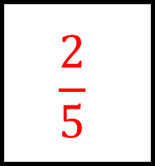
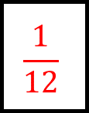
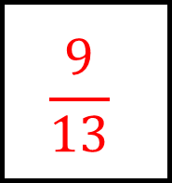
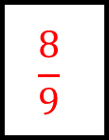
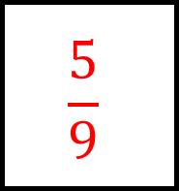
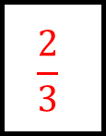
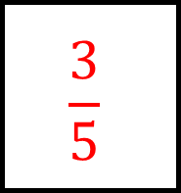
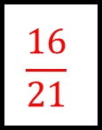
Multiplying and Dividing Fractions Spider 2 - Answers
$$\frac{1}{2}$$
$$\frac{5}{9}$$
$$\frac{3}{5}$$
You must show all your workings!
$$\frac{2}{3}$$
$$\frac{20}{27}$$
$$\frac{4}{5}$$
$$\frac{2}{3}$$
$$\frac{3}{4}$$
$$\frac{1}{16}$$
$$\frac{8}{9}$$
$$\frac{1}{12}$$
$$\frac{12}{13}$$
$$\frac{16}{21}$$
$$\frac{8}{15}$$
The fraction in the centre is multiplied by the fraction on each leg to give the fraction at the end.
$$\frac{9}{13}$$
$$\frac{2}{5}$$
Give your answers in their lowest terms.
$$\frac{4}{7}$$

Slide 5

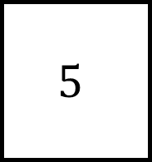

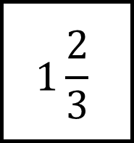
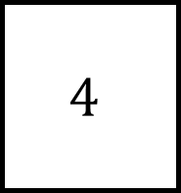
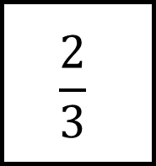

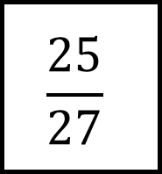

Multiplying and Dividing Fractions Spider 3
$$5$$
You must show all your workings!
$$1\frac{6}{7}$$
$$\frac{3}{4}$$
$$4$$
$$1\frac{2}{3}$$
$$\frac{2}{3}$$
$$1\frac{1}{2}$$
$$\frac{3}{7}$$
The fraction in the centre is multiplied by the fraction on each leg to give the fraction at the end.
Give your answers in their lowest terms and as mixed numbers where necessary.
$$\frac{25}{27}$$

Slide 6
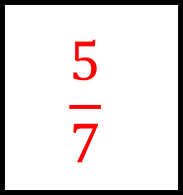
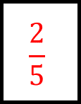
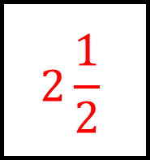
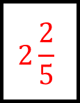
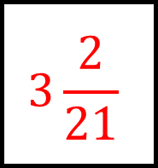
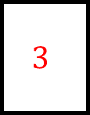
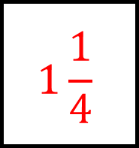
Multiplying and Dividing Fractions Spider 3 - Answers
$$5$$
$$3\frac{2}{21}$$
$$1\frac{1}{4}$$
You must show all your workings!
$$3$$
$$1\frac{6}{7}$$
$$\frac{3}{4}$$
$$4$$
$$1\frac{2}{3}$$
$$\frac{2}{3}$$
$$2\frac{2}{5}$$
$$\frac{2}{5}$$
$$1\frac{1}{2}$$
$$\frac{5}{9}$$
$$\frac{3}{7}$$
The fraction in the centre is multiplied by the fraction on each leg to give the fraction at the end.
Give your answers in their lowest terms and as mixed numbers where necessary.
$$2\frac{1}{2}$$
$$\frac{5}{7}$$
$$\frac{25}{27}$$

Slide 7









Multiplying and Dividing Fractions Spider 4
$$1\frac{13}{35}$$
You must show all your workings!
$$5\frac{1}{2}$$
$$\frac{3}{10}$$
$$7\frac{31}{35}$$
$$2\frac{2}{5}$$
$$3$$
$$2\frac{3}{4}$$
$$1\frac{2}{3}$$
The fraction in the centre is multiplied by the fraction on each leg to give the fraction at the end.
Give your answers in their lowest terms and as mixed numbers where necessary.
$$5\frac{1}{5}$$

Slide 8








Multiplying and Dividing Fractions Spider 4 - Answers
$$1\frac{13}{35}$$
$$13\frac{1}{5}$$
$$\frac{18}{25}$$
You must show all your workings!
$$\frac{4}{7}$$
$$5\frac{1}{2}$$
$$\frac{3}{10}$$
$$7\frac{31}{35}$$
$$2\frac{2}{5}$$
$$3$$
$$3\frac{2}{7}$$
$$1\frac{1}{4}$$
$$2\frac{3}{4}$$
$$2\frac{1}{6}$$
$$1\frac{2}{3}$$
The fraction in the centre is multiplied by the fraction on each leg to give the fraction at the end.
Give your answers in their lowest terms and as mixed numbers where necessary.
$$3\frac{3}{10}$$
$$4$$
$$5\frac{1}{5}$$

