Slide 1
Season 1
“a cold snack is Coming…”
New York Times: “It’s chilling”

Slide 2
Back Story:
The city of Easteros, situated on the coast of Wessos, is the scene of a bitter ice cream feud between two companies:
Lark Ices (run by Edward Lark)
Stannister Dairy (run by Bob Stannister)
Both men, through their companies, are trying to win control of the frozen dairy market in Easteros, and will stop at nothing to achieve their goal!
The saga has become known as the “Games Of Cones”.

Slide 3
Pitch Battles!
Each company sends vans to the four main beaches in Easteros. The company with the most vans at each beach is considered the “owner” of that beach.
Can you calculate how many vans each company has at each beach and therefore who owns them?

Slide 4
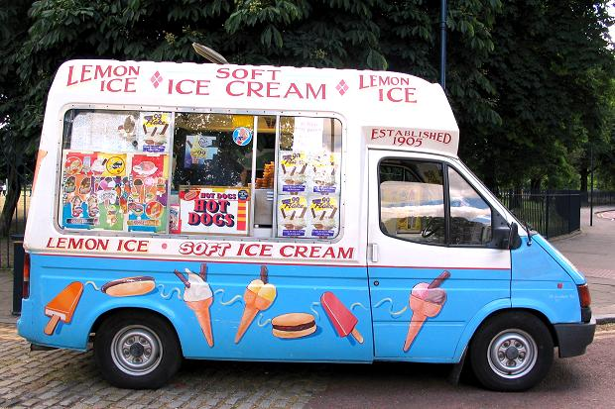
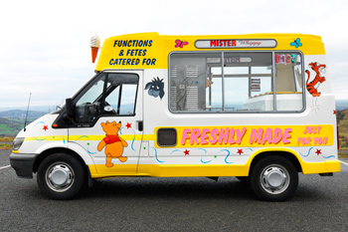
Pitch Battles!
Lark Ices have 32 vans.
The fraction of their fleet at each beach is listed below:
$\frac{1}{4}$ at the Walled Beach
$\frac{3}{8}$ at Valerie Beach
$\frac{5}{16}$ at Iron Beach
$\frac{1}{16}$ at Daroky Beach
Stannister Dairy own 36 vans.
The fraction of their fleet at each beach is listed below:
$\frac{1}{6}$ at the Walled Beach
$\frac{5}{18}$ at Valerie Beach
$\frac{1}{3}$ at Iron Beach
$\frac{2}{9}$ at Daroky Beach
8
6
Owned!
12
10
10
12
Owned!
2
8

Slide 5
The Great Wessos Flake Off!
Profits are maximised when customers get a flake with their “99”, in fact, both companies measure their success on the number of flakes they sell on a daily basis.
Can you calculate which company had the better of each day of one week?

Slide 6
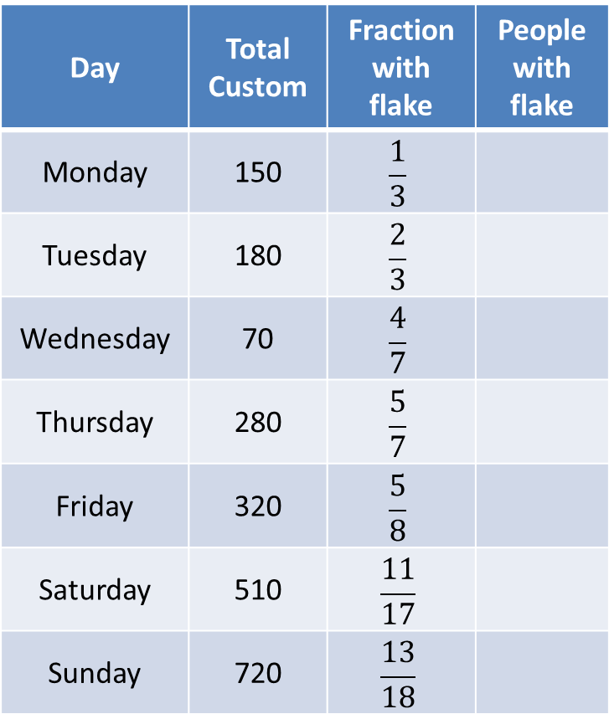
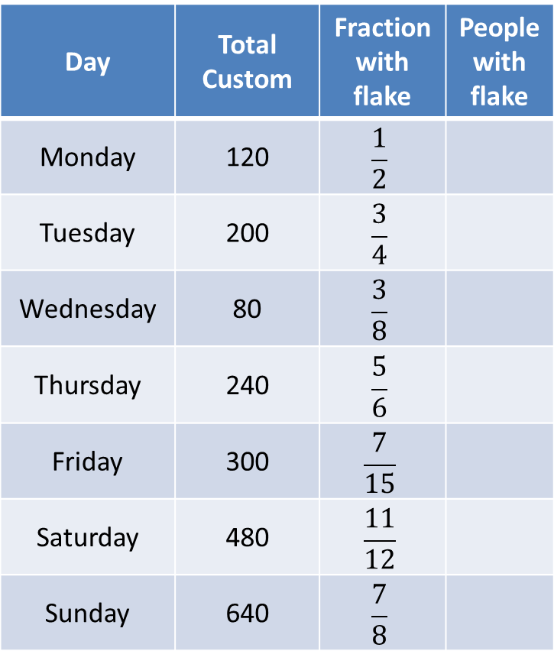
The Great Wessos Flake Off!
Lark Ices
Stannister Dairy
Day | Total Custom | Fraction with flake | People with flake
Monday | 120 | $$\frac{1}{2}$$
Tuesday | 200 | $$\frac{3}{4}$$
Wednesday | 80 | $$\frac{3}{8}$$
Thursday | 240 | $$\frac{5}{6}$$
Friday | 300 | $$\frac{7}{15}$$
Saturday | 480 | $$\frac{11}{12}$$
Sunday | 640 | $$\frac{7}{8}$$
Day | Total Custom | Fraction with flake | People with flake
Monday | 150 | $$\frac{1}{3}$$
Tuesday | 180 | $$\frac{2}{3}$$
Wednesday | 70 | $$\frac{4}{7}$$
Thursday | 280 | $$\frac{5}{7}$$
Friday | 320 | $$\frac{5}{8}$$
Saturday | 510 | $$\frac{11}{17}$$
Sunday | 720 | $$\frac{13}{18}$$
60
50
150
120
30
40
200
200
140
200
440
330
560
520

Slide 7
Ice To See You, To See You...
Both companies carried out a survey of the population of Easteros. They asked just one question:
“Have you visited a Lark Ices/Stannister Dairy van in the last year?”
From the responses they made the following claims...

Slide 8
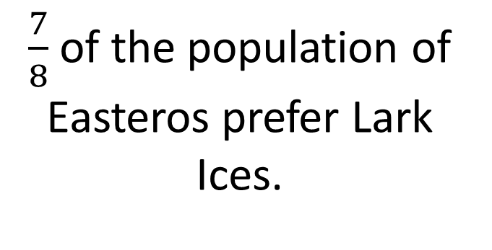
Ice To See You, To See You…
Lark Ices
Stannister Dairy
$\frac{7}{8}$ of the population of Easteros prefer Lark Ices.
Stannister Dairy is used by $\frac{31}{36}$ of the people of Easteros – a clear favourite!
Which company claims that more people like them?
Lark Ices: $\frac{63}{72}$; Stannister Dairy $\frac{62}{72}$
Lark Ices are claiming that they are more popular.

Slide 9
Wages - An Ice Cream War
Both companies want to attract the best ice cream sellers in the city of Easteros. In order to do this they must offer the best payment package they can.
Can you calculate what fraction of their wages an employee would have after deductions for each company?

Slide 10
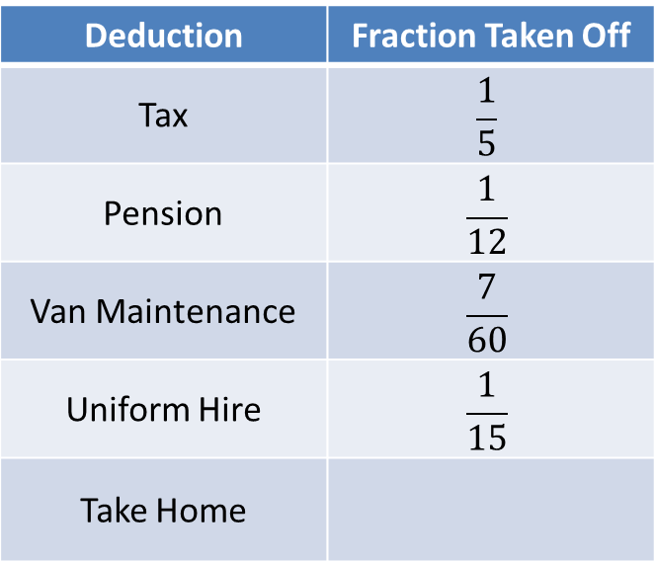
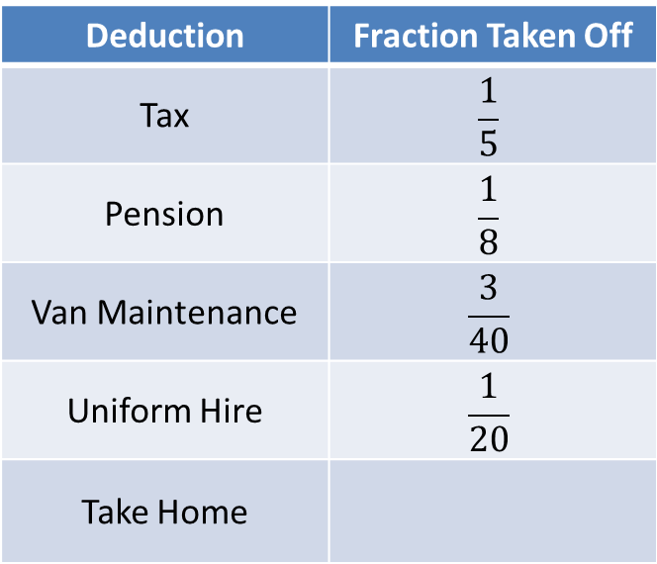
Wages - An Ice Cream War
Lark Ices
Stannister Dairy
Deduction | Fraction Taken Off
Tax | $$\frac{1}{5}$$
Pension | $$\frac{1}{12}$$
Van Maintenance | $$\frac{7}{60}$$
Uniform Hire | $$\frac{1}{15}$$
Take Home
Deduction | Fraction Taken Off
Tax | $$\frac{1}{5}$$
Pension | $$\frac{1}{8}$$
Van Maintenance | $$\frac{3}{40}$$
Uniform Hire | $$\frac{1}{20}$$
Take Home
$$\frac{28}{60}=\frac{14}{30}=\frac{8}{15}$$
$$\frac{22}{40}=\frac{11}{20}$$
Which company offers their employees the better deal?
Stannister Dairy offers its workers a better deal taking home $\frac{33}{60}ths$ of their wages compared to $\frac{32}{60}ths$ for Lark Ices.

Slide 11
Holiday On Ice!
As well as ice cream, the companies sell ice lollies. They like to know what fraction of each lolly they sell.
Can you find the missing fractional amounts?

Slide 12
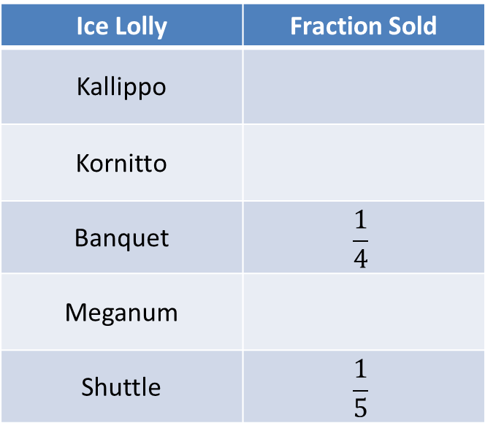
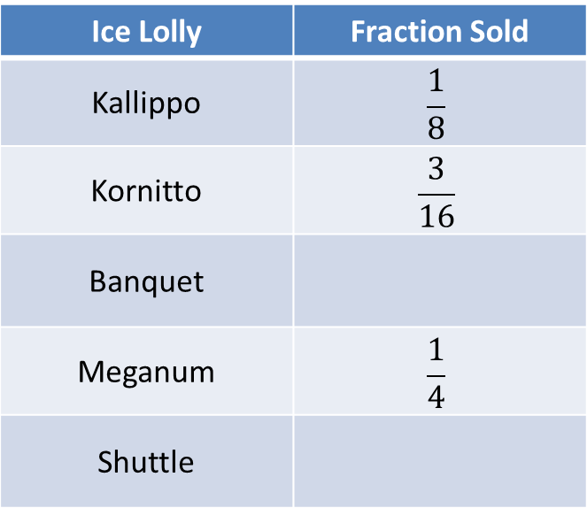
Holiday On Ice!
Lark Ices
Stannister Dairy
Ice Lolly | Fraction Sold
Kallippo | $$\frac{1}{8}$$
Kornitto | $$\frac{3}{16}$$
Banquet
Meganum | $$\frac{1}{4}$$
Shuttle
Ice Lolly | Fraction Sold
Kallippo
Kornitto
Banquet | $$\frac{1}{4}$$
Meganum
Shuttle | $$\frac{1}{5}$$
$$\frac{11}{60}$$
$$\frac{11}{60}$$
$$\frac{7}{32}$$
$$\frac{11}{60}$$
$$\frac{7}{32}$$
The same amount of Banquets and Shuttles were sold
The same amount of Kallippos, Kornittos and Meganums were sold

Slide 13
Season 2 – Coming soon

