Slide 1
Fractions Matching
Match one group to the other.
There will be a “spare” one – what answer should be there?

Slide 2
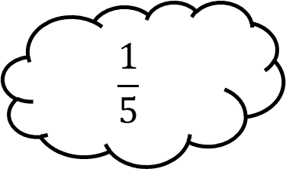
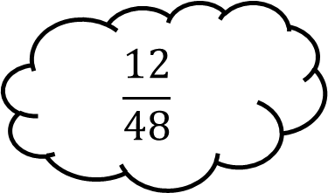
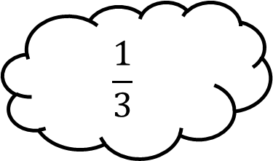
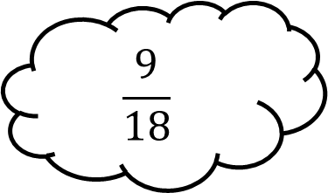
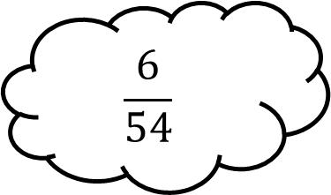
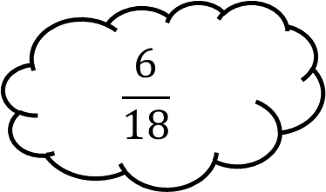
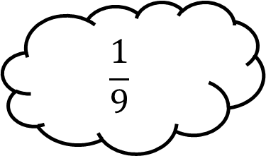
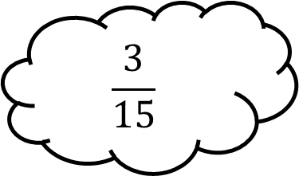
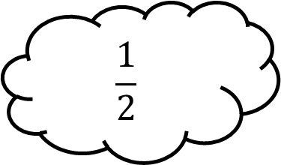
Matching 1
$$\frac{1}{3}$$
$$\frac{9}{18}$$
$$\frac{6}{18}$$
$$\frac{1}{5}$$
$$\frac{12}{48}$$
$$\frac{1}{2}$$
$$\frac{6}{54}$$
$$\frac{3}{15}$$
$$\frac{1}{9}$$

Slide 3
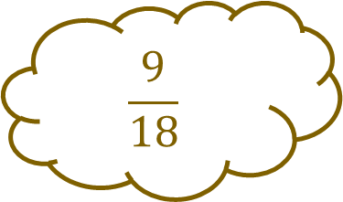
Matching 1 - Answers
$$\frac{1}{3}$$
$$\frac{9}{18}$$
$$\frac{6}{18}$$
$$\frac{1}{5}$$
$$\frac{9}{18}$$
$$\frac{12}{48}$$
$$\frac{1}{2}$$
$$\frac{6}{54}$$
$$\frac{3}{15}$$
$$\frac{1}{9}$$

Slide 4
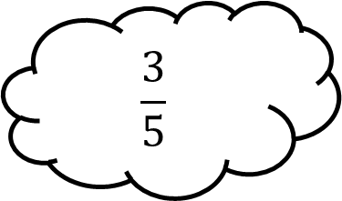
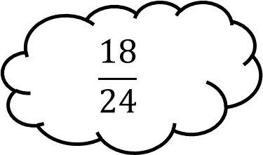
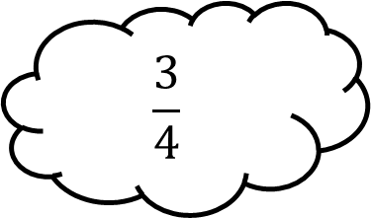
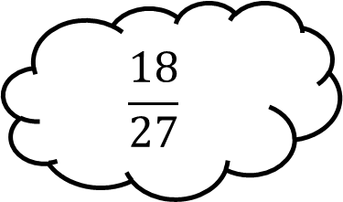
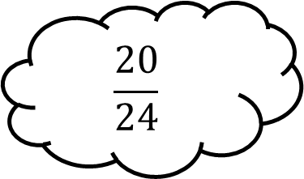
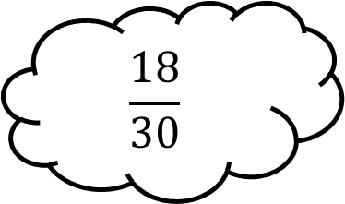
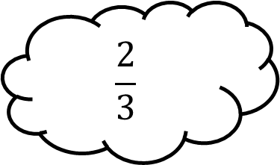
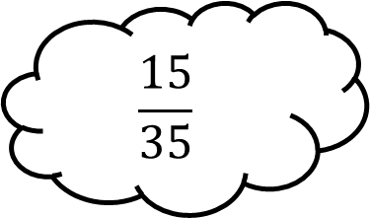
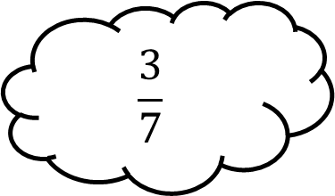
Matching 2
$$\frac{3}{4}$$
$$\frac{18}{27}$$
$$\frac{18}{30}$$
$$\frac{3}{5}$$
$$\frac{18}{24}$$
$$\frac{3}{7}$$
$$\frac{20}{24}$$
$$\frac{15}{35}$$
$$\frac{2}{3}$$

Slide 5
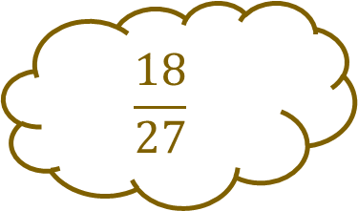
Matching 2 - Answers
$$\frac{3}{4}$$
$$\frac{18}{27}$$
$$\frac{18}{30}$$
$$\frac{3}{5}$$
$$\frac{18}{24}$$
$$\frac{3}{7}$$
$$\frac{20}{24}$$
$$\frac{15}{35}$$
$$\frac{18}{27}$$
$$\frac{2}{3}$$

Slide 6
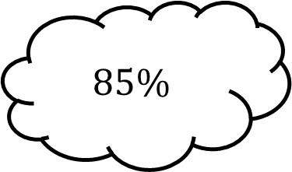
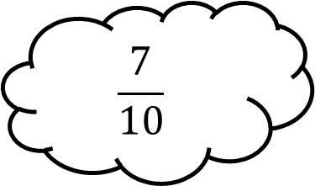
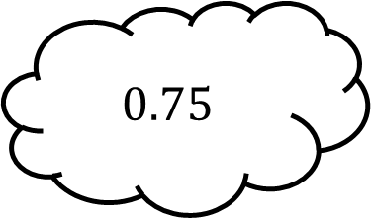
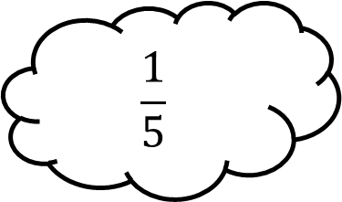
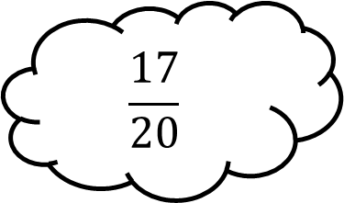
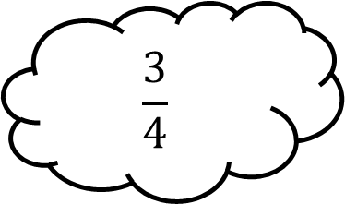
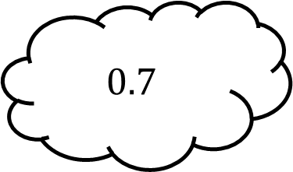
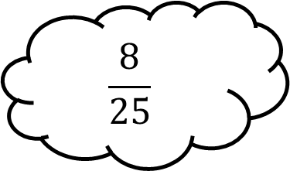
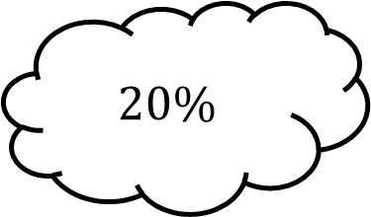
Matching 3
$$0.75$$
$$\frac{1}{5}$$
$$\frac{3}{4}$$
$$85\%$$
$$\frac{7}{10}$$
$$20\%$$
$$\frac{17}{20}$$
$$\frac{8}{25}$$
$$0.7$$

Slide 7
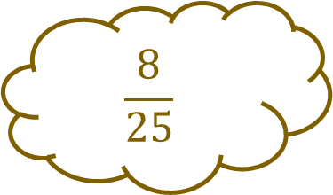
Matching 3 - Answers
$$0.75$$
$$\frac{1}{5}$$
$$\frac{3}{4}$$
$$85\%$$
$$\frac{7}{10}$$
$$20\%$$
$$\frac{17}{20}$$
$$\frac{8}{25}$$
$$\frac{8}{25}$$
$$0.7$$

Slide 8
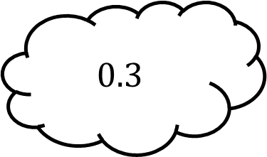
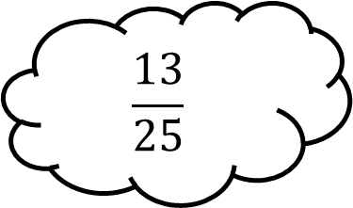
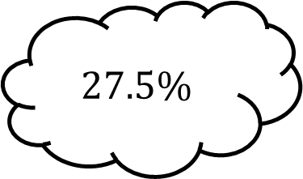
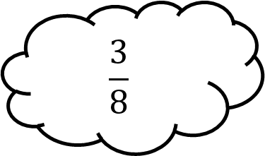
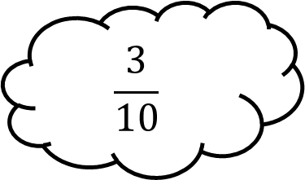
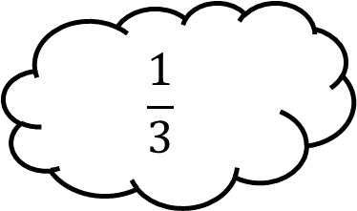
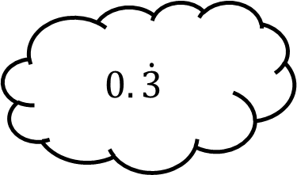
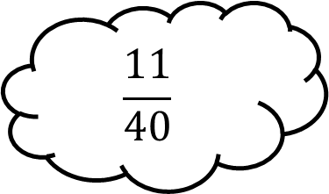
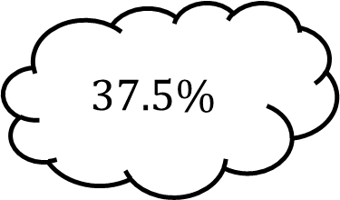
Matching 4
$$27.5\%$$
$$\frac{3}{8}$$
$$\frac{1}{3}$$
$$0.3$$
$$\frac{13}{25}$$
$$37.5\%$$
$$\frac{3}{10}$$
$$\frac{11}{40}$$
$$0.\dot{3}$$

Slide 9
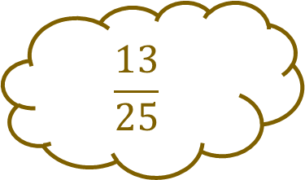
Matching 4 - Answers
$$27.5\%$$
$$\frac{3}{8}$$
$$\frac{1}{3}$$
$$0.3$$
$$\frac{13}{25}$$
$$37.5\%$$
$$\frac{3}{10}$$
$$\frac{11}{40}$$
$$\frac{13}{25}$$
$$0.\dot{3}$$

Slide 10
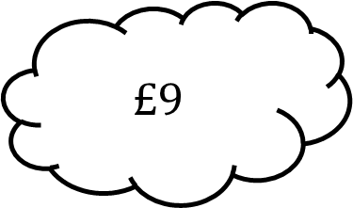
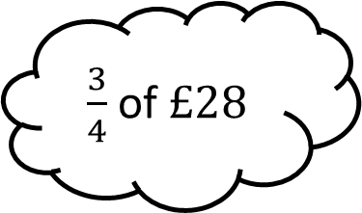
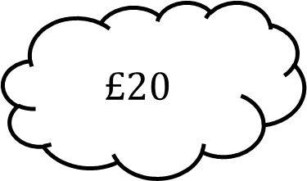
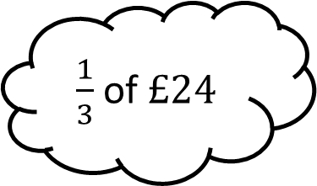
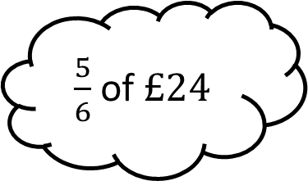
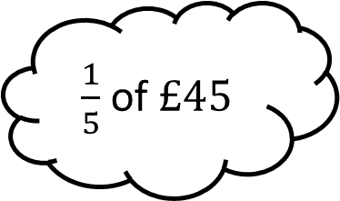
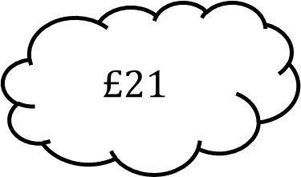
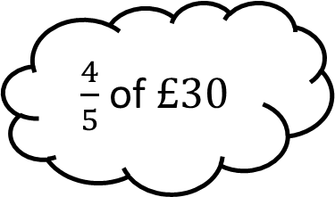
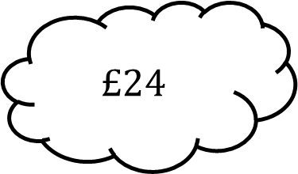
Matching 5
$$£20$$
$\frac{1}{3}$ of $£24$
$\frac{1}{5}$ of $£45$
$$£9$$
$\frac{3}{4}$ of $£28$
$$£24$$
$\frac{5}{6}$ of $£24$
$\frac{4}{5}$ of $£30$
$$£21$$

Slide 11
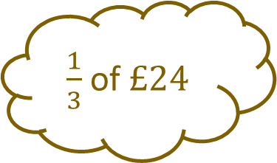
Matching 5 - Answers
$$£20$$
$\frac{1}{3}$ of $£24$
$\frac{1}{3}$ of $£24$
$\frac{1}{5}$ of $£45$
$$£9$$
$\frac{3}{4}$ of $£28$
$$£24$$
$\frac{5}{6}$ of $£24$
$\frac{4}{5}$ of $£30$
$$£21$$

Slide 12









Matching 6
$$£6.50$$
$\frac{3}{7}$ of $£42$
$\frac{1}{4}$ of $£26$
$$£20.25$$
$\frac{3}{8}$ of $£36$
$$£18$$
$\frac{5}{6}$ of $£21$
$\frac{3}{4}$ of $£27$
$$£17.50$$

Slide 13

Matching 6 - Answers
$$£6.50$$
$\frac{3}{7}$ of $£42$
$\frac{1}{4}$ of $£26$
$$£20.25$$
$\frac{3}{8}$ of $£36$
$$£13.50$$
$$£18$$
$\frac{5}{6}$ of $£21$
$\frac{3}{4}$ of $£27$
$$£17.50$$

Slide 14








Matching 7
$$\frac{5}{12}$$
$$\frac{1}{8}+\frac{3}{8}$$
$$\frac{7}{12}−\frac{1}{6}$$
$$\frac{4}{5}$$
$$\frac{11}{20}+\frac{1}{4}$$
$$\frac{1}{2}$$
$$\frac{9}{10}−\frac{1}{2}$$
$$\frac{2}{15}+\frac{3}{5}$$
$$\frac{8}{15}$$

Slide 15




Matching 7 - Answers
$$\frac{7}{10}$$
$$\frac{1}{8}+\frac{3}{8}$$
$$\frac{4}{5}−\frac{1}{10}$$
$$\frac{4}{5}$$
$$\frac{11}{20}+\frac{1}{4}$$
$$\frac{1}{2}$$
$$\frac{9}{10}−\frac{1}{2}$$
$$\frac{2}{5}$$
$$\frac{2}{15}+\frac{3}{5}$$
$$\frac{11}{15}$$

Slide 16









Matching 8
$$1\frac{5}{24}$$
$$\frac{2}{3}−\frac{1}{4}$$
$$\frac{5}{12}+\frac{5}{8}$$
$$\frac{5}{12}$$
$$\frac{11}{24}−\frac{3}{8}$$
$$1\frac{1}{24}$$
$$1\frac{7}{12}−\frac{1}{8}$$
$$\frac{5}{6}+\frac{3}{8}$$
$$1\frac{11}{24}$$

Slide 17

Matching 8 - Answers
$$1\frac{5}{24}$$
$$\frac{2}{3}−\frac{1}{4}$$
$$\frac{5}{12}+\frac{5}{8}$$
$$\frac{5}{12}$$
$$\frac{11}{24}−\frac{3}{8}$$
$$\frac{1}{12}$$
$$1\frac{1}{24}$$
$$1\frac{7}{12}−\frac{1}{8}$$
$$\frac{5}{6}+\frac{3}{8}$$
$$1\frac{11}{24}$$

Slide 18









Matching 9
$$1\frac{11}{24}$$
$$2\frac{1}{4}+1\frac{1}{5}$$
$$3\frac{3}{20}−1\frac{11}{40}$$
$$3\frac{1}{12}$$
$$2\frac{3}{8}−\frac{11}{12}$$
$$3\frac{9}{20}$$
$$1\frac{3}{5}+1\frac{5}{6}$$
$$5\frac{1}{2}−2\frac{5}{12}$$
$$3\frac{13}{30}$$

Slide 19

Matching 9 - Answers
$$1\frac{11}{24}$$
$$1\frac{7}{8}$$
$$2\frac{1}{4}+1\frac{1}{5}$$
$$3\frac{3}{20}−1\frac{11}{40}$$
$$3\frac{1}{12}$$
$$2\frac{3}{8}−\frac{11}{12}$$
$$3\frac{9}{20}$$
$$1\frac{3}{5}+1\frac{5}{6}$$
$$5\frac{1}{2}−2\frac{5}{12}$$
$$3\frac{13}{30}$$

Slide 20









Matching 10
$$\frac{2}{3}$$
$$\frac{1}{2}×\frac{3}{10}$$
$$\frac{2}{3}÷8$$
$$1\frac{3}{4}$$
$$\frac{5}{6}×\frac{4}{5}$$
$$\frac{1}{12}$$
$$\frac{7}{8}×\frac{5}{12}$$
$$\frac{7}{10}÷\frac{2}{5}$$
$$\frac{35}{96}$$

Slide 21

Matching 10 - Answers
$$\frac{2}{3}$$
$$\frac{1}{2}×\frac{3}{10}$$
$$\frac{3}{20}$$
$$\frac{2}{3}÷8$$
$$1\frac{3}{4}$$
$$\frac{5}{6}×\frac{4}{5}$$
$$\frac{1}{12}$$
$$\frac{7}{8}×\frac{5}{12}$$
$$\frac{7}{10}÷\frac{2}{5}$$
$$\frac{35}{96}$$

Slide 22









Matching 11
$$1\frac{1}{5}$$
$$\frac{4}{9}×\frac{3}{4}$$
$$\frac{7}{15}×\frac{10}{21}$$
$$1\frac{7}{8}$$
$$\frac{10}{11}÷\frac{5}{33}$$
$$\frac{1}{3}$$
$$\frac{9}{14}÷\frac{12}{35}$$
$$1\frac{1}{3}×\frac{9}{10}$$
$$\frac{2}{9}$$

Slide 23
Matching 11 - Answers
$$1\frac{1}{5}$$
$$\frac{4}{9}×\frac{3}{4}$$
$$\frac{7}{15}×\frac{10}{21}$$
$$1\frac{7}{8}$$
$$\frac{10}{11}÷\frac{5}{33}$$
$$\frac{1}{3}$$
$$\frac{9}{14}÷\frac{12}{35}$$
$$1\frac{1}{3}×\frac{9}{10}$$
6
$$\frac{2}{9}$$

Slide 24









Matching 12
$$1\frac{3}{25}$$
$$1\frac{2}{5}÷1\frac{1}{4}$$
$$2\frac{2}{7}×1\frac{5}{9}$$
$$1\frac{17}{28}$$
$$1\frac{1}{3}×2\frac{2}{9}$$
$$2\frac{2}{5}$$
$$3\frac{3}{8}÷2\frac{1}{10}$$
$$2\frac{4}{5}÷1\frac{1}{6}$$
$$3\frac{5}{9}$$

Slide 25

Matching 12 - Answers
$$1\frac{3}{25}$$
$$1\frac{2}{5}÷1\frac{1}{4}$$
$$2\frac{2}{7}×1\frac{5}{9}$$
$$1\frac{17}{28}$$
$$2\frac{26}{27}$$
$$1\frac{1}{3}×2\frac{2}{9}$$
$$2\frac{2}{5}$$
$$3\frac{3}{8}÷2\frac{1}{10}$$
$$2\frac{4}{5}÷1\frac{1}{6}$$
$$3\frac{5}{9}$$

Slide 26









Matching 13
Your task:
Complete all calculations so they equal the fraction at the centre.
$30$ out of as a fraction
$$\frac{}{}÷1\frac{2}{5}$$
$$\frac{}{}+\frac{1}{3}$$
$$\frac{4}{5}×\frac{}{}$$
$$\frac{2}{3}$$
$$\frac{5}{6}−\frac{}{}$$
$$\frac{1}{15}+\frac{}{}$$
$\%$ as a fraction
$$\frac{}{}−\frac{1}{4}$$
Give your answers in their simplest form.

Slide 27








Matching 13 - Answers
Your task:
Complete all calculations so they equal the fraction at the centre.
$30$ out of as a fraction
$$\frac{}{}÷1\frac{2}{5}$$
$$45$$
$$\frac{}{}+\frac{1}{3}$$
$$\frac{14}{15}$$
$$\frac{1}{3}$$
$$\frac{4}{5}×\frac{}{}$$
$$\frac{2}{3}$$
$$\frac{5}{6}−\frac{}{}$$
$$\frac{5}{6}$$
$$\frac{1}{6}$$
$$\frac{1}{15}+\frac{}{}$$
$\%$ as a fraction
$$\frac{3}{5}$$
$$66.\dot{6}$$
$$\frac{}{}−\frac{1}{4}$$
Give your answers in their simplest form.
$$\frac{11}{12}$$

Slide 28









Matching 14
Your task:
Complete all calculations so they equal the fraction at the centre.
$\%$ as a fraction
$$\frac{}{}÷\frac{3}{5}$$
$$\frac{3}{4}+\frac{}{}+\frac{11}{16}$$
$$\frac{}{}×\frac{5}{6}$$
$$1\frac{7}{8}$$
$$2\frac{3}{8}−\frac{}{}$$
$$2\frac{1}{12}÷ \frac{}{}$$
$$\frac{}{}−1\frac{5}{12}$$
$$1\frac{1}{4}× \frac{}{}$$
Give your answers in their simplest form.

Slide 29










Matching 14 - Answers
Your task:
Complete all calculations so they equal the fraction at the centre.
$\%$ as a fraction
$$\frac{}{}÷\frac{3}{5}$$
$$187.5$$
$$\frac{3}{4}+\frac{}{}+\frac{11}{16}$$
$$3\frac{1}{8}$$
$$\frac{7}{16}$$
$$\frac{}{}×\frac{5}{6}$$
$$1\frac{7}{8}$$
$$2\frac{3}{8}−\frac{}{}$$
$$2\frac{1}{4}$$
$$\frac{1}{2}$$
$$2\frac{1}{12}÷ \frac{}{}$$
$$\frac{}{}−1\frac{5}{12}$$
$$1\frac{1}{9}$$
$$3\frac{7}{24}$$
$$1\frac{1}{4}× \frac{}{}$$
Give your answers in their simplest form.
$$1\frac{1}{2}$$

Slide 30









Matching n

Slide 31









Matching n

