Slide 1
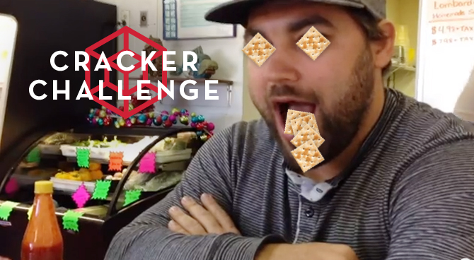
Celebrity Series

Slide 2
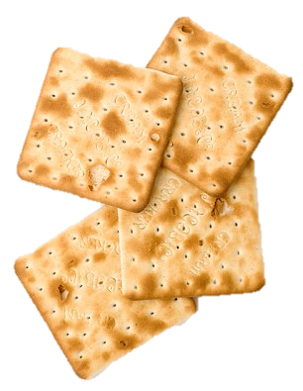
What is the cracker challenge?
The aim is to eat as many crackers as possible in 5 minutes.
The judges calculate the fraction of the crackers each celebrity contestant had to begin with remaining on their plate.
Your job is to find out the positions of each celebrity (your calculator is out of action by the way) contestant remembering that the least left is the winner.

Slide 3
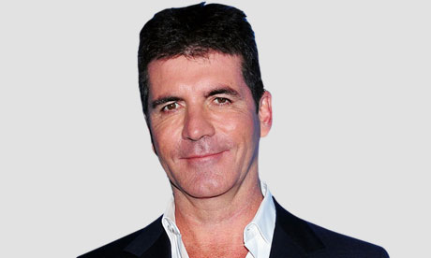
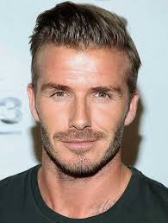
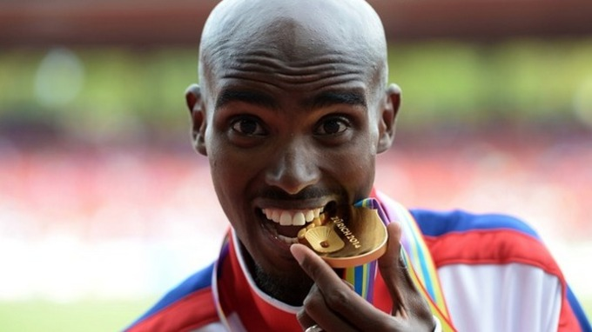
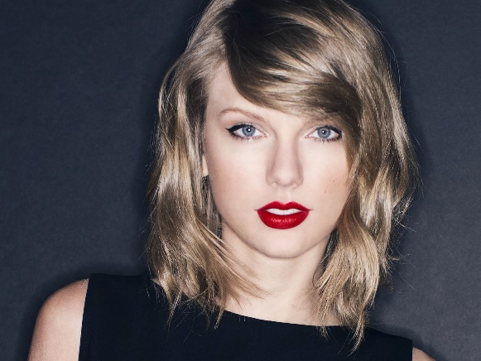
Heat 1
Ariana Grande
Simon Cowell
$\frac{5}{8}$ remain
$\frac{1}{2}$ remain
$\frac{1}{4}$ remain
$\frac{3}{4}$ remain
$\frac{7}{16}$ remain
David Beckham
Mo Farah
Taylor Swift
First | Second | Third | Fourth | Fifth
$\frac{1}{4}$ - Beckham
$\frac{7}{16}$ - Swift
$\frac{1}{2}$ - Grande
$\frac{5}{8}$ - Cowell
$\frac{3}{4}$ - Farah

Slide 4
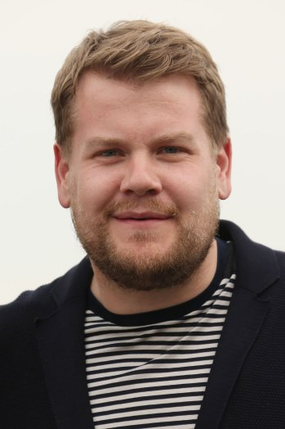
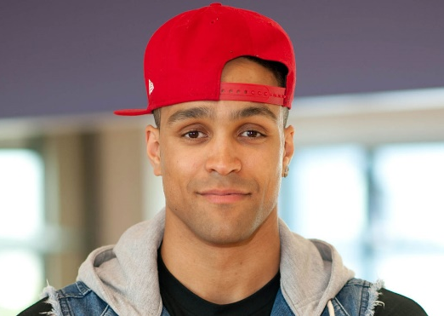
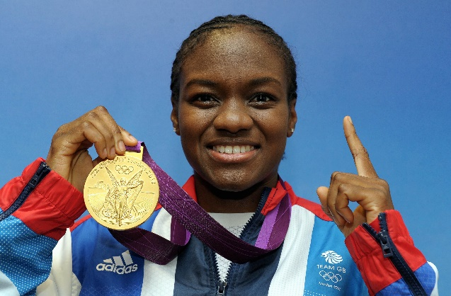
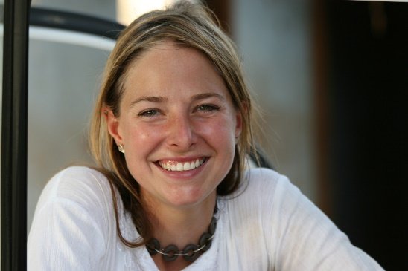
Heat 2
James Corden
Ashley Banjo
$\frac{13}{24}$ remain
$\frac{2}{3}$ remain
$\frac{7}{12}$ remain
$\frac{5}{6}$ remain
Nicola Adams
$\frac{5}{8}$ remain
Alice Roberts
Alex Jones
First | Second | Third | Fourth | Fifth
$\frac{13}{24}$ - Banjo
$\frac{7}{12}$ - Adams
$\frac{5}{8}$ - Jones
$\frac{2}{3}$ - Corden
$\frac{5}{6}$ - Roberts

Slide 5
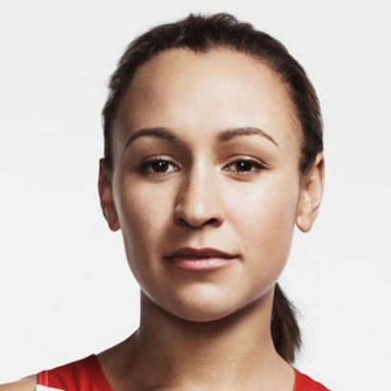
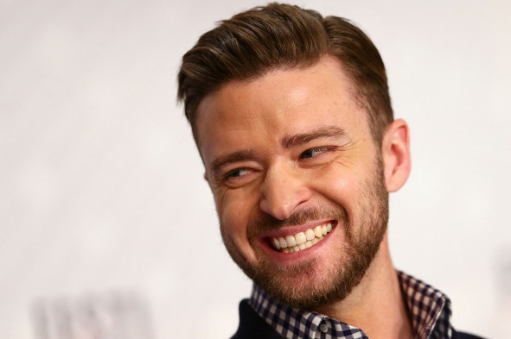
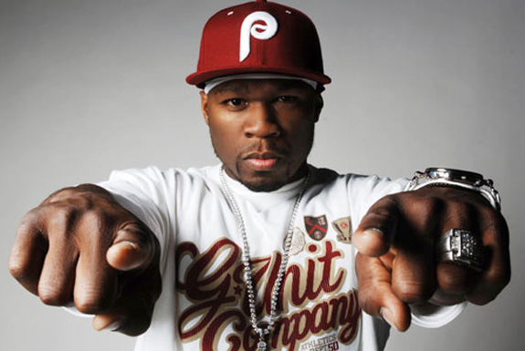
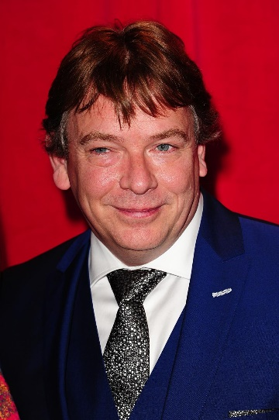
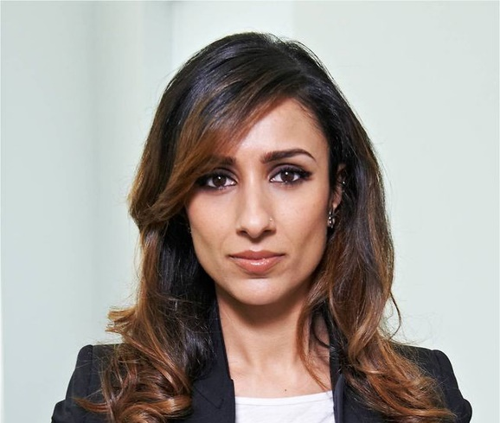
Heat 3
Justin Timberlake
Jessica Ennis
$\frac{1}{4}$ remain
$\frac{11}{30}$ remain
$\frac{5}{12}$ remain
$\frac{4}{15}$ remain
50 Cent
$\frac{3}{5}$ remain
Adam Woodyat
Anita Rani
First | Second | Third | Fourth | Fifth
$\frac{1}{4}$ - Ennis
$\frac{4}{15}$ - Woodyat
$\frac{11}{30}$ - JT
$\frac{5}{12}$ - Fiddy
$\frac{3}{5}$ - Rani

Slide 6
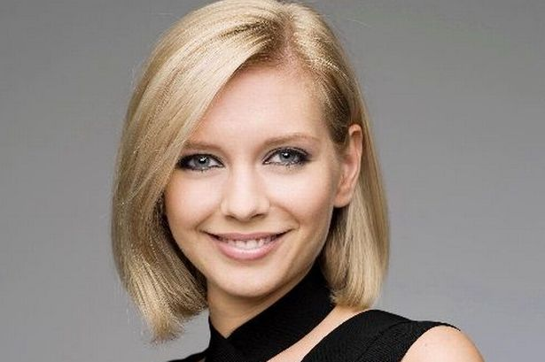
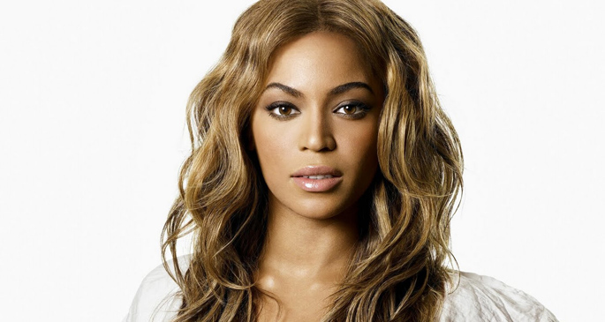
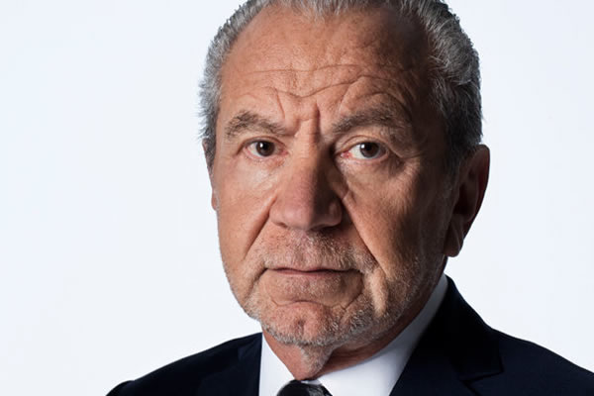
Heat 4
Beyoncé
Rachel Riley
$\frac{2}{5}$ remain
$\frac{3}{10}$ remain
$\frac{3}{8}$ remain
$\frac{7}{20}$ remain
Alan Sugar
$\frac{1}{2}$ remain
Madonna
Denise Parish
First | Second | Third | Fourth | Fifth
$\frac{3}{10}$ - Beyoncé
$\frac{3}{8}$ - Sugar
$\frac{7}{20}$ - Madonna
$\frac{2}{5}$ - Riley
$\frac{1}{2}$ - Parish

Slide 7
Series Final
Ashley Banjo
Beyoncé
$\frac{19}{81}$ remain
$\frac{5}{27}$ remain
$\frac{2}{9}$ remain
$\frac{7}{54}$ remain
David Beckham
Jessica Ennis
First | Second | Third | Fourth
$\frac{7}{54}$ - Beyoncé
$\frac{5}{27}$ - Banjo
$\frac{2}{9}$ - Ennis
$\frac{19}{81}$ - Beckham

Slide 8
Thank you for joining us on…
Celebrity Series

