Slide 1
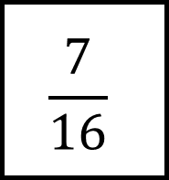
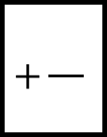
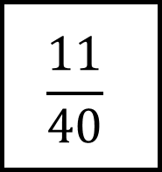
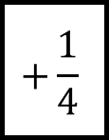
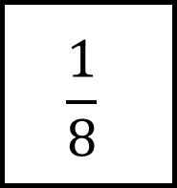
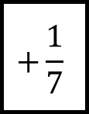
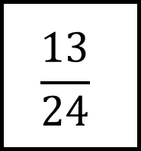
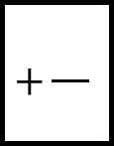
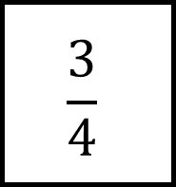
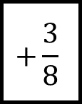
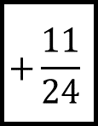
Fraction Spider 1
$$\frac{13}{24}$$
$$\frac{3}{4}$$
$$+\frac{3}{8}$$
$$+\frac{}{}$$
$$+\frac{}{}$$
$$\frac{1}{8}$$
$$+\frac{1}{7}$$
$$+\frac{1}{4}$$
$$+\frac{}{}$$
$$+\frac{11}{24}$$
$$+\frac{}{}$$
$$\frac{11}{40}$$
$$\frac{7}{16}$$

Slide 2
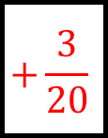
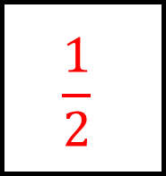
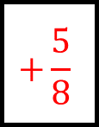
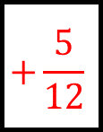
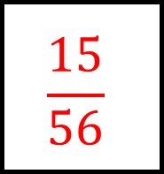
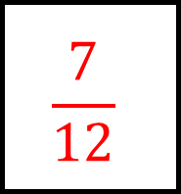
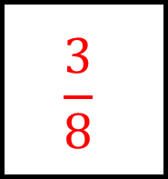
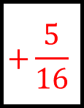
Fraction Spider 1 Answers
$$\frac{1}{2}$$
$$\frac{13}{24}$$
$$\frac{3}{4}$$
$$+\frac{3}{8}$$
$$+\frac{5}{12}$$
$$+\frac{5}{8}$$
$$\frac{15}{56}$$
$$\frac{1}{8}$$
$$\frac{3}{8}$$
$$+\frac{1}{7}$$
$$+\frac{1}{4}$$
$$+\frac{3}{20}$$
$$+\frac{11}{24}$$
$$+\frac{5}{16}$$
$$\frac{11}{40}$$
$$\frac{7}{16}$$
$$\frac{7}{12}$$

Slide 3
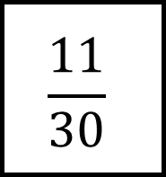
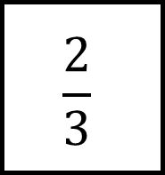
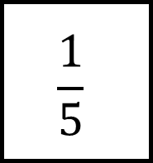
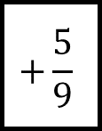
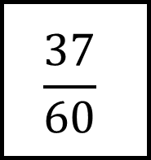
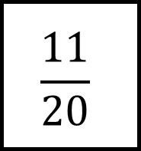
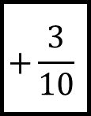
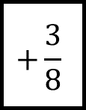
Fraction Spider 2
$$\frac{37}{60}$$
$$\frac{11}{20}$$
$$+\frac{3}{10}$$
$$+\frac{}{}$$
$$+\frac{}{}$$
$$\frac{1}{5}$$
$$+\frac{5}{9}$$
$$+\frac{1}{4}$$
$$+\frac{}{}$$
$$+\frac{3}{8}$$
$$+\frac{}{}$$
$$\frac{2}{3}$$
$$\frac{11}{30}$$

Slide 4
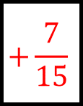
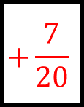
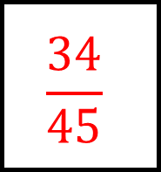
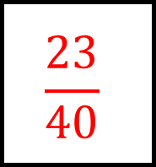
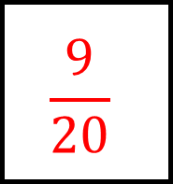
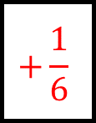
Fraction Spider 2 Answers
$$\frac{1}{2}$$
$$\frac{37}{60}$$
$$\frac{11}{20}$$
$$+\frac{3}{10}$$
$$+\frac{5}{12}$$
$$+\frac{7}{20}$$
$$\frac{34}{45}$$
$$\frac{1}{5}$$
$$\frac{9}{20}$$
$$+\frac{5}{9}$$
$$+\frac{1}{4}$$
$$+\frac{7}{15}$$
$$+\frac{3}{8}$$
$$+\frac{1}{6}$$
$$\frac{2}{3}$$
$$\frac{11}{30}$$
$$\frac{23}{40}$$

Slide 5
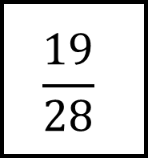
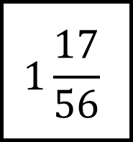
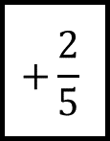
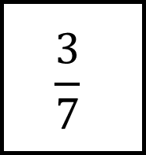
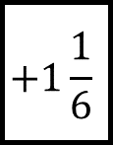
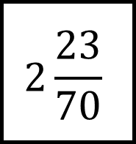
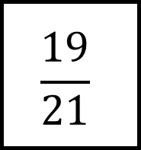
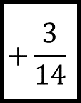
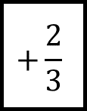
Fraction Spider 3
$$2\frac{23}{70}$$
$$\frac{19}{21}$$
$$+\frac{3}{14}$$
$$+\frac{}{}$$
$$+\frac{}{}$$
$$\frac{3}{7}$$
$$+1\frac{1}{6}$$
$$+\frac{2}{5}$$
$$+\frac{}{}$$
$$+\frac{2}{3}$$
$$+\frac{}{}$$
$$1\frac{17}{56}$$
$$\frac{19}{28}$$

Slide 6
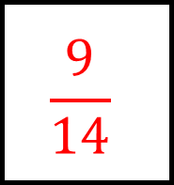
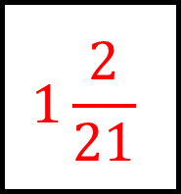
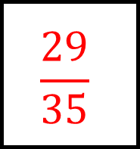
Fraction Spider 3 Answers
$$\frac{9}{14}$$
$$2\frac{23}{70}$$
$$\frac{19}{21}$$
$$+\frac{3}{14}$$
$$+1\frac{9}{10}$$
$$+\frac{10}{21}$$
$$1\frac{25}{42}$$
$$\frac{3}{7}$$
$$\frac{29}{35}$$
$$+1\frac{1}{6}$$
$$+\frac{2}{5}$$
$$+\frac{7}{8}$$
$$+\frac{2}{3}$$
$$+\frac{1}{4}$$
$$1\frac{17}{56}$$
$$\frac{19}{28}$$
$$1\frac{2}{21}$$

Slide 7
Fraction Spider 4
$$1\frac{3}{4}$$
$$1$$
$$+\frac{}{}$$
$$+\frac{}{}$$
$$+\frac{}{}$$
$$+\frac{}{}$$
$$\frac{4}{5}$$
$$\frac{4}{9}$$
$$2$$
$$+\frac{}{}$$
$$+\frac{}{}$$
$$+\frac{}{}$$
$$+\frac{}{}$$
$$+\frac{}{}$$
$$+\frac{}{}$$
$$+\frac{}{}$$
$$+\frac{}{}$$
$$\frac{31}{36}$$
$$\frac{17}{18}$$

Slide 8
Fraction Spider 4 Answers
(If fractions are equal)
$$1\frac{3}{4}$$
$$1$$
$$+\frac{47}{72}$$
$$+\frac{5}{18}$$
$$+\frac{47}{72}$$
$$+\frac{5}{18}$$
$$\frac{4}{5}$$
$$\frac{4}{9}$$
$$2$$
$$+\frac{8}{45}$$
$$+\frac{8}{45}$$
$$+\frac{7}{9}$$
$$+\frac{7}{9}$$
$$+\frac{5}{24}$$
$$+\frac{1}{4}$$
$$+\frac{5}{24}$$
$$+\frac{1}{4}$$
$$\frac{31}{36}$$
$$\frac{17}{18}$$
Fractions don’t have to be equal

Slide 9
Fraction Spider - Blank
$$+\frac{}{}$$
$$+\frac{}{}$$
$$+\frac{}{}$$
$$+\frac{}{}$$
$$+\frac{}{}$$
$$+\frac{}{}$$
$$+\frac{}{}$$
$$+\frac{}{}$$

