Slide 1
No Old Spec Q’s
t-Formulae
SAM
SAM
2018
2019
2019
Weierstrauss Substitution

Slide 2
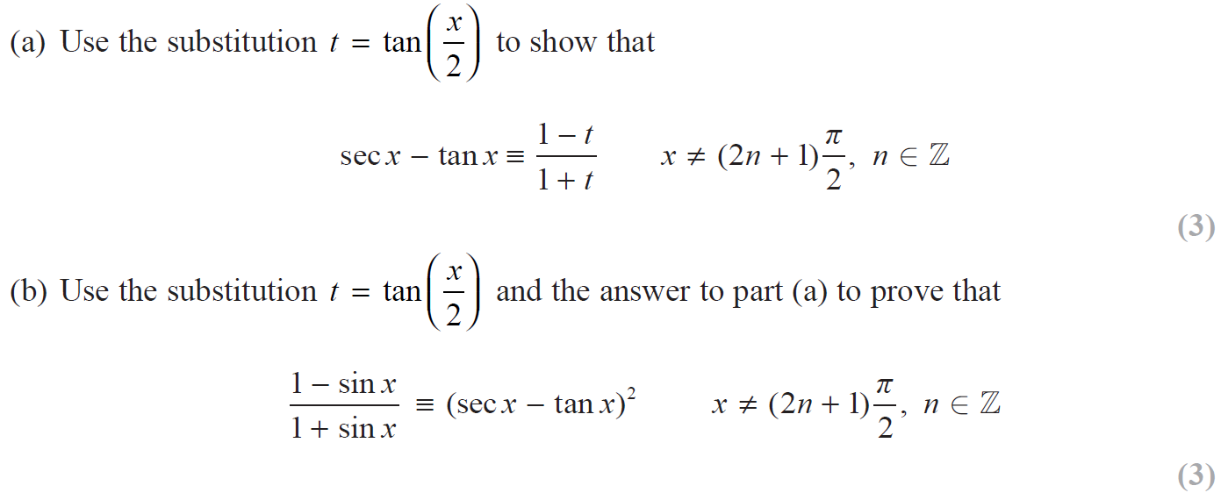
SAM

Slide 3
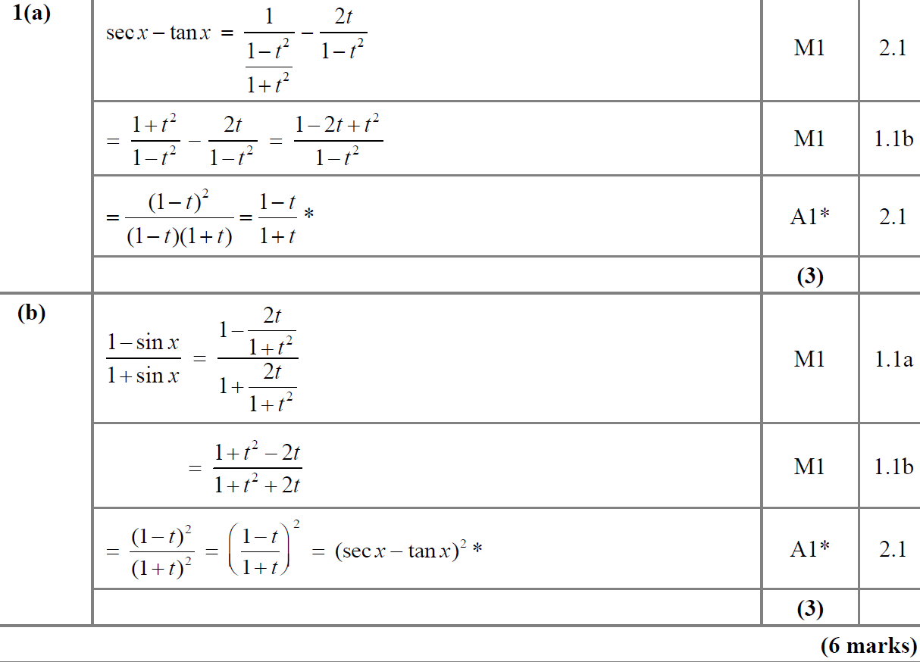
SAM
A
B

Slide 4
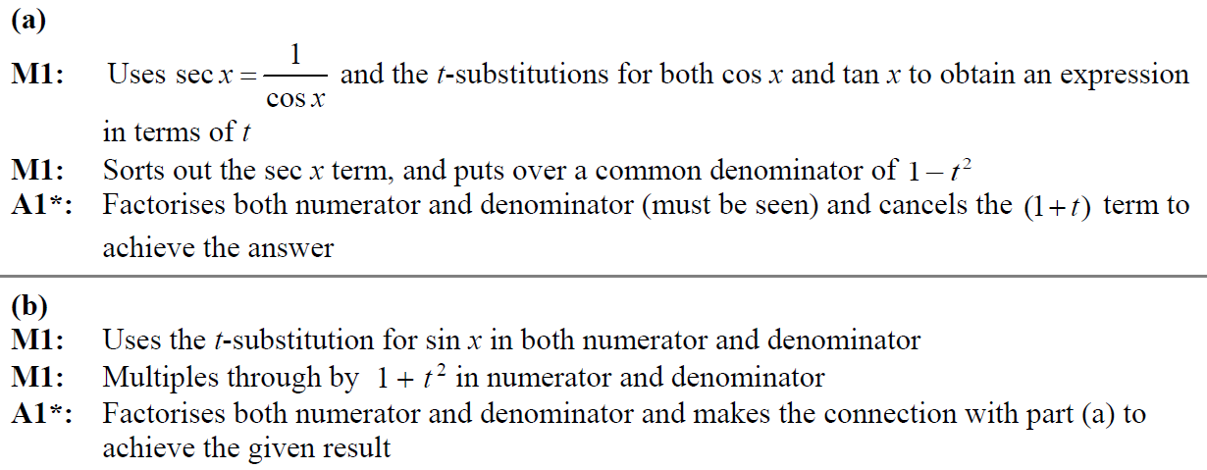
SAM
A notes
B notes

Slide 5
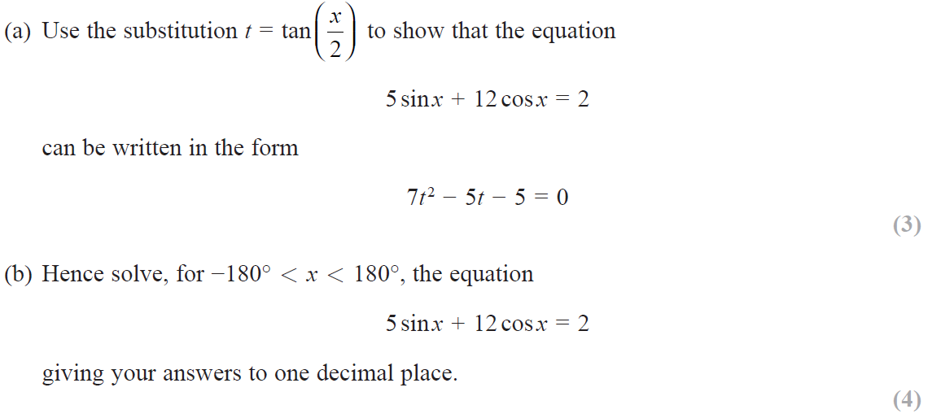
2018

Slide 6
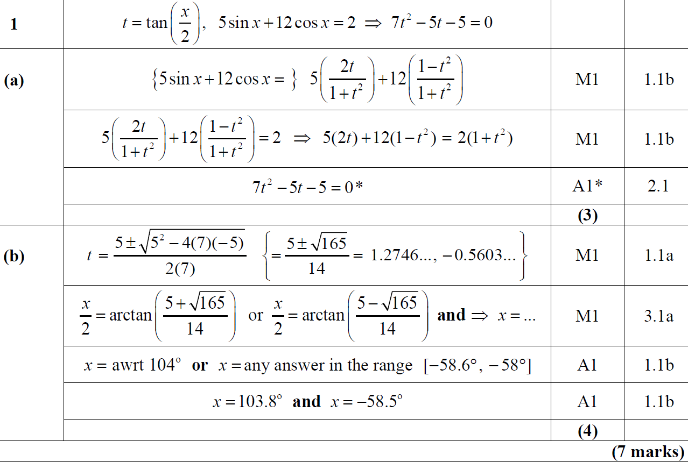
2018
A
B

Slide 7
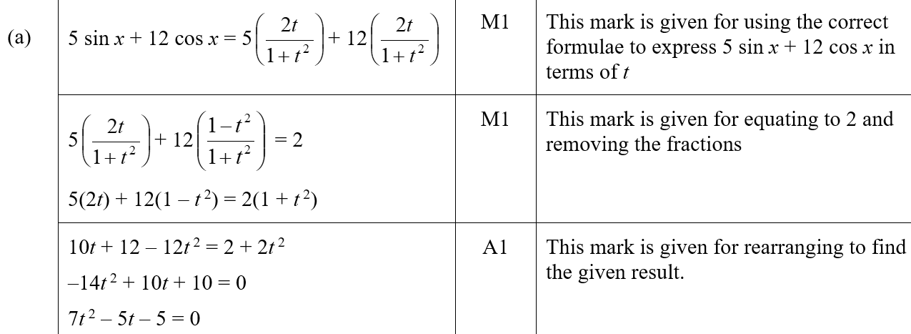
2018
A (SF)
A notes

Slide 8
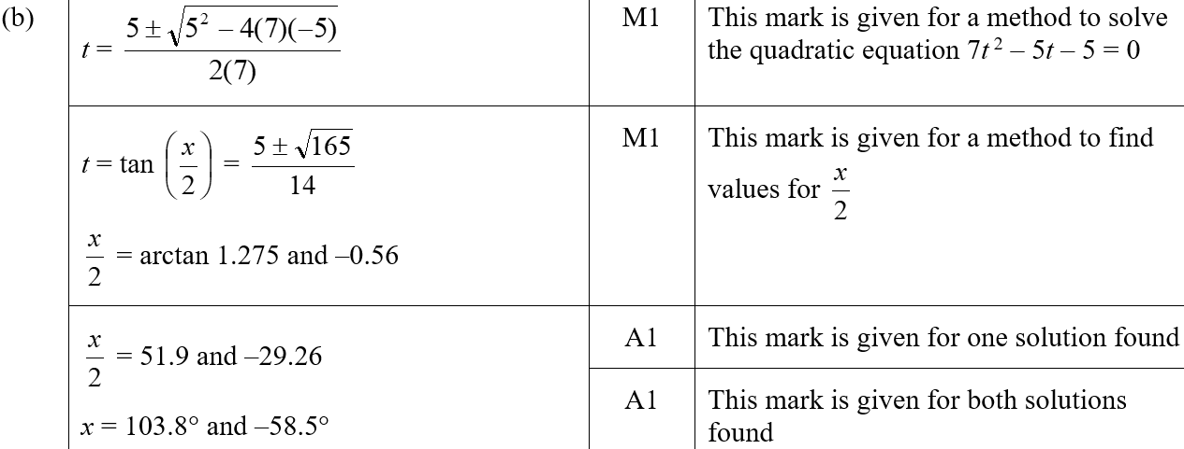
2018
B (SF)

Slide 9
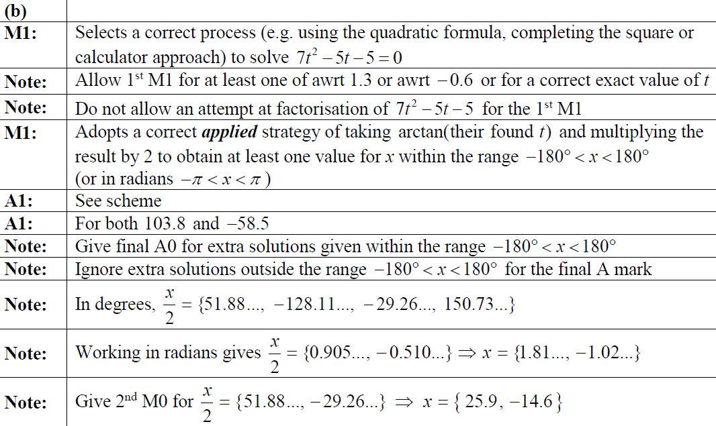
2018
B notes

Slide 10
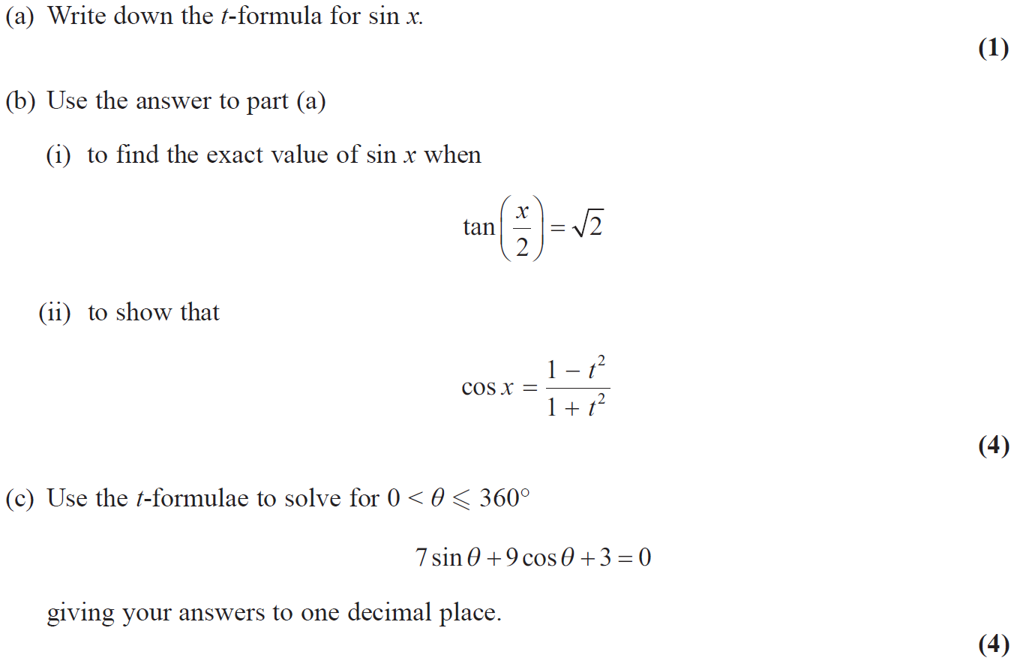
2019

Slide 11
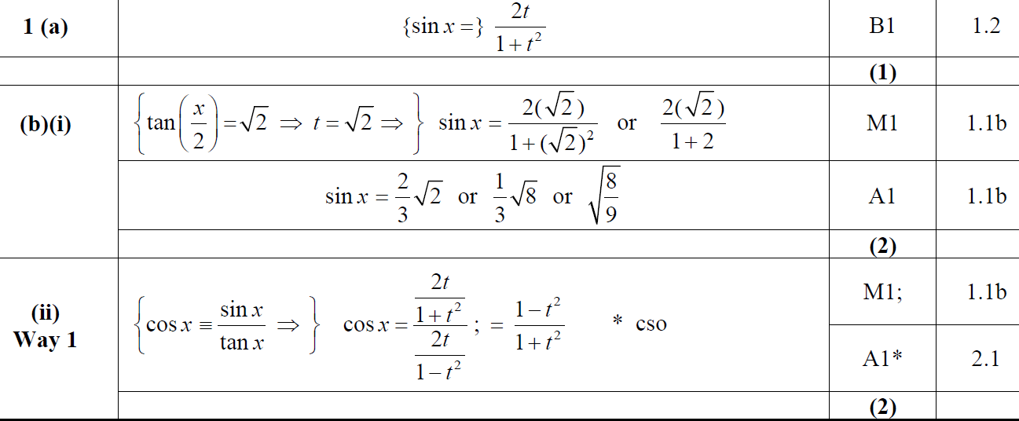
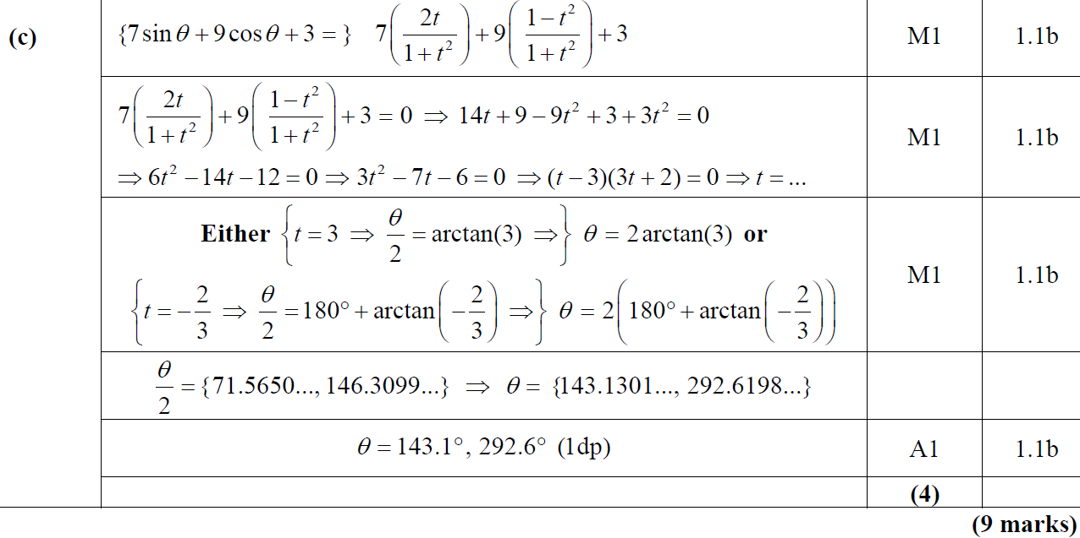
2019
A
B (i)
B (ii)
C

Slide 12
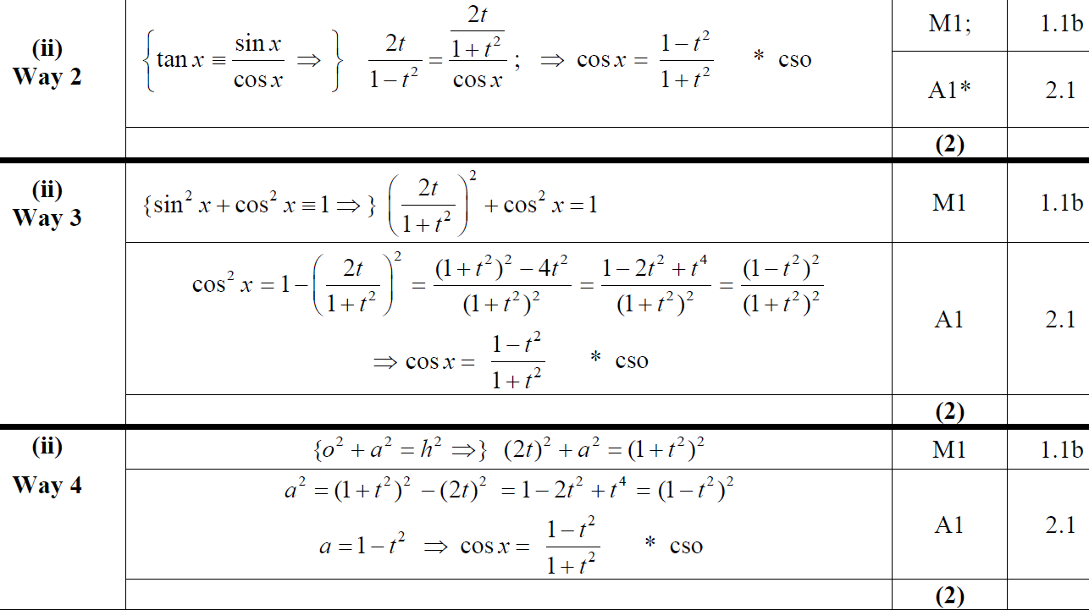
2019
B (ii) Alternative 1
B (ii) Alternative 2
B (ii) Alternative 3

Slide 13
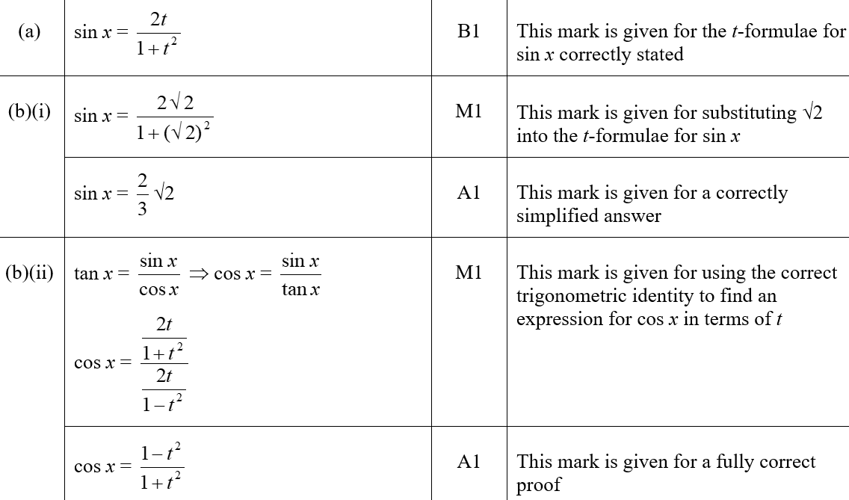
2019
A (SF)
B (i) (SF)
B (ii) (SF)

Slide 14
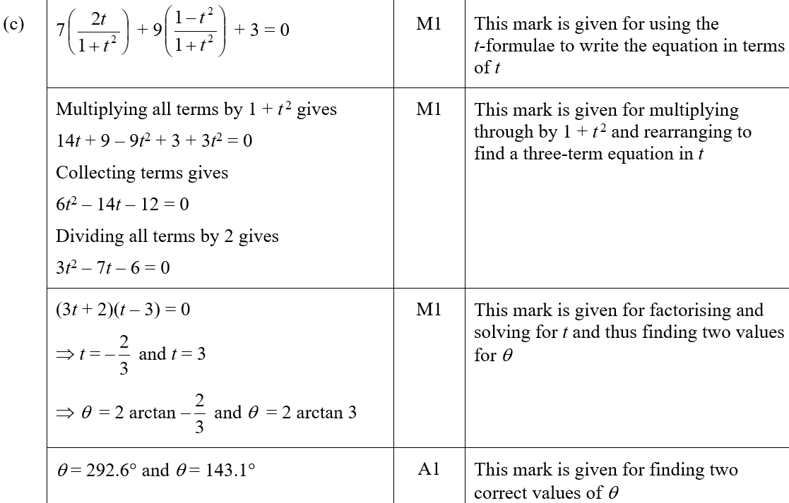
2019
C (SF)

Slide 15
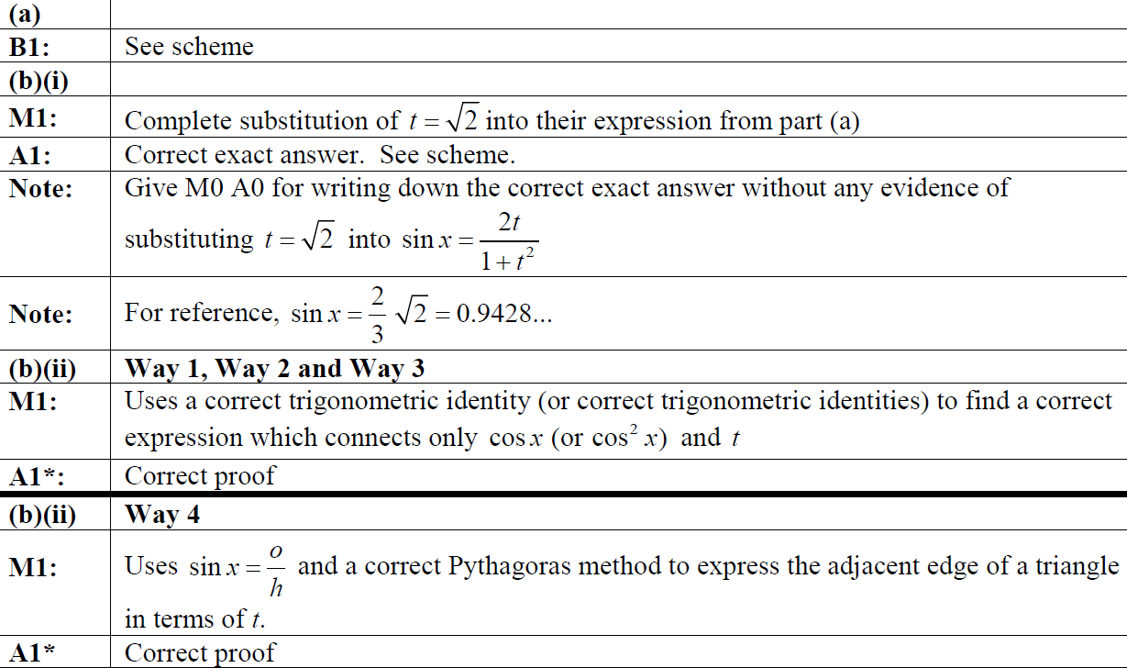
2019
A notes
B (i) notes
B (ii) notes

Slide 16
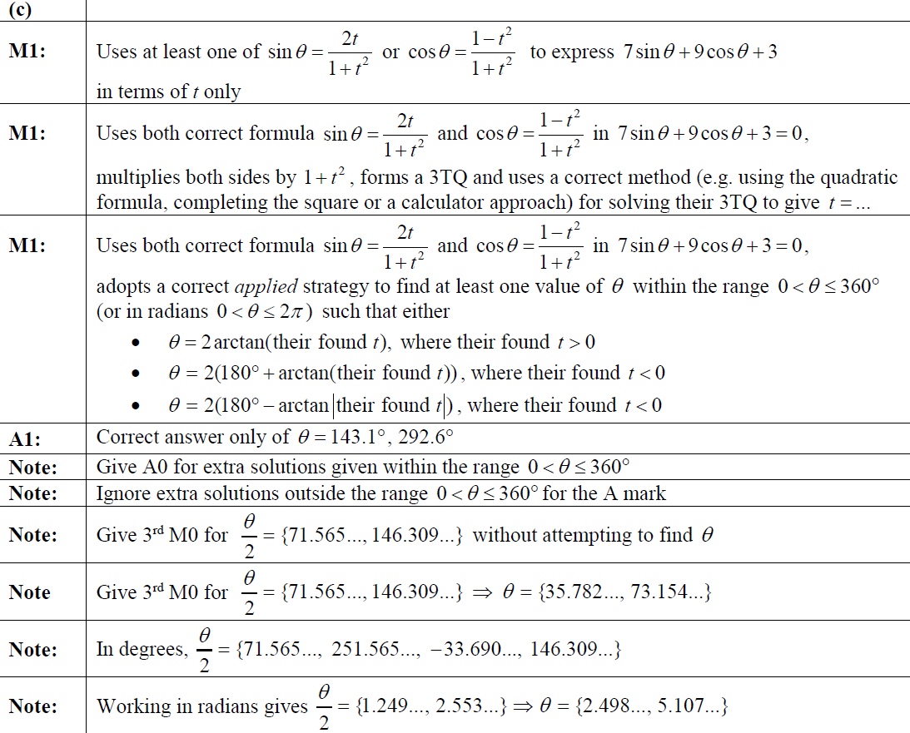
2019
C notes

Slide 17
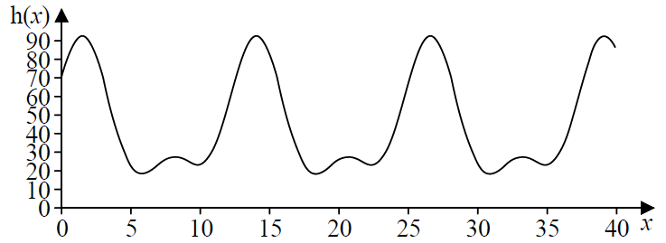
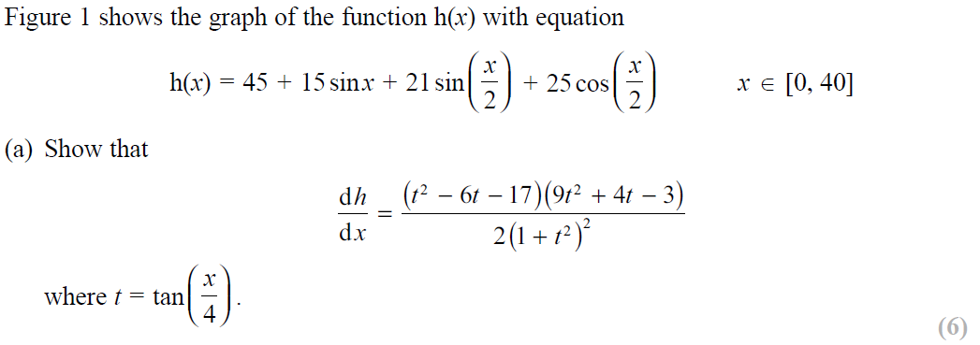
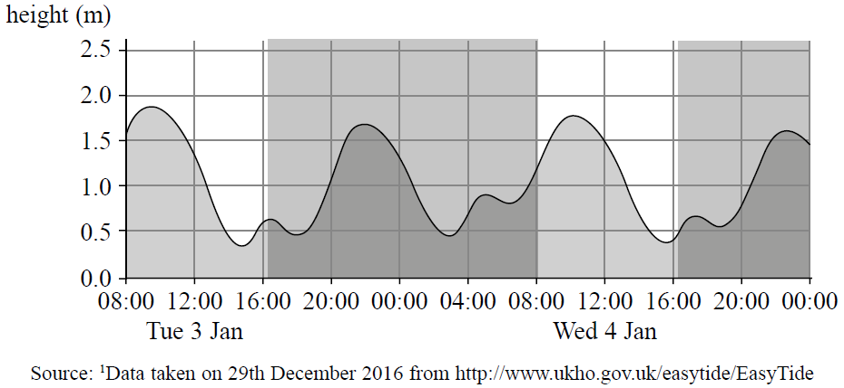
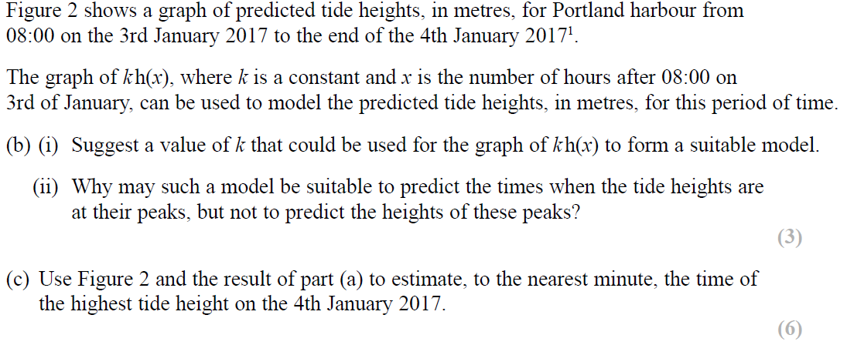
SAM

Slide 18
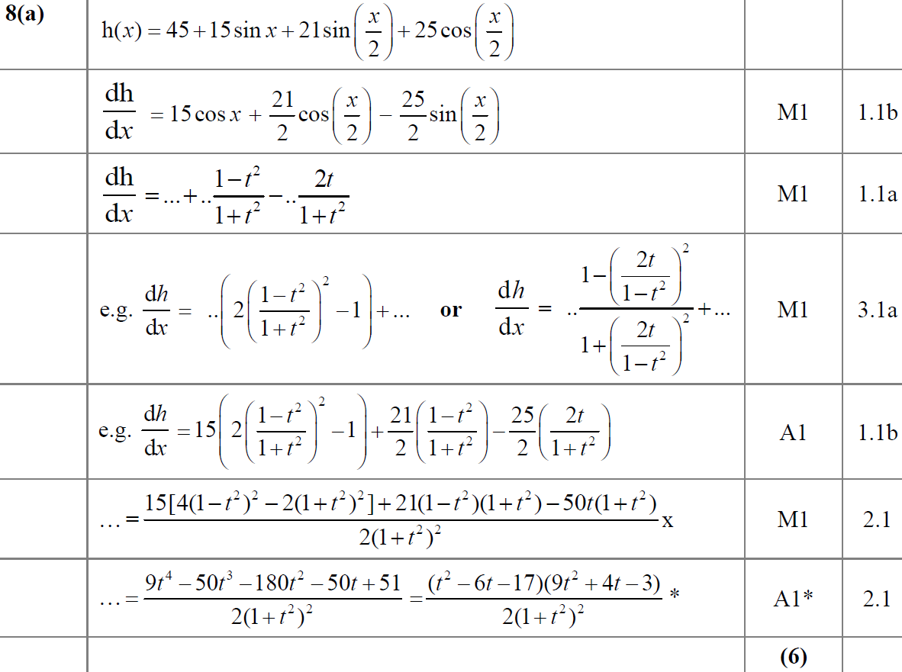
SAM
A

Slide 19
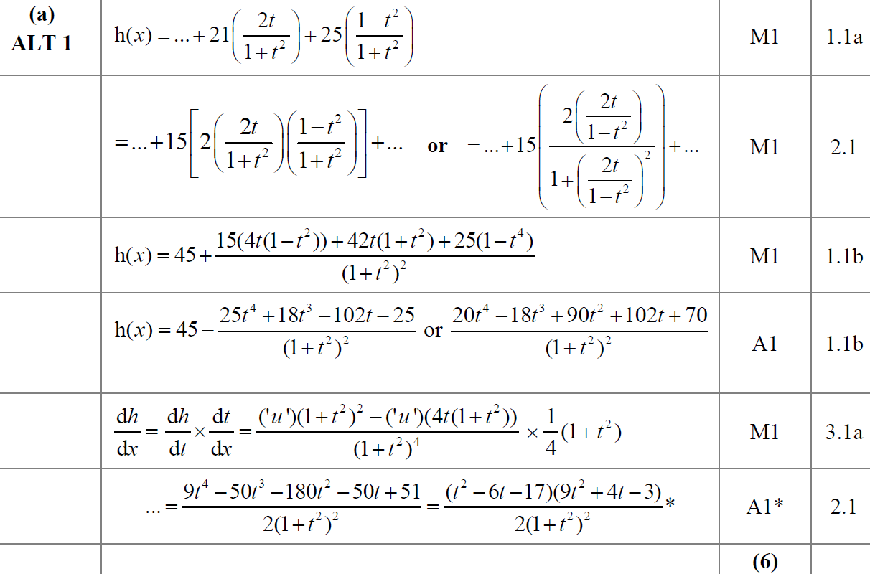
SAM
A Alternative

Slide 20
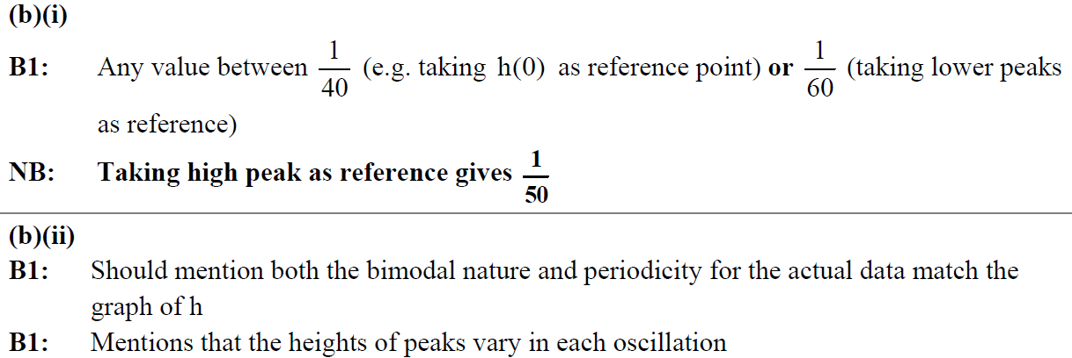
SAM
B (i)
B (ii)
B (i) notes
B (ii) notes

Slide 21
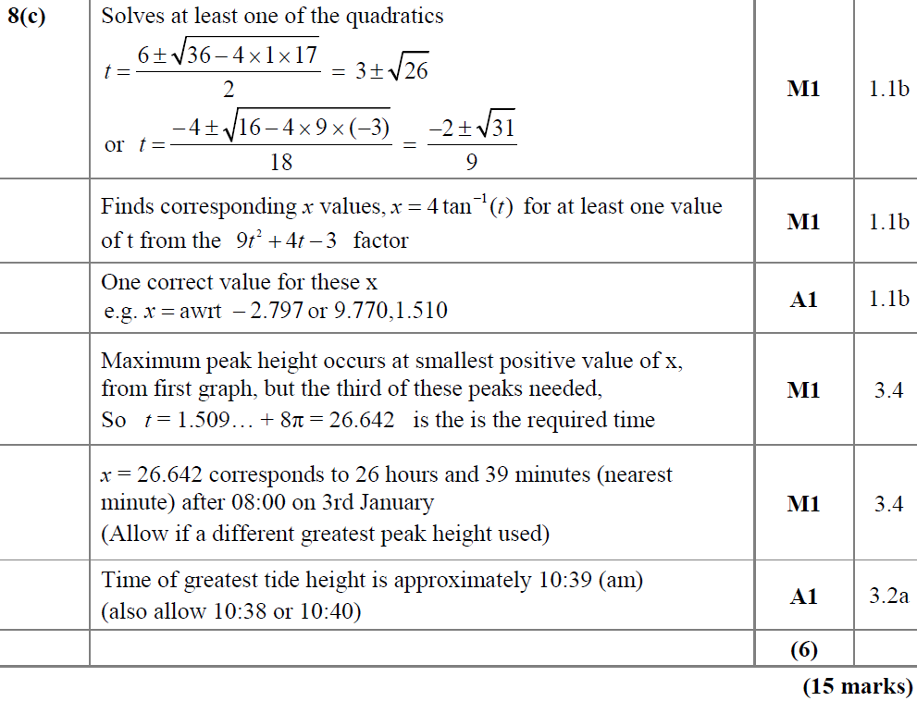
SAM
C

Slide 22
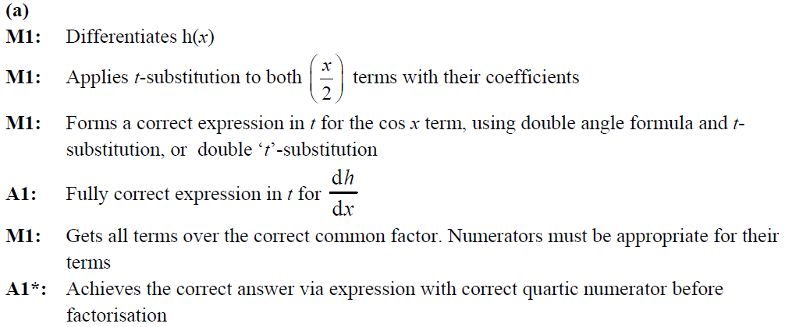
SAM
A notes

Slide 23
SAM
A Alternative notes

Slide 24
SAM
C notes

Slide 25
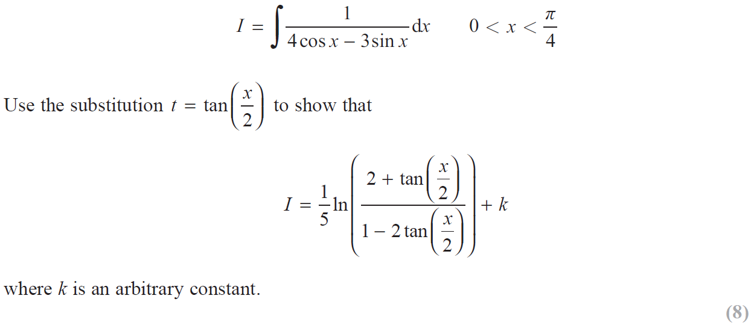
2019

Slide 26
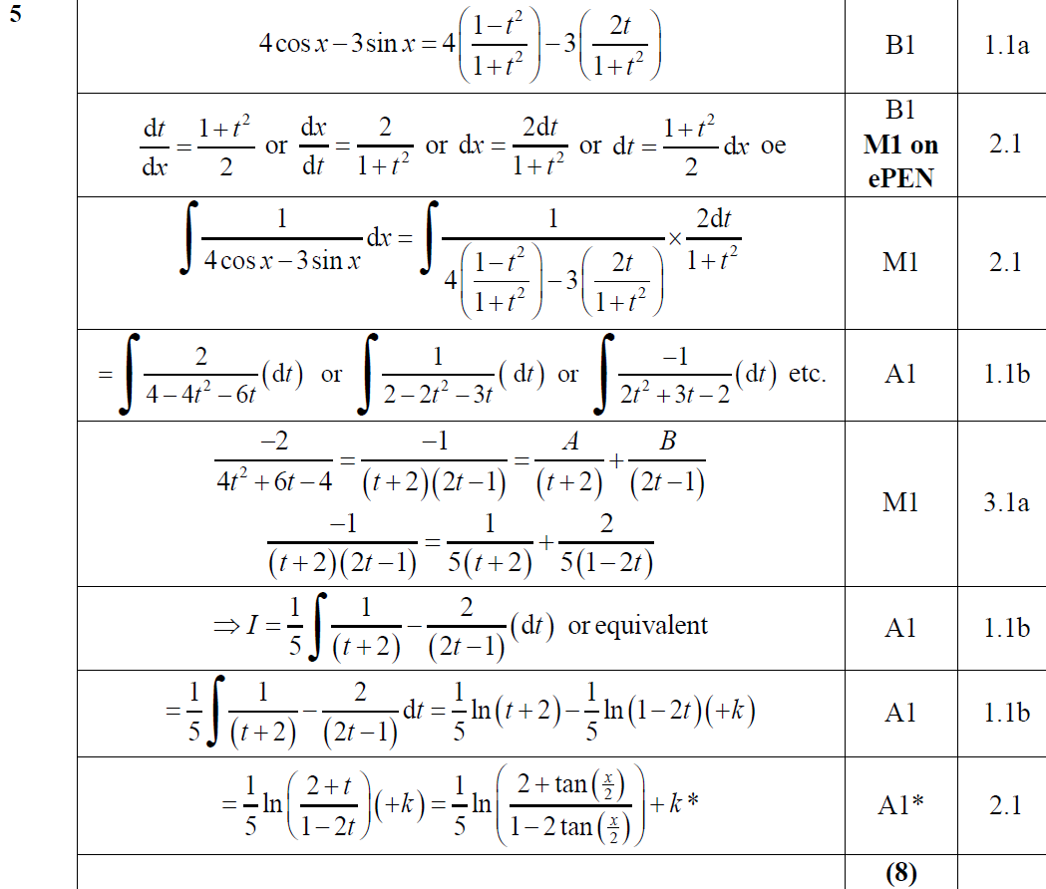
2019
A

Slide 27
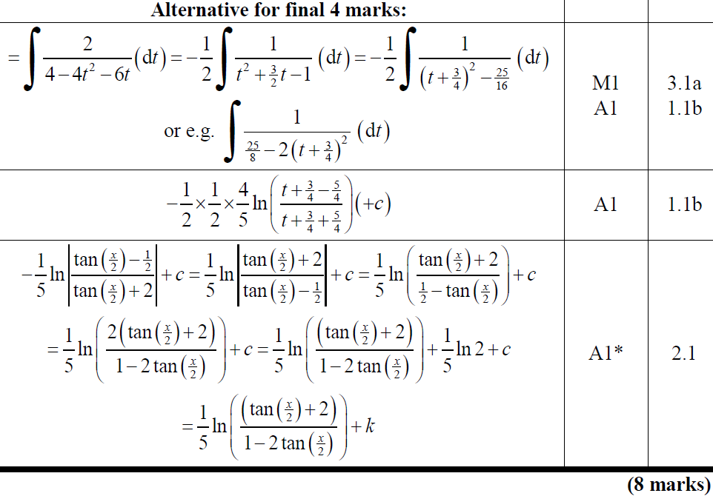
2019
A Alternative

Slide 28
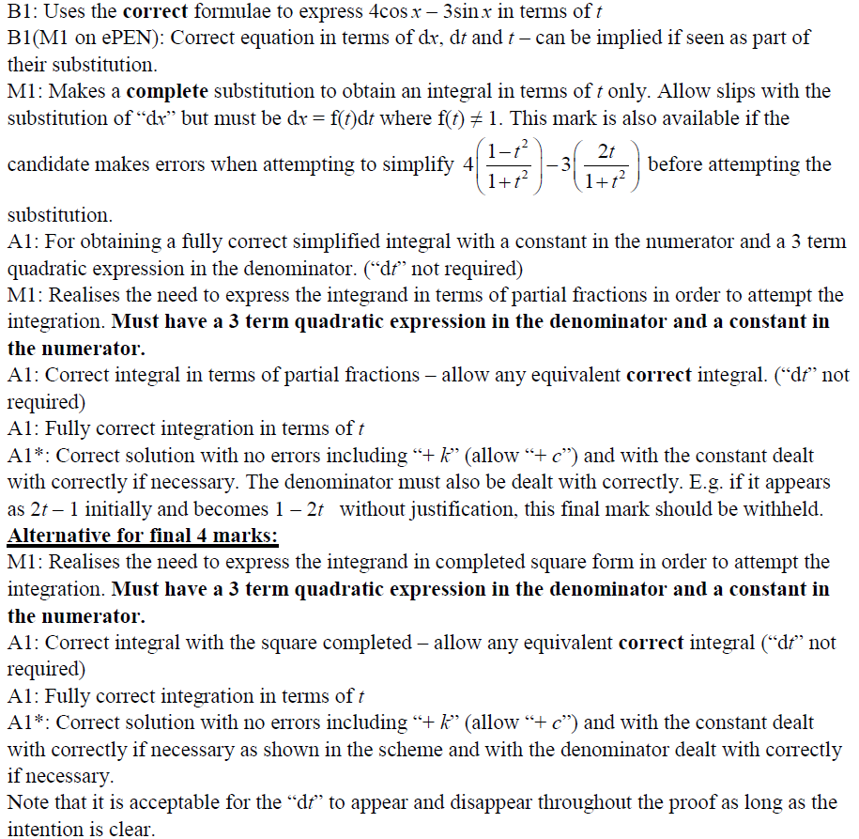
2019
A notes

