Slide 1
Old Spec Q’s
Vectors
SAM
SAM
2018
2019
2019

Slide 2
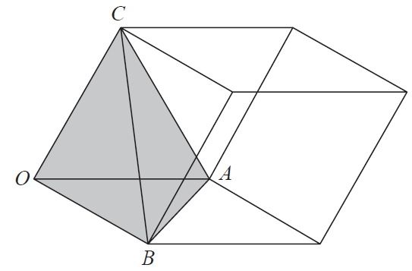
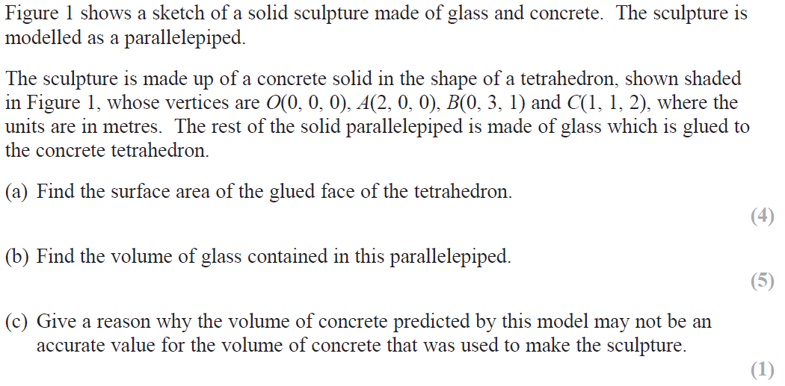
SAM

Slide 3
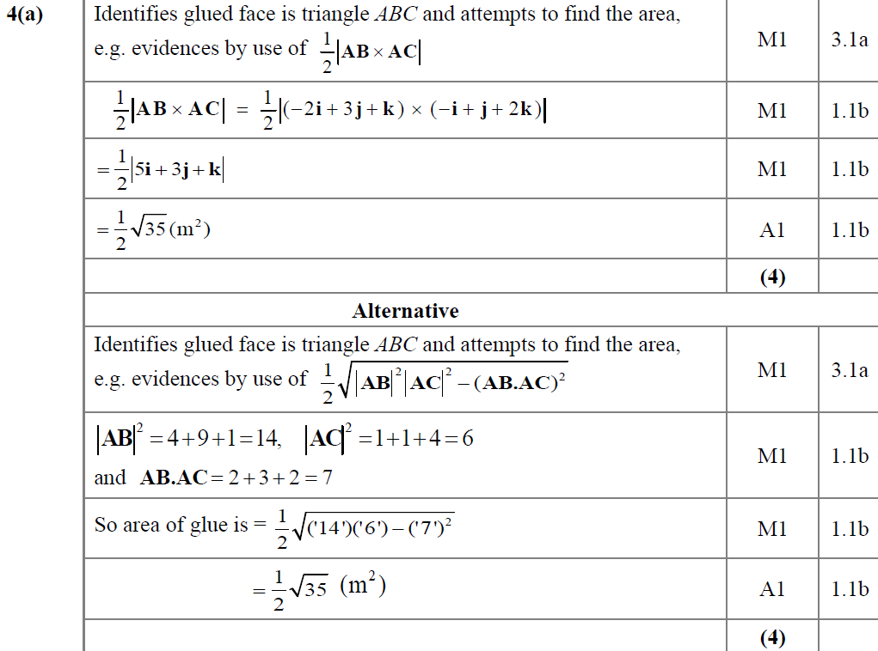
SAM
A
A Alternative

Slide 4
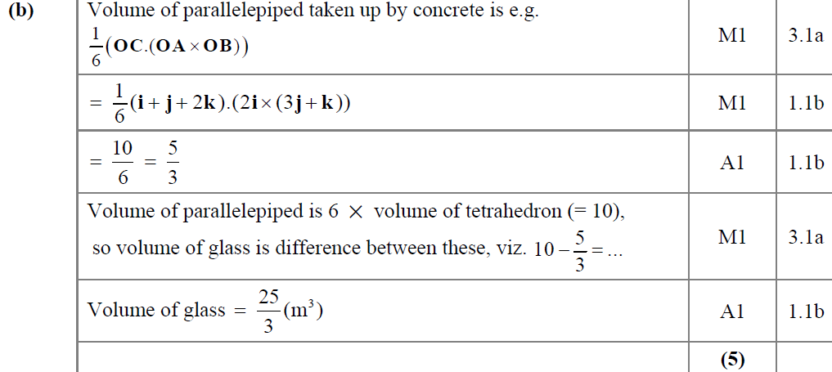
SAM
B

Slide 5
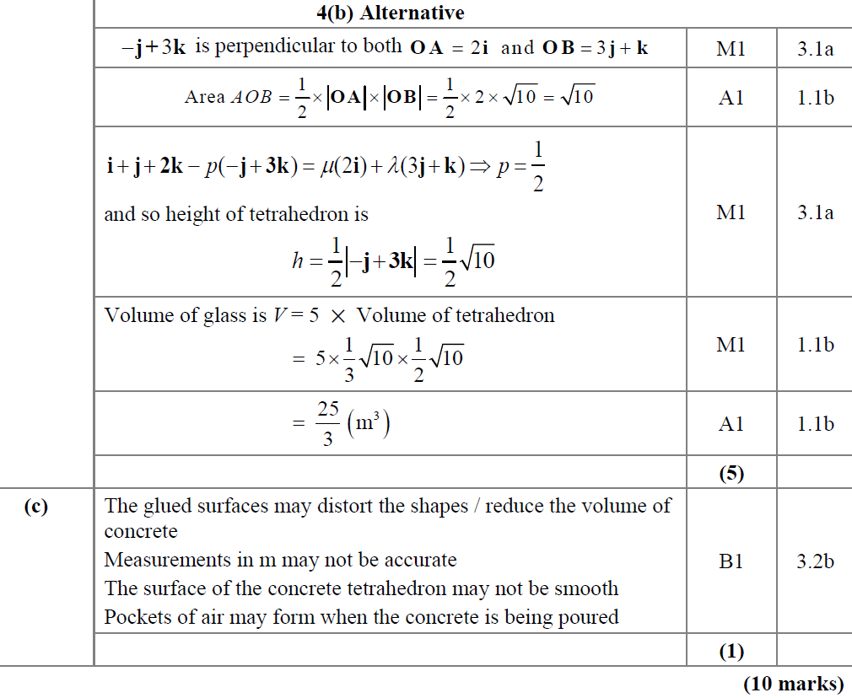
SAM
B Alternative
C

Slide 6
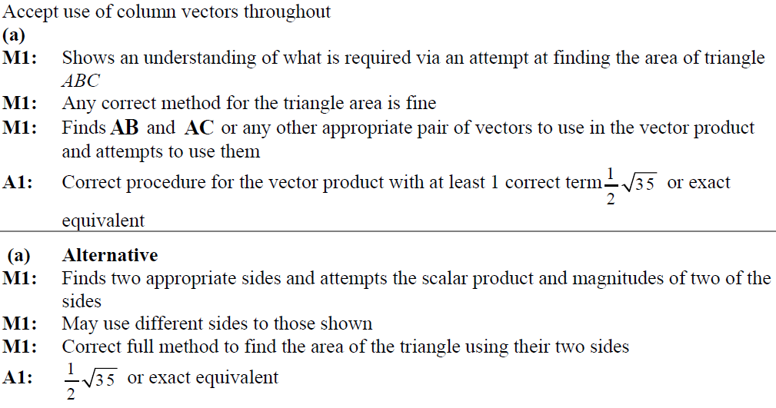
SAM
A notes
A Alternative notes

Slide 7
SAM
B notes
B Alternative notes
C notes

Slide 8
2018

Slide 9
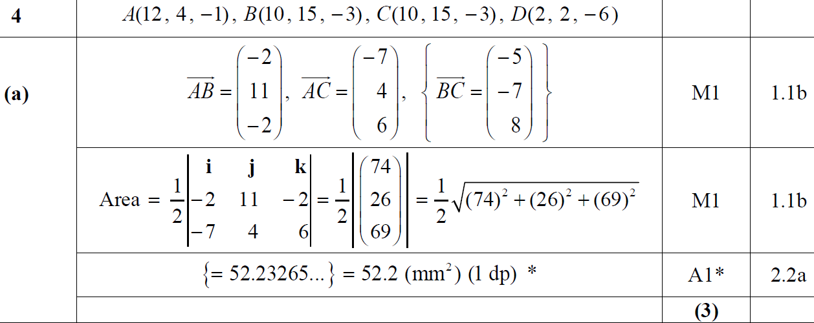
2018
A

Slide 10
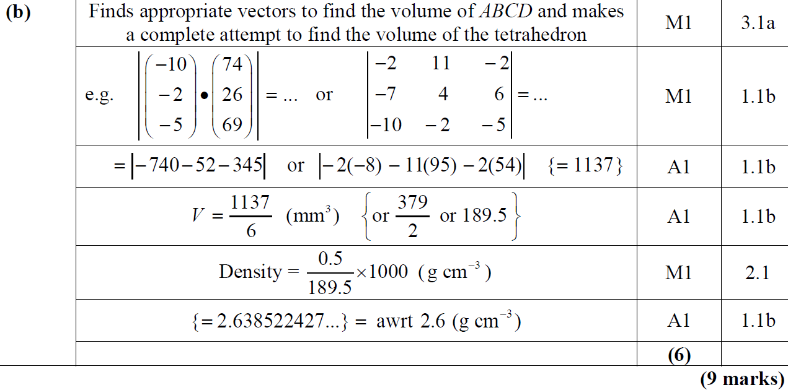
2018
B

Slide 11
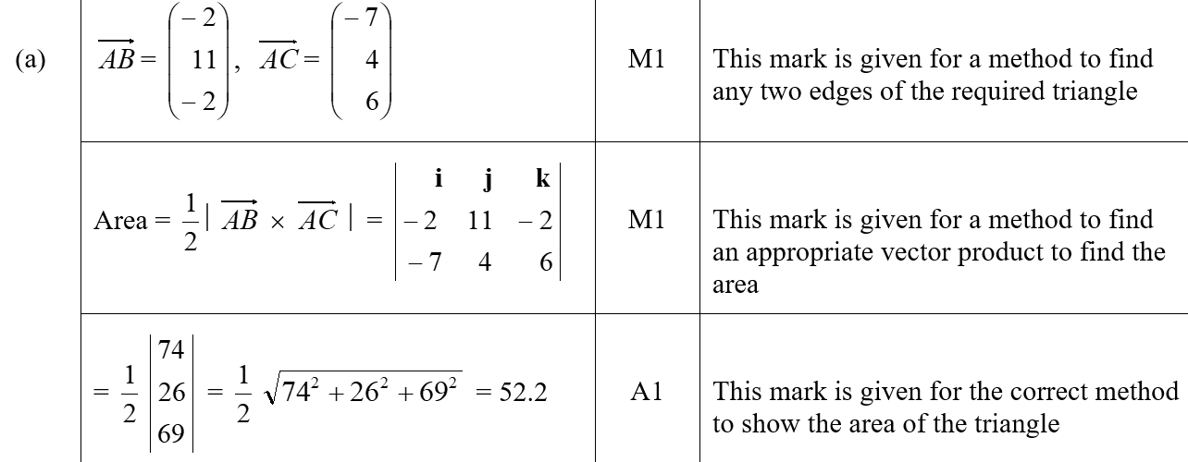
2018
A (SF)

Slide 12
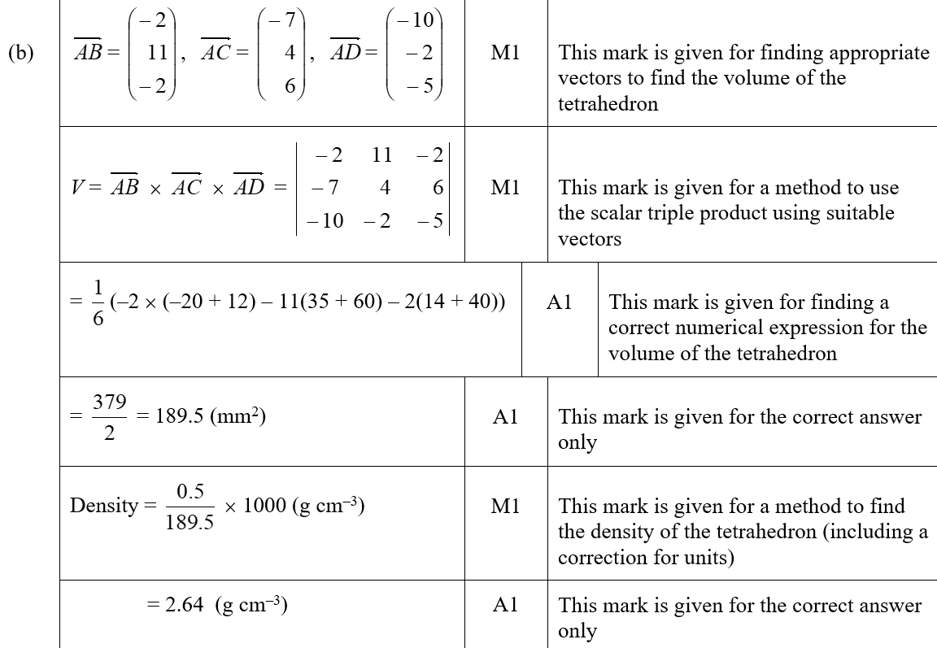
2018
B (SF)

Slide 13
2018
A notes

Slide 14
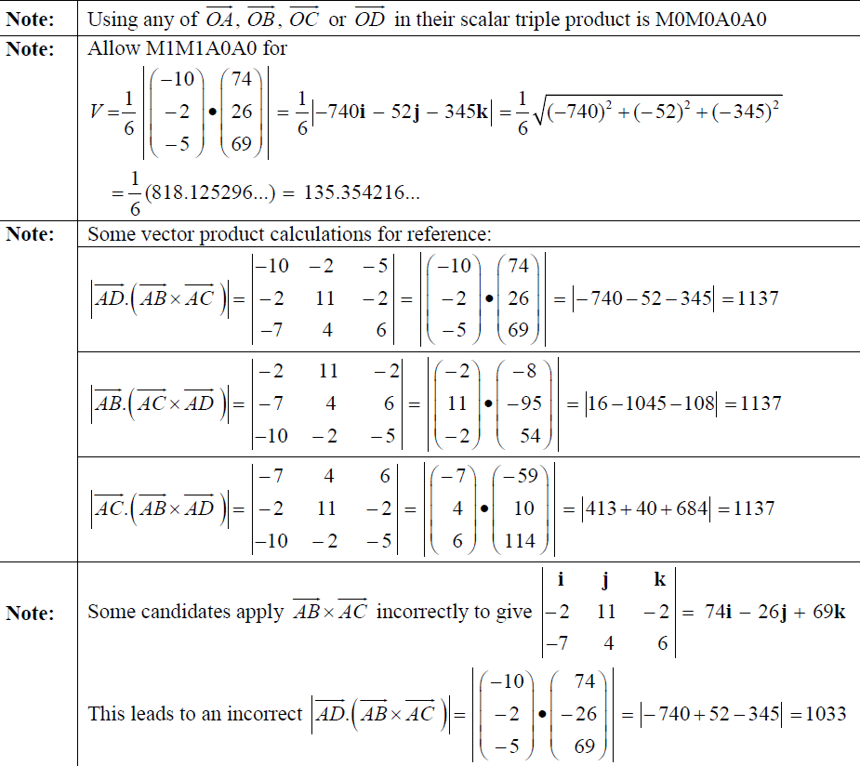
2018
B notes

Slide 15
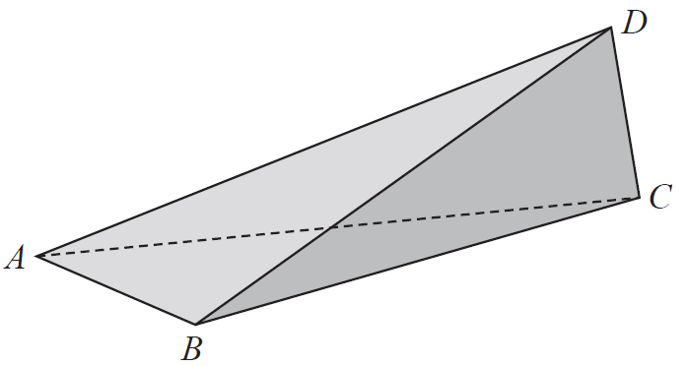
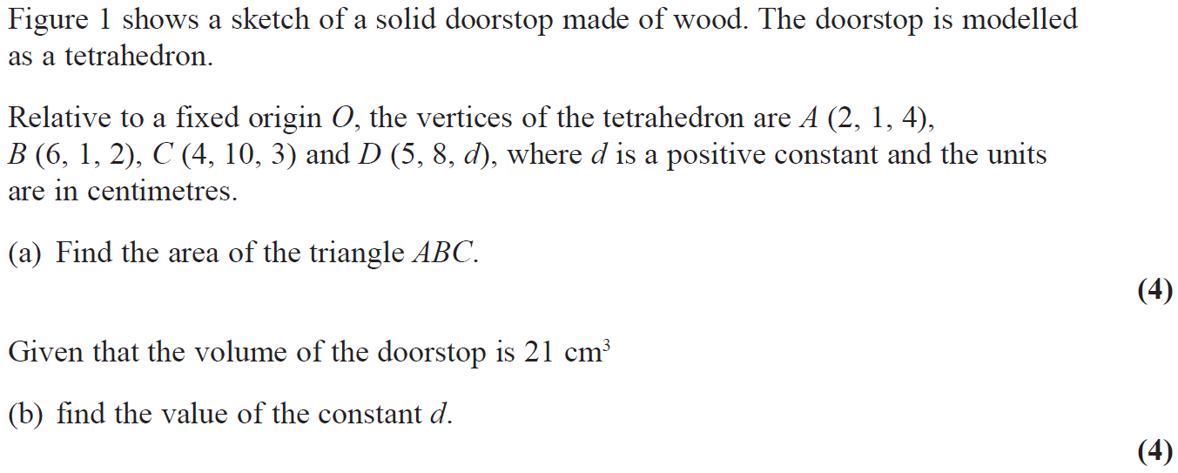
2019

Slide 16
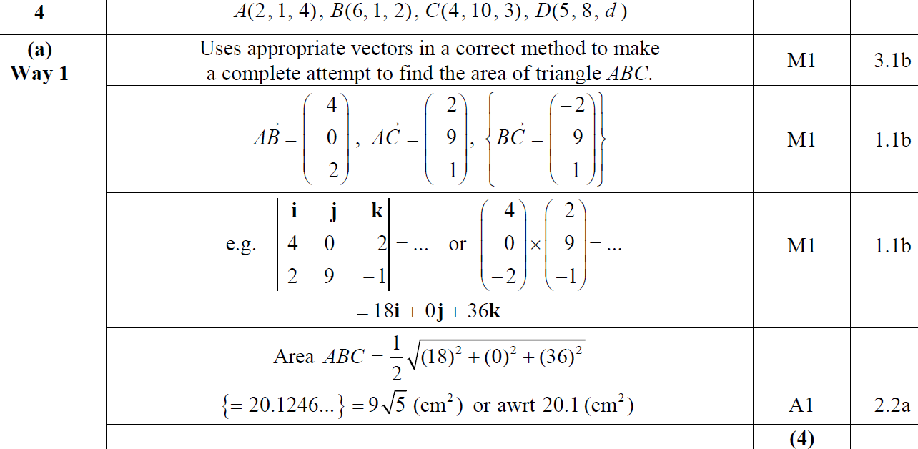
2019
A

Slide 17
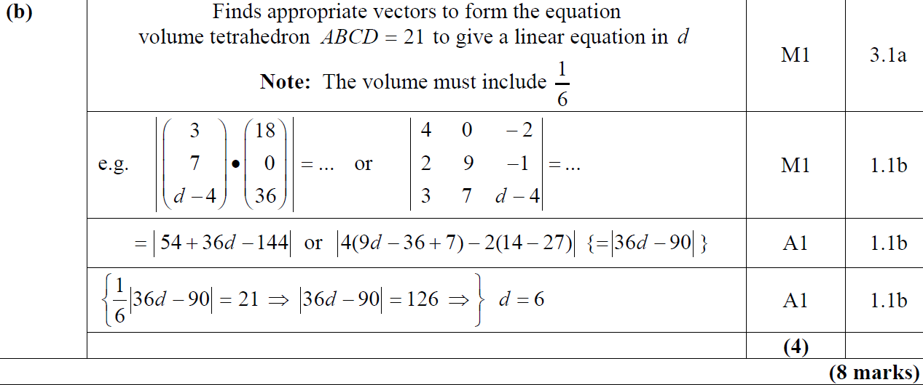
2019
B

Slide 18
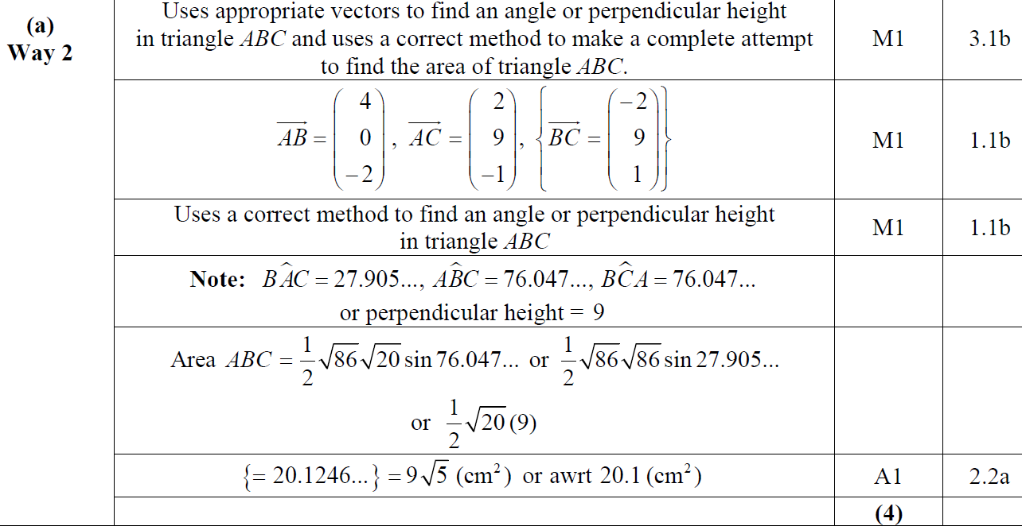
2019
A Alternative 1

Slide 19
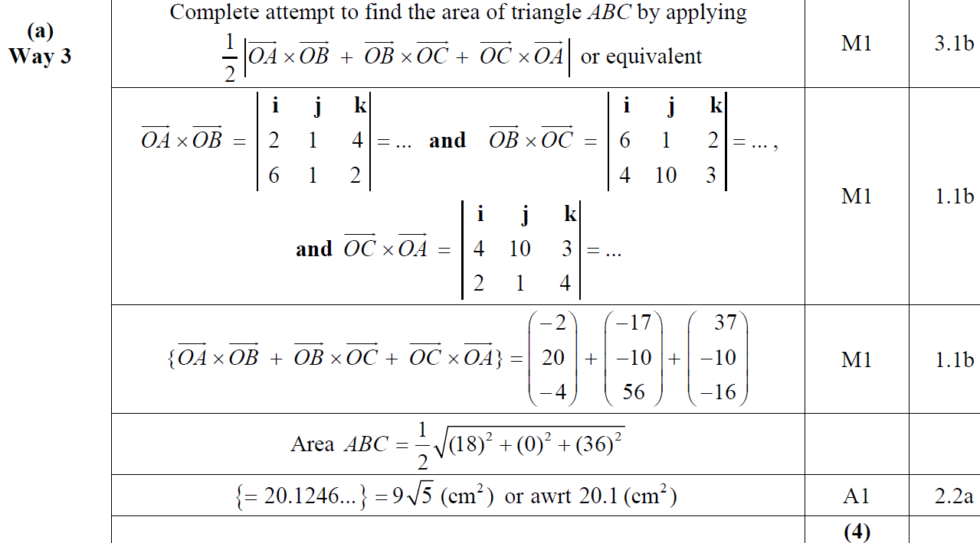
2019
A Alternative 2

Slide 20
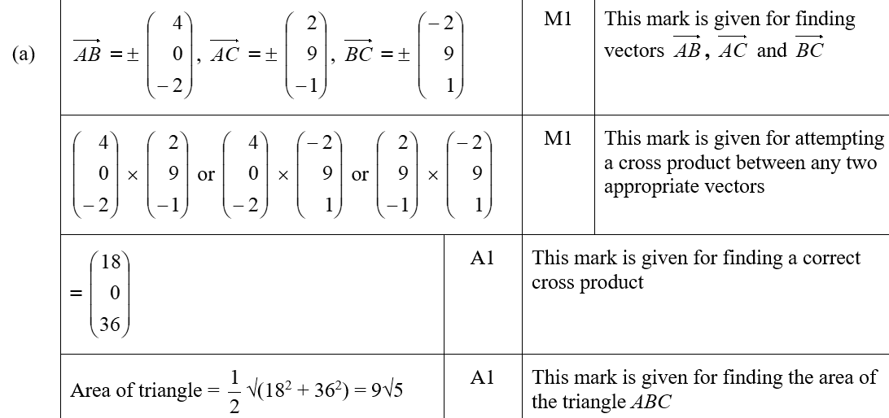
2019
A (SF)

Slide 21
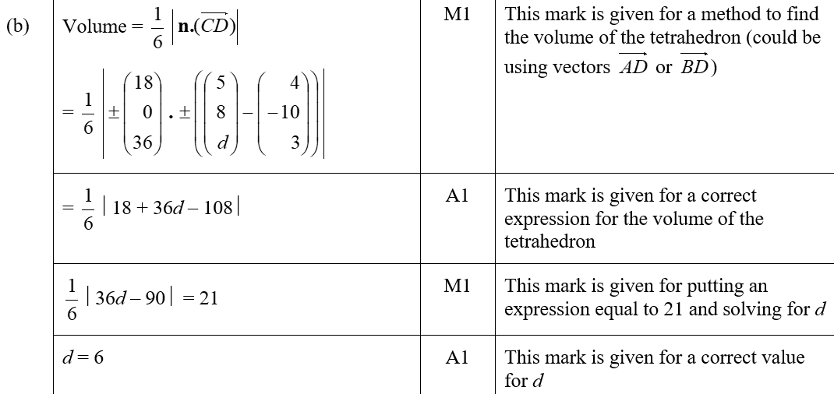
2019
B (SF)

Slide 22
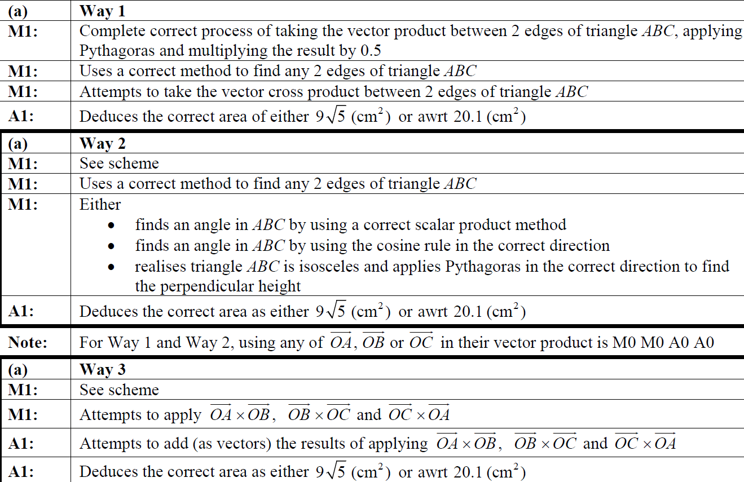
2019
A notes
A Alternative 1 notes
A Alternative 2 notes

Slide 23
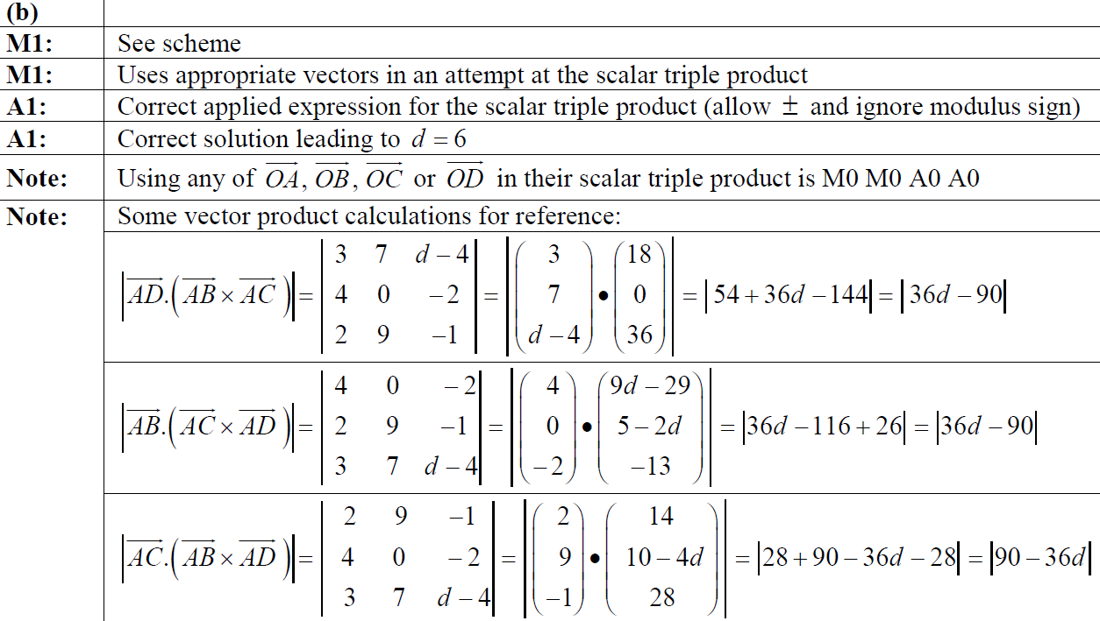
2019
B notes

Slide 24
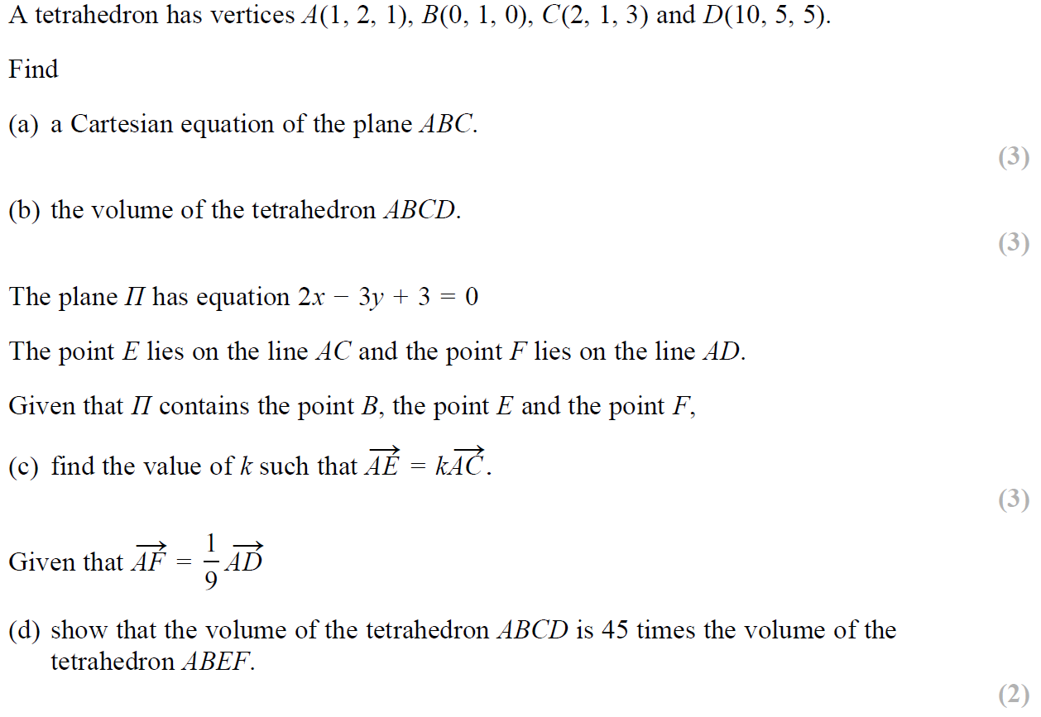
SAM

Slide 25
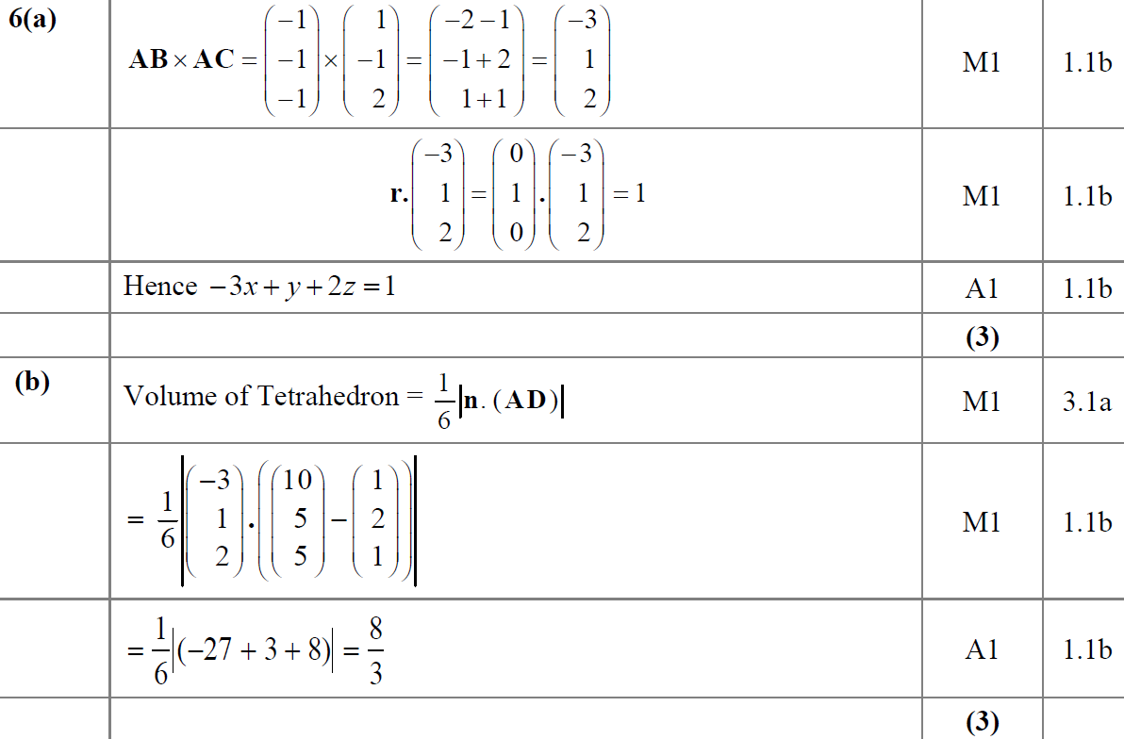
SAM
A
B

Slide 26
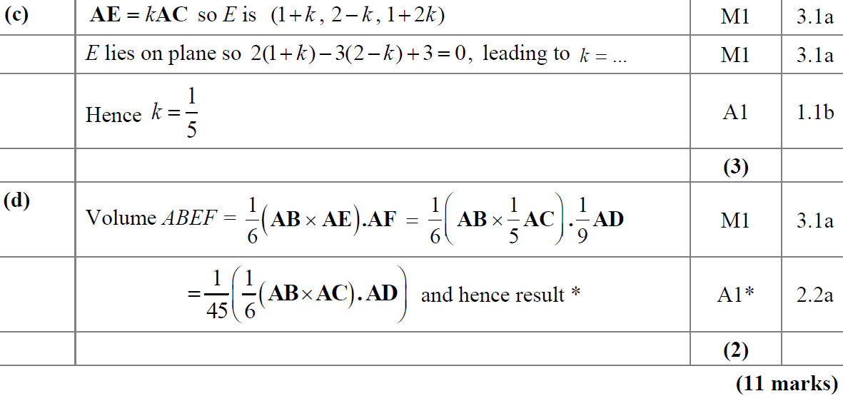
SAM
C
D

Slide 27
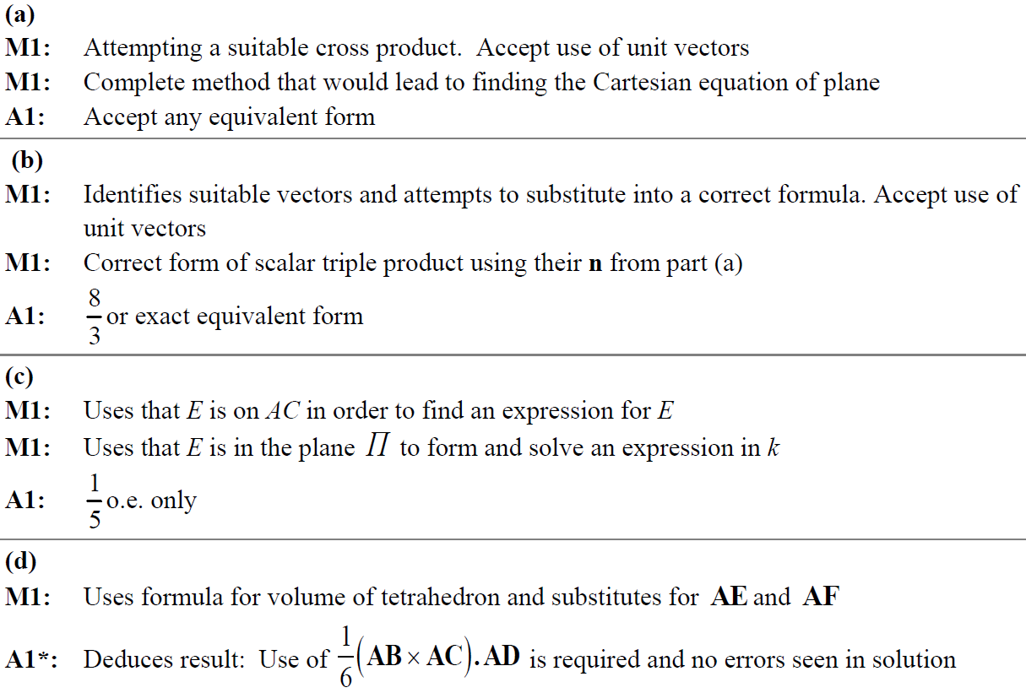
SAM
A notes
B notes
C notes
D notes

Slide 28
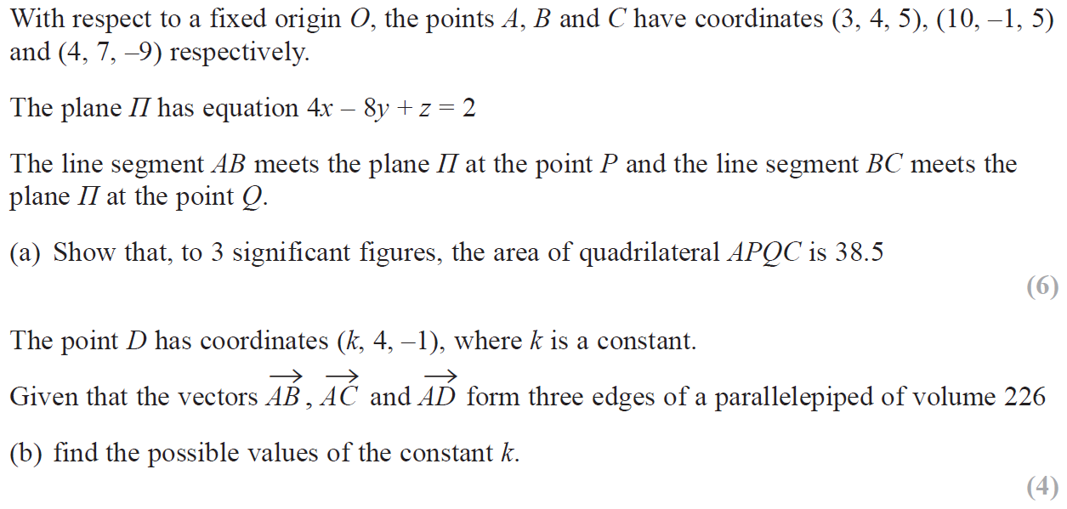
2019

Slide 29
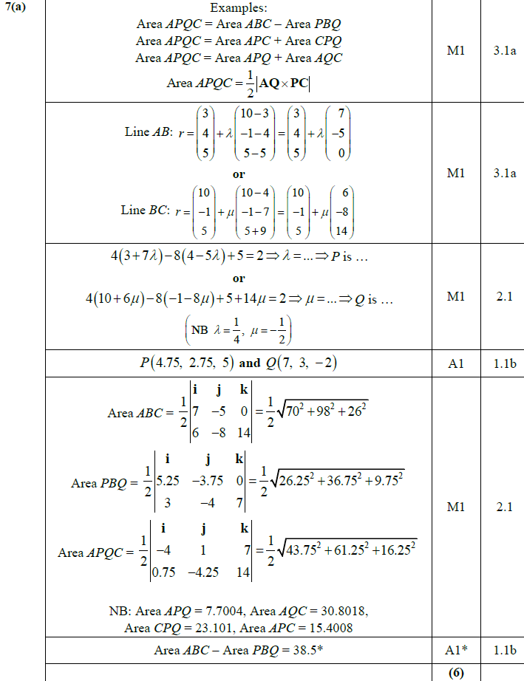
2019
A

Slide 30
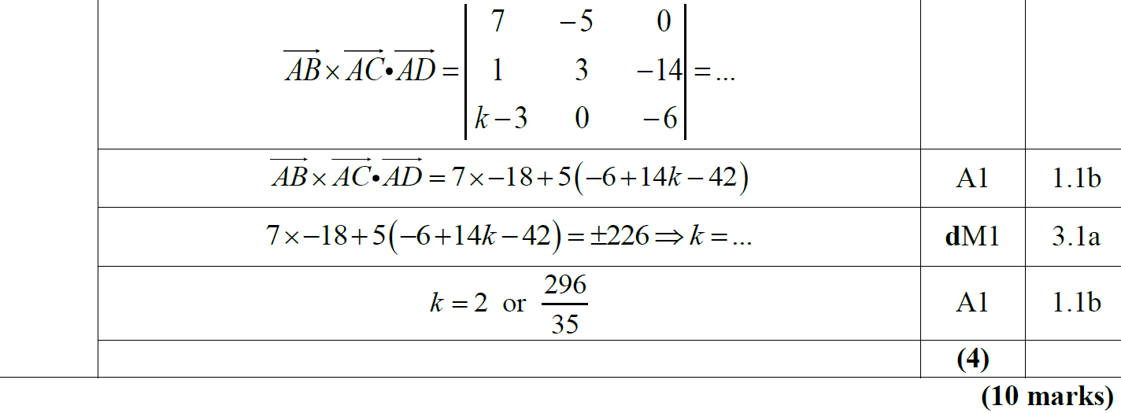
2019
B

Slide 31
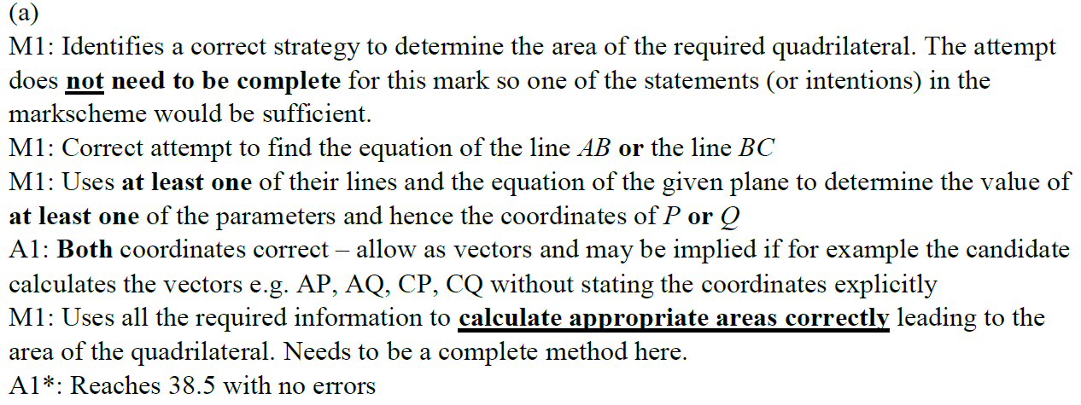
2019
A notes

Slide 32
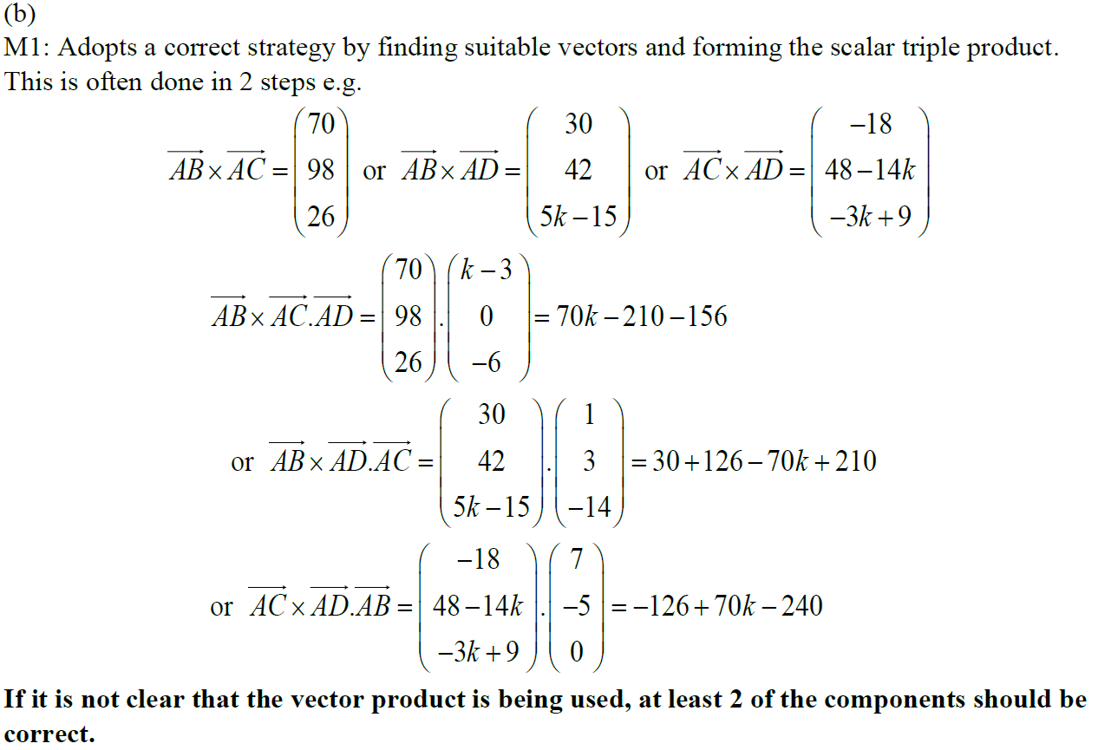
2019
B notes

Slide 33
New Spec Q’s
Old Spec Vectors
P6/ Old FP3
FP3
June 2002
June 2005 (i)
June 2006
June 2009
June 2009
June 2013 (W)
June 2003
June 2005 (ii)
June 2007
Jan 2010
June 2011
June 2014
June 2004
Jan 2006
June 2008
June 2013
June 2016

Slide 34
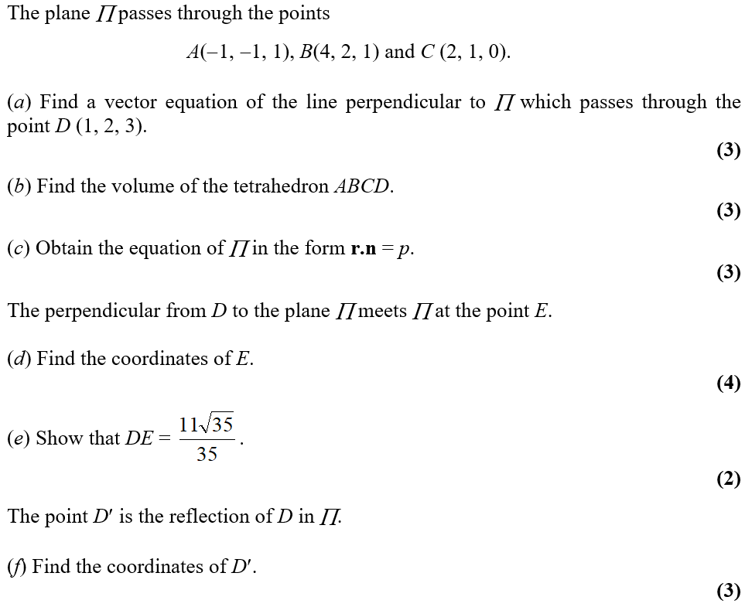
June 2002

Slide 35
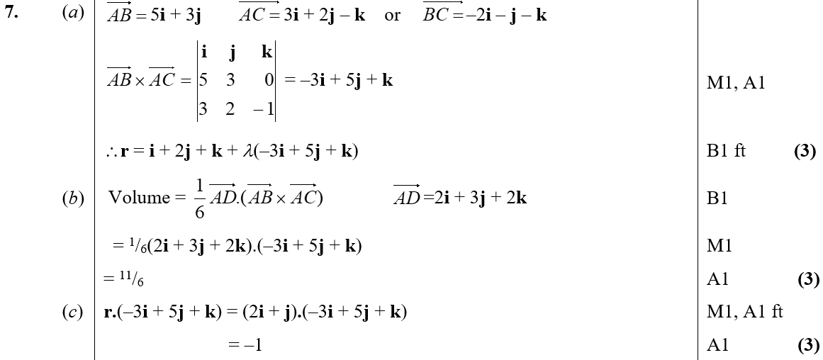
June 2002
A
B
C

Slide 36
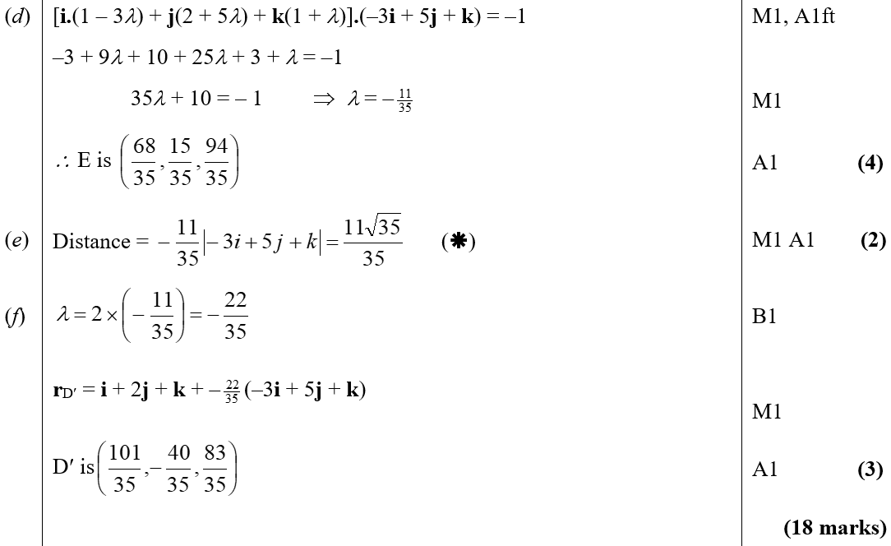
June 2002
D
E
F

Slide 37
June 2003

Slide 38
June 2003
A

Slide 39
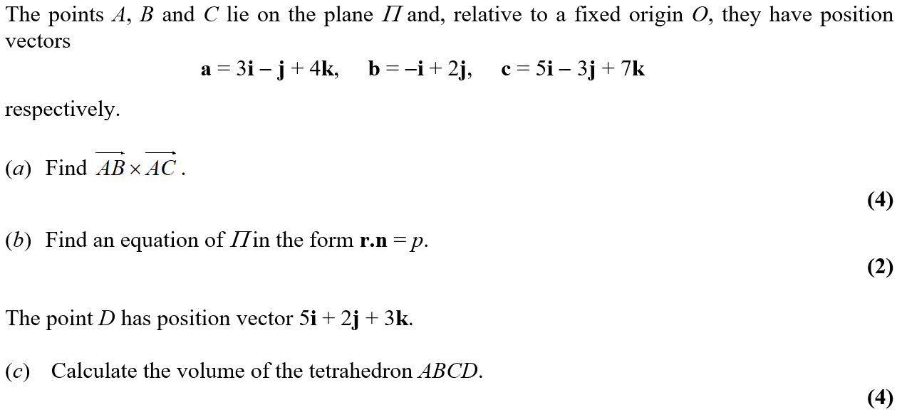
June 2004

Slide 40
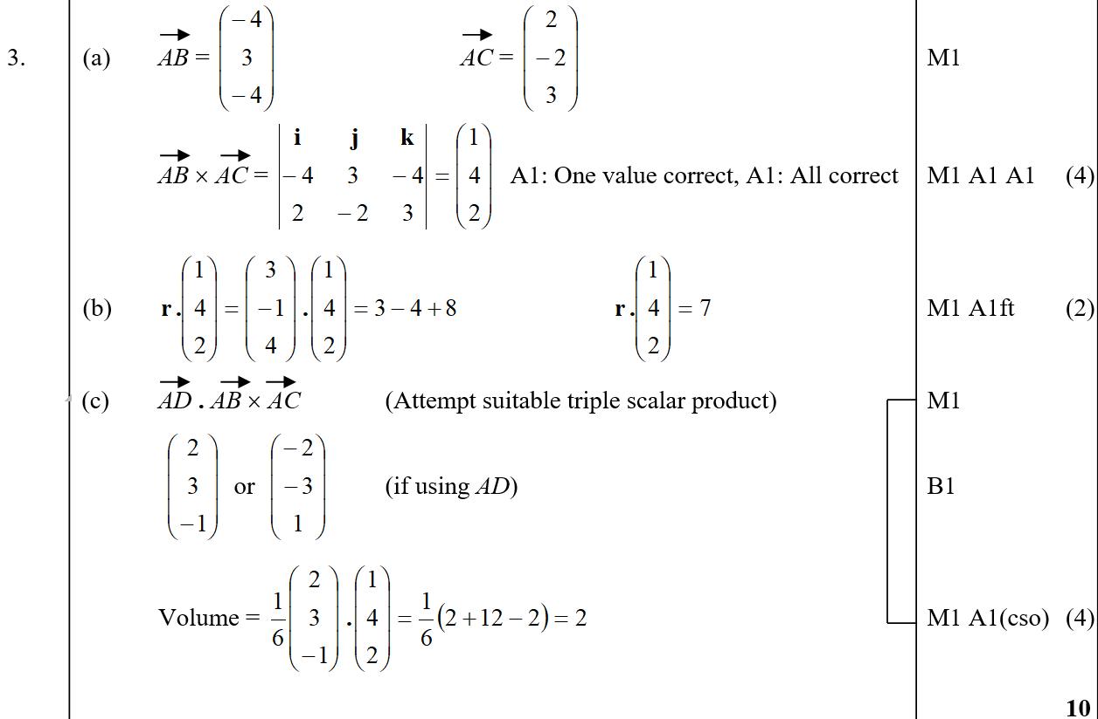
June 2004
A
B
C

Slide 41
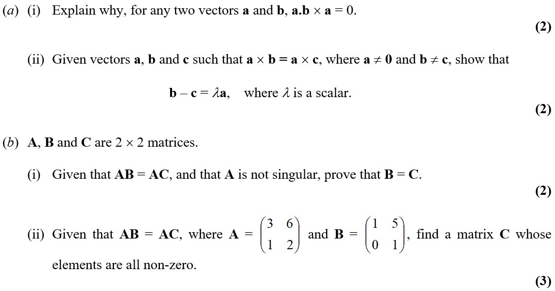
June 2005

Slide 42
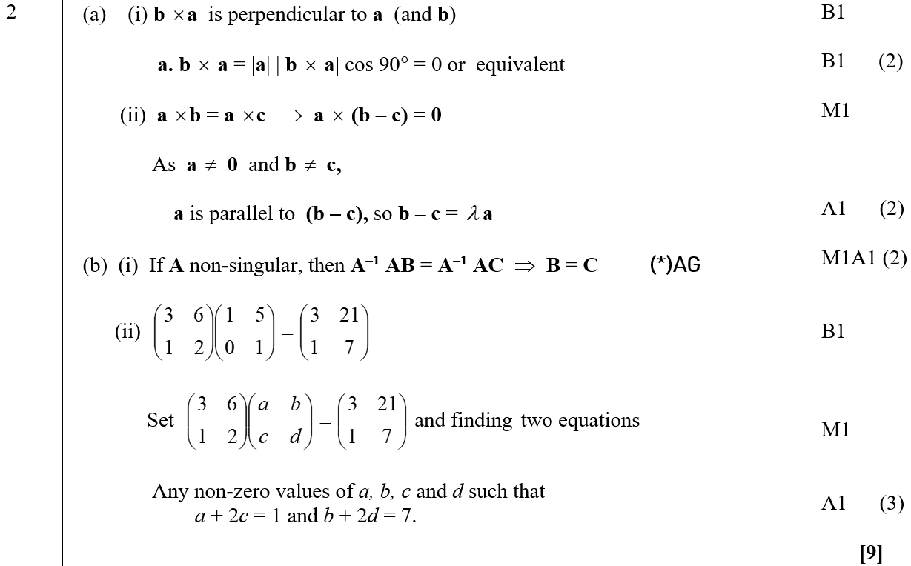
June 2005
A (i)
A (ii)
B (i)
B (ii)

Slide 43
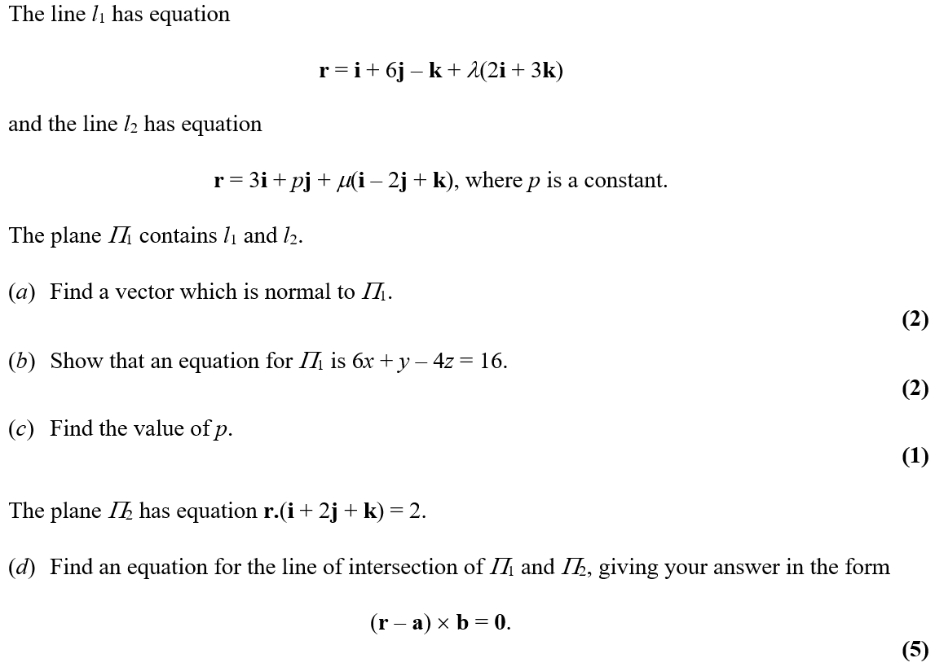
June 2005

Slide 44
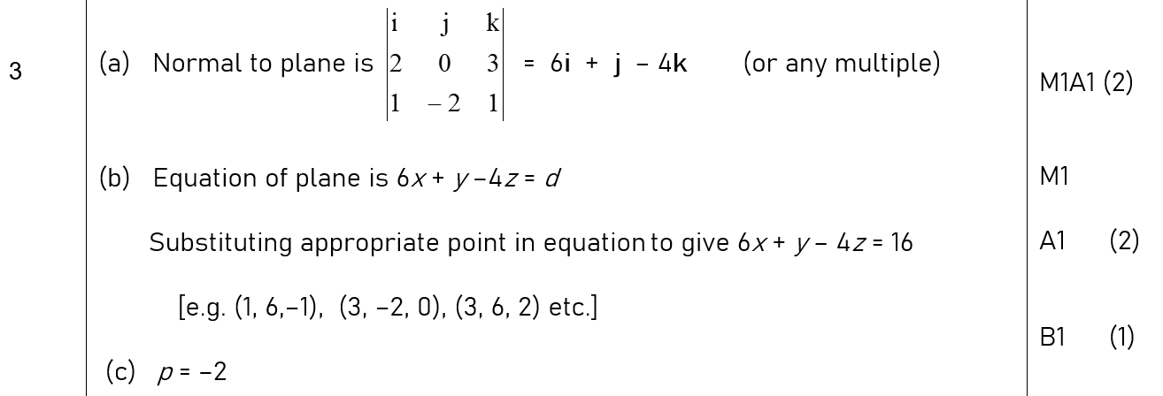
June 2005
A
B
C

Slide 45
June 2005
D

Slide 46
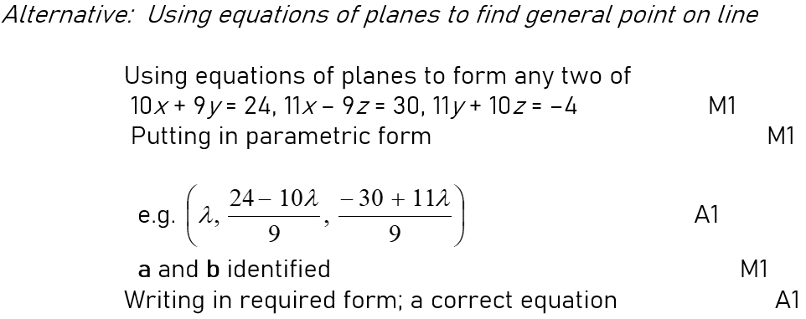
June 2005
D Alternative

Slide 47
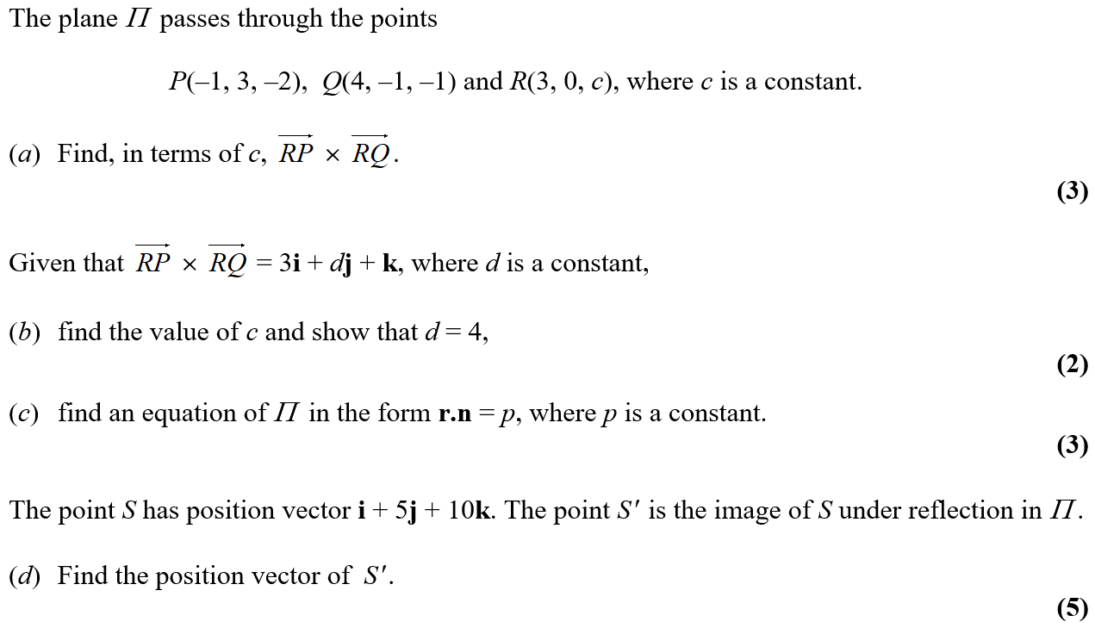
Jan 2006

Slide 48
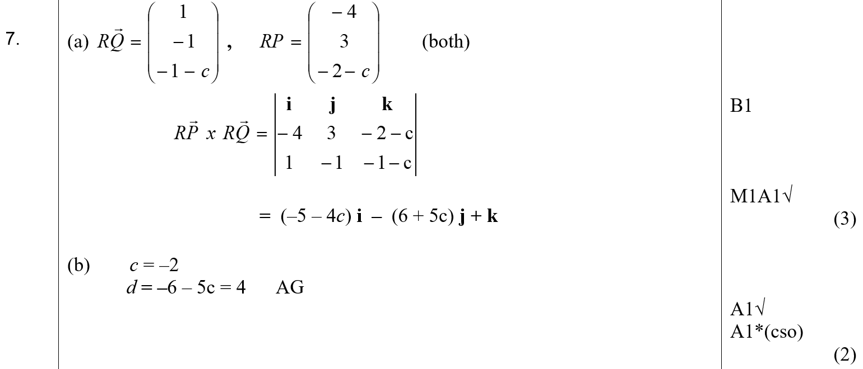
Jan 2006
A
B
C

Slide 49
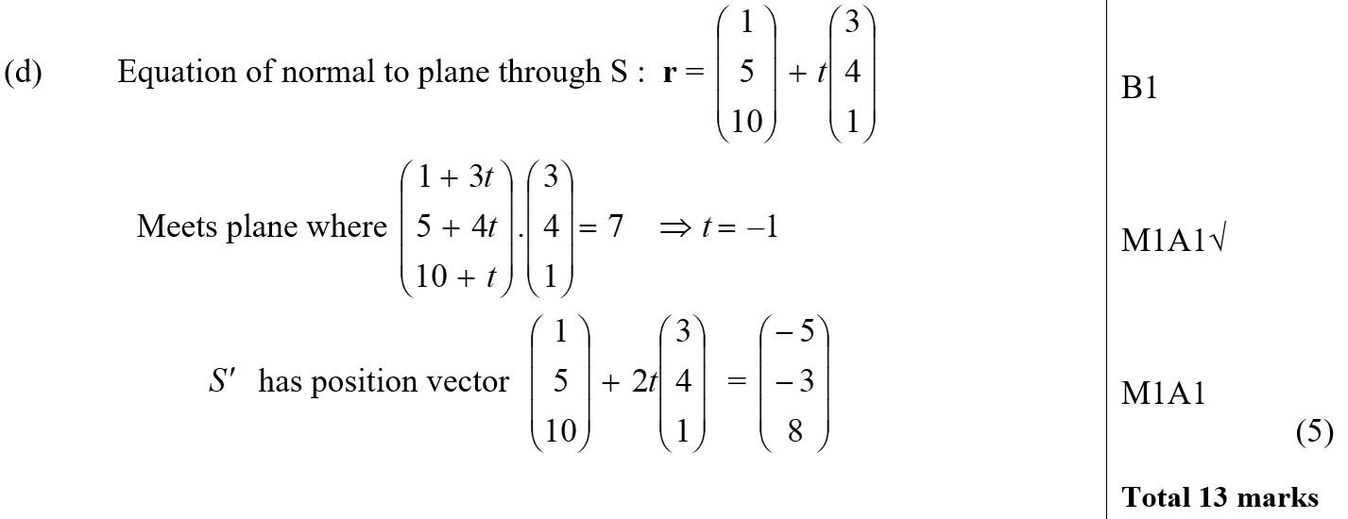
Jan 2006
D

Slide 50
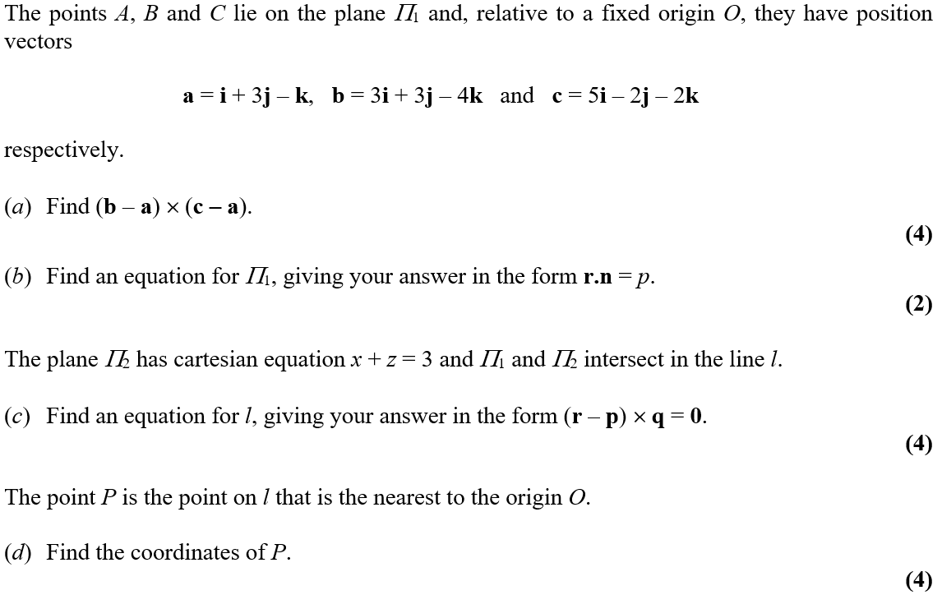
June 2006

Slide 51
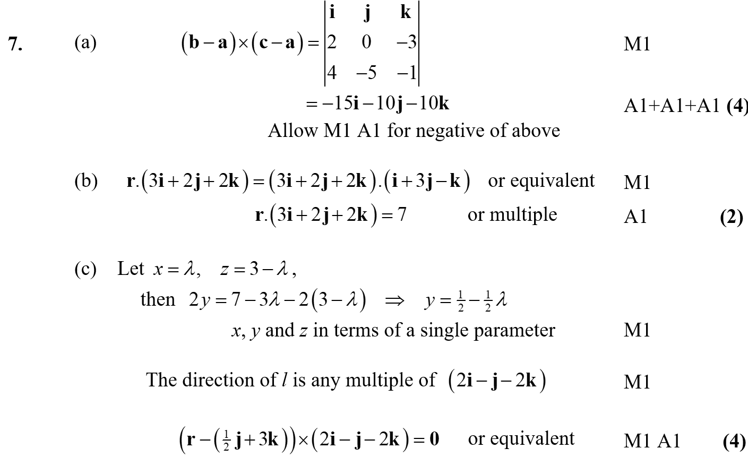
June 2006
A
B
C

Slide 52
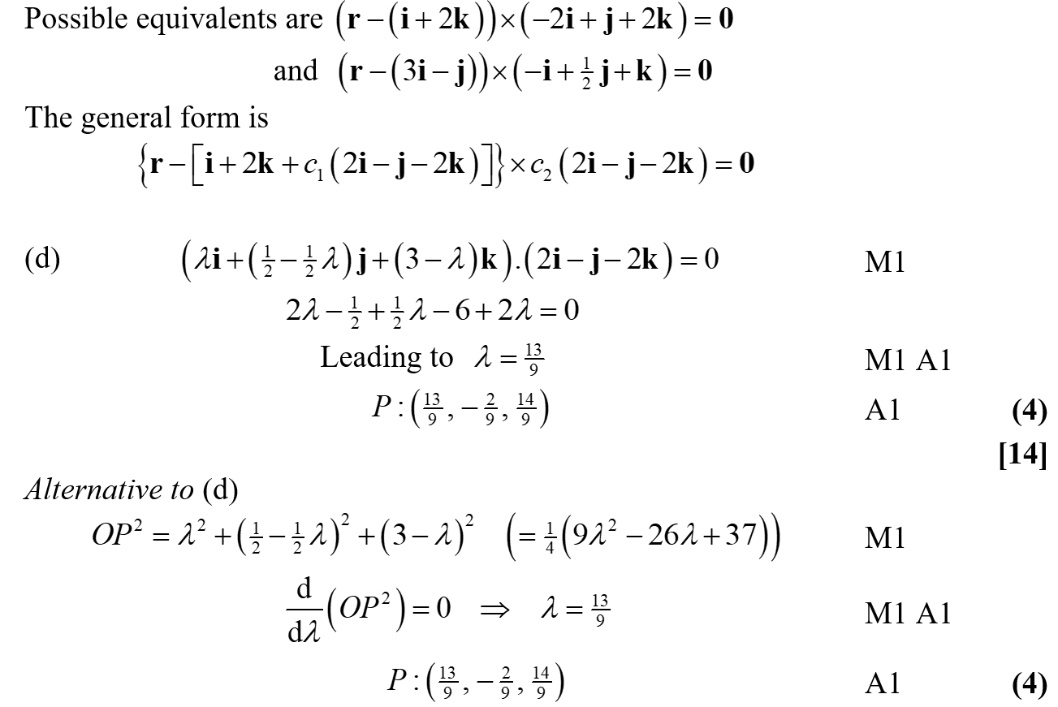
June 2006
C Equivalents
D

Slide 53
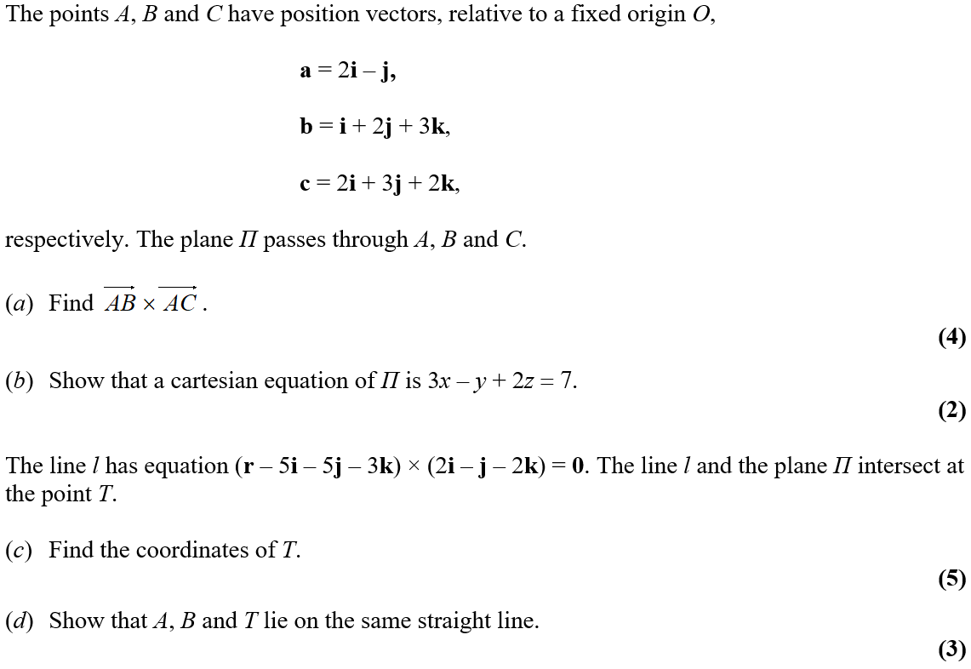
June 2007

Slide 54
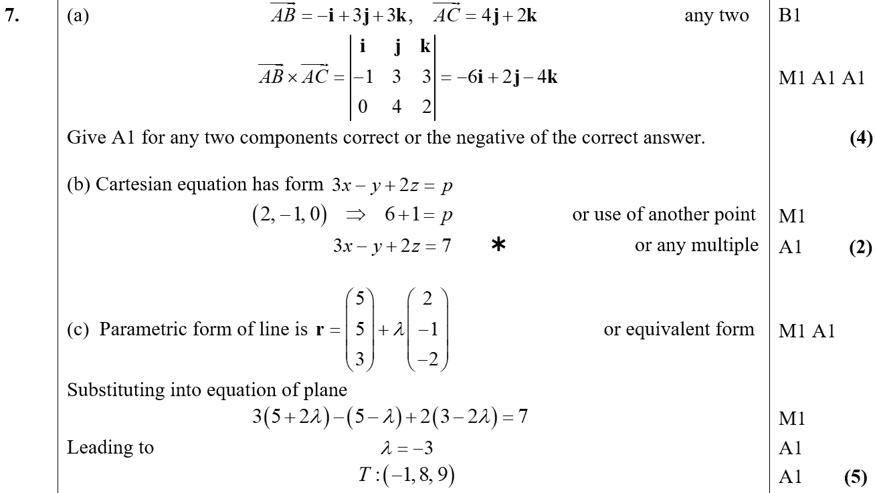
June 2007
A
B
C

Slide 55
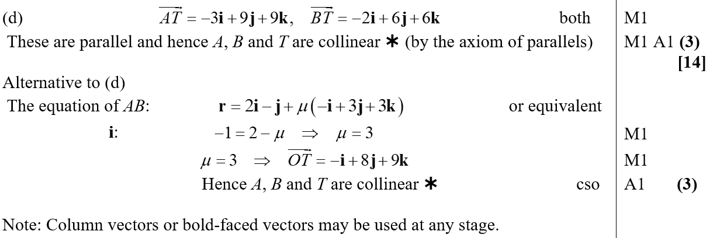
June 2007
D

Slide 56
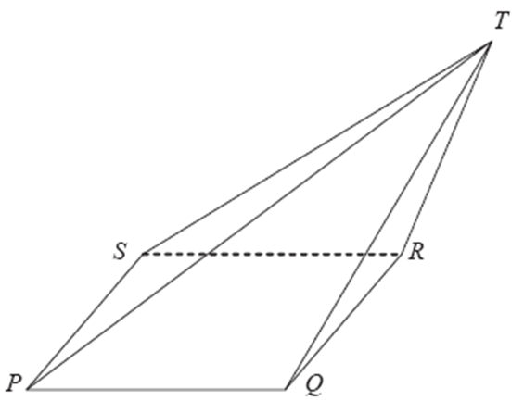
June 2008

Slide 57
June 2008
A
B
C
D

Slide 58
June 2008
A

Slide 59
June 2008
A notes
C Alternative
E Alternative

Slide 60
June 2009

Slide 61
June 2009
A
B
C
D

Slide 62
Jan 2010

Slide 63
Jan 2010
A
B
C

Slide 64
Jan 2010
D
E

Slide 65
June 2009

Slide 66
June 2009
A
B
C
D

Slide 67
June 2011

Slide 68
June 2011
A
B
C
A notes
B notes
C notes

Slide 69
June 2013

Slide 70
June 2013
A

Slide 71
June 2013
B
C

Slide 72
June 2013
C Alternative 1

Slide 73
June 2013
C Alternative 2

Slide 74
June 2013 (Withdrawn)

Slide 75
June 2013 (Withdrawn)
A
B

Slide 76
June 2013 (Withdrawn)
C

Slide 77
June 2014

Slide 78
June 2014
A

Slide 79
June 2014
B

Slide 80
June 2014
C

Slide 81
June 2016

Slide 82
June 2016
A

Slide 83
June 2016
B

Slide 84
June 2016
C

Slide 85
June 2016
C Alternative 1 by Simultaneous Equations

Slide 86
June 2016
C Alternative 2 by Simultaneous Equations

Slide 87
June 2016
C Alternative 3 by Simultaneous Equations

Slide 88
June 2016
C Alternatives 1 & 2 by Parameters

Slide 89
June 2016
C Alternative 3 by Parameters
C Alternative by 2 Points on a Line

