Slide 1
Old Spec Q’s
Taylor Series
SAM
2019

Slide 2
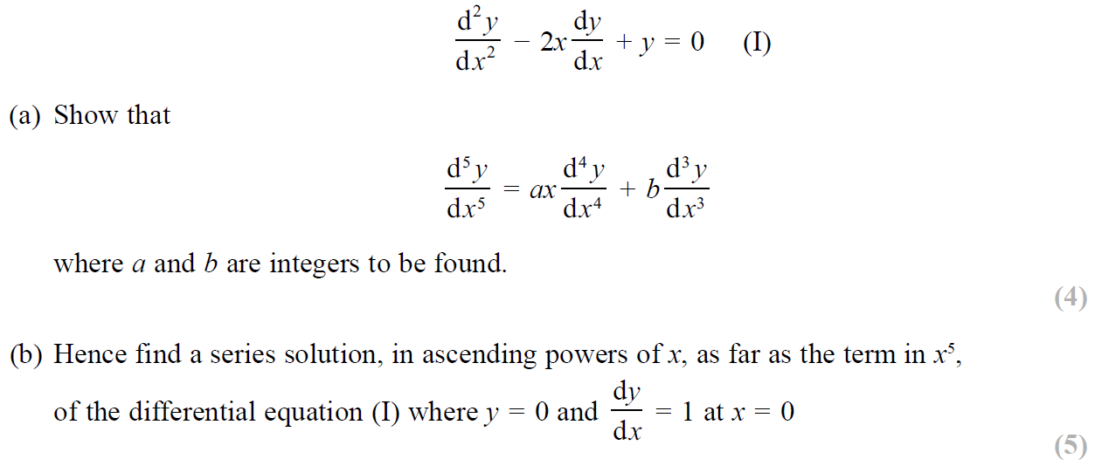
SAM

Slide 3
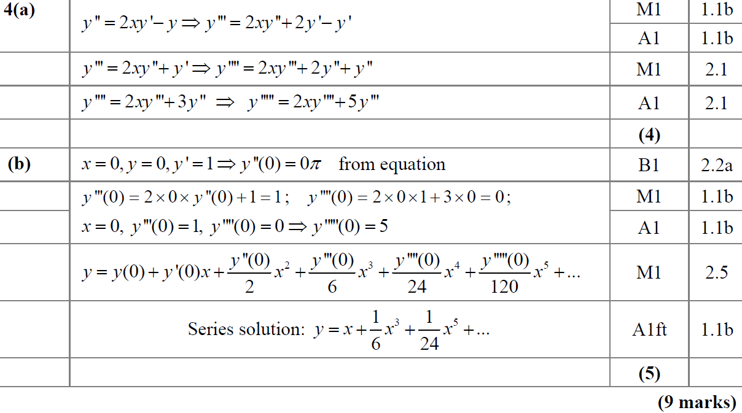
SAM
A
B

Slide 4
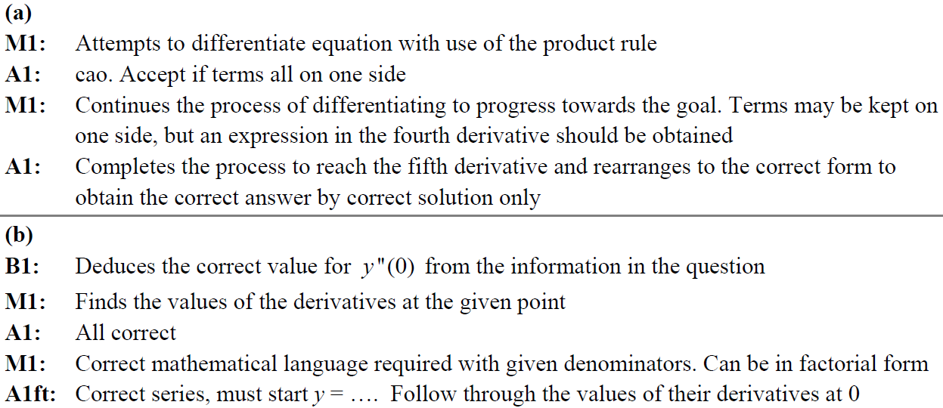
SAM
A notes
B notes

Slide 5
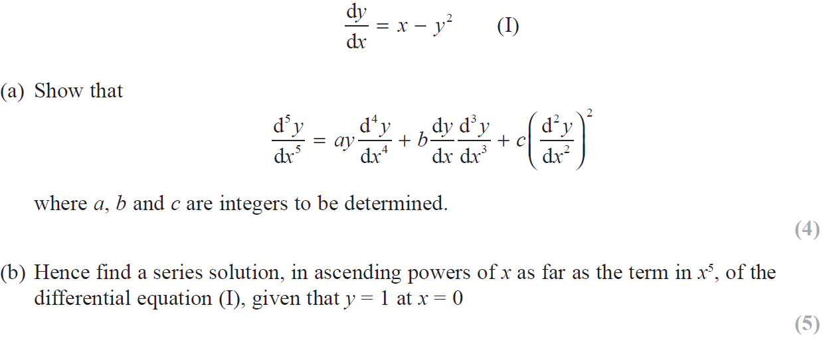
2019

Slide 6
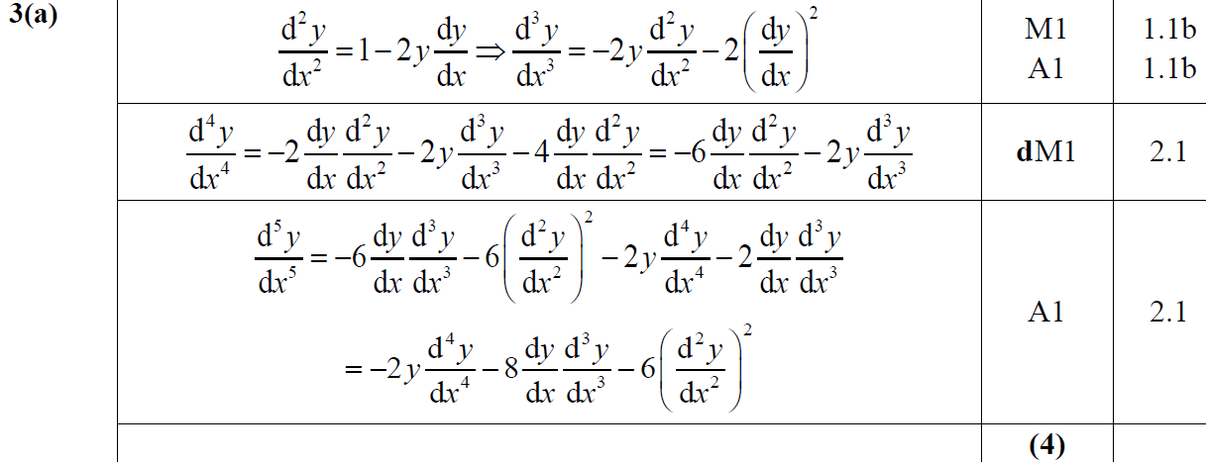
2019
A

Slide 7
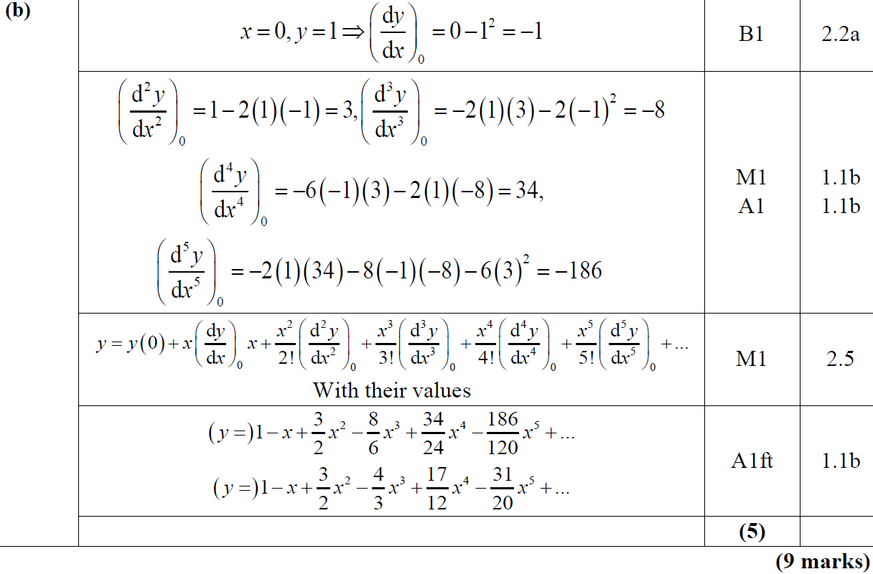
2019
B

Slide 8
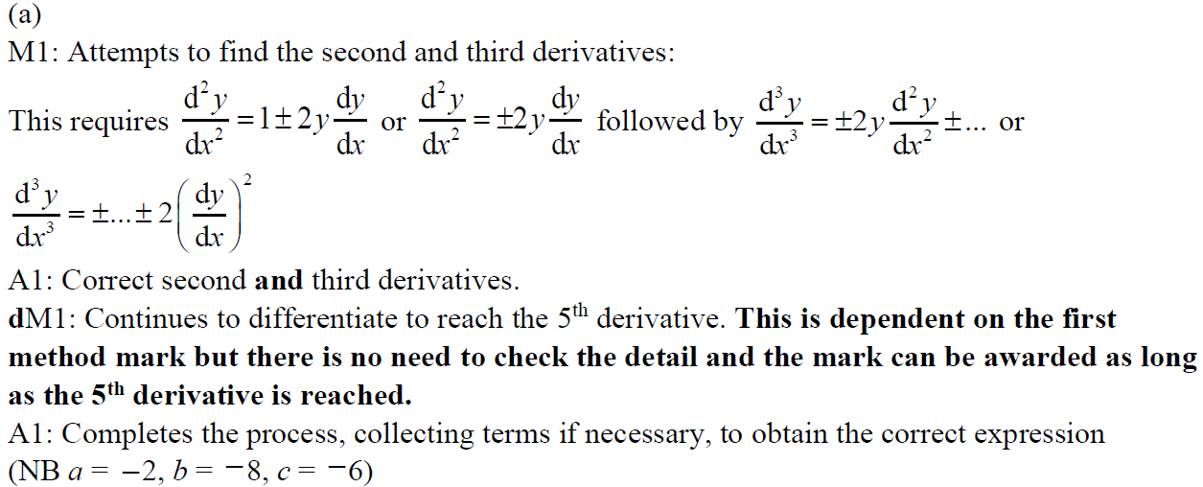
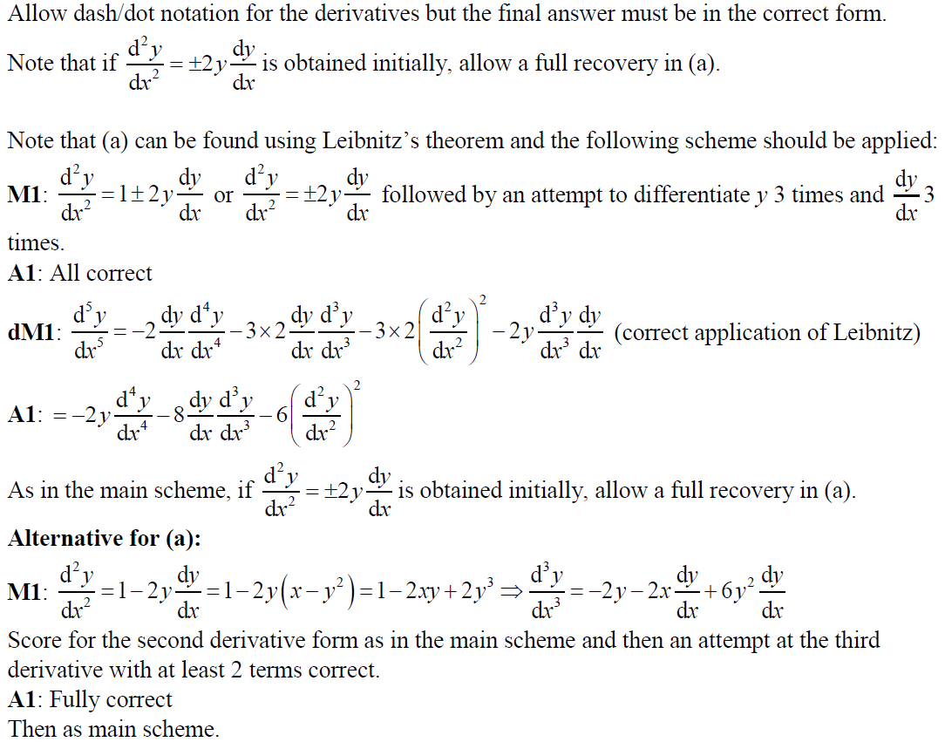
2019
A notes

Slide 9
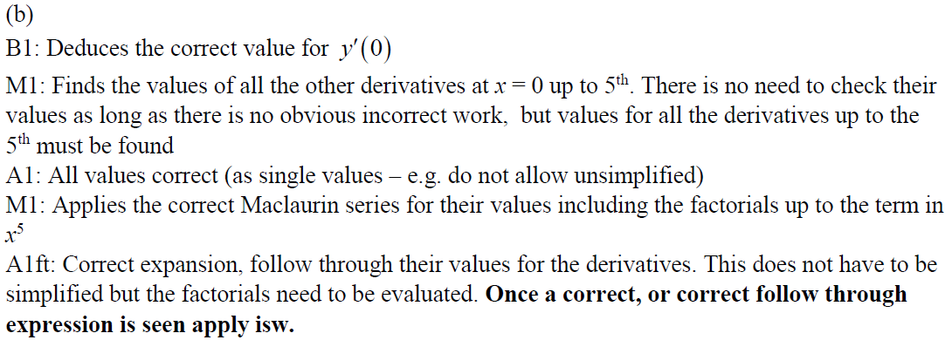
2019
A Alternative
B notes

Slide 10
New Spec Q’s
Old Spec Taylor Series
P6/ Old FP3
FP2
June 2002
June 2006 (ii)
June 2009
June 2013 (R)
June 2016
June 2003
June 2007
June 2010
June 2013 (W)
June 2017
June 2004
June 2008
June 2011
June 2014
June 2018
June 2005
June 2009
June 2012
June 2014 (R)
June 2019
Jan 2006
Jan 2010
June 2013
June 2015
June 2006 (i)

Slide 11
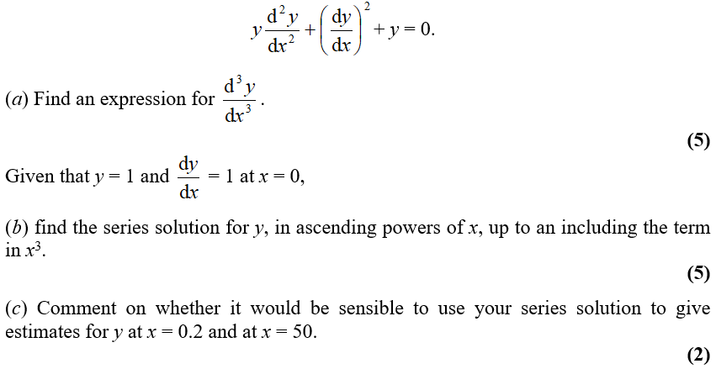
June 2002

Slide 12
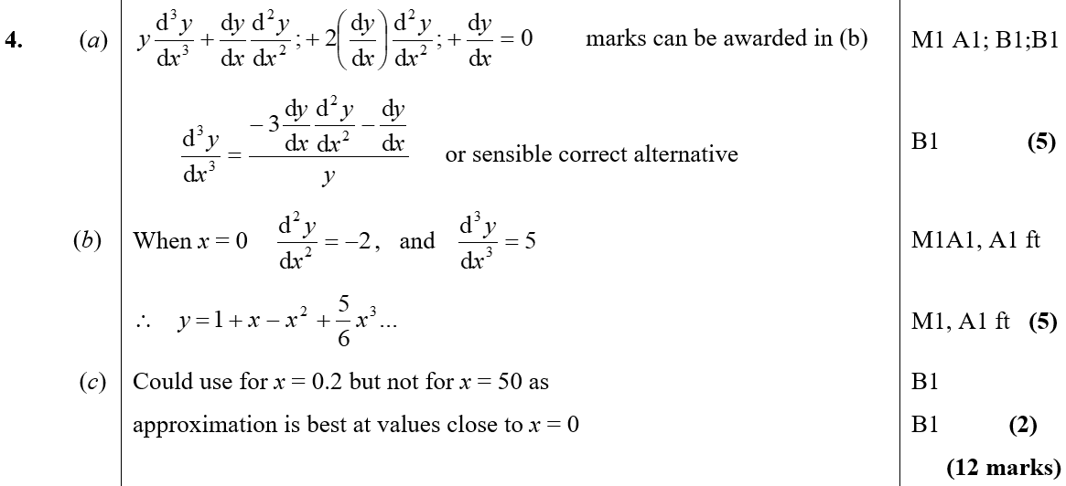
June 2002
A
B
C

Slide 13
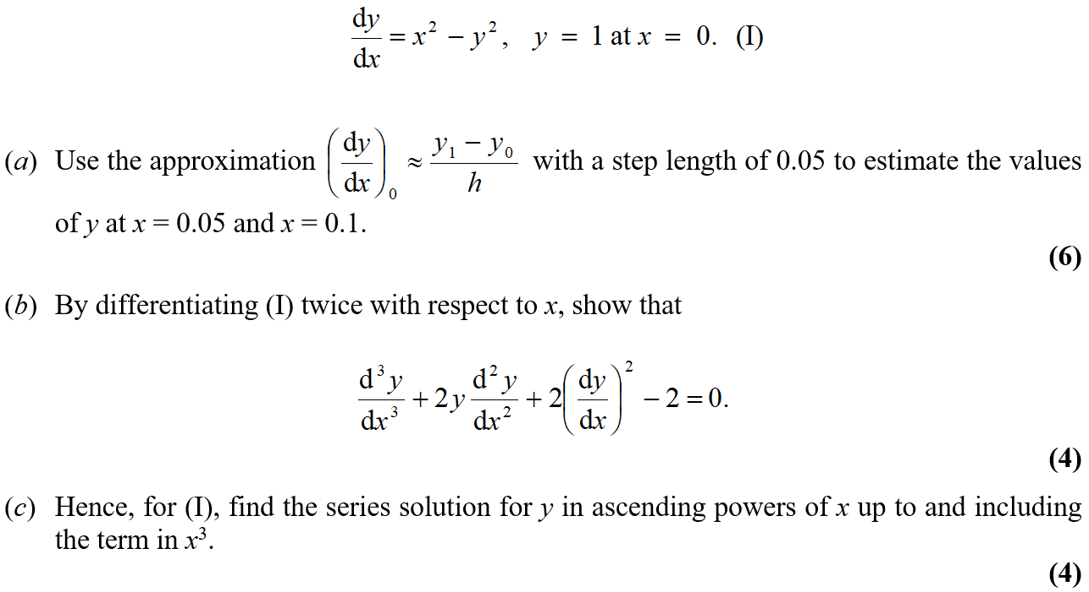
June 2003

Slide 14
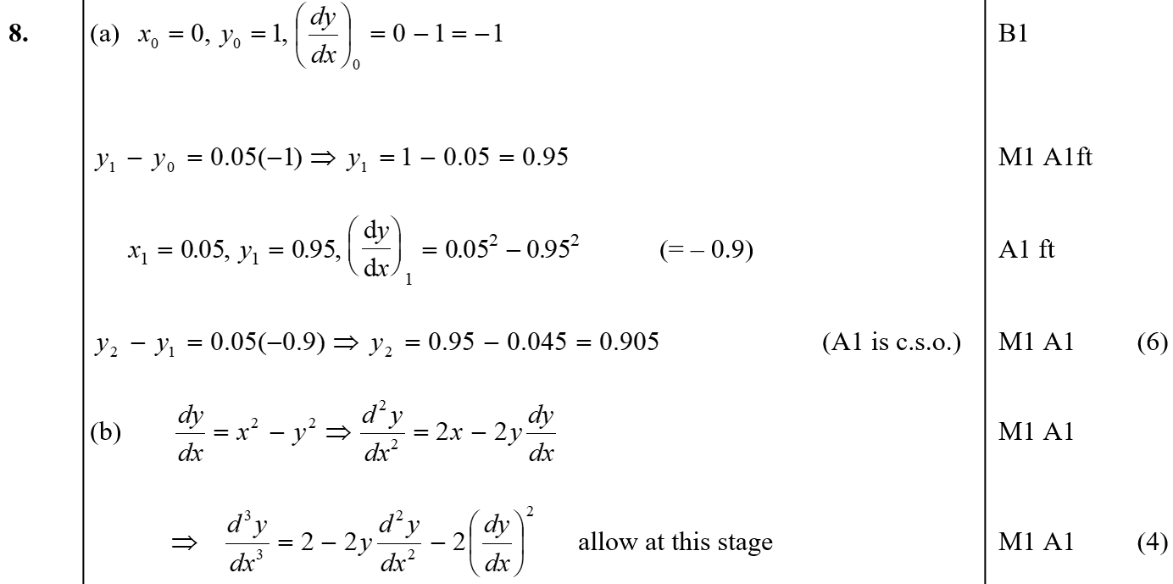
June 2003
A
B

Slide 15
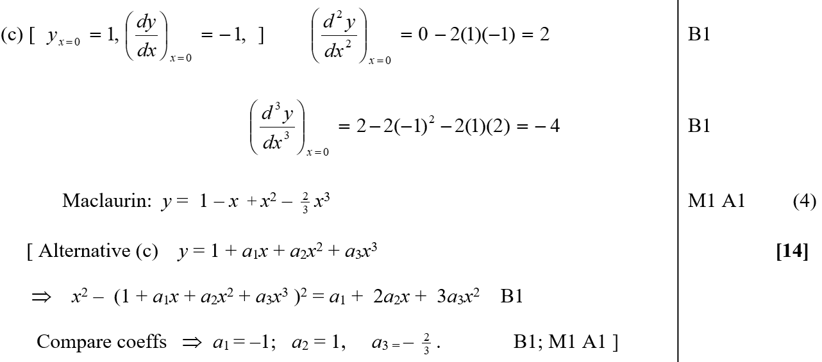
June 2003
C

Slide 16
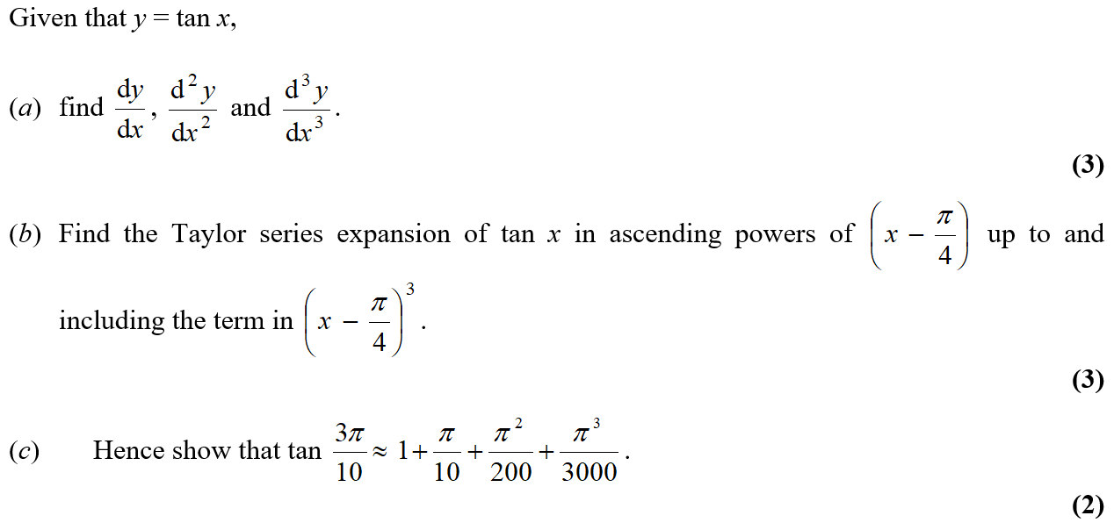
June 2004

Slide 17
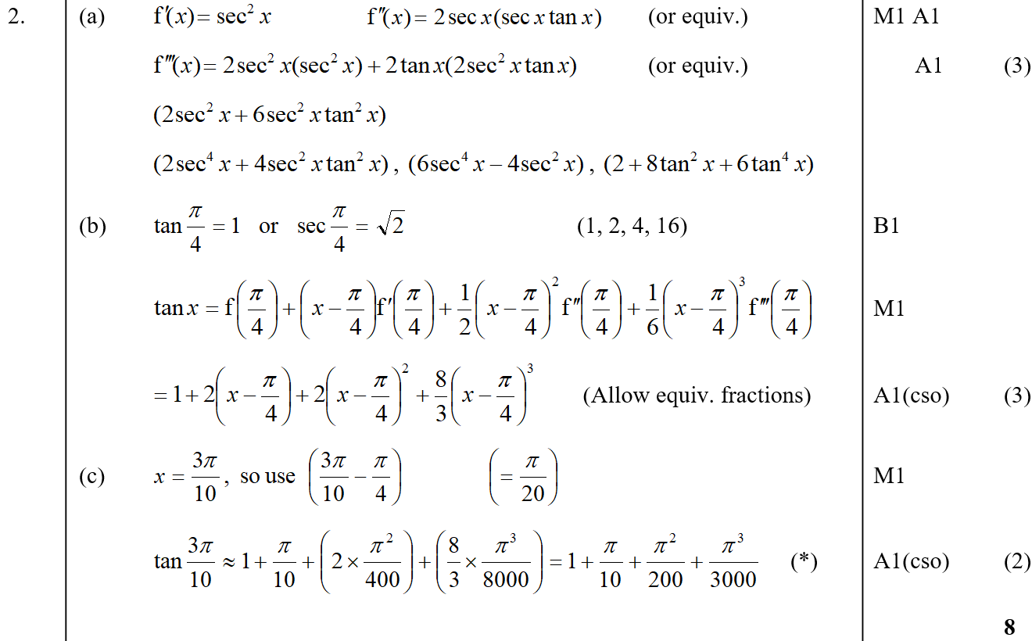
June 2004
A
B
C

Slide 18
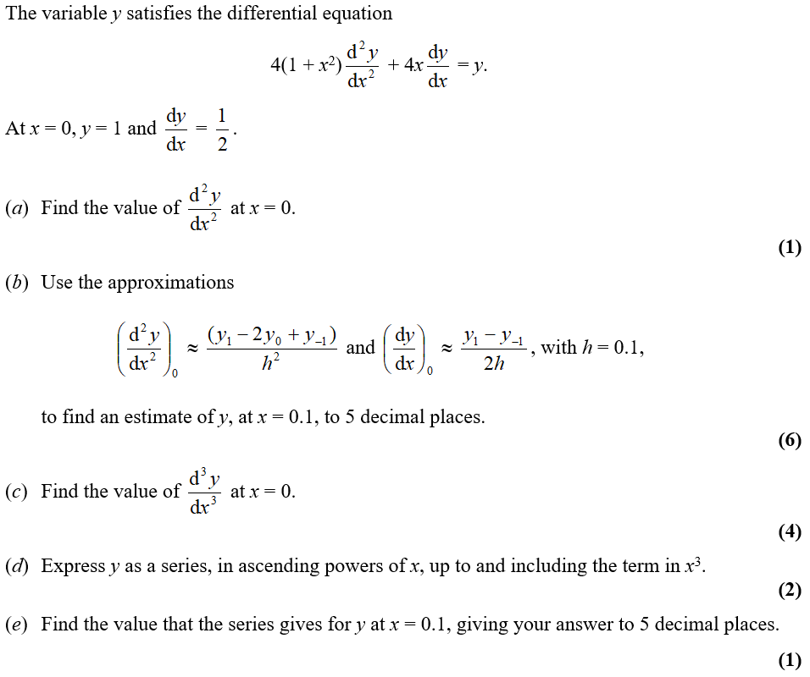
June 2005

Slide 19
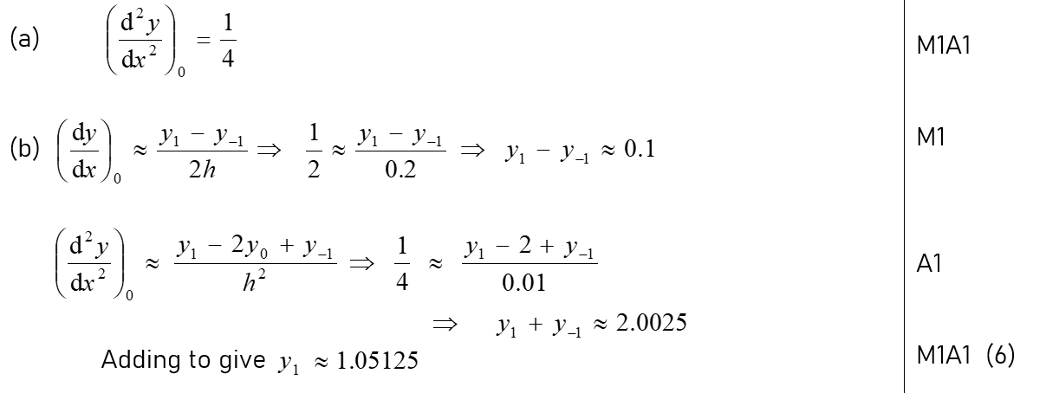
June 2005
A
B

Slide 20
June 2005
C
D
E

Slide 21
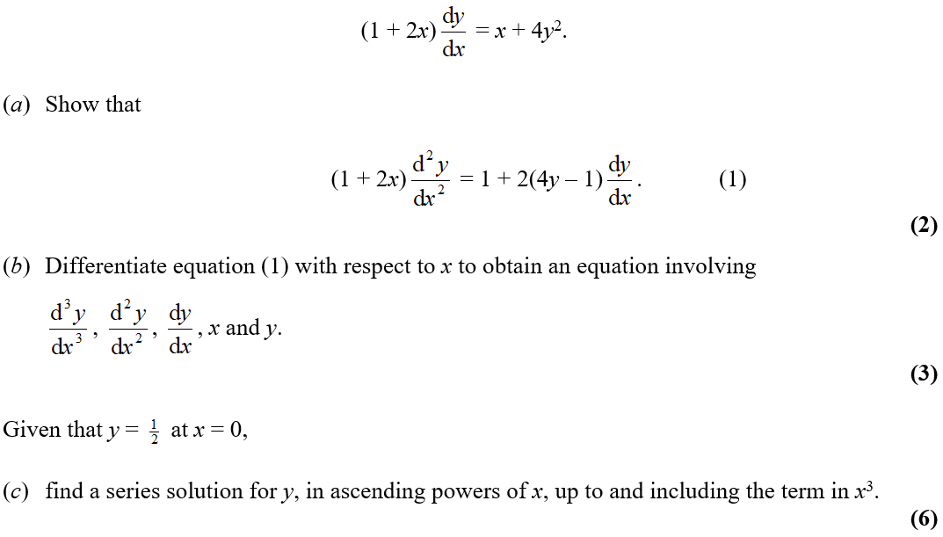
Jan 2006

Slide 22
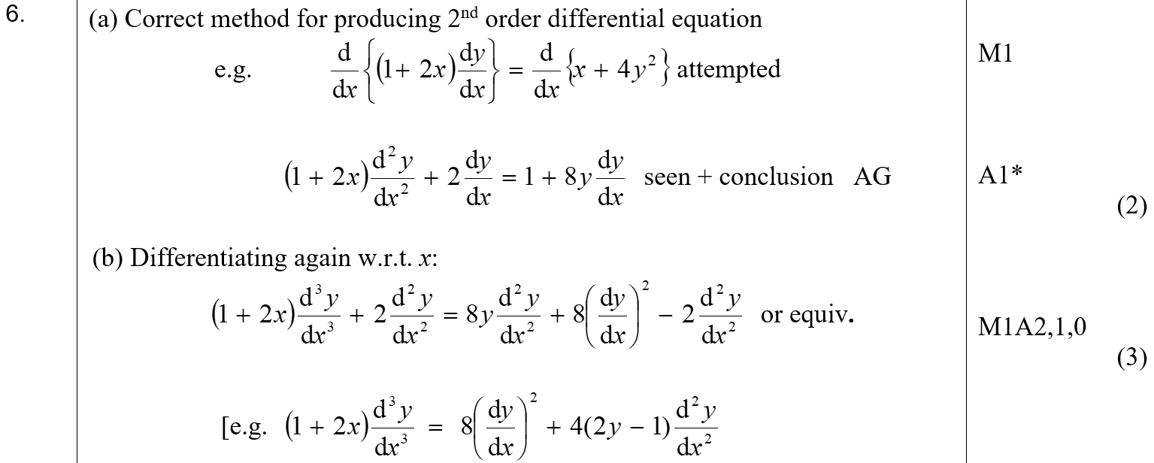
Jan 2006
A
B

Slide 23
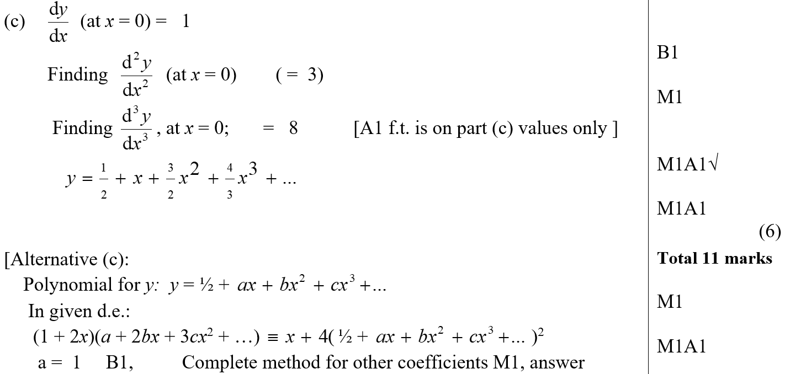
Jan 2006
C

Slide 24
June 2006

Slide 25
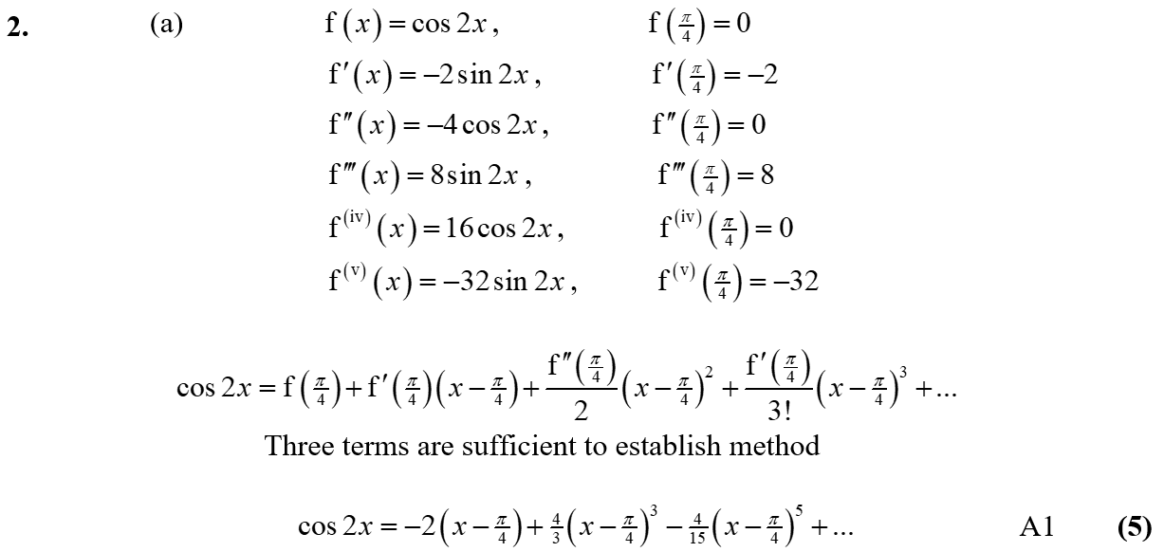
June 2006
A
B

Slide 26
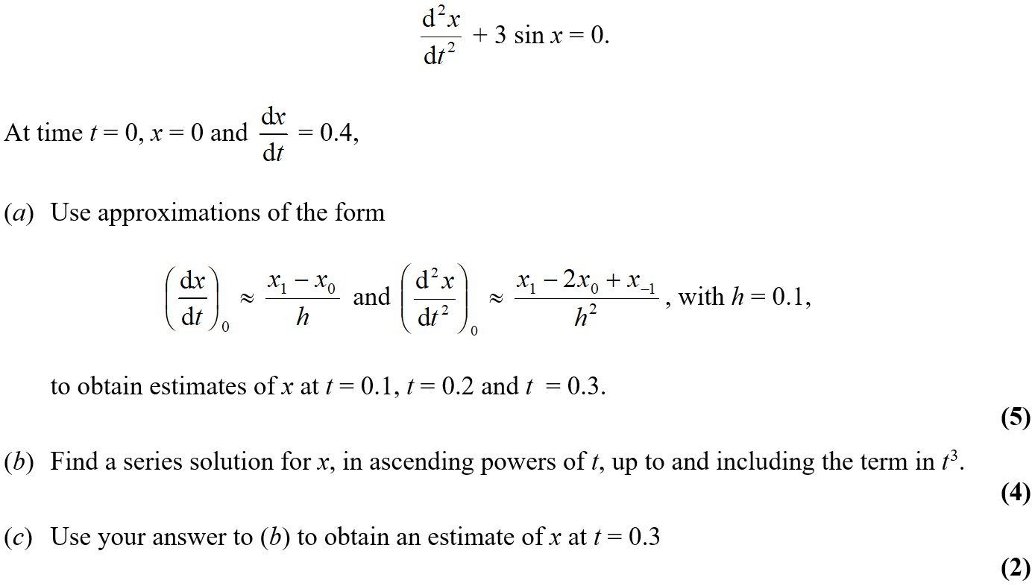
June 2006

Slide 27
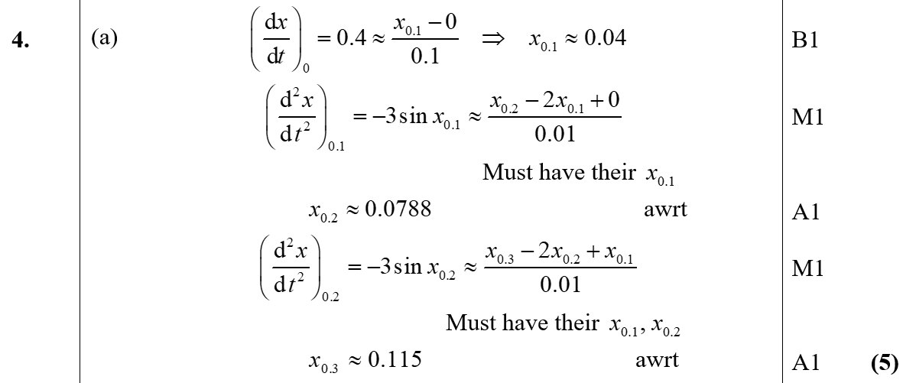
June 2006
A

Slide 28
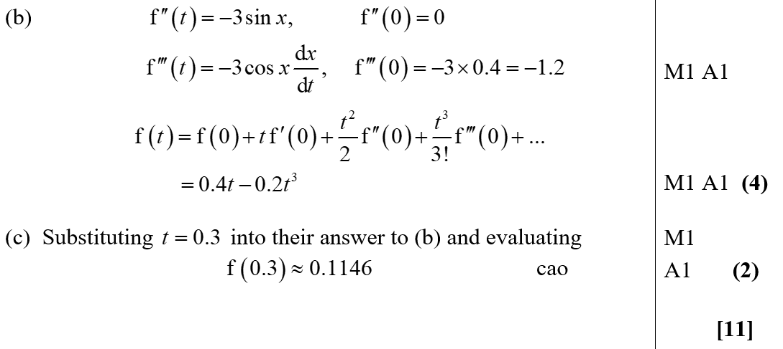
June 2006
B
C

Slide 29
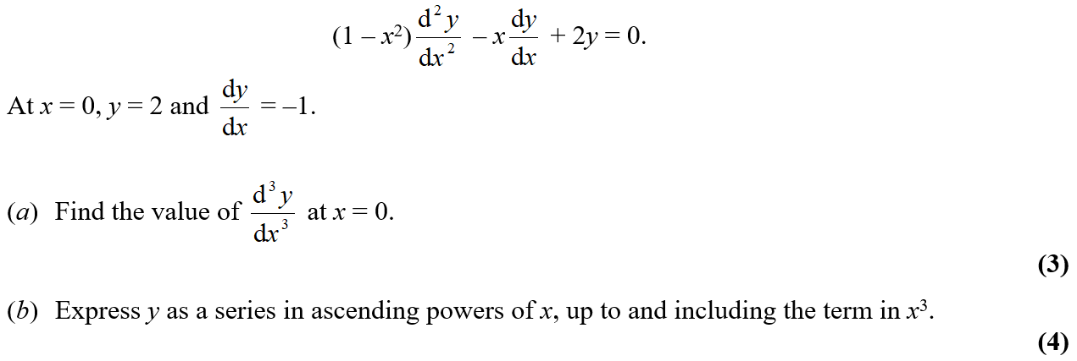
June 2007

Slide 30
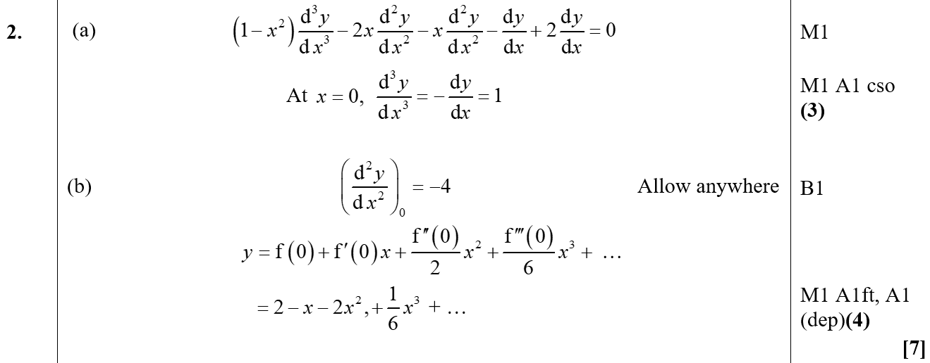
June 2007
A
B

Slide 31
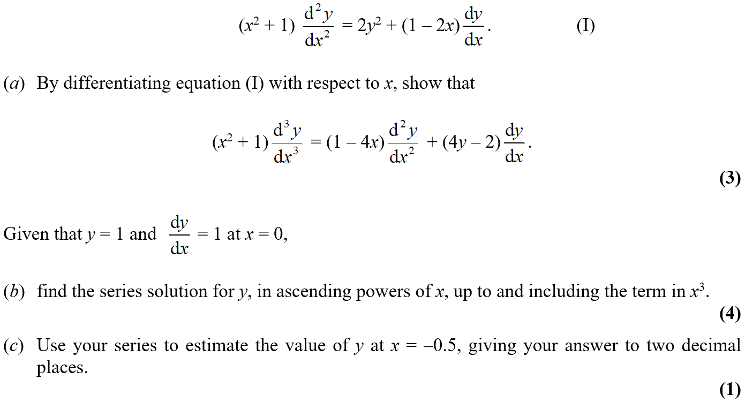
June 2008

Slide 32
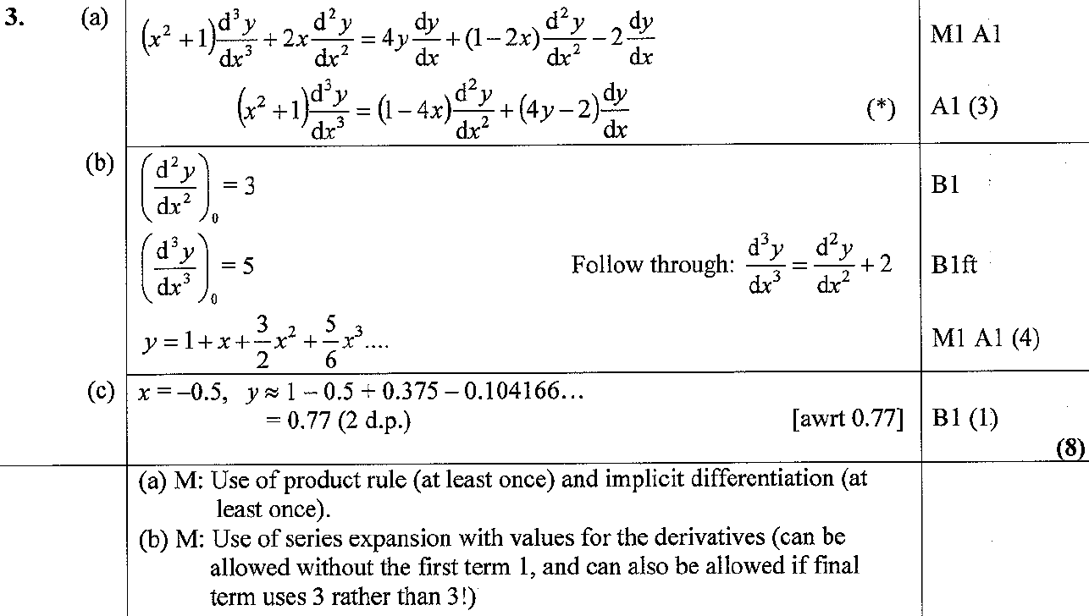
June 2008
A
B
C
A notes
B notes

Slide 33
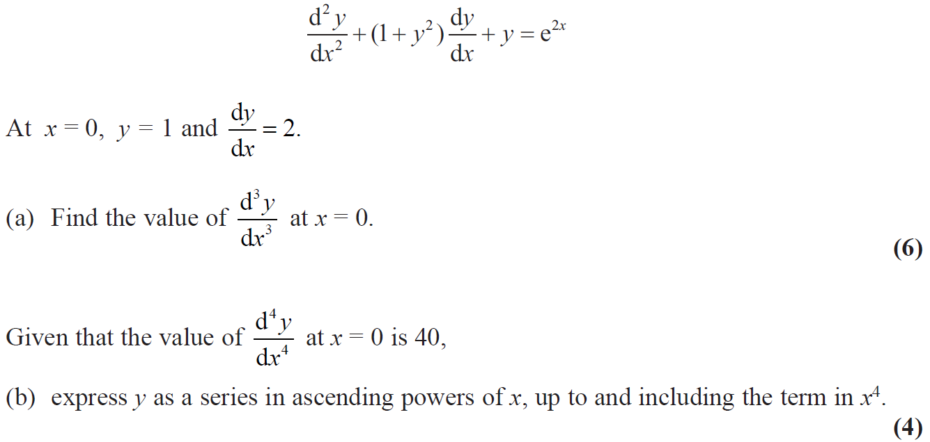
June 2009

Slide 34
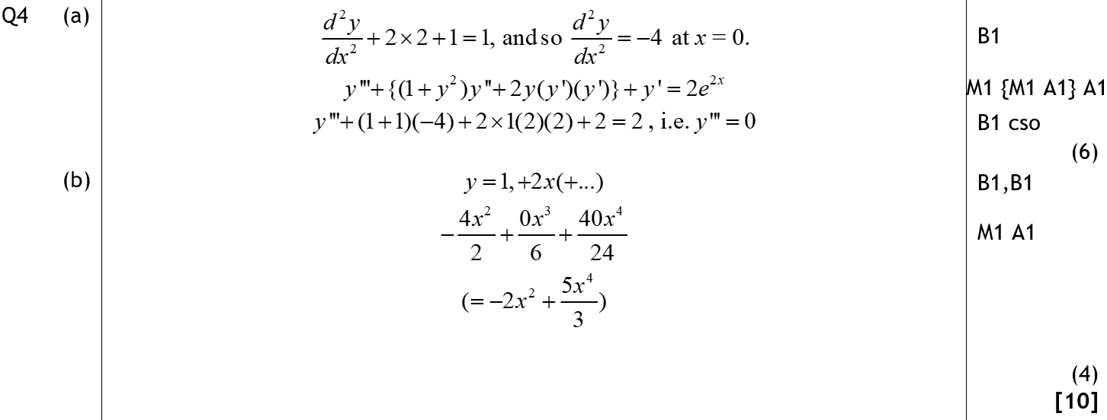
June 2009
A
B

Slide 35
Jan 2010

Slide 36
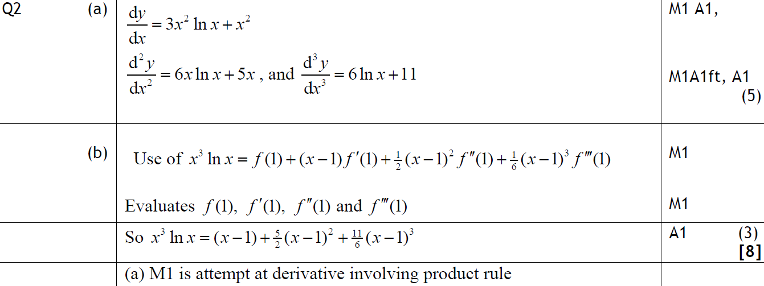
Jan 2010
A
B
A notes

Slide 37
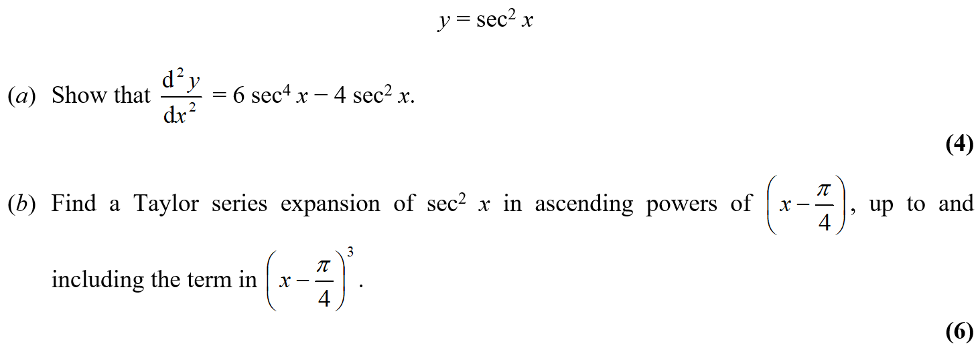
June 2009

Slide 38
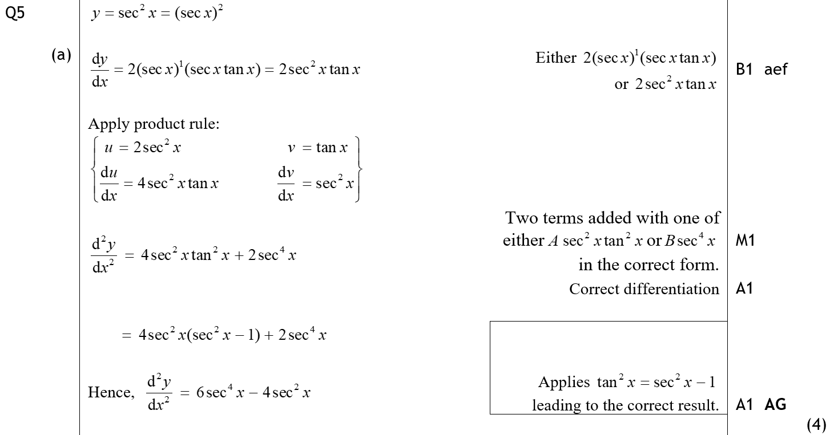
June 2009
A

Slide 39
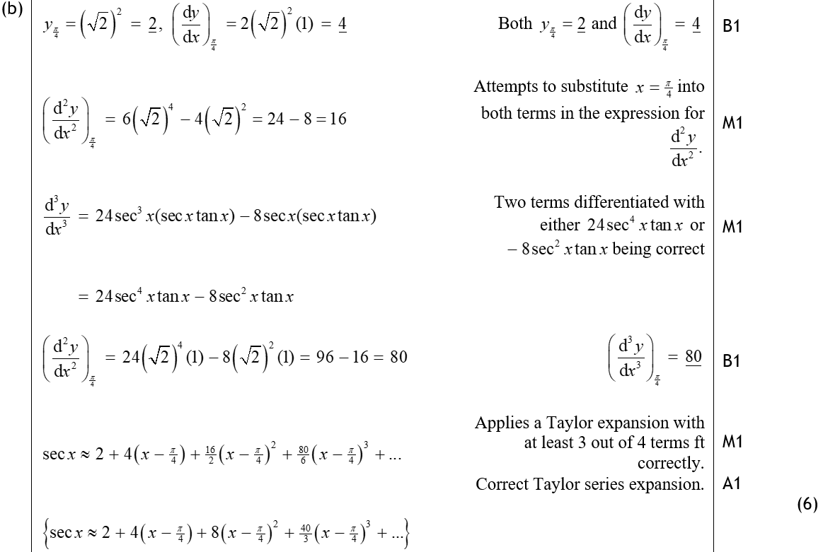
June 2009
B

Slide 40
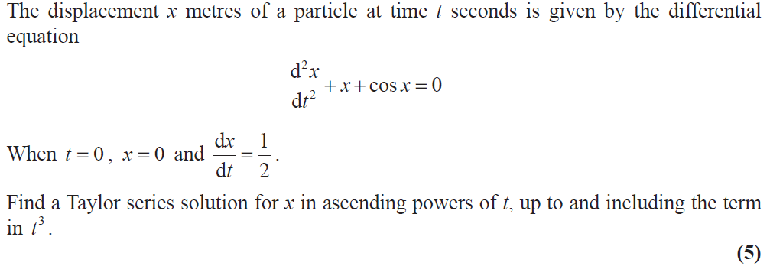
June 2010

Slide 41
June 2010
A

Slide 42
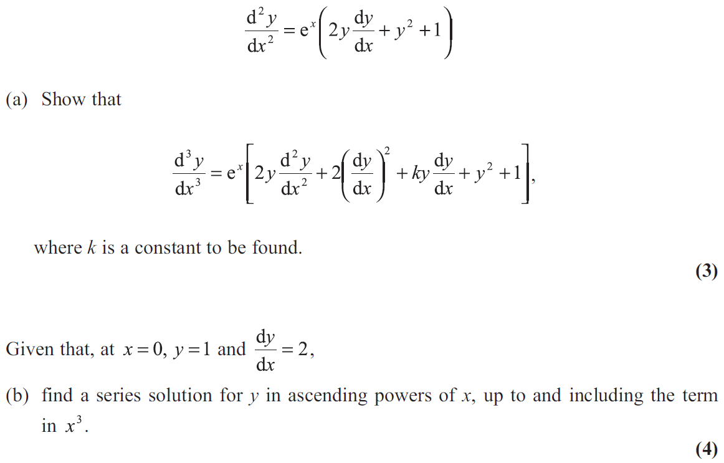
June 2011

Slide 43
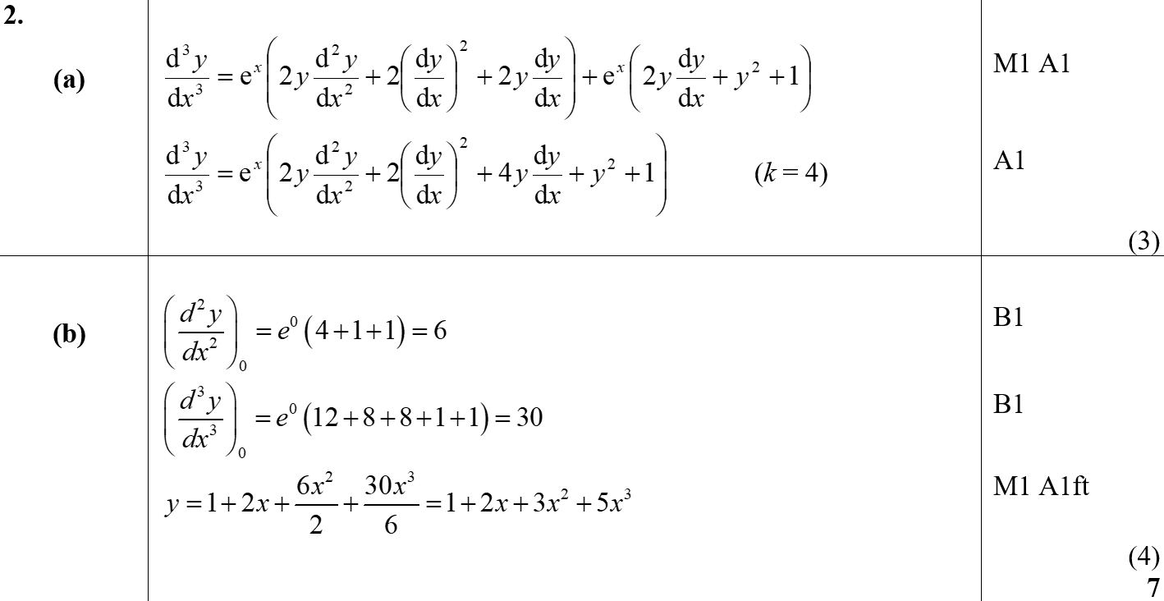
June 2011
A
B

Slide 44
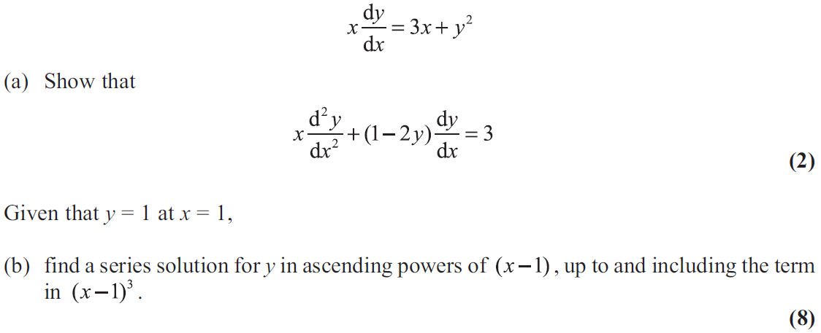
June 2012

Slide 45
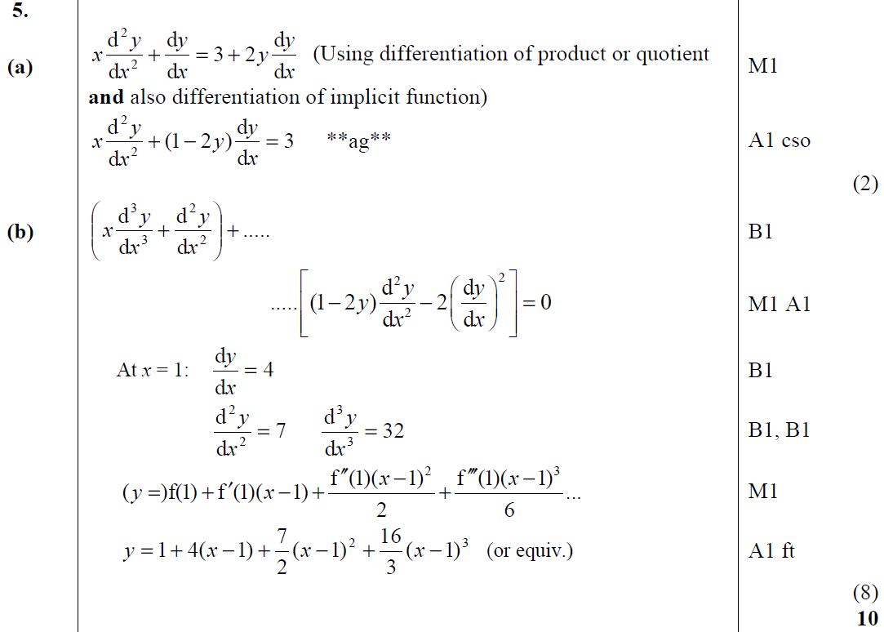
June 2012
A
B

Slide 46
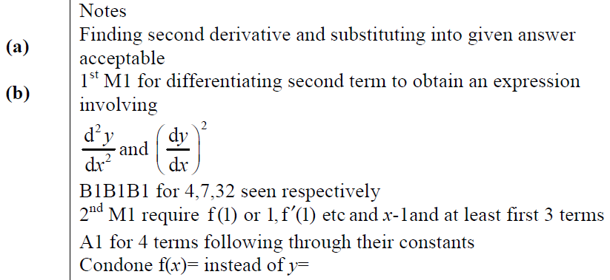
June 2012
A notes
B notes

Slide 47
June 2013

Slide 48
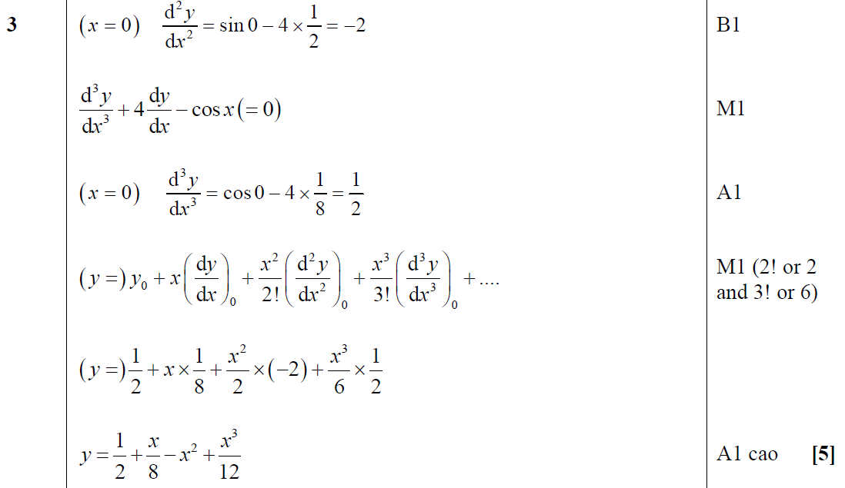
June 2013
A

Slide 49
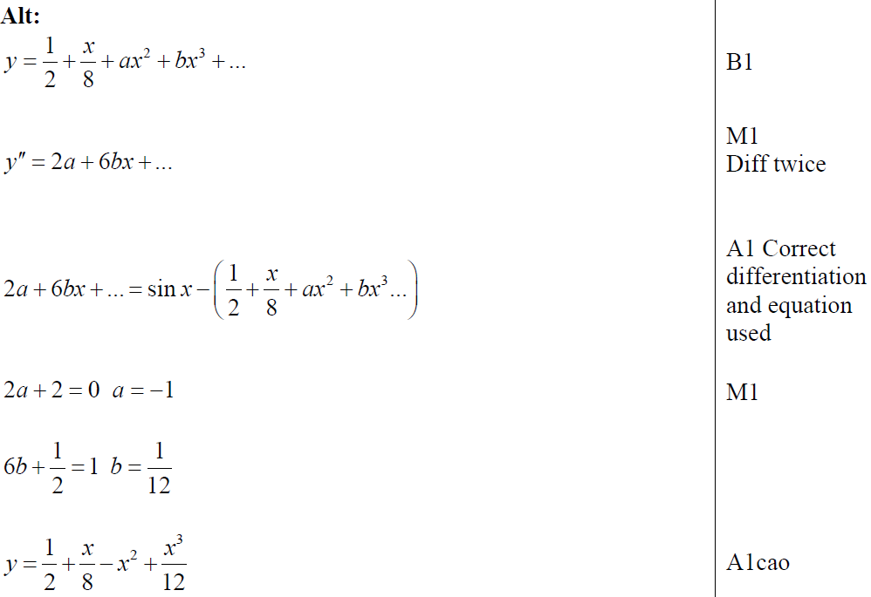
June 2013
A

Slide 50
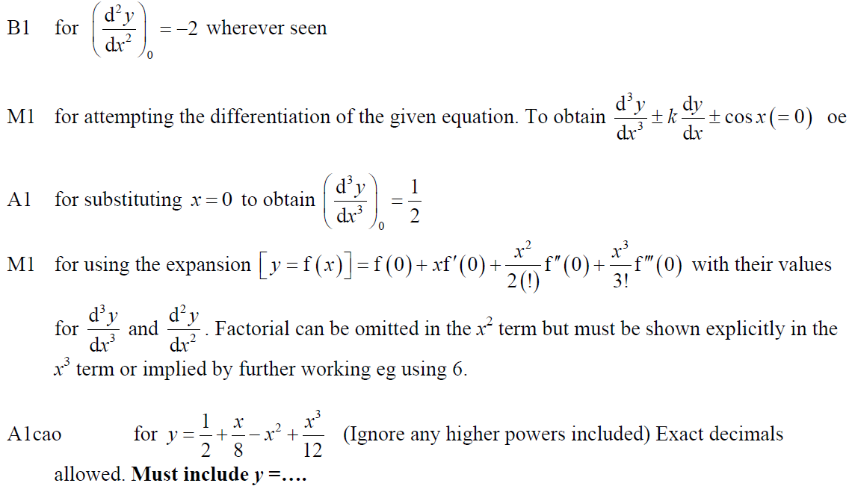
June 2013
A notes

Slide 51
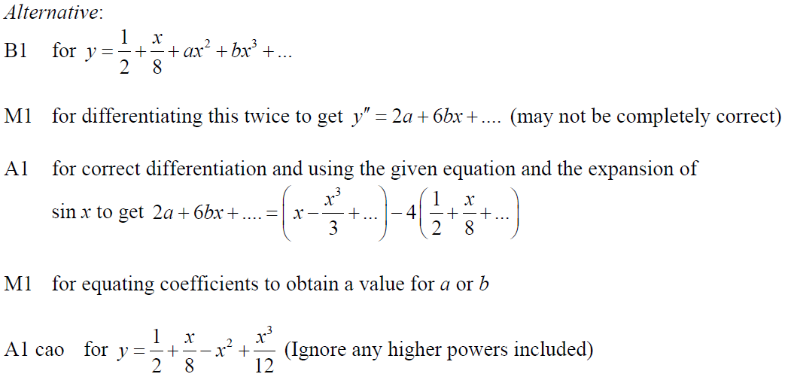
June 2013
A Alternative notes

Slide 52
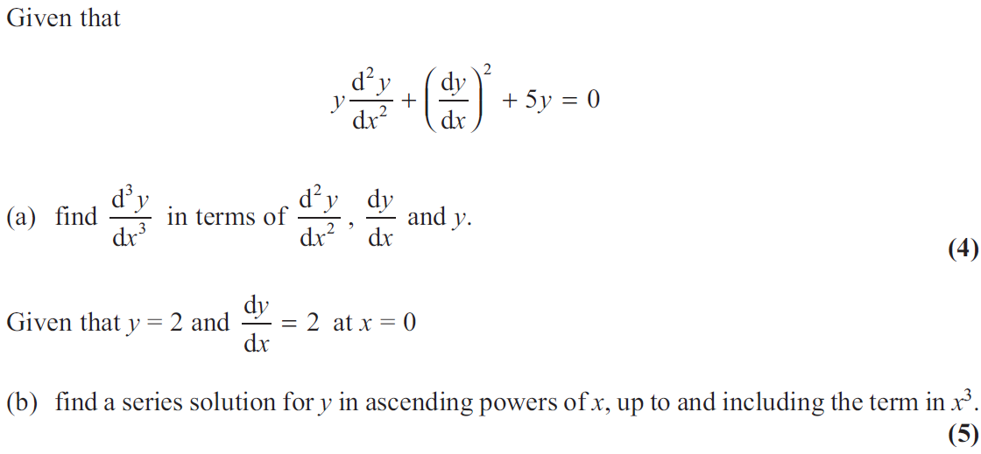
June 2013 (R)

Slide 53
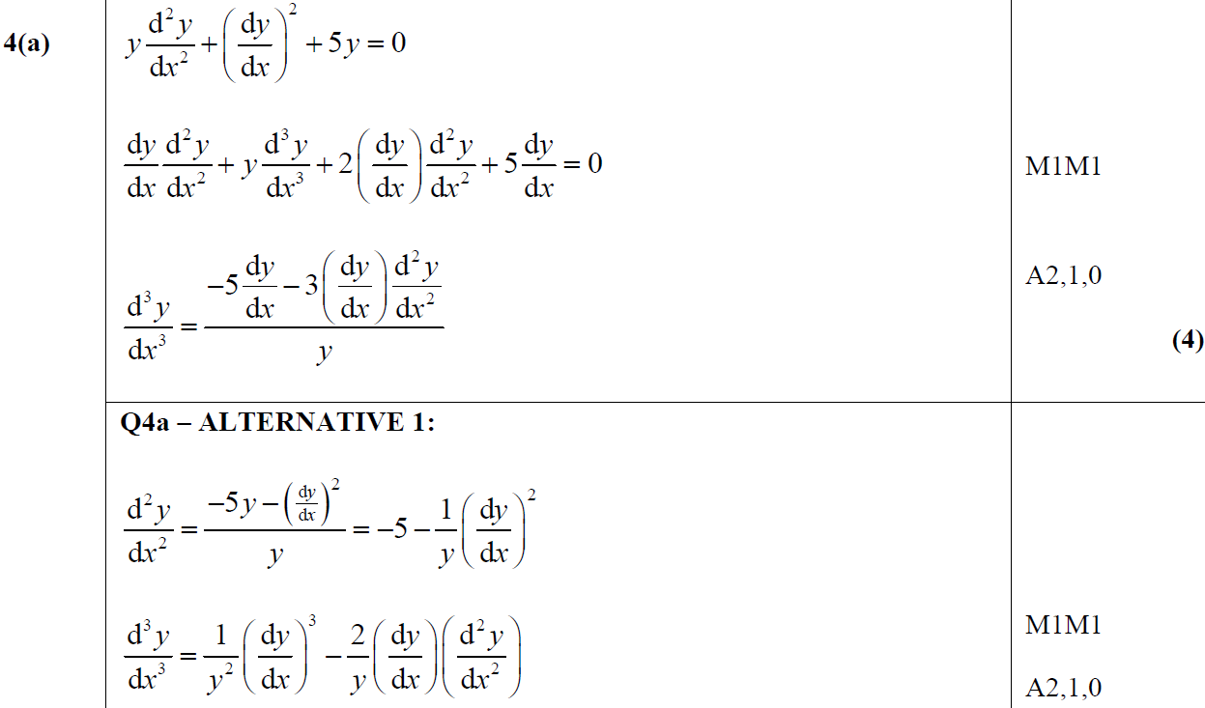
June 2013 (R)
A
A Alternative

Slide 54
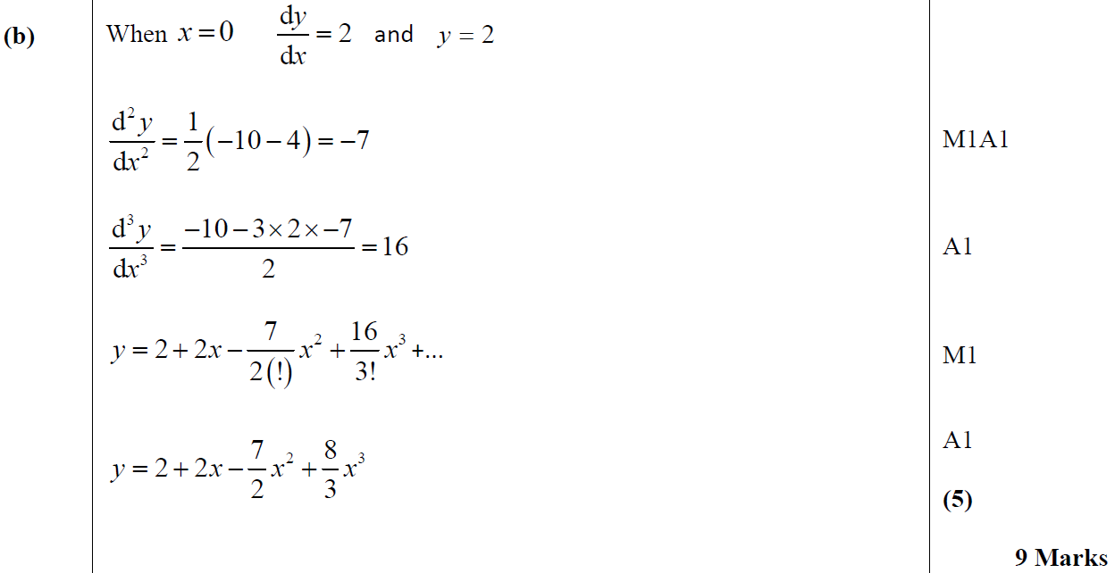
June 2013 (R)
B

Slide 55
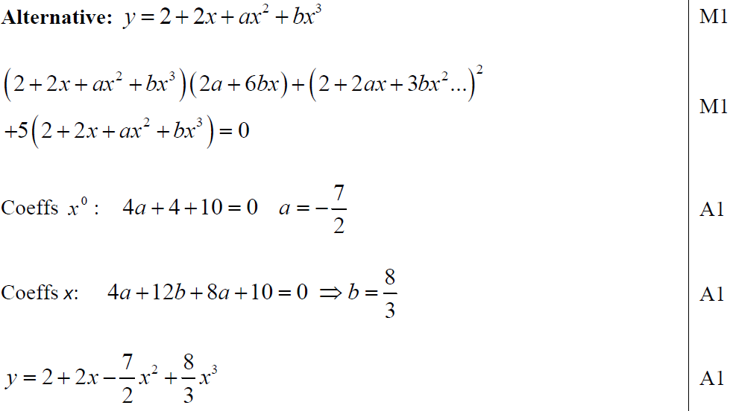
June 2013 (R)
B Alternative

Slide 56
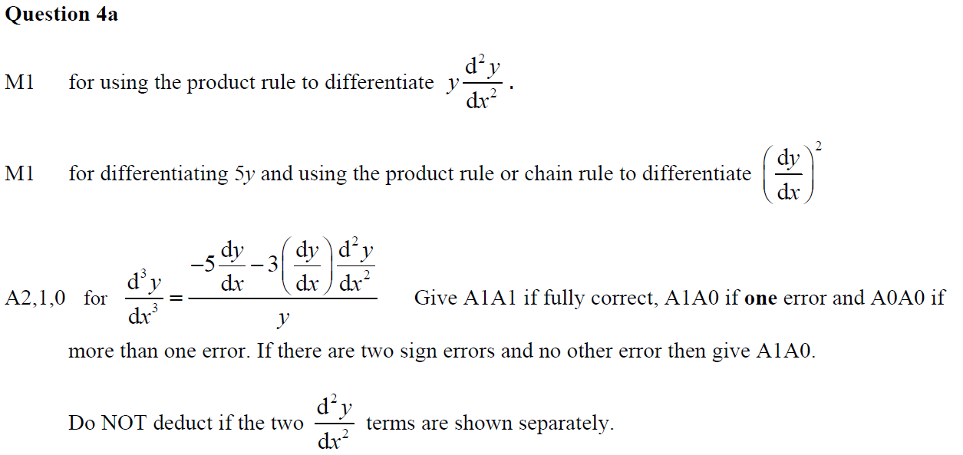
June 2013 (R)
A notes

Slide 57
June 2013 (R)
A Alternative notes

Slide 58
June 2013 (R)
B notes

Slide 59
June 2013 (R)
B Alternative notes

Slide 60
June 2013 (Withdrawn)

Slide 61
June 2013 (Withdrawn)
A
B
C

Slide 62
June 2014

Slide 63
June 2014
A

Slide 64
June 2014
A Alternative and notes

Slide 65
June 2014 (R)

Slide 66
June 2014 (R)
A

Slide 67
June 2014 (R)
B

Slide 68
June 2014 (R)
A notes
B notes

Slide 69
June 2015

Slide 70
June 2015
A
B

Slide 71
June 2015
C
A notes

Slide 72
June 2015
B notes
C notes

Slide 73
June 2016

Slide 74
June 2016
A

Slide 75
June 2016
A Alternative Derivatives

Slide 76
June 2016
B

Slide 77
June 2017

Slide 78
June 2017
A

Slide 79
June 2017
A Alternative

Slide 80
June 2017
B

Slide 81
June 2017
C

Slide 82
June 2018

Slide 83
June 2018
A

Slide 84
June 2018
A Alternative 1

Slide 85
June 2018
A Alternative 2

Slide 86
June 2018
B

Slide 87
June 2019

Slide 88
June 2019
A
A Alternative
B

Slide 89
June 2019
A notes
A Alternative notes
B notes

