Slide 1
No Old Spec Q’s
Simpson’s Rule
SAM
2019

Slide 2
SAM

Slide 3
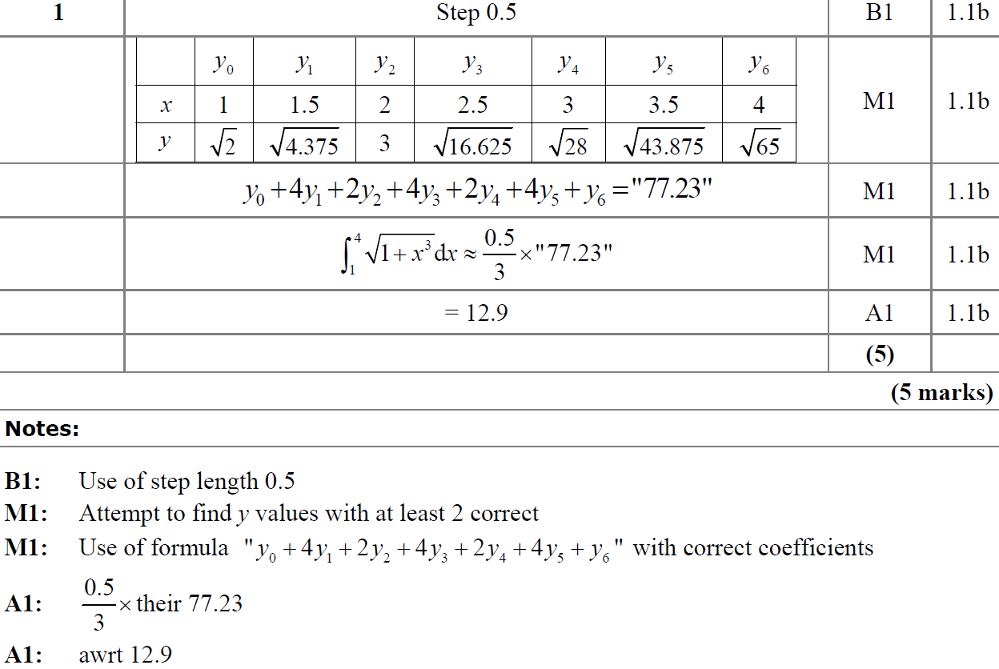
SAM
A
A notes

Slide 4
2019

Slide 5
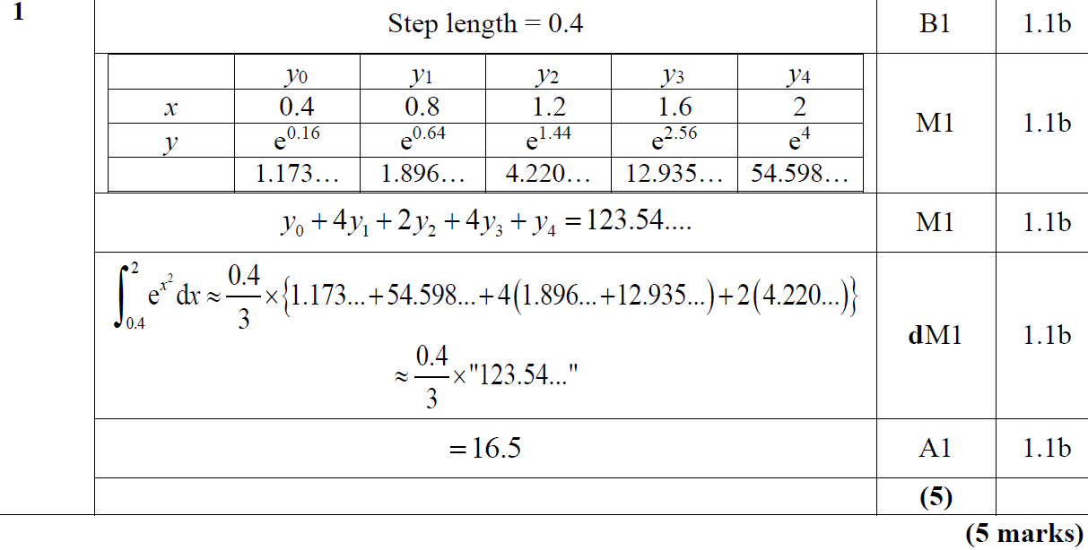
2019
A

Slide 6
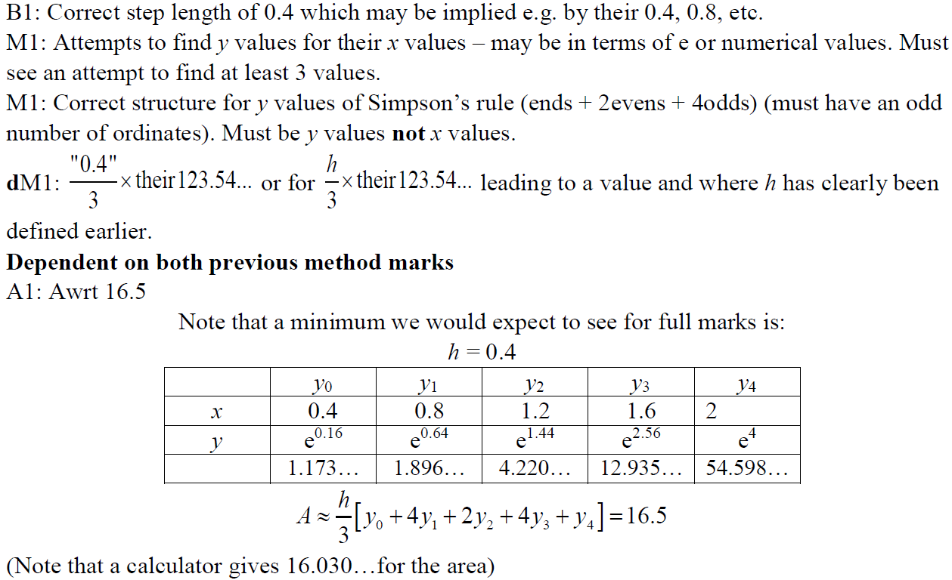
2019
A notes

