Slide 1
No Old Spec Q’s
Methods in Calculus
SAM
2019 (i)
2019 (ii)
Leibnitz’ Rule
L’Hospital’s’ Rule
Weierstrauss Substitution

Slide 2
SAM

Slide 3
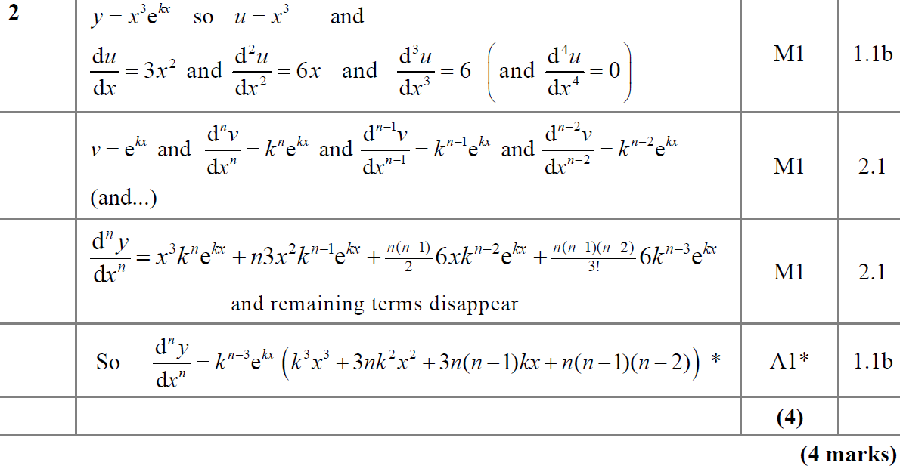
SAM
A

Slide 4
SAM
A notes

Slide 5
2019

Slide 6
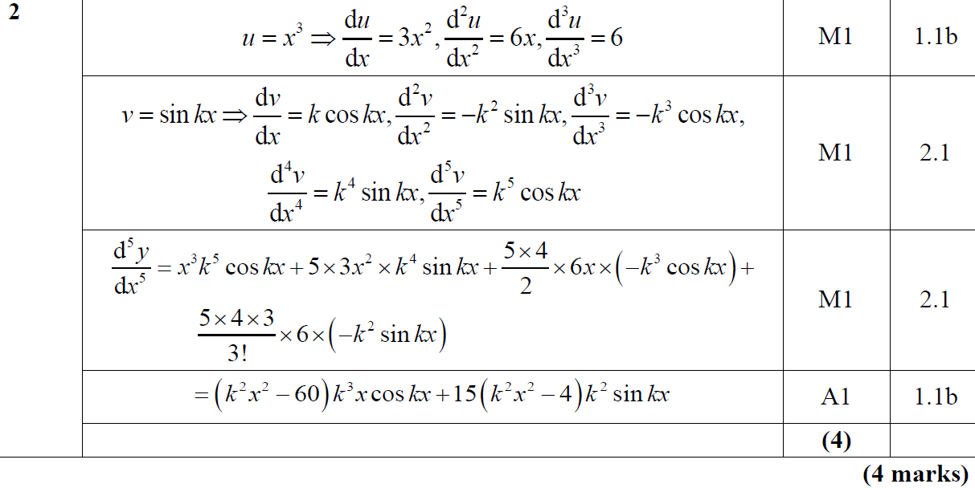
2019
A

Slide 7
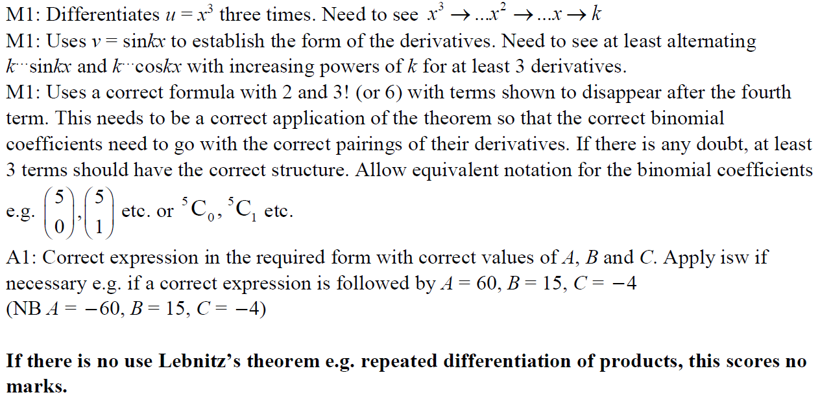
2019
A notes

Slide 8
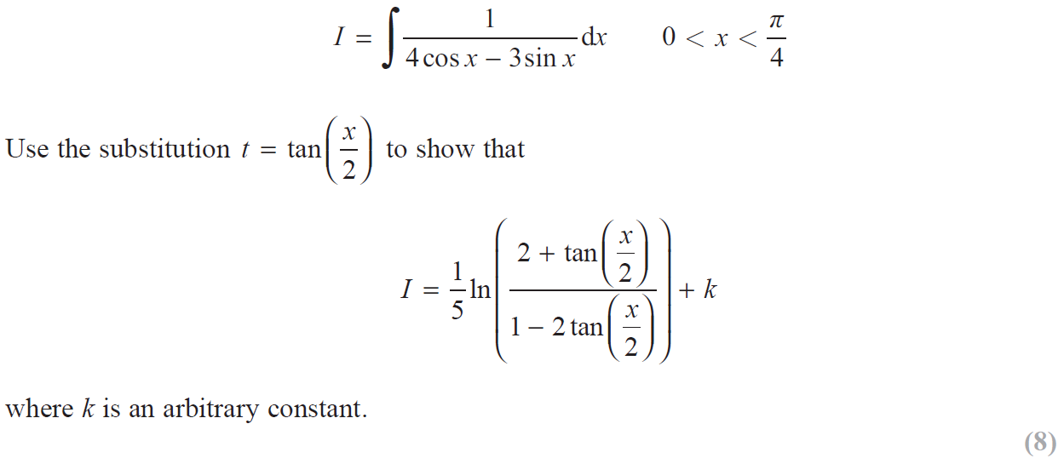
2019

Slide 9
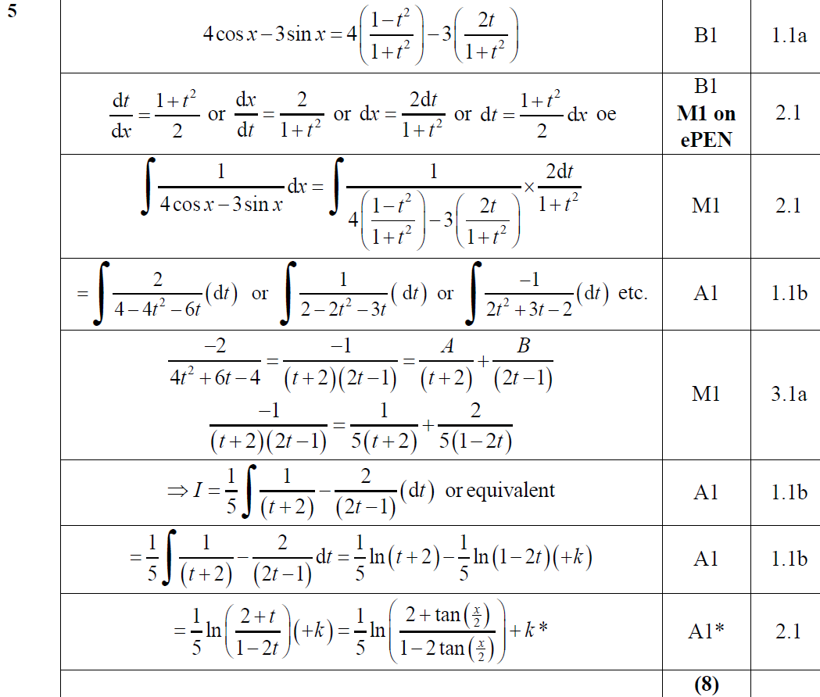
2019
A

Slide 10
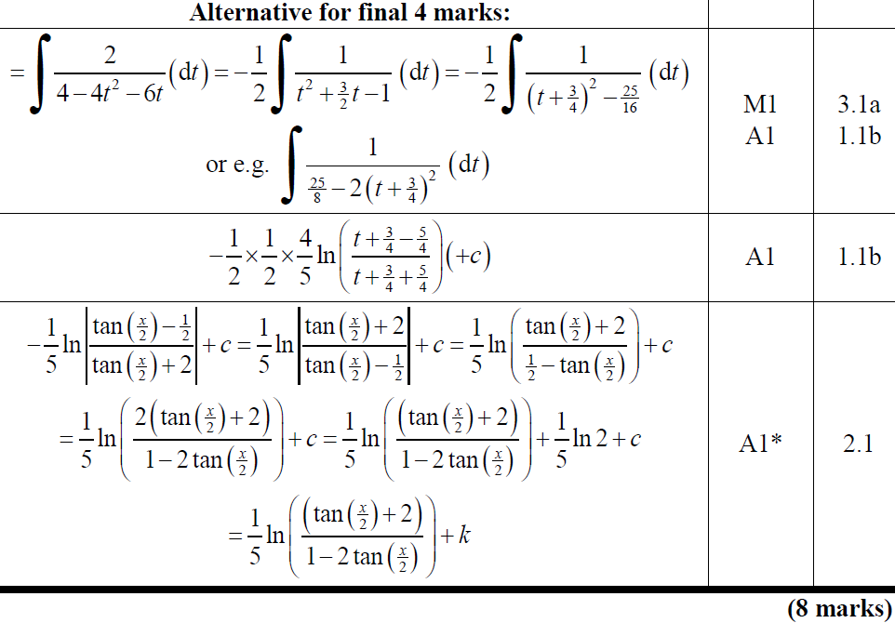
2019
A Alternative

Slide 11
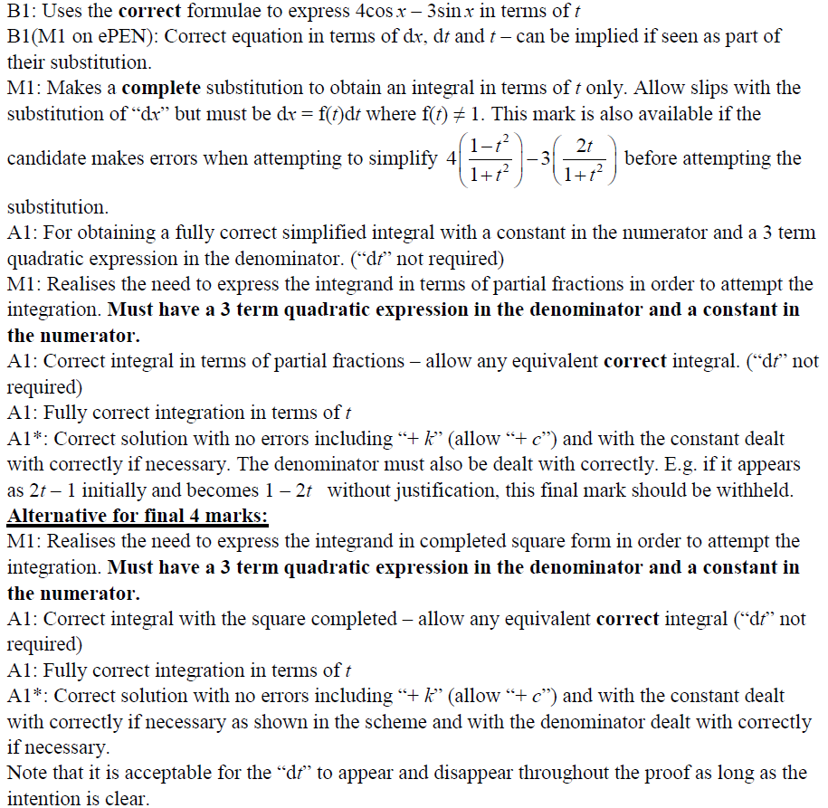
2019
A notes

