Slide 1
Old Spec Q’s
Inequalities
SAM
2018
2019

Slide 2
SAM

Slide 3
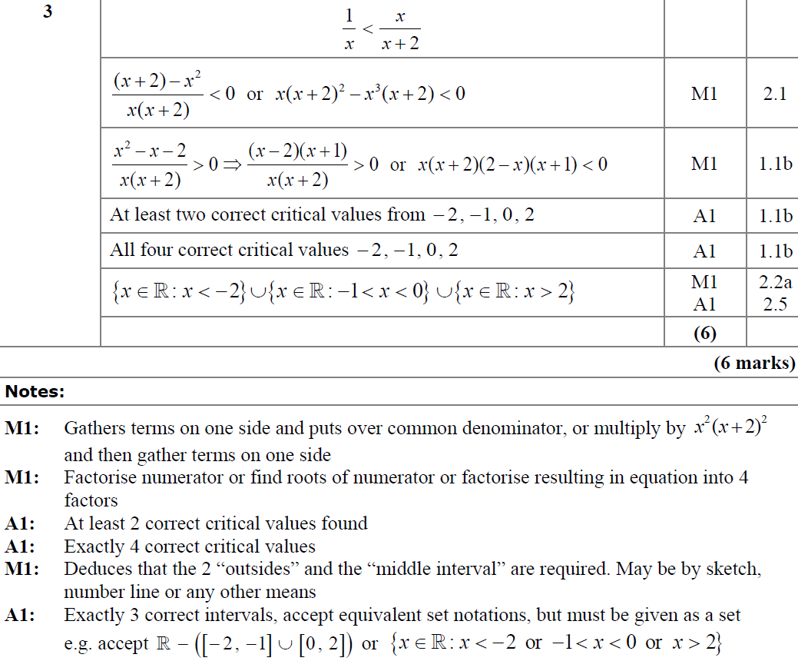
SAM
A
A notes

Slide 4
2018

Slide 5
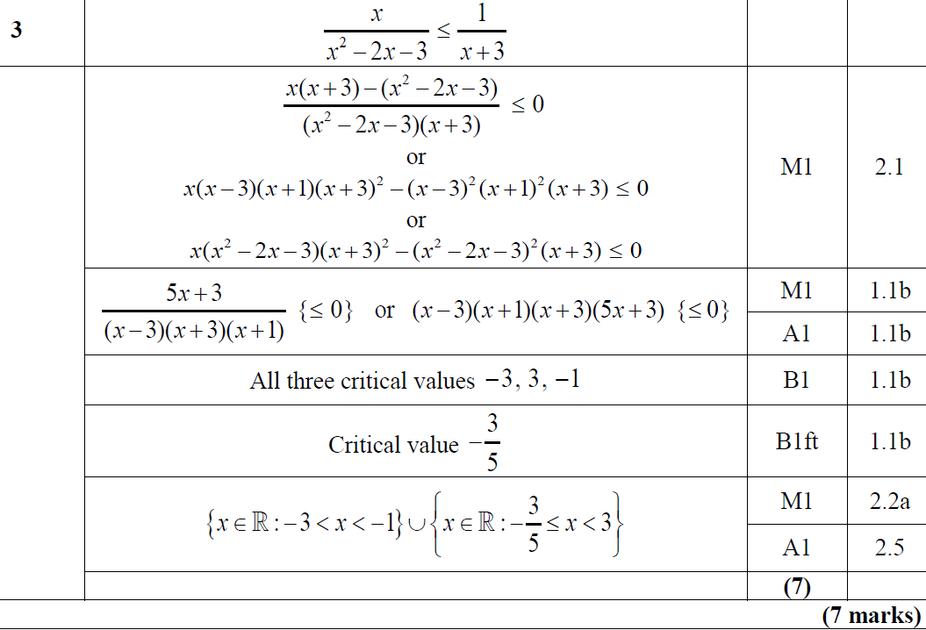
2018
A

Slide 6
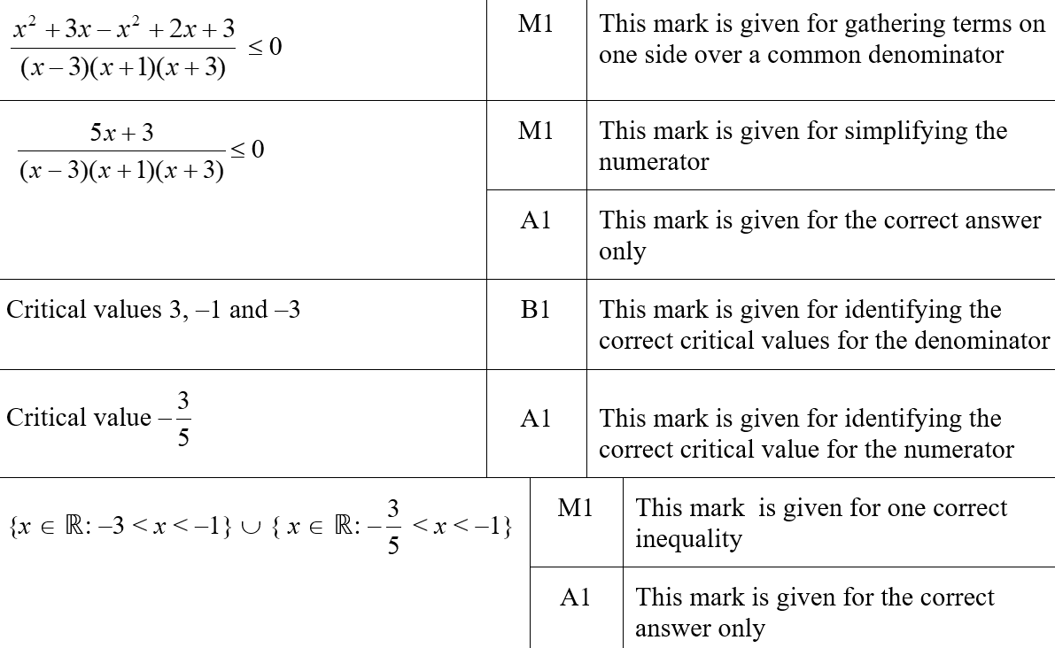
2018
A (SF)

Slide 7
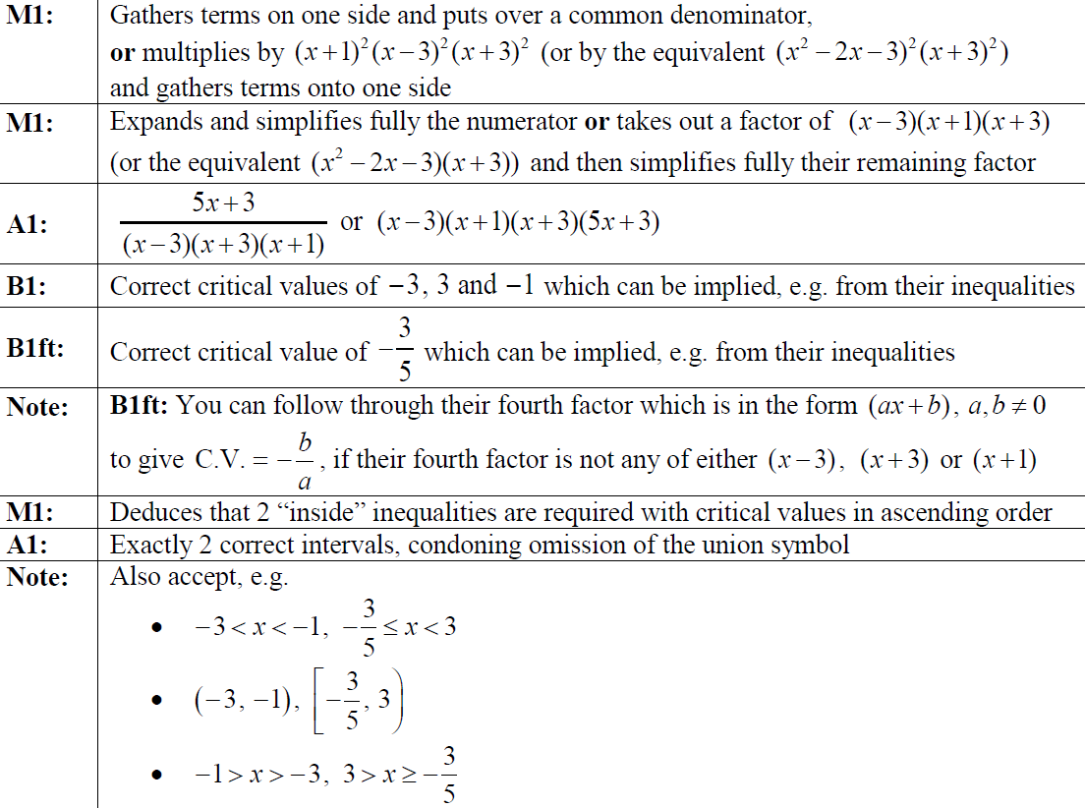
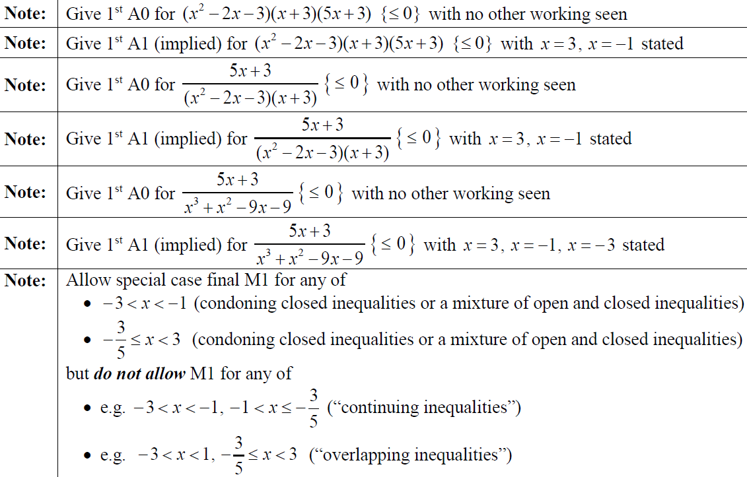
2018
A notes

Slide 8
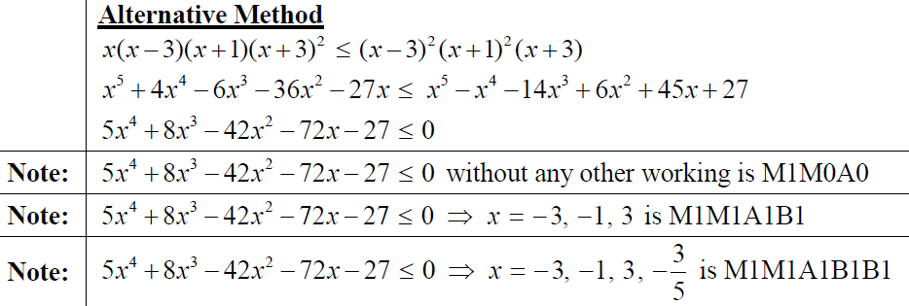
2018
A Alternative Method

Slide 9
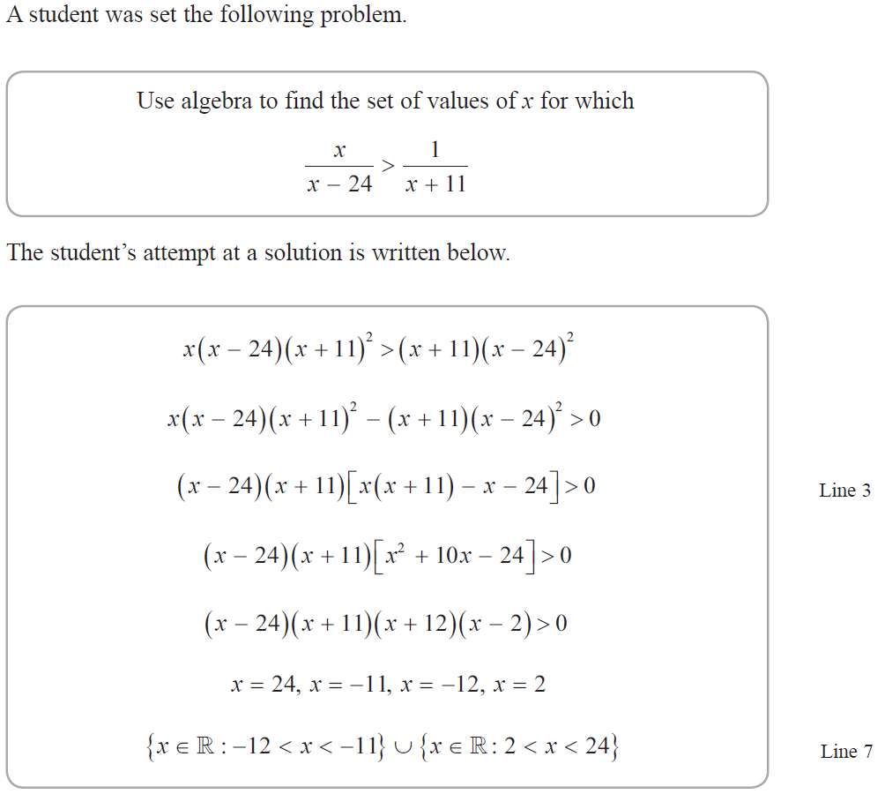
2019

Slide 10
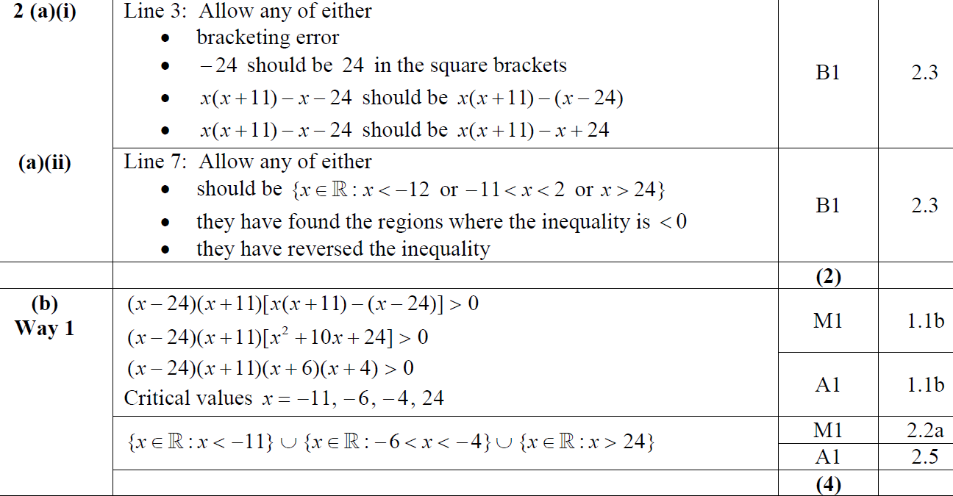
2019
A (i)
A (ii)
B

Slide 11
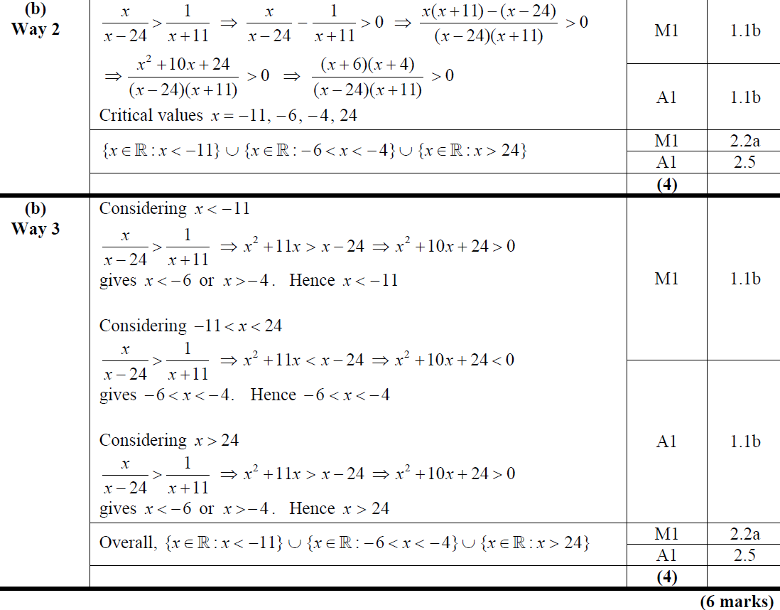
2019
B Alternative 1
B Alternative 2

Slide 12
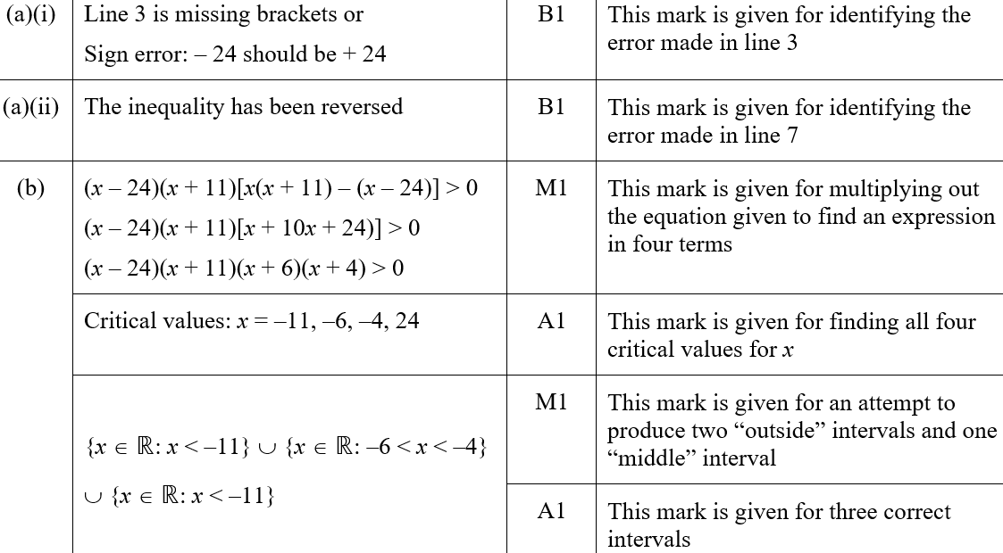
2019
A (i) (SF)
A (ii) (SF)
B (SF)

Slide 13
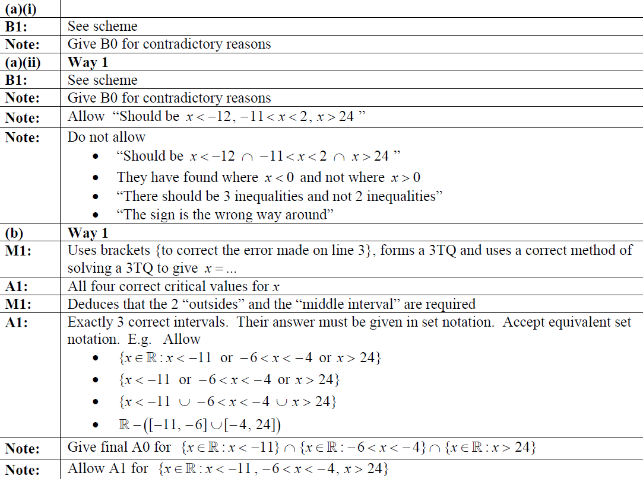
2019
A (i) notes
A (ii) notes
B notes

Slide 14
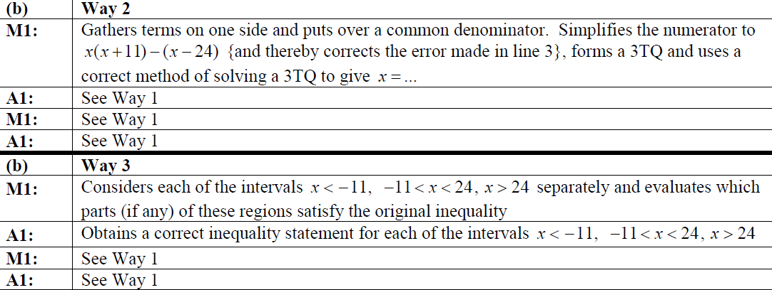
2019
B Alternative 1 notes
B Alternative 2 notes

Slide 15
New Spec Q’s
Old Spec Inequalities
P4/ Old FP1
FP2
Jan 2002
Jan 2005
Jan 2008
June 2009
June 2013 (R)
June 2016
June 2002
June 2005
June 2008
June 2010
June 2013 (W)
June 2017
Jan 2003
Jan 2006
Jan 2009
June 2011
June 2014
June 2018
June 2003
June 2006
June 2009
June 2012
June 2014 (R)
June 2019
Jan 2004
Jan 2007
Jan 2010
June 2013
June 2015
June 2004
June 2007

Slide 16
Jan 2002

Slide 17
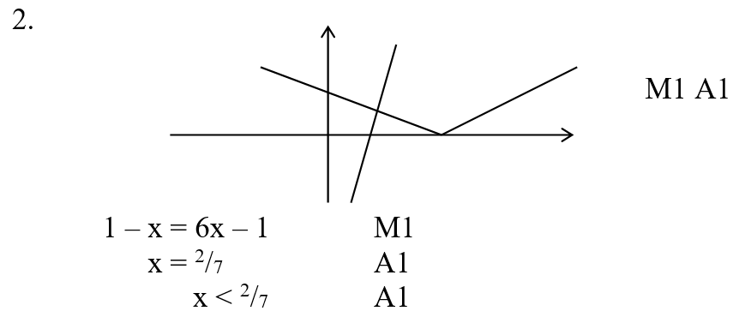
Jan 2002
A

Slide 18
June 2002

Slide 19
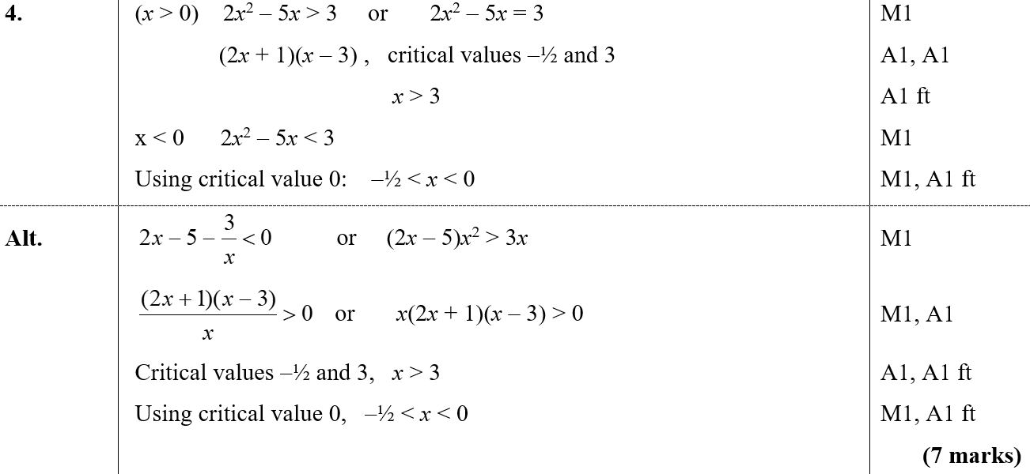
June 2002
A

Slide 20
Jan 2003

Slide 21
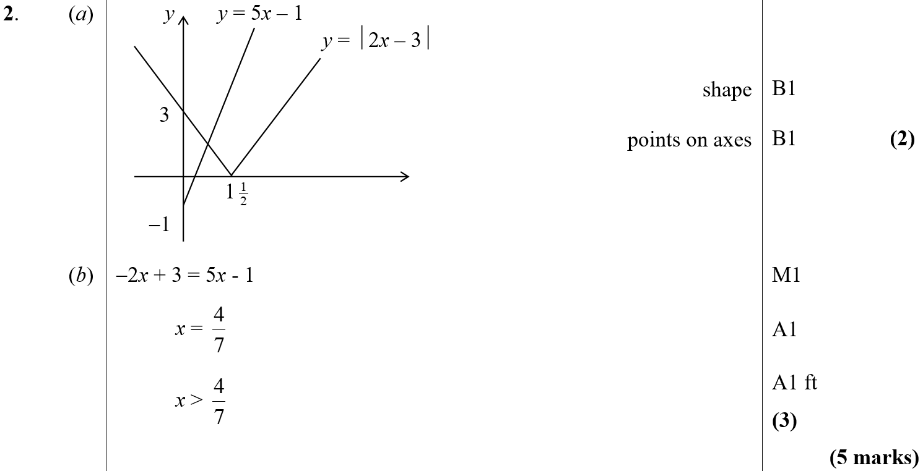
Jan 2003
A
B

Slide 22
June 2003

Slide 23
June 2003
A

Slide 24
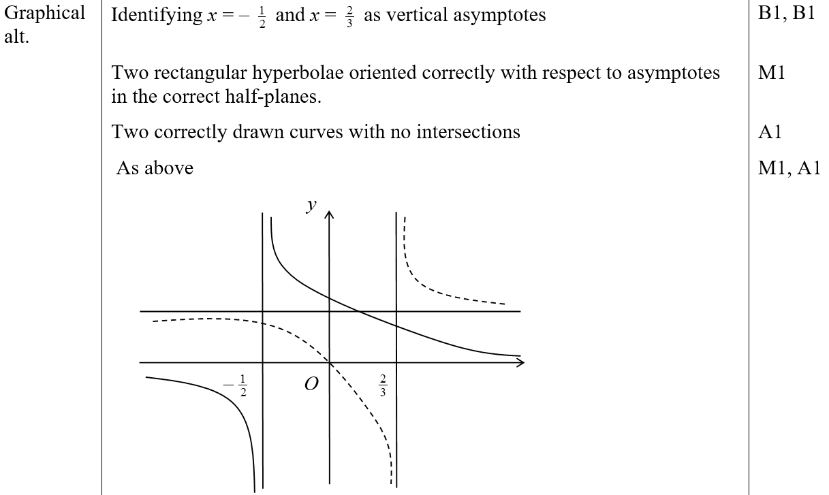
June 2003
A Graphing Alternative

Slide 25
Jan 2004

Slide 26
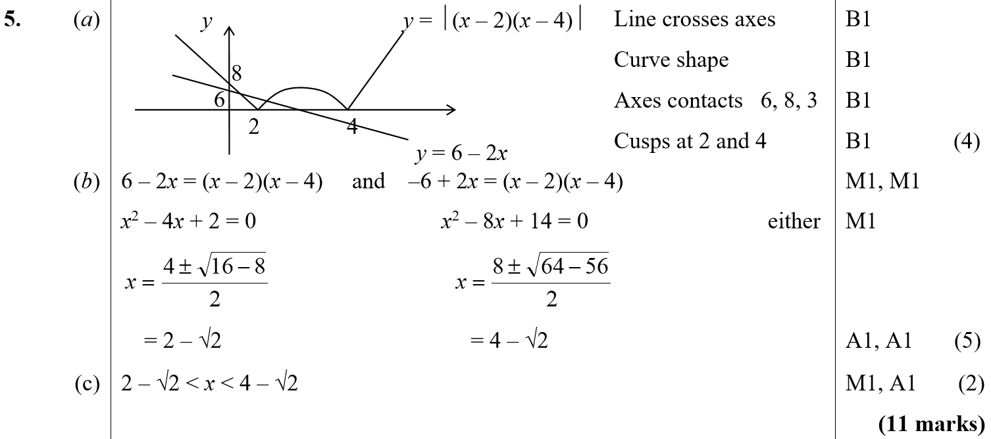
Jan 2004
A
B
C

Slide 27
June 2004

Slide 28
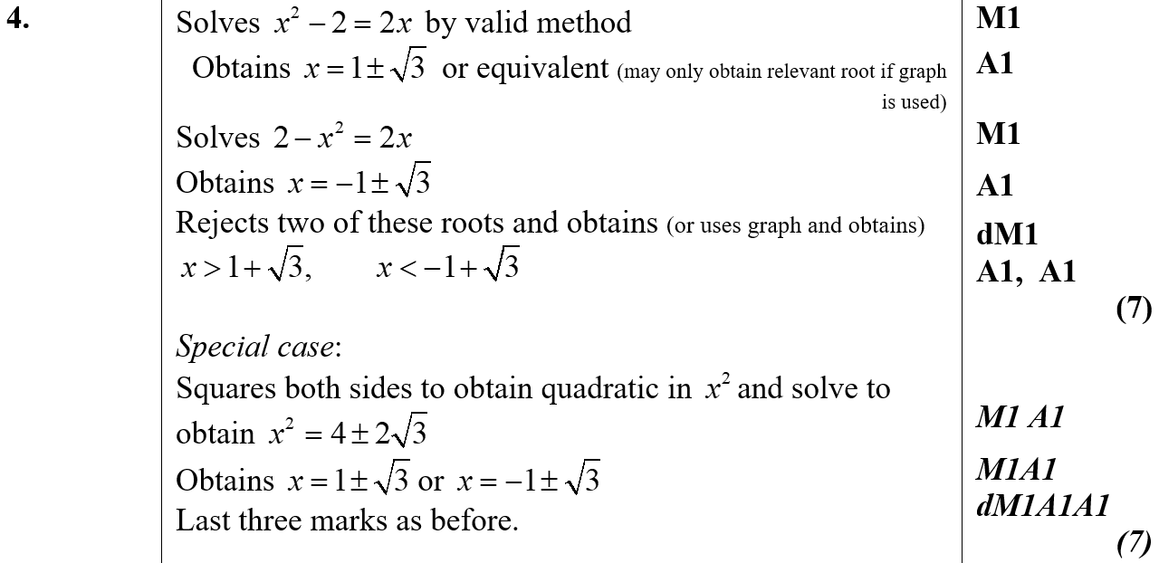
June 2004
A

Slide 29
Jan 2005

Slide 30
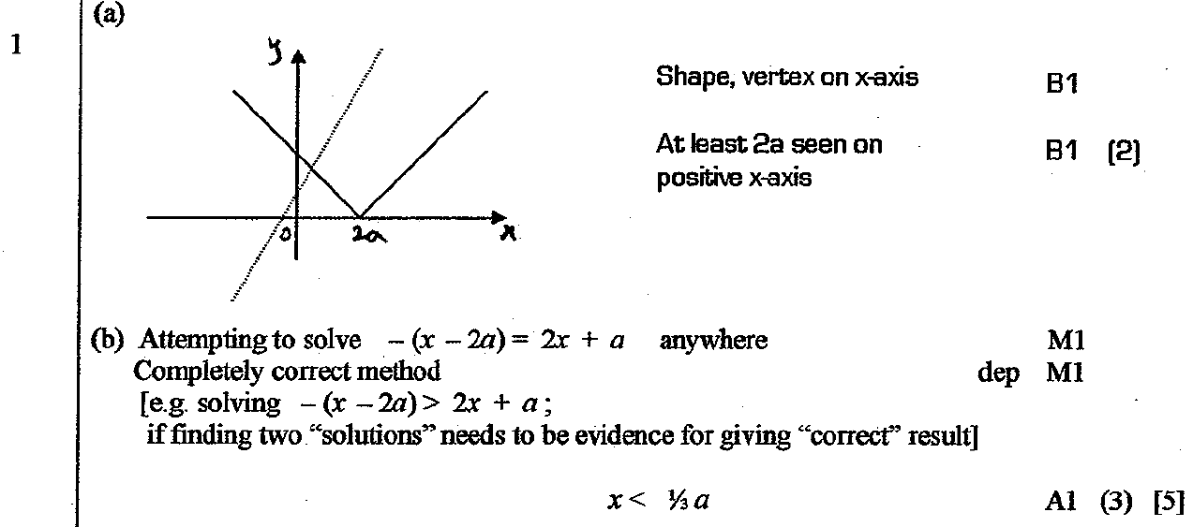
Jan 2005
A
B

Slide 31
June 2005

Slide 32
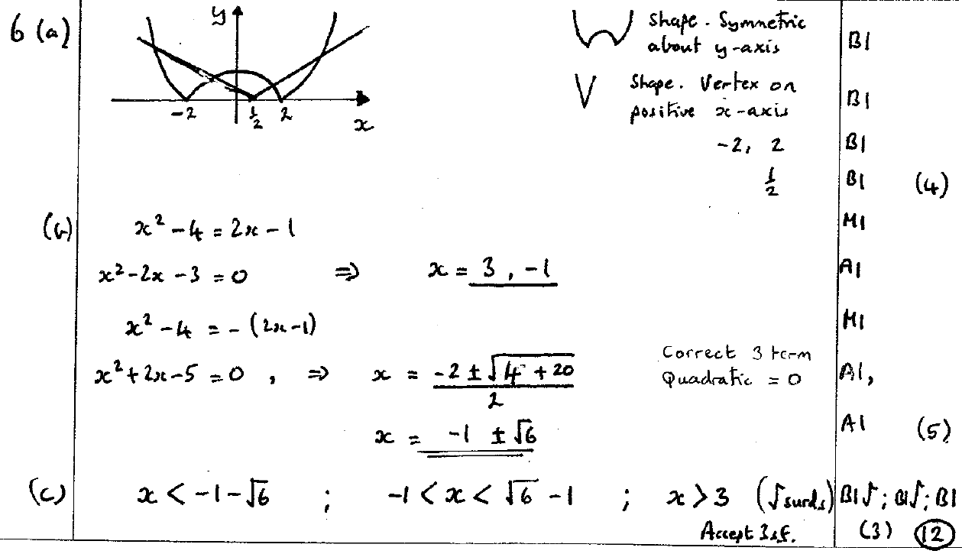
June 2005
A
B
C

Slide 33
Jan 2006

Slide 34
Jan 2006
A

Slide 35
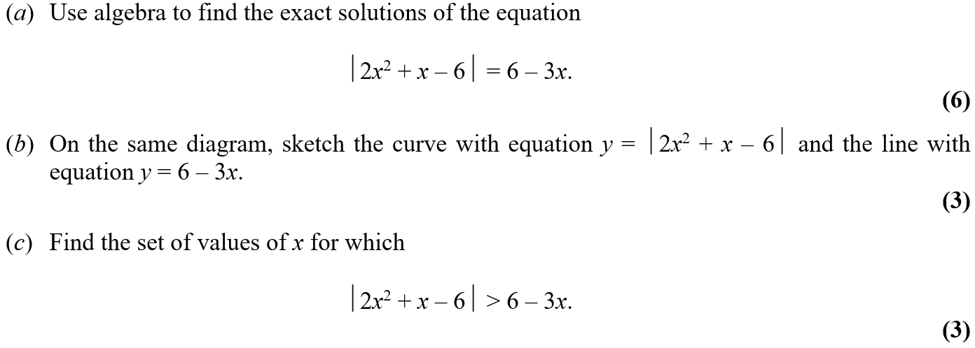
June 2006

Slide 36
June 2006
A

Slide 37
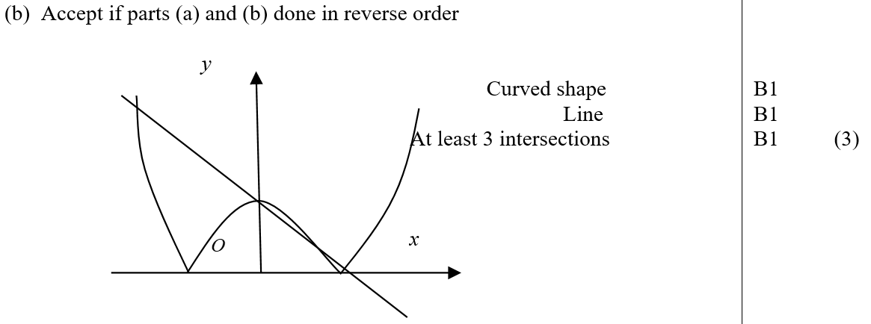
June 2006
B

Slide 38
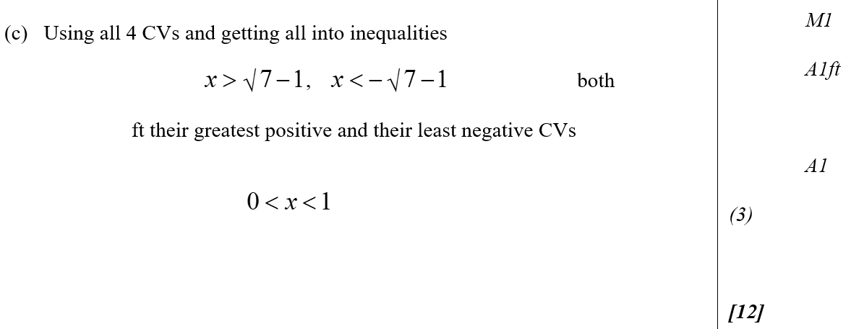
June 2006
C

Slide 39
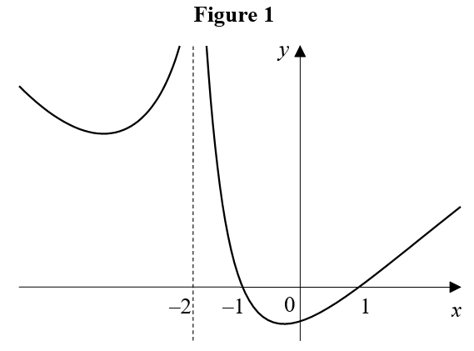
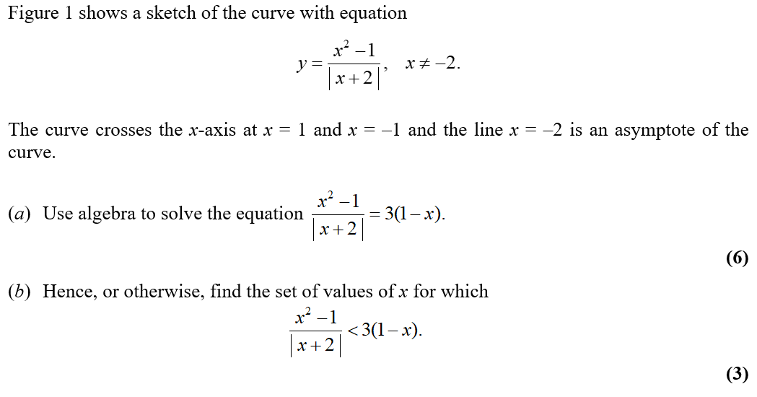
Jan 2007

Slide 40
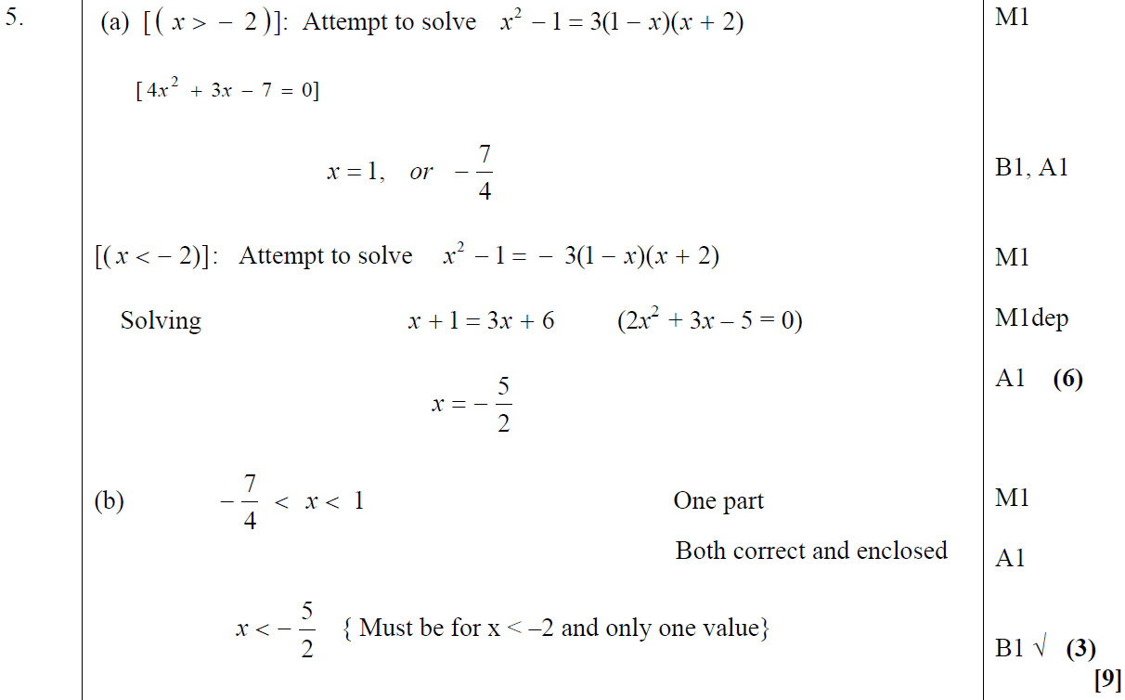
Jan 2007
A
B

Slide 41
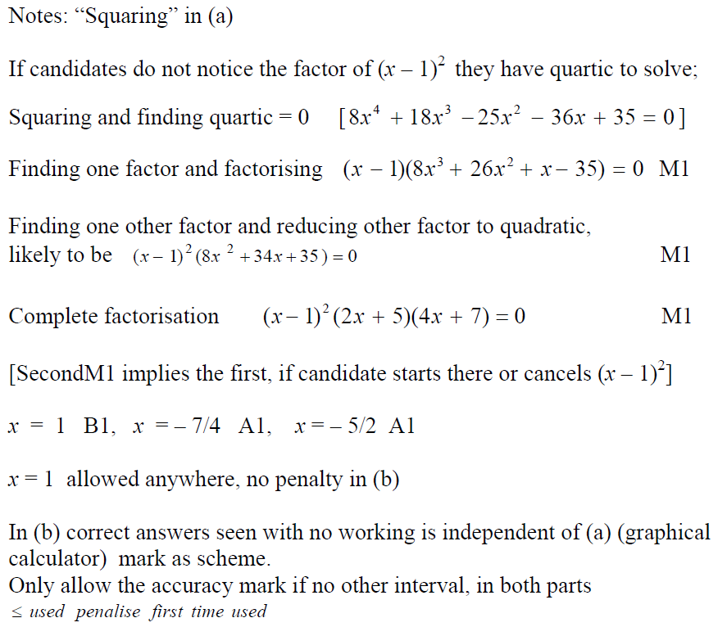
Jan 2007
A notes
B notes

Slide 42
June 2007

Slide 43
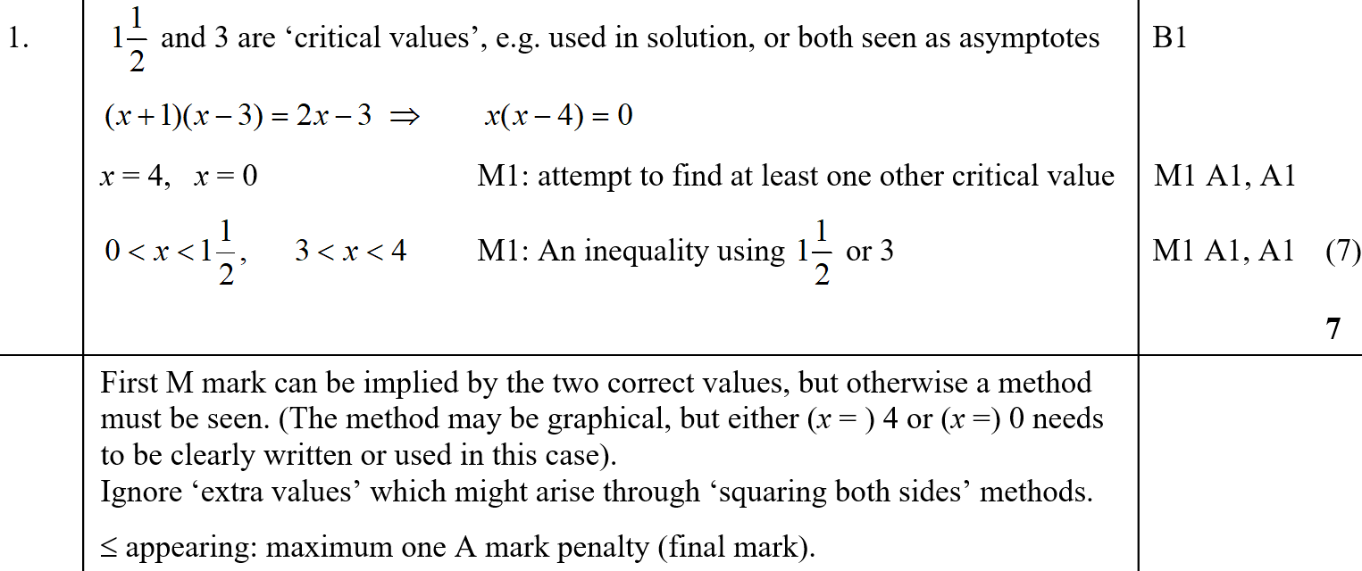
June 2007
A
A notes

Slide 44
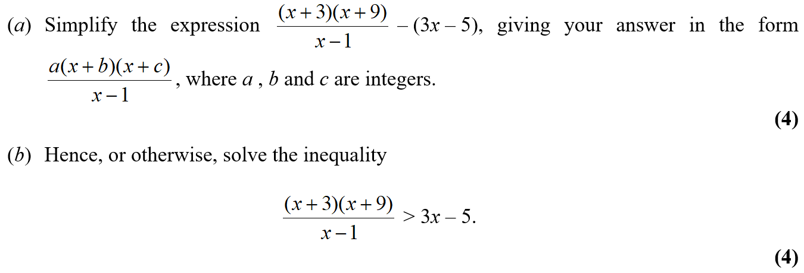
Jan 2008

Slide 45
Jan 2008
A
B
A notes

Slide 46
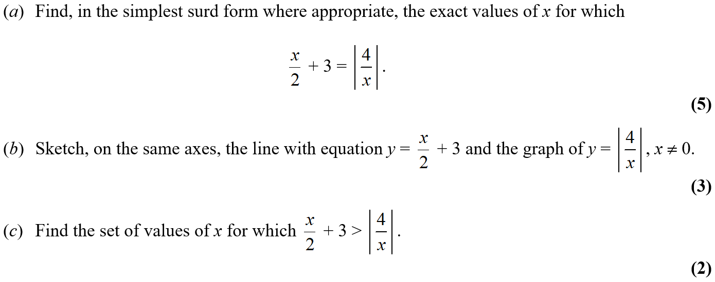
June 2008

Slide 47
June 2008
A

Slide 48
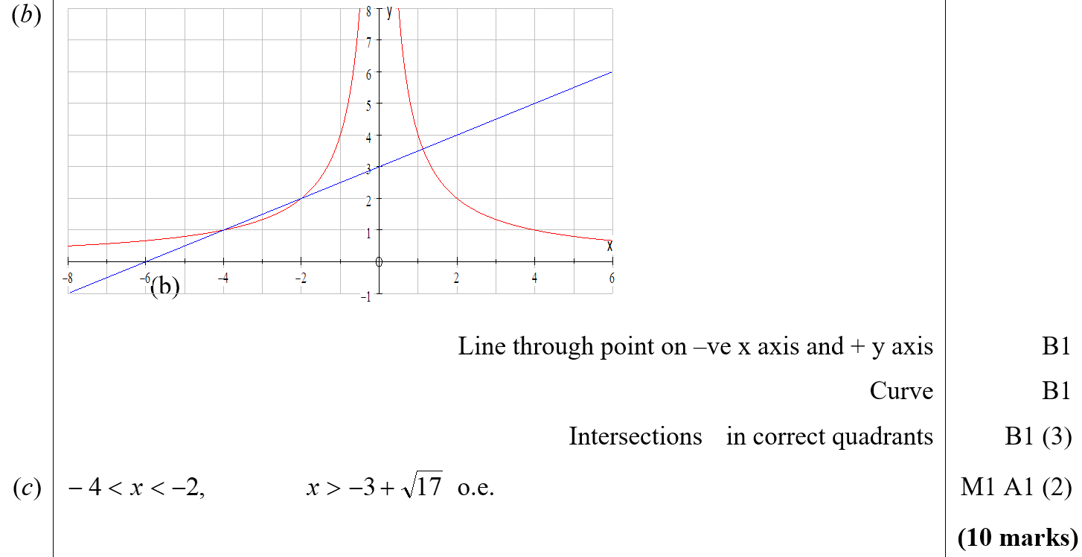
June 2008
B
C

Slide 49
Jan 2009

Slide 50
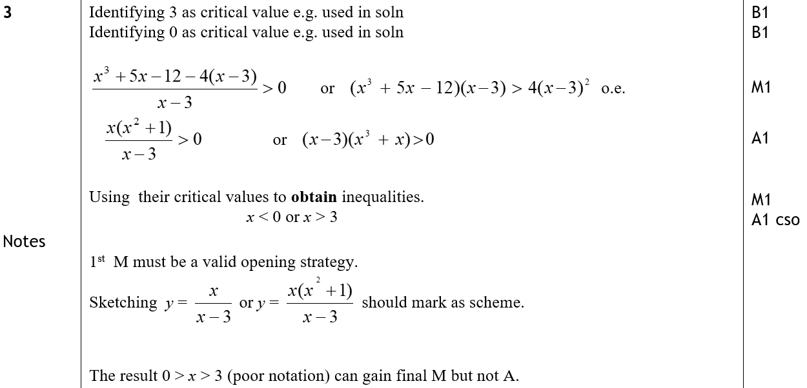
Jan 2009
A
A notes

Slide 51
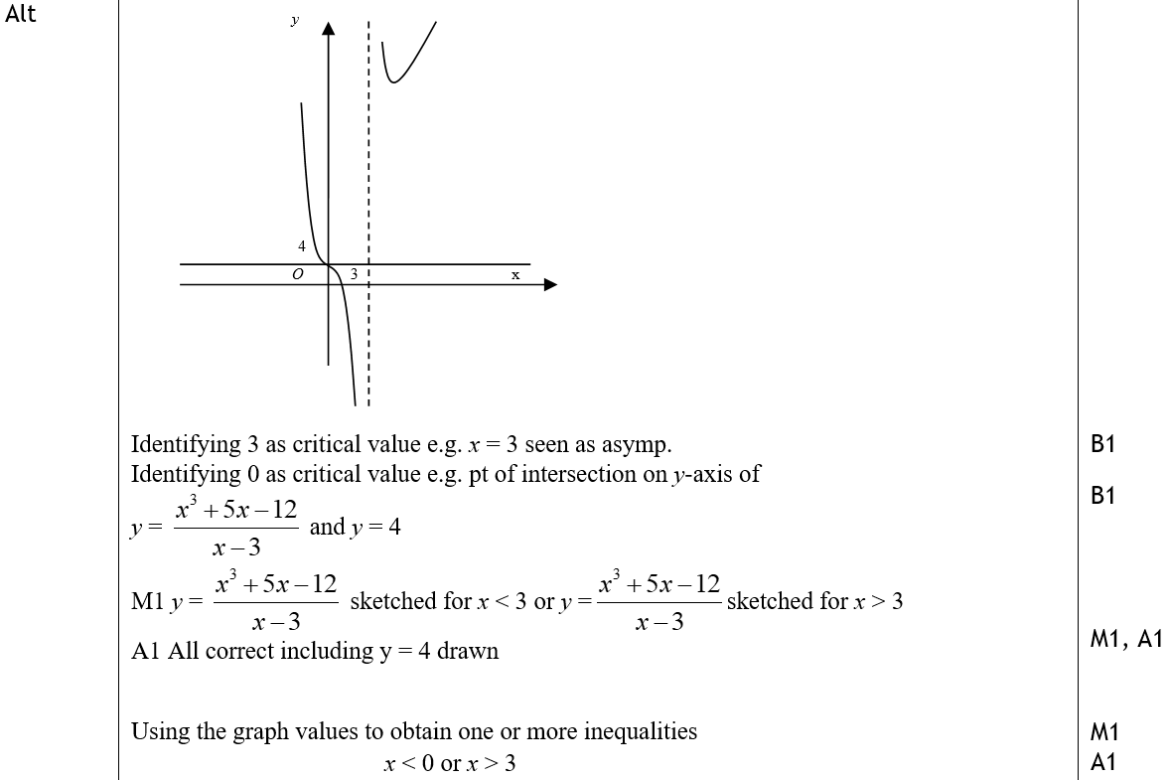
Jan 2009
A Alternative

Slide 52
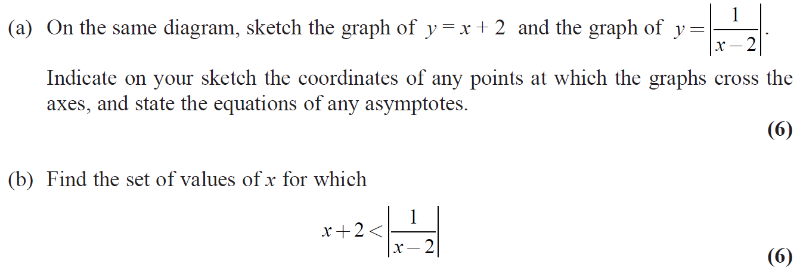
June 2009

Slide 53
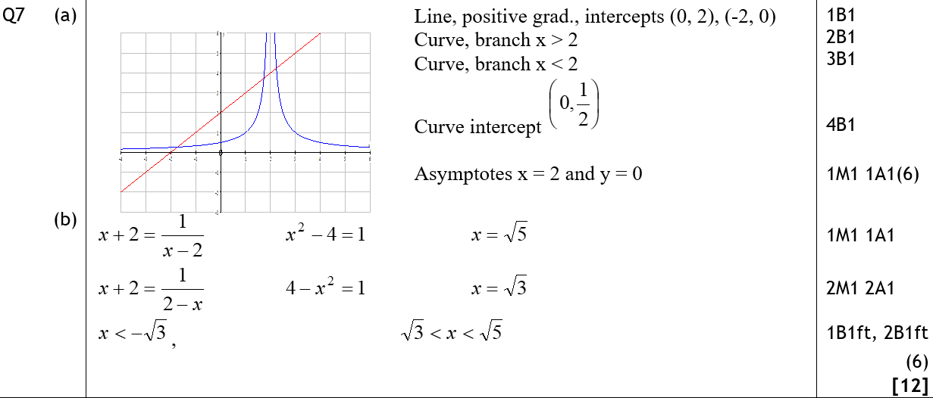
June 2009
A
B

Slide 54
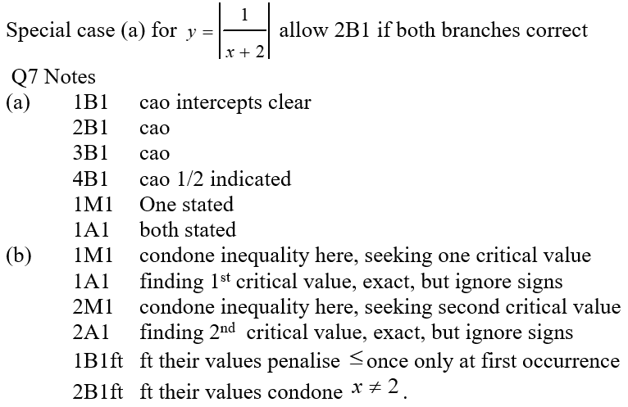
June 2009
A notes
B notes

Slide 55
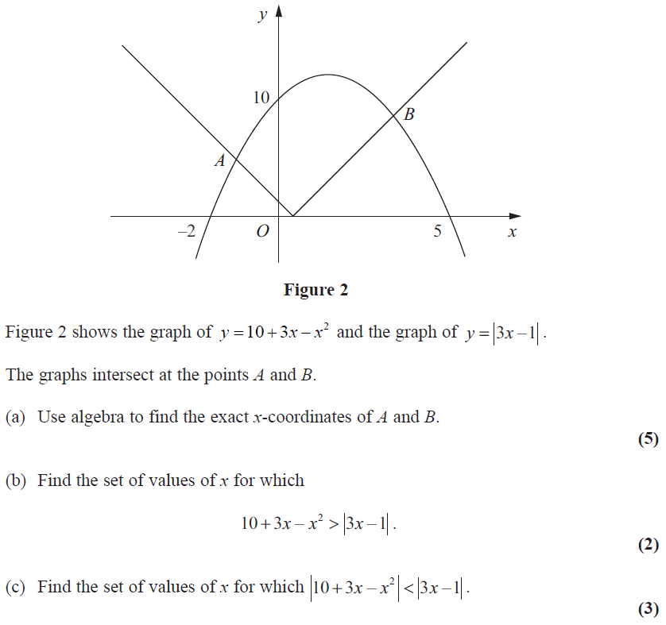
Jan 2010

Slide 56
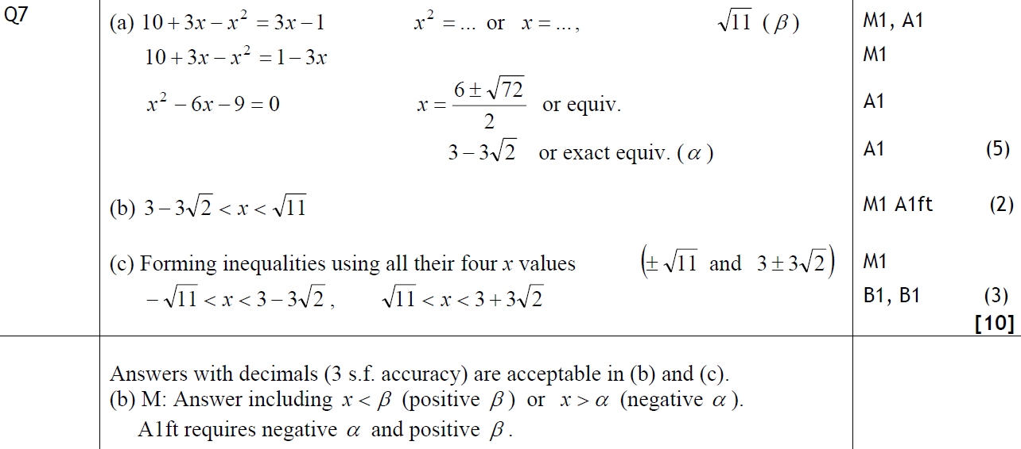
Jan 2010
A
B
C
B notes

Slide 57
June 2009

Slide 58
June 2009
A
C

Slide 59
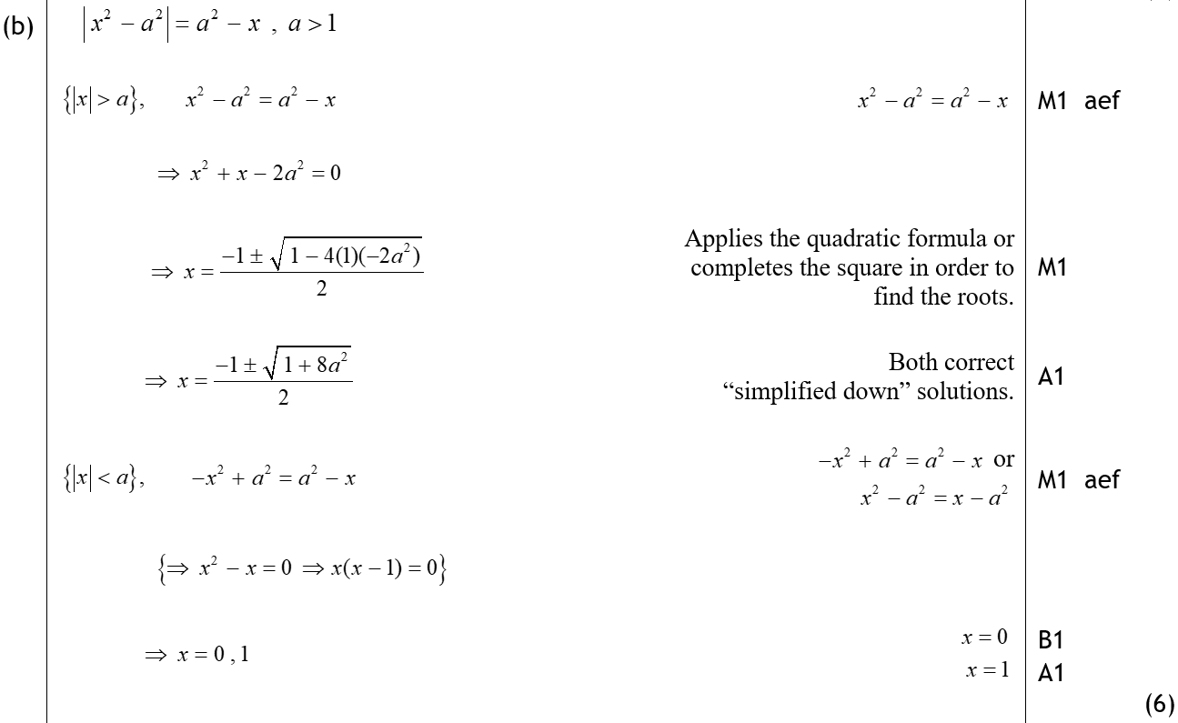
June 2009
B

Slide 60
June 2010

Slide 61
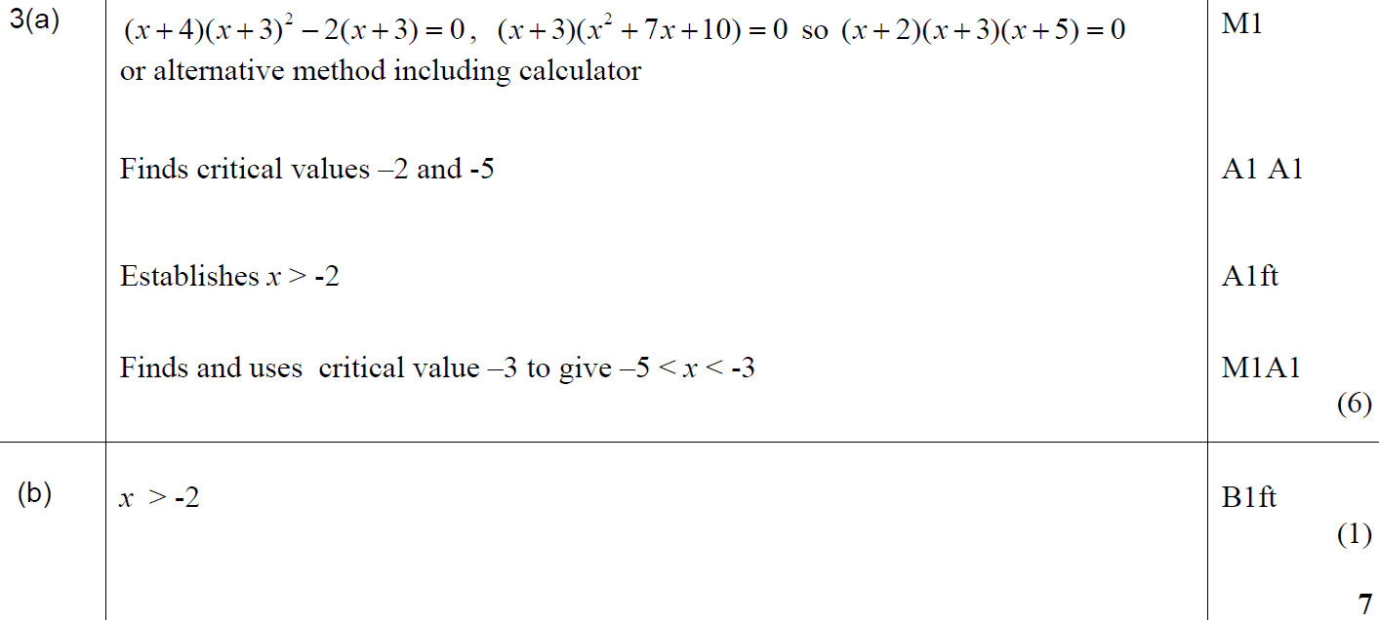
June 2010
A
B

Slide 62
June 2011

Slide 63
June 2011
A

Slide 64
June 2012

Slide 65
June 2012
A

Slide 66
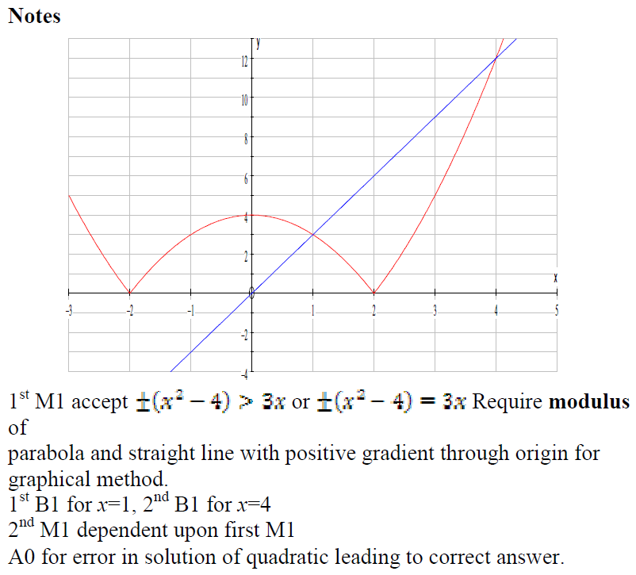
June 2012
A notes

Slide 67
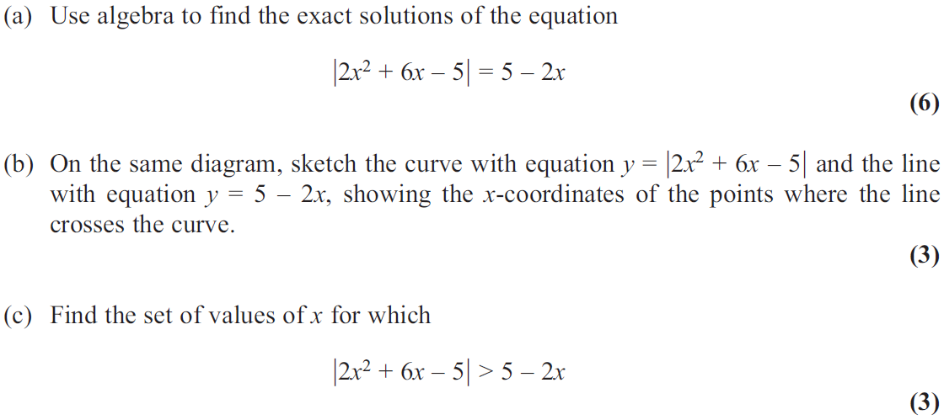
June 2013

Slide 68
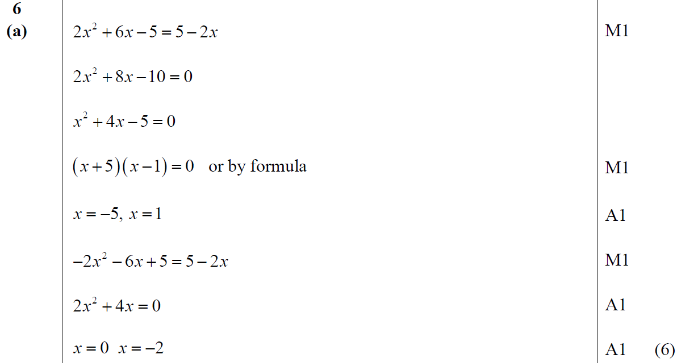
June 2013
A

Slide 69
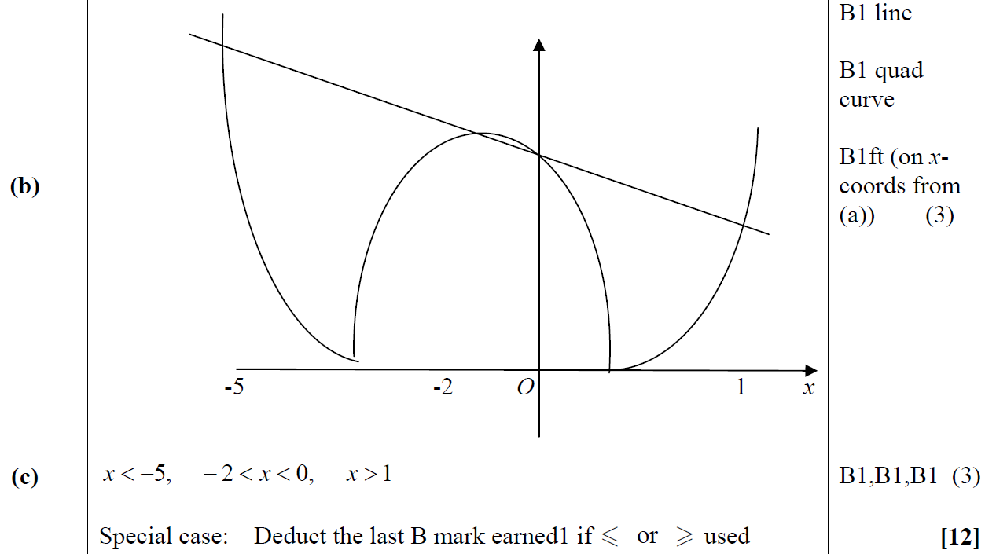
June 2013
B
C

Slide 70
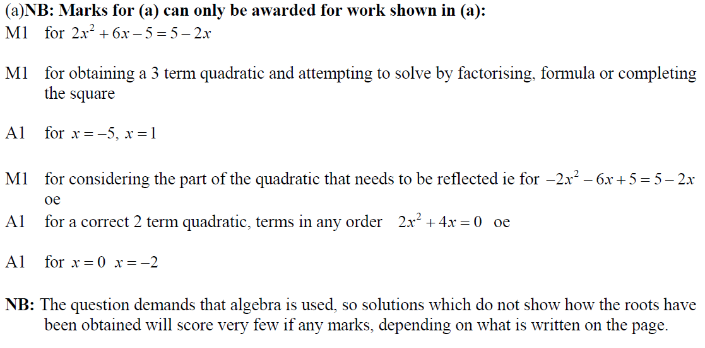
June 2013
A notes
A Alternative notes

Slide 71
June 2013
B notes
C notes

Slide 72
June 2013 (R)

Slide 73
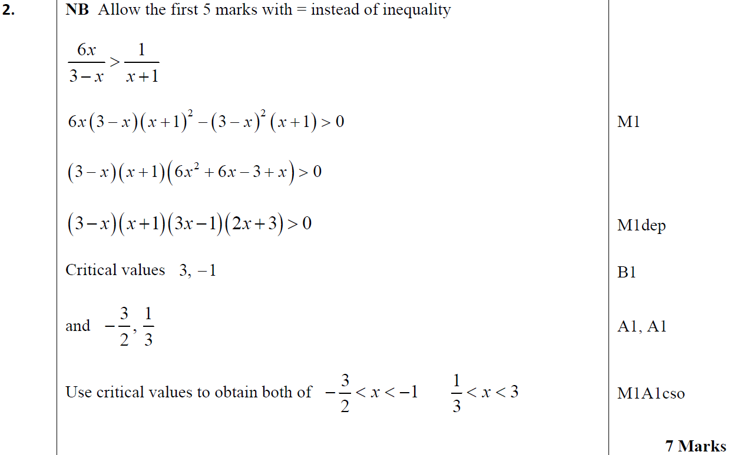
June 2013 (R)
A

Slide 74
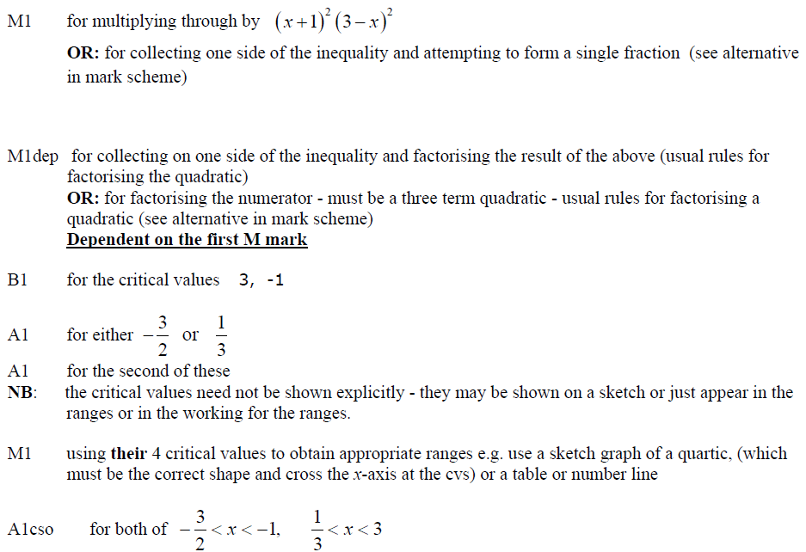
June 2013 (R)
A notes

Slide 75
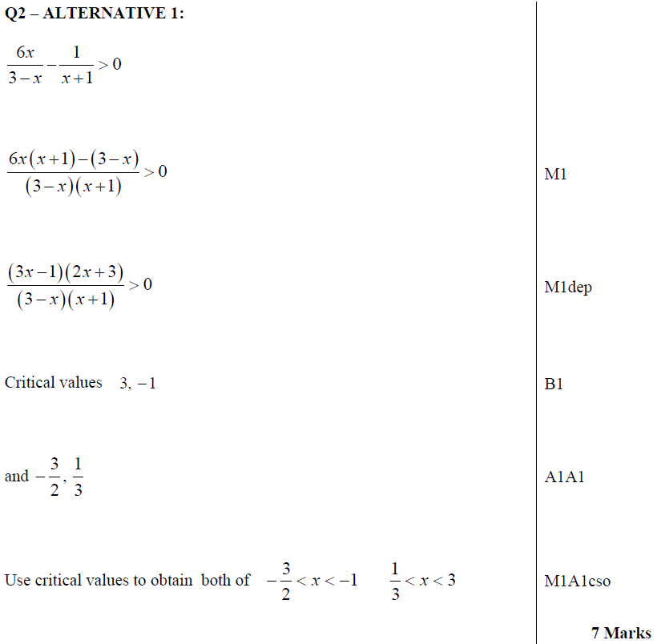
June 2013 (R)
A Alternative

Slide 76
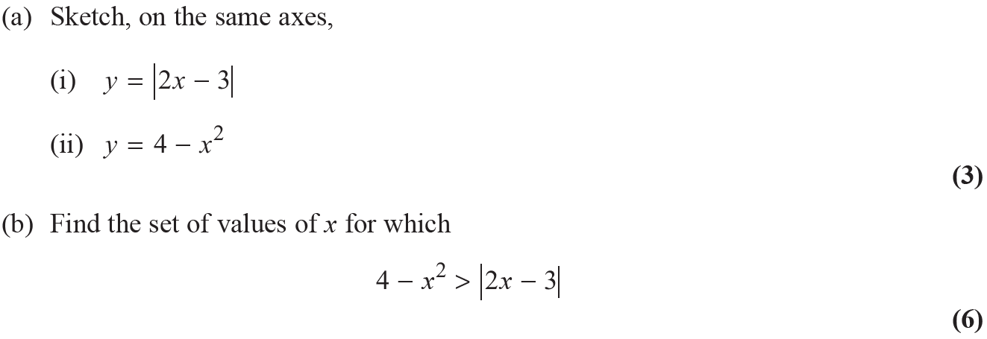
June 2013 (Withdrawn)

Slide 77
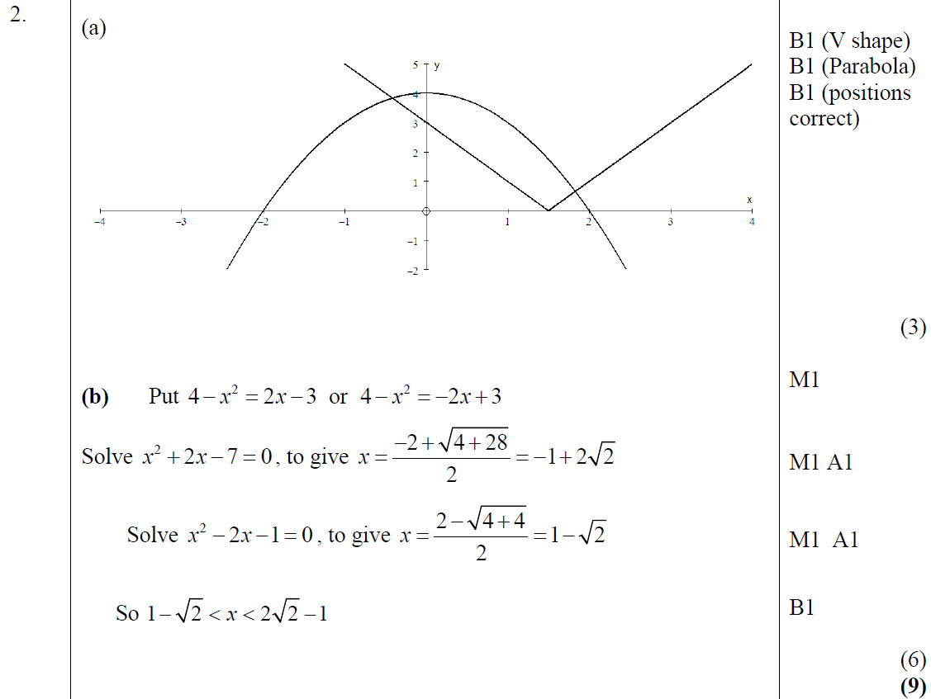
June 2013 (Withdrawn)
A
B

Slide 78
June 2014

Slide 79
June 2014
A

Slide 80
June 2014
A notes

Slide 81
June 2014 (R)

Slide 82
June 2014 (R)
A

Slide 83
June 2014 (R)
A notes

Slide 84
June 2015

Slide 85
June 2015
A
B

Slide 86
June 2015
A notes
B notes

Slide 87
June 2016

Slide 88
June 2016
A

Slide 89
June 2016
A Alternatives

Slide 90
June 2016
A notes

Slide 91
June 2017

Slide 92
June 2017
A

Slide 93
June 2017
A Alternative 1

Slide 94
June 2017
A Alternative 2

Slide 95
June 2018

Slide 96
June 2018
A

Slide 97
June 2018
A Alternative

Slide 98
June 2019

Slide 99
June 2019
A

Slide 100
June 2019
A notes
A Alternative 1
A Alternative 1 notes

Slide 101
June 2019
A Alternative 2
A Alternative 3

