Slide 1
Further Pure 1 Past Paper Questions
Revision Past Paper Questions
Go back to home screen to select a topic
Go back to topic screen to select a question
Go to the mark scheme for that question
Go back to the question from the mark scheme
Or see more solutions
Or go back to first solutions
Next

Slide 2
Notes on operating this resource
When creating this, I used and to quickly navigate between slides directly before or after the slide in question.
As some mark schemes give additional notes, you can continue to see answers by clicking but you will not return to the original question with one click of .
To view the original question again, continue to click which should take you back.
Next

Slide 3
Notes on Further Pure 1 for Edexcel and this resource
There is some overlap between topics, particularly with Methods in Calculus, where t-formulae are often combined with a Weierstrauss Substitution and Taylor Series with Leibnitz’s Rule.
Differential Equations (First and Second Order) may be asked initially or following a reduction from a given substitution.
Most topics are only asked once per sitting, but both Vectors and Conic Sections have had multiple questions per sitting in the past.
Conversely, both Simpson’s Rule and Inequalities are more likely that not to come up, but not guaranteed.
On average, there are 8 Questions per paper (5 in the AS)
Next

Slide 4
Home
Includes AS Further Maths Questions
t-Formulae
Differential Equations
Simpson’s Rule
Inequalities
Methods in Calculus
Vectors
Taylor Series
Conic Sections

Slide 5
New Spec Q’s
Old Spec Vectors
P6/ Old FP3
FP3
June 2002
June 2005 (i)
June 2006
June 2009
June 2009
June 2013 (W)
June 2003
June 2005 (ii)
June 2007
Jan 2010
June 2011
June 2014
June 2004
Jan 2006
June 2008
June 2013
June 2016

Slide 6
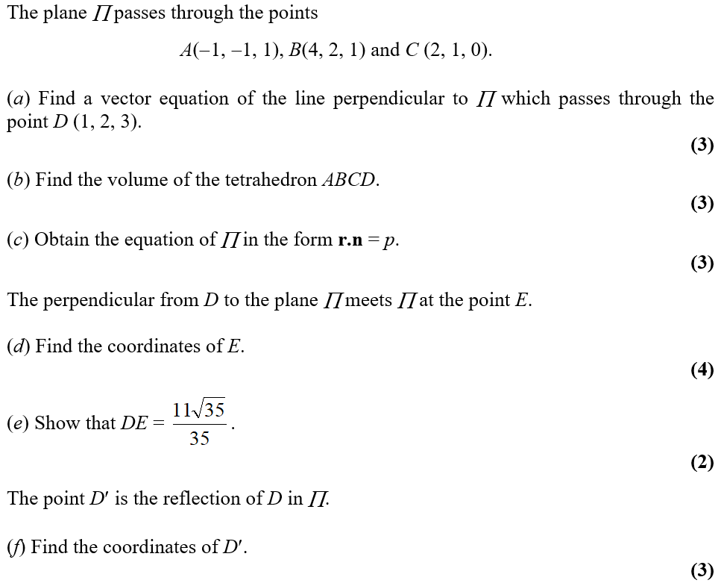
June 2002

Slide 7
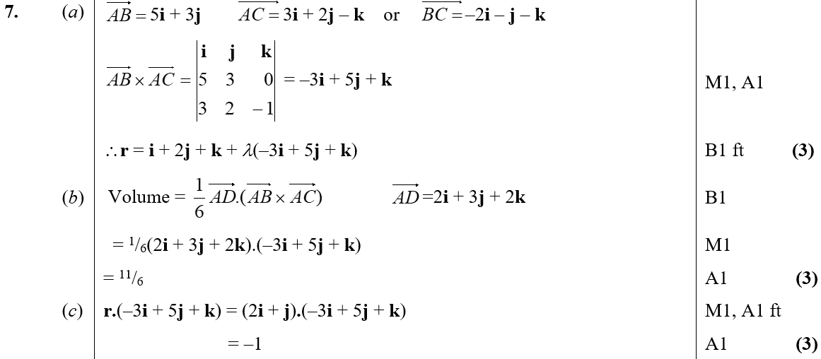
June 2002
A
B
C

Slide 8
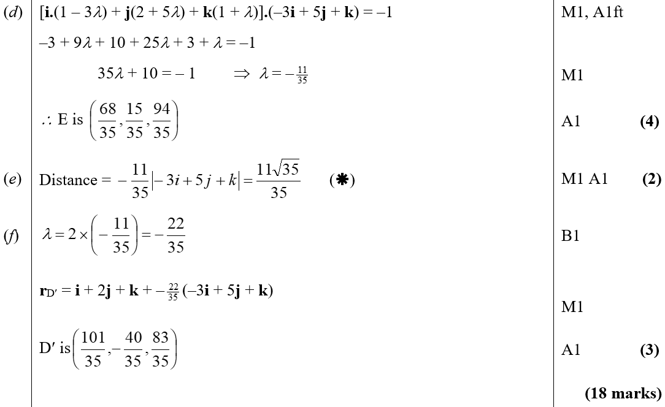
June 2002
D
E
F

Slide 9
June 2003

Slide 10
June 2003
A

Slide 11
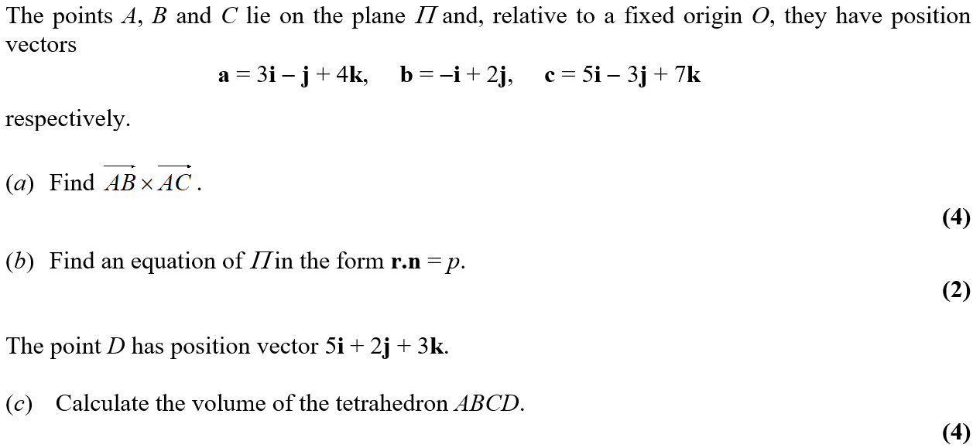
June 2004

Slide 12
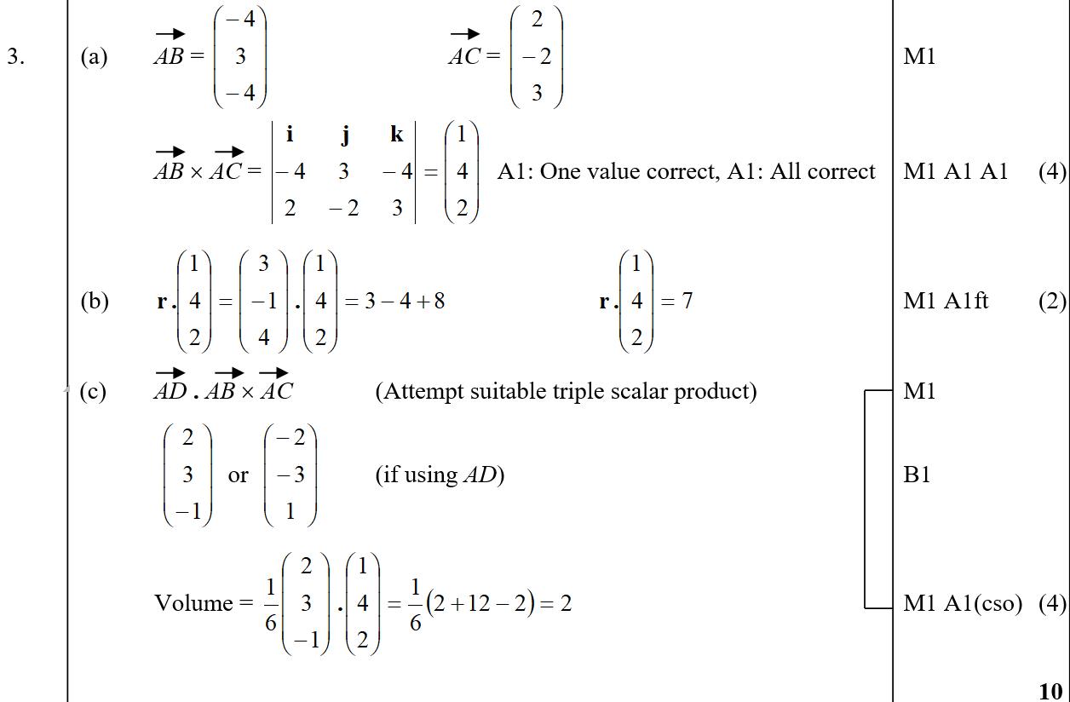
June 2004
A
B
C

Slide 13
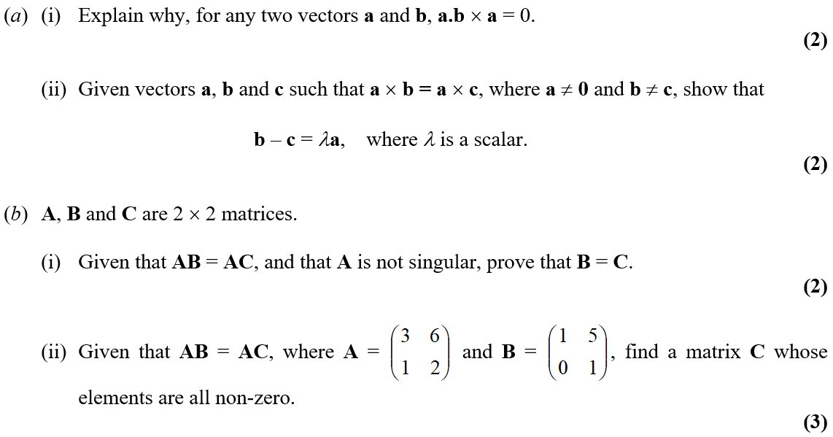
June 2005

Slide 14
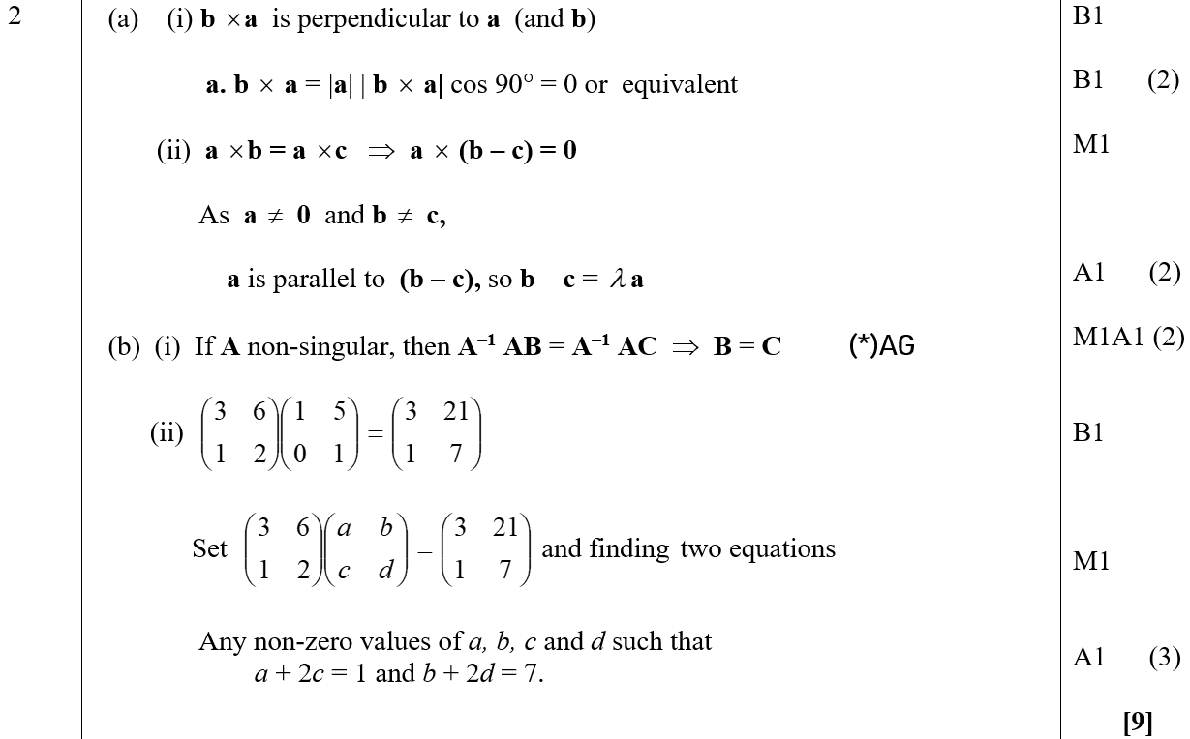
June 2005
A (i)
A (ii)
B (i)
B (ii)

Slide 15
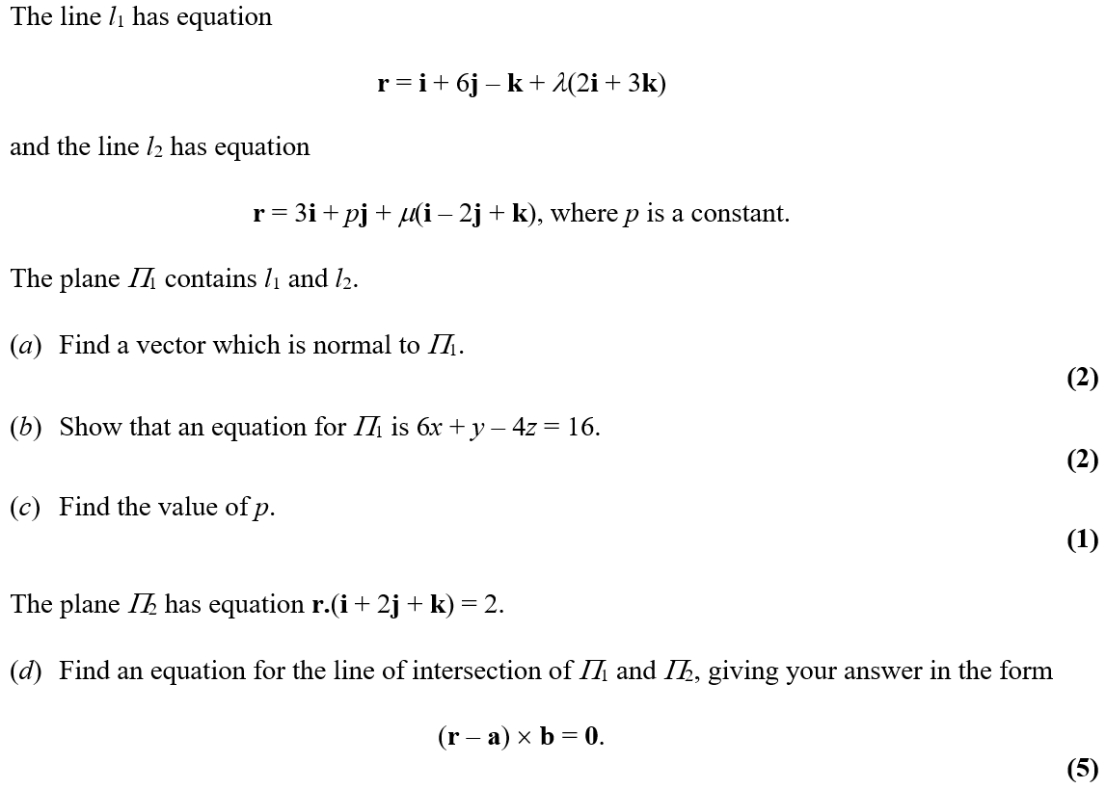
June 2005

Slide 16
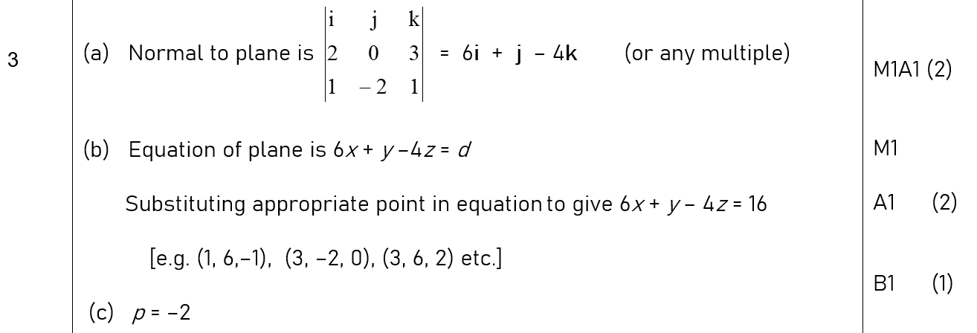
June 2005
A
B
C

Slide 17
June 2005
D

Slide 18
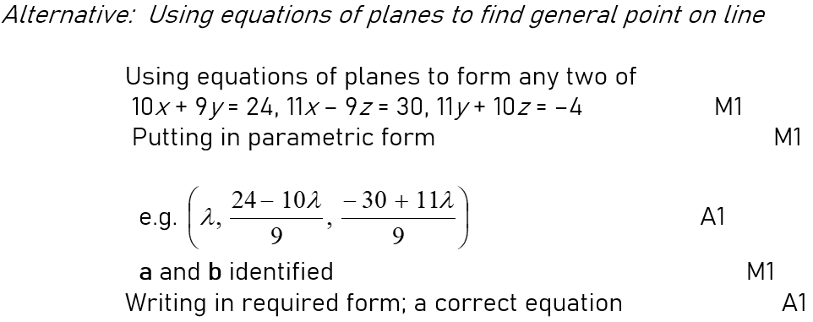
June 2005
D Alternative

Slide 19
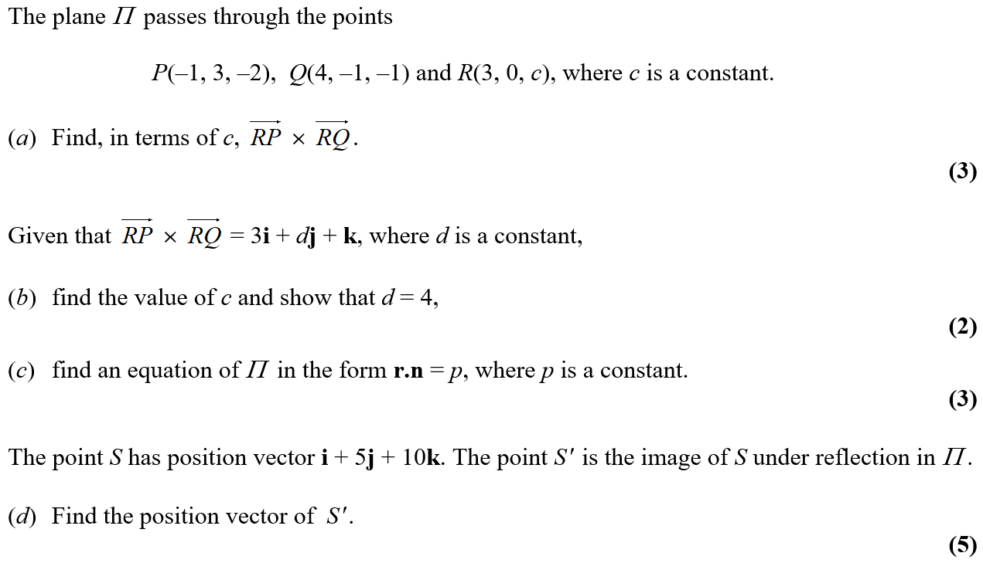
Jan 2006

Slide 20
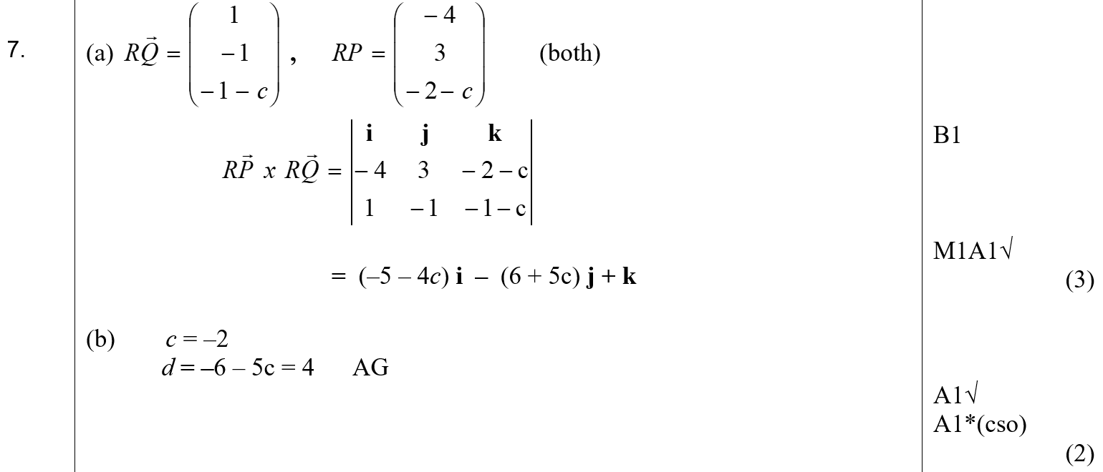
Jan 2006
A
B
C

Slide 21
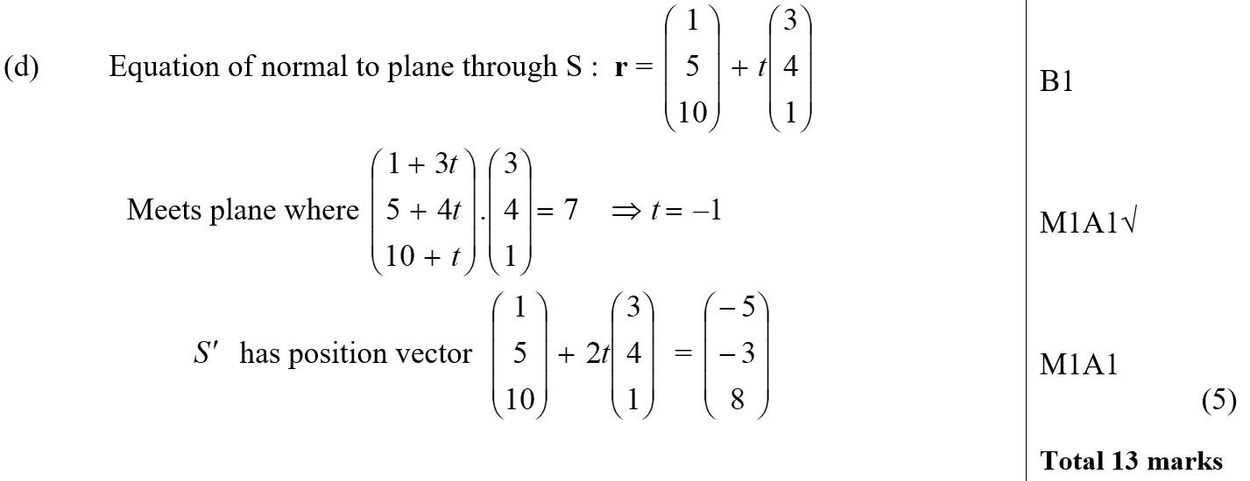
Jan 2006
D

Slide 22
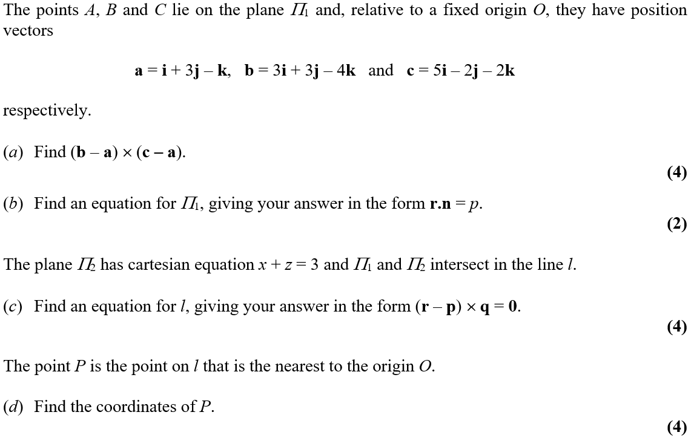
June 2006

Slide 23
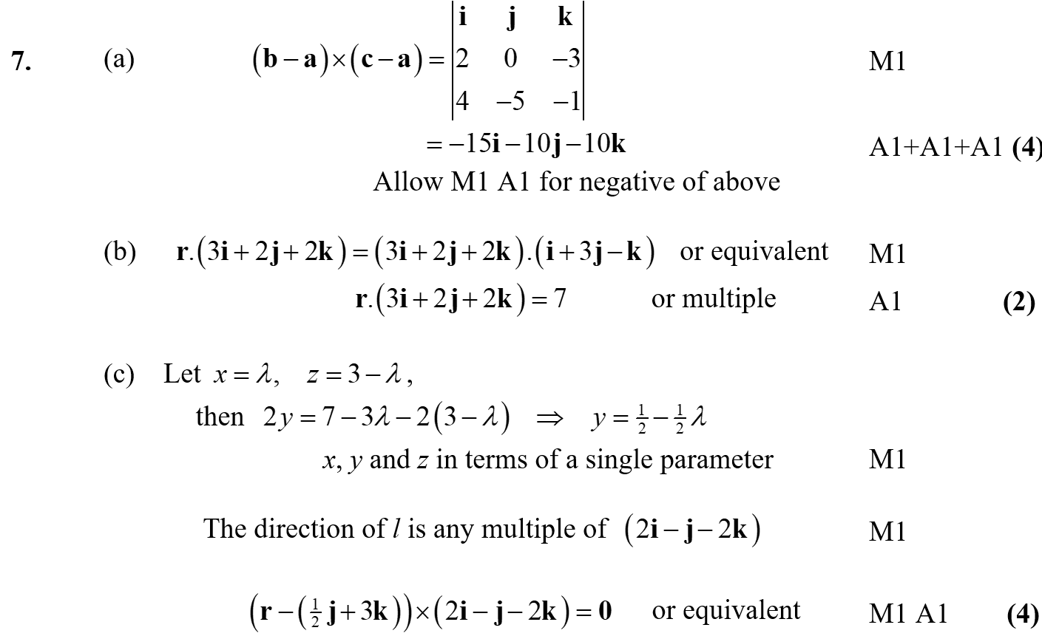
June 2006
A
B
C

Slide 24
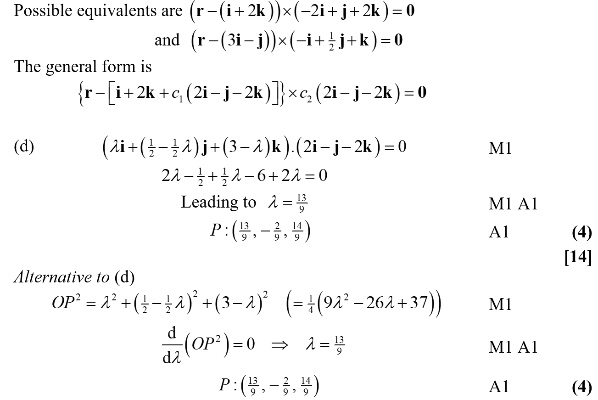
June 2006
C Equivalents
D

Slide 25
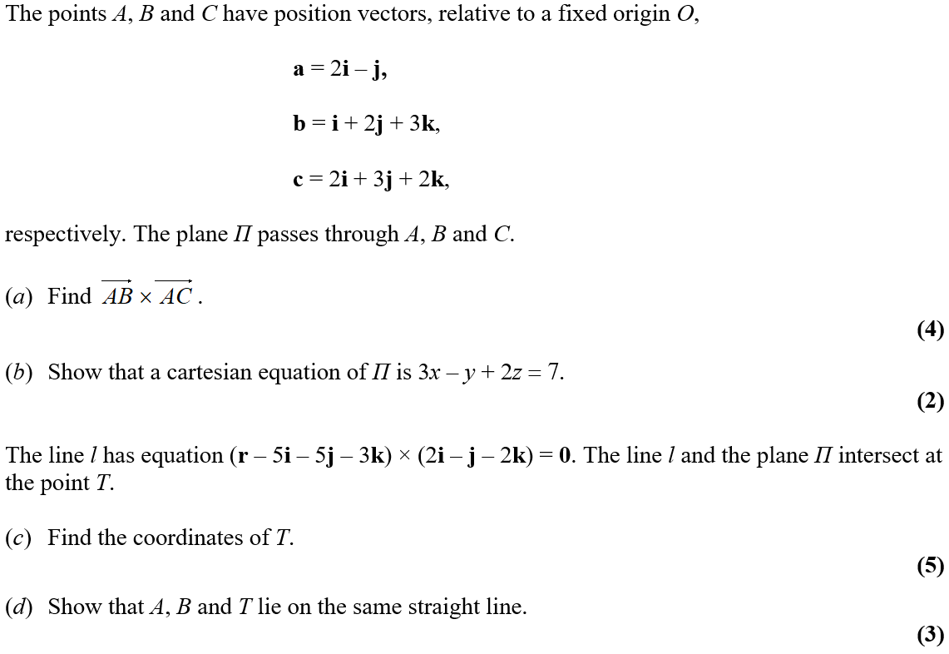
June 2007

Slide 26
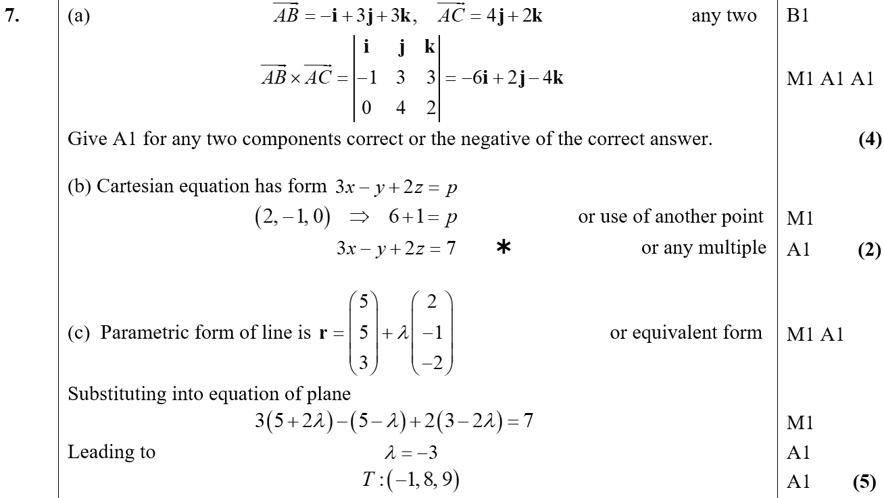
June 2007
A
B
C

Slide 27
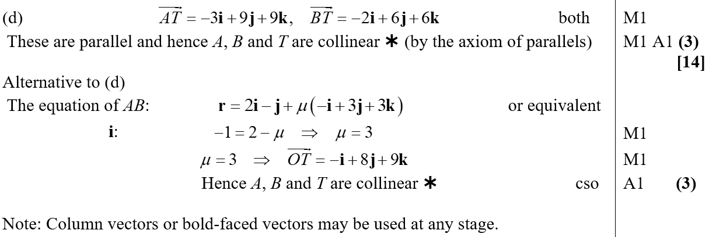
June 2007
D

Slide 28
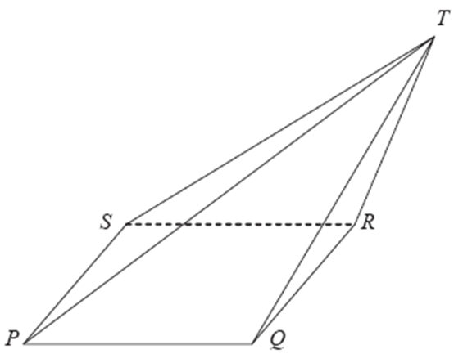
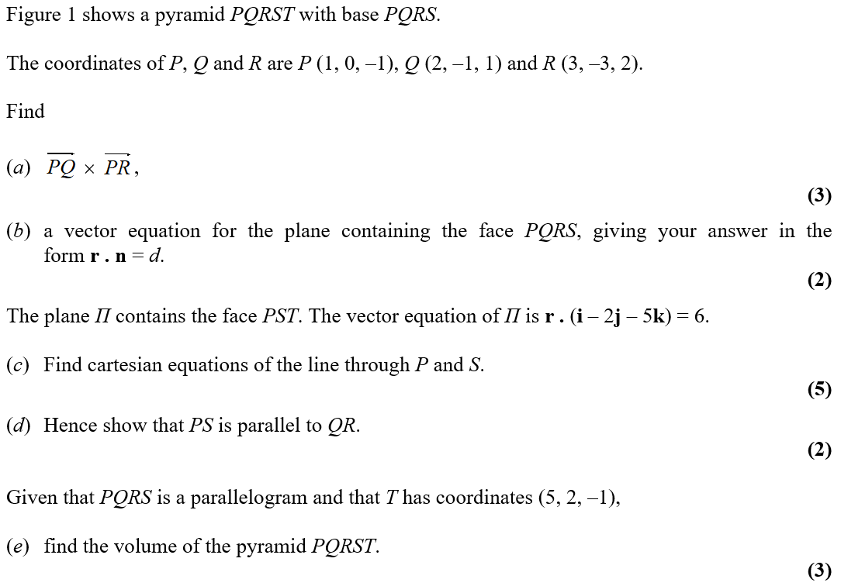
June 2008

Slide 29
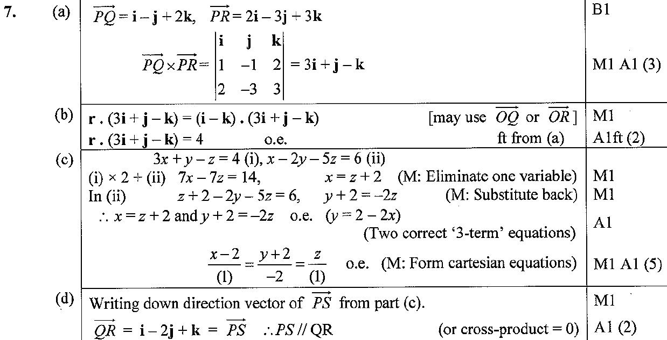
June 2008
A
B
C
D

Slide 30
June 2008
A

Slide 31
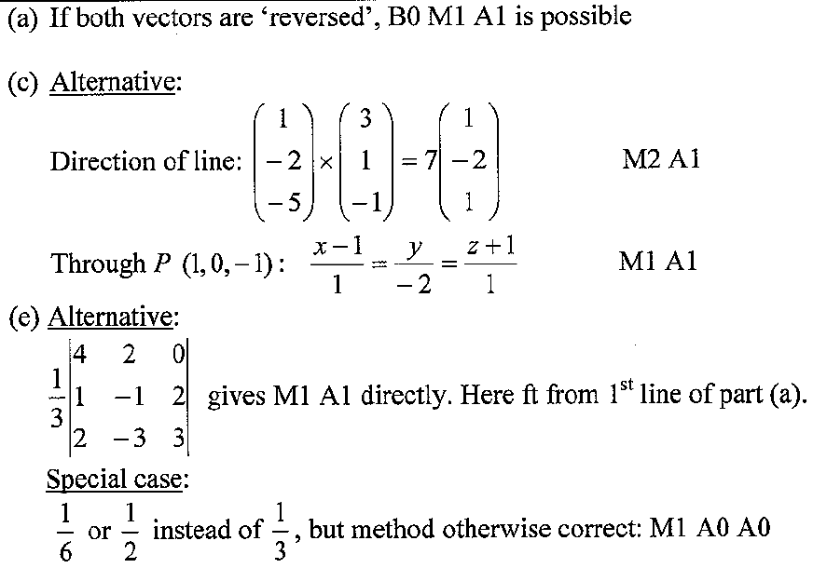
June 2008
A notes
C Alternative
E Alternative

Slide 32
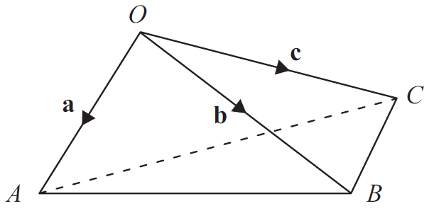
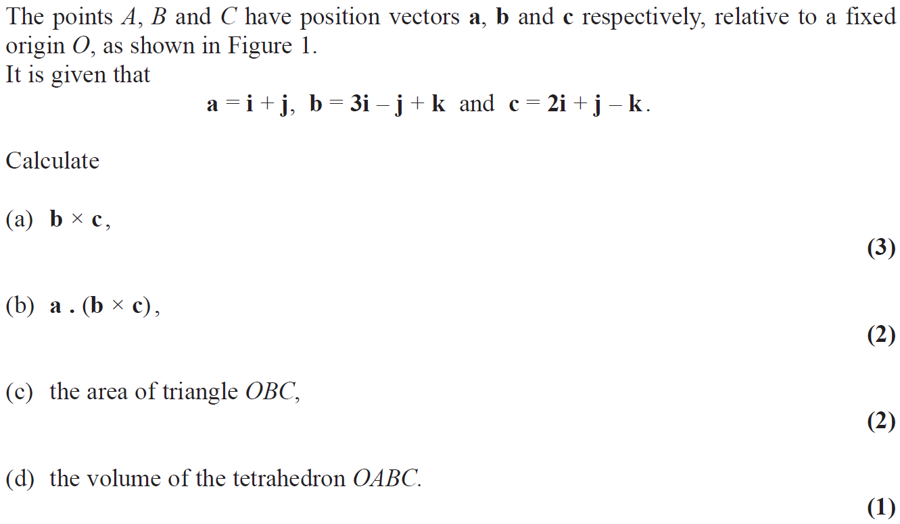
June 2009

Slide 33
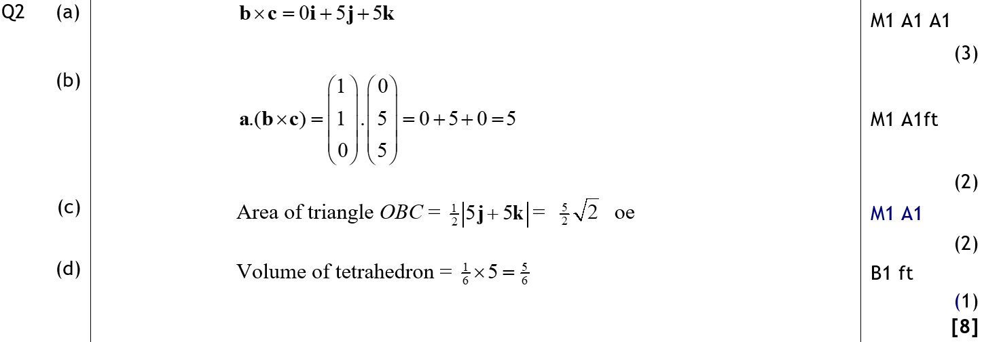
June 2009
A
B
C
D

Slide 34
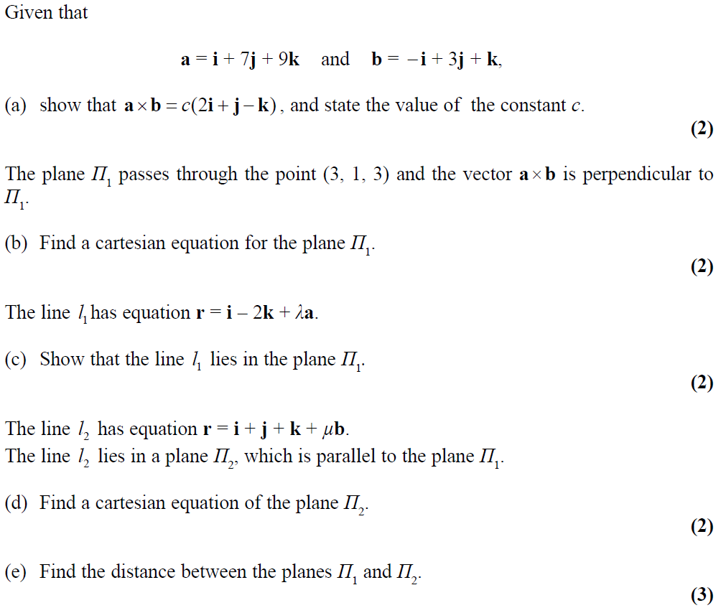
Jan 2010

Slide 35
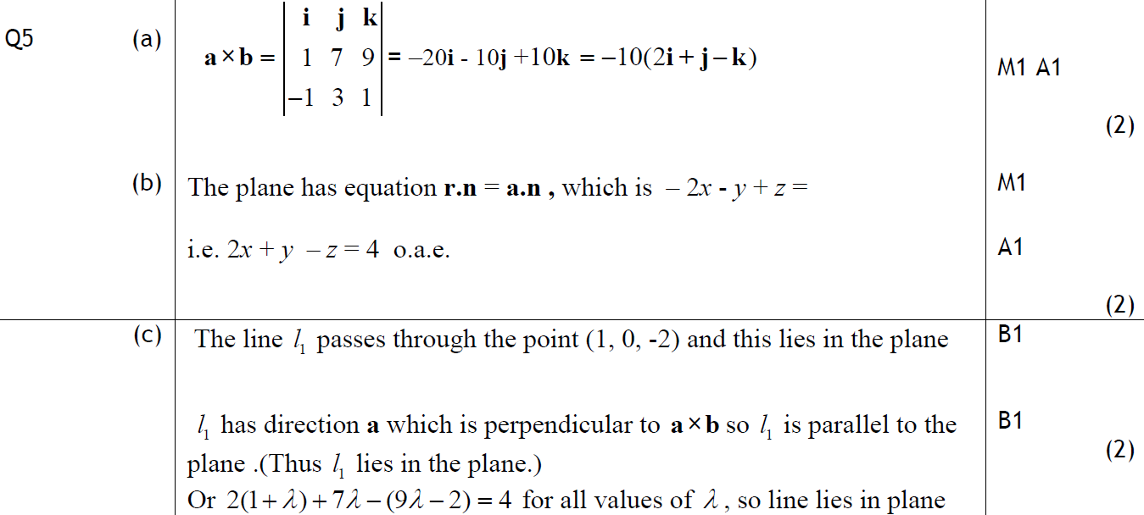
Jan 2010
A
B
C

Slide 36
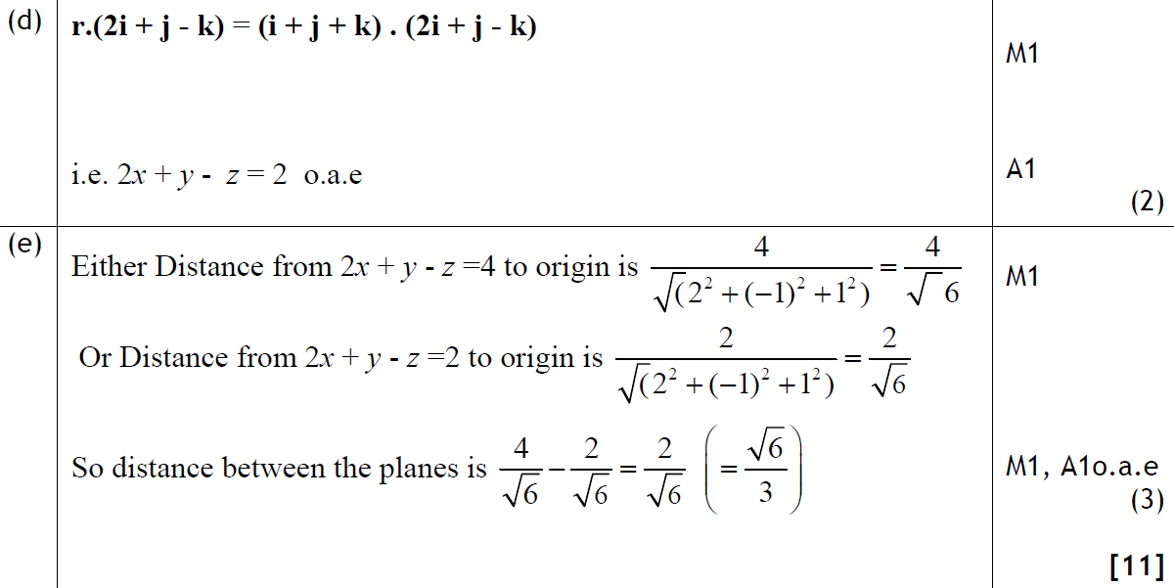
Jan 2010
D
E

Slide 37
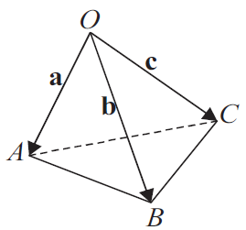
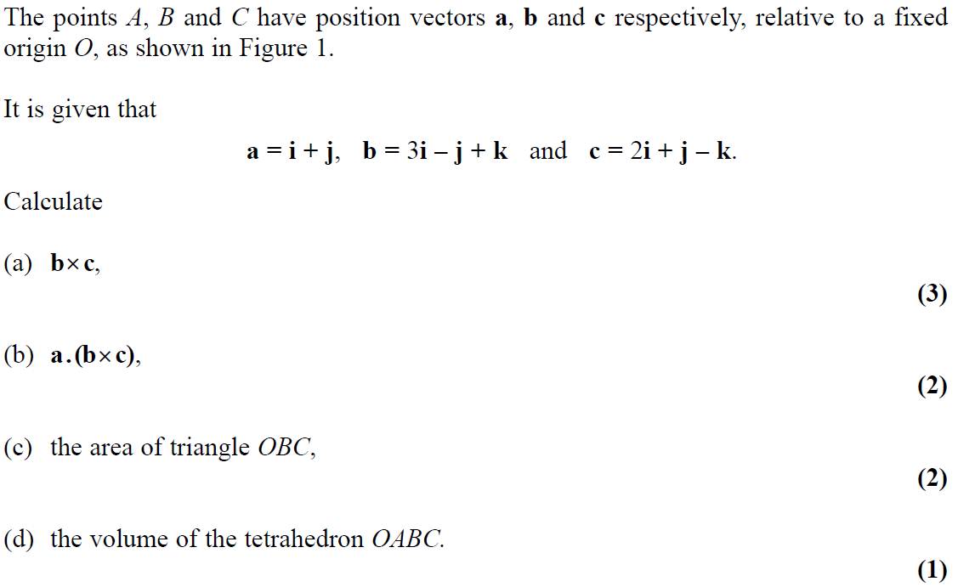
June 2009

Slide 38
June 2009
A
B
C
D

Slide 39
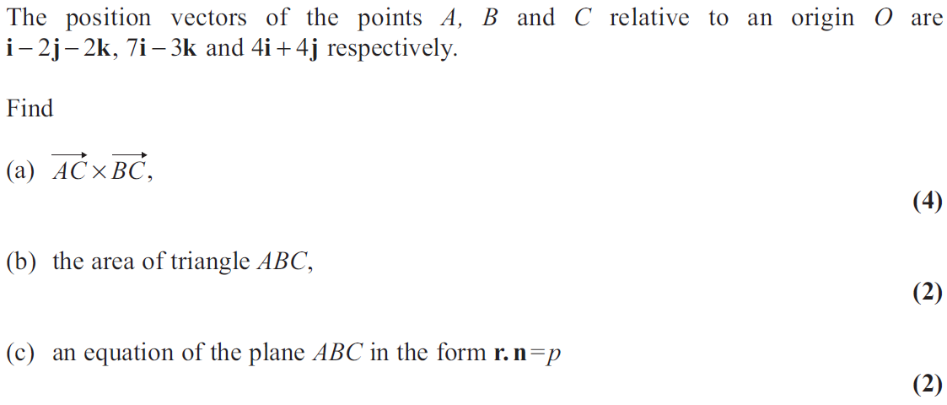
June 2011

Slide 40
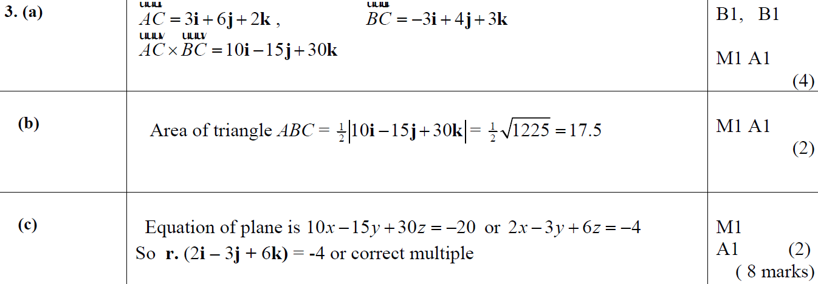
June 2011
A
B
C
A notes
B notes
C notes

Slide 41
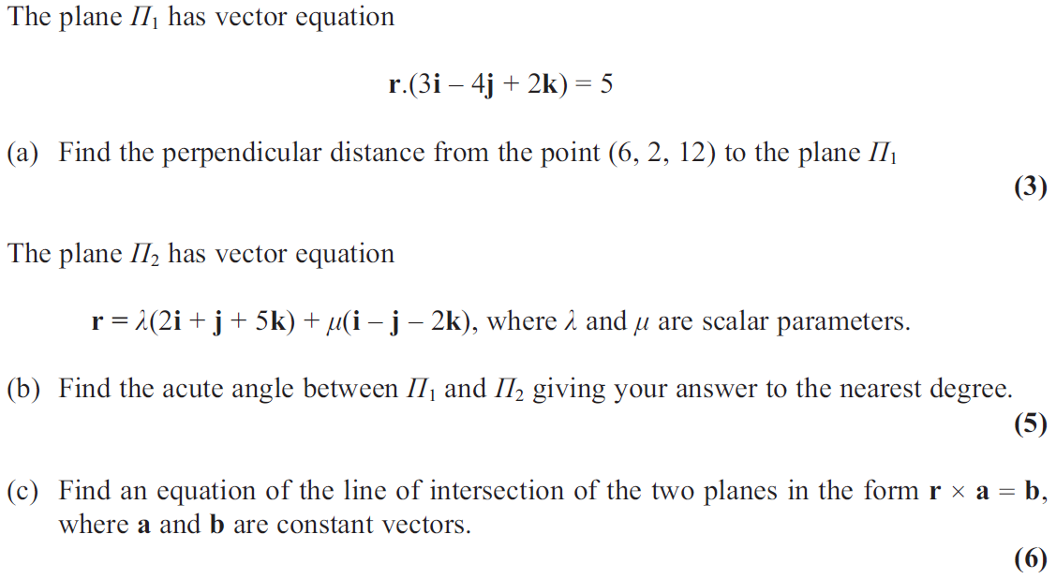
June 2013

Slide 42
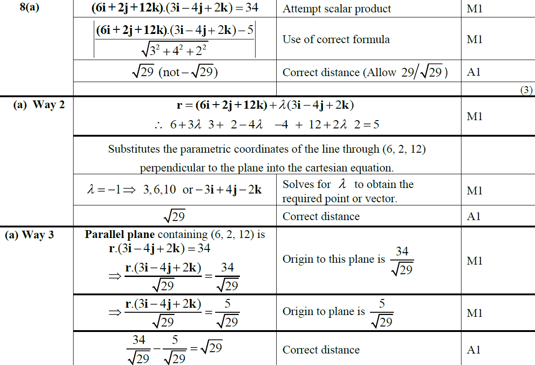
June 2013
A

Slide 43
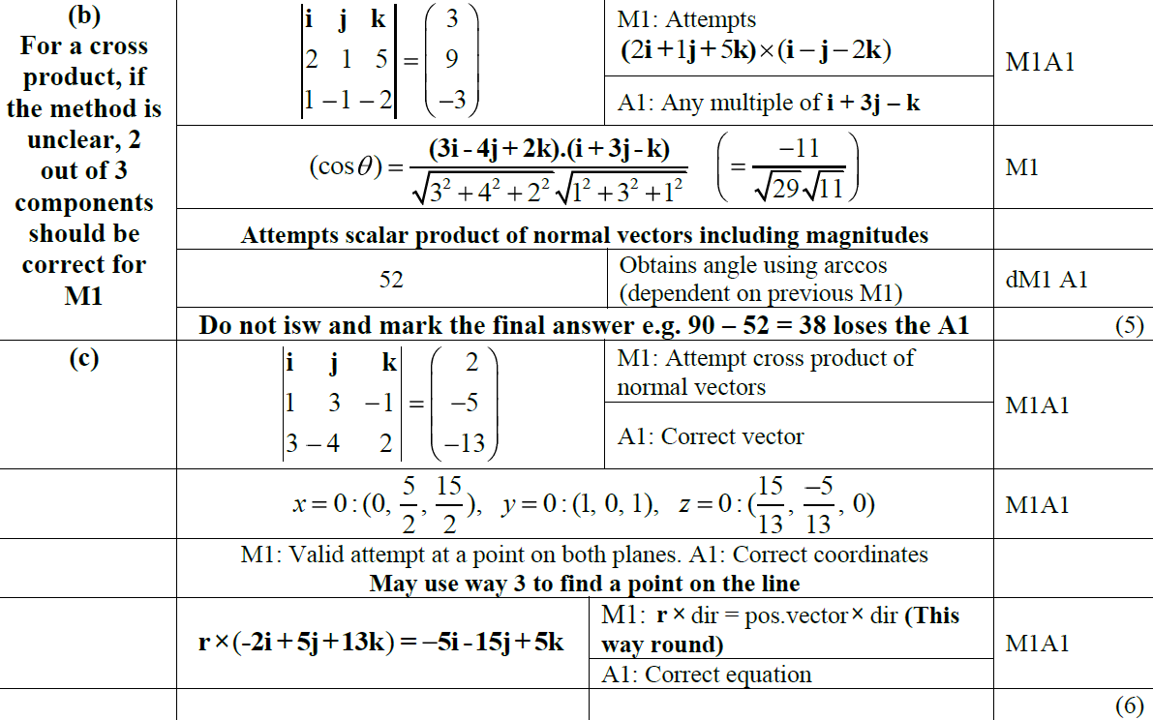
June 2013
B
C

Slide 44
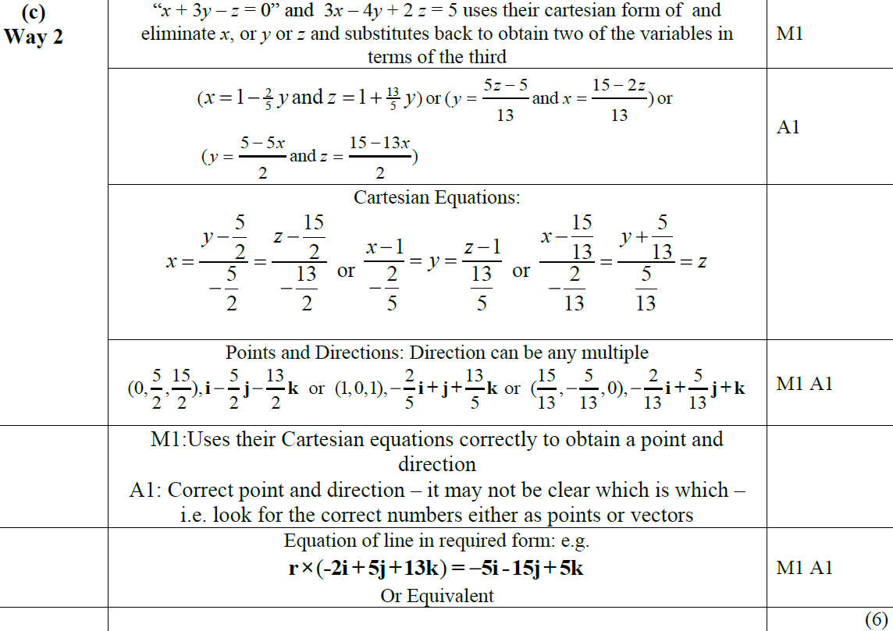
June 2013
C Alternative 1

Slide 45
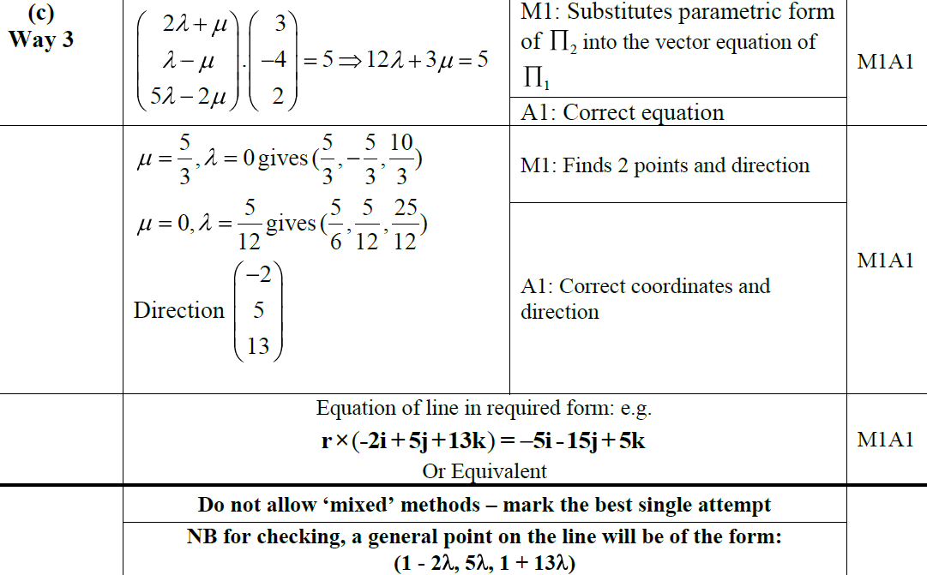
June 2013
C Alternative 2

Slide 46
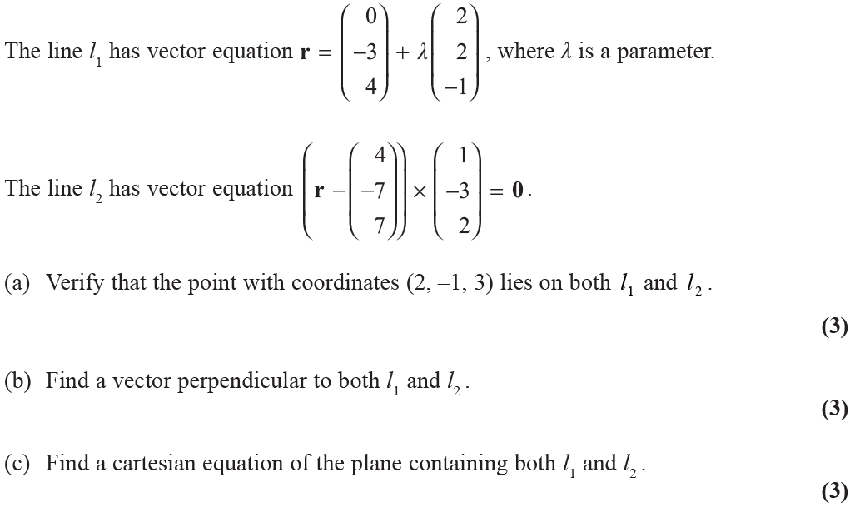
June 2013 (Withdrawn)

Slide 47
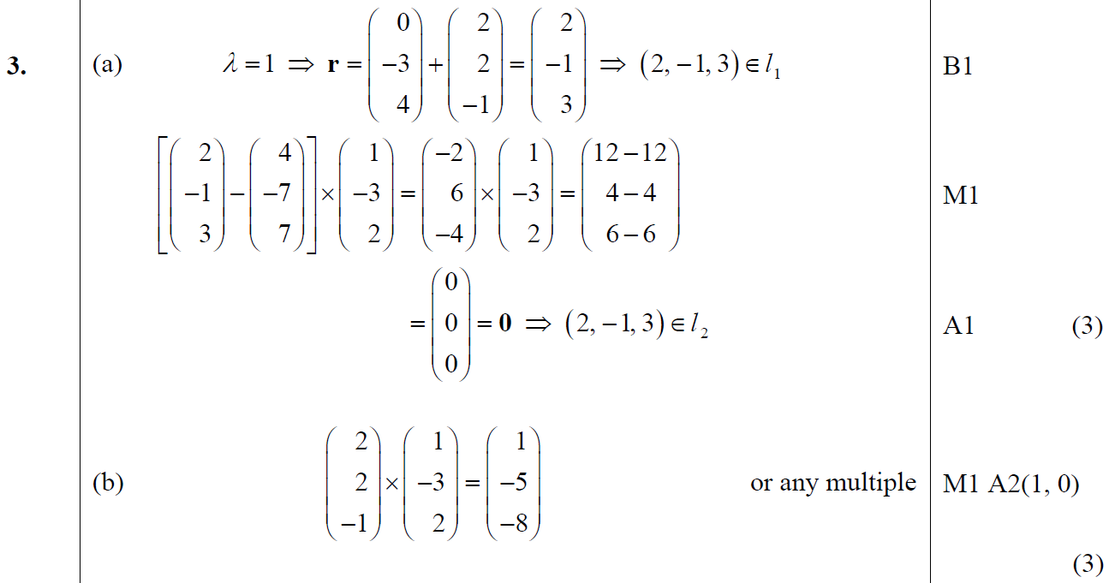
June 2013 (Withdrawn)
A
B

Slide 48
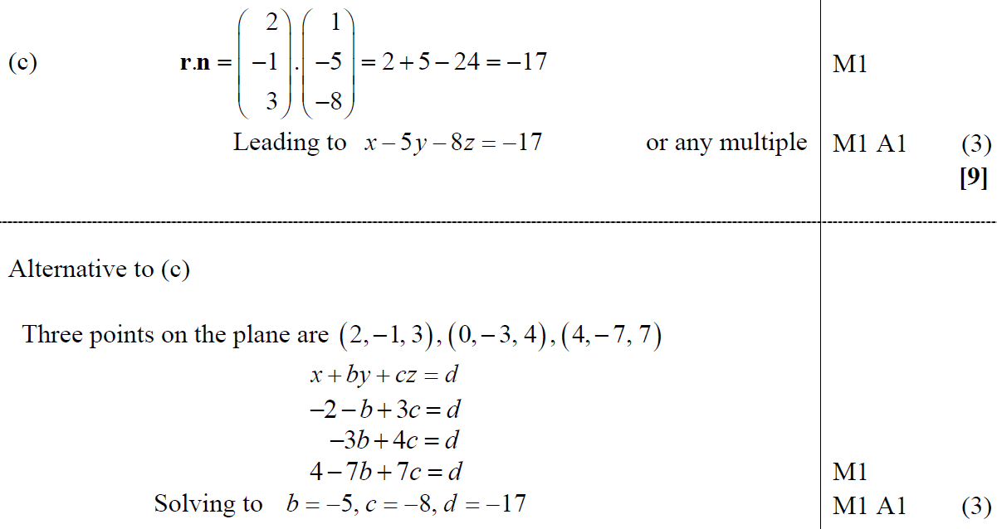
June 2013 (Withdrawn)
C

Slide 49
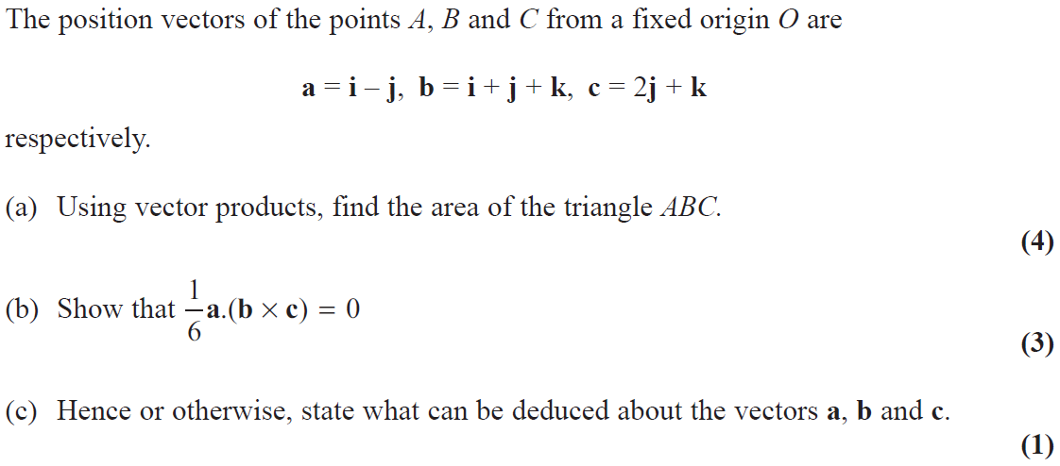
June 2014

Slide 50
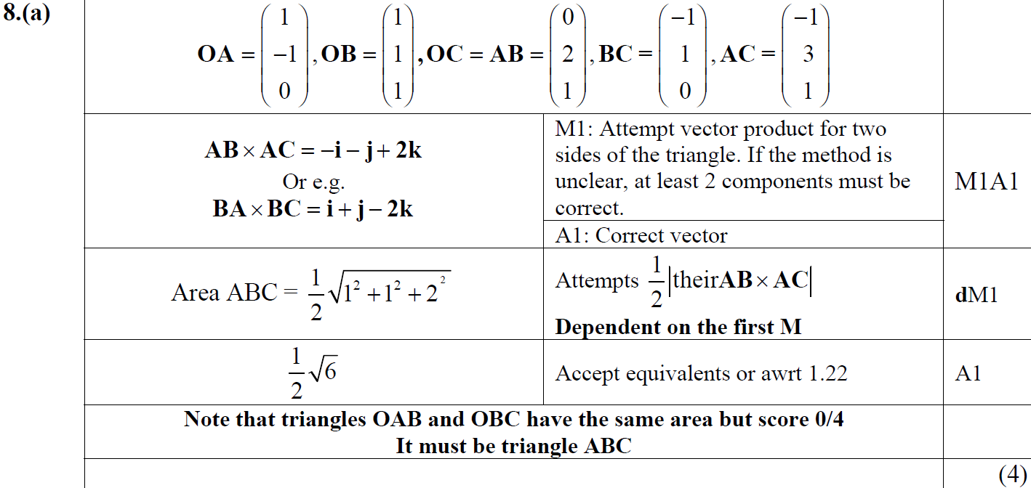
June 2014
A

Slide 51
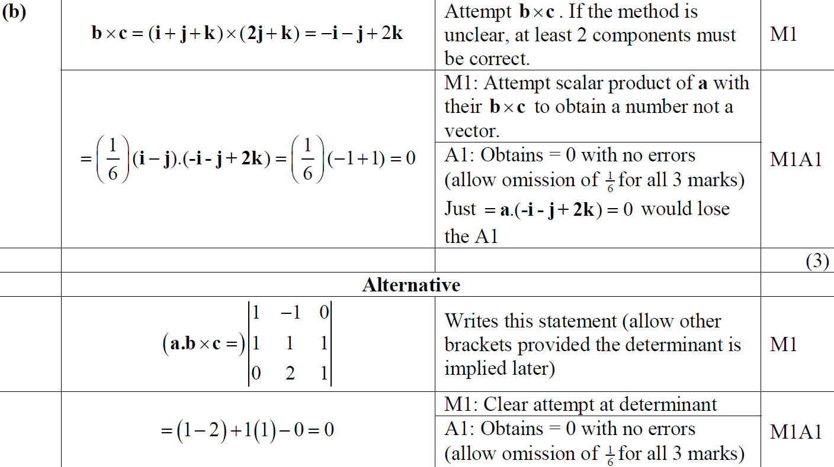
June 2014
B

Slide 52
June 2014
C

Slide 53
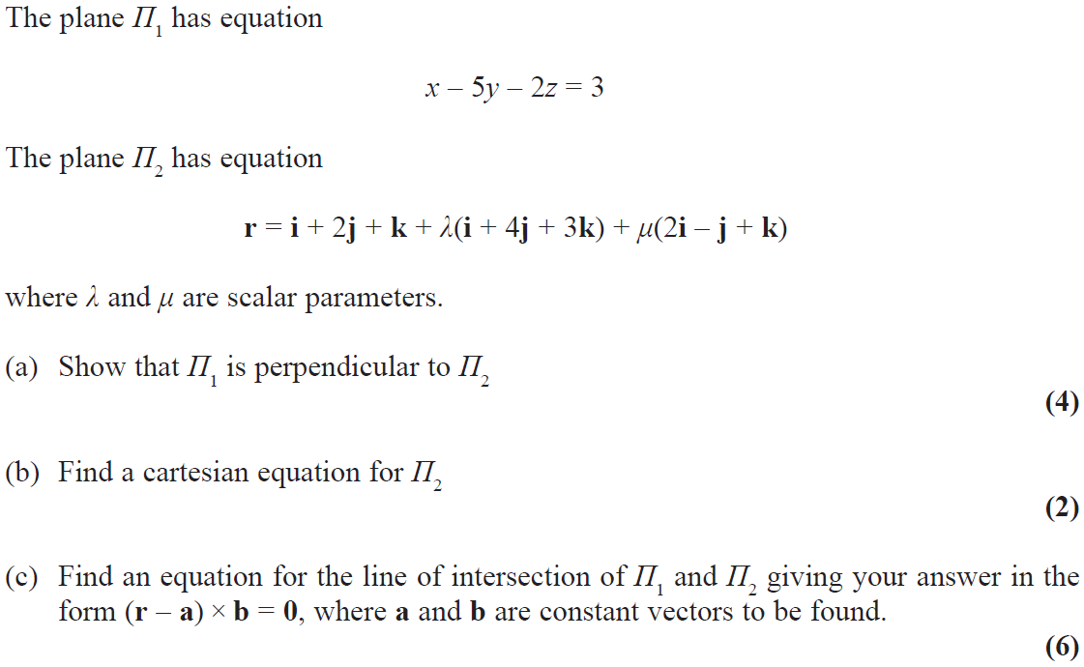
June 2016

Slide 54
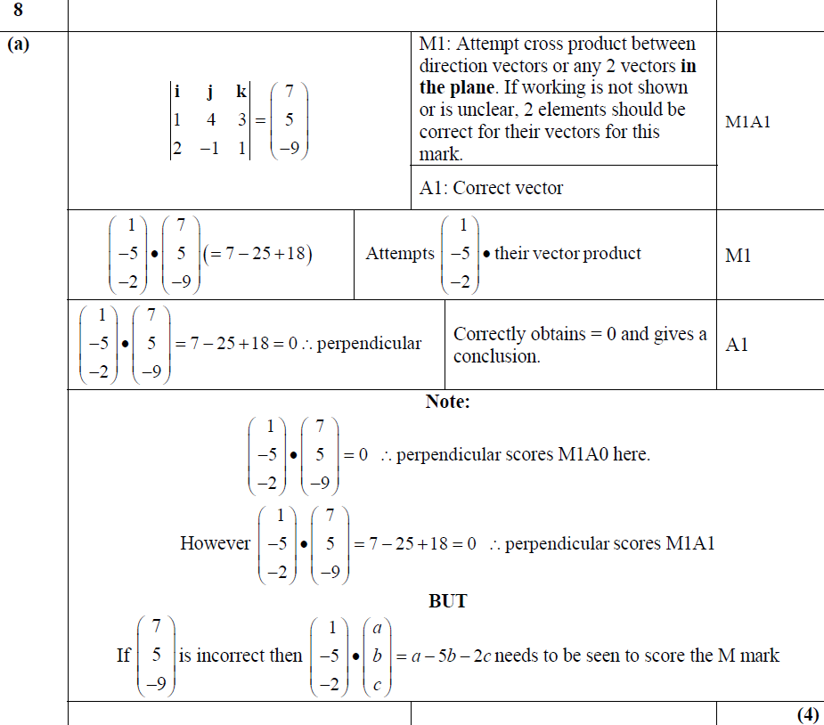
June 2016
A

Slide 55
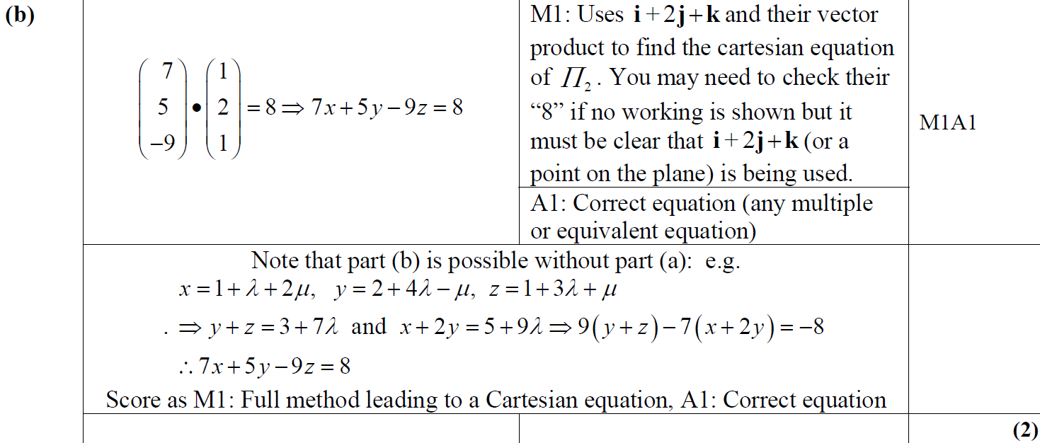
June 2016
B

Slide 56
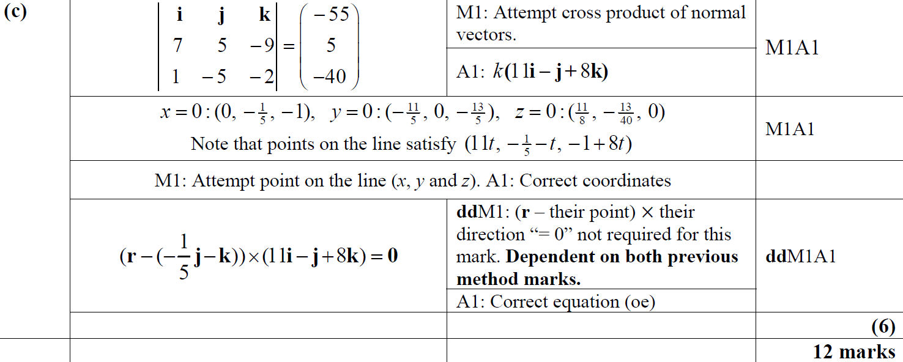
June 2016
C

Slide 57
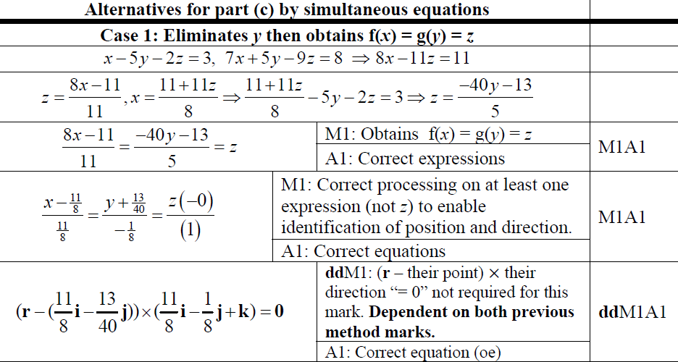
June 2016
C Alternative 1 by Simultaneous Equations

Slide 58
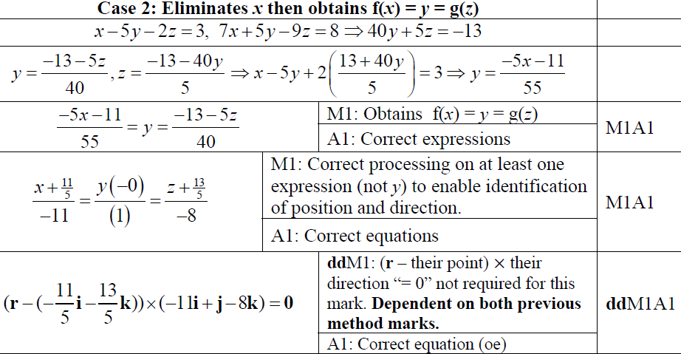
June 2016
C Alternative 2 by Simultaneous Equations

Slide 59
June 2016
C Alternative 3 by Simultaneous Equations

Slide 60
June 2016
C Alternatives 1 & 2 by Parameters

Slide 61
June 2016
C Alternative 3 by Parameters
C Alternative by 2 Points on a Line

Slide 62
Old Spec Q’s
Vectors
SAM
SAM
2018
2019
2019

Slide 63
SAM

Slide 64
SAM
A
A Alternative

Slide 65
SAM
B

Slide 66
SAM
B Alternative
C

Slide 67
SAM
A notes
A Alternative notes

Slide 68
SAM
B notes
B Alternative notes
C notes

Slide 69
2018

Slide 70
2018
A

Slide 71
2018
B

Slide 72
2018
A (SF)

Slide 73
2018
B (SF)

Slide 74
2018
A notes

Slide 75
2018
B notes

Slide 76
2019

Slide 77
2019
A

Slide 78
2019
B

Slide 79
2019
A Alternative 1

Slide 80
2019
A Alternative 2

Slide 81
2019
A (SF)

Slide 82
2019
B (SF)

Slide 83
2019
A notes
A Alternative 1 notes
A Alternative 2 notes

Slide 84
2019
B notes

Slide 85
SAM

Slide 86
SAM
A
B

Slide 87
SAM
C
D

Slide 88
SAM
A notes
B notes
C notes
D notes

Slide 89
2019

Slide 90
2019
A

Slide 91
2019
B

Slide 92
2019
A notes

Slide 93
2019
B notes

Slide 94
New Spec Q’s
See Also: Old Spec Core Pure Vectors (Separate Ppt)
Old Spec Conic Sections
Hyperbolic Functions
P5/ Old FP2
FP1
Parabola and Rectangular Hyperbola Only
FP3
June 2002 (i)
June 2006 (i)
Jan 2009 (i)
June 2011
June 2013 (R) (i)
June 2015 (ii)
June 2009 (i)
June 2013 (R) (i)
June 2017
June 2002 (ii)
June 2006 (ii)
Jan 2009 (ii)
Jan 2012 (i)
June 2013 (R) (ii)
June 2016 (i)
June 2009 (ii)
June 2013 (R) (ii)
June 2018
June 2003 (i)
June 2007 (i)
June 2009
Jan 2012 (ii)
June 2013 (W) (i)
June 2016 (ii)
June 2010 (i)
June 2013 (W) (i)
June 2019
June 2003 (ii)
June 2007 (ii)
Jan 2010 (i)
June 2012 (i)
June 2013 (W) (ii)
June 2017 (i)
June 2010 (ii)
June 2013 (W) (ii)
June 2004 (i)
June 2008
Jan 2010 (ii)
June 2012 (ii)
June 2014 (i)
June 2017 (ii)
June 2011
June 2014
June 2004 (ii)
June 2009 (i)
June 2010 (i)
Jan 2013 (i)
June 2014 (ii)
June 2012 (i)
June 2014 (R)
June 2005
June 2009 (ii)
June 2010 (ii)
Jan 2013 (ii)
June 2014 (R) (i)
June 2012 (ii)
June 2015 (i)
Jan 2006 (i)
Jan 2010 (i)
Jan 2011 (i)
June 2013 (i)
June 2014 (R) (ii)
June 2013 (i)
June 2015 (ii)
Jan 2006 (ii)
Jan 2010 (ii)
Jan 2011 (ii)
June 2013 (ii)
June 2015 (i)
June 2013 (ii)
June 2016

Slide 95
June 2002

Slide 96
June 2002
A
B
C

Slide 97
June 2002

Slide 98
June 2002
A

Slide 99
June 2002
B

Slide 100
June 2003

Slide 101
June 2003
A
B

Slide 102
June 2003

Slide 103
June 2003
A

Slide 104
June 2003
B

Slide 105
June 2004

Slide 106
June 2004
A
B

Slide 107
June 2004

Slide 108
June 2004
A

Slide 109
June 2004
B

Slide 110
June 2004
C
D

Slide 111
June 2005

Slide 112
June 2005
A
B
C
D

Slide 113
June 2005
E

Slide 114
Jan 2006

Slide 115
Jan 2006
A
B
C

Slide 116
Jan 2006

Slide 117
Jan 2006
A
B

Slide 118
Jan 2006
C

Slide 119
June 2006

Slide 120
June 2006
A
B

Slide 121
June 2007

Slide 122
June 2007
A
B

Slide 123
June 2007

Slide 124
June 2007
A
B

Slide 125
June 2007
C

Slide 126
June 2008

Slide 127
June 2008
A
B

Slide 128
June 2008
C
A notes
B notes
C notes

Slide 129
June 2009

Slide 130
June 2009
A
B

Slide 131
June 2009

Slide 132
June 2009
A
B

Slide 133
June 2009
C

Slide 134
Jan 2010

Slide 135
Jan 2010
A
B

Slide 136
Jan 2010

Slide 137
Jan 2010
A
B

Slide 138
Jan 2010
C

Slide 139
Jan 2010
A Alternative 1

Slide 140
Jan 2010
A Alternative 2

Slide 141
Jan 2010
B Alternative

Slide 142
Jan 2009

Slide 143
Jan 2009
A
B
A notes
B notes

Slide 144
Jan 2009

Slide 145
Jan 2009
A
B
C
D

Slide 146
Jan 2009
A notes
B notes
C notes
D notes

Slide 147
June 2009

Slide 148
June 2009
A
B
C
C Alternatives

Slide 149
June 2009
D
C notes
D notes

Slide 150
Jan 2010

Slide 151
Jan 2010
A
B
B notes

Slide 152
Jan 2010

Slide 153
Jan 2010
A
B
A notes
B notes

Slide 154
Jan 2010
A Alternatives

Slide 155
June 2010

Slide 156
June 2010
A
B
A notes
B notes

Slide 157
June 2010

Slide 158
June 2010
A
B
C

Slide 159
June 2010
B notes
C notes

Slide 160
Jan 2011

Slide 161
Jan 2011
A
B
C
D
E

Slide 162
Jan 2011

Slide 163
Jan 2011
A

Slide 164
Jan 2011
B

Slide 165
June 2011

Slide 166
June 2011
A
C

Slide 167
June 2011
B

Slide 168
Jan 2012

Slide 169
Jan 2012
A

Slide 170
Jan 2012
B

Slide 171
Jan 2012

Slide 172
Jan 2012
A

Slide 173
Jan 2012
B
C

Slide 174
June 2012

Slide 175
June 2012
A
B

Slide 176
June 2012
C

Slide 177
June 2012

Slide 178
June 2012
A

Slide 179
June 2012
B

Slide 180
Jan 2013

Slide 181
Jan 2013
A
B
C

Slide 182
Jan 2013
D

Slide 183
Jan 2013
A Alternative

Slide 184
Jan 2013
A notes
B notes
C notes

Slide 185
Jan 2013

Slide 186
Jan 2013
A
B

Slide 187
Jan 2013
A notes
B notes

Slide 188
June 2013

Slide 189
June 2013
A

Slide 190
June 2013
B

Slide 191
June 2013

Slide 192
June 2013
A
B

Slide 193
June 2013
C
D

Slide 194
June 2013 (R)

Slide 195
June 2013 (R)
A
B

Slide 196
June 2013 (R)
B Alternative

Slide 197
June 2013 (R)

Slide 198
June 2013 (R)
A

Slide 199
June 2013 (R)
B
C

Slide 200
June 2013 (Withdrawn)

Slide 201
June 2013 (Withdrawn)
A

Slide 202
June 2013 (Withdrawn)
A notes

Slide 203
June 2013 (Withdrawn)
B
B notes

Slide 204
June 2013 (Withdrawn)

Slide 205
June 2013 (Withdrawn)
A
B (i)

Slide 206
June 2013 (Withdrawn)
B (ii)
A notes

Slide 207
June 2013 (Withdrawn)
B (i) notes
B (ii) notes

Slide 208
June 2014

Slide 209
June 2014
A

Slide 210
June 2014
B
C

Slide 211
June 2014

Slide 212
June 2014
A

Slide 213
June 2014
B

Slide 214
June 2014 (R)

Slide 215
June 2014 (R)
A

Slide 216
June 2014 (R)
B
C
D

Slide 217
June 2014 (R)

Slide 218
June 2014 (R)
A

Slide 219
June 2015

Slide 220
June 2015
A
B

Slide 221
June 2015
B Alternative
A notes
B notes

Slide 222
June 2015

Slide 223
June 2015
A

Slide 224
June 2015
B

Slide 225
June 2015
C

Slide 226
June 2016

Slide 227
June 2016
A
B

Slide 228
June 2016
C
D
A notes
B notes
C notes
D notes

Slide 229
June 2016

Slide 230
June 2016
A
B

Slide 231
June 2016
C
A notes
B notes
C notes

Slide 232
June 2017

Slide 233
June 2017
A
B

Slide 234
June 2017
C

Slide 235
June 2017

Slide 236
June 2017
A

Slide 237
June 2017
B

Slide 238
June 2017
C

Slide 239
June 2017
C Alternatives

Slide 240
June 2009

Slide 241
June 2009
A
B

Slide 242
June 2009
C

Slide 243
June 2009

Slide 244
June 2009
A

Slide 245
June 2009
B

Slide 246
June 2010

Slide 247
June 2010
A

Slide 248
June 2010

Slide 249
June 2010
A

Slide 250
June 2010
B

Slide 251
June 2011

Slide 252
June 2011
A
B
C

Slide 253
June 2011
D

Slide 254
June 2012

Slide 255
June 2012
A
B
A notes
B notes

Slide 256
June 2012

Slide 257
June 2012
A
B
C
D

Slide 258
June 2012
A notes
B notes
C notes
D notes

Slide 259
June 2013

Slide 260
June 2013
A & B

Slide 261
June 2013

Slide 262
June 2013
A

Slide 263
June 2013
B
C

Slide 264
June 2013 (R)

Slide 265
June 2013 (R)
A

Slide 266
June 2013 (R)

Slide 267
June 2013 (R)
A
B

Slide 268
June 2013 (R)
C

Slide 269
June 2013 (Withdrawn)

Slide 270
June 2013 (Withdrawn)
A
B

Slide 271
June 2013 (Withdrawn)

Slide 272
June 2013 (Withdrawn)
A
B

Slide 273
June 2014

Slide 274
June 2014
A

Slide 275
June 2014
B

Slide 276
June 2014
C

Slide 277
June 2014 (R)

Slide 278
June 2014 (R)
A
B
C

Slide 279
June 2014 (R)
D

Slide 280
June 2015

Slide 281
June 2015
A
B

Slide 282
June 2015
C

Slide 283
June 2015
D

Slide 284
June 2015

Slide 285
June 2015
A
B

Slide 286
June 2015
B Alternative 1

Slide 287
June 2015
B Alternative 2

Slide 288
June 2015
C

Slide 289
June 2015
C Alternative

Slide 290
June 2016

Slide 291
June 2016
A

Slide 292
June 2016
B

Slide 293
June 2017

Slide 294
June 2017
A

Slide 295
June 2017
B

Slide 296
June 2018

Slide 297
June 2018
A
B

Slide 298
June 2018
C
D

Slide 299
June 2018
D Alternative

Slide 300
June 2018
E
E Alternative

Slide 301
June 2019

Slide 302
June 2019
A
B
A notes

Slide 303
June 2019
C
D

Slide 304
Old Spec Q’s
Conic Sections
SAM
SAM (i)
2018
SAM (ii)
2019
2019 (i)
2019 (ii)

Slide 305
SAM

Slide 306
SAM
A
B

Slide 307
SAM
C

Slide 308
SAM
C Alternative 1

Slide 309
SAM
C Alternative 2

Slide 310
SAM
A notes
B notes
C notes

Slide 311
SAM
C Alternative 1 notes

Slide 312
SAM
C Alternative 2 notes

Slide 313
2018

Slide 314
2018
A

Slide 315
2018
B

Slide 316
2018
A (SF)

Slide 317
2018
B (SF)

Slide 318
2018
A notes

Slide 319
2018
B notes

Slide 320
2018
B Alternative
B Alternative notes

Slide 321
2019

Slide 322
2019
A

Slide 323
2019
A (SF)

Slide 324
2019
A Alternative 1

Slide 325
2019
A Alternative 2

Slide 326
2019
A Alternative 3

Slide 327
2019
A notes

Slide 328
2019
A Alternative 1 notes

Slide 329
2019
A Alternative 2 notes

Slide 330
2019
A Alternative 2 notes

Slide 331
2019
A Alternative 3 notes

Slide 332
SAM

Slide 333
SAM
A

Slide 334
SAM
A notes

Slide 335
SAM
A Alternative 1

Slide 336
SAM
A Alternative 1 notes

Slide 337
SAM
A Alternative 2

Slide 338
SAM
A Alternative 2 notes

Slide 339
SAM

Slide 340
SAM
A

Slide 341
SAM
A notes

Slide 342
2019

Slide 343
2019
A (First 6 Marks)

Slide 344
2019
A (Final 2 Marks)

Slide 345
2019
A notes

Slide 346
2019
A notes and diagram

Slide 347
2019

Slide 348
2019
A

Slide 349
2019
B
B notes

Slide 350
2019
A notes

Slide 351
New Spec Q’s
Old Spec Differential Equations
P4/ Old FP1
P6/ Old FP3
FP2
Jan 2003
June 2008
June 2002
June 2006
June 2010
June 2015
Jan 2005
Jan 2009
June 2003
June 2007
June 2012
June 2016
Jan 2006
Jan 2010
June 2004
June 2008
June 2013
June 2018
Jan 2007
June 2005
June 2009
June 2014
June 2019
Jan 2006
Jan 2010
June 2014 (R)
Reducible
Approximations

Slide 352
Jan 2003

Slide 353
Jan 2003
A
B
C

Slide 354
Jan 2005

Slide 355
Jan 2005
A

Slide 356
Jan 2005
B
C

Slide 357
Jan 2006

Slide 358
Jan 2006
A
B

Slide 359
Jan 2006
C

Slide 360
Jan 2007

Slide 361
Jan 2007
A
B

Slide 362
Jan 2007
C
D

Slide 363
Jan 2007
A notes
B notes

Slide 364
June 2008

Slide 365
June 2008
A
B
C
D

Slide 366
Jan 2009

Slide 367
Jan 2009
A
B
C

Slide 368
Jan 2009
D
A notes
B notes
C notes
D notes

Slide 369
Jan 2010

Slide 370
Jan 2010
A
B
C

Slide 371
Jan 2010
B notes

Slide 372
June 2002

Slide 373
June 2002
A
B

Slide 374
June 2003

Slide 375
June 2003
A
B

Slide 376
June 2003
C

Slide 377
June 2004

Slide 378
June 2004
A

Slide 379
June 2005

Slide 380
June 2005
A
B

Slide 381
June 2005
C
D
E

Slide 382
Jan 2006

Slide 383
Jan 2006
A

Slide 384
June 2006

Slide 385
June 2006
A

Slide 386
June 2006
B
C

Slide 387
June 2007

Slide 388
June 2007
A
B

Slide 389
June 2008

Slide 390
June 2008
A

Slide 391
June 2009

Slide 392
June 2009
A

Slide 393
Jan 2010

Slide 394
Jan 2010
A

Slide 395
June 2010

Slide 396
June 2010
A
B
C

Slide 397
June 2012

Slide 398
June 2012
A
B

Slide 399
June 2012
C
A notes
B notes
C notes

Slide 400
June 2013

Slide 401
June 2013
A
C

Slide 402
June 2013
B
x’
x’’

Slide 403
June 2013
A Alternative

Slide 404
June 2013
A notes

Slide 405
June 2013
A Alternative notes

Slide 406
June 2013
B notes
C notes

Slide 407
June 2014

Slide 408
June 2014
A

Slide 409
June 2014
A Alternative 1

Slide 410
June 2014
A Alternative 2
B

Slide 411
June 2014 Reserve

Slide 412
June 2014 Reserve
A

Slide 413
June 2014 Reserve
A Alternative

Slide 414
June 2014 Reserve
B

Slide 415
June 2014 Reserve
C
A notes

Slide 416
June 2014 Reserve
B notes
C notes

Slide 417
June 2015

Slide 418
June 2015
A

Slide 419
June 2015
A notes

Slide 420
June 2015
A Alternative 1

Slide 421
June 2015
A Alternative 2

Slide 422
June 2015
B

Slide 423
June 2015
C
B notes
C notes

Slide 424
June 2016

Slide 425
June 2016
A

Slide 426
June 2016
A notes

Slide 427
June 2016
A Alternative 1

Slide 428
June 2016
A Alternative 2

Slide 429
June 2016
B

Slide 430
June 2016
C

Slide 431
June 2018

Slide 432
June 2018
A

Slide 433
June 2018
B

Slide 434
June 2018
B Alternative

Slide 435
June 2018
C
A Alternative Forms

Slide 436
June 2018
B Alternative Forms
C Alternative Forms

Slide 437
June 2019

Slide 438
June 2019
A
A notes

Slide 439
June 2019
A Alternative 1
A Alternative 2

Slide 440
June 2019
B
C

Slide 441
June 2019
B notes
C notes

Slide 442
Old Spec Q’s
Differential Equations
SAM
SAM
2018
2019
2019
Reducible
Approximations

Slide 443
SAM

Slide 444
SAM
A

Slide 445
SAM
A notes

Slide 446
2018

Slide 447
2018
A
B

Slide 448
2018
A (SF)
B (SF)

Slide 449
2018
A notes
B notes

Slide 450
2019

Slide 451
2019
A

Slide 452
2019
A (SF)

Slide 453
2019
A notes

Slide 454
SAM

Slide 455
SAM
A

Slide 456
SAM
B
C (i)
C (ii)

Slide 457
SAM
A notes

Slide 458
SAM
B notes
C (i) notes
C (ii) notes

Slide 459
2019

Slide 460
2019
A

Slide 461
2019
B
C

Slide 462
2019
A notes

Slide 463
2019
B notes

Slide 464
2019
C notes

Slide 465
No Old Spec Q’s
t-Formulae
SAM
SAM
2018
2019
2019
Weierstrauss Substitution

Slide 466
SAM

Slide 467
SAM
A
B

Slide 468
SAM
A notes
B notes

Slide 469
2018

Slide 470
2018
A
B

Slide 471
2018
A (SF)
A notes

Slide 472
2018
B (SF)

Slide 473
2018
B notes

Slide 474
2019

Slide 475
2019
A
B (i)
B (ii)
C

Slide 476
2019
B (ii) Alternative 1
B (ii) Alternative 2
B (ii) Alternative 3

Slide 477
2019
A (SF)
B (i) (SF)
B (ii) (SF)

Slide 478
2019
C (SF)

Slide 479
2019
A notes
B (i) notes
B (ii) notes

Slide 480
2019
C notes

Slide 481
SAM

Slide 482
SAM
A

Slide 483
SAM
A Alternative

Slide 484
SAM
B (i)
B (ii)
B (i) notes
B (ii) notes

Slide 485
SAM
C

Slide 486
SAM
A notes

Slide 487
SAM
A Alternative notes

Slide 488
SAM
C notes

Slide 489
2019

Slide 490
2019
A

Slide 491
2019
A Alternative

Slide 492
2019
A notes

Slide 493
No Old Spec Q’s
Simpson’s Rule
SAM
2019

Slide 494
SAM

Slide 495
SAM
A
A notes

Slide 496
2019

Slide 497
2019
A

Slide 498
2019
A notes

Slide 499
New Spec Q’s
Old Spec Inequalities
P4/ Old FP1
FP2
Jan 2002
Jan 2005
Jan 2008
June 2009
June 2013 (R)
June 2016
June 2002
June 2005
June 2008
June 2010
June 2013 (W)
June 2017
Jan 2003
Jan 2006
Jan 2009
June 2011
June 2014
June 2018
June 2003
June 2006
June 2009
June 2012
June 2014 (R)
June 2019
Jan 2004
Jan 2007
Jan 2010
June 2013
June 2015
June 2004
June 2007

Slide 500
Jan 2002

Slide 501
Jan 2002
A

Slide 502
June 2002

Slide 503
June 2002
A

Slide 504
Jan 2003

Slide 505
Jan 2003
A
B

Slide 506
June 2003

Slide 507
June 2003
A

Slide 508
June 2003
A Graphing Alternative

Slide 509
Jan 2004

Slide 510
Jan 2004
A
B
C

Slide 511
June 2004

Slide 512
June 2004
A

Slide 513
Jan 2005

Slide 514
Jan 2005
A
B

Slide 515
June 2005

Slide 516
June 2005
A
B
C

Slide 517
Jan 2006

Slide 518
Jan 2006
A

Slide 519
June 2006

Slide 520
June 2006
A

Slide 521
June 2006
B

Slide 522
June 2006
C

Slide 523
Jan 2007

Slide 524
Jan 2007
A
B

Slide 525
Jan 2007
A notes
B notes

Slide 526
June 2007

Slide 527
June 2007
A
A notes

Slide 528
Jan 2008

Slide 529
Jan 2008
A
B
A notes

Slide 530
June 2008

Slide 531
June 2008
A

Slide 532
June 2008
B
C

Slide 533
Jan 2009

Slide 534
Jan 2009
A
A notes

Slide 535
Jan 2009
A Alternative

Slide 536
June 2009

Slide 537
June 2009
A
B

Slide 538
June 2009
A notes
B notes

Slide 539
Jan 2010

Slide 540
Jan 2010
A
B
C
B notes

Slide 541
June 2009

Slide 542
June 2009
A
C

Slide 543
June 2009
B

Slide 544
June 2010

Slide 545
June 2010
A
B

Slide 546
June 2011

Slide 547
June 2011
A

Slide 548
June 2012

Slide 549
June 2012
A

Slide 550
June 2012
A notes

Slide 551
June 2013

Slide 552
June 2013
A

Slide 553
June 2013
B
C

Slide 554
June 2013
A notes
A Alternative notes

Slide 555
June 2013
B notes
C notes

Slide 556
June 2013 (R)

Slide 557
June 2013 (R)
A

Slide 558
June 2013 (R)
A notes

Slide 559
June 2013 (R)
A Alternative

Slide 560
June 2013 (Withdrawn)

Slide 561
June 2013 (Withdrawn)
A
B

Slide 562
June 2014

Slide 563
June 2014
A

Slide 564
June 2014
A notes

Slide 565
June 2014 (R)

Slide 566
June 2014 (R)
A

Slide 567
June 2014 (R)
A notes

Slide 568
June 2015

Slide 569
June 2015
A
B

Slide 570
June 2015
A notes
B notes

Slide 571
June 2016

Slide 572
June 2016
A

Slide 573
June 2016
A Alternatives

Slide 574
June 2016
A notes

Slide 575
June 2017

Slide 576
June 2017
A

Slide 577
June 2017
A Alternative 1

Slide 578
June 2017
A Alternative 2

Slide 579
June 2018

Slide 580
June 2018
A

Slide 581
June 2018
A Alternative

Slide 582
June 2019

Slide 583
June 2019
A

Slide 584
June 2019
A notes
A Alternative 1
A Alternative 1 notes

Slide 585
June 2019
A Alternative 2
A Alternative 3

Slide 586
Old Spec Q’s
Inequalities
SAM
2018
2019

Slide 587
SAM

Slide 588
SAM
A
A notes

Slide 589
2018

Slide 590
2018
A

Slide 591
2018
A (SF)

Slide 592
2018
A notes

Slide 593
2018
A Alternative Method

Slide 594
2019

Slide 595
2019
A (i)
A (ii)
B

Slide 596
2019
B Alternative 1
B Alternative 2

Slide 597
2019
A (i) (SF)
A (ii) (SF)
B (SF)

Slide 598
2019
A (i) notes
A (ii) notes
B notes

Slide 599
2019
B Alternative 1 notes
B Alternative 2 notes

Slide 600
New Spec Q’s
Old Spec Taylor Series
P6/ Old FP3
FP2
June 2002
June 2006 (ii)
June 2009
June 2013 (R)
June 2016
June 2003
June 2007
June 2010
June 2013 (W)
June 2017
June 2004
June 2008
June 2011
June 2014
June 2018
June 2005
June 2009
June 2012
June 2014 (R)
June 2019
Jan 2006
Jan 2010
June 2013
June 2015
June 2006 (i)

Slide 601
June 2002

Slide 602
June 2002
A
B
C

Slide 603
June 2003

Slide 604
June 2003
A
B

Slide 605
June 2003
C

Slide 606
June 2004

Slide 607
June 2004
A
B
C

Slide 608
June 2005

Slide 609
June 2005
A
B

Slide 610
June 2005
C
D
E

Slide 611
Jan 2006

Slide 612
Jan 2006
A
B

Slide 613
Jan 2006
C

Slide 614
June 2006

Slide 615
June 2006
A
B

Slide 616
June 2006

Slide 617
June 2006
A

Slide 618
June 2006
B
C

Slide 619
June 2007

Slide 620
June 2007
A
B

Slide 621
June 2008

Slide 622
June 2008
A
B
C
A notes
B notes

Slide 623
June 2009

Slide 624
June 2009
A
B

Slide 625
Jan 2010

Slide 626
Jan 2010
A
B
A notes

Slide 627
June 2009

Slide 628
June 2009
A

Slide 629
June 2009
B

Slide 630
June 2010

Slide 631
June 2010
A

Slide 632
June 2011

Slide 633
June 2011
A
B

Slide 634
June 2012

Slide 635
June 2012
A
B

Slide 636
June 2012
A notes
B notes

Slide 637
June 2013

Slide 638
June 2013
A

Slide 639
June 2013
A

Slide 640
June 2013
A notes

Slide 641
June 2013
A Alternative notes

Slide 642
June 2013 (R)

Slide 643
June 2013 (R)
A
A Alternative

Slide 644
June 2013 (R)
B

Slide 645
June 2013 (R)
B Alternative

Slide 646
June 2013 (R)
A notes

Slide 647
June 2013 (R)
A Alternative notes

Slide 648
June 2013 (R)
B notes

Slide 649
June 2013 (R)
B Alternative notes

Slide 650
June 2013 (Withdrawn)

Slide 651
June 2013 (Withdrawn)
A
B
C

Slide 652
June 2014

Slide 653
June 2014
A

Slide 654
June 2014
A Alternative and notes

Slide 655
June 2014 (R)

Slide 656
June 2014 (R)
A

Slide 657
June 2014 (R)
B

Slide 658
June 2014 (R)
A notes
B notes

Slide 659
June 2015

Slide 660
June 2015
A
B

Slide 661
June 2015
C
A notes

Slide 662
June 2015
B notes
C notes

Slide 663
June 2016

Slide 664
June 2016
A

Slide 665
June 2016
A Alternative Derivatives

Slide 666
June 2016
B

Slide 667
June 2017

Slide 668
June 2017
A

Slide 669
June 2017
A Alternative

Slide 670
June 2017
B

Slide 671
June 2017
C

Slide 672
June 2018

Slide 673
June 2018
A

Slide 674
June 2018
A Alternative 1

Slide 675
June 2018
A Alternative 2

Slide 676
June 2018
B

Slide 677
June 2019

Slide 678
June 2019
A
A Alternative
B

Slide 679
June 2019
A notes
A Alternative notes
B notes

Slide 680
Old Spec Q’s
Taylor Series
SAM
2019

Slide 681
SAM

Slide 682
SAM
A
B

Slide 683
SAM
A notes
B notes

Slide 684
2019

Slide 685
2019
A

Slide 686
2019
B

Slide 687
2019
A notes

Slide 688
2019
A Alternative
B notes

Slide 689
No Old Spec Q’s
Methods in Calculus
SAM
2019 (i)
2019 (ii)
Leibnitz’ Rule
L’Hospital’s’ Rule
Weierstrauss Substitution

Slide 690
SAM

Slide 691
SAM
A

Slide 692
SAM
A notes

Slide 693
2019

Slide 694
2019
A

Slide 695
2019
A notes

Slide 696
2019

Slide 697
2019
A

Slide 698
2019
A Alternative

Slide 699
2019
A notes

