Slide 1
Old Spec Q’s
Differential Equations
SAM
SAM
2018
2019
2019
Reducible
Approximations

Slide 2
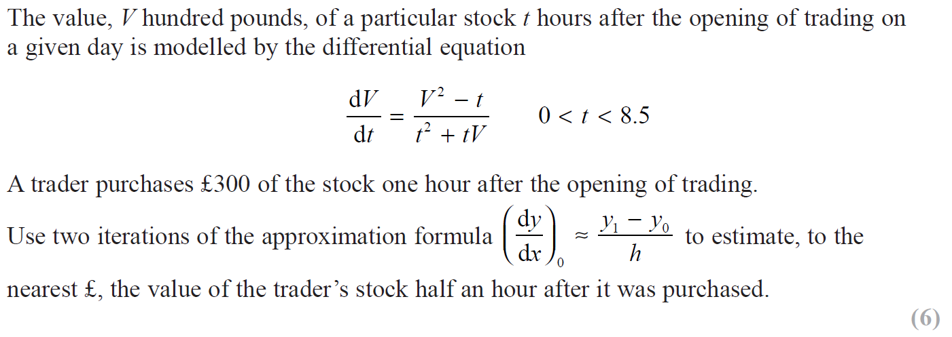
SAM

Slide 3
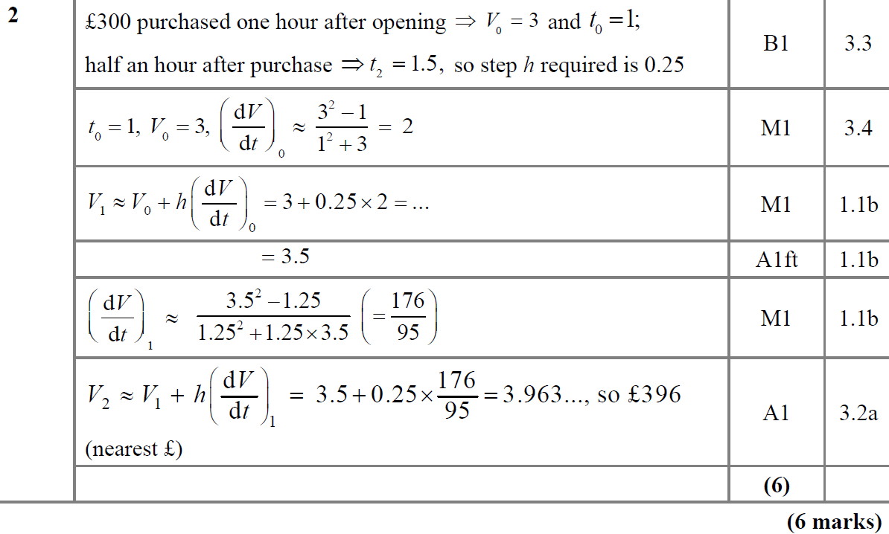
SAM
A

Slide 4
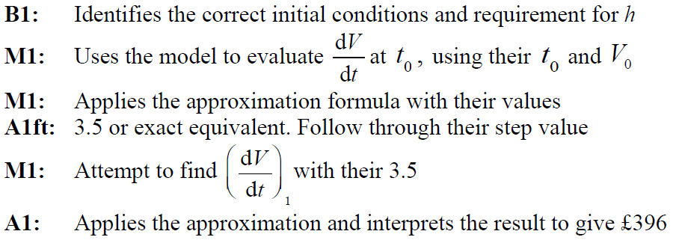
SAM
A notes

Slide 5
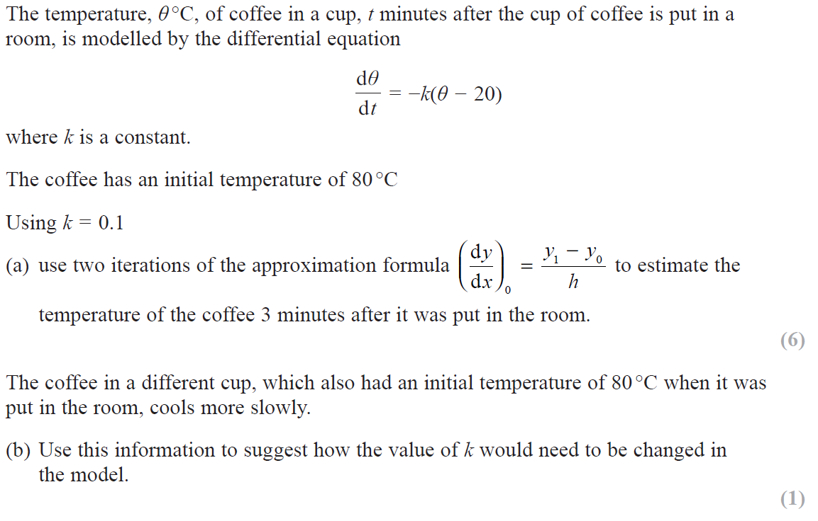
2018

Slide 6
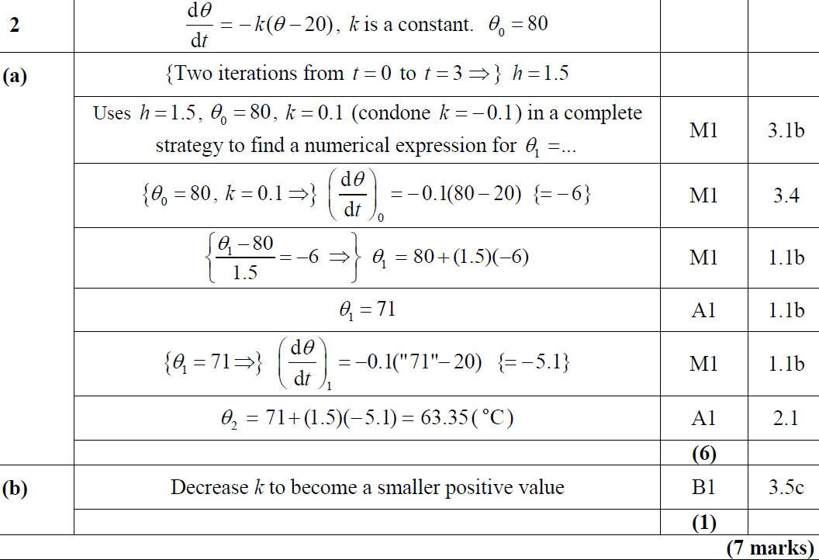
2018
A
B

Slide 7
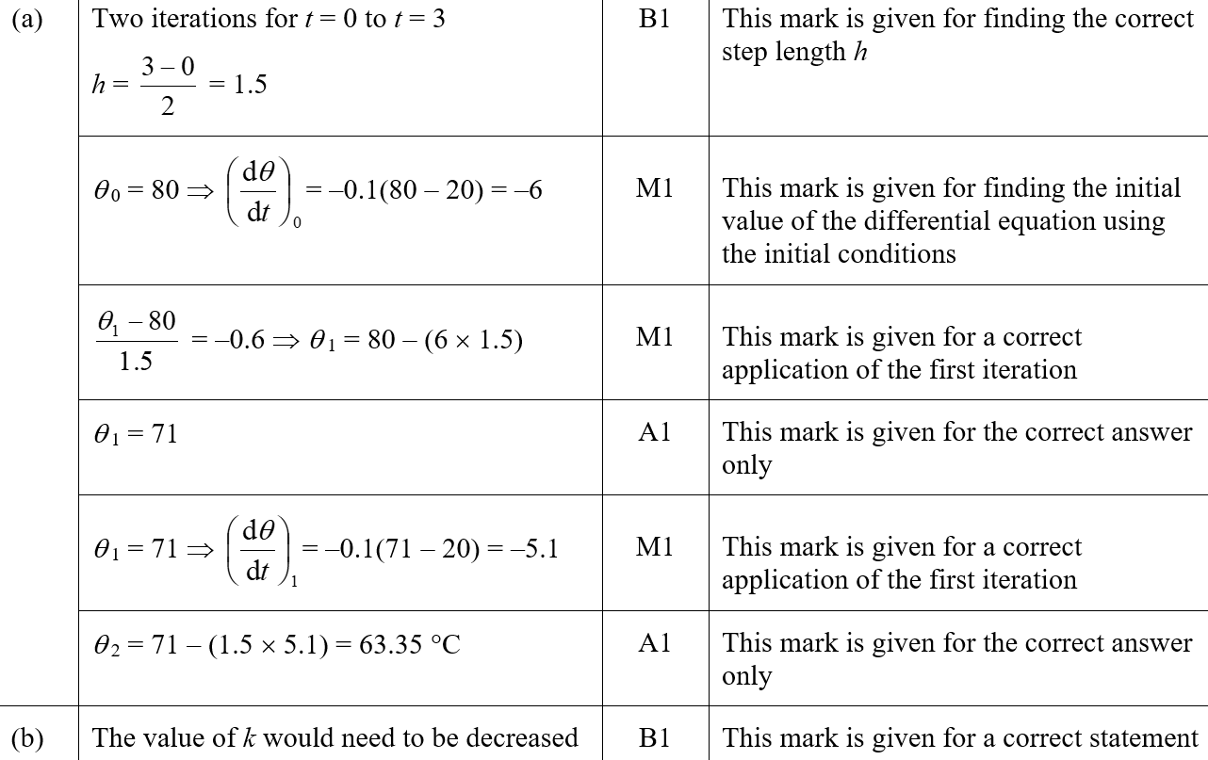
2018
A (SF)
B (SF)

Slide 8
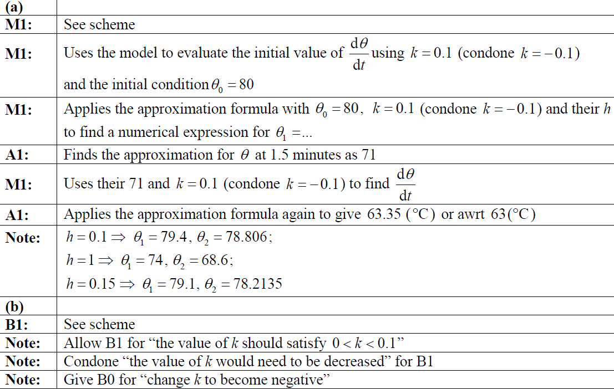
2018
A notes
B notes

Slide 9
2019

Slide 10
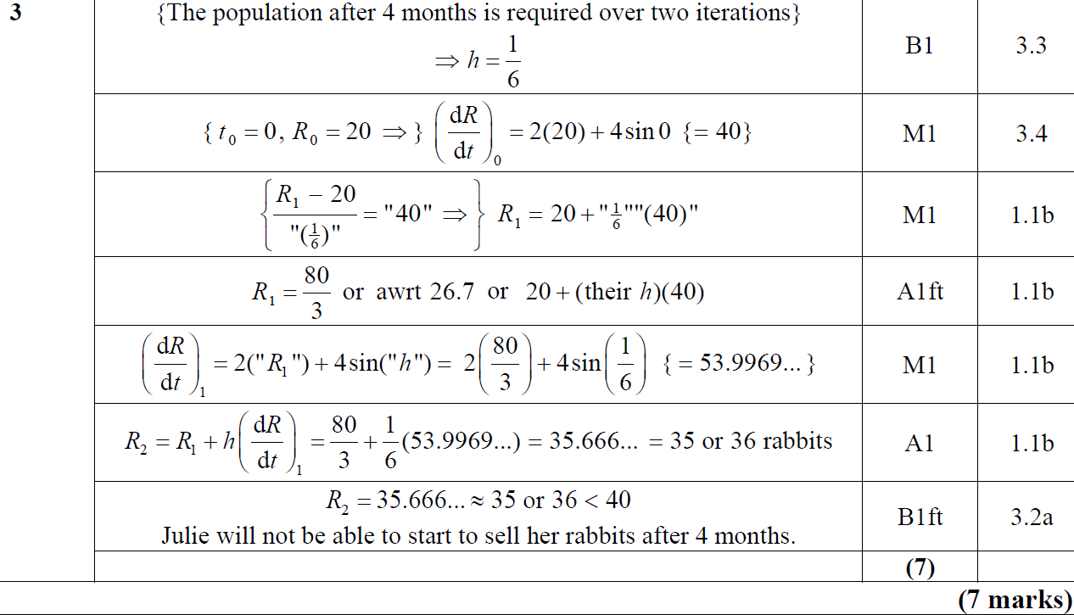
2019
A

Slide 11
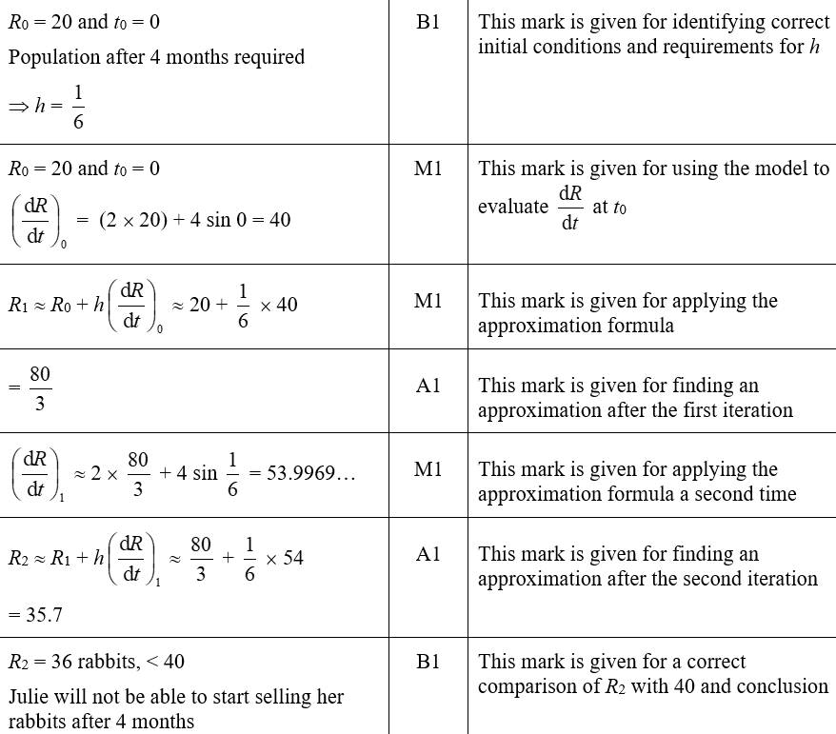
2019
A (SF)

Slide 12
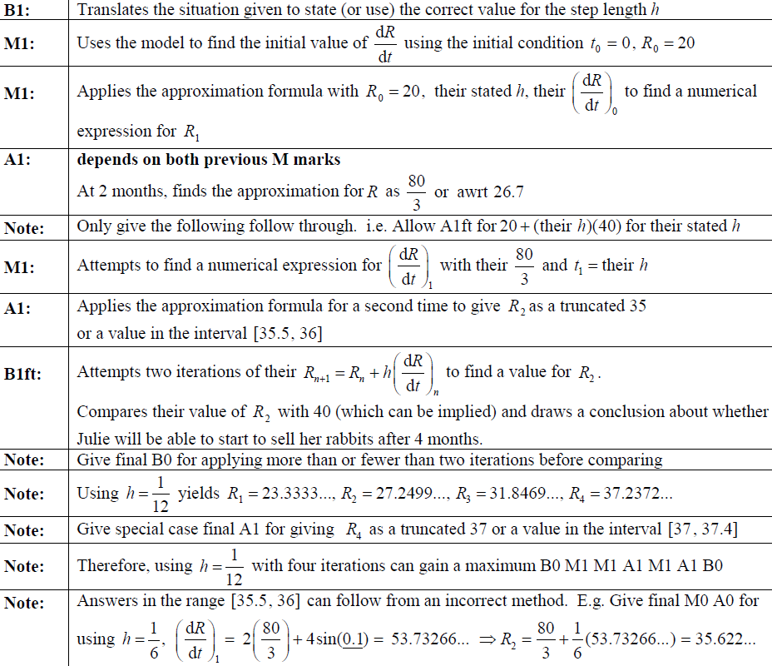
2019
A notes

Slide 13
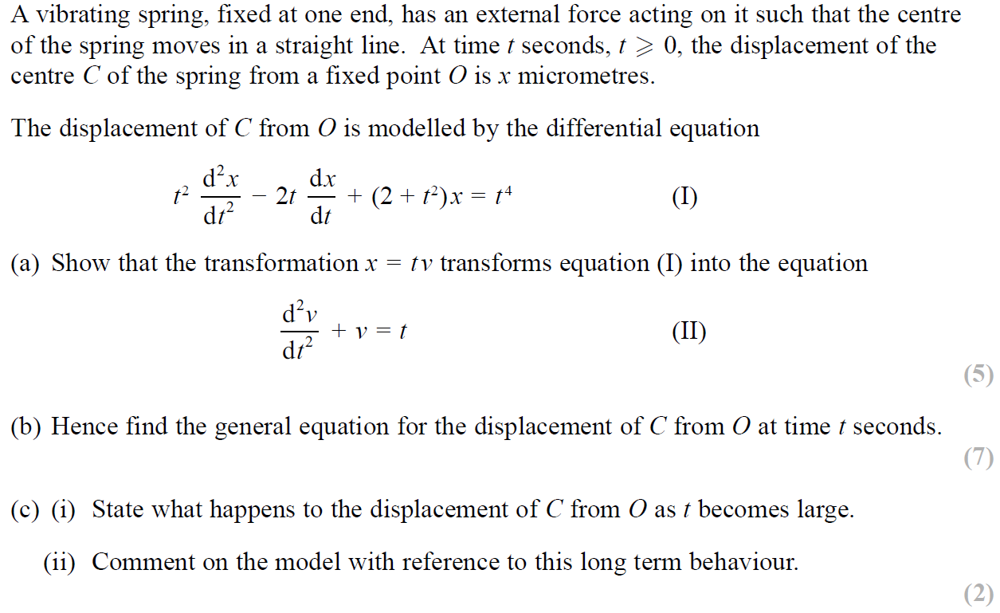
SAM

Slide 14
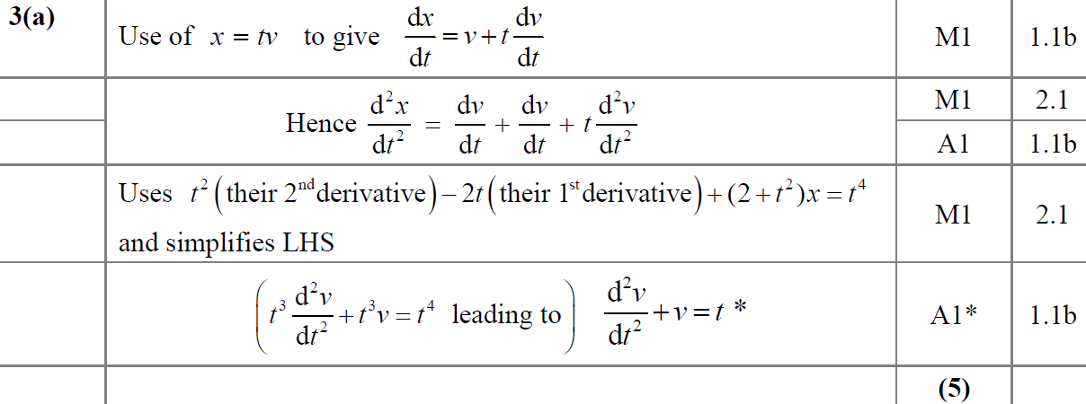
SAM
A

Slide 15
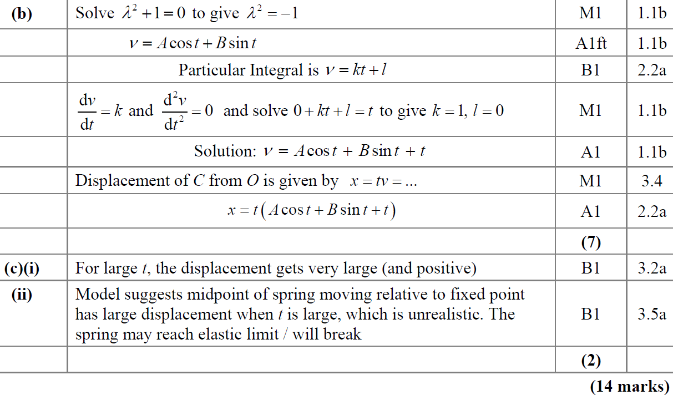
SAM
B
C (i)
C (ii)

Slide 16
SAM
A notes

Slide 17
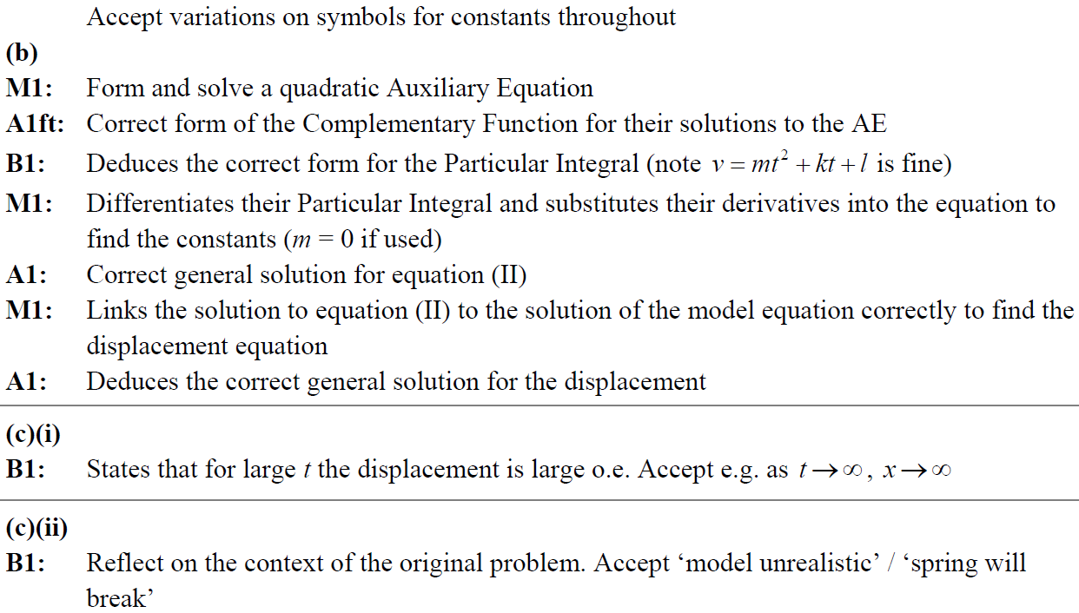
SAM
B notes
C (i) notes
C (ii) notes

Slide 18
2019

Slide 19
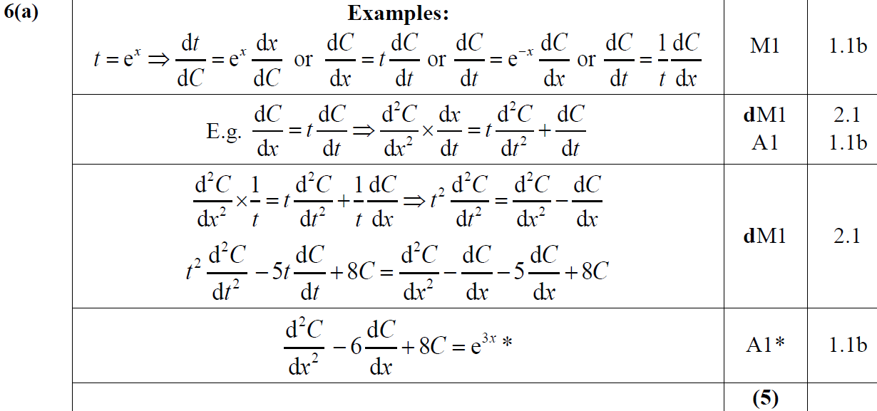
2019
A

Slide 20
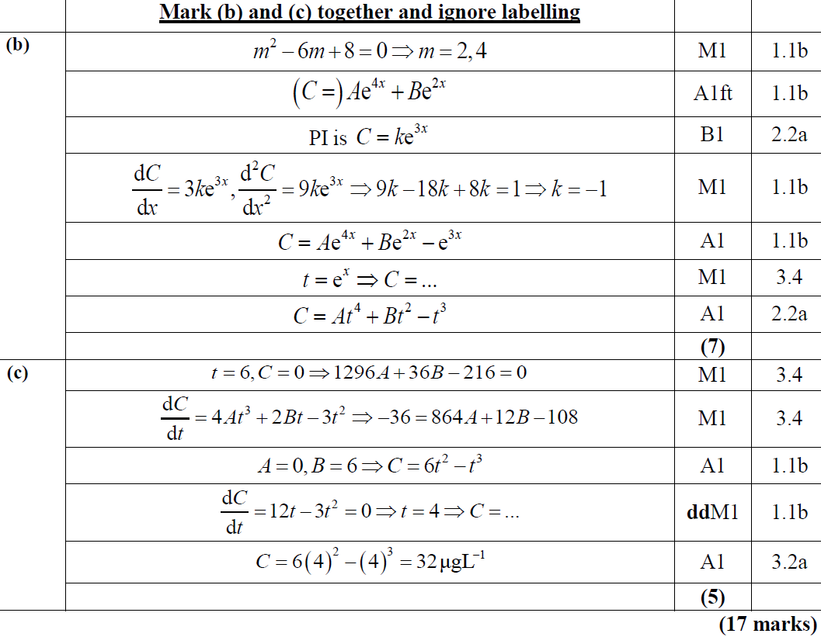
2019
B
C

Slide 21
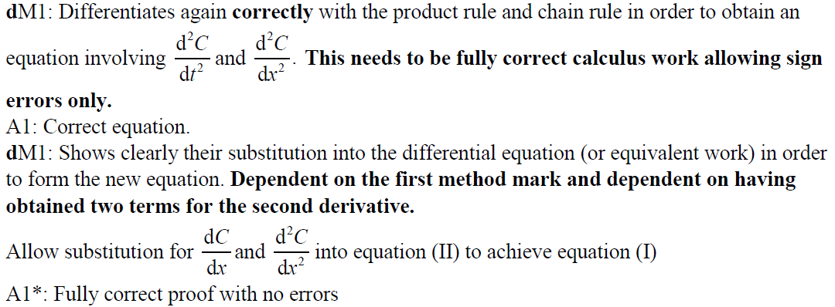
2019
A notes

Slide 22
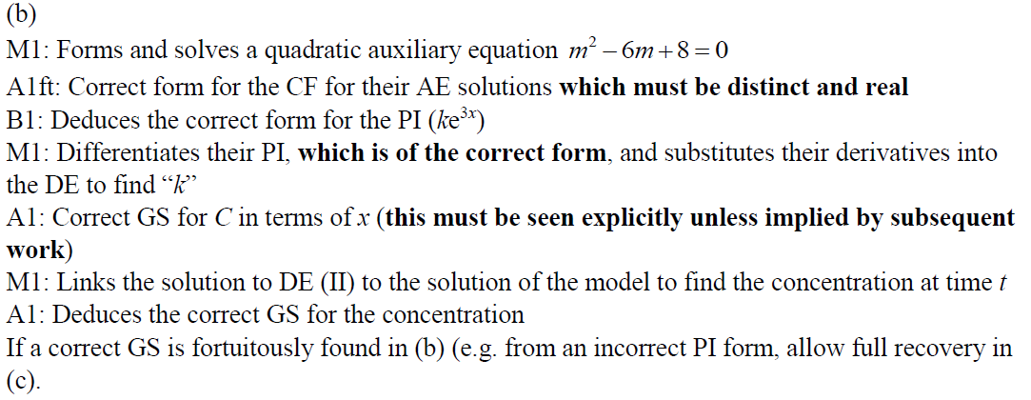
2019
B notes

Slide 23
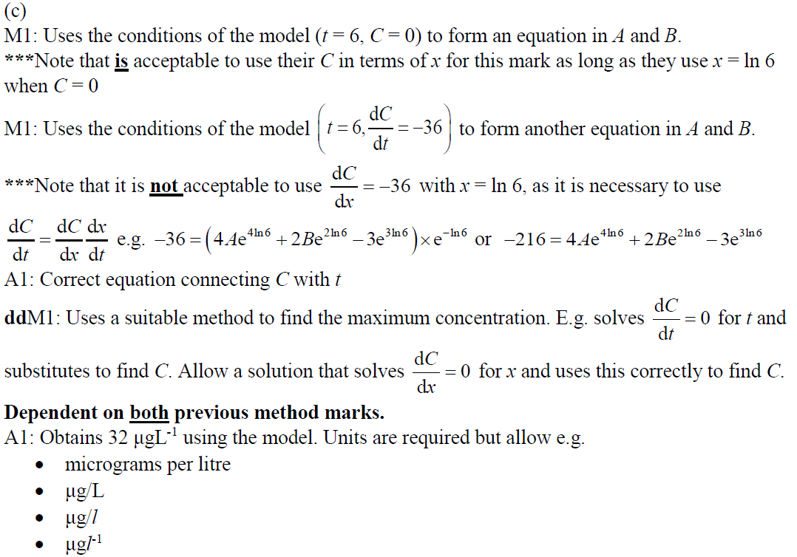
2019
C notes

Slide 24
New Spec Q’s
Old Spec Differential Equations
P4/ Old FP1
P6/ Old FP3
FP2
Jan 2003
June 2008
June 2002
June 2006
June 2010
June 2015
Jan 2005
Jan 2009
June 2003
June 2007
June 2012
June 2016
Jan 2006
Jan 2010
June 2004
June 2008
June 2013
June 2018
Jan 2007
June 2005
June 2009
June 2014
June 2019
Jan 2006
Jan 2010
June 2014 (R)
Reducible
Approximations

Slide 25
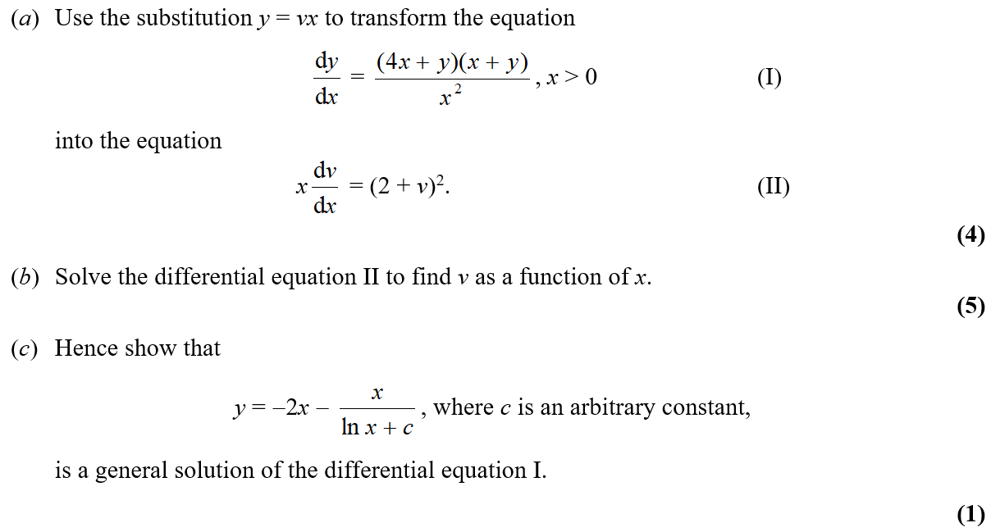
Jan 2003

Slide 26
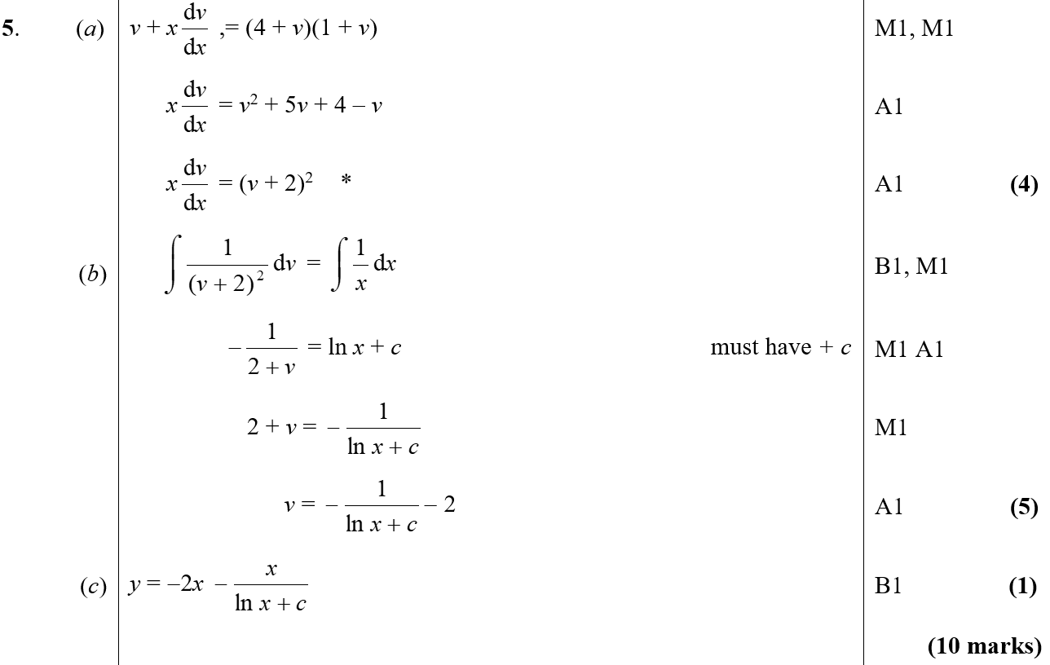
Jan 2003
A
B
C

Slide 27
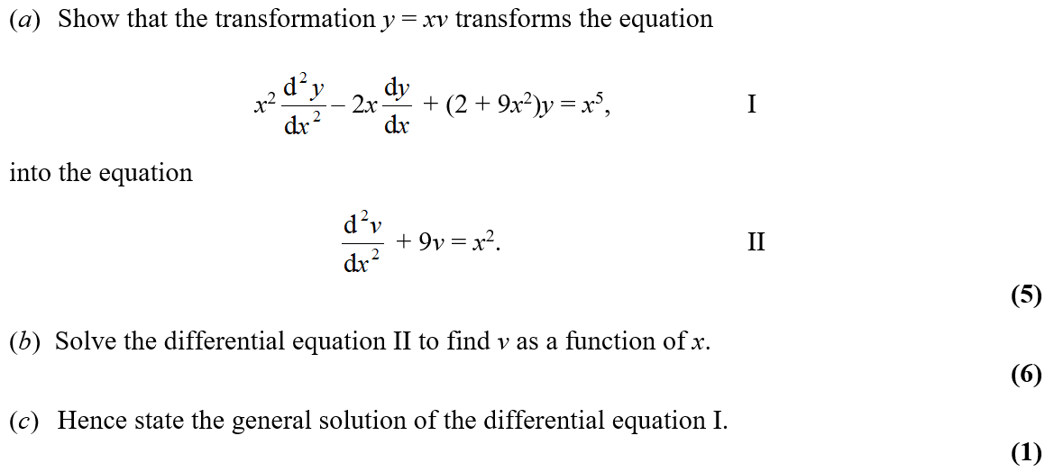
Jan 2005

Slide 28
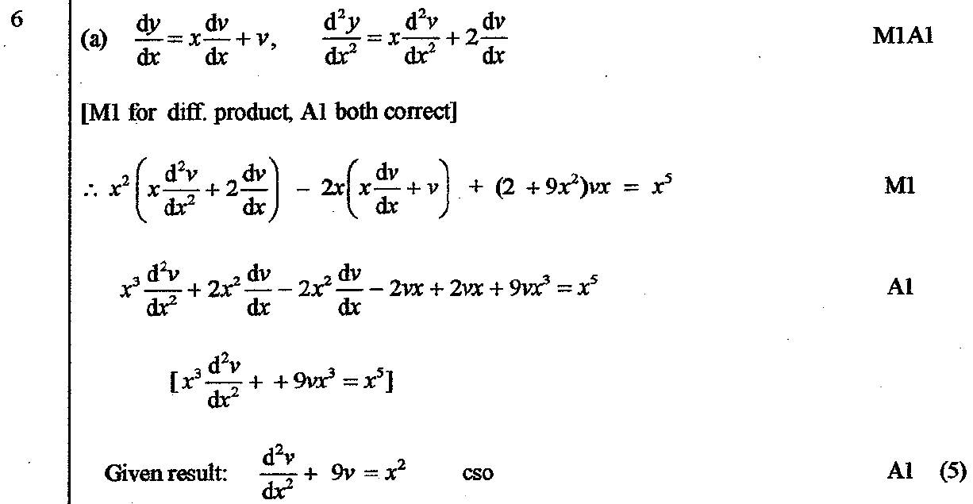
Jan 2005
A

Slide 29
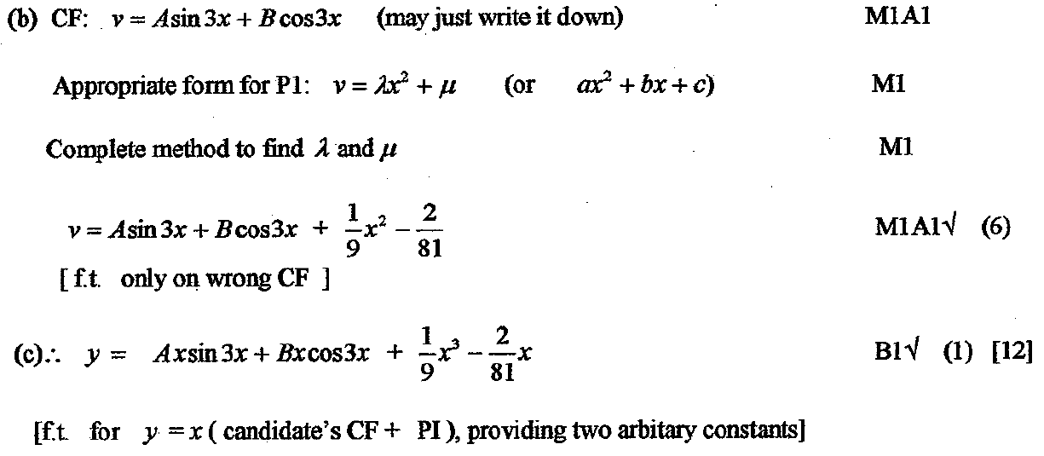
Jan 2005
B
C

Slide 30
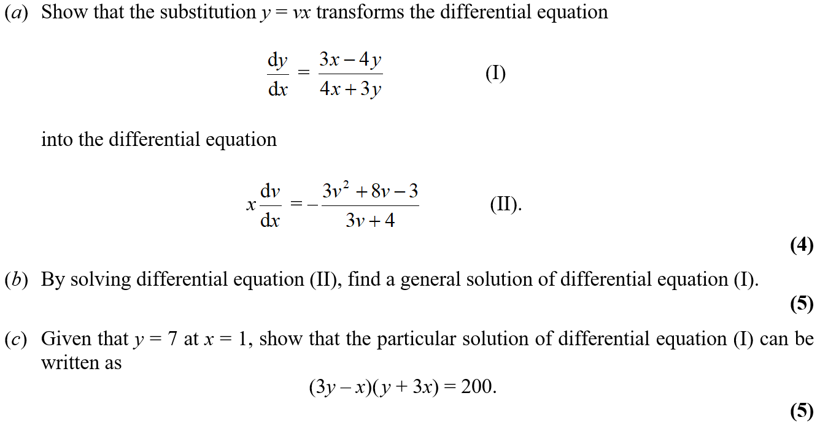
Jan 2006

Slide 31
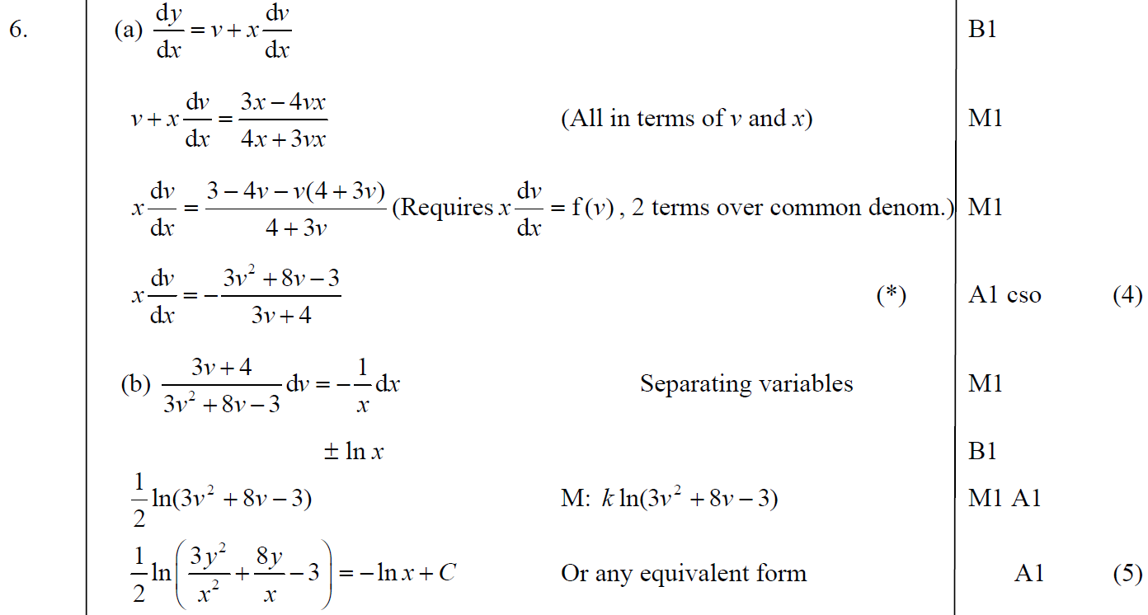
Jan 2006
A
B

Slide 32
Jan 2006
C

Slide 33
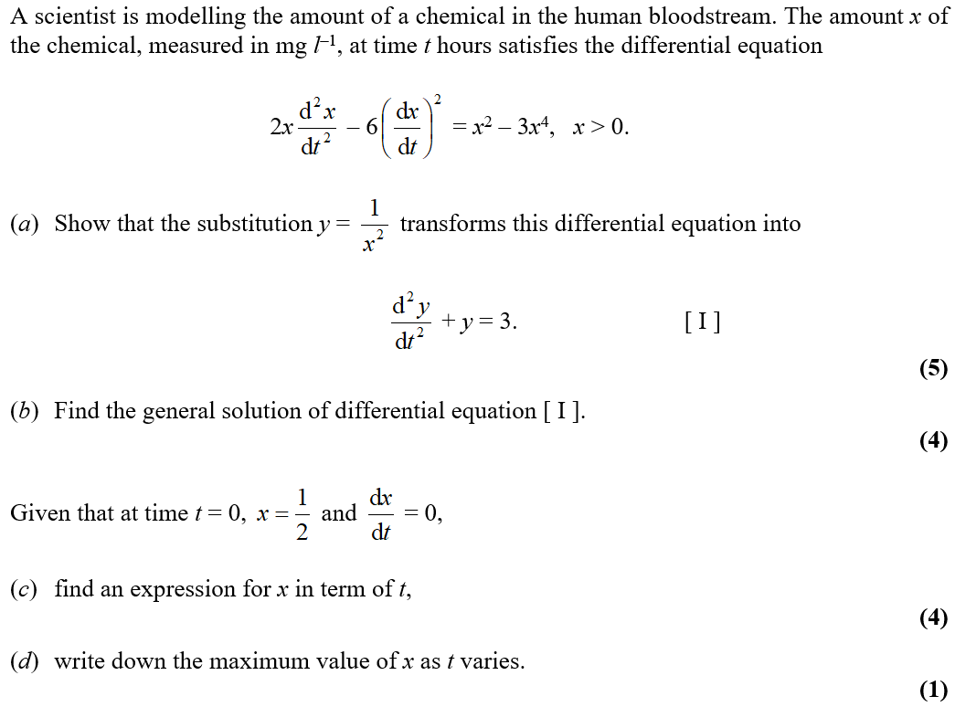
Jan 2007

Slide 34
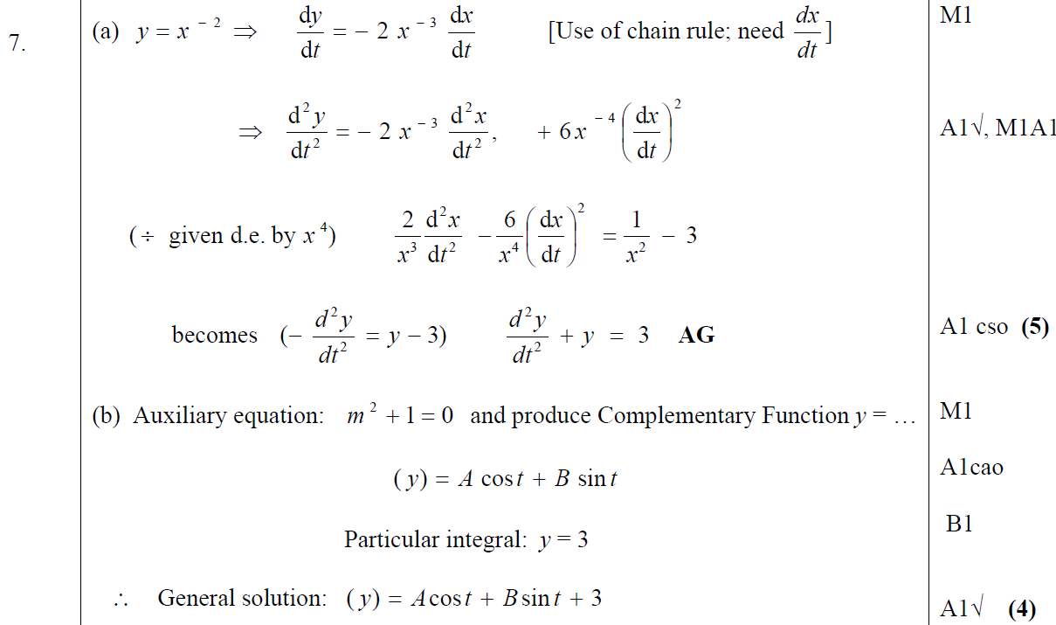
Jan 2007
A
B

Slide 35
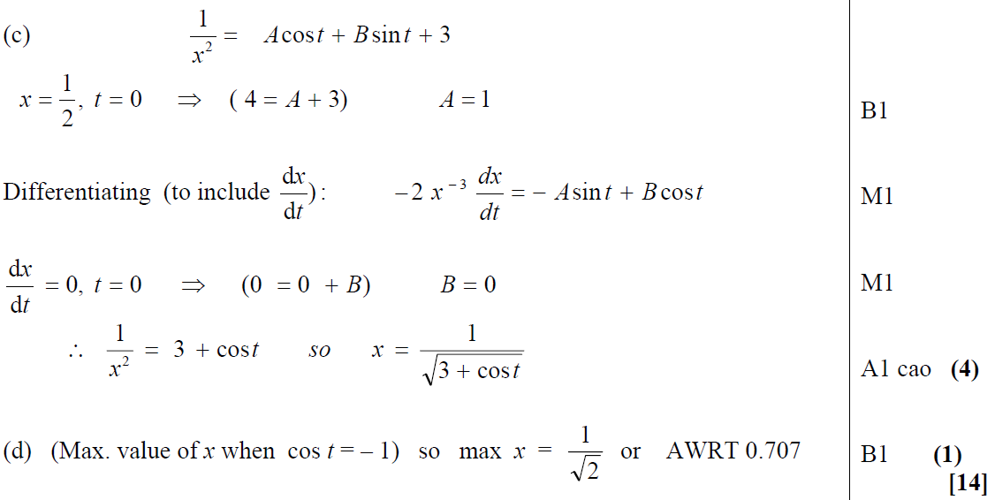
Jan 2007
C
D

Slide 36
Jan 2007
A notes
B notes

Slide 37
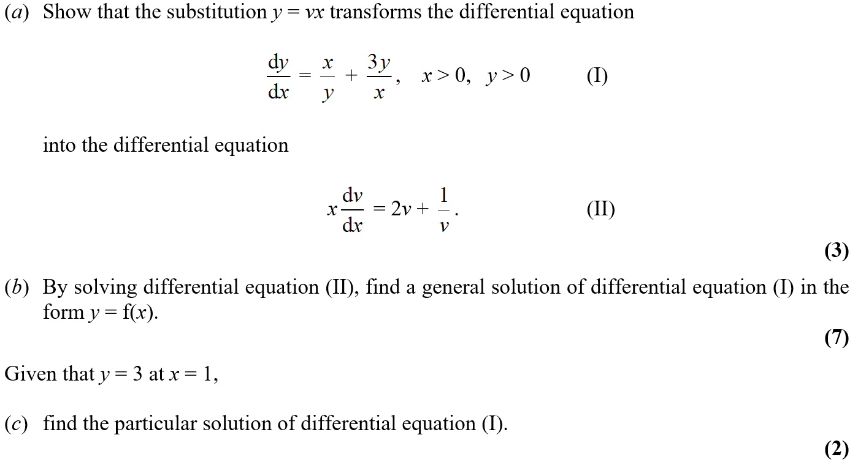
June 2008

Slide 38
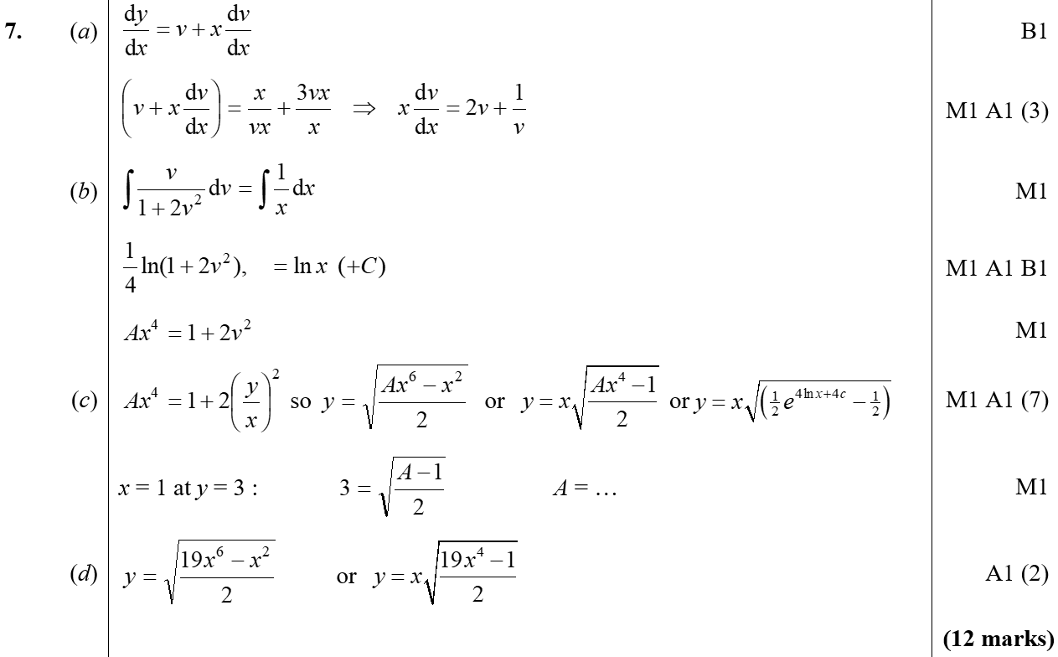
June 2008
A
B
C
D

Slide 39
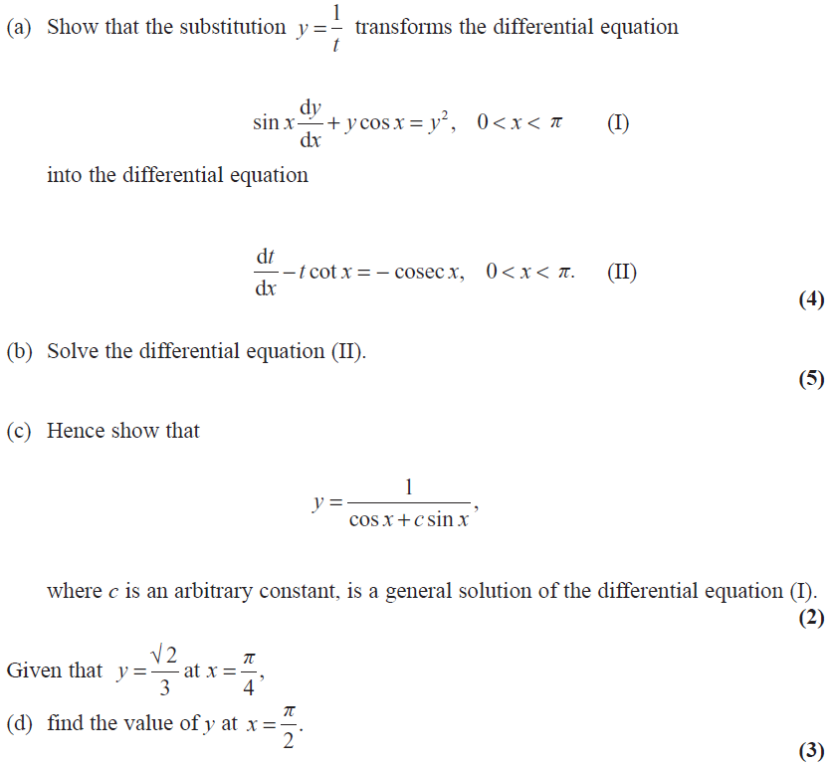
Jan 2009

Slide 40
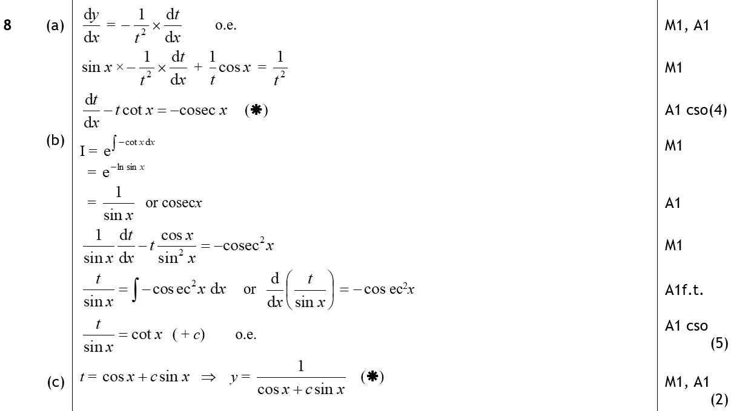
Jan 2009
A
B
C

Slide 41
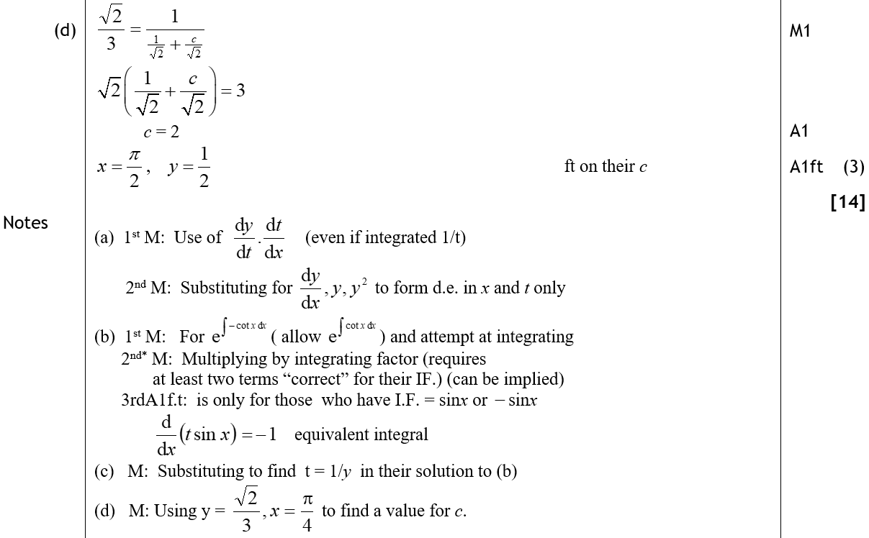
Jan 2009
D
A notes
B notes
C notes
D notes

Slide 42
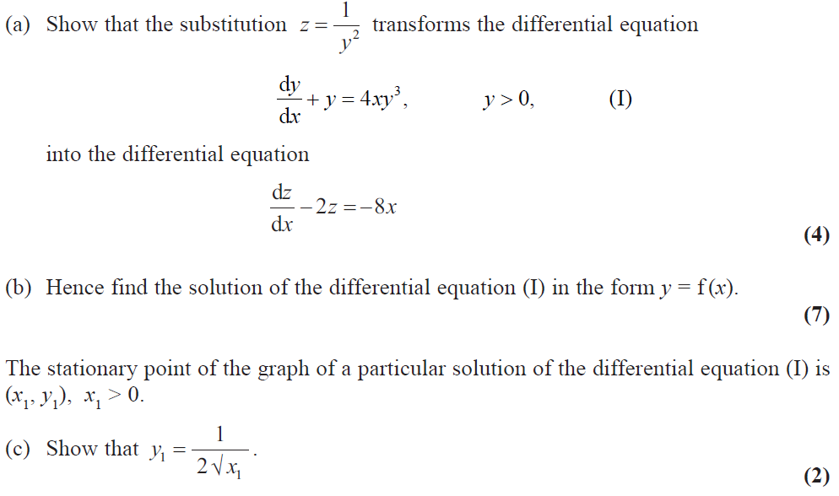
Jan 2010

Slide 43
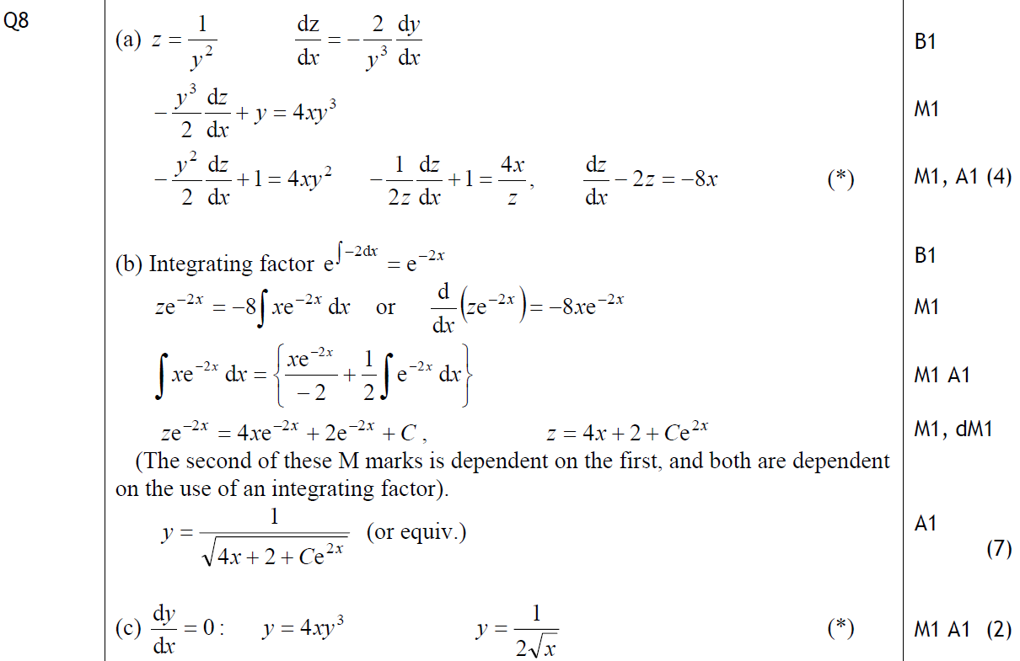
Jan 2010
A
B
C

Slide 44
Jan 2010
B notes

Slide 45
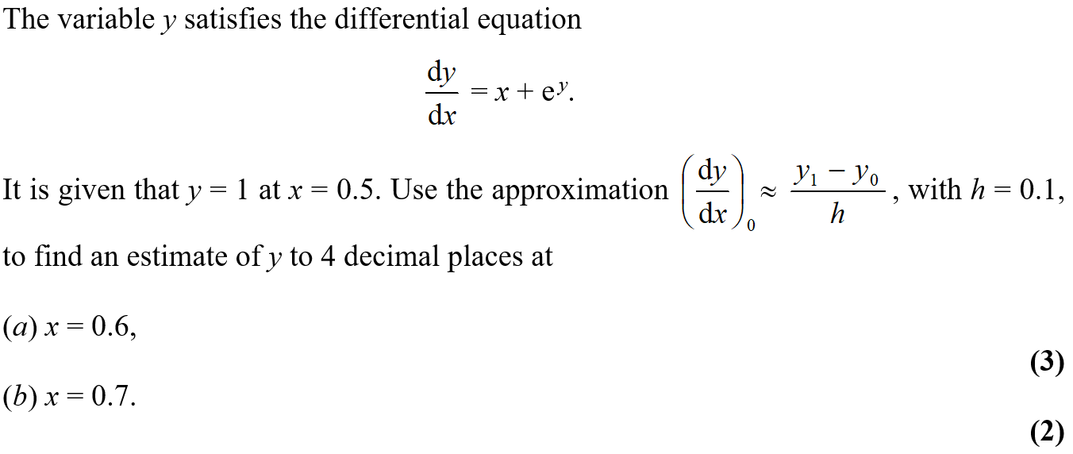
June 2002

Slide 46
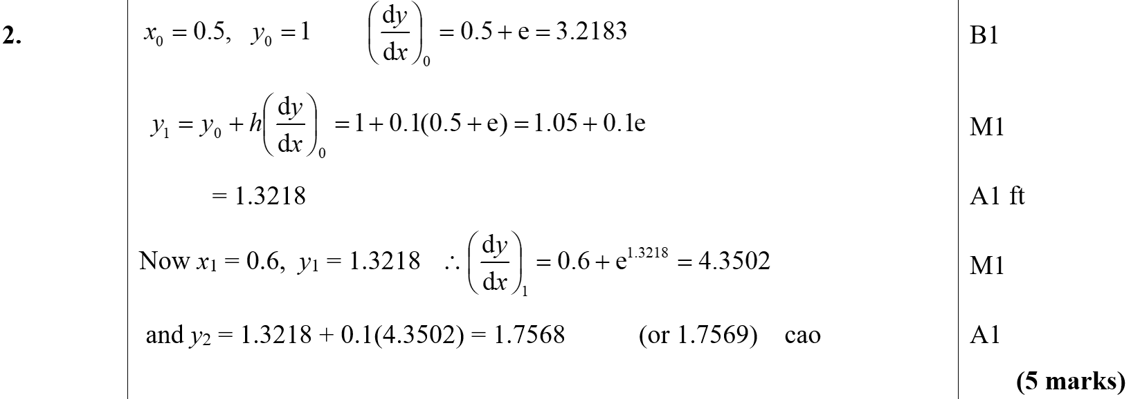
June 2002
A
B

Slide 47
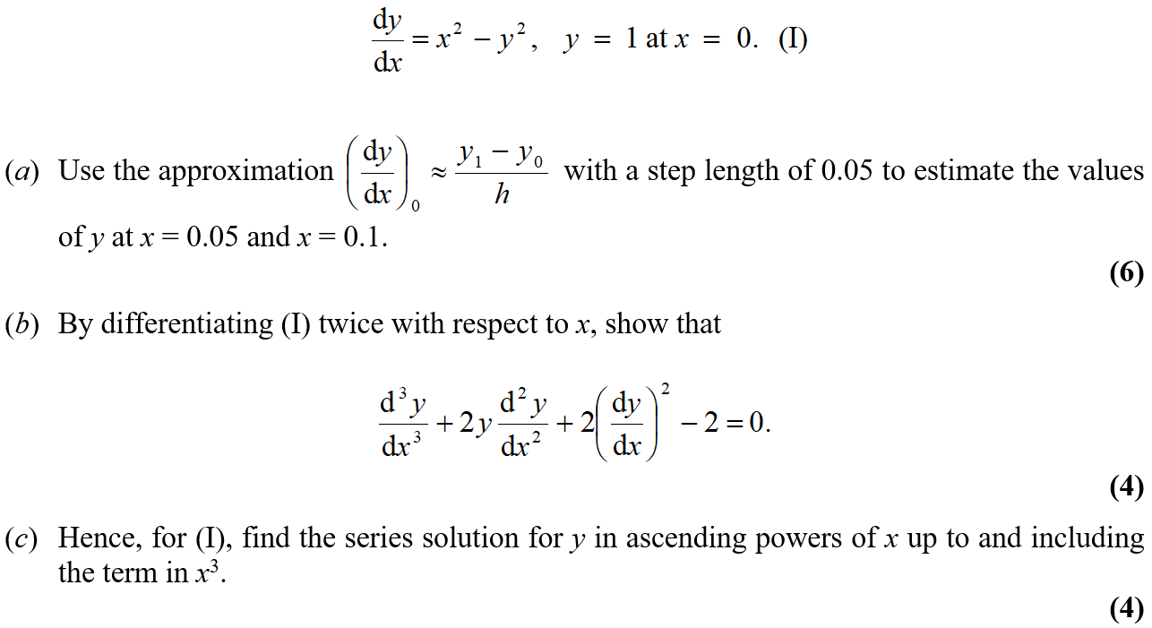
June 2003

Slide 48
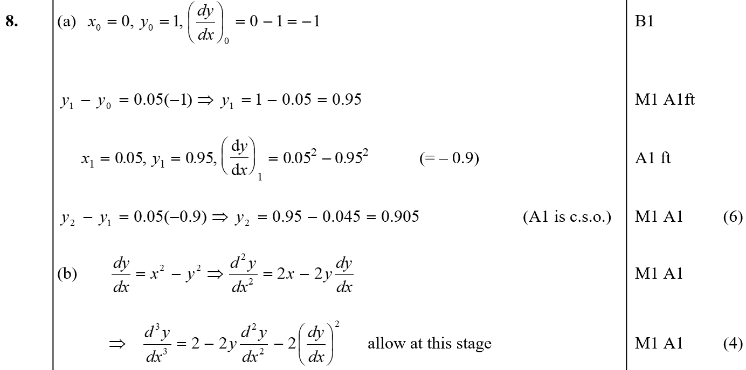
June 2003
A
B

Slide 49
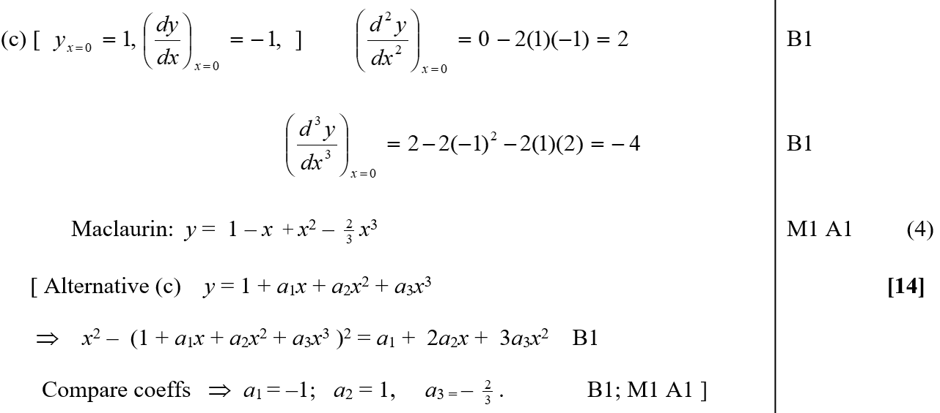
June 2003
C

Slide 50
June 2004

Slide 51
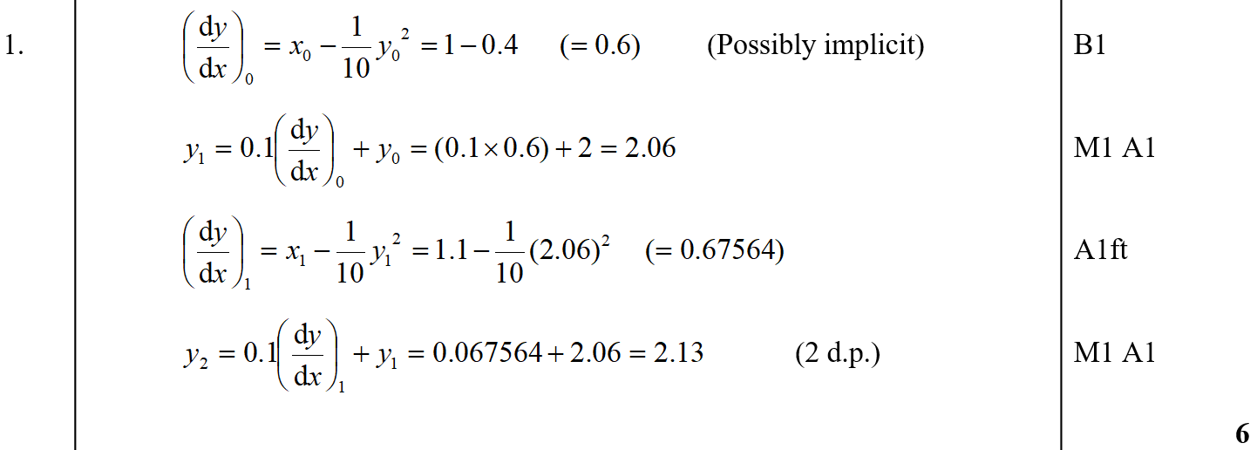
June 2004
A

Slide 52
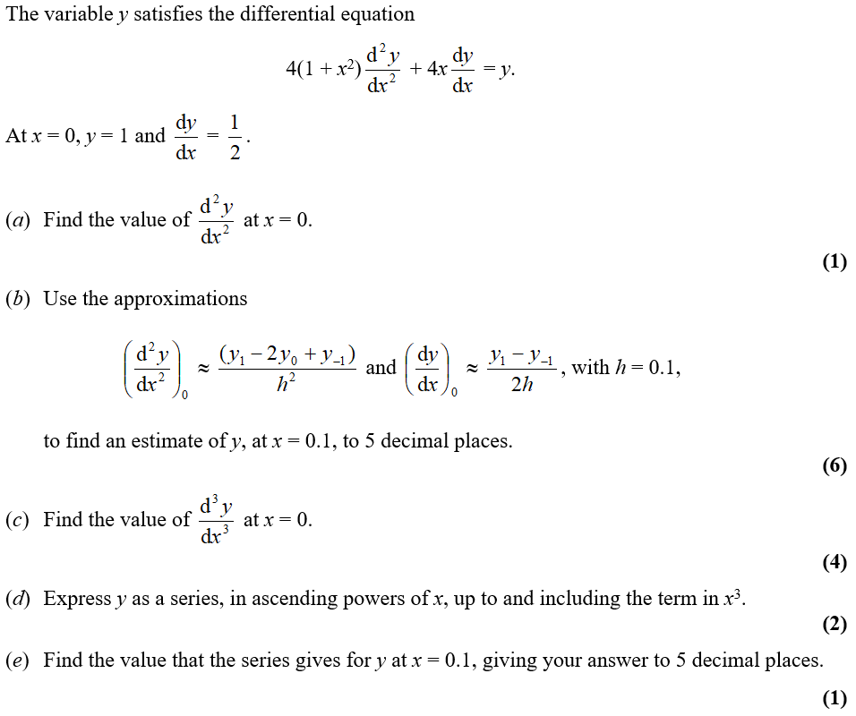
June 2005

Slide 53
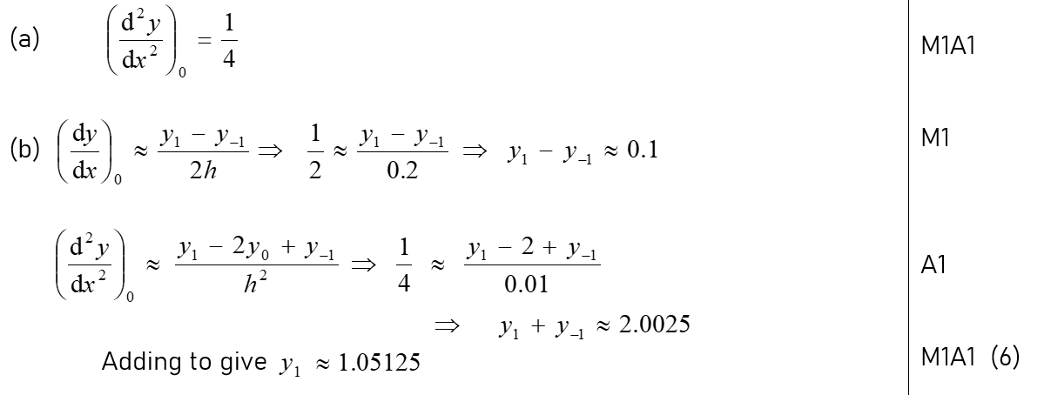
June 2005
A
B

Slide 54
June 2005
C
D
E

Slide 55
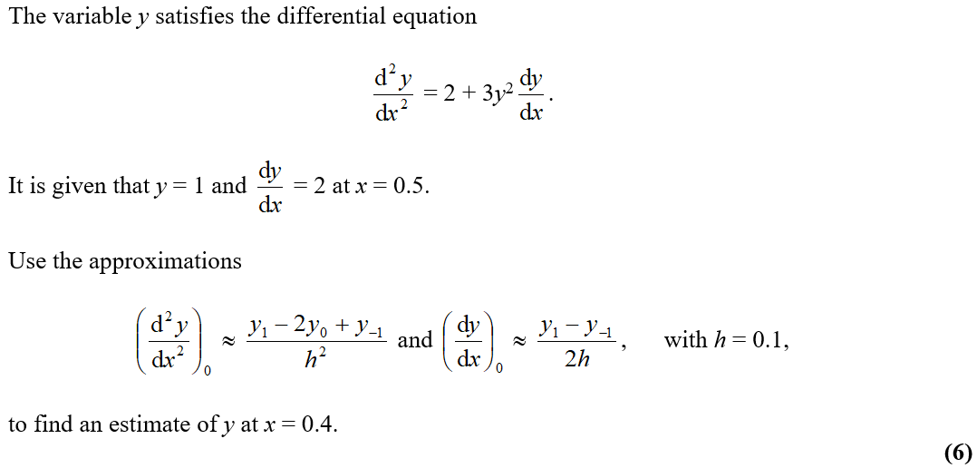
Jan 2006

Slide 56
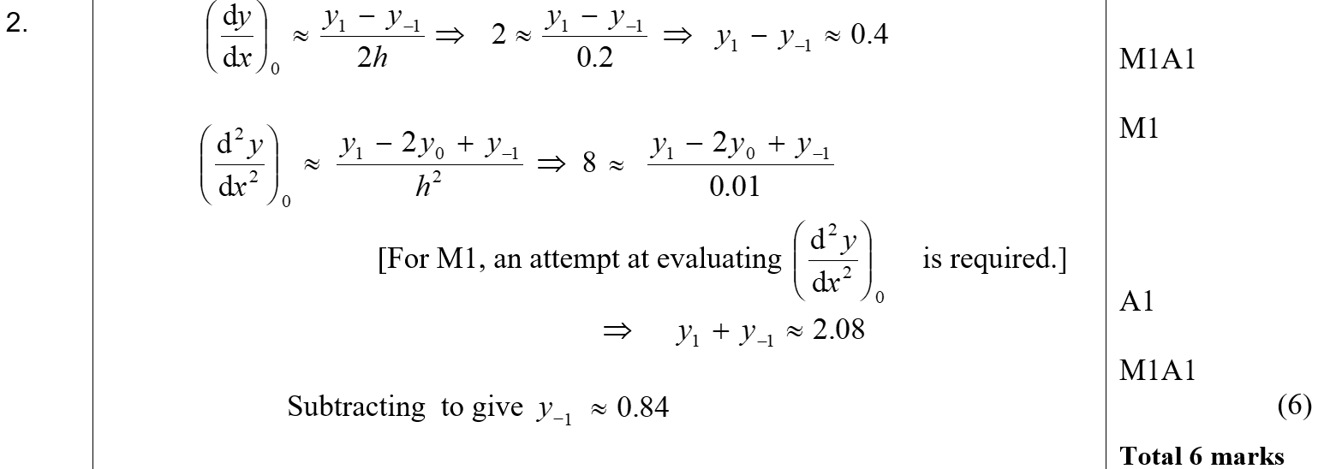
Jan 2006
A

Slide 57
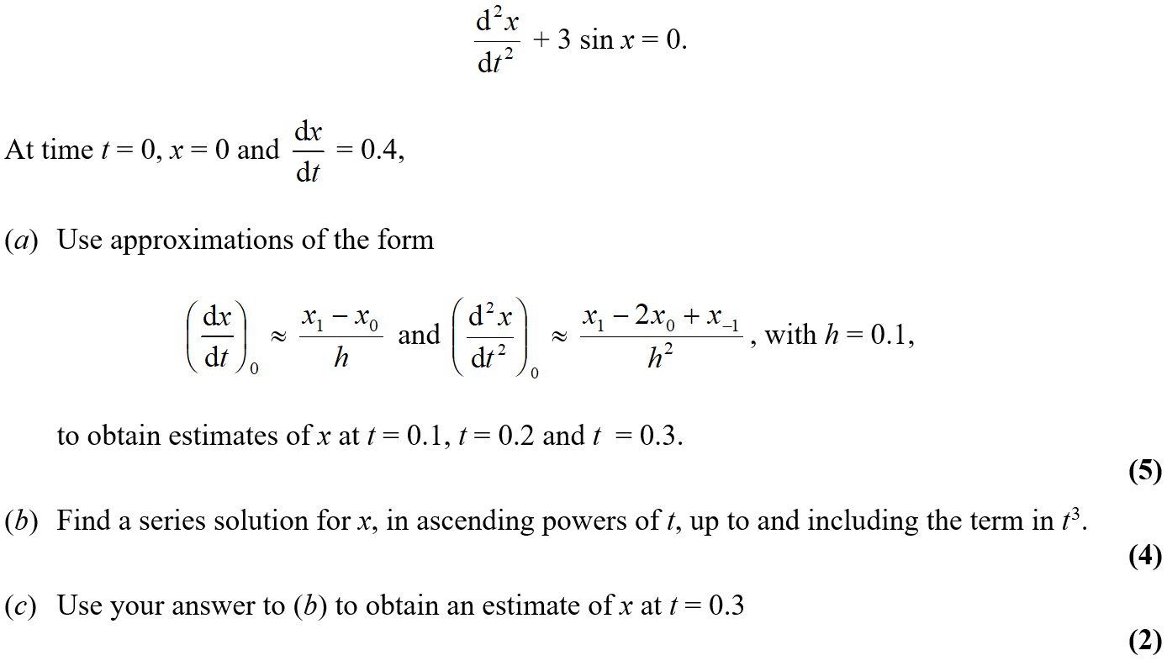
June 2006

Slide 58
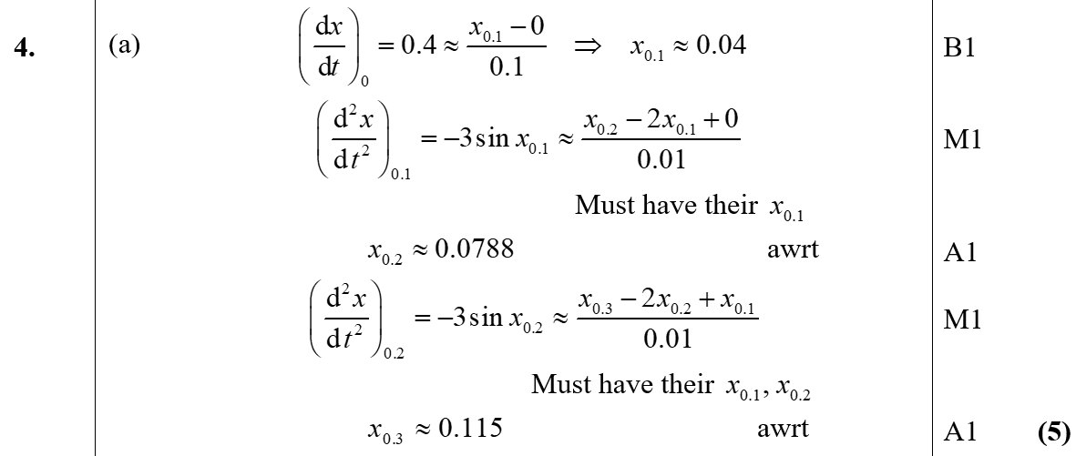
June 2006
A

Slide 59
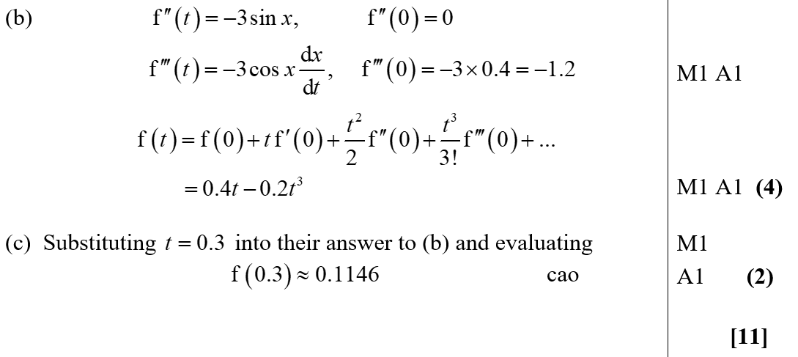
June 2006
B
C

Slide 60
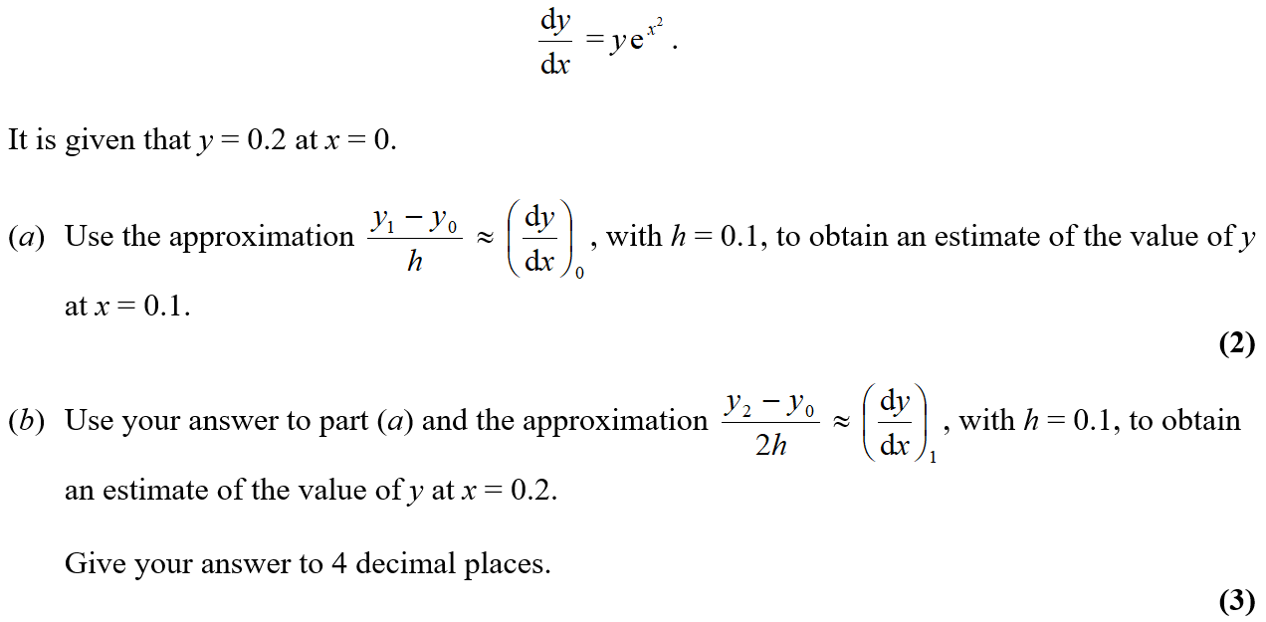
June 2007

Slide 61
June 2007
A
B

Slide 62
June 2008

Slide 63
June 2008
A

Slide 64
June 2009

Slide 65
June 2009
A

Slide 66
Jan 2010

Slide 67
Jan 2010
A

Slide 68
June 2010

Slide 69
June 2010
A
B
C

Slide 70
June 2012

Slide 71
June 2012
A
B

Slide 72
June 2012
C
A notes
B notes
C notes

Slide 73
June 2013

Slide 74
June 2013
A
C

Slide 75
June 2013
B
x’
x’’

Slide 76
June 2013
A Alternative

Slide 77
June 2013
A notes

Slide 78
June 2013
A Alternative notes

Slide 79
June 2013
B notes
C notes

Slide 80
June 2014

Slide 81
June 2014
A

Slide 82
June 2014
A Alternative 1

Slide 83
June 2014
A Alternative 2
B

Slide 84
June 2014 Reserve

Slide 85
June 2014 Reserve
A

Slide 86
June 2014 Reserve
A Alternative

Slide 87
June 2014 Reserve
B

Slide 88
June 2014 Reserve
C
A notes

Slide 89
June 2014 Reserve
B notes
C notes

Slide 90
June 2015

Slide 91
June 2015
A

Slide 92
June 2015
A notes

Slide 93
June 2015
A Alternative 1

Slide 94
June 2015
A Alternative 2

Slide 95
June 2015
B

Slide 96
June 2015
C
B notes
C notes

Slide 97
June 2016

Slide 98
June 2016
A

Slide 99
June 2016
A notes

Slide 100
June 2016
A Alternative 1

Slide 101
June 2016
A Alternative 2

Slide 102
June 2016
B

Slide 103
June 2016
C

Slide 104
June 2018

Slide 105
June 2018
A

Slide 106
June 2018
B

Slide 107
June 2018
B Alternative

Slide 108
June 2018
C
A Alternative Forms

Slide 109
June 2018
B Alternative Forms
C Alternative Forms

Slide 110
June 2019

Slide 111
June 2019
A
A notes

Slide 112
June 2019
A Alternative 1
A Alternative 2

Slide 113
June 2019
B
C

Slide 114
June 2019
B notes
C notes

