Slide 1
Old Spec Q’s
Conic Sections
SAM
SAM (i)
2018
SAM (ii)
2019
2019 (i)
2019 (ii)

Slide 2
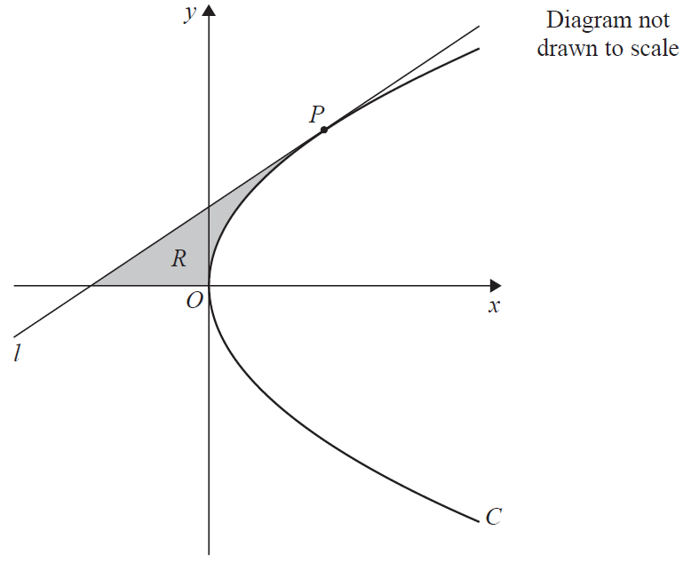
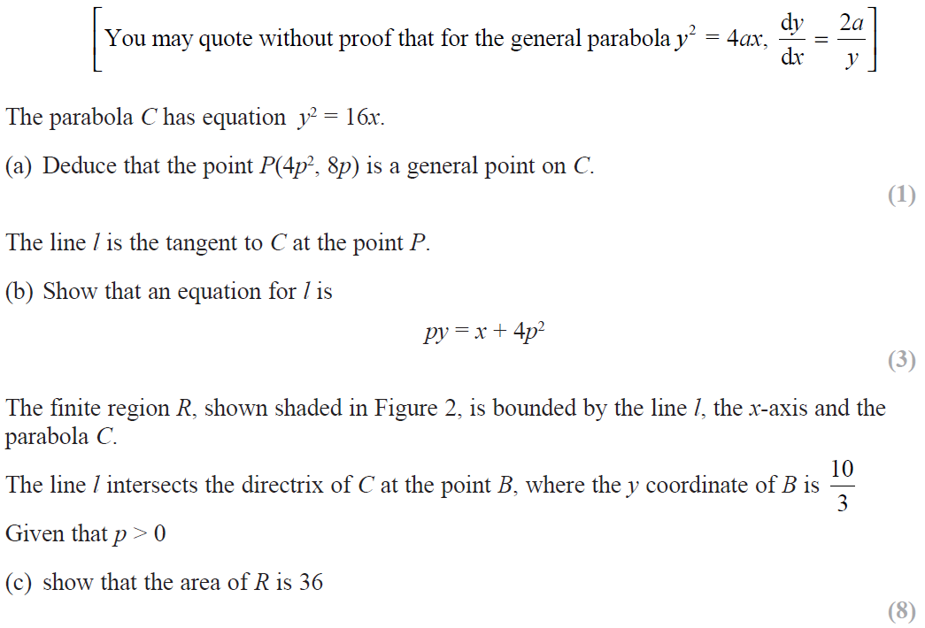
SAM

Slide 3
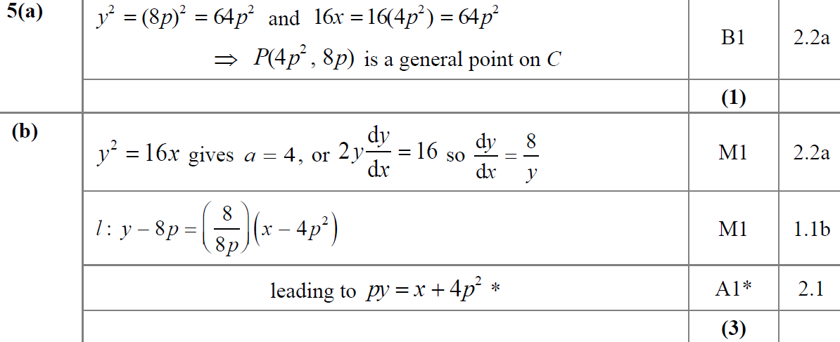
SAM
A
B

Slide 4
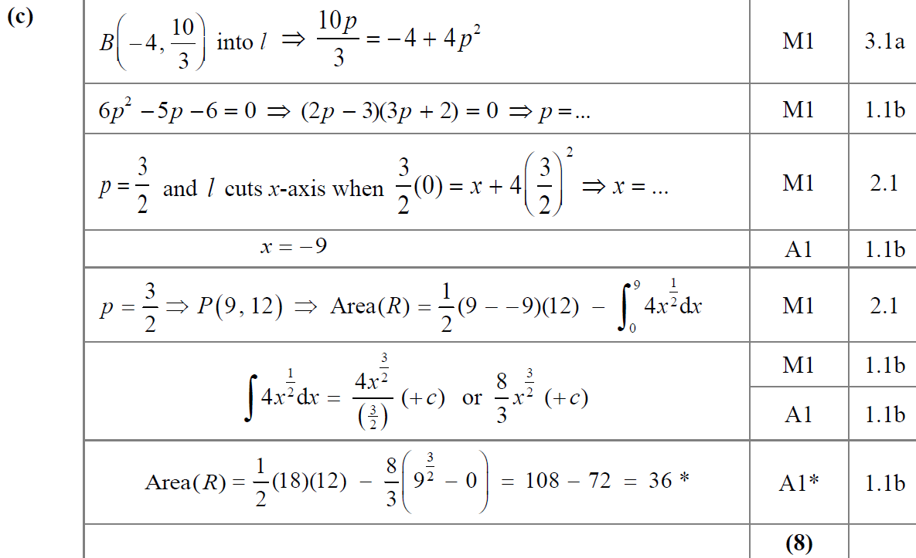
SAM
C

Slide 5
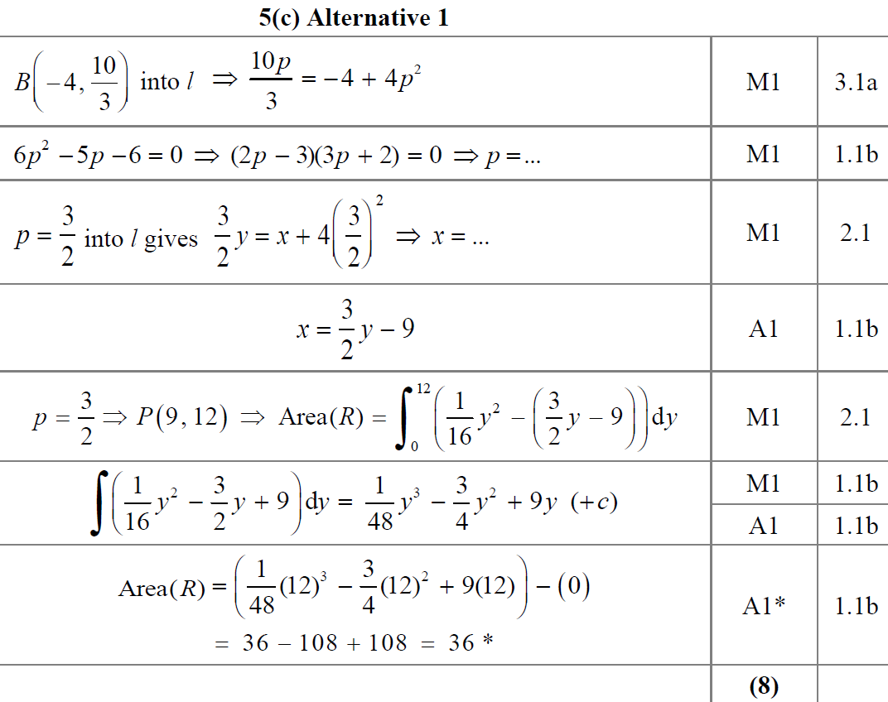
SAM
C Alternative 1

Slide 6
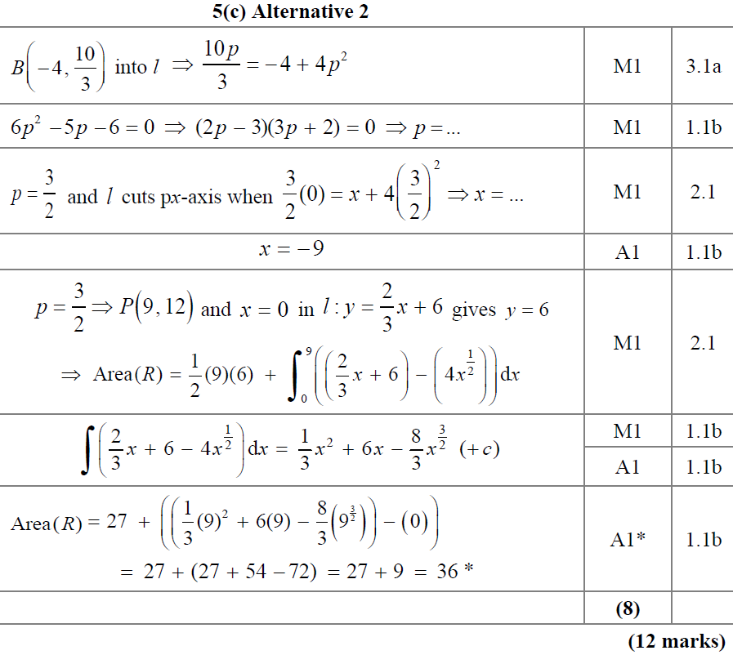
SAM
C Alternative 2

Slide 7
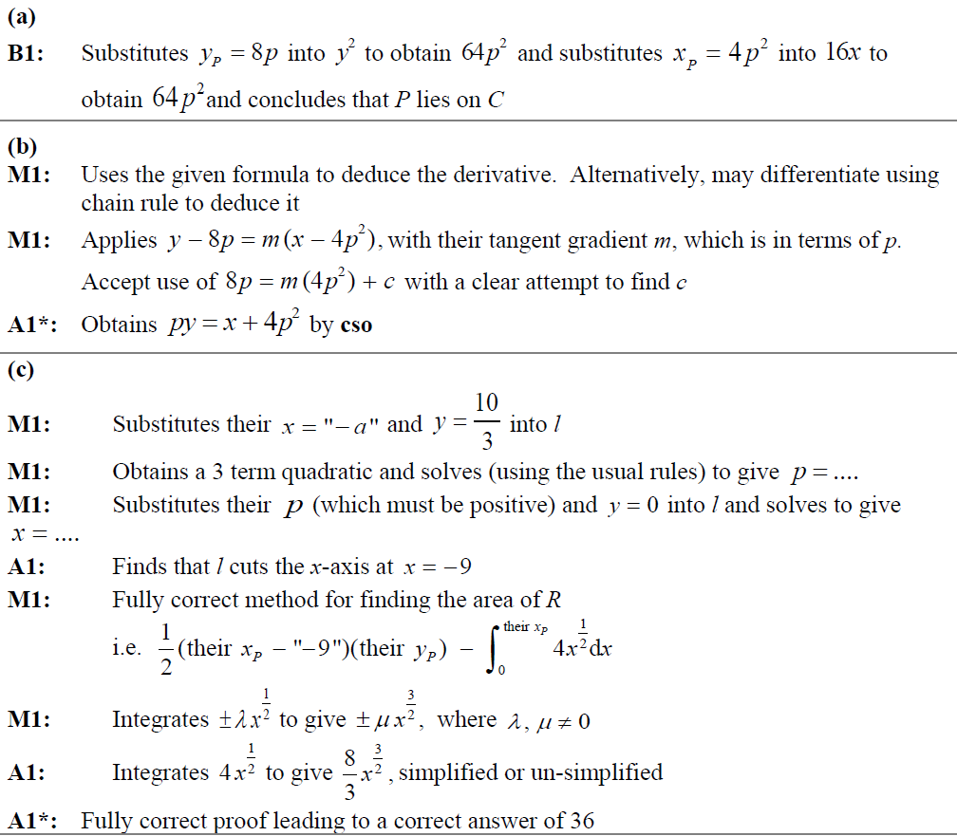
SAM
A notes
B notes
C notes

Slide 8
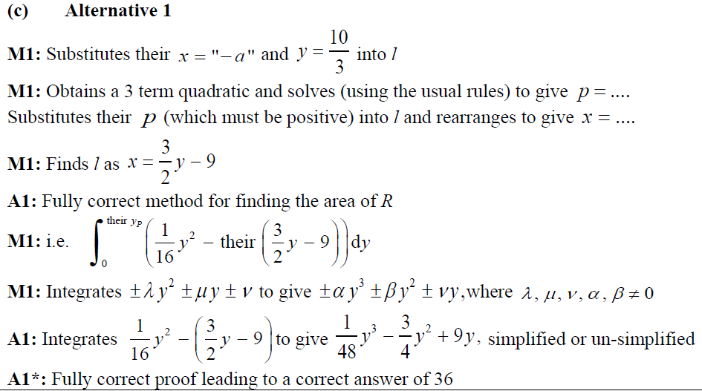
SAM
C Alternative 1 notes

Slide 9
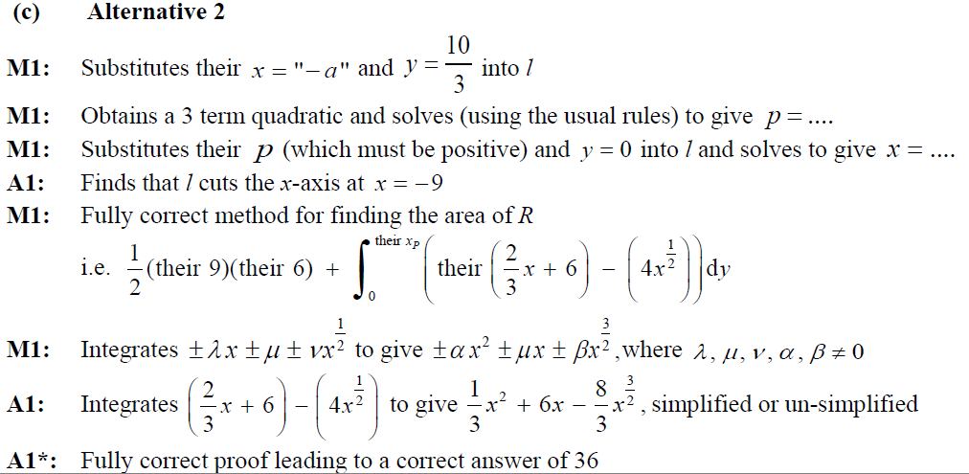
SAM
C Alternative 2 notes

Slide 10
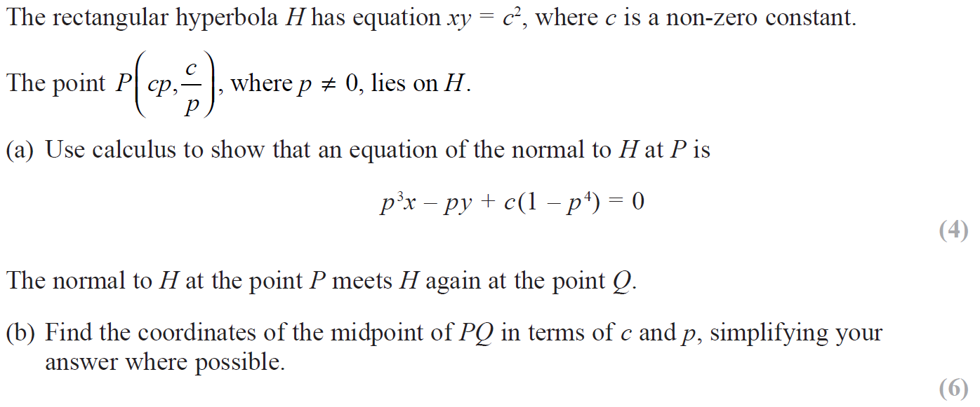
2018

Slide 11
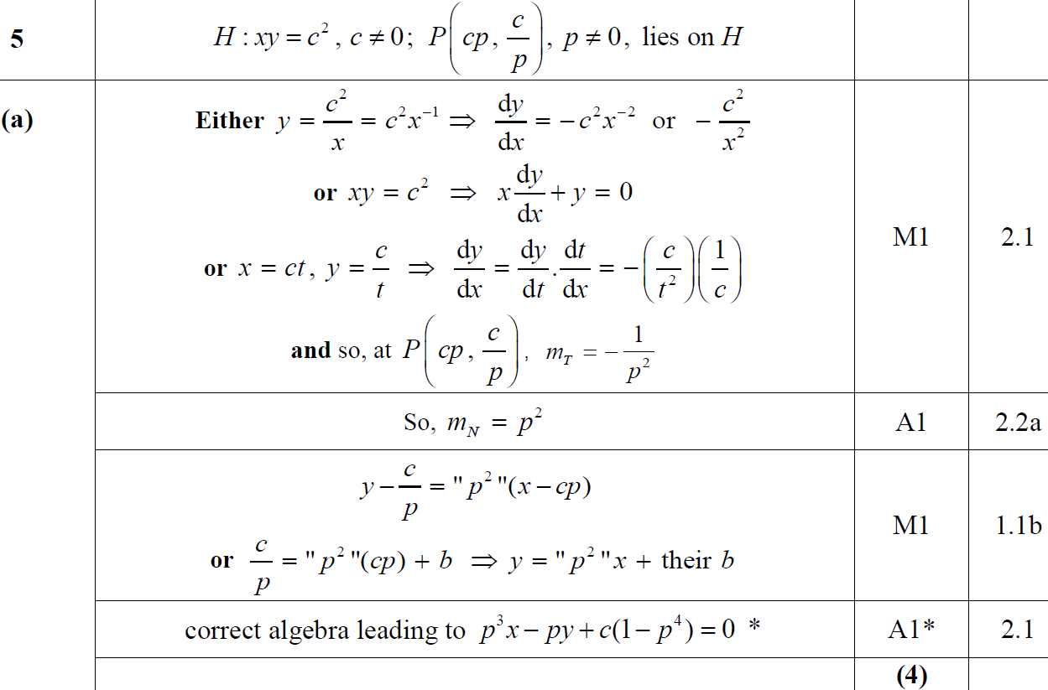
2018
A

Slide 12
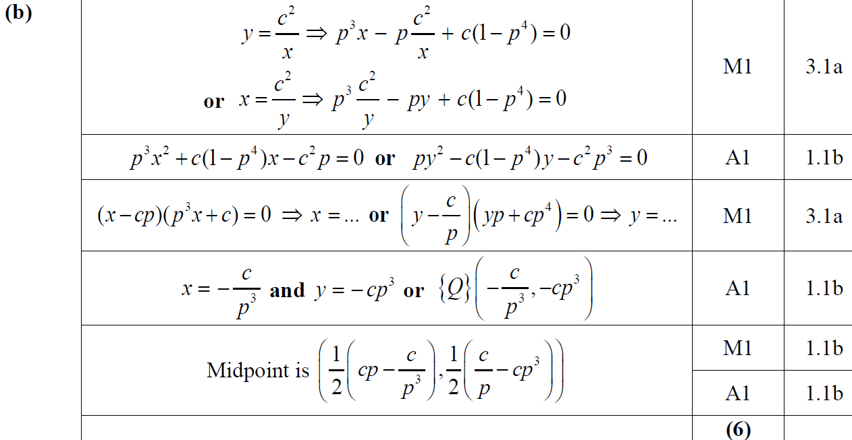
2018
B

Slide 13
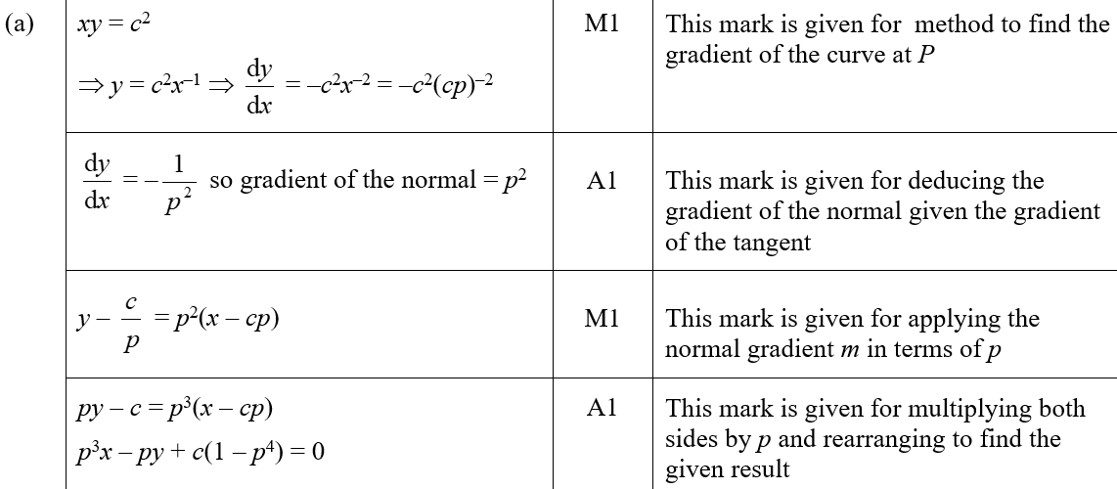
2018
A (SF)

Slide 14
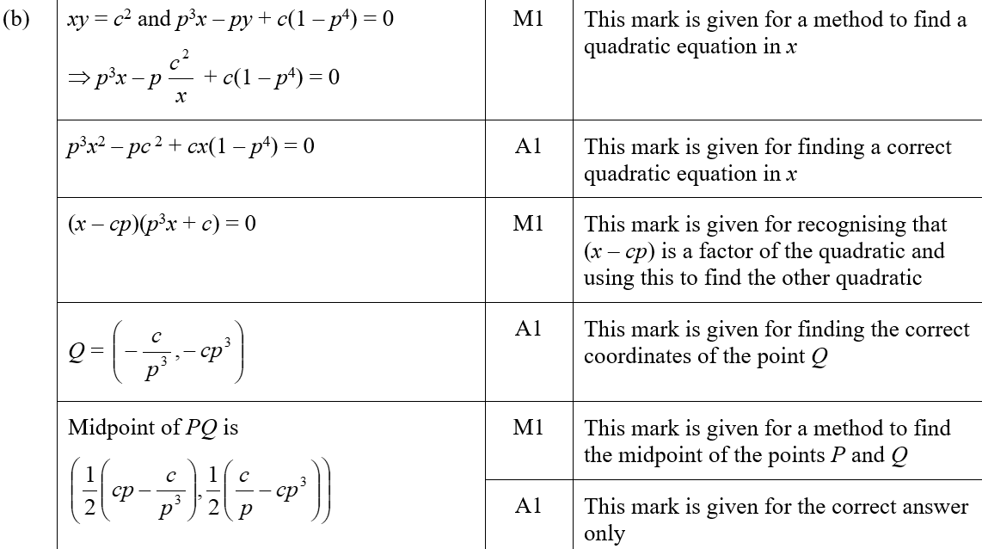
2018
B (SF)

Slide 15
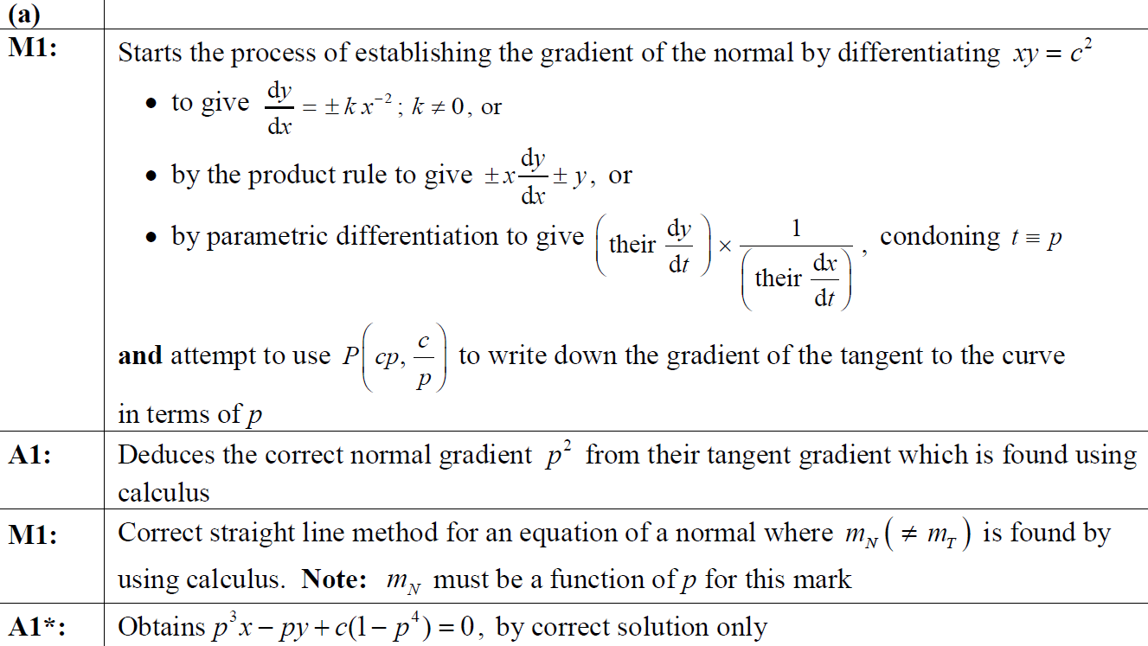
2018
A notes

Slide 16
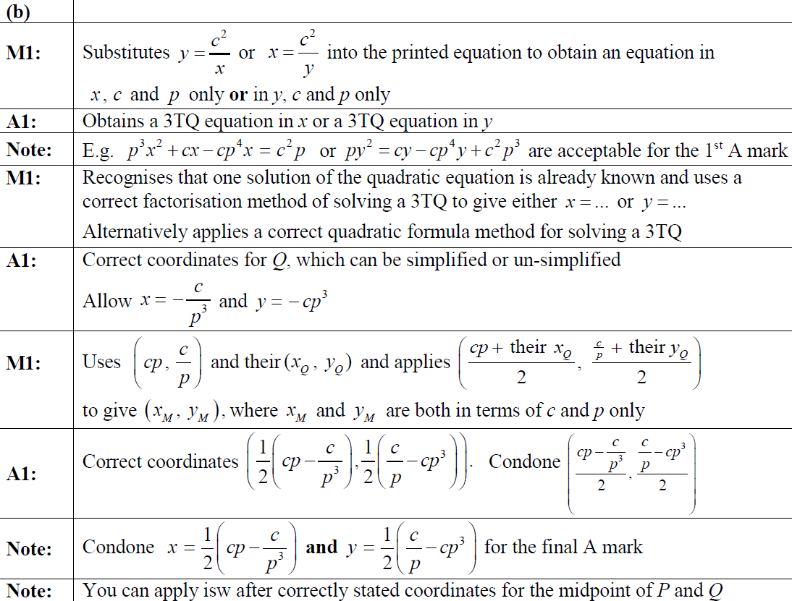
2018
B notes

Slide 17
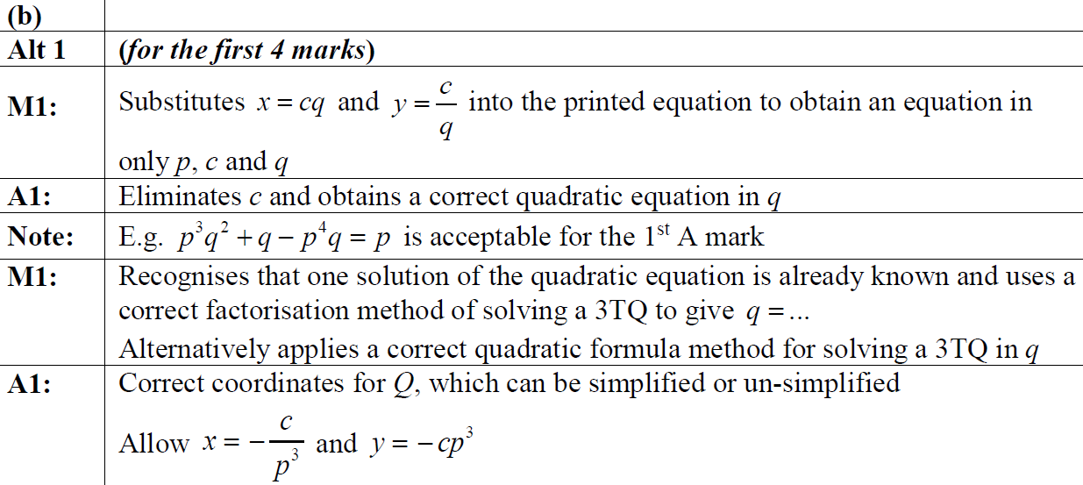
2018
B Alternative
B Alternative notes

Slide 18
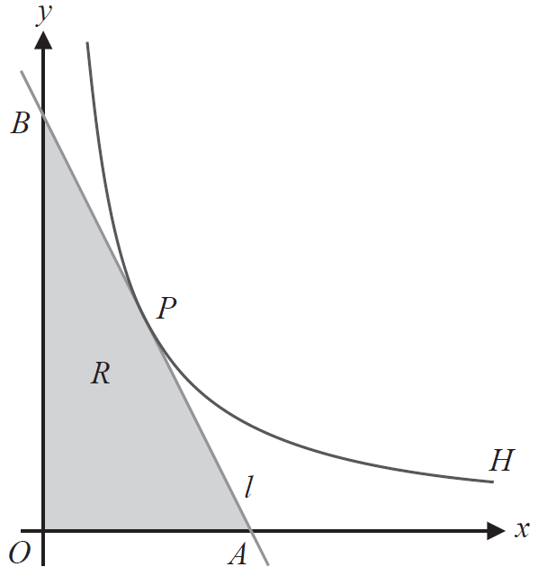
2019

Slide 19
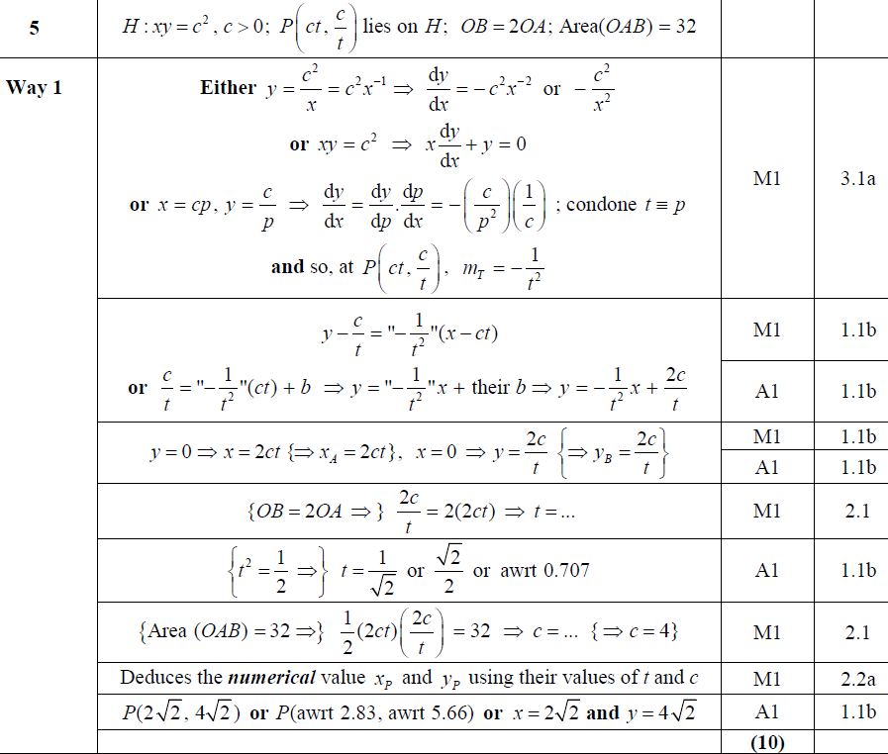
2019
A

Slide 20
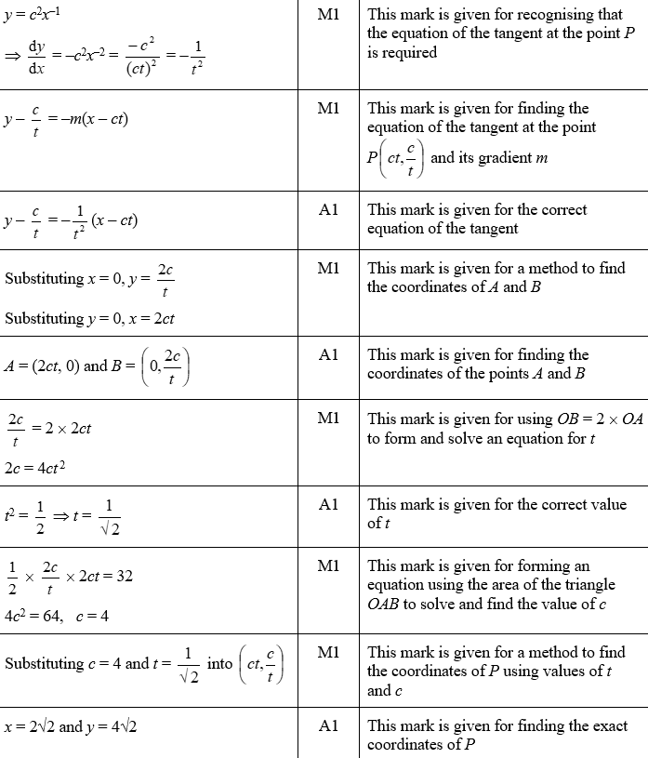
2019
A (SF)

Slide 21
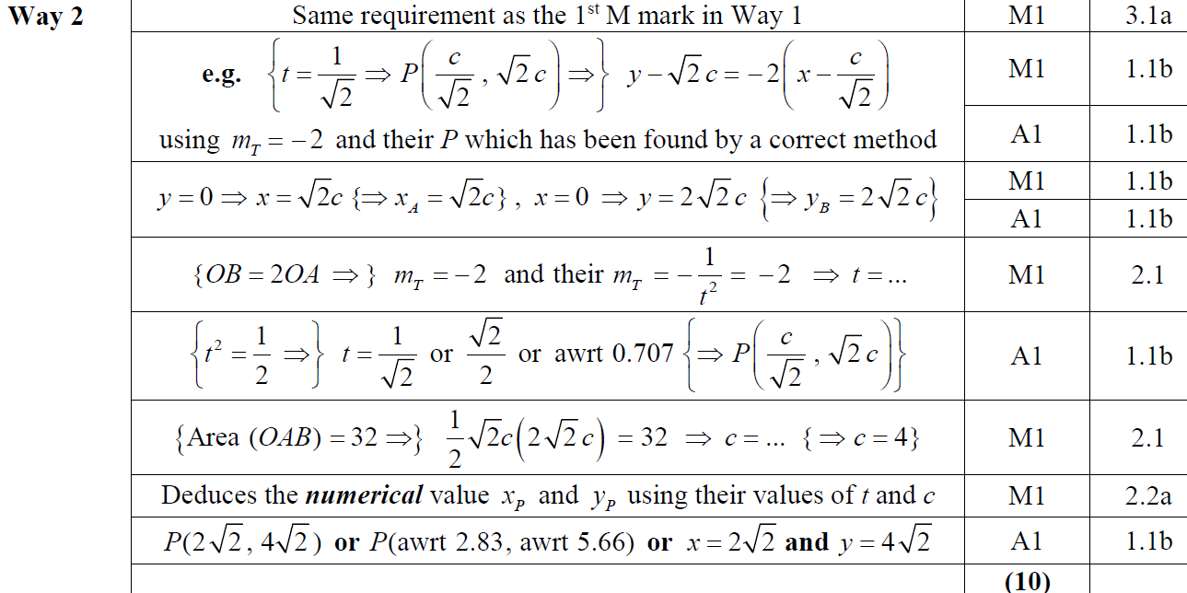
2019
A Alternative 1

Slide 22
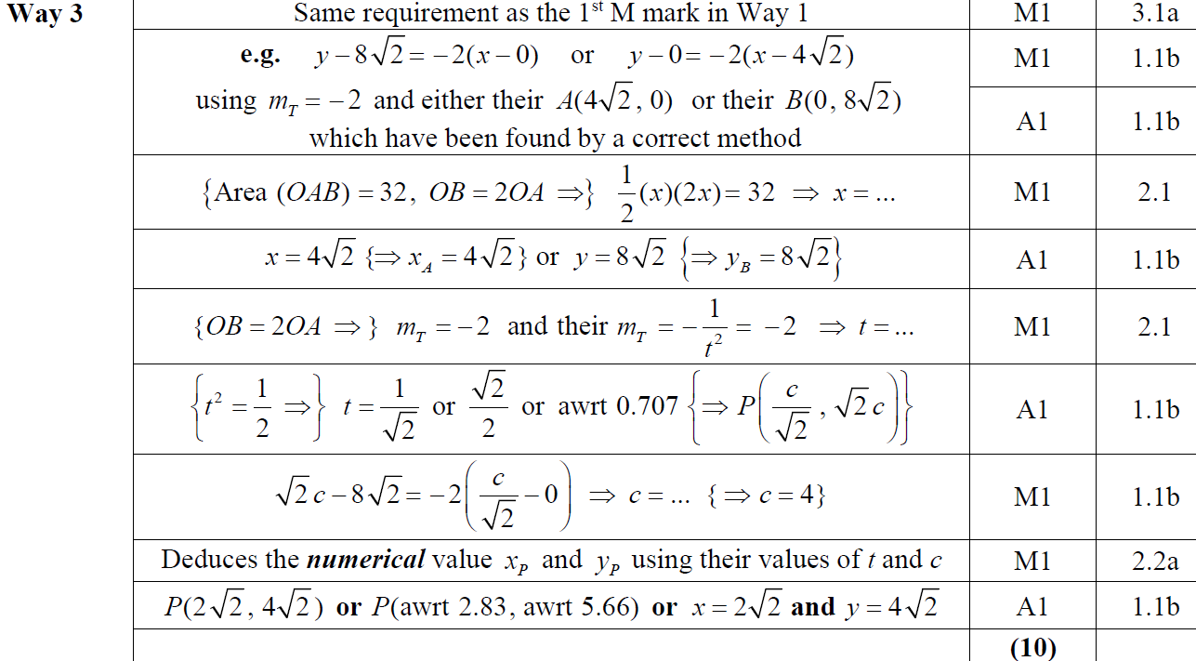
2019
A Alternative 2

Slide 23
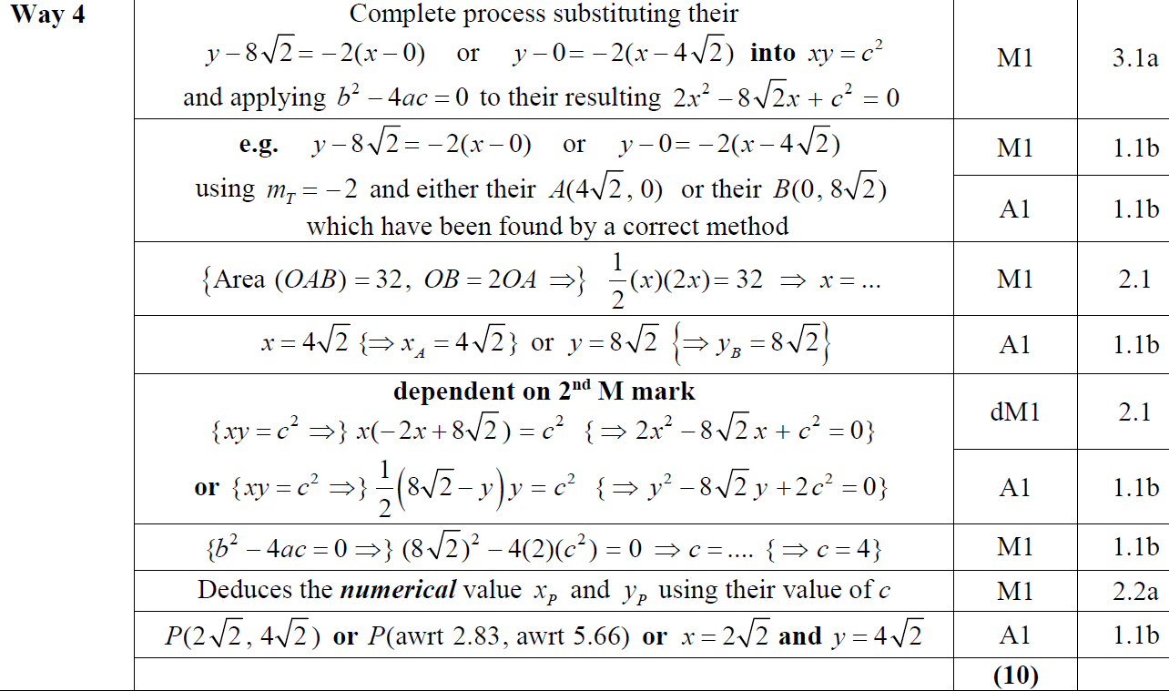
2019
A Alternative 3

Slide 24
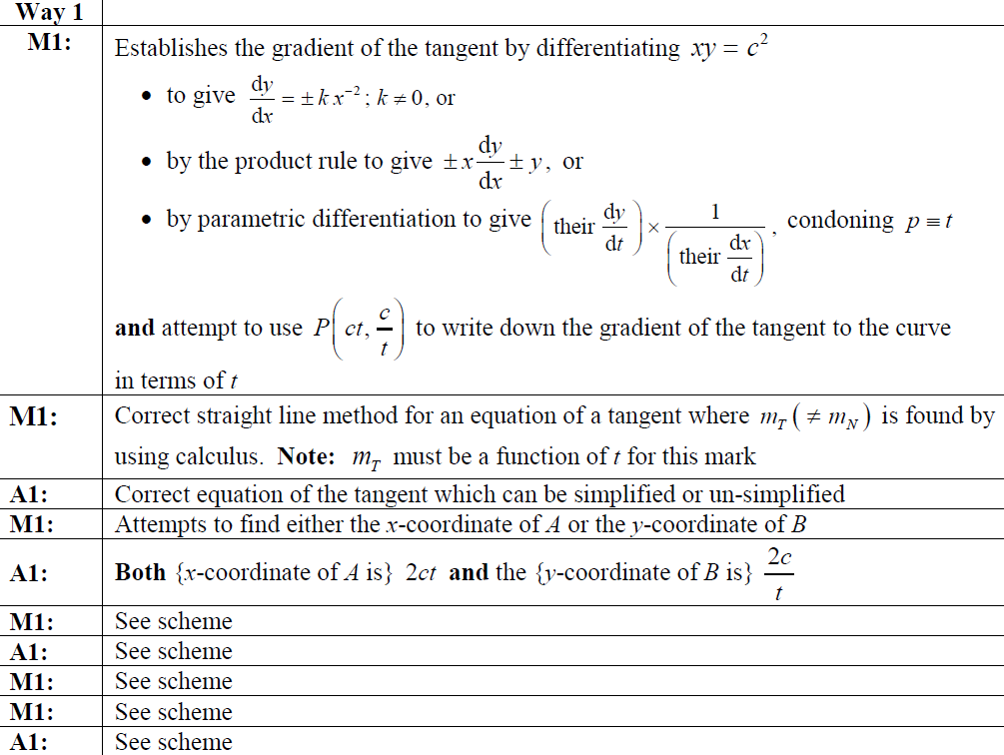
2019
A notes

Slide 25
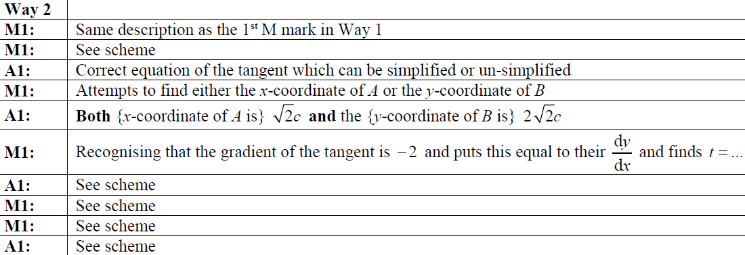
2019
A Alternative 1 notes

Slide 26
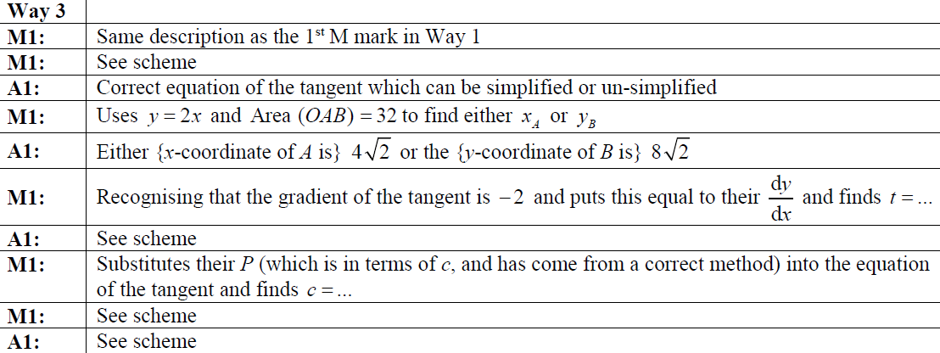
2019
A Alternative 2 notes

Slide 27
2019
A Alternative 2 notes

Slide 28
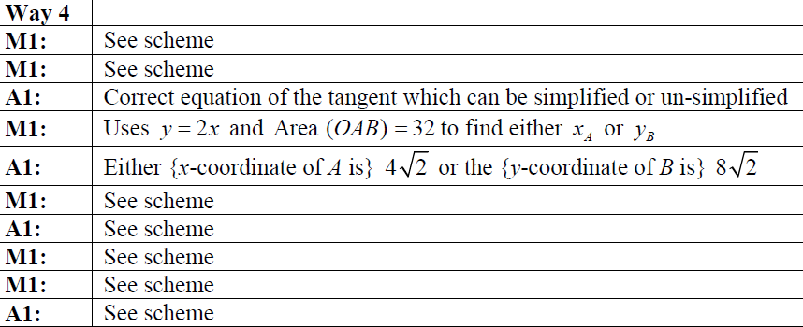
2019
A Alternative 3 notes

Slide 29
SAM

Slide 30
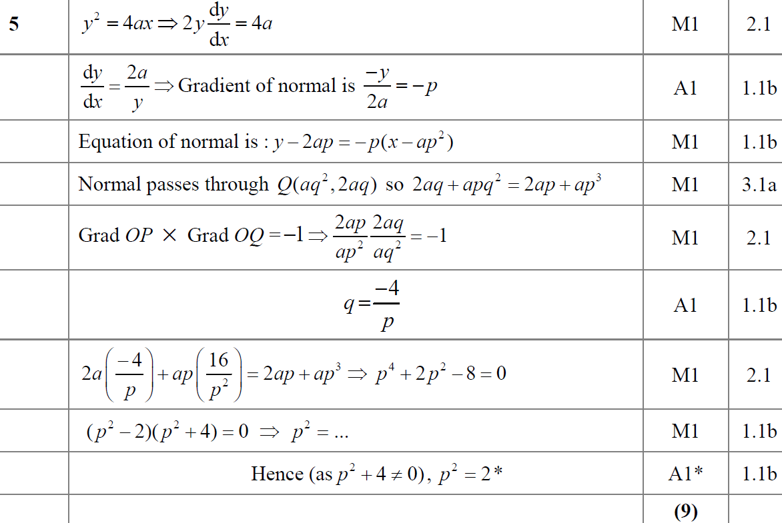
SAM
A

Slide 31
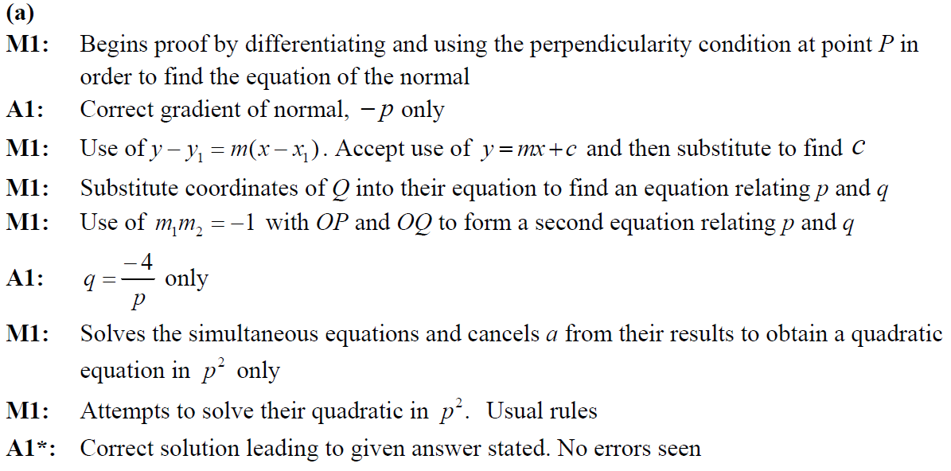
SAM
A notes

Slide 32
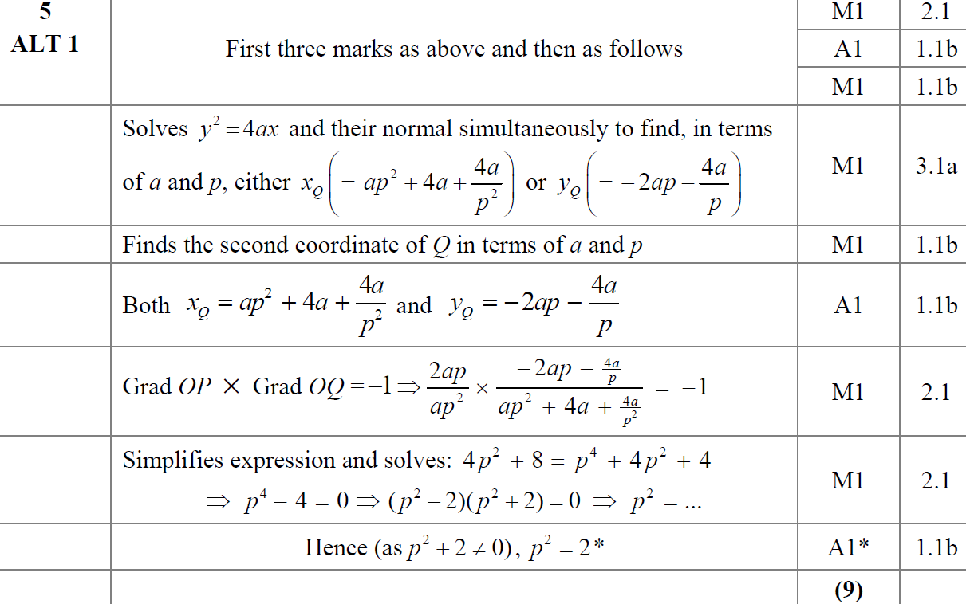
SAM
A Alternative 1

Slide 33
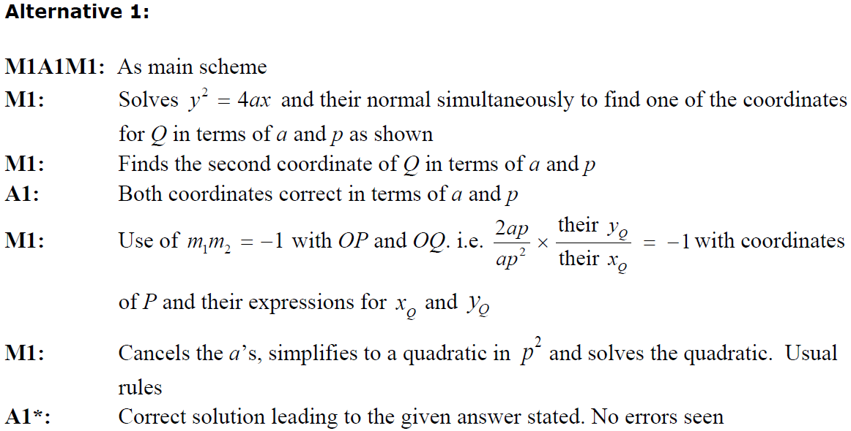
SAM
A Alternative 1 notes

Slide 34
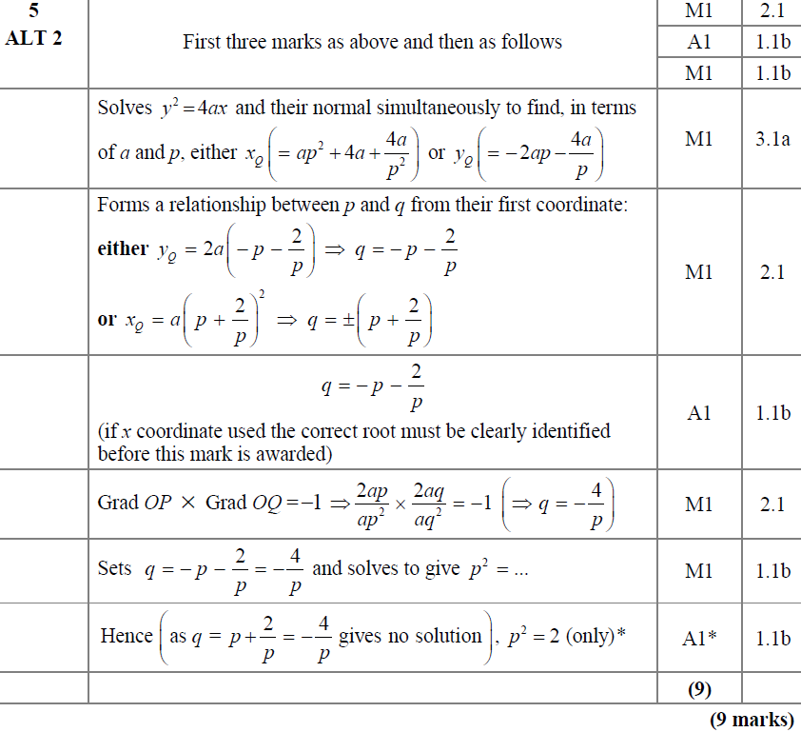
SAM
A Alternative 2

Slide 35
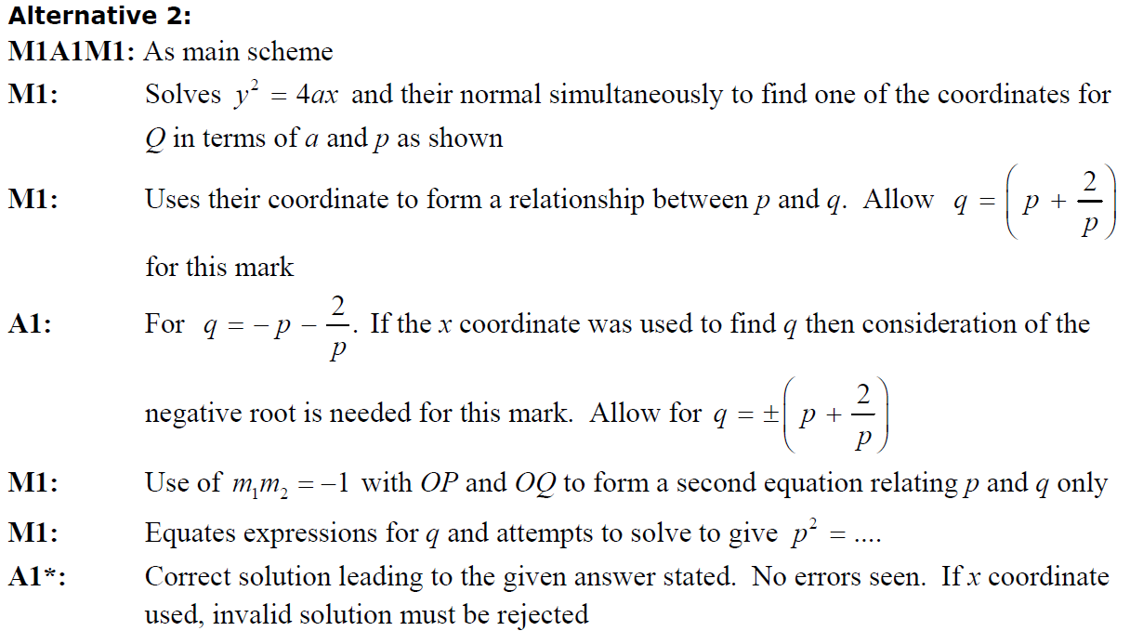
SAM
A Alternative 2 notes

Slide 36
SAM

Slide 37
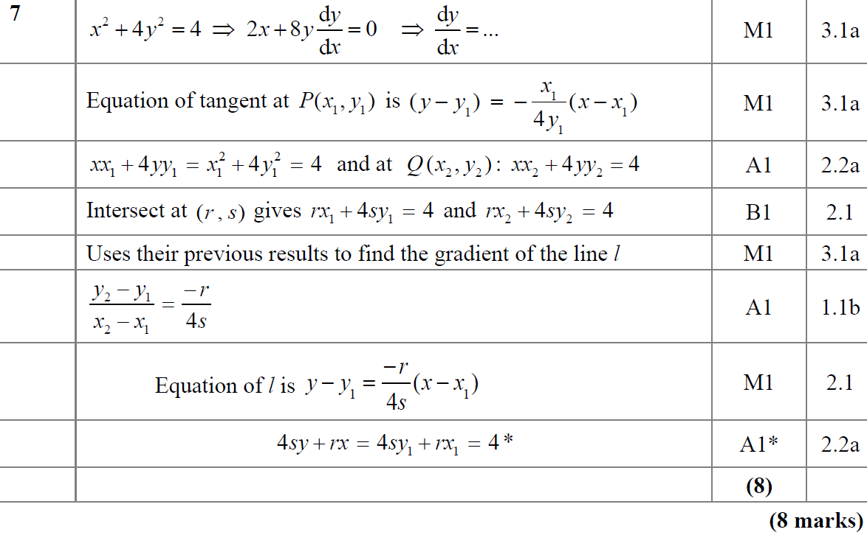
SAM
A

Slide 38
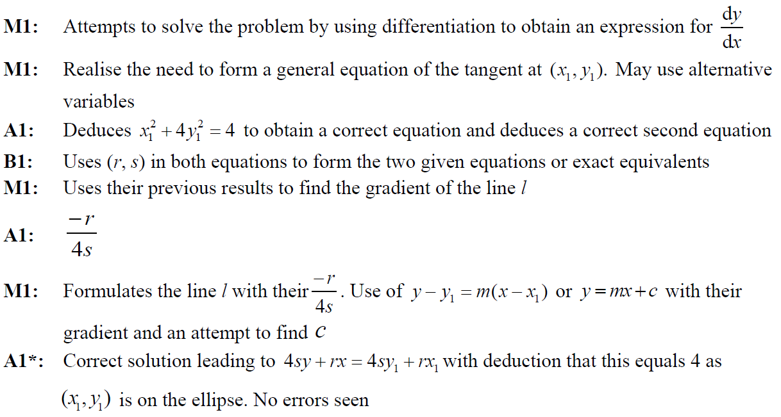
SAM
A notes

Slide 39
2019

Slide 40
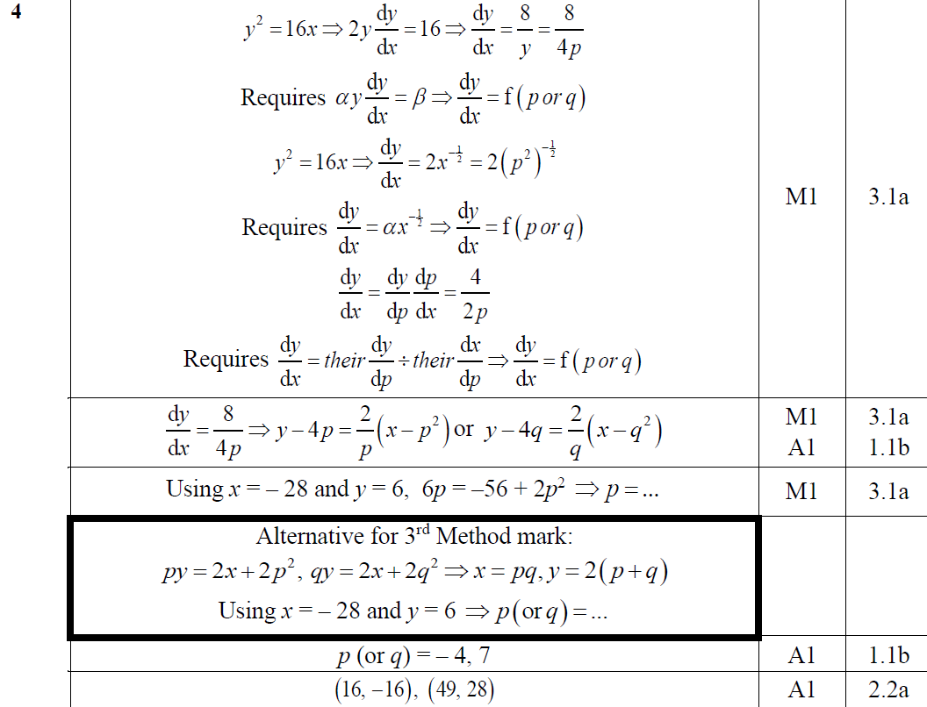
2019
A (First 6 Marks)

Slide 41
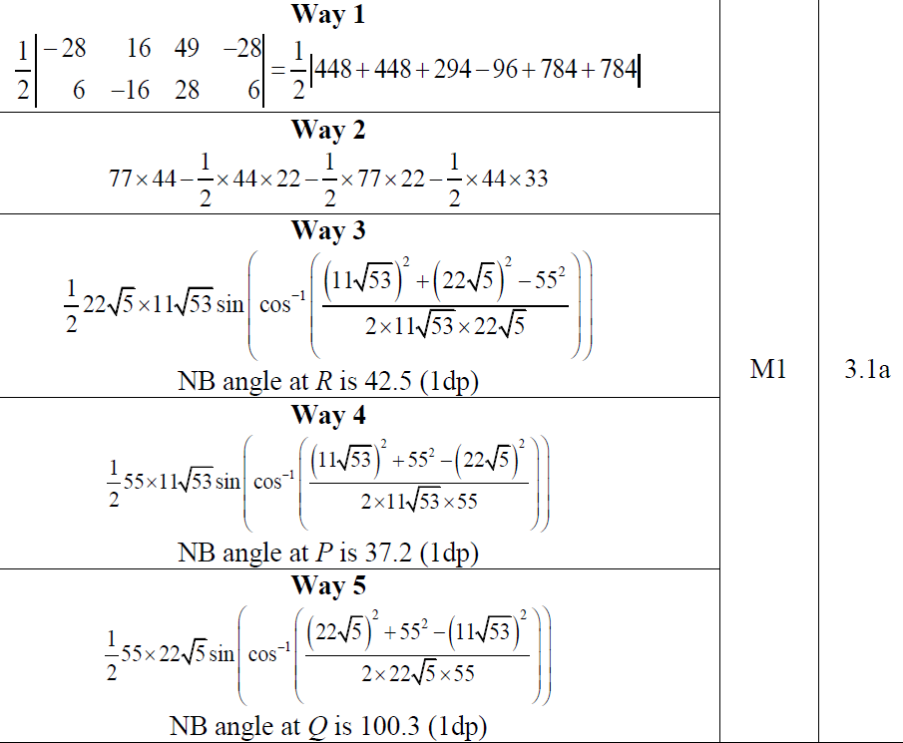
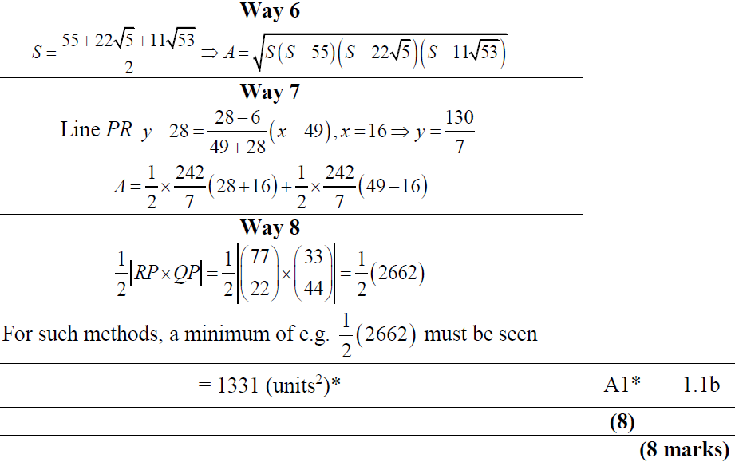
2019
A (Final 2 Marks)

Slide 42
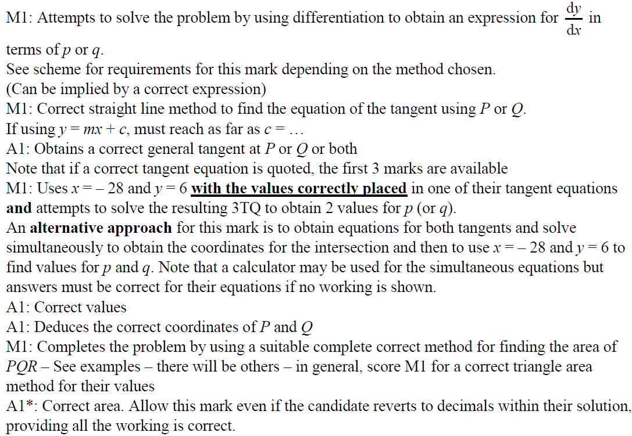
2019
A notes

Slide 43
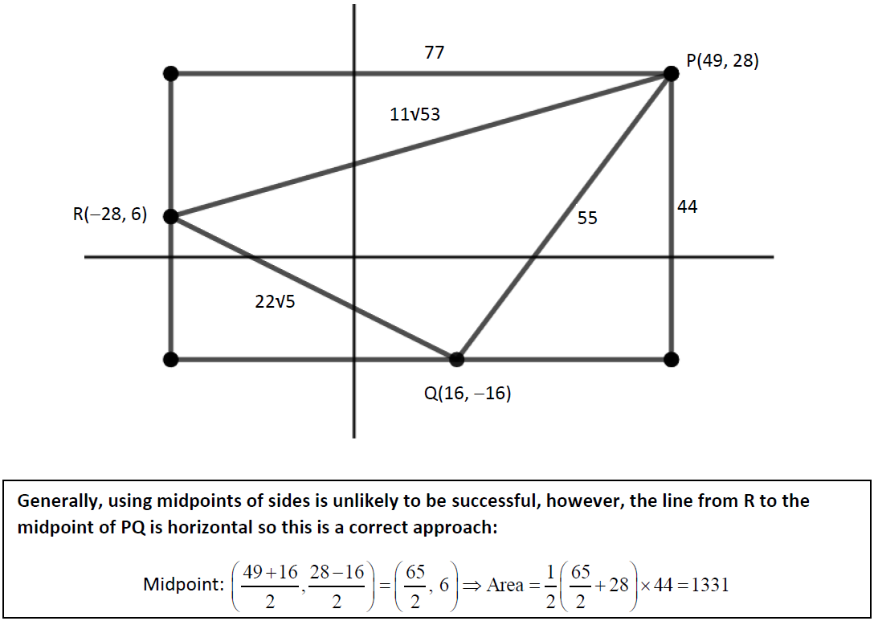
2019
A notes and diagram

Slide 44
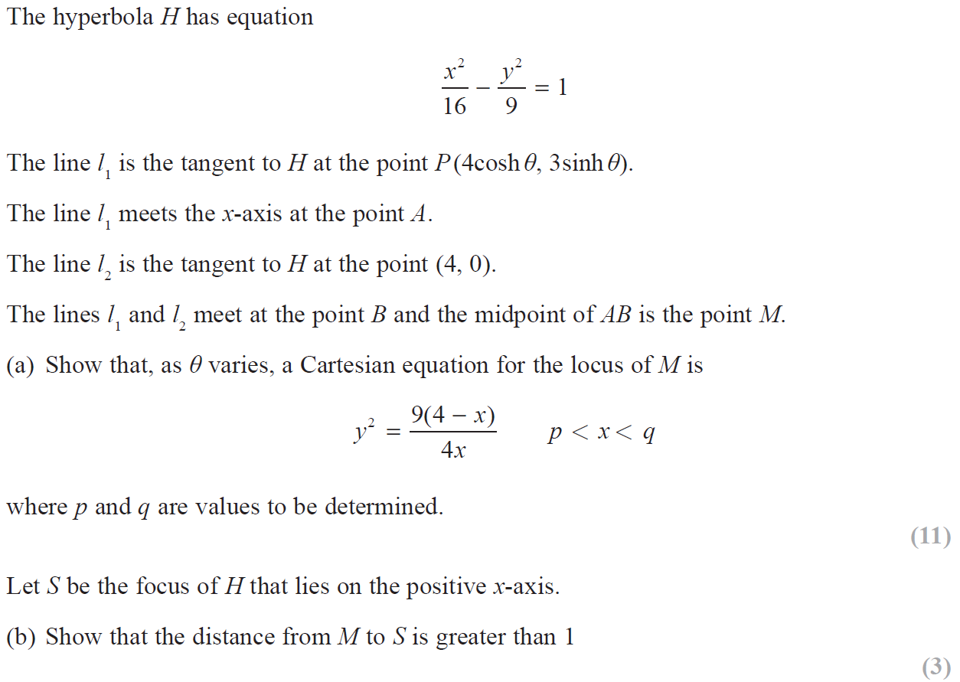
2019

Slide 45
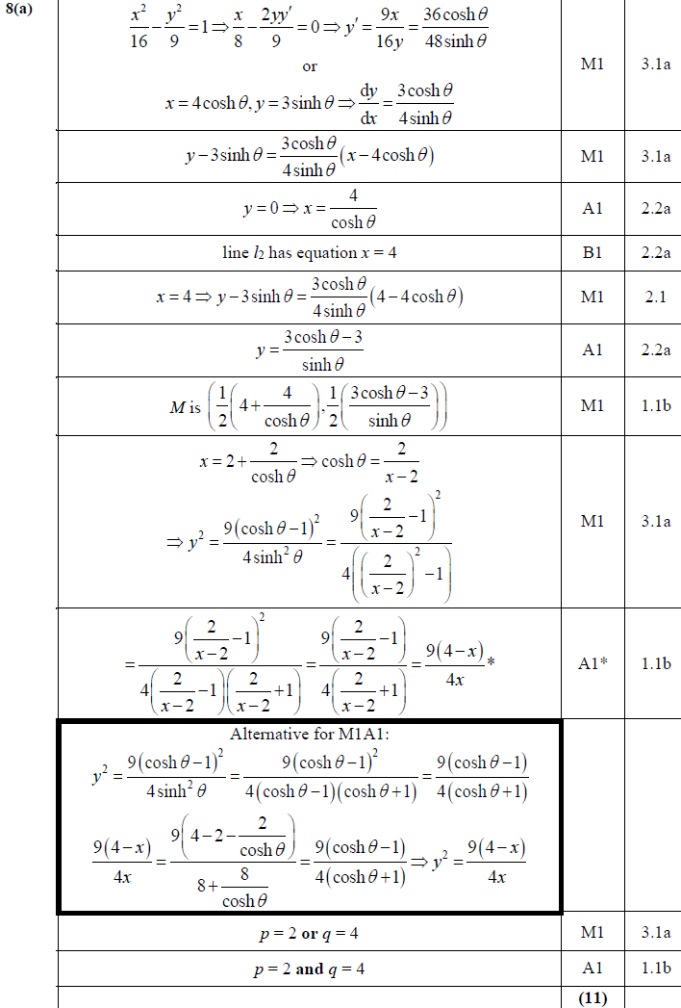
2019
A

Slide 46
2019
B
B notes

Slide 47
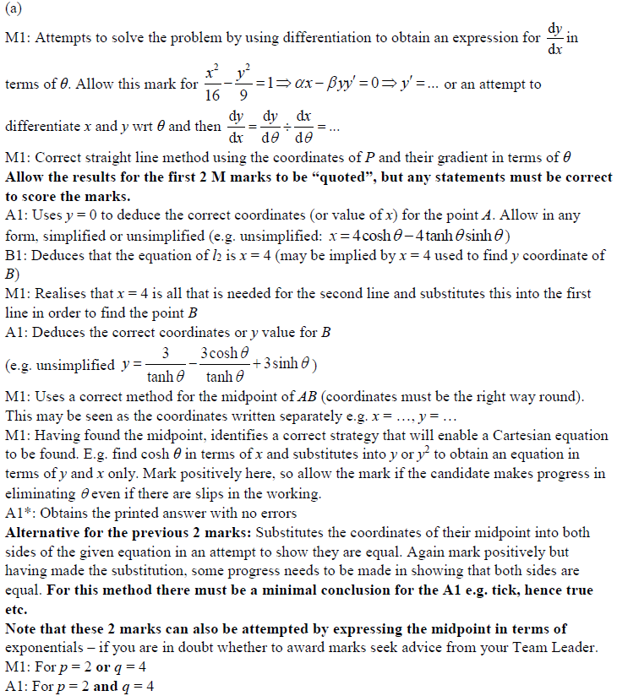
2019
A notes

Slide 48
New Spec Q’s
See Also: Old Spec Core Pure Vectors (Separate Ppt)
Old Spec Conic Sections
Hyperbolic Functions
P5/ Old FP2
FP1
Parabola and Rectangular Hyperbola Only
FP3
June 2002 (i)
June 2006 (i)
Jan 2009 (i)
June 2011
June 2013 (R) (i)
June 2015 (ii)
June 2009 (i)
June 2013 (R) (i)
June 2017
June 2002 (ii)
June 2006 (ii)
Jan 2009 (ii)
Jan 2012 (i)
June 2013 (R) (ii)
June 2016 (i)
June 2009 (ii)
June 2013 (R) (ii)
June 2018
June 2003 (i)
June 2007 (i)
June 2009
Jan 2012 (ii)
June 2013 (W) (i)
June 2016 (ii)
June 2010 (i)
June 2013 (W) (i)
June 2019
June 2003 (ii)
June 2007 (ii)
Jan 2010 (i)
June 2012 (i)
June 2013 (W) (ii)
June 2017 (i)
June 2010 (ii)
June 2013 (W) (ii)
June 2004 (i)
June 2008
Jan 2010 (ii)
June 2012 (ii)
June 2014 (i)
June 2017 (ii)
June 2011
June 2014
June 2004 (ii)
June 2009 (i)
June 2010 (i)
Jan 2013 (i)
June 2014 (ii)
June 2012 (i)
June 2014 (R)
June 2005
June 2009 (ii)
June 2010 (ii)
Jan 2013 (ii)
June 2014 (R) (i)
June 2012 (ii)
June 2015 (i)
Jan 2006 (i)
Jan 2010 (i)
Jan 2011 (i)
June 2013 (i)
June 2014 (R) (ii)
June 2013 (i)
June 2015 (ii)
Jan 2006 (ii)
Jan 2010 (ii)
Jan 2011 (ii)
June 2013 (ii)
June 2015 (i)
June 2013 (ii)
June 2016

Slide 49
June 2002

Slide 50
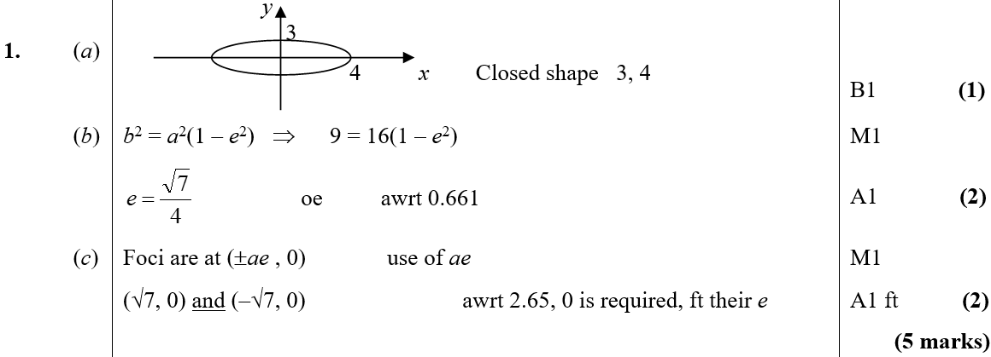
June 2002
A
B
C

Slide 51
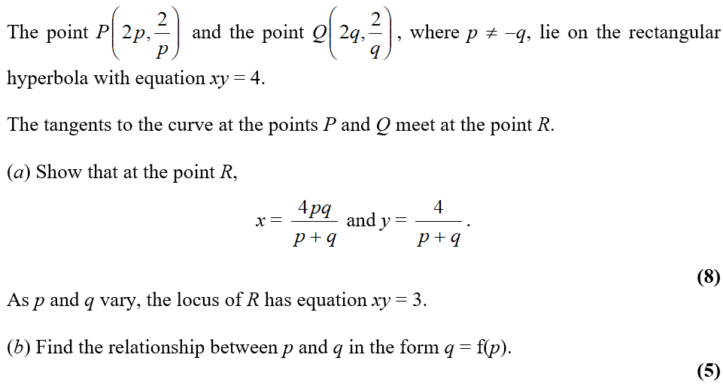
June 2002

Slide 52
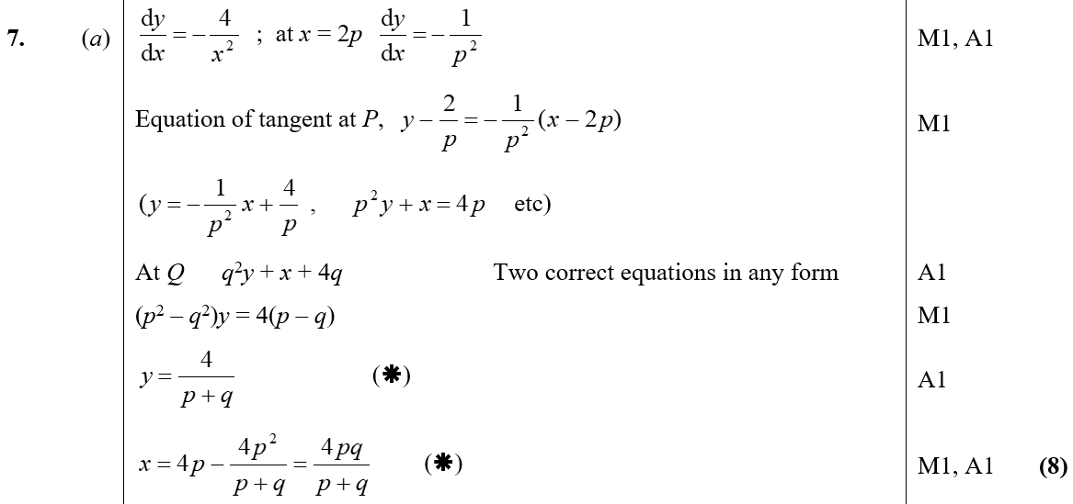
June 2002
A

Slide 53
June 2002
B

Slide 54
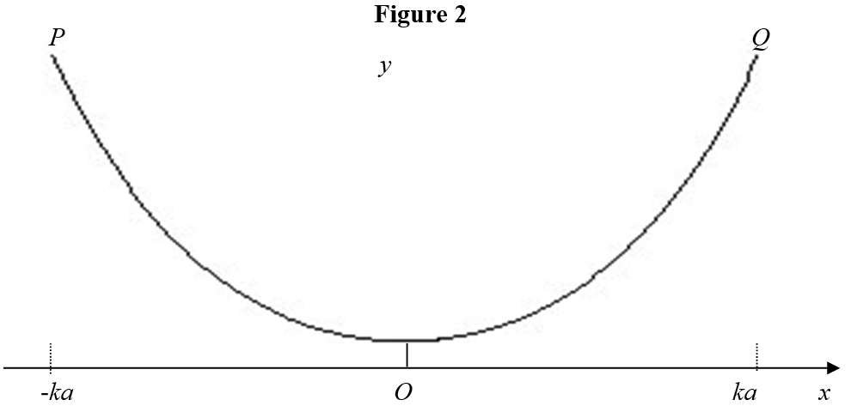
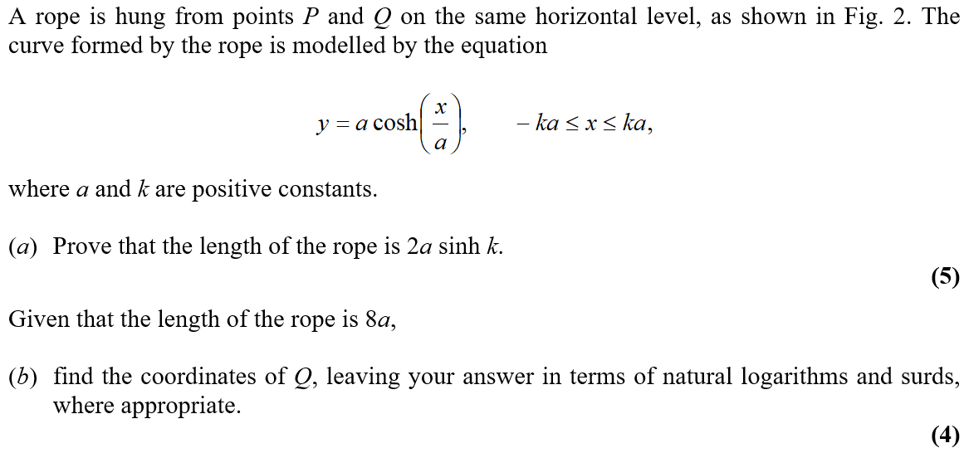
June 2003

Slide 55
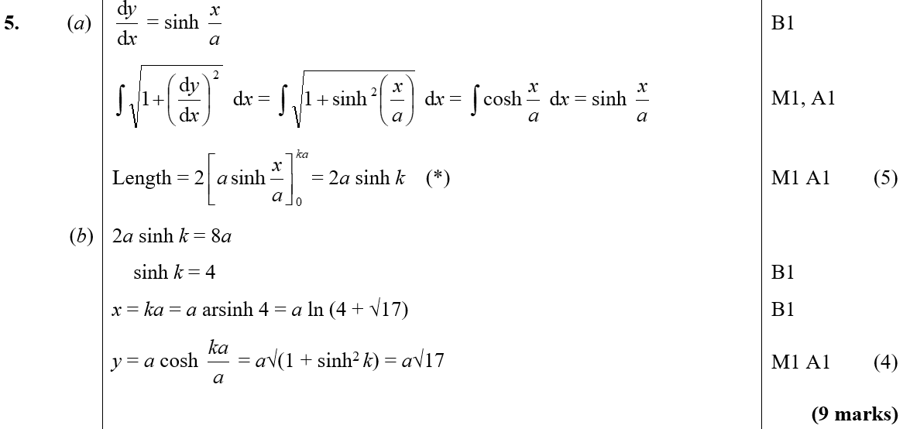
June 2003
A
B

Slide 56
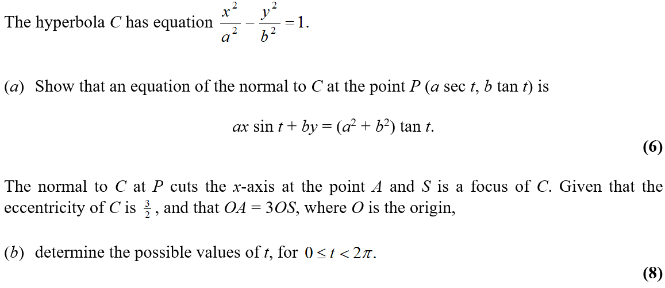
June 2003

Slide 57
June 2003
A

Slide 58
June 2003
B

Slide 59
June 2004

Slide 60
June 2004
A
B

Slide 61
June 2004

Slide 62
June 2004
A

Slide 63
June 2004
B

Slide 64
June 2004
C
D

Slide 65
June 2005

Slide 66
June 2005
A
B
C
D

Slide 67
June 2005
E

Slide 68
Jan 2006

Slide 69
Jan 2006
A
B
C

Slide 70
Jan 2006

Slide 71
Jan 2006
A
B

Slide 72
Jan 2006
C

Slide 73
June 2006

Slide 74
June 2006
A
B

Slide 75
June 2007

Slide 76
June 2007
A
B

Slide 77
June 2007

Slide 78
June 2007
A
B

Slide 79
June 2007
C

Slide 80
June 2008

Slide 81
June 2008
A
B

Slide 82
June 2008
C
A notes
B notes
C notes

Slide 83
June 2009

Slide 84
June 2009
A
B

Slide 85
June 2009

Slide 86
June 2009
A
B

Slide 87
June 2009
C

Slide 88
Jan 2010

Slide 89
Jan 2010
A
B

Slide 90
Jan 2010

Slide 91
Jan 2010
A
B

Slide 92
Jan 2010
C

Slide 93
Jan 2010
A Alternative 1

Slide 94
Jan 2010
A Alternative 2

Slide 95
Jan 2010
B Alternative

Slide 96
Jan 2009

Slide 97
Jan 2009
A
B
A notes
B notes

Slide 98
Jan 2009

Slide 99
Jan 2009
A
B
C
D

Slide 100
Jan 2009
A notes
B notes
C notes
D notes

Slide 101
June 2009

Slide 102
June 2009
A
B
C
C Alternatives

Slide 103
June 2009
D
C notes
D notes

Slide 104
Jan 2010

Slide 105
Jan 2010
A
B
B notes

Slide 106
Jan 2010

Slide 107
Jan 2010
A
B
A notes
B notes

Slide 108
Jan 2010
A Alternatives

Slide 109
June 2010

Slide 110
June 2010
A
B
A notes
B notes

Slide 111
June 2010

Slide 112
June 2010
A
B
C

Slide 113
June 2010
B notes
C notes

Slide 114
Jan 2011

Slide 115
Jan 2011
A
B
C
D
E

Slide 116
Jan 2011

Slide 117
Jan 2011
A

Slide 118
Jan 2011
B

Slide 119
June 2011

Slide 120
June 2011
A
C

Slide 121
June 2011
B

Slide 122
Jan 2012

Slide 123
Jan 2012
A

Slide 124
Jan 2012
B

Slide 125
Jan 2012

Slide 126
Jan 2012
A

Slide 127
Jan 2012
B
C

Slide 128
June 2012

Slide 129
June 2012
A
B

Slide 130
June 2012
C

Slide 131
June 2012

Slide 132
June 2012
A

Slide 133
June 2012
B

Slide 134
Jan 2013

Slide 135
Jan 2013
A
B
C

Slide 136
Jan 2013
D

Slide 137
Jan 2013
A Alternative

Slide 138
Jan 2013
A notes
B notes
C notes

Slide 139
Jan 2013

Slide 140
Jan 2013
A
B

Slide 141
Jan 2013
A notes
B notes

Slide 142
June 2013

Slide 143
June 2013
A

Slide 144
June 2013
B

Slide 145
June 2013

Slide 146
June 2013
A
B

Slide 147
June 2013
C
D

Slide 148
June 2013 (R)

Slide 149
June 2013 (R)
A
B

Slide 150
June 2013 (R)
B Alternative

Slide 151
June 2013 (R)

Slide 152
June 2013 (R)
A

Slide 153
June 2013 (R)
B
C

Slide 154
June 2013 (Withdrawn)

Slide 155
June 2013 (Withdrawn)
A

Slide 156
June 2013 (Withdrawn)
A notes

Slide 157
June 2013 (Withdrawn)
B
B notes

Slide 158
June 2013 (Withdrawn)

Slide 159
June 2013 (Withdrawn)
A
B (i)

Slide 160
June 2013 (Withdrawn)
B (ii)
A notes

Slide 161
June 2013 (Withdrawn)
B (i) notes
B (ii) notes

Slide 162
June 2014

Slide 163
June 2014
A

Slide 164
June 2014
B
C

Slide 165
June 2014

Slide 166
June 2014
A

Slide 167
June 2014
B

Slide 168
June 2014 (R)

Slide 169
June 2014 (R)
A

Slide 170
June 2014 (R)
B
C
D

Slide 171
June 2014 (R)

Slide 172
June 2014 (R)
A

Slide 173
June 2015

Slide 174
June 2015
A
B

Slide 175
June 2015
B Alternative
A notes
B notes

Slide 176
June 2015

Slide 177
June 2015
A

Slide 178
June 2015
B

Slide 179
June 2015
C

Slide 180
June 2016

Slide 181
June 2016
A
B

Slide 182
June 2016
C
D
A notes
B notes
C notes
D notes

Slide 183
June 2016

Slide 184
June 2016
A
B

Slide 185
June 2016
C
A notes
B notes
C notes

Slide 186
June 2017

Slide 187
June 2017
A
B

Slide 188
June 2017
C

Slide 189
June 2017

Slide 190
June 2017
A

Slide 191
June 2017
B

Slide 192
June 2017
C

Slide 193
June 2017
C Alternatives

Slide 194
June 2009

Slide 195
June 2009
A
B

Slide 196
June 2009
C

Slide 197
June 2009

Slide 198
June 2009
A

Slide 199
June 2009
B

Slide 200
June 2010

Slide 201
June 2010
A

Slide 202
June 2010

Slide 203
June 2010
A

Slide 204
June 2010
B

Slide 205
June 2011

Slide 206
June 2011
A
B
C

Slide 207
June 2011
D

Slide 208
June 2012

Slide 209
June 2012
A
B
A notes
B notes

Slide 210
June 2012

Slide 211
June 2012
A
B
C
D

Slide 212
June 2012
A notes
B notes
C notes
D notes

Slide 213
June 2013

Slide 214
June 2013
A & B

Slide 215
June 2013

Slide 216
June 2013
A

Slide 217
June 2013
B
C

Slide 218
June 2013 (R)

Slide 219
June 2013 (R)
A

Slide 220
June 2013 (R)

Slide 221
June 2013 (R)
A
B

Slide 222
June 2013 (R)
C

Slide 223
June 2013 (Withdrawn)

Slide 224
June 2013 (Withdrawn)
A
B

Slide 225
June 2013 (Withdrawn)

Slide 226
June 2013 (Withdrawn)
A
B

Slide 227
June 2014

Slide 228
June 2014
A

Slide 229
June 2014
B

Slide 230
June 2014
C

Slide 231
June 2014 (R)

Slide 232
June 2014 (R)
A
B
C

Slide 233
June 2014 (R)
D

Slide 234
June 2015

Slide 235
June 2015
A
B

Slide 236
June 2015
C

Slide 237
June 2015
D

Slide 238
June 2015

Slide 239
June 2015
A
B

Slide 240
June 2015
B Alternative 1

Slide 241
June 2015
B Alternative 2

Slide 242
June 2015
C

Slide 243
June 2015
C Alternative

Slide 244
June 2016

Slide 245
June 2016
A

Slide 246
June 2016
B

Slide 247
June 2017

Slide 248
June 2017
A

Slide 249
June 2017
B

Slide 250
June 2018

Slide 251
June 2018
A
B

Slide 252
June 2018
C
D

Slide 253
June 2018
D Alternative

Slide 254
June 2018
E
E Alternative

Slide 255
June 2019

Slide 256
June 2019
A
B
A notes

Slide 257
June 2019
C
D

