Slide 1










$$The Below tree diagram represents the probability of two events occuring or not occuring$$
$$X is the label for the first event happening$$
$$Y is the label for the second event happening$$
$$X^{′}is the label for the first event not happening$$
$$Y^{′}is the label for the second event not happening$$
Lower case letters all represent various probabilities
a, b, c, d, e, f all represent the probability of that individual event happening at that point in the tree diagram eg. C represents the probability of Y happening after X has already happened
g, h, i and j are all probabilities calculated at the end of the tree diagram, where two prior scenarios have already occurred
$$c$$
Y
$$g$$
X
$$a$$
$$d$$
$$h$$
Y’
$$e$$
Y
$$i$$
$$b$$
X’
$$f$$
$$j$$
Y’

Slide 2
$$Either click through slide by slide to experience a logical progression of any possible scenario$$
$$and how we would mathematically represent it$$
$$Or hold tab and press enter to pick at random one of the hyperlinks on the right$$
Scenario 1
Scenario 11
$$c$$
Y
$$g$$
Scenario 2
Scenario 12
Scenario 3
Scenario 13
X
$$a$$
Scenario 4
Scenario 14
$$d$$
$$h$$
Y’
Scenario 5
Scenario 15
Scenario 6
Scenario 16
$$e$$
Y
$$i$$
Scenario 7
Scenario 17
$$b$$
X’
Scenario 8
Scenario 18
Scenario 9
Scenario 19
$$f$$
Scenario 10
Scenario 20
$$j$$
Y’

Slide 3





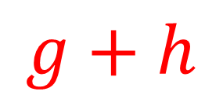







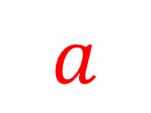
$$Find an algebraic expression to represent:$$
$$P(X)$$
$$c$$
Y
$$g$$
$$a$$
X
$$a$$
$$d$$
$$h$$
Y’
$$or$$
$$e$$
Y
$$i$$
$$b$$
X’
$$g+h$$
$$f$$
$$j$$
Y’

Slide 4

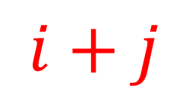
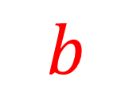
$$Find an algebraic expression to represent:$$
$$P(X′)$$
$$c$$
Y
$$g$$
$$b$$
X
$$a$$
$$d$$
$$h$$
$$or$$
Y’
$$e$$
Y
$$i$$
$$b$$
$$i+j$$
X’
$$f$$
$$j$$
Y’

Slide 5
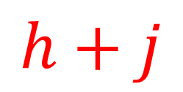
$$Find an algebraic expression to represent:$$
$$P(Y′)$$
$$c$$
Y
$$g$$
X
$$a$$
$$d$$
$$h$$
Y’
$$h+j$$
$$e$$
Y
$$i$$
$$b$$
X’
$$f$$
$$j$$
Y’

Slide 6
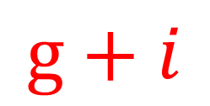
$$Find an algebraic expression to represent:$$
$$P(Y)$$
$$c$$
Y
$$g$$
X
$$a$$
$$d$$
$$h$$
Y’
$$g+i$$
$$e$$
Y
$$i$$
$$b$$
X’
$$f$$
$$j$$
Y’

Slide 7

$$Find an algebraic expression to represent:$$
$$P(X∩Y)$$
$$c$$
Y
$$g$$
X
$$a$$
$$d$$
$$h$$
Y’
$$g$$
$$e$$
Y
$$i$$
$$b$$
X’
$$f$$
$$j$$
Y’

Slide 8

$$Find an algebraic expression to represent:$$
$$P(X∩Y′)$$
$$c$$
Y
$$g$$
X
$$a$$
$$d$$
$$h$$
Y’
$$h$$
$$e$$
Y
$$i$$
$$b$$
X’
$$f$$
$$j$$
Y’

Slide 9

$$Find an algebraic expression to represent:$$
$$P(X′∩Y)$$
$$c$$
Y
$$g$$
X
$$a$$
$$d$$
$$h$$
Y’
$$i$$
$$e$$
Y
$$i$$
$$b$$
X’
$$f$$
$$j$$
Y’

Slide 10

$$Find an algebraic expression to represent:$$
$$P(X′∩Y′)$$
$$c$$
Y
$$g$$
X
$$a$$
$$d$$
$$h$$
Y’
$$j$$
$$e$$
Y
$$i$$
$$b$$
X’
$$f$$
$$j$$
Y’

Slide 11


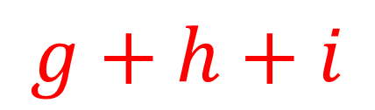
$$Find an algebraic expression to represent:$$
$$P(X∪Y)$$
$$c$$
Y
$$g$$
$$g+h+i$$
X
$$a$$
$$d$$
$$h$$
Y’
$$or$$
$$e$$
Y
$$i$$
$$b$$
$$a+i$$
X’
$$f$$
$$j$$
Y’

Slide 12


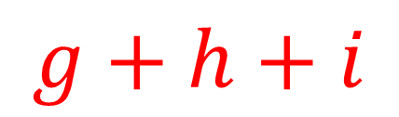
$$Find an algebraic expression to represent:$$
$$P(X∪Y′)$$
$$c$$
Y
$$g$$
$$g+h+i$$
X
$$a$$
$$d$$
$$h$$
Y’
$$or$$
$$e$$
Y
$$i$$
$$b$$
X’
$$a+i$$
$$f$$
$$j$$
Y’

Slide 13

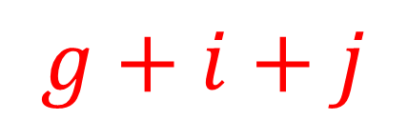
$$Find an algebraic expression to represent:$$
$$P(X′∪Y)$$
$$c$$
Y
$$g$$
$$g+i+j$$
X
$$a$$
$$d$$
$$h$$
Y’
$$or$$
$$e$$
Y
$$i$$
$$b$$
X’
$$b+g$$
$$f$$
$$j$$
Y’

Slide 14

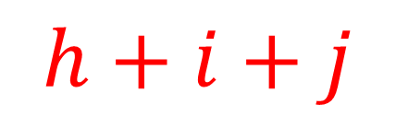
$$Find an algebraic expression to represent:$$
$$P(X′∪Y′)$$
$$c$$
Y
$$g$$
$$h+i+j$$
X
$$a$$
$$d$$
$$h$$
Y’
$$or$$
$$e$$
Y
$$i$$
$$b$$
X’
$$b+h$$
$$f$$
$$j$$
Y’

Slide 15
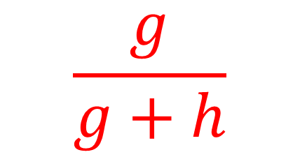


$$Find an algebraic expression to represent:$$
$$P(Y|X)$$
$$c$$
Y
$$g$$
$$c$$
X
$$a$$
$$d$$
$$h$$
$$or$$
Y’
$$e$$
Y
$$i$$
$$b$$
$$\frac{g}{g+h}$$
X’
$$f$$
$$j$$
Y’

Slide 16
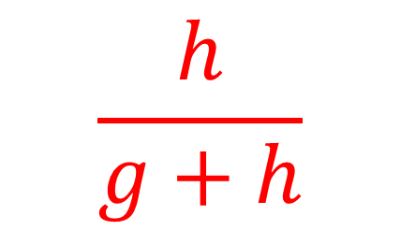

$$Find an algebraic expression to represent:$$
$$P(Y′|X)$$
$$c$$
Y
$$g$$
$$d$$
X
$$a$$
$$d$$
$$h$$
$$or$$
Y’
$$e$$
Y
$$i$$
$$b$$
$$\frac{h}{g+h}$$
X’
$$f$$
$$j$$
Y’

Slide 17
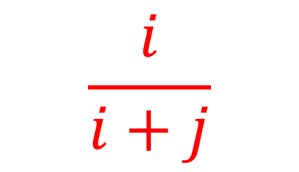

$$Find an algebraic expression to represent:$$
$$P(Y|X′)$$
$$c$$
Y
$$g$$
$$e$$
X
$$a$$
$$d$$
$$h$$
$$or$$
Y’
$$e$$
Y
$$i$$
$$b$$
$$\frac{i}{i+j}$$
X’
$$f$$
$$j$$
Y’

Slide 18
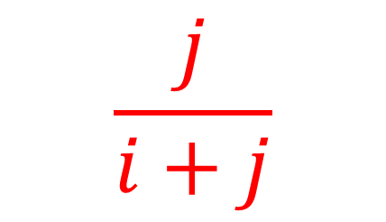

$$Find an algebraic expression to represent:$$
$$P(Y′|X′)$$
$$c$$
Y
$$g$$
$$f$$
X
$$a$$
$$d$$
$$h$$
$$or$$
Y’
$$e$$
Y
$$i$$
$$b$$
$$\frac{j}{i+j}$$
X’
$$f$$
$$j$$
Y’

Slide 19
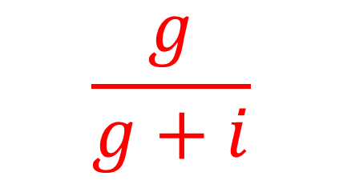
$$Find an algebraic expression to represent:$$
$$P(X|Y)$$
$$c$$
Y
$$g$$
X
$$a$$
$$\frac{g}{g+i}$$
$$d$$
$$h$$
Y’
$$e$$
Y
$$i$$
$$b$$
X’
$$f$$
$$j$$
Y’

Slide 20
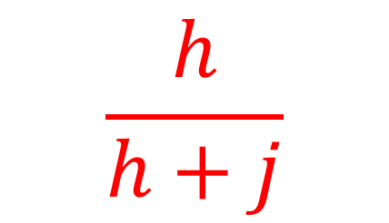
$$Find an algebraic expression to represent:$$
$$P(X|Y′)$$
$$c$$
Y
$$g$$
X
$$a$$
$$\frac{h}{h+j}$$
$$d$$
$$h$$
Y’
$$e$$
Y
$$i$$
$$b$$
X’
$$f$$
$$j$$
Y’

Slide 21
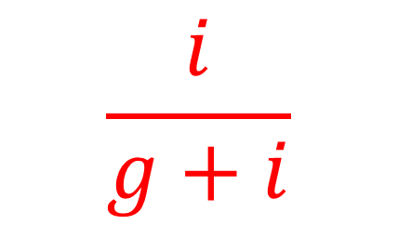
$$Find an algebraic expression to represent:$$
$$P(X′|Y)$$
$$c$$
Y
$$g$$
X
$$a$$
$$\frac{i}{g+i}$$
$$d$$
$$h$$
Y’
$$e$$
Y
$$i$$
$$b$$
X’
$$f$$
$$j$$
Y’

Slide 22
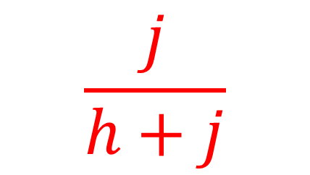
$$Find an algebraic expression to represent:$$
$$P(X′|Y′)$$
$$c$$
Y
$$g$$
X
$$a$$
$$\frac{j}{h+j}$$
$$d$$
$$h$$
Y’
$$e$$
Y
$$i$$
$$b$$
X’
$$f$$
$$j$$
Y’

