Slide 1
9.10) Rates of change

Slide 2
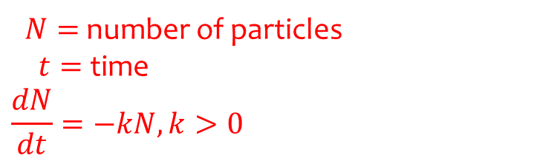
Worked example
Your turn
Atmospheric pressure decreases as altitude increases. The rate at which atmospheric pressure decreases is proportional to the current air pressure. Write down a differential equation for the rate of change of the atmospheric pressure.
In the decay of radioactive particles, the rate at which particles decay is proportional to the number of particles remaining. Write down a differential equation for the rate of change of the number of particles.
$N=$ number of particles
$t=$ time
$$\frac{dN}{dt}=−kN, k>0$$

Slide 3
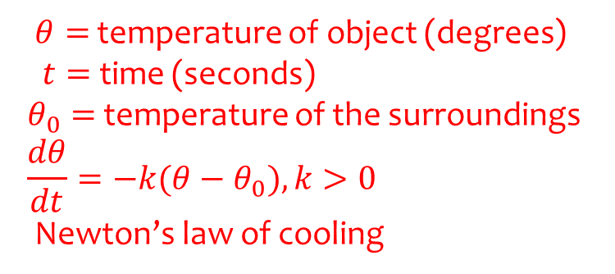
Worked example
Your turn
An metal bar is heated from a starting temperature. It is noted that the rate of gain of temperature of the metal bar is proportional to the difference between the temperature of the metal bar and its surroundings. Write a differential equation to represent this situation.
An object is heated to a certain temperature, then allowed to cool down. It is noted that the rate of loss of temperature of the object is proportional to the difference between the temperature of the object and its surroundings. Write a differential equation to represent this situation.
$θ=$ temperature of object (degrees)
$t=$ time (seconds)
$θ_{0}=$temperature of the surroundings
$$\frac{dθ}{dt}=−k(θ−θ_{0}), k>0$$
Newton’s law of cooling

Slide 4
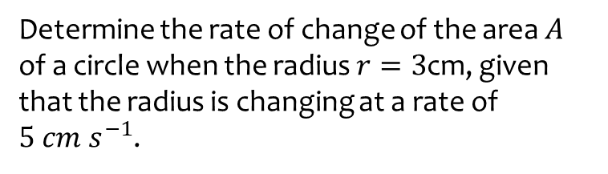
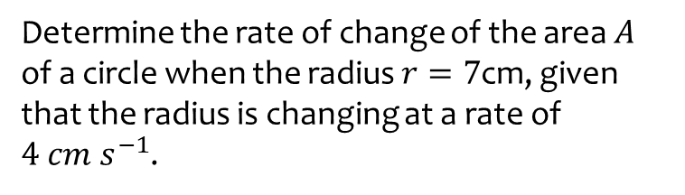

Worked example
Your turn
Determine the rate of change of the area $A$ of a circle when the radius $r=7$cm, given that the radius is changing at a rate of $4 cm s^{−1}$.
Determine the rate of change of the area $A$ of a circle when the radius $r=3$cm, given that the radius is changing at a rate of $5 cm s^{−1}$.
$$\frac{dA}{dt}=30π cm^{2} s^{−1}$$

Slide 5
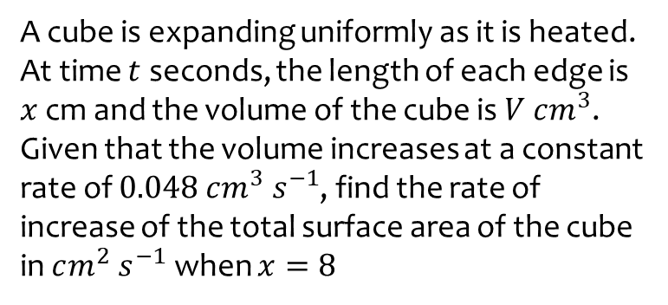
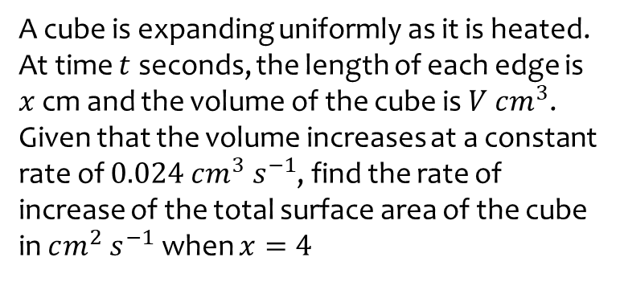
Worked example
Your turn
A cube is expanding uniformly as it is heated. At time $t$ seconds, the length of each edge is $x$ cm and the volume of the cube is $V$ $cm^{3}$.
Given that the volume increases at a constant rate of $0.024 cm^{3} s^{−1}$, find the rate of increase of the total surface area of the cube in $cm^{2} s^{−1}$ when $x=4$
A cube is expanding uniformly as it is heated. At time $t$ seconds, the length of each edge is $x$ cm and the volume of the cube is $V$ $cm^{3}$.
Given that the volume increases at a constant rate of $0.048 cm^{3} s^{−1}$, find the rate of increase of the total surface area of the cube in $cm^{2} s^{−1}$ when $x=8$
$$0.024 cm^{2} s^{−1}$$

Slide 6
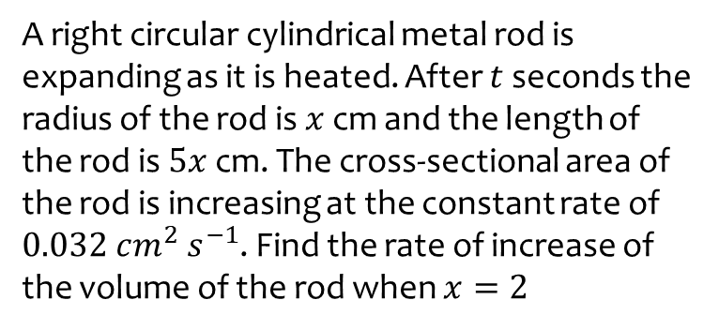
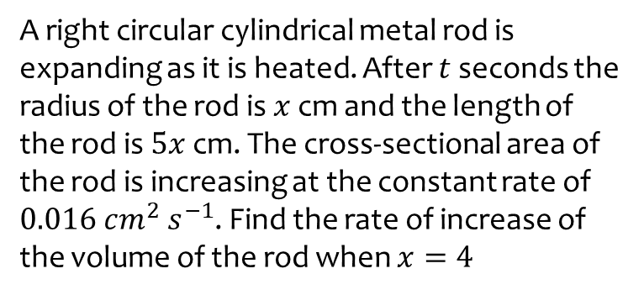
Worked example
Your turn
A right circular cylindrical metal rod is expanding as it is heated. After $t$ seconds the radius of the rod is $x$ cm and the length of the rod is $5x$ cm. The cross-sectional area of the rod is increasing at the constant rate of $0.016 cm^{2} s^{−1}$. Find the rate of increase of the volume of the rod when $x=4$
A right circular cylindrical metal rod is expanding as it is heated. After $t$ seconds the radius of the rod is $x$ cm and the length of the rod is $5x$ cm. The cross-sectional area of the rod is increasing at the constant rate of $0.032 cm^{2} s^{−1}$. Find the rate of increase of the volume of the rod when $x=2$
$$0.48 cm^{3} s^{−1}$$

