Slide 1
9.9) Using second derivatives

Slide 2
Worked example
Your turn
Find the interval on which the function is concave:
$$f(x)=x^{3}−2x+5$$
$$g\left(x\right)={2x}^{3}−5x^{2}−6$$
Find the interval on which the function is concave:
$$h(x)=x^{3}+4x+3$$
$$x≤0$$

Slide 3
Worked example
Your turn
Find the interval on which the function is convex:
$$f(x)=x^{3}−2x+5$$
$$g\left(x\right)={2x}^{3}−5x^{2}−6$$
Find the interval on which the function is convex:
$$h(x)=x^{3}+4x+3$$
$$x≥0$$

Slide 4
Worked example
Your turn
Show that the function is convex for all real values of $x:$
$$f\left(x\right)=e^{3x}+x^{2}$$
$$g\left(x\right)=e^{4x}+x^{4}$$
Show that the function is convex for all real values of $x:$
$$h\left(x\right)=e^{2x}+x^{2}$$
Shown that $h^{′′}\left(x\right)≥0$ for $x∈ℝ$

Slide 5
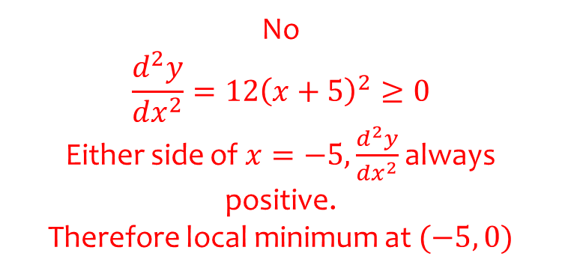
Worked example
Your turn
Determine if there is a point of inflection on the curve with equation $y={\left(x−3\right)}^{4}$
Determine if there is a point of inflection on the curve with equation $y={\left(x+5\right)}^{4}$
No
$$\frac{d^{2}y}{dx^{2}}=12{\left(x+5\right)}^{2}≥0$$
Either side of $x=−5,\frac{d^{2}y}{dx^{2}}$ always positive.
Therefore local minimum at $(−5, 0)$

Slide 6
Worked example
Your turn
A curve C has equation
$$y=\frac{1}{4}x^{2}\ln{x}−3x+7, x>0$$
Find where C is convex
A curve C has equation
$$y=\frac{1}{5}x^{2}\ln{x}+4x−3, x>0$$
Find where C is convex
$$x≥e^{−\frac{3}{2}}$$

