Slide 1
9.8) Implicit differentiation

Slide 2



Worked example
Your turn
Find:
$$\frac{d}{dx}(y^{4})$$
$$\frac{d}{dx}({3y}^{5})$$
Find:
$$\frac{d}{dx}(2y^{3})$$
$$6y^{2}\frac{dy}{dx}$$

Slide 3



Worked example
Your turn
Find:
$$\frac{d}{dx}(\cos{y})$$
$$\frac{d}{dx}(\tan{2y})$$
Find:
$$\frac{d}{dx}(\sin{3y})$$
$$3\cos{3y}\frac{dy}{dx}$$

Slide 4



Worked example
Your turn
Find:
$$\frac{d}{dx}(e^{y})$$
$$\frac{d}{dx}(e^{2y})$$
Find:
$$\frac{d}{dx}(e^{3y})$$
$$3e^{3y}\frac{dy}{dx}$$

Slide 5



Worked example
Your turn
Find:
$$\frac{d}{dx}(xy)$$
$$\frac{d}{dx}(x^{2}y)$$
Find:
$$\frac{d}{dx}(x^{3}y)$$
$$x^{3}\frac{dy}{dx}+3x^{2}y$$

Slide 6



Worked example
Your turn
Find:
$$\frac{d}{dx}(e^{xy})$$
$$\frac{d}{dx}(e^{x^{2}y})$$
Find:
$$\frac{d}{dx}(e^{x^{3}y})$$
$$\left(x^{3}\frac{dy}{dx}+3x^{2}y\right)e^{x^{3}y}$$

Slide 7
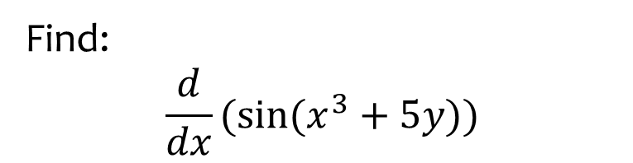

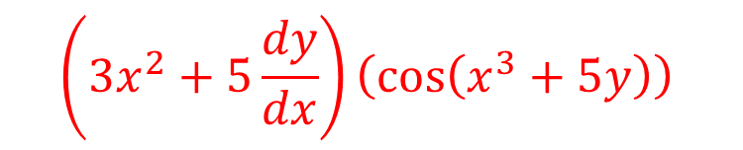
Worked example
Your turn
Find:
$$\frac{d}{dx}(\cos{(x+y)})$$
$$\frac{d}{dx}(\tan{(x^{2}−4y)})$$
Find:
$$\frac{d}{dx}(\sin{(x^{3}+5y)})$$
$$\left(3x^{2}+5\frac{dy}{dx}\right)\left(\cos\left(x^{3}+5y\right)\right)$$

Slide 8
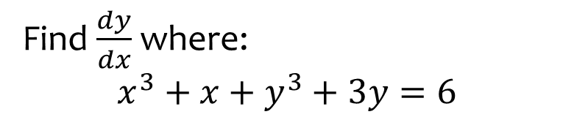
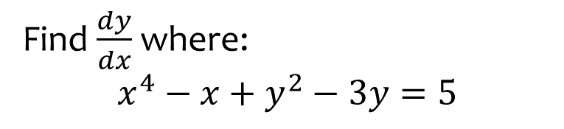

Worked example
Your turn
Find $\frac{dy}{dx}$ where:
$$x^{4}−x+y^{2}−3y=5$$
Find $\frac{dy}{dx}$ where:
$$x^{3}+x+y^{3}+3y=6$$
$$\frac{dy}{dx}=\frac{−3x^{2}−1}{3y^{2}+3}$$

Slide 9
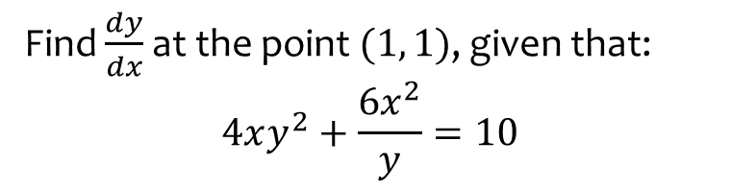
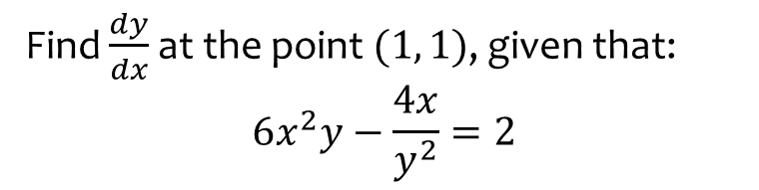

Worked example
Your turn
Find $\frac{dy}{dx}$ at the point $(1, 1)$, given that:
$$6x^{2}y−\frac{4x}{y^{2}}=2$$
Find $\frac{dy}{dx}$ at the point $(1, 1)$, given that:
$$4xy^{2}+\frac{6x^{2}}{y}=10$$
$$\frac{dy}{dx}=−8$$

Slide 10
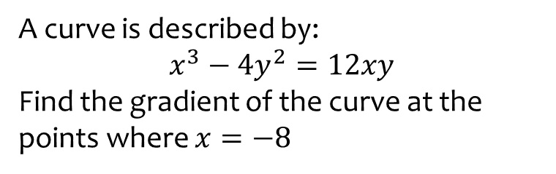
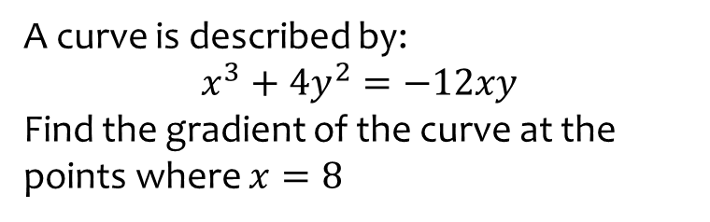
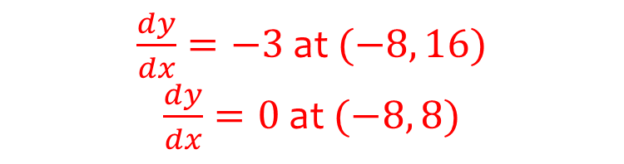
Worked example
Your turn
A curve is described by:
$$x^{3}+4y^{2}=−12xy$$
Find the gradient of the curve at the points where $x=8$
A curve is described by:
$$x^{3}−4y^{2}=12xy$$
Find the gradient of the curve at the points where $x=−8$
$\frac{dy}{dx}=−3$ at $(−8, 16)$
$\frac{dy}{dx}=0$ at $(−8, 8)$

Slide 11
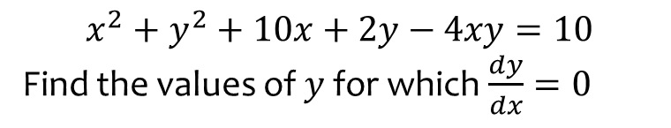
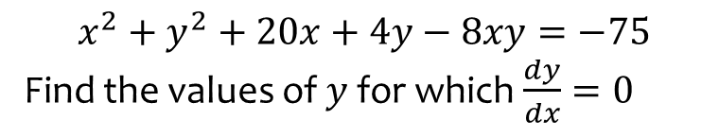

Worked example
Your turn
$$x^{2}+y^{2}+20x+4y−8xy=−75$$
Find the values of $y$ for which $\frac{dy}{dx}=0$
$$x^{2}+y^{2}+10x+2y−4xy=10$$
Find the values of $y$ for which $\frac{dy}{dx}=0$
$$y=\frac{7}{3}, 5$$

Slide 12
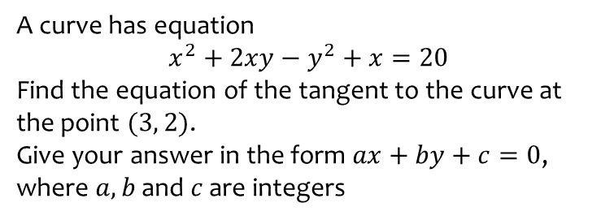
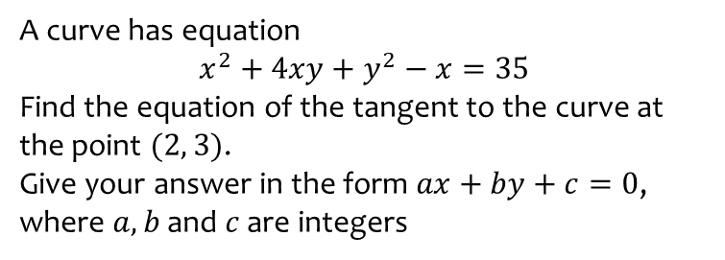
Worked example
Your turn
A curve has equation
$$x^{2}+4xy+y^{2}−x=35$$
Find the equation of the tangent to the curve at the point $(2, 3)$.
Give your answer in the form $ax+by+c=0$, where $a, b$ and $c$ are integers
A curve has equation
$$x^{2}+2xy−y^{2}+x=20$$
Find the equation of the tangent to the curve at the point $(3, 2)$.
Give your answer in the form $ax+by+c=0$, where $a, b$ and $c$ are integers
$$11x+2y−37=0$$

Slide 13
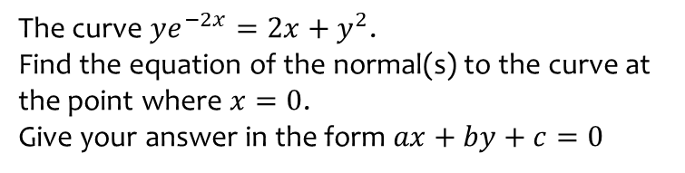
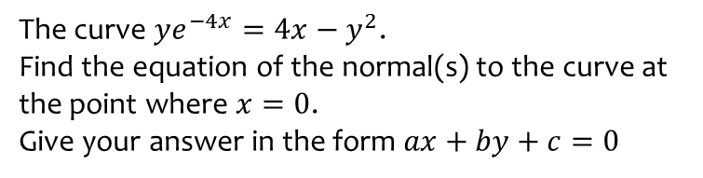

Worked example
Your turn
The curve $ye^{−4x}=4x−y^{2}$.
Find the equation of the normal(s) to the curve at the point where $x=0$.
Give your answer in the form $ax+by+c=0$
The curve $ye^{−2x}=2x+y^{2}$.
Find the equation of the normal(s) to the curve at the point where $x=0$.
Give your answer in the form $ax+by+c=0$
$$2x+y=0 \text{at} (0,0)$$
$$x−4y+4=0 \text{at} (0, 1)$$

